Slide 1
In-situ observation of ZnO containing Cu slag solidification by confocal laser scanning microscope S.G. Huang*, M.X. Guo*, Y. Pontikes*, J. Van Dyck*, C. Mathias**, P.T. Jones*, B. Blanpain* *Department of Metallurgy and Materials Engineering, KU Leuven, Kasteelpark Arenberg 44, B-3001 Heverlee, Belgium ** Metallo-chimique N.V. 2340 Beerse, Belgium

Slide 2
Goal
To observe the crystallization of primary phases in a molten Cu slag in situ by confocal laser scanning microscope (CLSM) method.
To construct a CCT diagram of the Cu slag was using Pt foil as crucible.

Slide 3
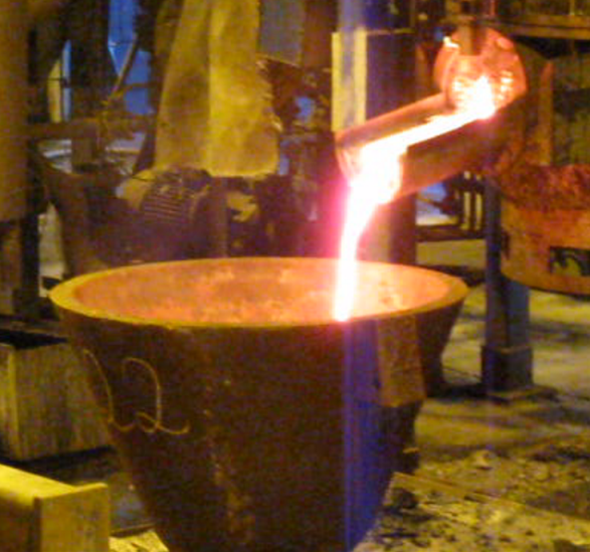
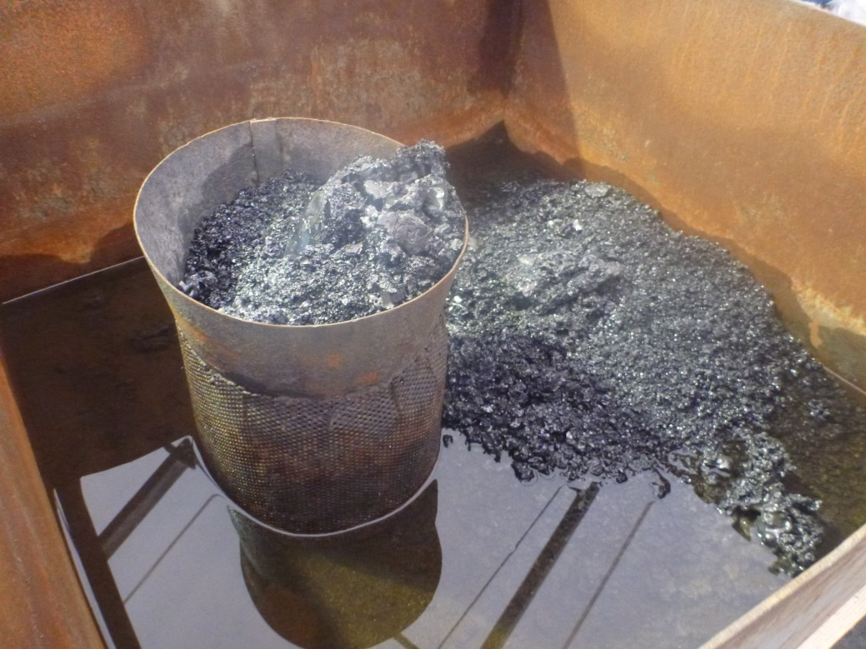
Slag solidification
Introduction
Steel plate
Water granulation
Big slag pot
What is the crystal combination of slag under different cooling rate?

Slide 4
Experimental
Material:
Cu slag: 57 FeO, 26 SiO₂, 6 ZnO, 3 Al₂O₃ and 2 CaO (wt%)
Minerals: 73 wt% amorphous + 24 wt% fayalite + balanced spinel.
Methods:
confocal scanning laser microscope (CSLM, Lasertec, 1LM21H-SVF17SP, Japan).
The slag sample was either heated in an Al₂O₃ crucible or a thin Pt foil at a rate of 200 ºC/min to 1250 ºC and dwelled for 3 min in Ar to homogenize its composition. After that, the slag was cooled down to 500 ºC at a rate of 30 to 2400 ºC/min.

Slide 5
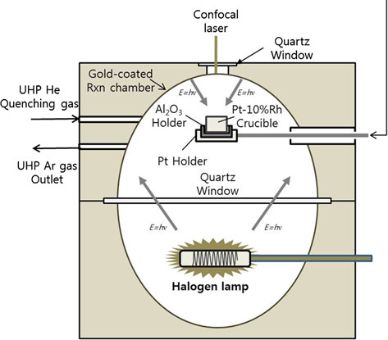
CLSM (Confocal laser scanning microscopy) set-up
Al₂O₃ crucible
slag
1250°C,3min
Crucible
100°C/min
Pt plate
and TC
Pt sheet
CSLM setup
Pt plate
Slag
Pt foil
Pt sheet

Slide 6
Continuous cooling in an Al₂O₃ crucible
Good wetting of slag with the Al₂O₃ crucible
Chemical reaction of Al₂O₃ and slag
Unstable liquid surface
Inhomogeneous cooling
Al2O3 crucible

Slide 7
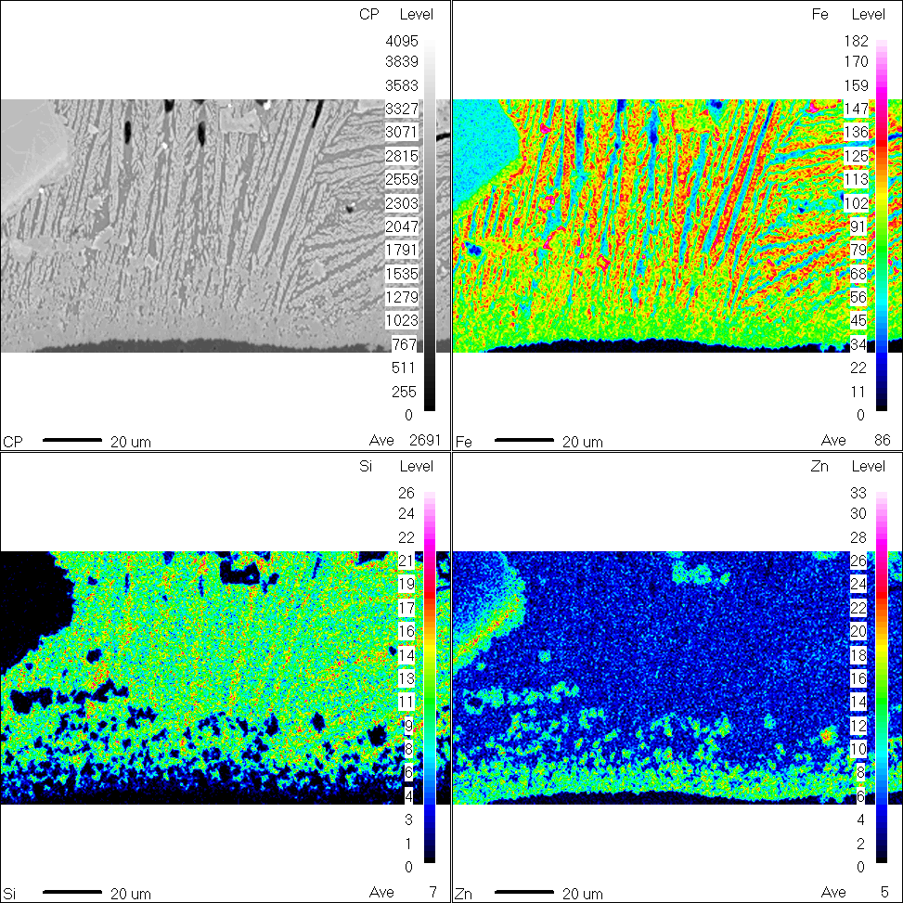
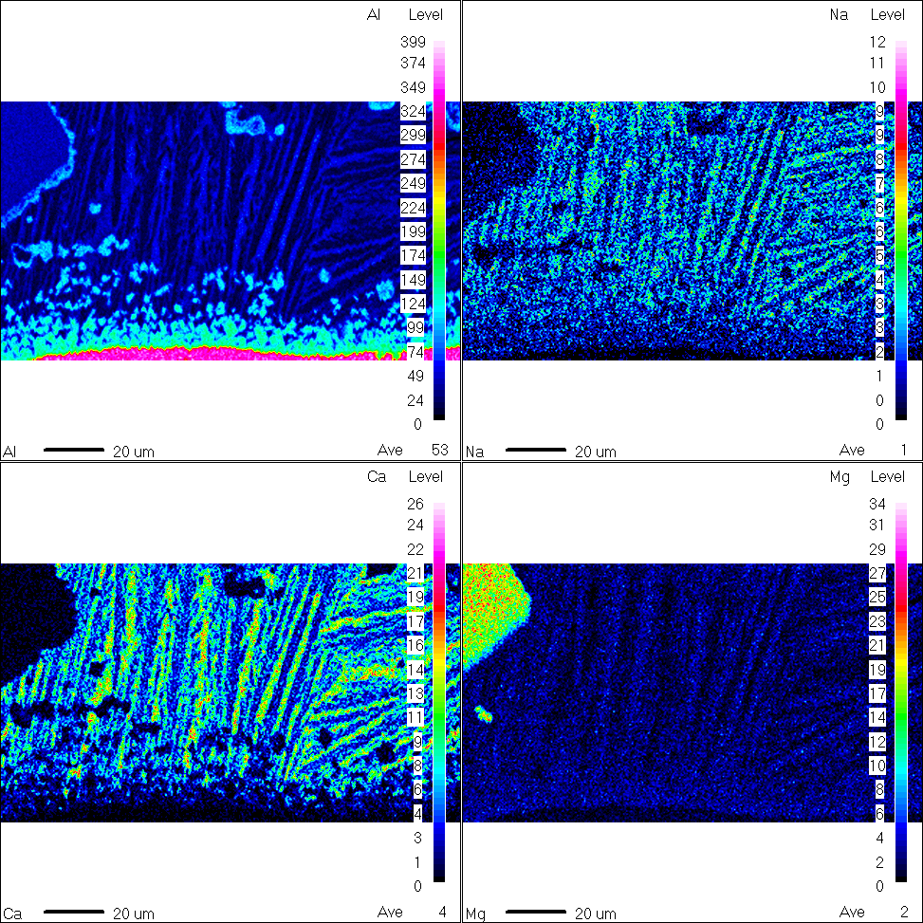
Elemental mapping
Al-Zn-Fe-O Spinel formation
Change of solidification behavior

Slide 8
Continuous cooling in a Pt foil
Continuous cooling tests
Dendritic structure precipitation temperature

Slide 9
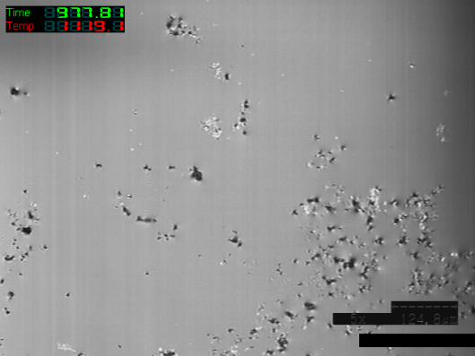
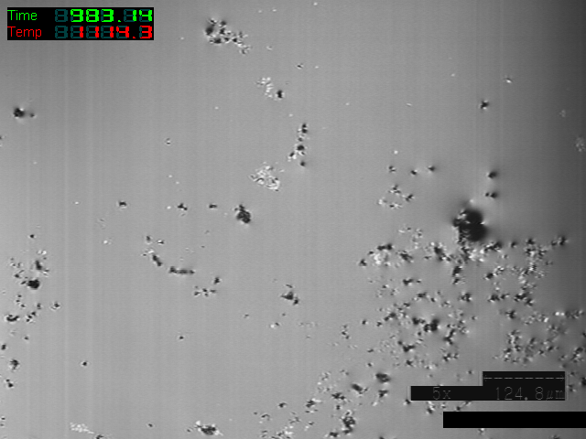
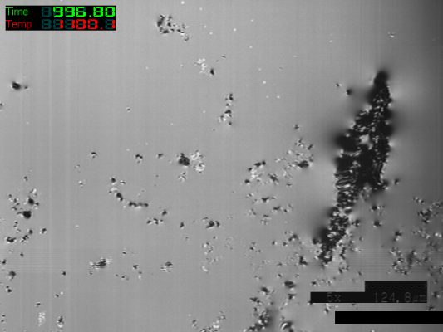
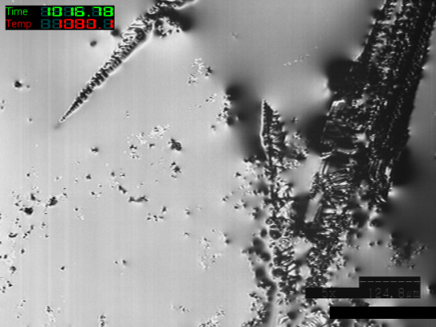
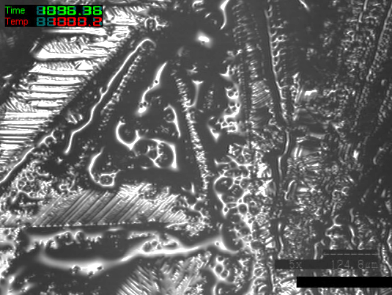
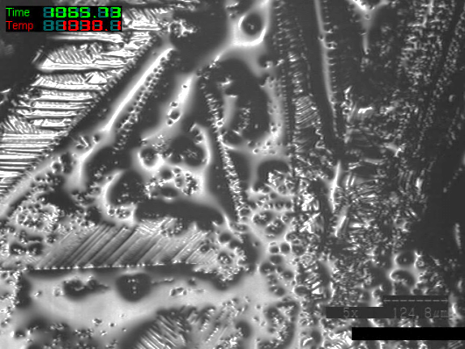
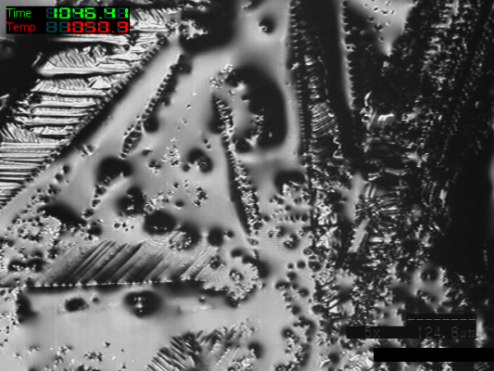
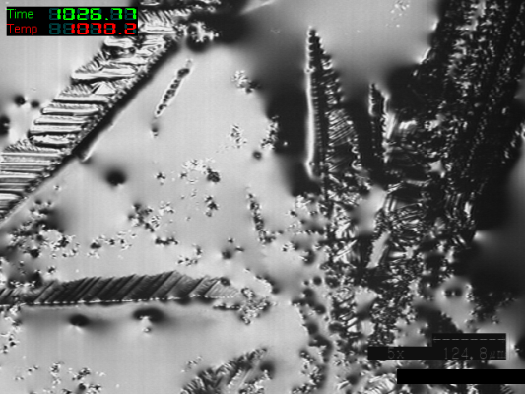
Continuous cooling in a Pt foil
In-situ observation, 1°C/s
Liquid 1
liquid 1+Fayalite
1119°C
1114°C
1100°C
1080°C
liquid 2+Fayalite
1000°C
1030°C
1050°C
1070°C
1200-1114 °C liquid 1
1114-1050°C: fayalite + liquid 1+ liquid 2
1050-RT: fayalite+liquid 2
deltaT=94°C
All the fayalite precipitate at 1050°C

Slide 10
CCT diagram of Cu slag
At a cooling rate of 40°C/s, FA crystal is formed
Critical cooling rate need to be larger than 40°C/s

Slide 11
Conclusions:
The Al₂O₃ crucible is not ideal for the high temperature experiments due to the moving liquid slag surface and the slag/Al₂O₃ reaction as well as inhomogeneous temperature distribution.
The Pt foil is able to in-situ observe the slag solidification behavior at different cooling rates. The onset temperature is decreased continuously with the increased cooling rate. A cooling rate higher than 2400 ºC /min is however needed to make a full amorphous slag.

