Slide 1
Meeting our Material Services within Planetary Boundaries
Ernst Worrell
Leuven, April 4th, 2017

Slide 2

  Anyone who believes that exponential growth
  can go on forever in a finite world is either
  a madman or an economist.
Kenneth E. Boulding
(1910 -1993)

Slide 3
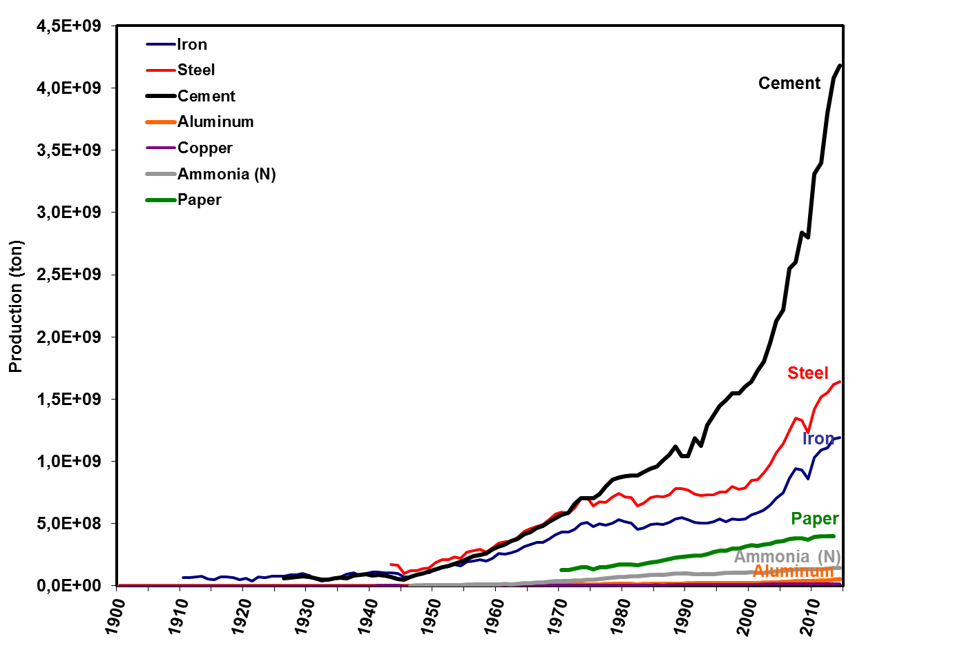
Global material demand grows exponentially

Slide 4
The Human Bulldozer
Source: Klee & Graedel, 2004
Notes:
Mankind dominates material flows; we zijn een bulldozer van formaat
Koolstof nog niet, maar is een ander probleem; er is onvoldoende atmosfeer om het afvalproduct in te stoppen

Slide 5
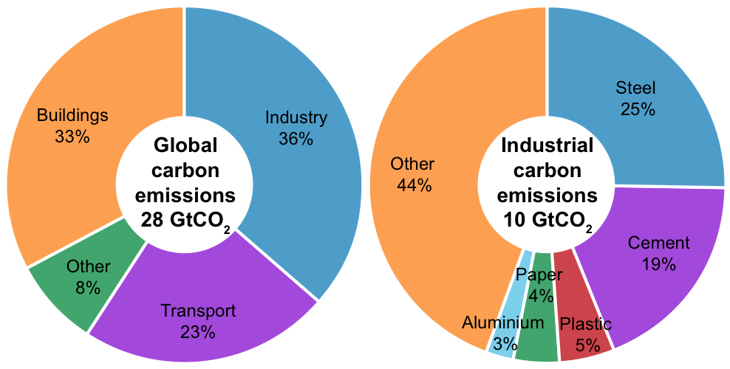
Materials Production emits over 20% of
Global GHG Emissions
Notes:
5
Contributions
Fuel to final services, through technical categories
89% theoretical potential in conversion devices, breakdown of conversion loss
73% practical potential in passive systems
Combined: suggests a 30 fold improvement in the current energy network is possible from efficiency measures, without using alternatives energy supply.
Approaching this problem from a technical perspective, based on physical and engineering laws, has resulted in a consistent
framework for comparing efficiency options. Research and energy policy can be directed towards the actions that
will make the most difference.

Slide 6
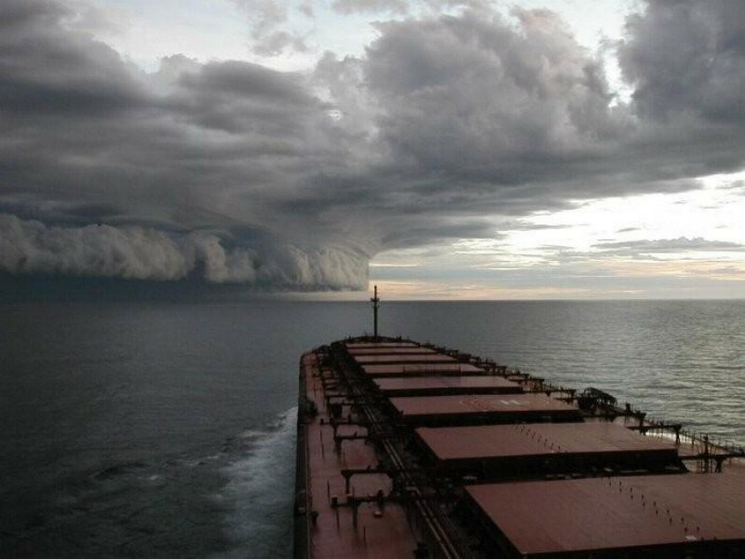
Approaching the Perfect Storm
Notes:
In the U.S. there is the expresion “the Perfect Storm” A storm that is the result of all conditions being perfect to contribute to a storm of a biblical magnitude. The world, the energy sector, our whole system of production and consumption, is in this storm. Our consumption patterns are affecting the world, as plastic waste is already found at the North Pole itself. The climate is changing as it is absorbing the greenhouse gases that we emit, and people die on a daily basis as a result of air pollution, or climate-inflicted weather changes. You could see us as this bulk carrier; we see the storm coming, but are we able to timely change course....

Slide 7
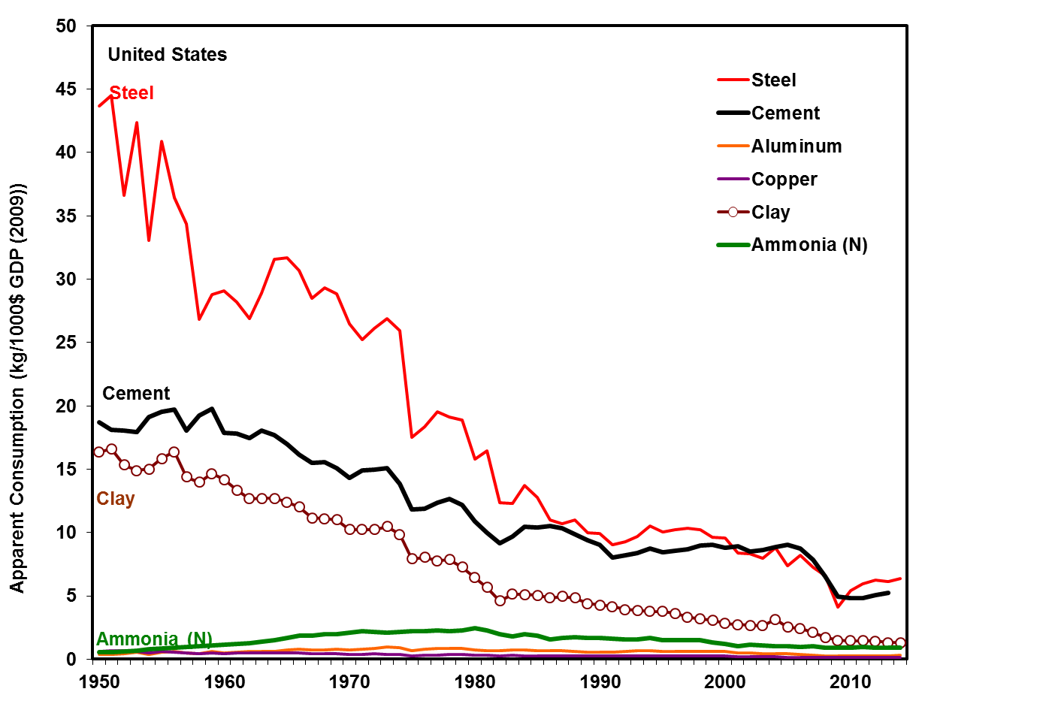
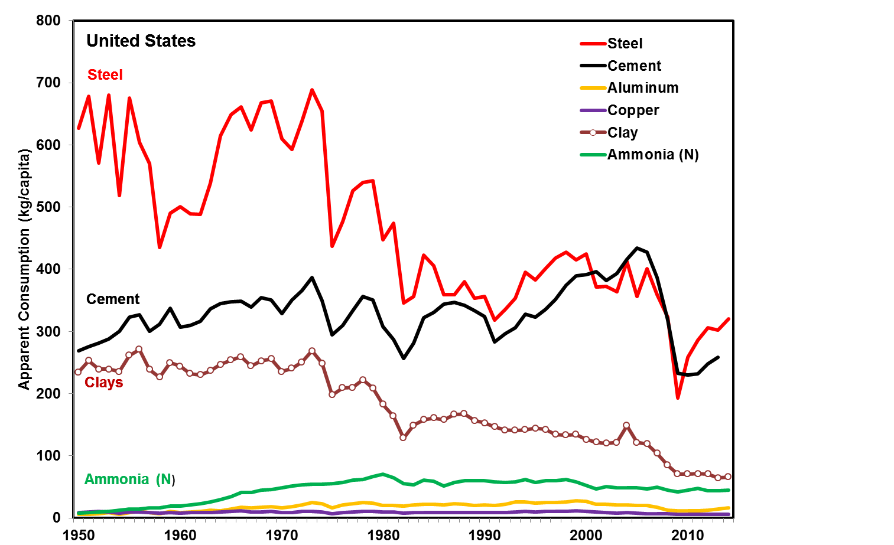
Will Growth Continue?
Material Intensity (GDP)
Material Intensity (capita)

Slide 8
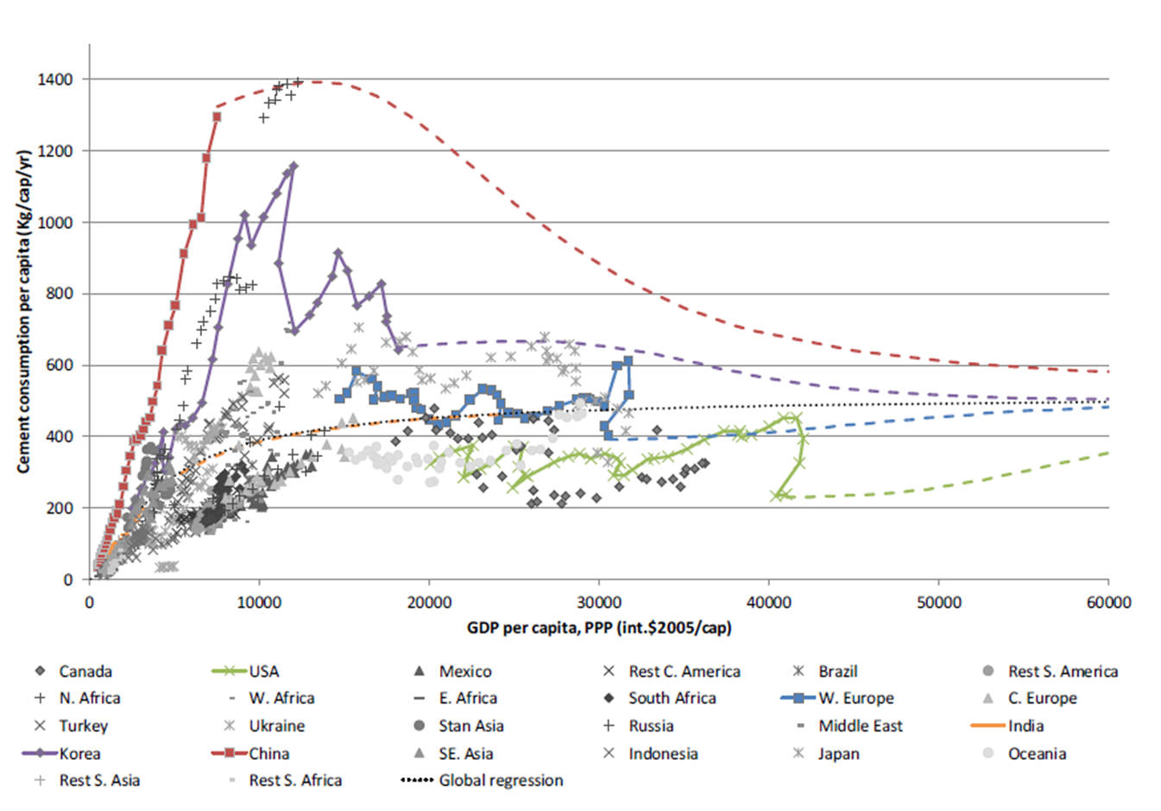
Will Growth Continue? - Cement
Source: Kermeli et al., 2015

Slide 9
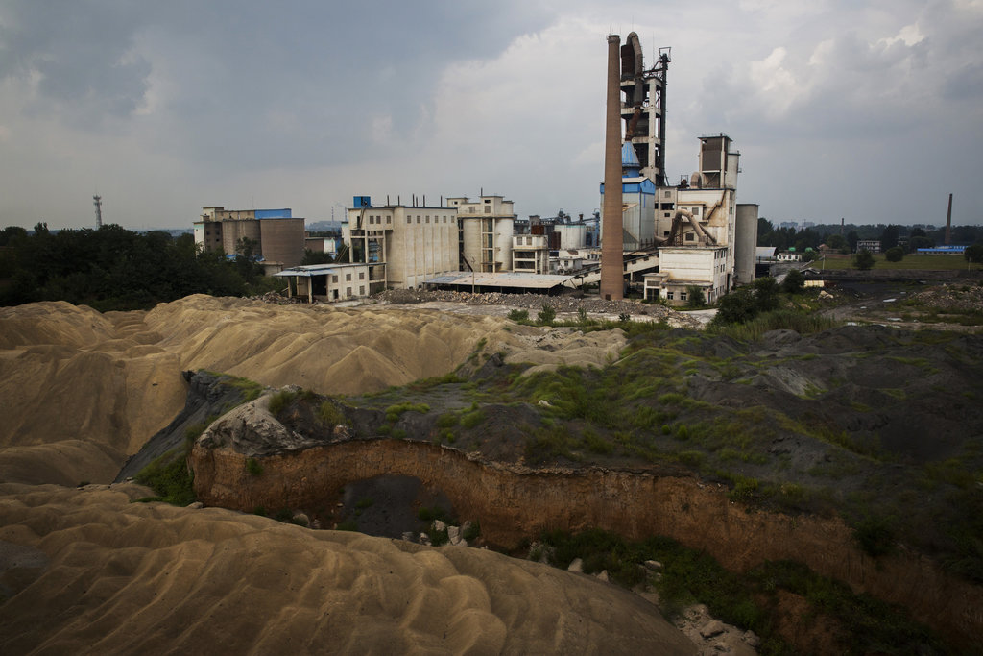
Zombie Factories
Source: New York Times

Slide 10
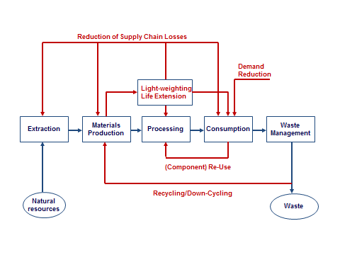
Reducing Material Use

Slide 11
Material Efficiency and Steelmaking
Future determined by view on steel consumption
    “High” growth: need for primary steel (Oda, RITE)
    “Low” growth: scrap stocks cover most of future demand (Pauliuk/Müller, NTNU)
Points of attention:
    With today’s technology markets industry cannot grow in a climate constrained world (e.g. if global buildings stock grows to OECD average: 35-60% carbon budget till 2100 will be used)
    New energy technologies
    Steel quality for future markets
    Availability alloying elements (molybdenum, zinc)
    Technology development: R&D agenda

Slide 12
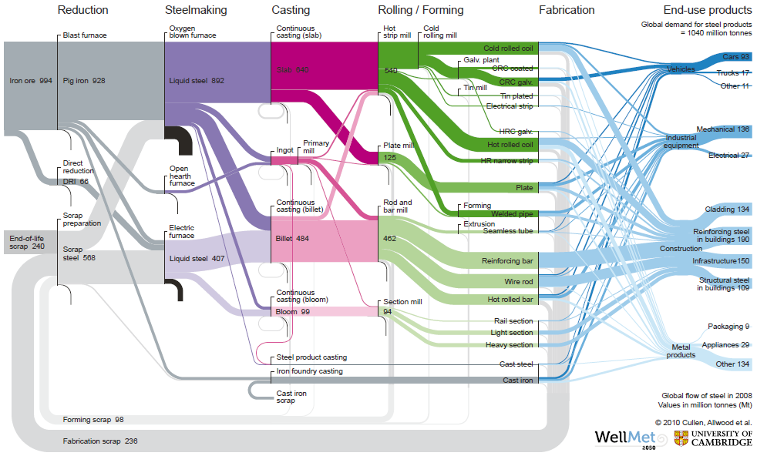
Steel: losses in supply chain use energy
Source: Cullen, University of Cambridge

Slide 13
Follow the material: Understand the Losses
Source: Milford et al., 2011

Slide 14
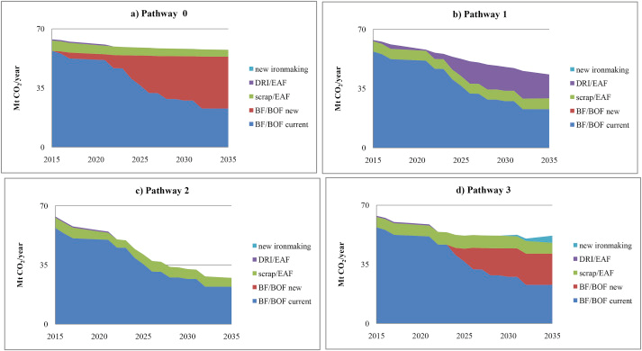
CO₂ emissions depend on demand, scrap use & technology: Germany
Source: Arens et al., in press

Slide 15
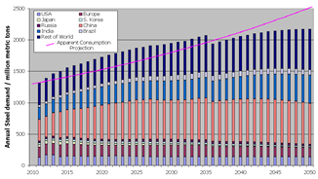
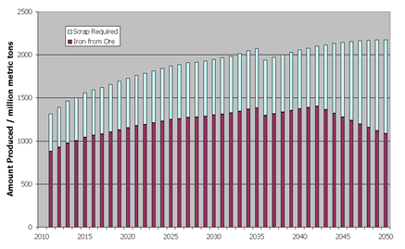
Future Steel: Low Demand Scenario
High Quality Iron Ore peaks by 2040
Source: Matthews, 2012
Lower ore quality will result in increasing energy intensity

Slide 16
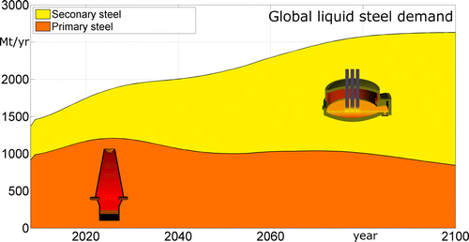
Future Steel: Increased Recycling
Source: Pauliuk et al., 2013

Slide 17
Sustainable materials production require integration - Slags
Blast furnace slags and fly ash play a key role in the sustainability strategy of the cement industry
Yet....
    Pig iron production will likely decline, as the steel industry will use more scrap
    Coal-fired power production will be phased out (unless carbon capture will be available timely)
  Need to reserve slags for high-quality applications (as in any recycling strategy)
    Granulated slags over air-cooled slags
    Stockpile granulated slags?

Slide 18
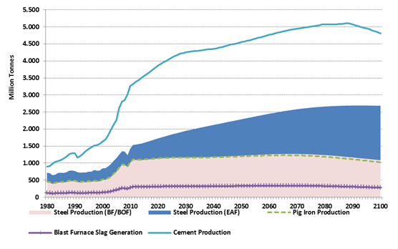
(Granulated) Slags essential for a sustainable cement industry
If all slags would be granulated, the cement industry can reduce emissions by 280 MtCO₂

Slide 19
Adding up: Material energy & CO₂ savings
Energy demand & CO₂ emissions from the production of selected energy-intensive materials in the New Policies Scenario & Material Efficiency Scenario
Energy demand
CO₂ emissions
2 000
Aluminium
Gt
8
Indirect
(heat and power)
Mtoe
Paper
1 500
Plastics
6
Process-related
Cement
Energy-related
1 000
Steel
4
500
2
2013
NPS
MES
2013
NPS
MES
2040
2040
Material efficiency can keep energy demand from energy-intensive sectors
stable & cut energy- & process-related CO₂ emissions by 1.4 Gt

Slide 20

Zen in a changing world:
New business models
Retain ownership
Multiple use: manage quality
The anthropocene mine
Avoid downcycling
New technology:
  Product design
  Separation

Slide 21
In summary
Large potentials exist to improve material efficiency (up to 50%) for most materials and applications
Large menu of opportunities:
    Alternative material services (sharing, redundancy)
    Product design, re-use, recycling
    Every material has also unique efficiency opportunities
In the current world potentials are not realized
Absolute reduction of materials use is necessary to reach Paris target of “well below 2°C”
Large societal transition: energy, materials, and economics

Slide 22

Thank you for your attention
Ernst Worrell
Utrecht University
e.worrell@uu.nl

