Slide 1


SUSTAINABLE UTILIZATION OF EAF-SLAG BY SUCCESSFUL RESEARCH AND OPTIMIZED OPERATIONAL PRACTICE
S. Schüler¹, D. Mudersbach¹, M. Knoll²
¹⁾ Max Aicher Umwelt GmbH
²⁾ Lech-Stahlwerke GmbH

Slide 2
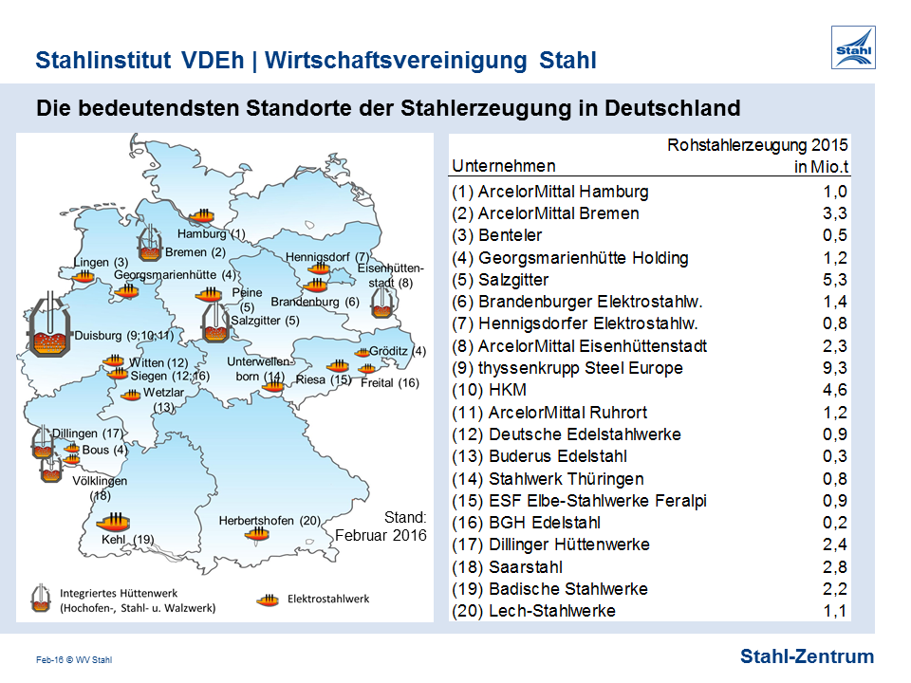

Slide 3
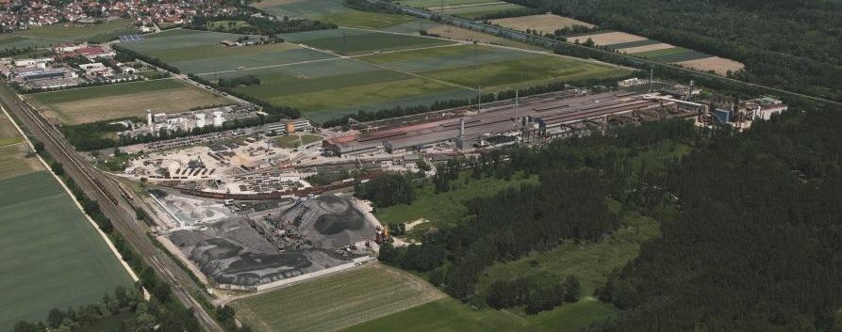
Lech-Stahlwerke GmbH
Slag pit
EAF 1 & 3
Max Aicher Umwelt GmbH

Slide 4
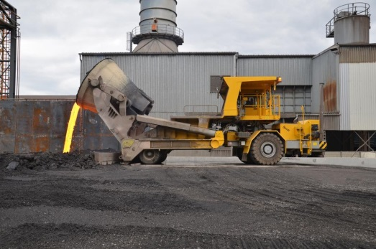
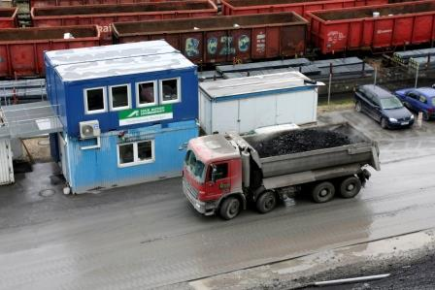

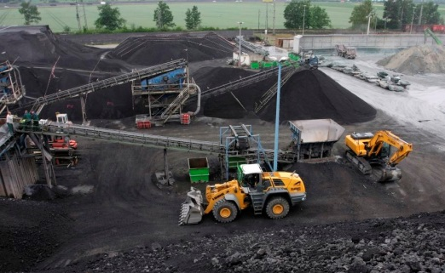
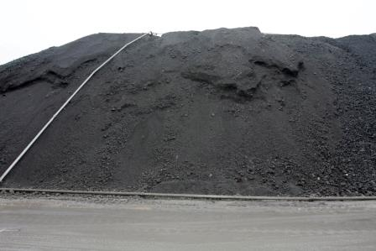

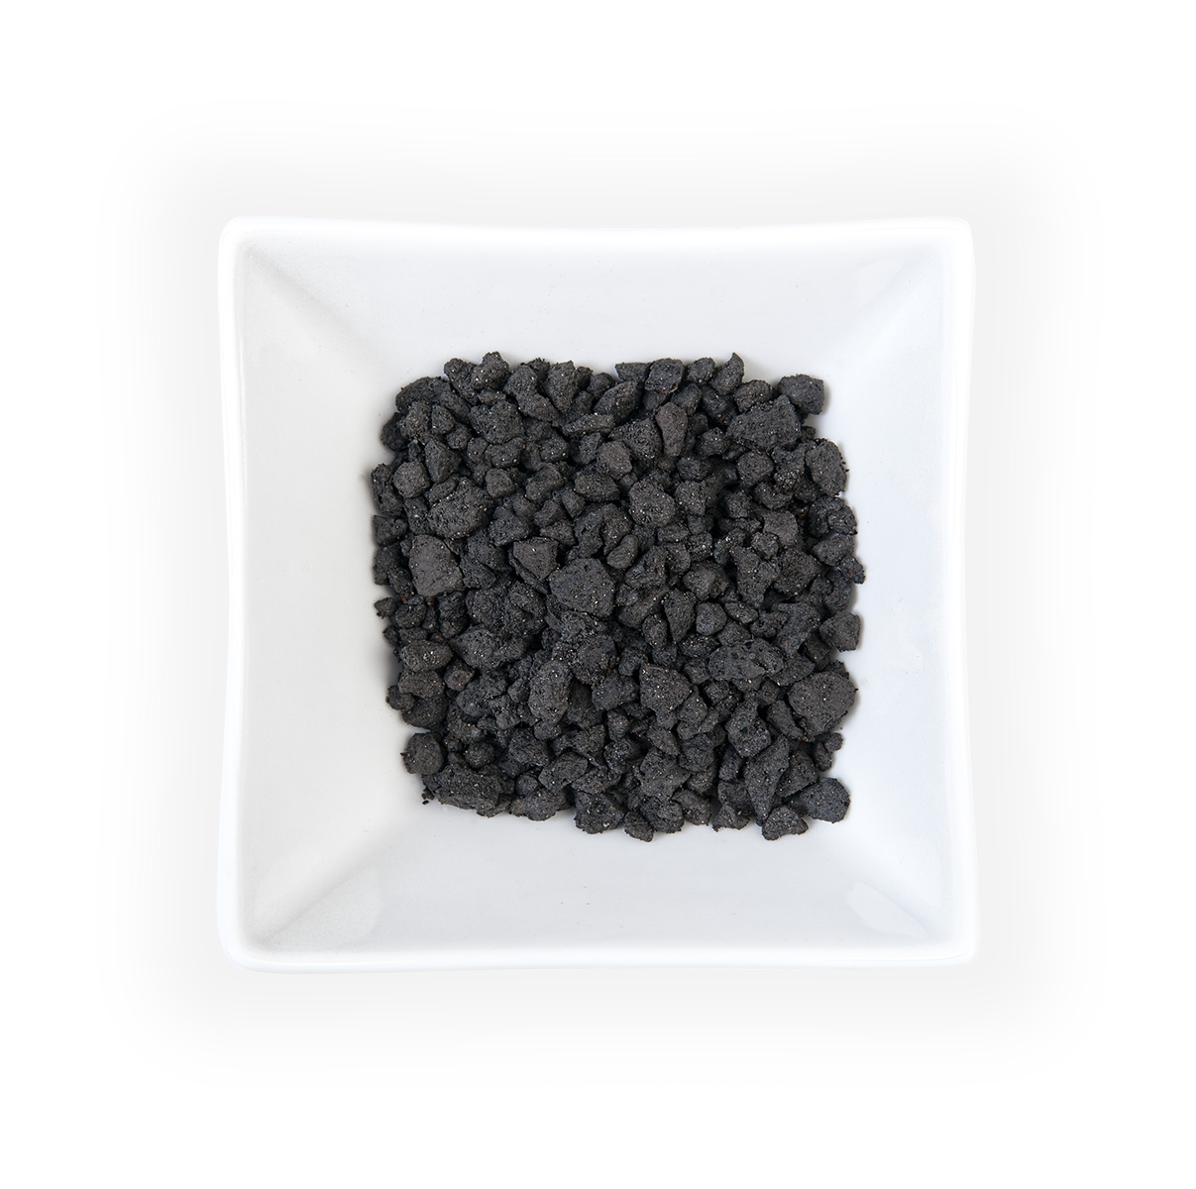
Slag pit
Unprocessed slag
Slag processing
EOS < 150 mm
costumer
ELOMINIT™

Slide 5
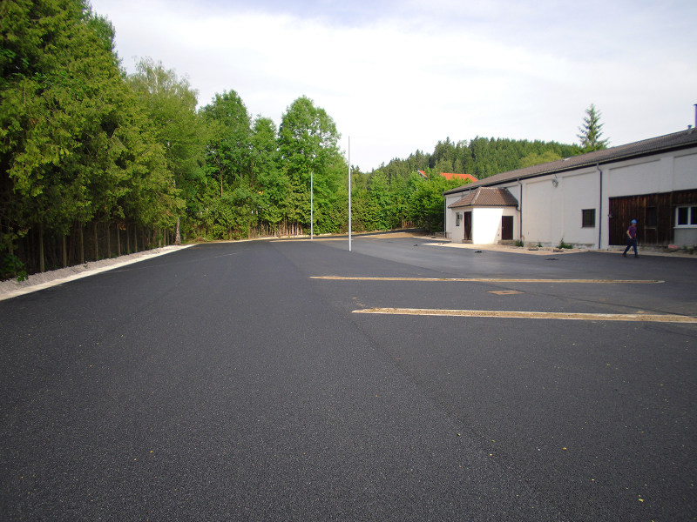
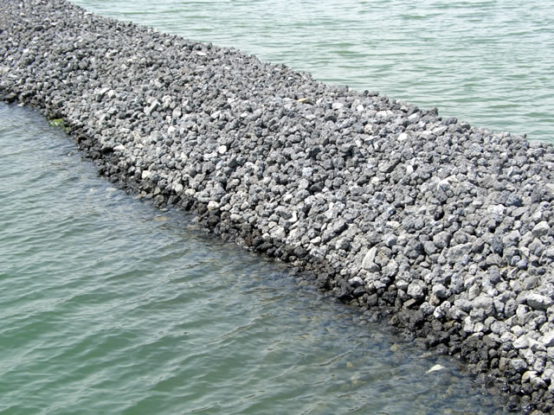
Utilization in asphaltic layer
Quelle: http://www.leistra3.de
Utilization for waterway construction
Quelle: BSW Stahl-Nebenprodukte GmbH

Slide 6
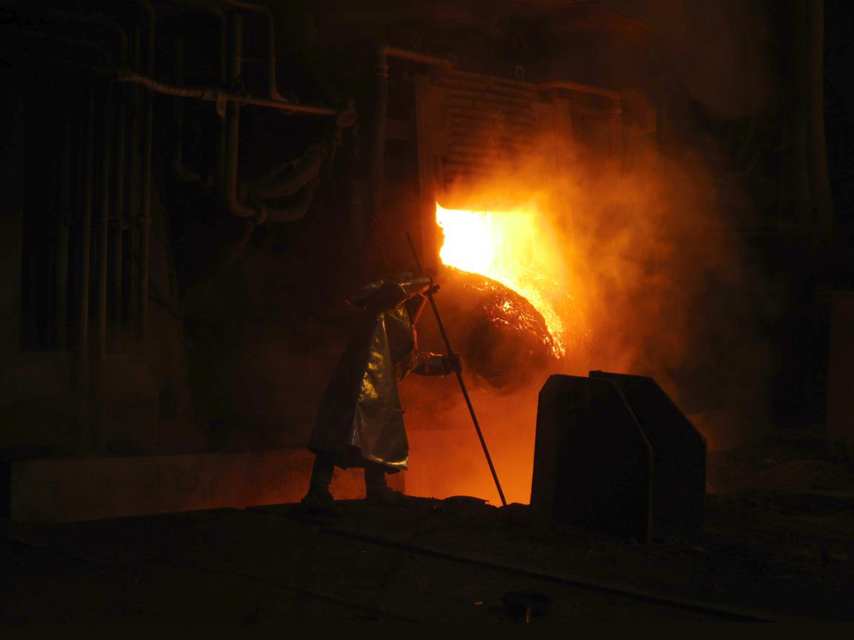
SLACON
MiLeSlag
STRAHLEOS
PROEOS

Slide 7
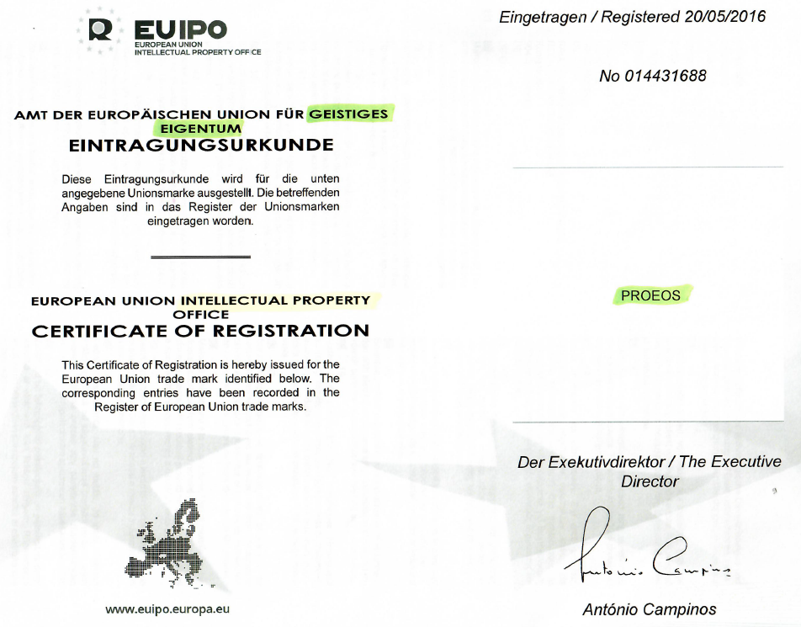
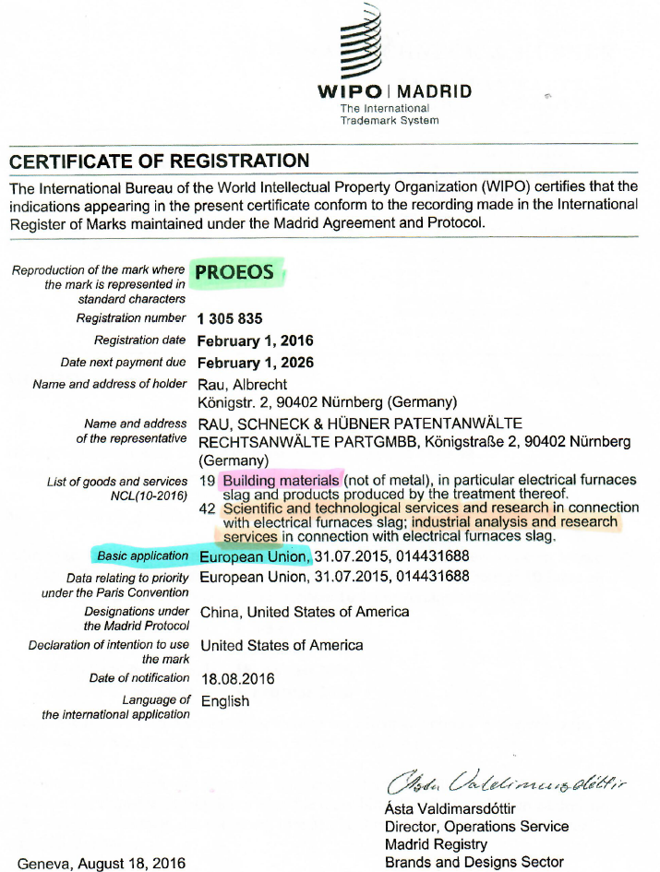

Slide 8
Volume
Stability

Slide 9
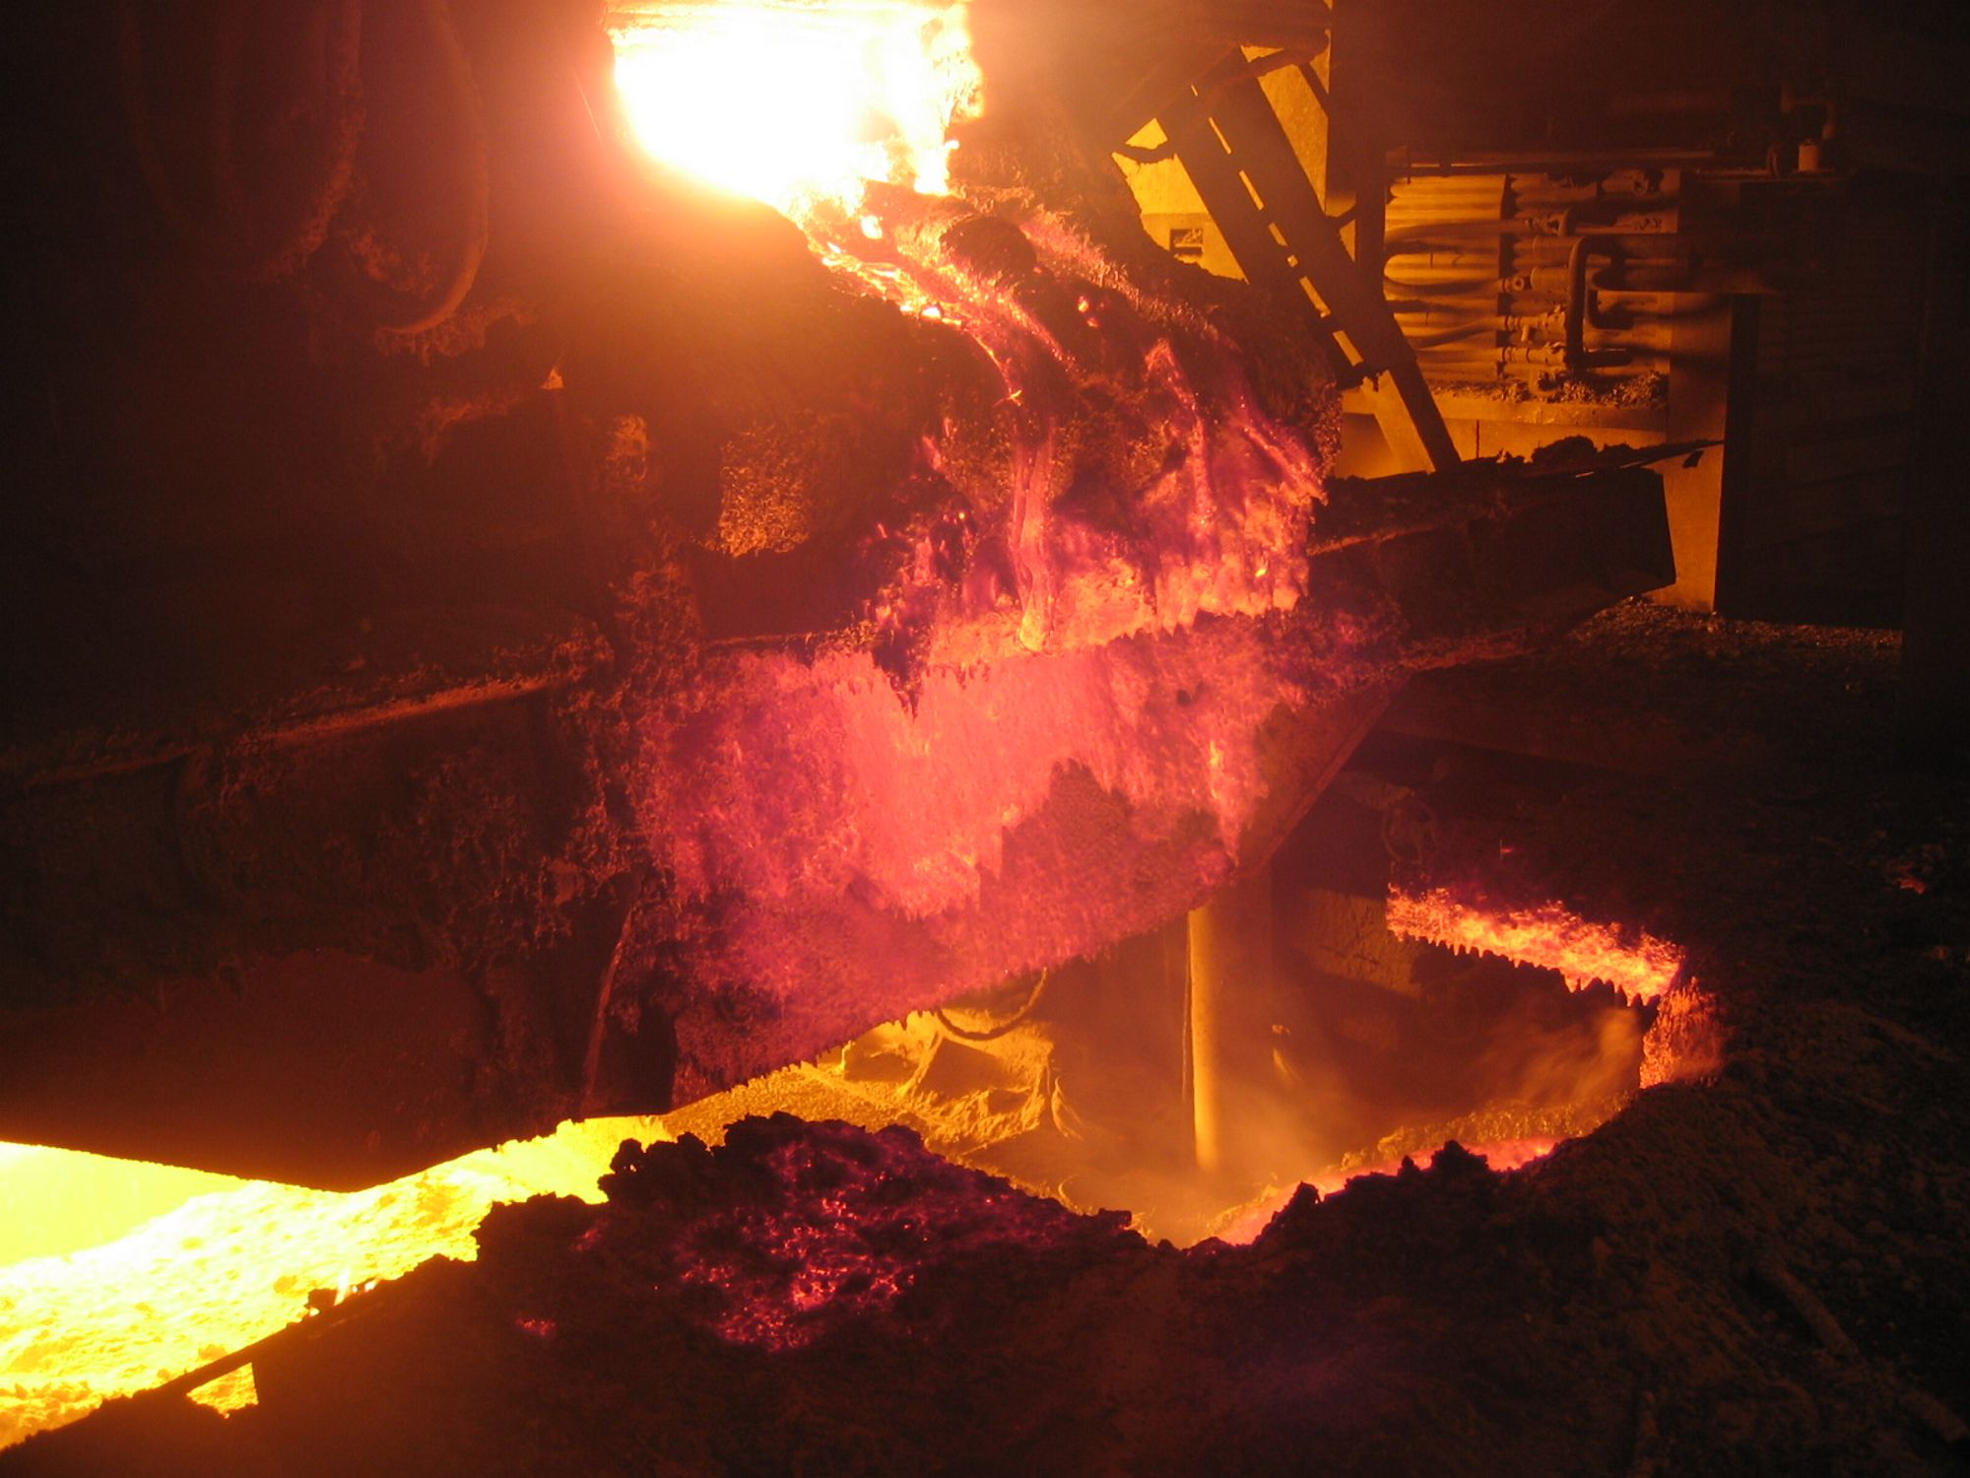

Slide 10
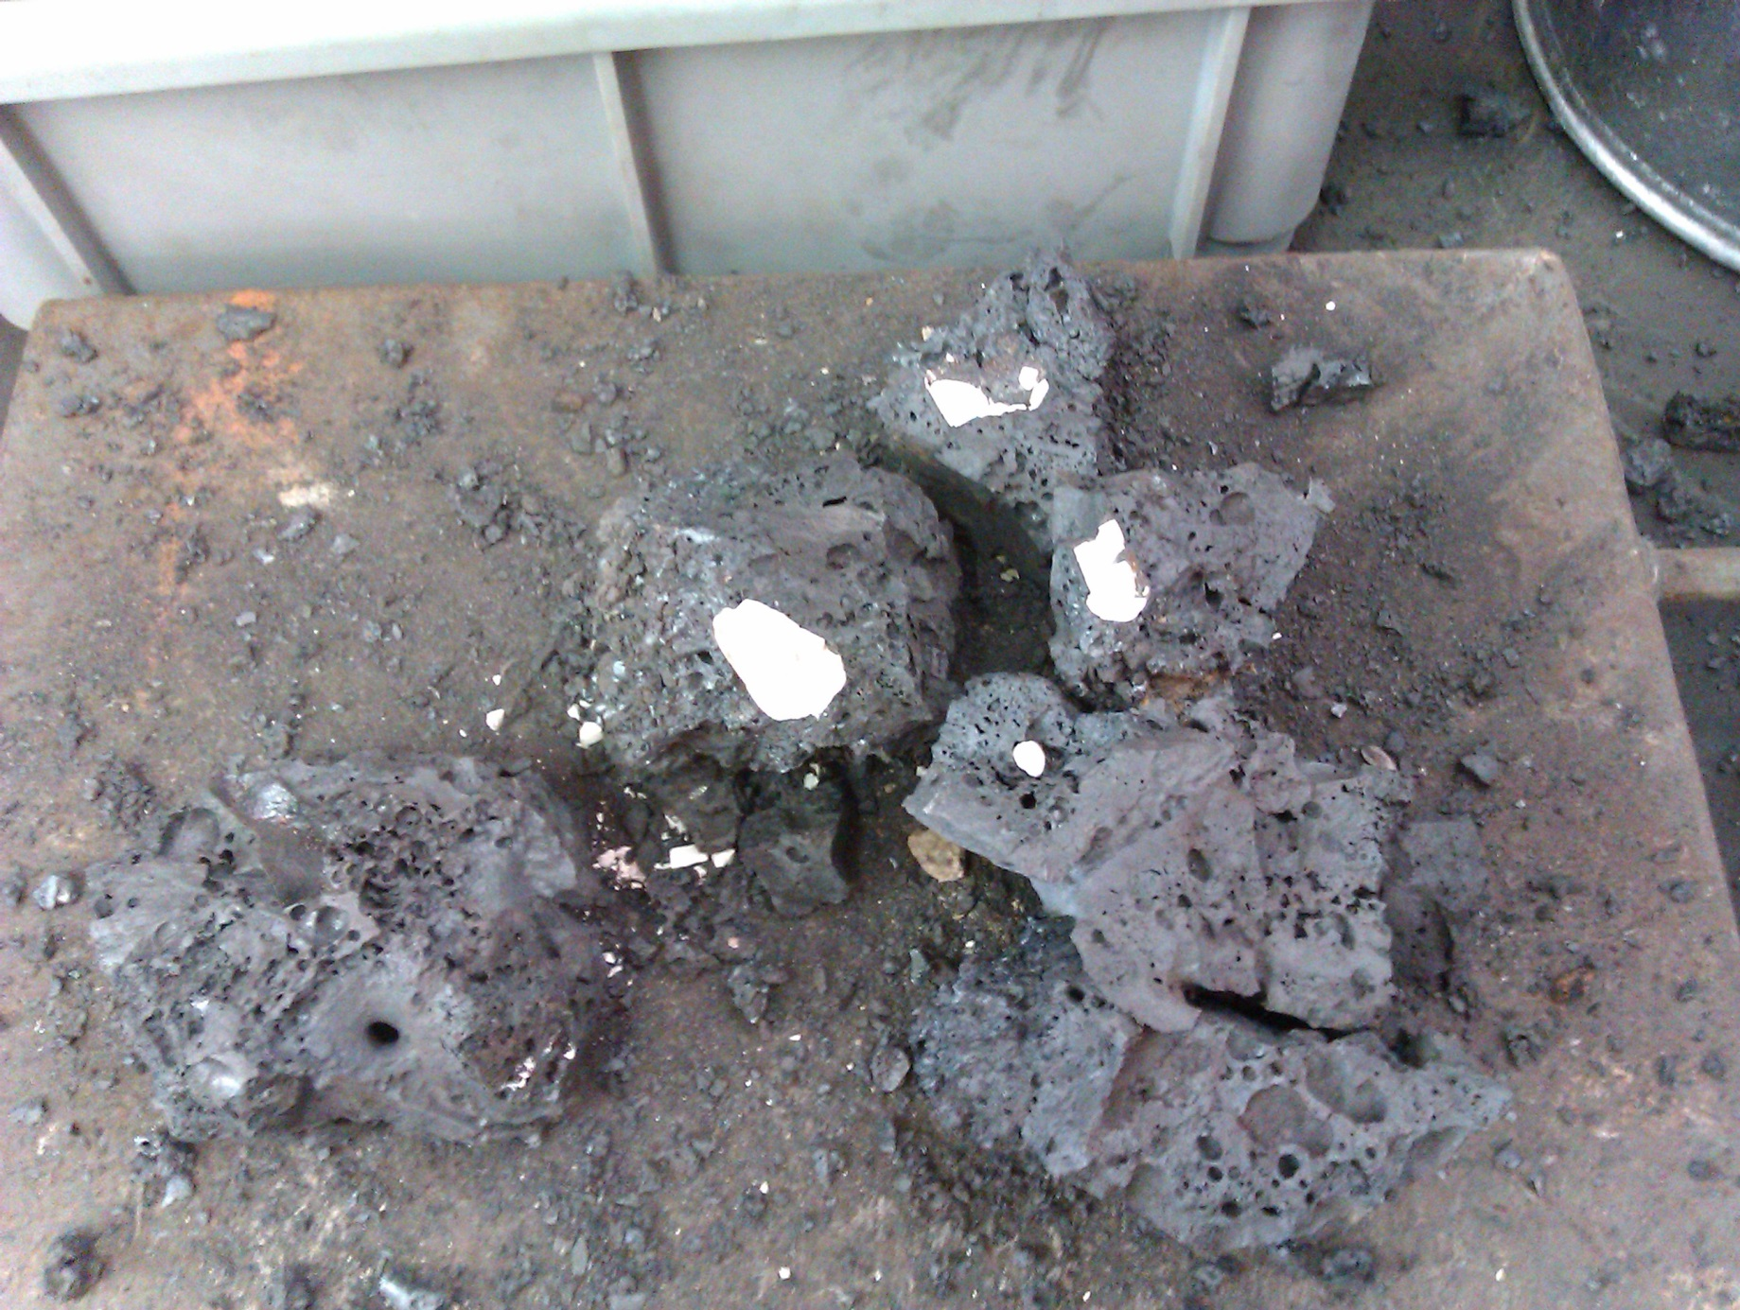
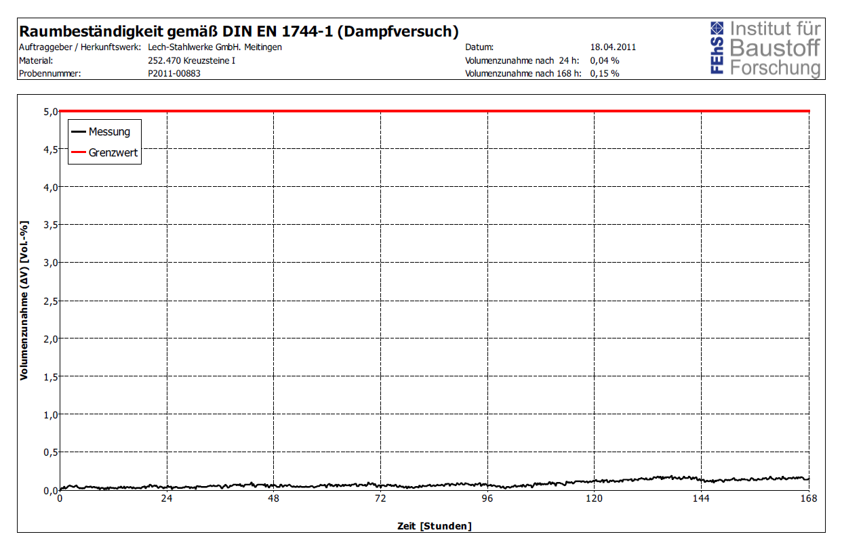

Slide 11
Environmental
Behaviour

Slide 12
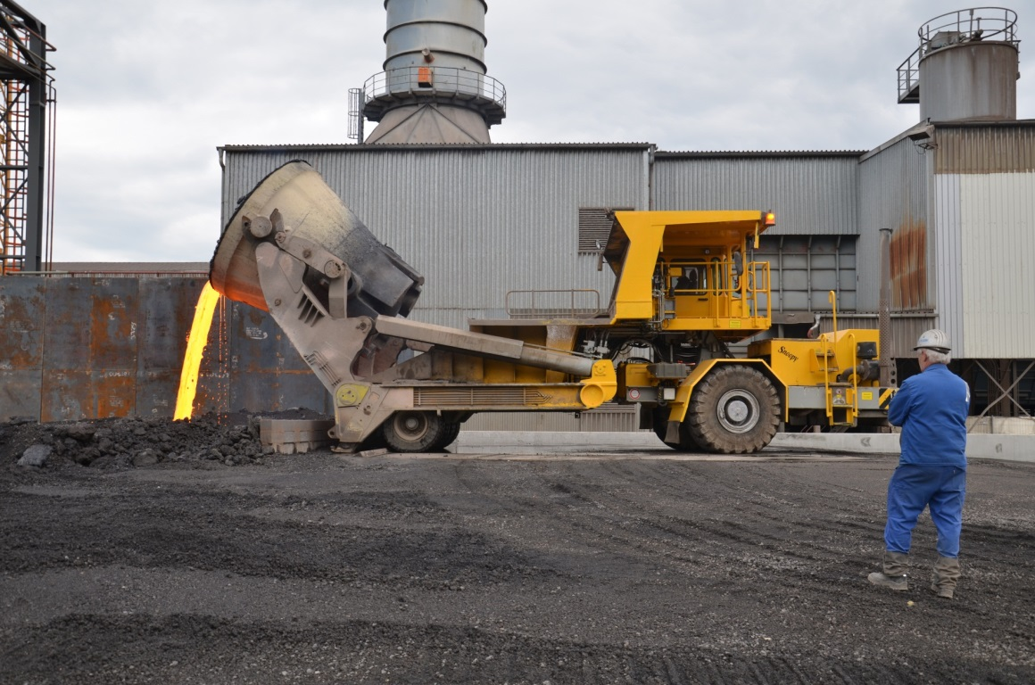
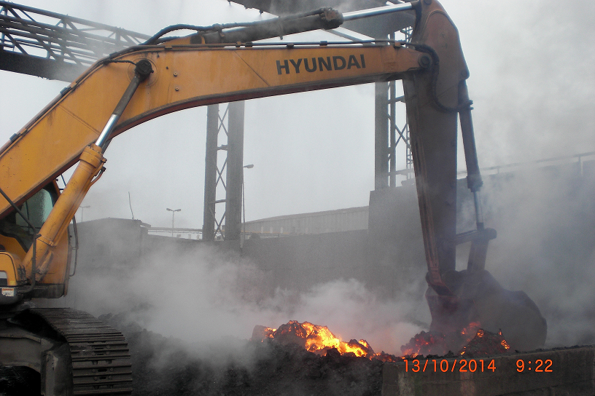

Slide 13
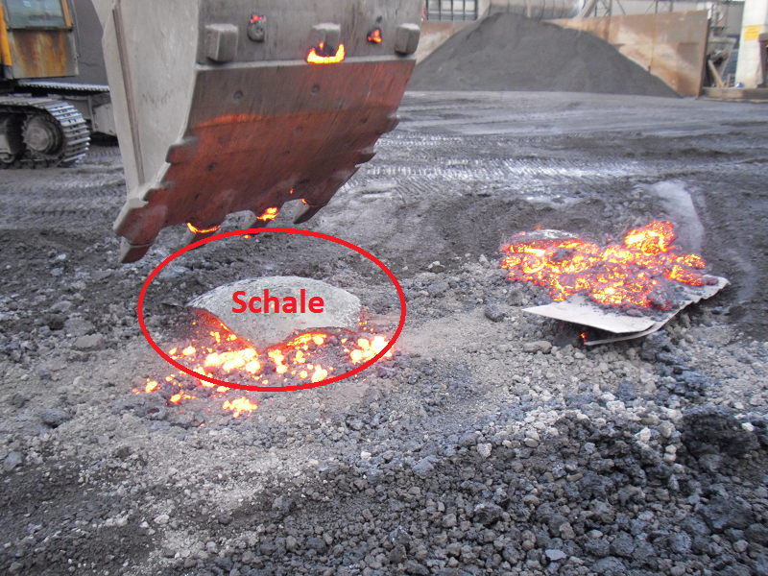

Slide 14
Classification of „Schale“ (shell = worst case)) concerning environmental behaviour of slag as function of the scrap quality

Slide 15
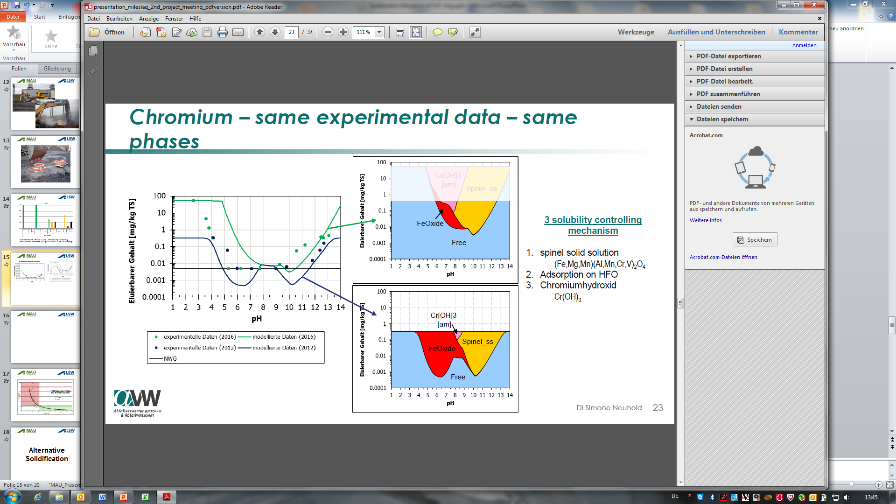
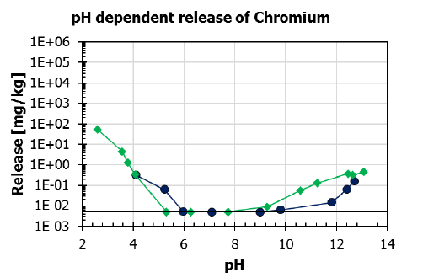
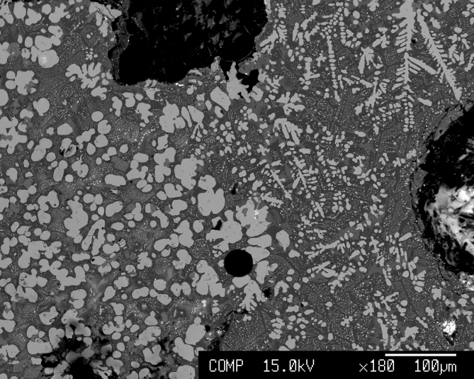

Slide 17
>100 measured values with 90% from operational tests

Slide 18
Alternative
Solidification

Slide 19
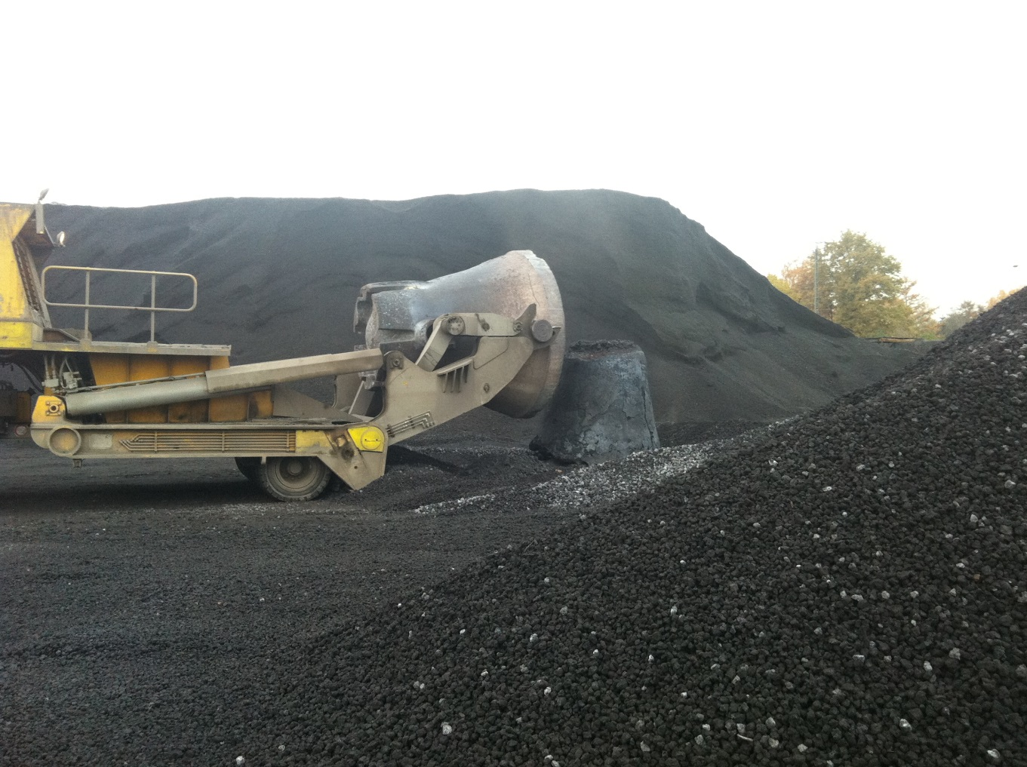
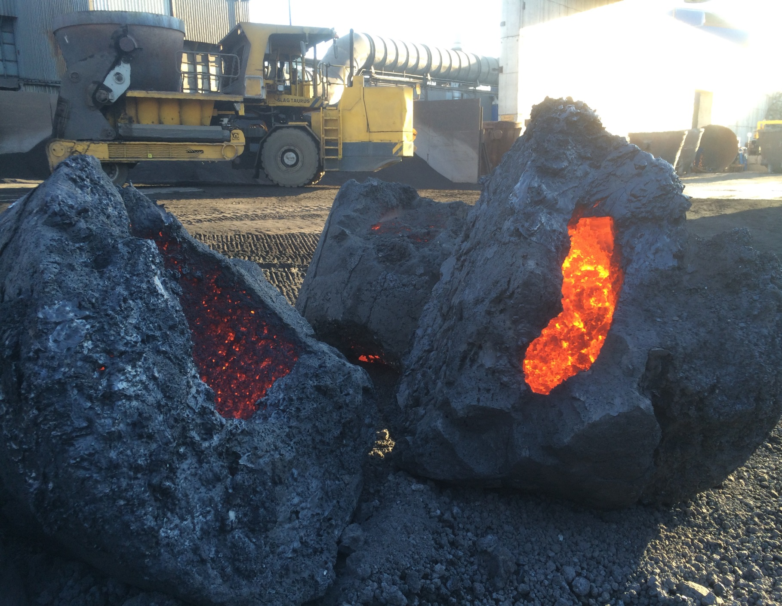
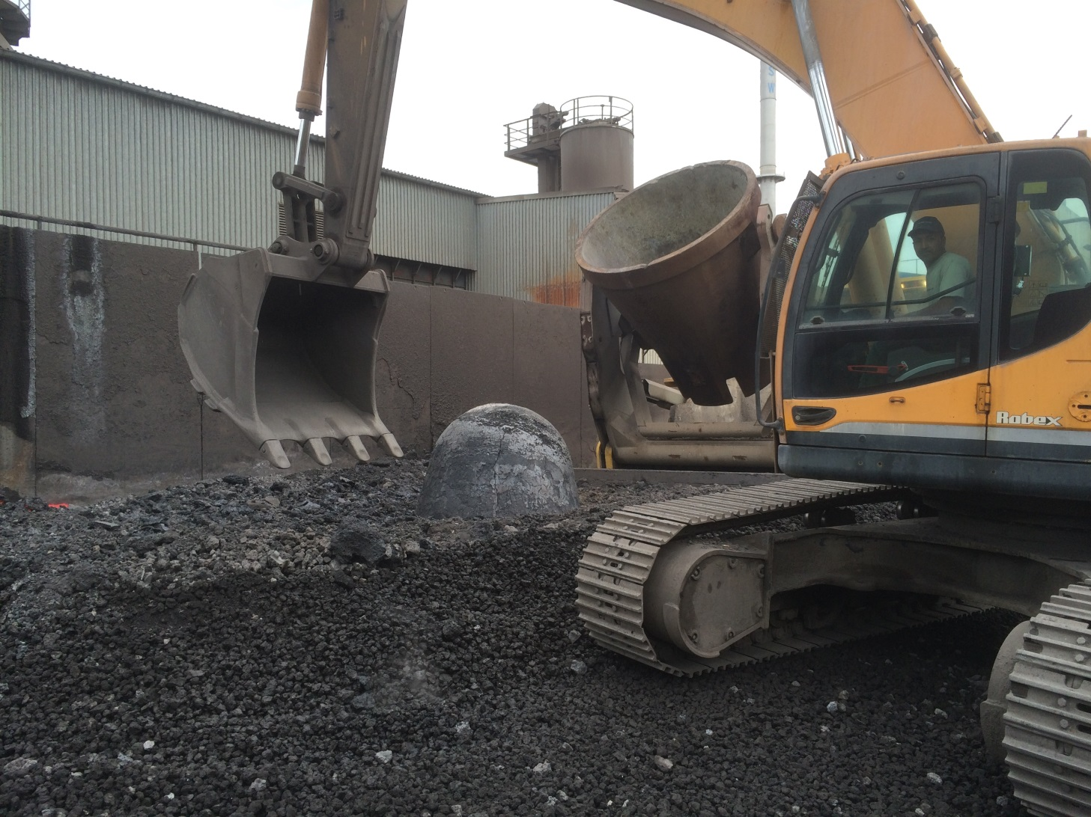
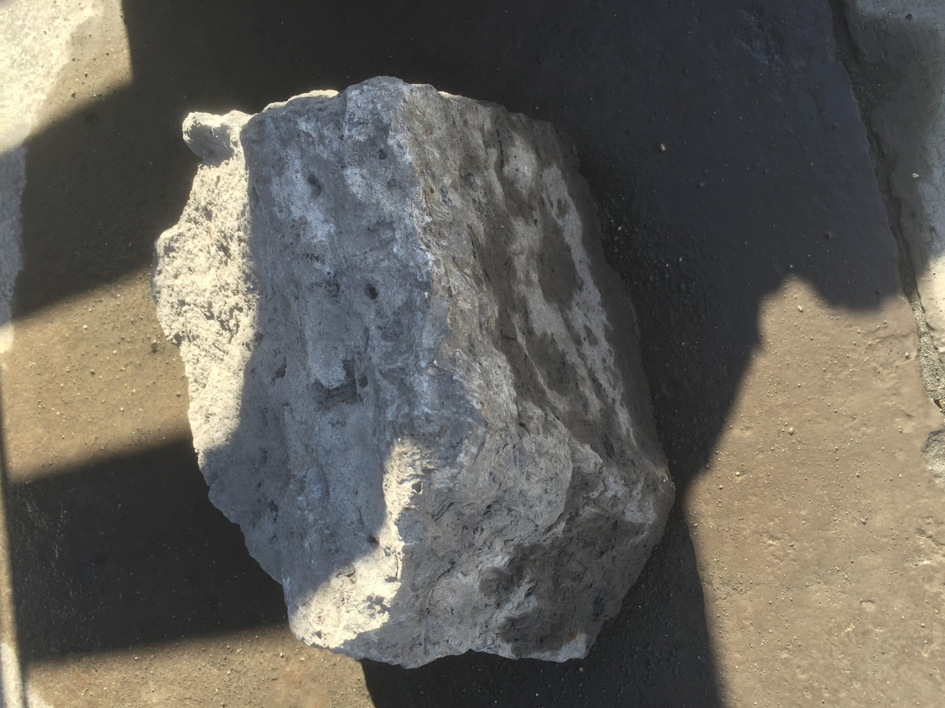
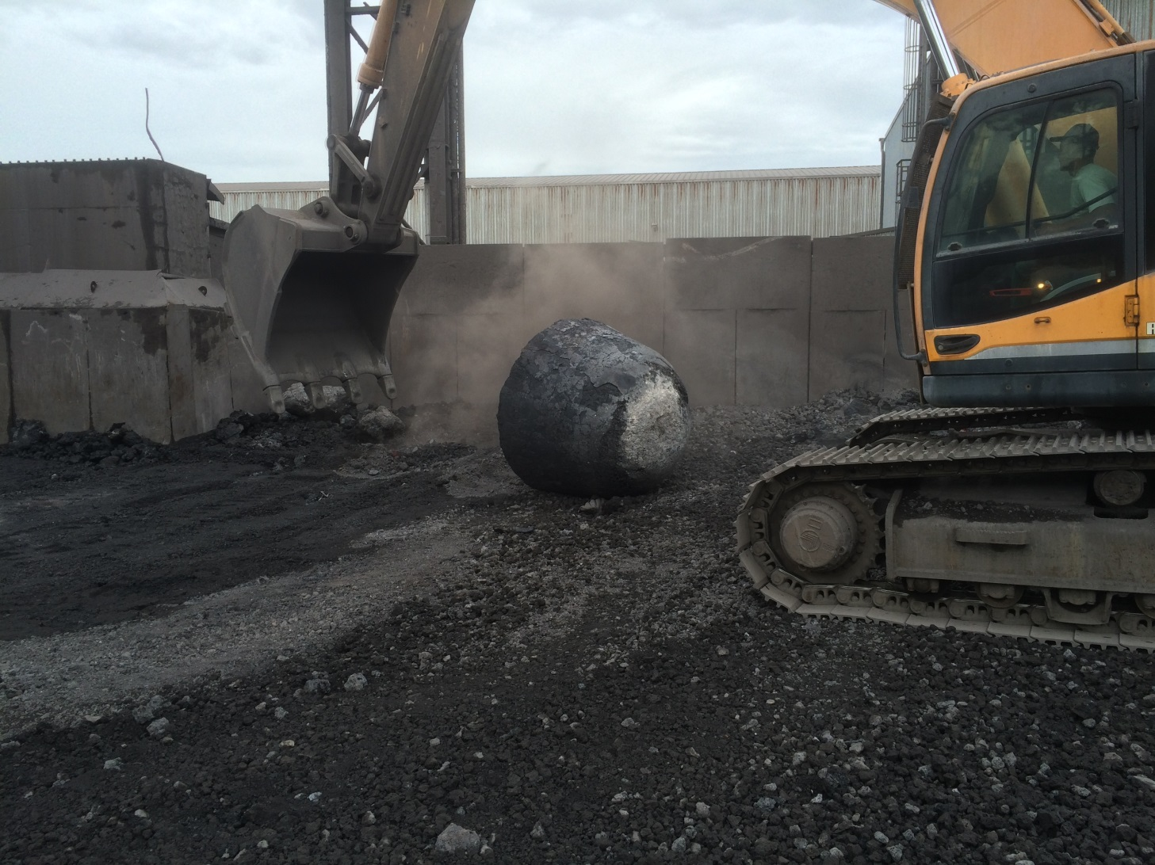
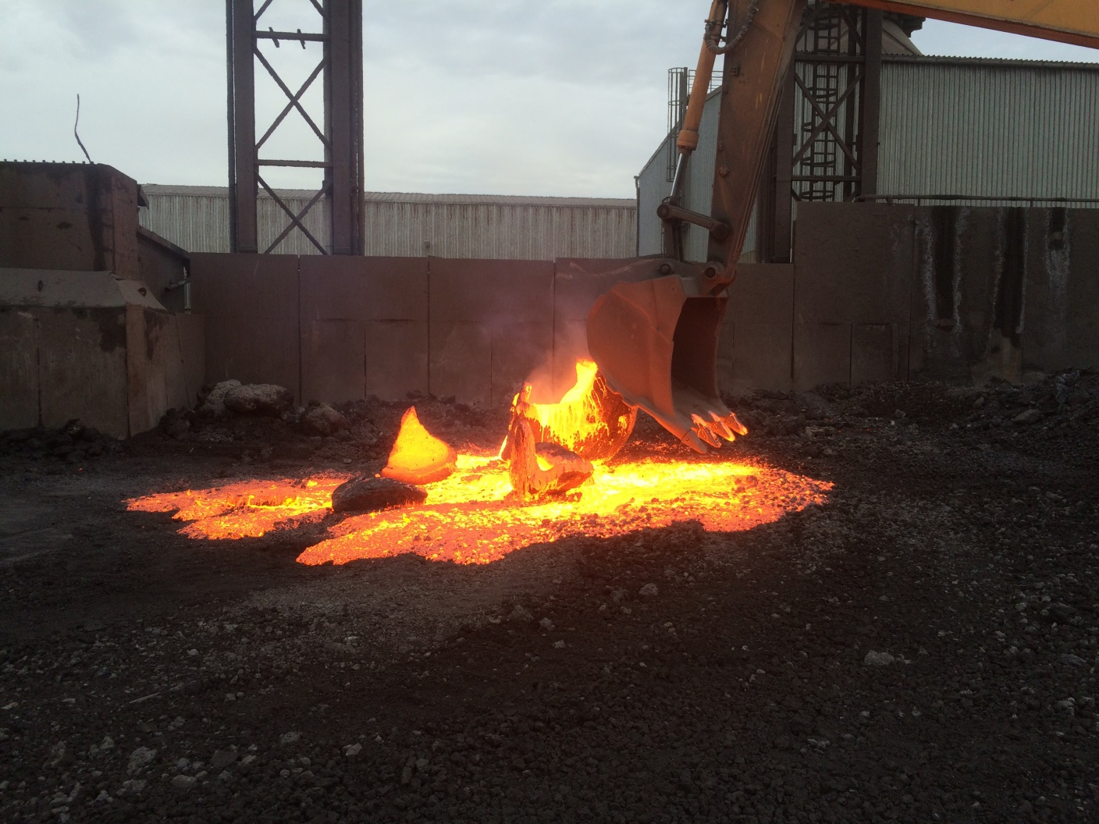

Slide 20
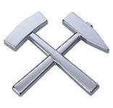
GLÜCK AUF !

