Slide 1
CO₂ Capture at High Temperature Using Slag – Derived Lithium Silicates
B. Alcánter, R. Schouwenaars, R.M. Ramírez Zamora
Instituto de Ingeniería,
Universidad Nacional Autónoma de México,
Avenida Universidad 3000, Coyoacán,
04510, México D.F.
Departamento de Materiales y Manufactura,
Universidad Nacional Autónoma de México,
Avenida Universidad 3000, Coyoacán,
04510, México D.F.

Slide 2
Introduction
General goal of the research group:
Waste valorisation for environmental applications
Examples:
Recovery of heavy metals using activated carbon produced from high-sulphur petroleum coque.
Production of zeolites from copper mining tailings.
Production of zeolites and cellular ceramics from water potabilisation sludge
Catalysis and photocatalysis by means of copper slag
Removal of As and B from groundwater by means of iron and steel slag

Slide 3
Introduction
CO₂ capture at point sources:
Separation of CO₂ from flue gas (capture)
Recovery of CO₂ for sequestration and regeneration of reagents.
Issues
Energy balance
Efficiency
Lifetime of reagents

Slide 4
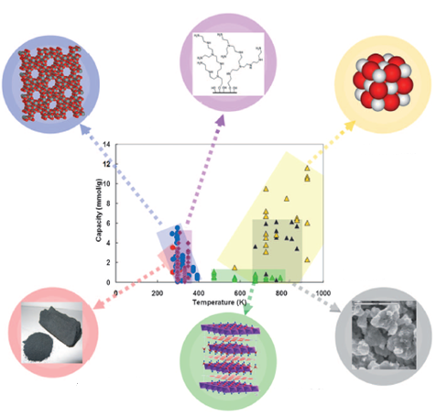
Introduction
Materials for CO₂ capture:
Slag
Organic-inorganic hybrids
Zeolites
CaO
Alkaline ceramics
Li-silicates produced from slag
Activated carbons
Hydrotalcites

Slide 5
Introduction
Issues in materials selection:
Alternative materials proposed for silicate-based materials:
Material | Selectivity | High temperatura capture | Kinetics | Regeneration | Stability | Cost
CaO
Li₂ZrO₃
Li₄SiO₄
Waste or by product | CO₂ capture capacity | Reference
Rice husk ash | High / 15 cycles | Wang, 2011.
Fly ash | High / 10 cycles | Olivares-Marín, 2011.

Slide 6
Introduction
Goal of the present work:
Use CaO present in slag for CO₂- capture.
Evaluate slags as source of silicate material for the production of Li-silicates for CO₂- capture.
Materials used
S1: Blast furnace slag
S2: Electric induction furnace slag

Slide 7
Experimental:
Slag and product characterisation:
XRF
XRD
Surface area by means of adsorption-desorption of N₂ (BET-isotherm)
Silicate synthesis
Mixing of Li₂CO₃ with ground slag at a Li₂CO₃ /SiO₂ ratio of 2:1
Calcination at 850°C for 8h.

Slide 8
Experimental:
Analysis of CO₂ capture
Temperature programmed carbonation
Temperature programmed decarbonation
TPC: 100 mg of sorbent placed in He-gas stream with 5 % (molar fraction) of CO₂.
Heating at 5°C/min
TPD: samples saturated with CO2 at temperatures between 500 and 650°C for 1 h.
Desorption by 30 mL/min He-flow
Ramp of 10°C/min up to 850°C

Slide 9
Results:
Mineral composition of raw slag
 | Mineralogical phases | Semicuantitative (RIR)
S1 | Aluminite: Al₂SO₄(OH)₄∙7H₂O Alite: Ca₃SiO₅ | 79 21
S2 | Larnite: Ca₂SiO₄ Brownmillerite: Ca₂(AlFe)₂O₅ Quartz: SiO₂ | 75 22 3

Slide 10
Results:
Mineral composition after treatment
 | Mineralogical phases | Semicuantitative (RIR)
S1 | Lithium silicate: Li₄SiO₄ Lime: CaO β Eucryptite: LiAlSiO₄ α Eucryptite: LiAlSiO₄ Alite: Ca₃SiO₅ | 47 20 18 8 7
S2 | Acmite: FeLiO₆SiO₂ α Eucryptite: LiAlSiO₄ Pseudoeucryptite: Li_{0.9}AlSiO₄ γ Eucryptite: LiAlSiO₄ Lithium and manganese oxide | 27 23 17 13 8

Slide 11
Results:
N₂ adsorption and specific surface area
Raw slag
S1: 4.4 m²/g
S2: 1.2 m²/g
Modified slag
S1: 1m²/g
S2: 1 m²/g

Slide 12
Results:
TPC-TPDC

Slide 13
Discussion:
Both slags show a conversion point of 595°C
Slag 1 shows higher CO₂ capacity
Production of Li₄SiO₄ as compared to more complex silicates in slag 2.
Presence of CaO
Both slags show some sintering during synthesis.

Slide 14
Conclusions:
Li-based sorbents for CO₂ capture could successfully be prepared from steel slag.
The amount of CO₂ removed of material compares favourably with other proposed sorbents
The inversion temperature of the present material is lower than other lithium and calcium based materials reported in literature.

Slide 15
Acknowledgement
The authors acknowledge support to their laboratories under DGAPA grant n° IV100616.

