Slide 1

The Effect of Slag Composition on its
Alkali-Activation
Peter Keeley^{1,2}, Neil Rowson¹, Tim Johnson ², David Deegan²
¹School of Chemical Engineering, University of Birmingham, UK.
²Tetronics International, Swindon, Wiltshire, UK.
5th International Slag Valorisation Symposium, 3rd April 2017.

Slide 2

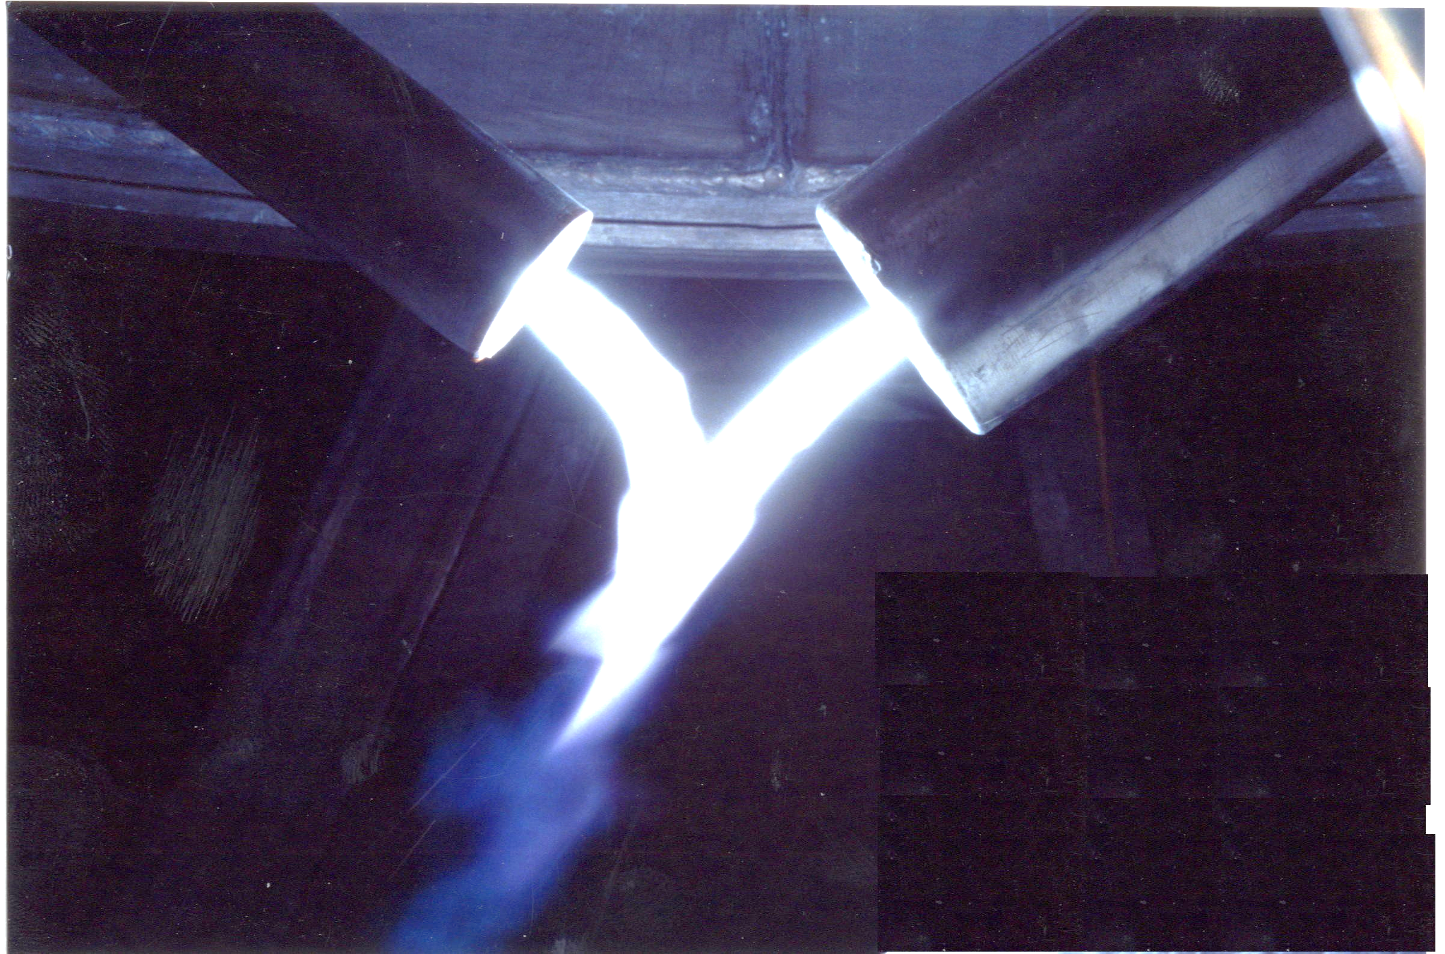
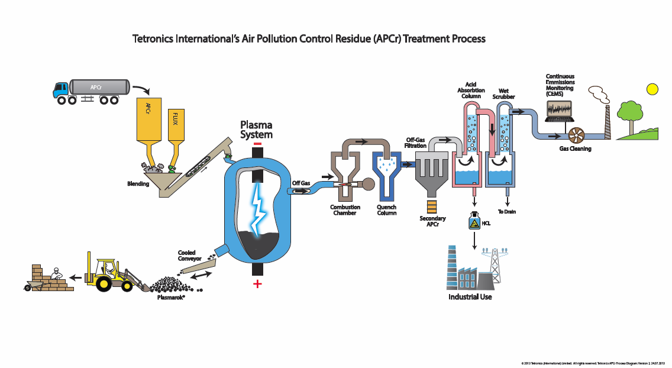
Plasma is an intense but clean heat source which is used for a wide range of industrial applications.
Tetronics have 90+ plasma installations around the world and applications involve:
Hazardous waste vitrification processes.
Air pollution control residue vitrification.
Metal recovery processes.
Recovery of ferrous alloys from electric arc steel furnace dust.
Recovery of precious metals from waste.
Installed PGM recycling capacity circa 1.2 million troy oz. per year.

Slide 3
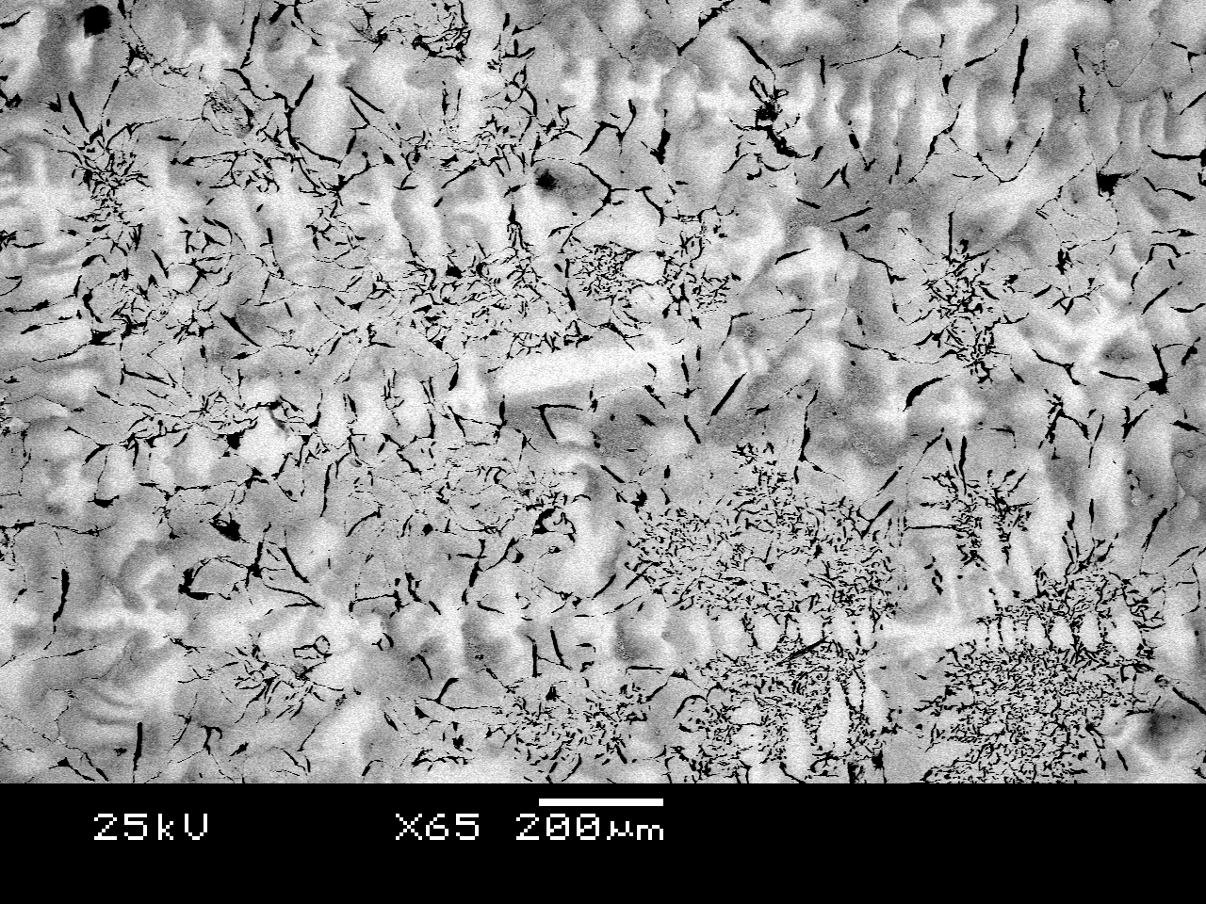
Precious and metals are extracted from waste materials like catalysts in a plasma furnace.
FLUX
CATALYST
COLLECTOR METAL
Collector metal
OFF GAS
Target metals
Fe
SLAG
METAL
Pt and Re containing Fe-alloy. Bright phases are where the Pt and Re are located.

Slide 4
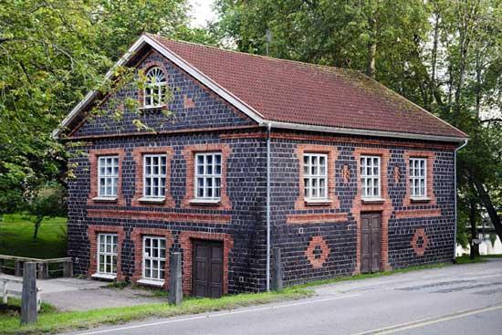
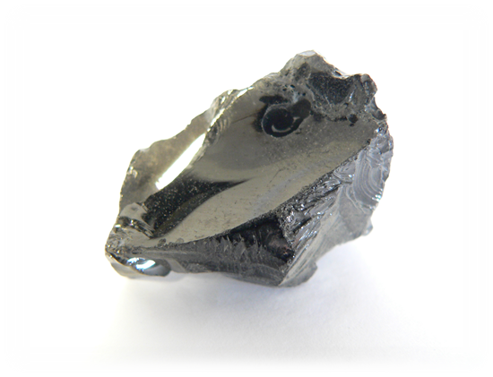
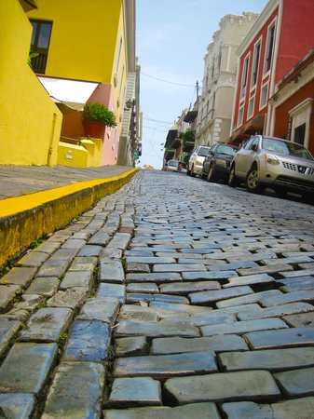
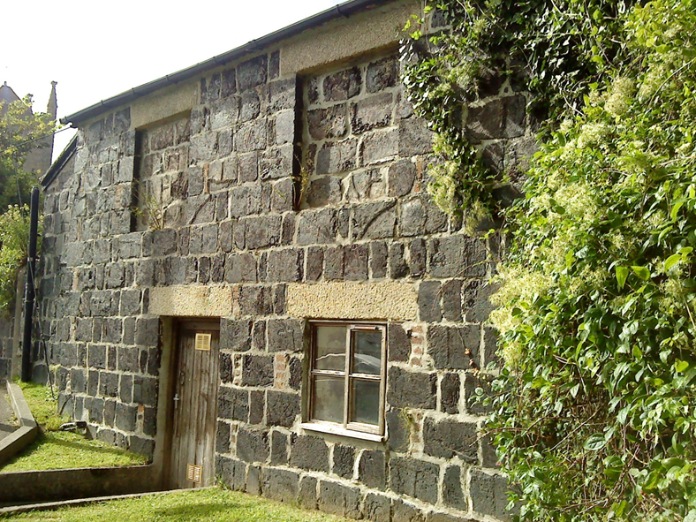
Most plasma processes produce large volumes of slag.
A precious metal recovery plant would produce around 3000 to 4000 tonnes per year.
A hazardous waste treatment plant would produce between 30,000 to 40,000 tonnes per year.
A mill made out of slag bricks in Finland early 20th century.
Increasing the value of this material would have significant economic impacts on the process.
One of the most successful applications of slag has been as a cement replacement.
Church vestry in Cornwall built in the early 19th century.
Cobble stones in San Juan Puerto Rico made from slag circa 18th century!

Slide 5
Waste is variable and materials processed using plasma vary.
The composition of APCr from municipal solid waste varies greatly depending on the country of origin and the removal techniques.
Ultimately we end up with slags with different compositions.
We wanted to find the effect of this composition variation on the alkali-activation.

Slide 6
Slag source
Si and Al species dissolve from the slag in an alkaline environment.
Dissolution of species
Gelation
Dissolved silicate and aluminate species coagulate and poly-condense to for a gel phase.
Polymerization and hardening
The gel phase reorganizes and hardens developing high mechanical strengths.
Binding phase
Unreacted slag

Slide 7
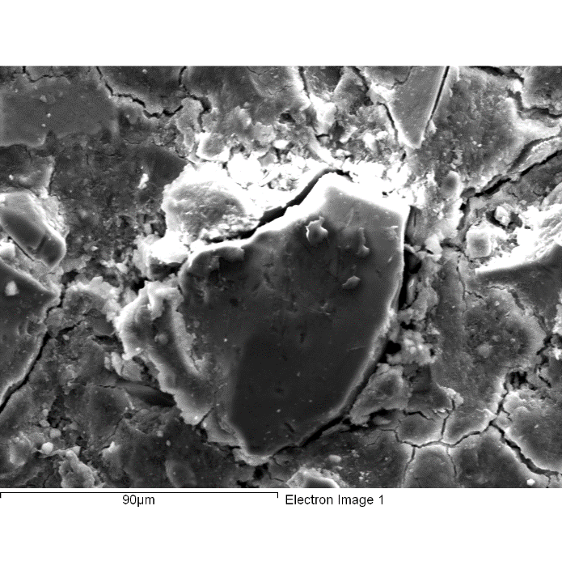
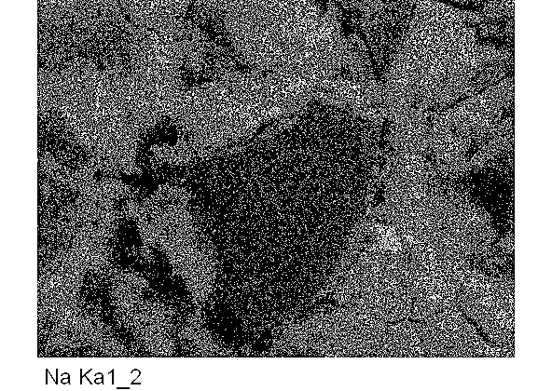
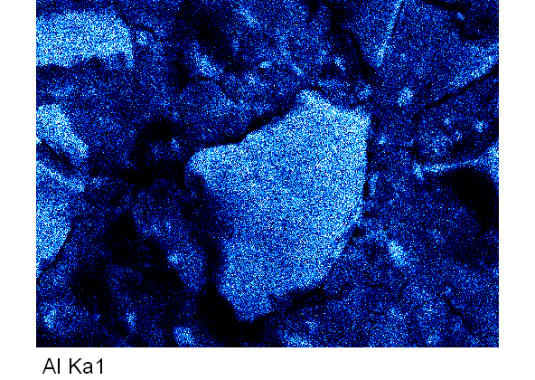
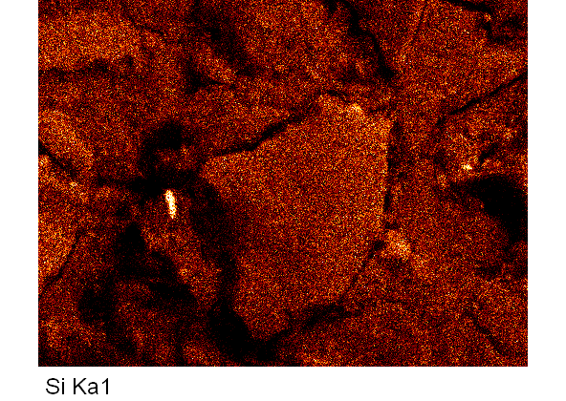
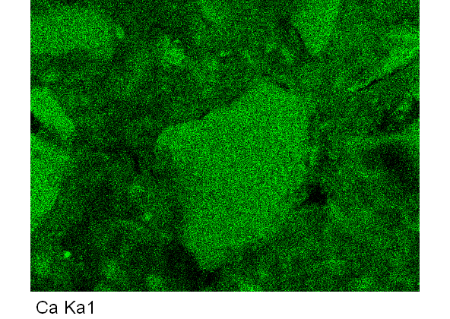
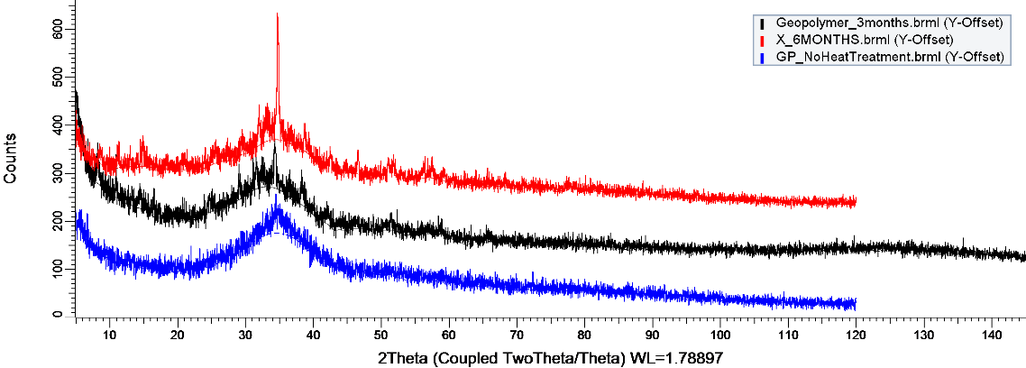
The binding phase is a calcium-sodium-aluminium-silicate-hydrate and so can be represented as a C-(N)-A-S-H binding phase.
The binding phase is at first amorphous but gradually develops a semi-crystalline structure over time.
6 months
3 months
1 month

Slide 8
The composition of the binding phase is important for material properties:
Si/Al ratio
An increased substitution of Si by Al the binding phase framework reduces the strength of the material.
As the Si/Al ratio increases, the strength of the material increases.
Ca/Si ratio
Increased calcium in the binding phase can promote the formation of calcium silicate hydrate (CSH) phases.
These CSH phases contain short silicate chains where calcium acts as a bridge rather than silicate sheet structures present in AA binders where calcium acts as a charge balancer.

Slide 9
Si/Al ratio greatly effects the strength of the binding gel. The more Al substitution for Si in the framework, the weaker the structure.
However…
Silicon dissolves much more slowly
than aluminium from the slag.
Si-O bonds are stronger than Al-O bonds
and are more stable under attack.
The strength of the binder is closely related to the reactivity of the slag.
A high silicon content in a slag reduces it reactivity.

Slide 10
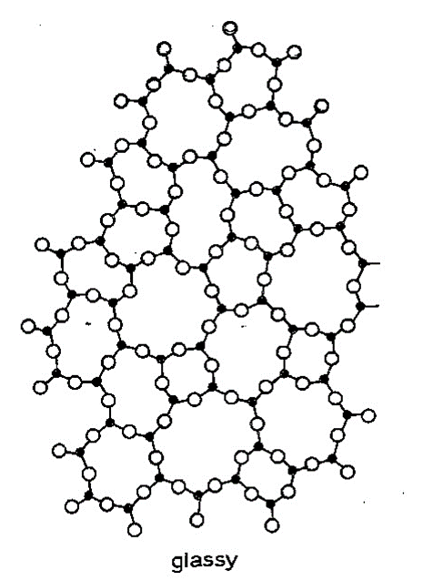
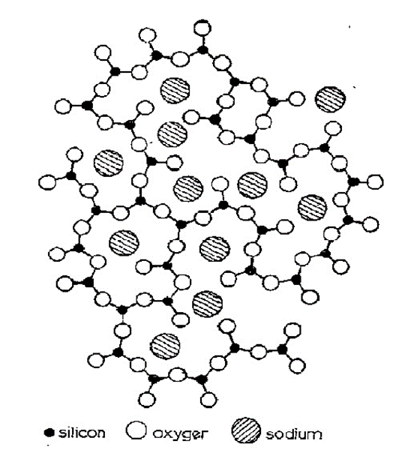
A high silicon content in the slag causes a greater polymerisation of the slags structure. A greater polymerisation decreases a slag’s reactivity during alkali-activation.
Components in the slag act to either break up the silicate network or to increase and stabilise it.
Components such as Ca²⁺ and Na⁺ depolymerise the slag’s structure and make the slag more reactive.
Decrease Polymerisation
Increase Polymerisation
Can do both!
Network Modifiers (Basic oxides) | Network Formers (Acidic oxides) | Amphoteric Oxides
Na₂O | SiO₂ | Al₂O₃
CaO | TiO₂ | Fe₂O₃
MgO | P₂O₅
FeO

Slide 11
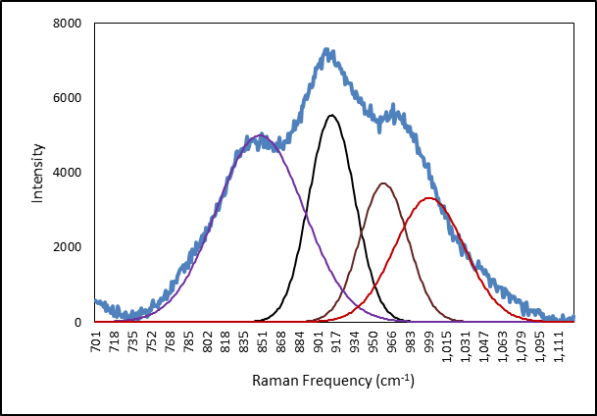

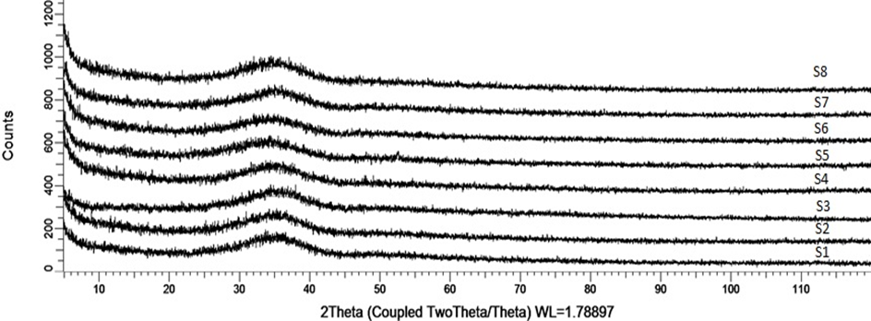
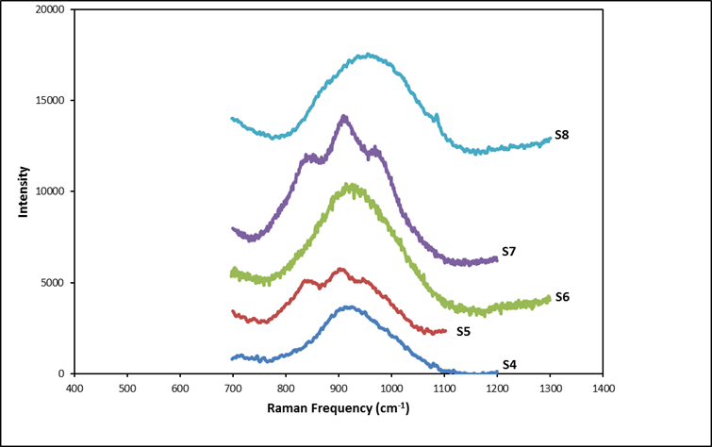
Slags have a complex structure, with a number of silicate structures.
Even though different slag compositions all appear fully x-ray amorphous…
…the slags still show the presence of different silicate structures. Some are more polymerised than others.

Slide 12
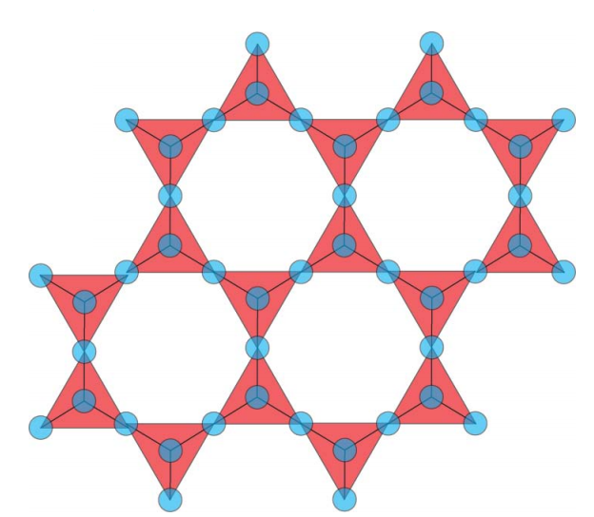
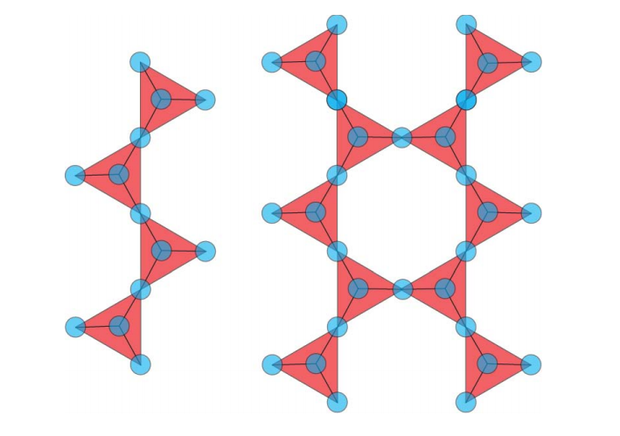
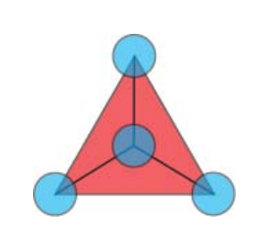
SiQ₀
SiQ₁/SiQ₂
SiQ₃/SiQ₄
Increase in slag polymerisation

Slide 13
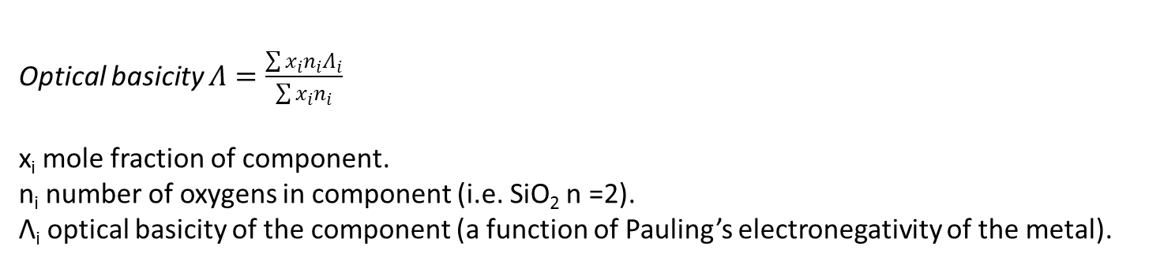
Attempt to predict the depolymerisation by the composition of the material using basicity calculations.
Optical basicity $Λ=\frac{\sum{x_{i}n_{i}Λ_{i}}}{\sum{x_{i}n_{i}}}$
x_{i} mole fraction of component.
n_{i} number of oxygens in component (i.e. SiO₂ n =2).
Λ_{i} optical basicity of the component (a function of Pauling’s electronegativity of the metal).
Network modifiers increase the basicity of the composition.
As the optical basicity increases, the reactivity of the slag increases.
An optical basicity greater than 0.615 tends to produce slags glasses with greater depolymerisation.
Greater depolymerisation

Slide 14
Influence of processing conditions
Internal voids from process flaws
Compaction of the paste in the mould prior to curing helps to increase the green body density of the material.
This improves the characteristic strength of the material and reduces the variability of the material’s strength.

Slide 15
Other Processing Variables
The reactivity of the slag can be increased by decreasing its particle size and a higher curing temperature.
Nucleation seeds can be added to increase the strength of the material. Ca(OH)₂ additions to the mix cause an increase in the strength of the material.
The low dissolution rate of silicon from slag can be alleviated by using Na₂SiO₃ (sodium silicate solution which has pre-dissolved silicate ions).

Slide 16
Sodium silicate solution can be used to overcome the problem of low silicon dissolution from the slag.
O
Na⁺
Na⁺
Na₂SiO₃
Si
O⁻
O⁻
Silicate ions can reinforce the silicate ions released from the slag and so increase the Si/Al ratio in the binding gel.
Increased silicon content in the gel causes a shift towards a more polymerised gel framework.

Slide 17
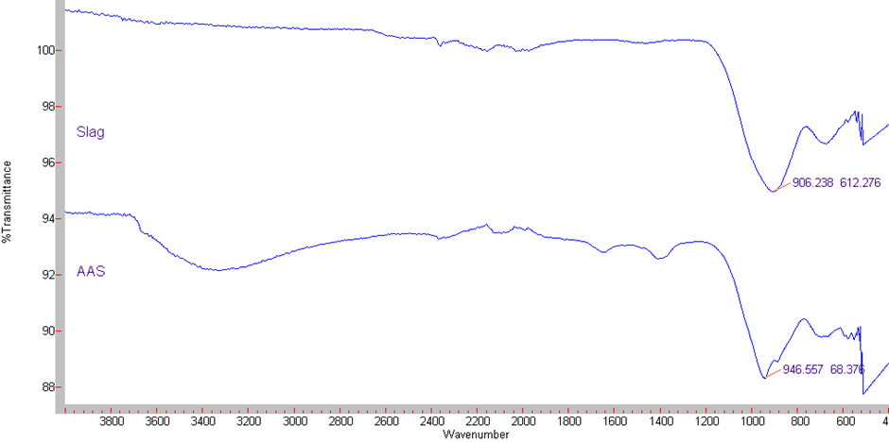
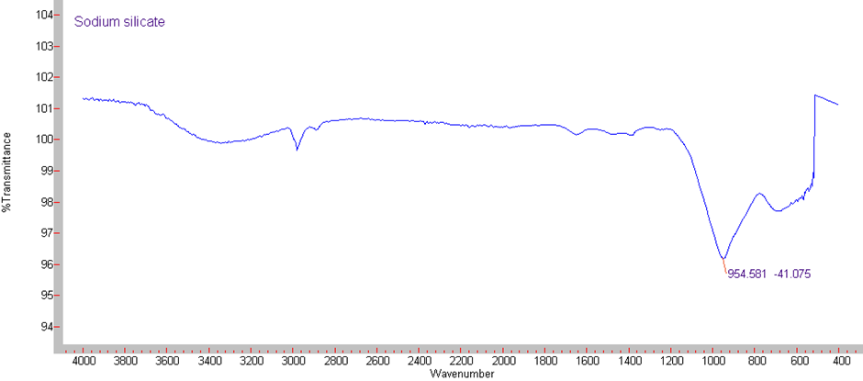

Slide 18
Conclusions
Generally, alkali-activated slags have greater strength than ordinary cement based concretes and have a much smaller CO₂ footprint.
The chemistry of the slag and the polymerisation of the slag’s structure has a great effect on its performance as a cement replacement.
Processing conditions also influence the characteristics of the material, just like any ceramic material.
The consistency of cement gives a predictable and less complex material than the alkali activated slags.
Understanding the multicomponent nature of the alkali activated slags presents a challenge before it can be widely used.
The lack of regulations and specifications surrounding new binders are a practical barrier to their commercialisation.

Slide 19



Thank you.
Any questions?
Acknowledgments
EPRSC
University of Birmingham – Professor Neil Rowson, Dr. Richard Greenwood
Tetronics International – Dr. David Deegan, Dr. Tim Johnson

