Slide 1
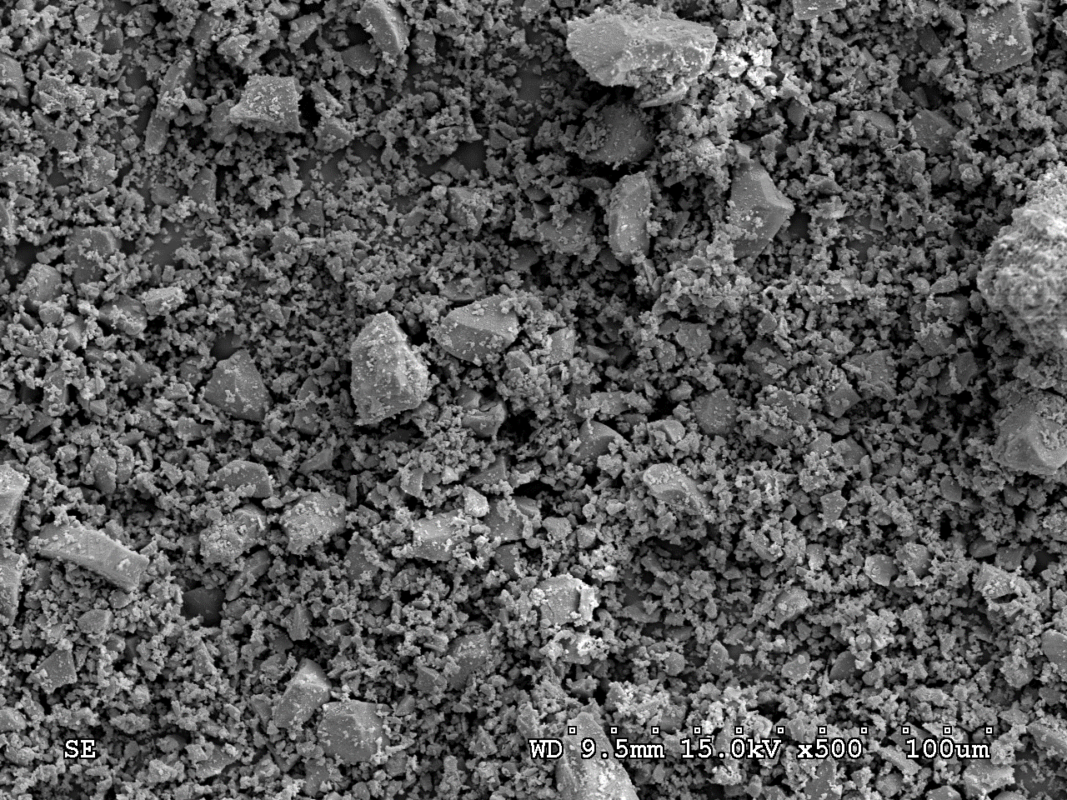
Initial Approach to the Alkaline Activation of
Ground Granulated SiMn Slag
Rosa NAVARRO¹, Eva G. ALCOCEL², Pedro GARCÉS¹, Verónica FERRÁNDIZ-MAS³, Emilio ZORNOZA¹
1 Department of Civil Engineering, University of Alicante, Spain
2 Department of Architectonical Constructions, University of Alicante, Spain
3 Department of Civil and Environmental Engineering, Imperial College, United Kingdom
Objective
Results
The aim of this research is to explore the viability of using ground-granulated SiMn slag as raw material for producing alkali-activated binders. For that reason, the slag has been characterized in terms of its chemical composition, mineralogy, physical properties and microstructure. The factors and interactions which affect the properties of pastes were studied by ad-hoc designs based on the d-optimal criterion.
Experimental
Composition of the SiMn slag determined by X-ray fluorescence analysis
Comp. | % | Comp. | % | Comp. | % | Comp. | %
SiO₂ | 36.53 | MgO | 4.69 | SO₃ | 2.77 | SrO | 0.14
CaO | 29.10 | Fe₂O₃ | 0.92 | Cl⁻ | 0.16 | TiO₂ | 0.19
MnO | 12.23 | K₂O | 1.08 | BaO | 1.60 | ZrO₂ | 0.04
Al₂O₃ | 9.86 | Na₂O | 0.34 | P₂O₅ | 0.35 | L.O.I. | -1.25
SEM image of the ground-granulated SiMn slag
Particle size distribution of ground-granulated SiMn slag
DRX analysis of ground-granulated SiMn slag
Alabandite (MnS) | Graphite (C) | Vitreous
2% | 2% | 96%
Equation of the presence-absence model
y = β₀ + β_{A1}X_{A1} + β_{Β1}X_{Β1} + β_{C1}X_{C1} + β_{C2}X_{C2} + β_{D1}X_{D1} + β_{D2}X_{D2} + β_{A1Β1}X_{A1}X_{Β1} + β_{A1C1}X_{A1}X_{C1} + β_{A1C2}X_{A1}X_{C2} + β_{Β1C1}X_{Β1}X_{C1} + β_{Β1C2}X_{Β1}X_{C2} + β_{A1D1}X_{A1}X_{D1} + β_{A1D2}X_{A1}X_{D2} + β_{Β1D1}X_{Β1}X_{D1} + β_{Β1D2}X_{Β1}X_{D2} + β_{C1D1}X_{C1}X_{D1} + β_{C1D2}X_{C1}X_{D2} + β_{C2D1}X_{C2}X_{D1} + β_{C2D2}X_{C2}X_{D2} + ε
Factors and levels chosen for the proposed experimental design.
Factor | Number of levels | Levels
Fineness | 2 | A1 | 5500 cm²/g
 |  | A2 | 6800 cm²/g
Activator | 2 | B1 | NaOH
 |  | B2 | WG
%Na₂O | 3 | C1 | 3.0%
 |  | C2 | 4.0%
 |  | C3 | 5.5%
s/s ratio | 3 | D1 | 0.35
 |  | D2 | 0.40
 |  | D3 | 0.45
Graphic analysis of the effects of the studied experimental factors on the response for compressive strength at 7 (left), 14 (center) and 28 (right) days of curing time. Light orange bars are for significant coefficients (5% significant level); dark blue bars are for the non-significant ones.
Compressive strength of pastes after 7, 14 and 28 days of curing time.
Conclusions
Fineness (cm²/g) | Activator | %Na₂O | s/s | Sc 7 days (MPa) | Sc 14 days (MPa) | Sc 28 days (MPa)
6800 | NaOH | 4.0 | 0.35 | 21 | 35 | 43
6800 | NaOH | 3.0 | 0.35 | 9 | 28 | 33
6800 | NaOH | 4.0 | 0.40 | 18 | 21 | 31
6800 | WG | 4.0 | 0.35 | 18 | 31 | 41
5500 | WG | 5.5 | 0.40 | 17 | 19 | 33
6800 | WG | 5.5 | 0.35 | 23 | 31 | 29
1. The compressive strength developed by the alkali activation process of ground granulated SiMn slag depends on: slag fineness, type of activator, %Na2O and solution to slag ratio.
2. In order to enhance the compressive strength it should increase slag fineness, use NaOH as activator, increase %Na2O and decrease solution to slag ratio
Acknowledgements
The authors wish to thank the Spanish Ministry of Economy and Competitiveness and European Union (FEDER) for project funding (BIA 2014-58194-R). The authors also wish to thank Cristina Rodríguez from Ferroatlántica, S.A., for the supply of SiMn slag necessary to carry out this research

