Slide 1


Utilization of activated GGBS for non-reinforced concrete applications
Ludovic ANDRE, Laurent STEGER, Diane ACHARD, Laurent FROUIN, Martin CYR
3-5 April 2017, 5th Slag Valorisation Symposium, Leuven, Belgium

Slide 2
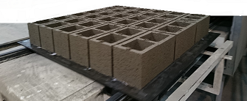
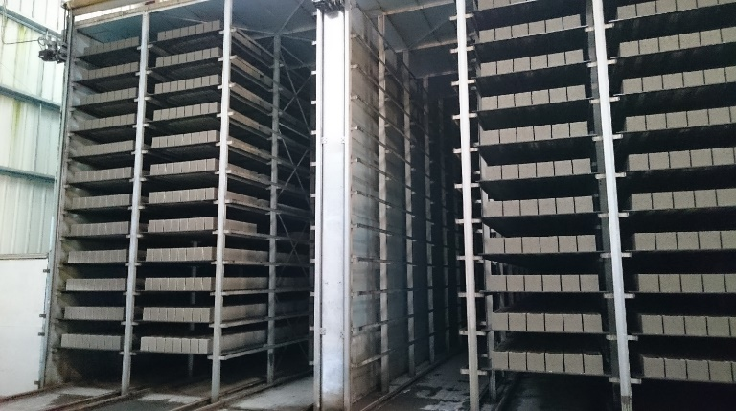
Summary
Introduction
Industrial trials (low GGBS content)
Laboratory development (increasing GGBS content)
Conclusion

Slide 3
Introduction
Non-reinforced concrete applications: dry concrete
  Blocks, kerbs, pavers, slabs, pool coping…
  Without standards on concrete (NF EN 206)
  Immediate or delayed demoulding
Interest of GGBS in the products
  Reduction of carbon footprint
  Cost/cement (CEM I ; CEM II)
  Reduction or elimination of efflorescence

Slide 4
Introduction
Difficulties to overcome with GGBS
Technical:
  Low binder content < 10%
  Low W/B ratio < 0.4
  Irregular PSD of aggregates
  Instant demoulding
  Short curing in various conditions (cold)
GGBS:
  Slow hydration speed
  Favour desiccation
  Needs to harden faster
GGBS activation
Chemical
Thermal
(Fineness)

Slide 5
Industrial trials: low GGBS content
Activation for dry concrete applications has to remain cheap:
Historical activator for non reinforced applications: chlorides
Results from literature + internal works: sulfates (alkali)
Association to lower Cl⁻ content
= industrial trials with moderate quantity of GGBS
Trials in 3 different plants, with several activators
NaCl
Na₂SO₄
NaCl + Na₂SO₄
2 ways to add chemical activators
per mass of total binder
per mass of GGBS only
The more GGBS, the more activator
Compressive strength measured after 14 days, typical age for testing

Slide 6
Industrial trials: low GGBS content
Results in Plant ‛A’ and ‛B’ on blocks
Plant ‛A’:
Activator: [1% NaCl + 1% Na₂SO₄] / total binder
Conservation 2d at 30°C then stockpiled outside
Chemicals allows to enhance GGBS by 10%
Strength of blocks containing GGBS inferior to the
reference (OPC) but over 6 MPa, required by the
producer
Plant ‛B’:
Activator:
Conservation 4d at 28°C then stockpiled outside
50% GGBS without activator = 100% OPC
Impossible to reach good strength with 70+% of
GGBS
2% Na₂SO₄
0.3% (NaCl + Na₂SO₄)
1% (NaCl + Na₂SO₄)
Justifies needs for lab development

Slide 7
Industrial trials: low GGBS content
Results in Plant ‛C’ on blocks and curbs
Plant ‛C1’ :Blocks
Activator: [0.4% NaCl + 0.4% Na₂SO₄] of GGBS content
Conservation 3d at 10-15°C then stockpiled outside
Results were correct up to 48% of GGBS with SAI ≈ 0.9
Plant ‛C2’ :Kerbs
Activator: [0.4% NaCl + 0.4% Na₂SO₄] of GGBS content
Conservation 1d at 10-15°C then stockpiled outside
Better results than with OPC only

Slide 8
Industrial trials: low GGBS content
Already possible to get good results with 50% GGBS with a good curing conditions
Needs for a laboratory development to work on combination of chemicals activation + thermal curing to enhance GGBS content

Slide 9
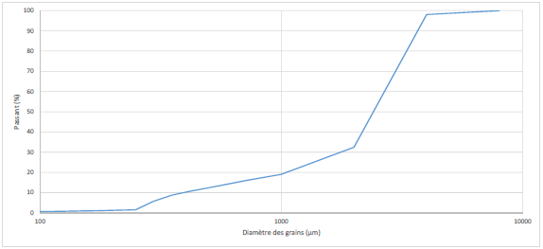
Laboratory development
Materials
binder:
Specific Blaine area (cm²/g) | Density (g/cm³)
4000 | 3.13
4400 | 2.91
OPC: CEM I 52.5R CE CP2 NF
GGBS: ECOCEM France
Activators: Analytical grade
aggregates:
Quartz sand
30% 0-2mm + 70% 2-4 mm
Packing favorising some voids

Slide 10
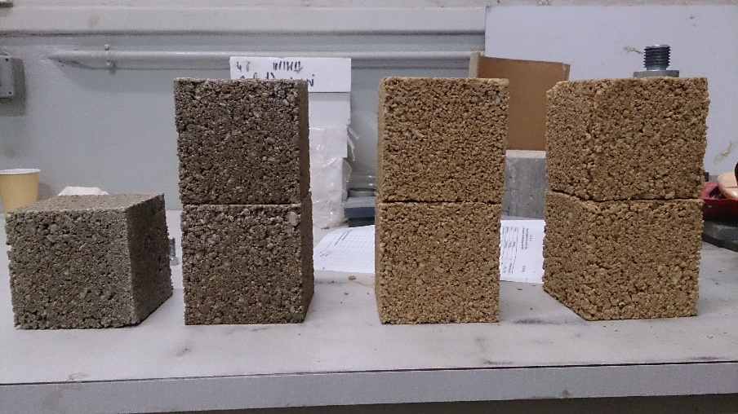
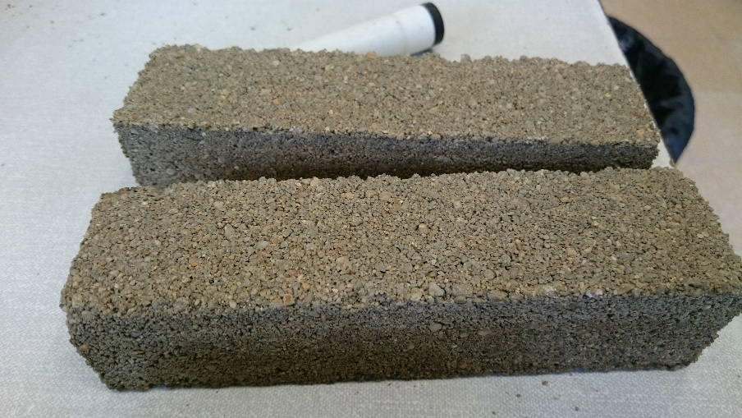
Laboratory development
Methods: 2 phases
Great variability on compressive strength
Vibro-compaction
(10*10*10cm)
    Controled volume + weight
    = controled density
    Blocks density: 1.95 T/m³
    Binder content: 197 kg/m³
Switching to phase 2
ASTM (C90)
(4*4*16cm)
Compressive strength test after 24h

Slide 11
Laboratory development
Trials at 20°C: effect of chemical activation
Ref: SAI < 0.4
Alkali:
  OH- led to the lowest results
  88%GGBS + 7.4% Sodium silicate = 100% OPC
Other combination: ineffective at 20°C
(OH⁻,
alkali silicates)
(NaCl,
CaCl₂)
(NaCl + Na₂SO₄)
(Na₂SO₄)
(NaCl + CaSO₄)

Slide 12
Laboratory development
Trials at 30°C: synergy between chemical and thermal activation
Ref: SAI < 0.4 to 0.6
Alkali:
  Low effect of the temperature
Other combination: highlighted synergy between thermal and chemical activation

Slide 13
Conclusion
With only thermal curing, possible to use 50% of GGBS
To enhance GGBS content over 70%, it is necessary to combine thermal + chemical activation = synergy
Chlorides + Na sulfates combined with temperature is efficient and easy to handle
Alkali-activation could allow to realize Portland cement free concrete, however sodium-silicate is expensive and must be manipulate with precaution

Slide 14
Perspectives & on going work
2 PhD student currently working on chlorides effect on GGBS blended with OPC binders
  Hydration mechanisms → where do chlorides go in the matrix?
  Durability behaviour → effect on corrosion, releases of chlorides by carbonation?
Would it be possible to include chlorides also in reinforced concrete application without any risks for durability?

Slide 15
Thank you for your attention!

