Slide 1

Thermodynamic prediction for chromium reduction behavior from molten slag
Yanling Zhang Ph.D
State Key Laboratory of Advanced Metallurgy
University of Science and Technology Beijing, China

Slide 2
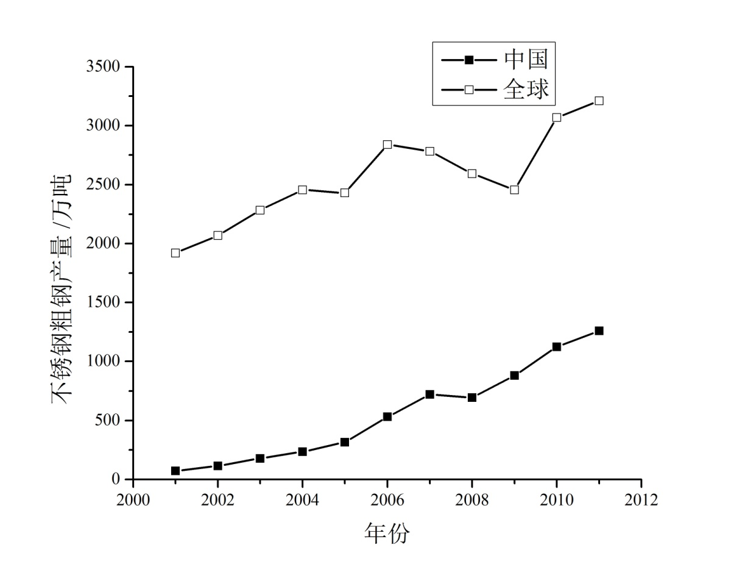
1.Background
35
30
Worldwide
Annual out put of stainless steel, million ton
25
20
15
10
China
5
0
Year
◆ 18-33 kg/t dust produced in stainless steel making process;
◆ Capital of Cr/Ni-bearing raw materials, ≥ 50% production cost.

Slide 3
1.Background
Stainless steel slag wt.%
From | CaO | SiO2 | MgO | Cr₂O₃ | Al₂O₃ | Fe₂O₃ | TiO₂ | MnO | NiO | CaF₂ | other
Baosteel Co., Ltd. | 44.5 | 28.0 | 9.3 | 8.3 | 3.2 | 3.1 | 2.1 | 0.7 | — | — | 0.8
Jiuquan iron and steel company (JISCO) | 35.7 | 25.6 | 12.3 | 13.4 | 2.1 | 2.5 | 0.8 | 1.6 | — | 3.7 | 2.3
Stainless steel dust wt.%
From | Fe₂O₃ | Cr₂O₃ | NiO | CaO | SiO₂ | MgO | Al₂O₃ | MnO | other | Σ(Fe+Cr+Ni+Mn)
Baosteel Co., Ltd. | 20.9 | 28.1 | 0.1 | 31.3 | 5.3 | 10.6 | 2.4 | — | 1.3 | 33.9
Jin hui stainless steel Co., Ltd. | 41.9 | 9.3 | 0.7 | 26.7 | 2 | 2.2 | — | 7.7 | 9.5 | 42.2
◆ 18-33 kg/t dust produced in stainless steel making process;
◆ Capital of Cr/Ni-bearing raw materials, ≥ 50% production cost.

Slide 4




◆ Smelting is a promising method to recovery Fe/ Cr/Ni resources from stainless steel dust;
◆ Compared to Fe₂O₃ and NiO, Cr₂O₃ is much more difficult to be reduced;
◆ Behaviors of Cr in Fe-Cr-Ni-C (-Si/Al) melt and CaO-SiO₂-MgO-Al₂O₃ based slag are necessary knowledge；
CaO-SiO₂-MgO-Al₂O₃ based
slag
stainless steel dust
Fe-Cr-Ni-C (-Si/Al) melt
Smelting treatment
$$γ_{CrOx}↑, γ_{Cr}↓ \frac{γ_{CrOx}}{γ_{Cr}}↑$$
$$↑$$
$$η_{Cr}$$
$$↑$$

Slide 5
2.Thermodynamic predictions
2.1 Activity coefficient of Cr in Fe-Cr-Ni-C(-Si/Al) melt
Redlich-Kister polynomial:
In Fe-Cr-C melts:

Slide 6
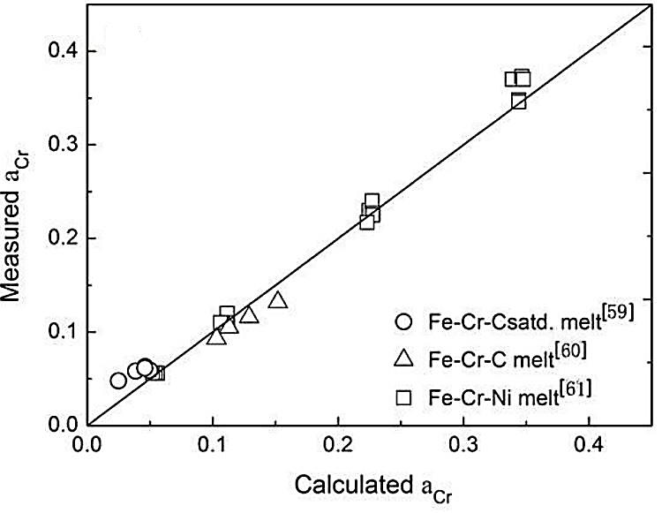
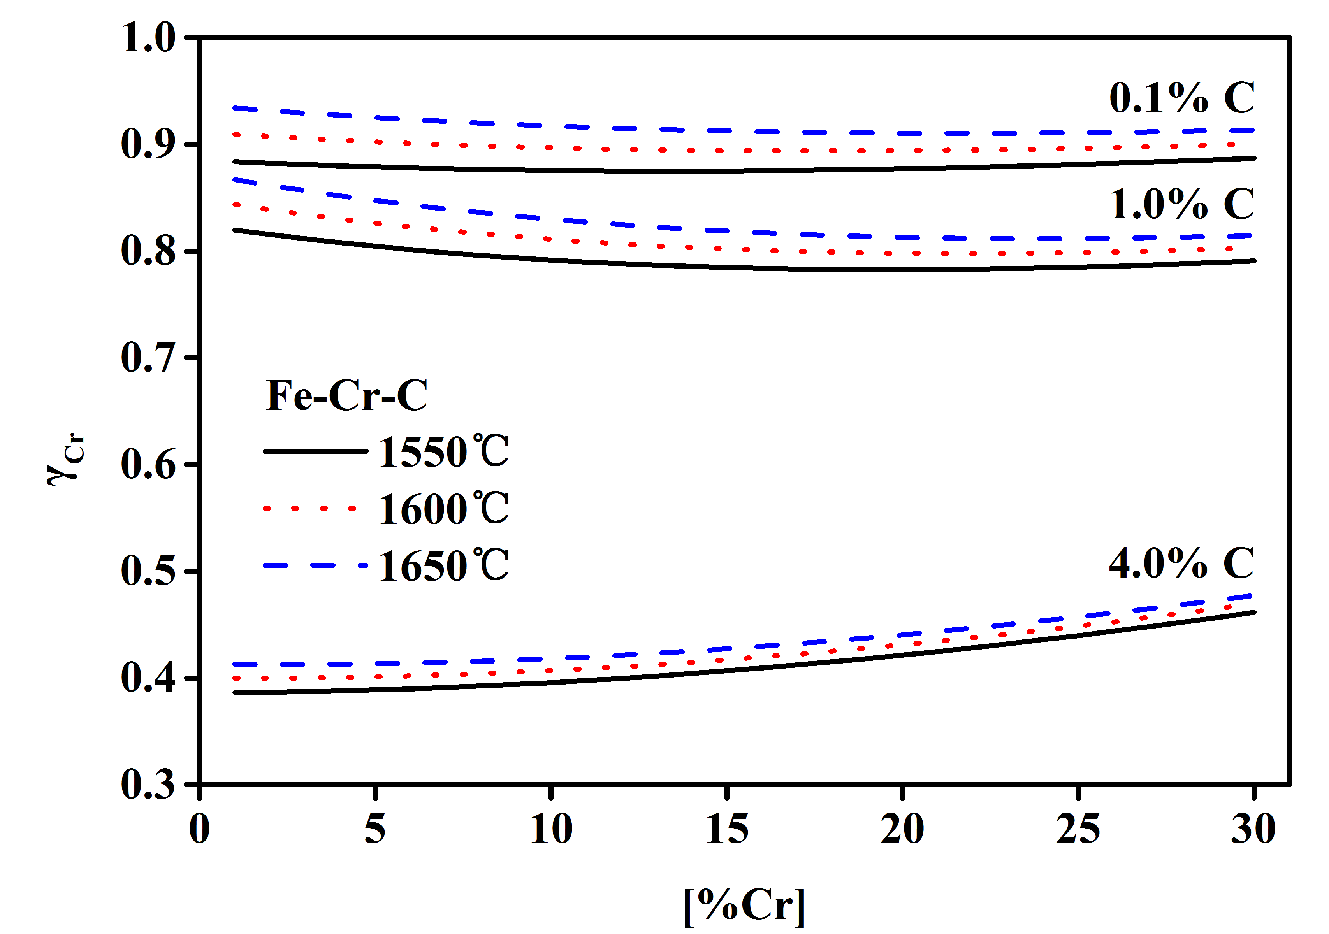
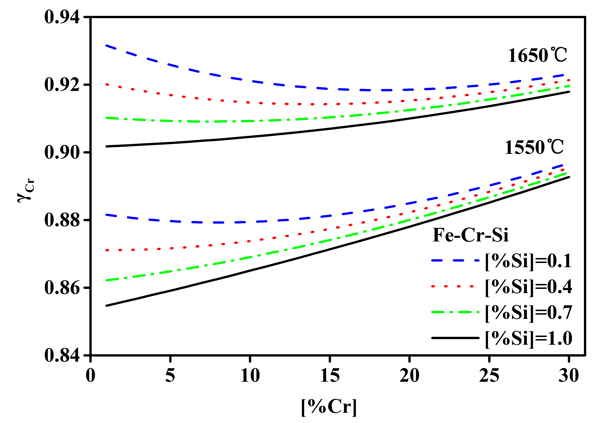
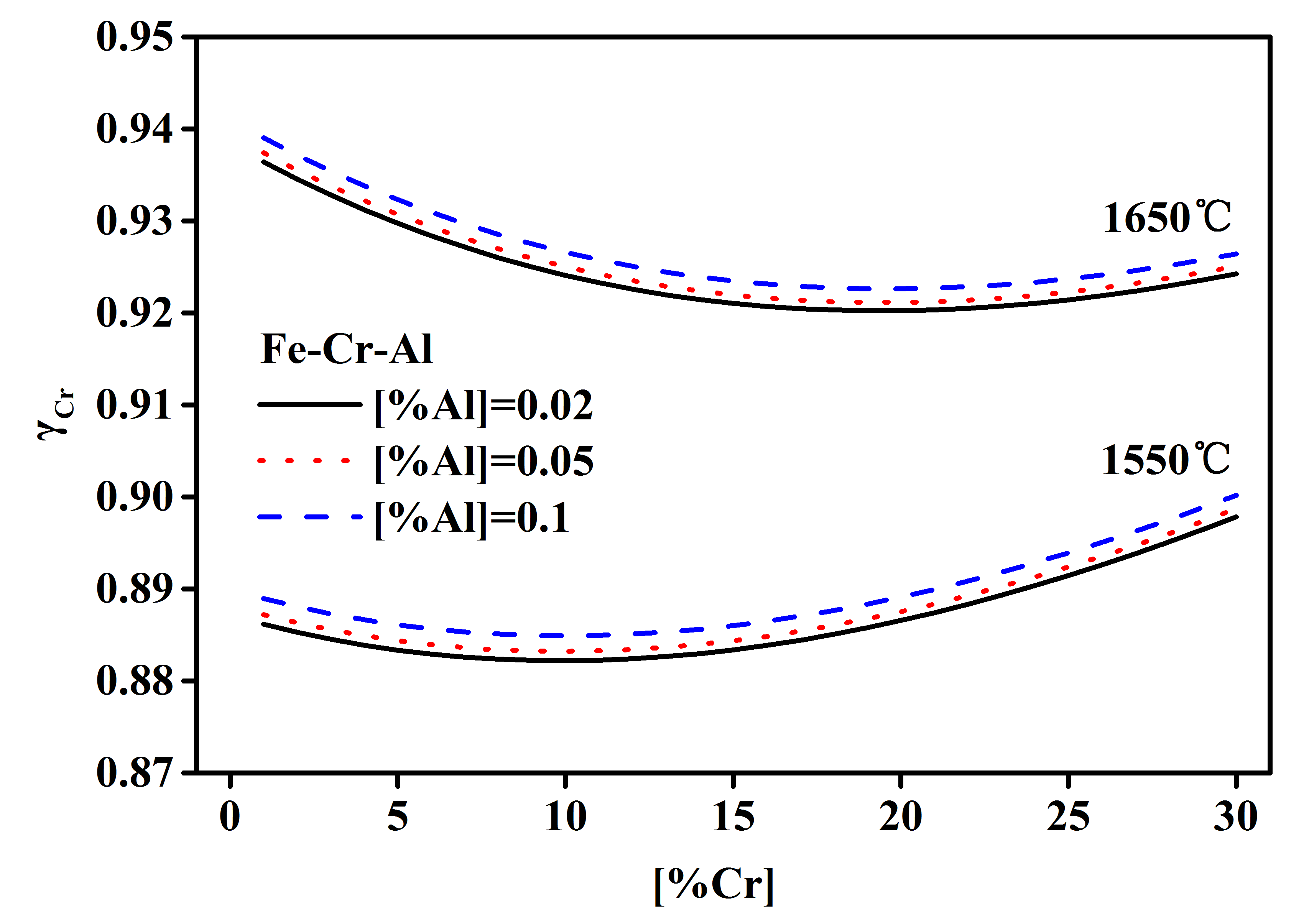
(a)
(b)
(c)
(d)

Slide 7
2.2 Activity coefficient of CrO in CaO-SiO₂-MgO-Al₂O₃-3%CrO
by L.J. Wang and S. Seetharaman
◆ T , P_{O2} , 
◆ It was assumed that the oxides state of chromium in residual slag is CrO during smelting treatment of stainless steel dust.
◆ Liquid areas of 1823–1923K in CaO-SiO₂-Al₂O₃/MgO-3%CrO systems were predicted by using of Phase Diagram Module of FactSage software; Iso-activity coefficient lines of CrO at1873 K in the above systems were predicted by using FactSage software based on a modified quasichemical model.

Slide 8
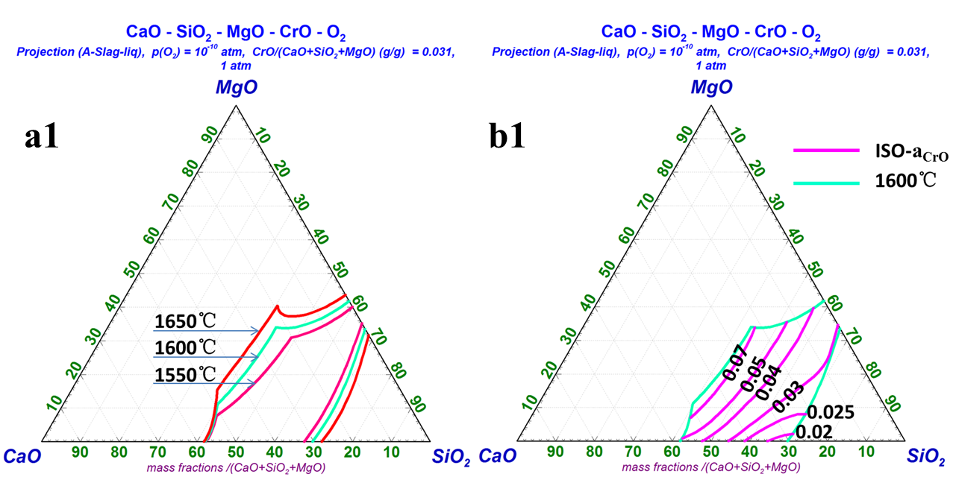
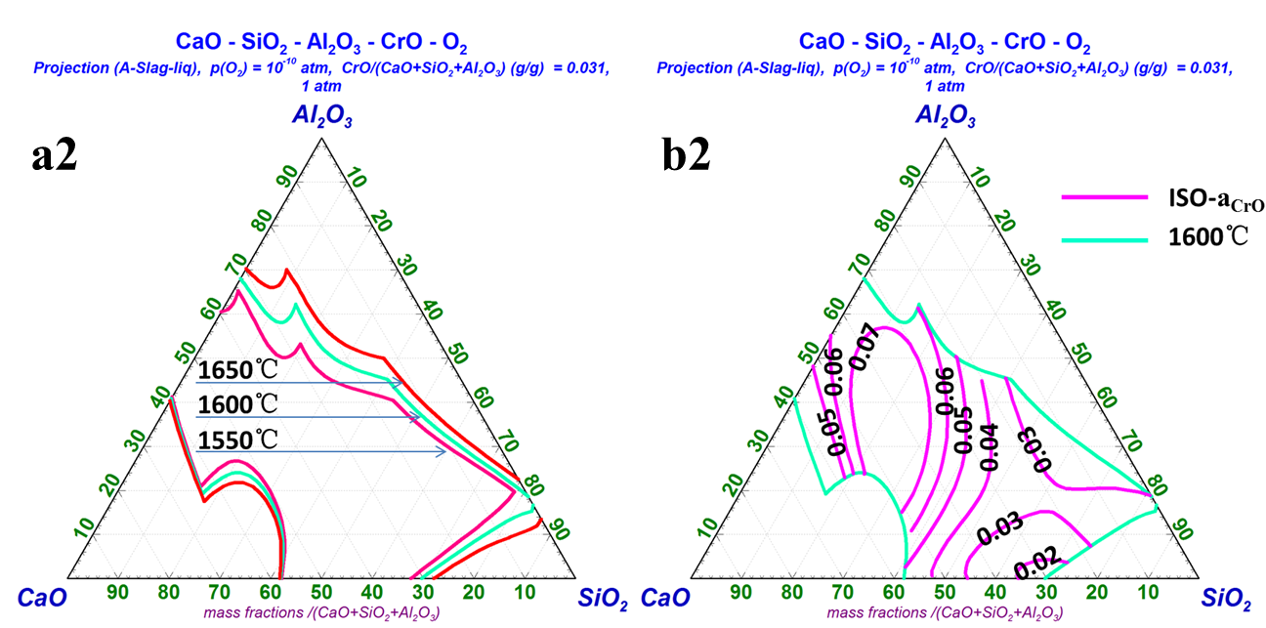

Slide 9
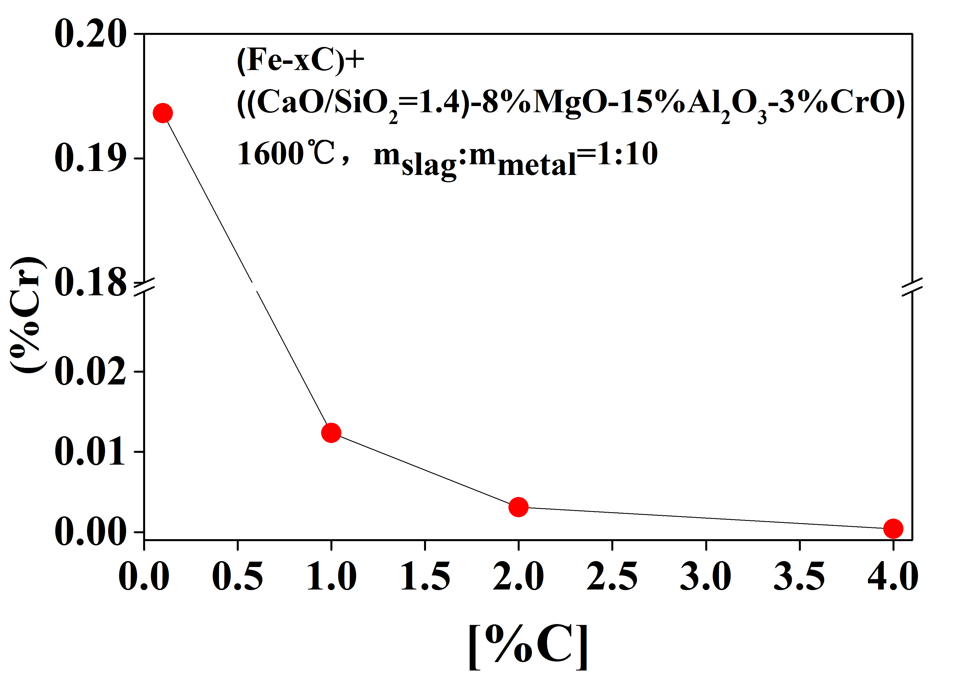
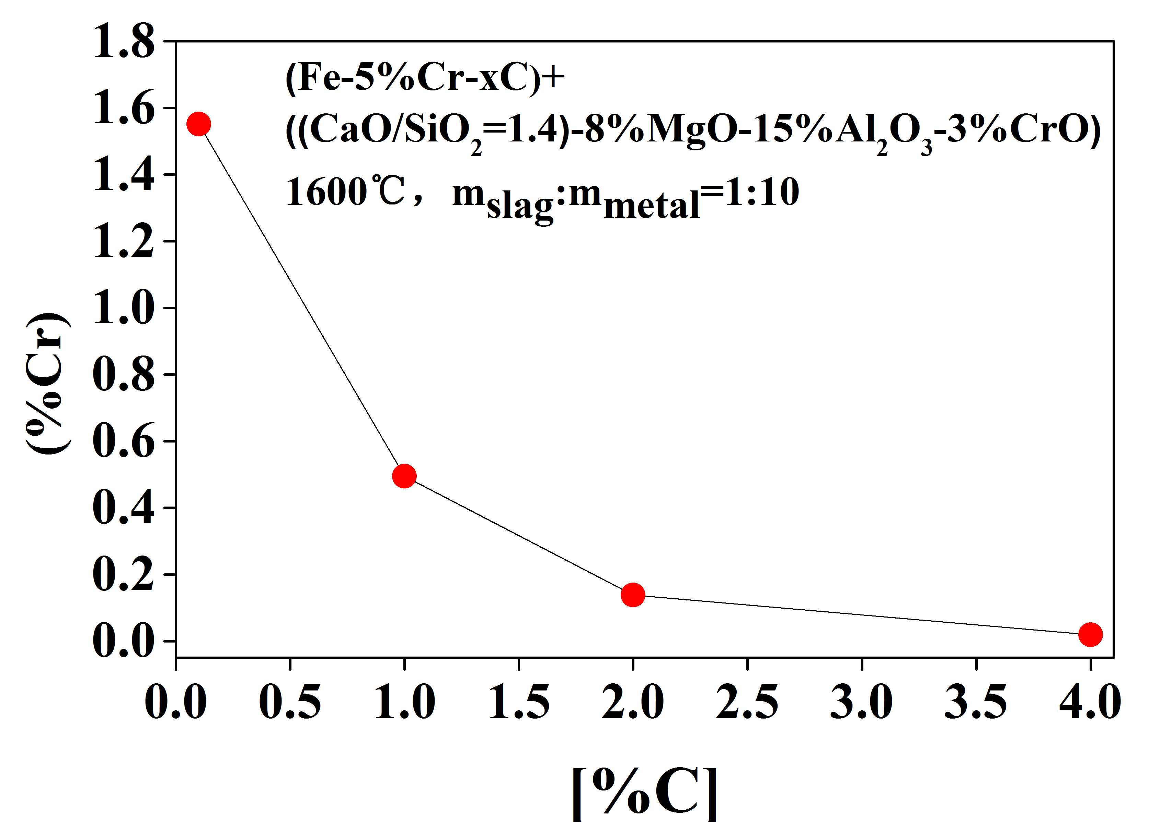
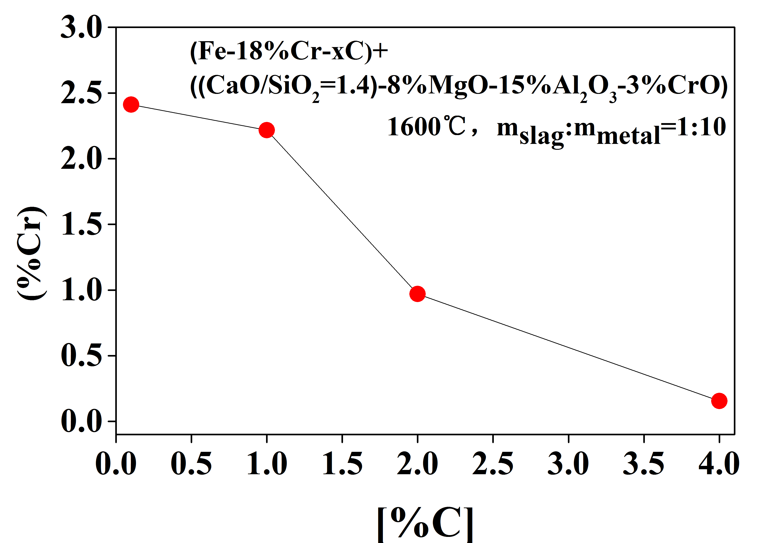
2.3 Final (%Cr) in CaO-SiO₂-Al₂O₃-MgO-CrO slag when equilibrating with different melts
a
Effect of [%C] on (%Cr)
b
c

Slide 10
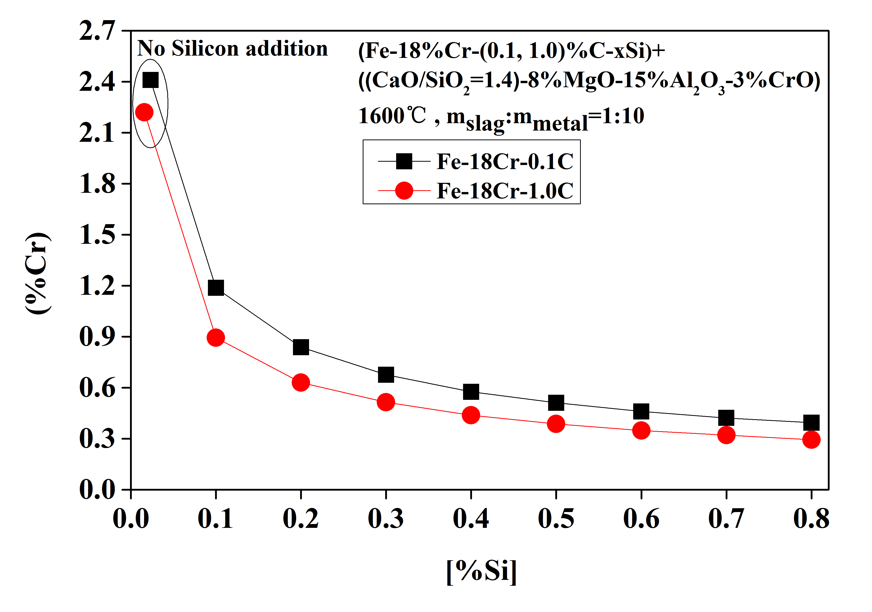
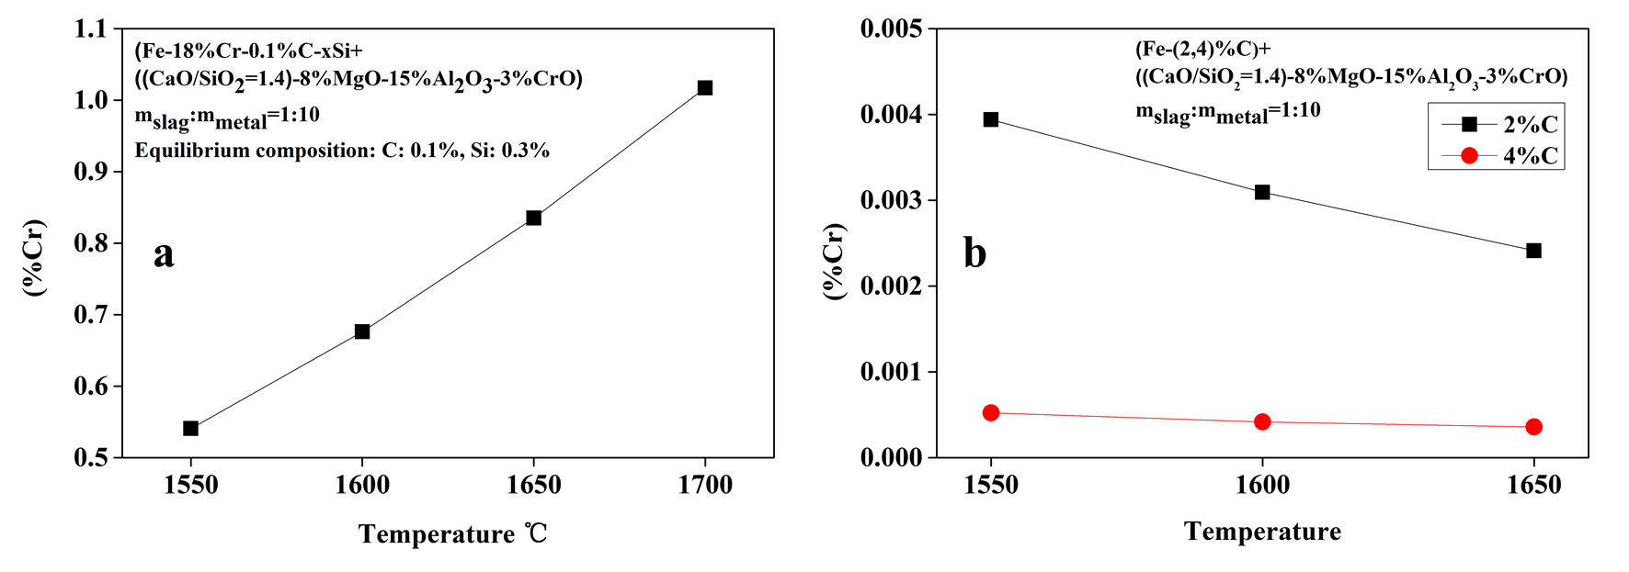
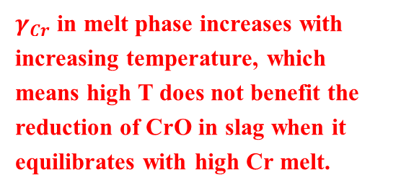
Influence of [%Si] on %Cr
$γ_{Cr}$ in melt phase increases with increasing temperature, which means high T does not benefit the reduction of CrO in slag when it equilibrates with high Cr melt.
Influence of temperature on (%Cr)

Slide 11
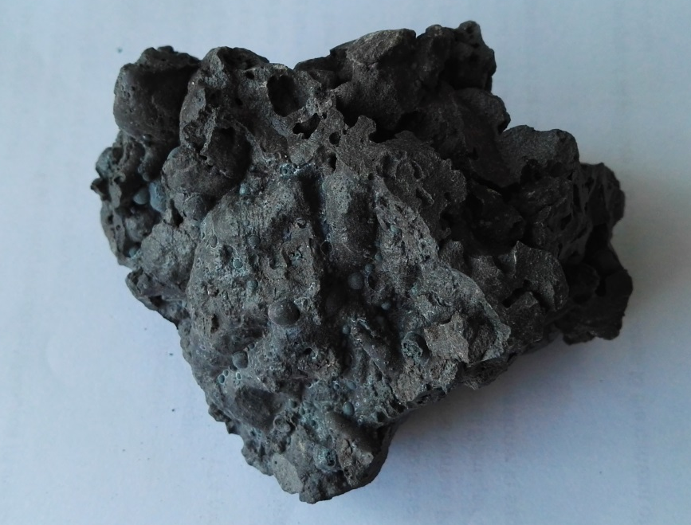
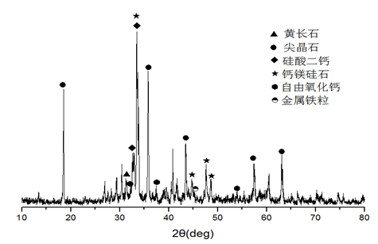
3.Experiments
3.1 Materials
成分 | CaO | SiO₂ | Al₂O₃ | MgO | Cr₂O₃ | CaF₂ | FeO | MnO | TiO₂ | other | R
% | 35.7 | 25.6 | 2.1 | 12.3 | 13.4 | 3.7 | 3.2 | 1.6 | 0.8 | 1.6 | 1.4
(Fe+Cr+Mn)%=12.8%，Direct discharge or improper management will lead to the pollution of environment and the waste of valuable metal, especially Cr.

Slide 12
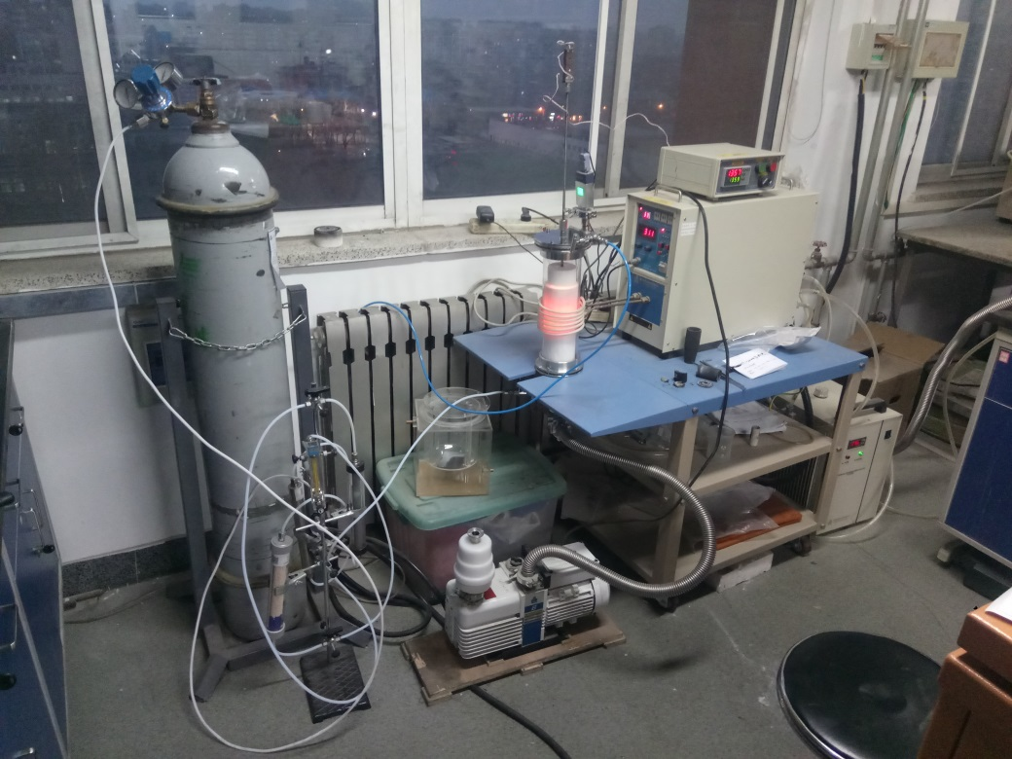
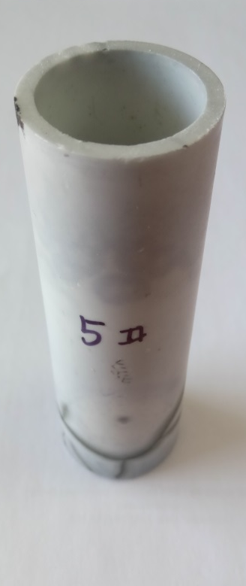
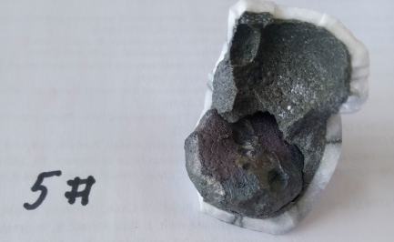
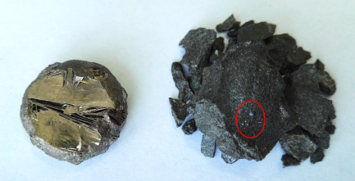
3.2 Apparatus
MgO Crucible
Slag pretreatment：Crashing—Fine grinding—Removing Iron particle—Screening to 60 mesh——Drying
Procedure：20g metal (Pig iron or Fe-xC) was set in the bottom of MgO crucible and 20g the slag block containing reductant (C, 78%SiFe, or Aluminum) and flux (SiO₂,CaO, or Al₂O₃) was pressed under the 20MPa and then was charged above the metal.

Slide 13
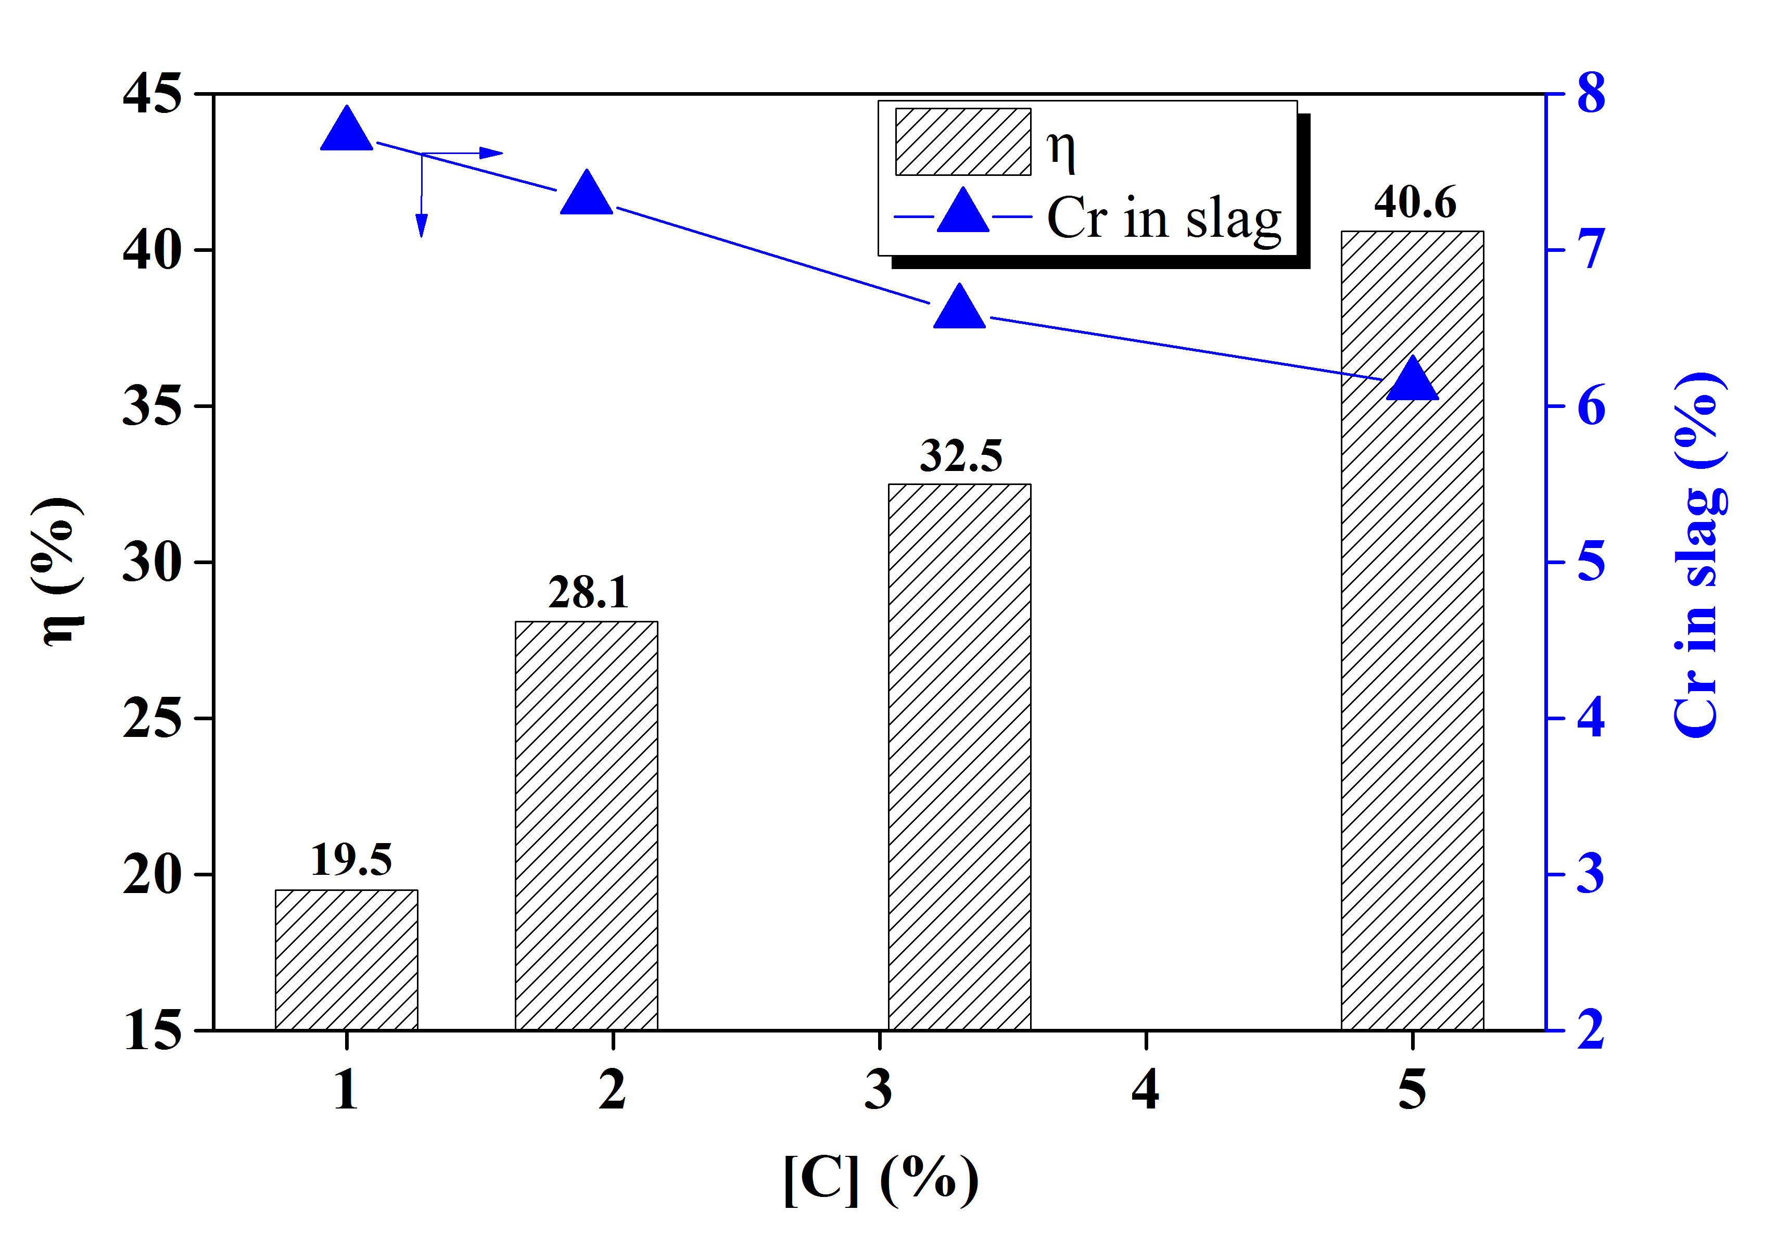
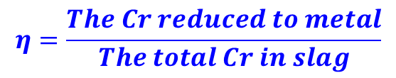
3.3 Results
$$η=\frac{The Cr reduced to metal}{The total Cr in slag}$$
η_{Cr}—Reduction ratio of Cr
M_{f,m}—Final weight of metal, g
W_{f,Cr}—The content of Cr in the final metal, wt.%
M_{i,m}—Inital weight of metal, g
W_{i,Cr}—The content of Cr in the inital metal, wt.%
M_{i,s}—The initial weight of slag,g
W_{i,Cr}—The content of Cr in the inital slag, wt.%
Fig.1 Effect of [%C] in Fe-C melts on (%Cr) and ƞ_{Cr}
20g Fe-xC and 20g stainless steel slag, 1550℃, 20min

Slide 14
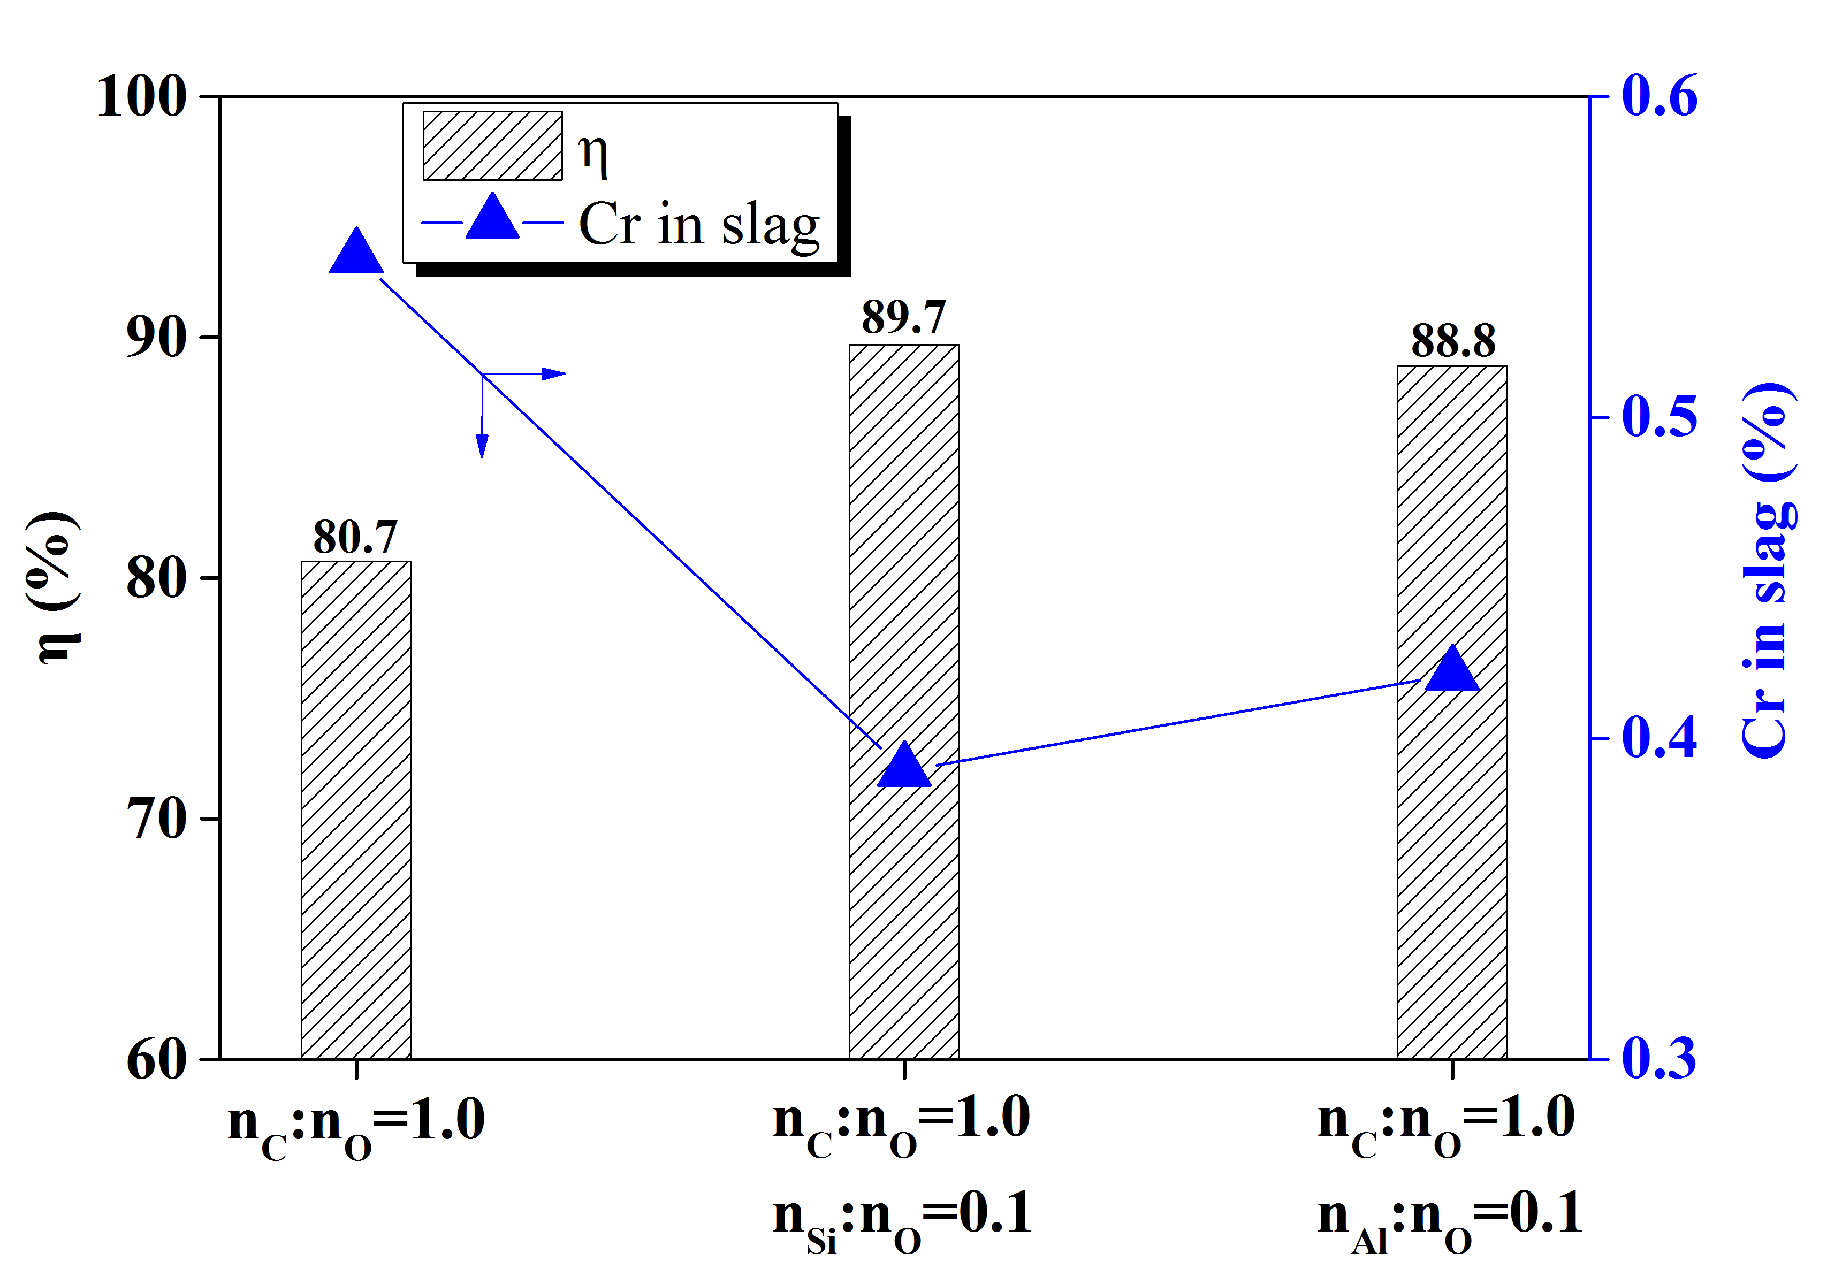
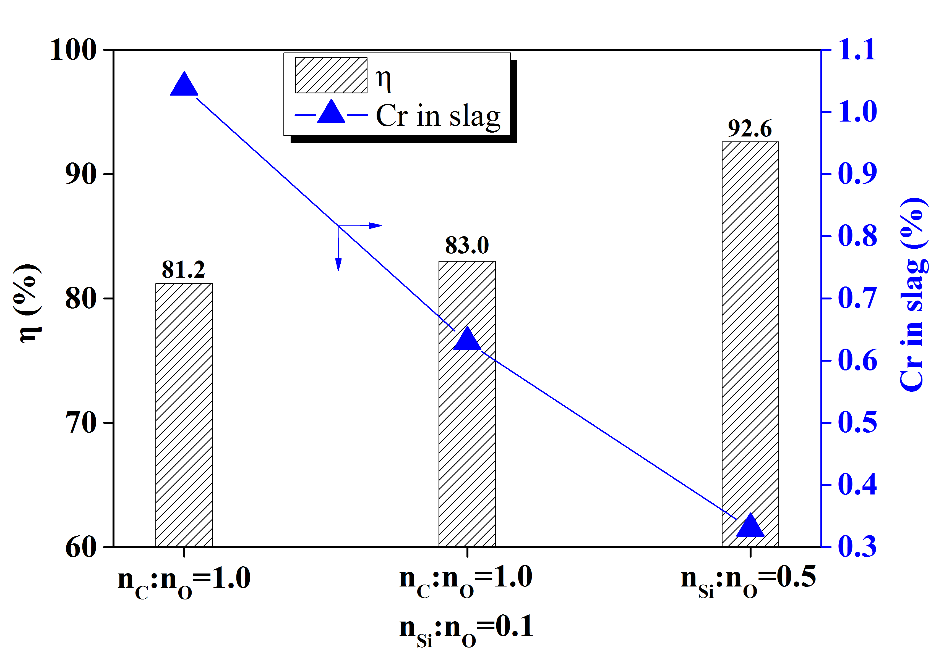
Fig.2 Different C/SiFe/Al-containing slag pellets reduced by Fe-5.0C melts
Fig.3 Different C/SiFe/Al-containing slag pellets reduced by Fe-1.9C melts
Experiment condition
20g Fe-xC and 20g stainless steel slag
The addition quantity of reductant is based on the oxygen combined with Fe, Cr, and Mn in the slag
The sample was kept at 1550℃ for 20min

Slide 15
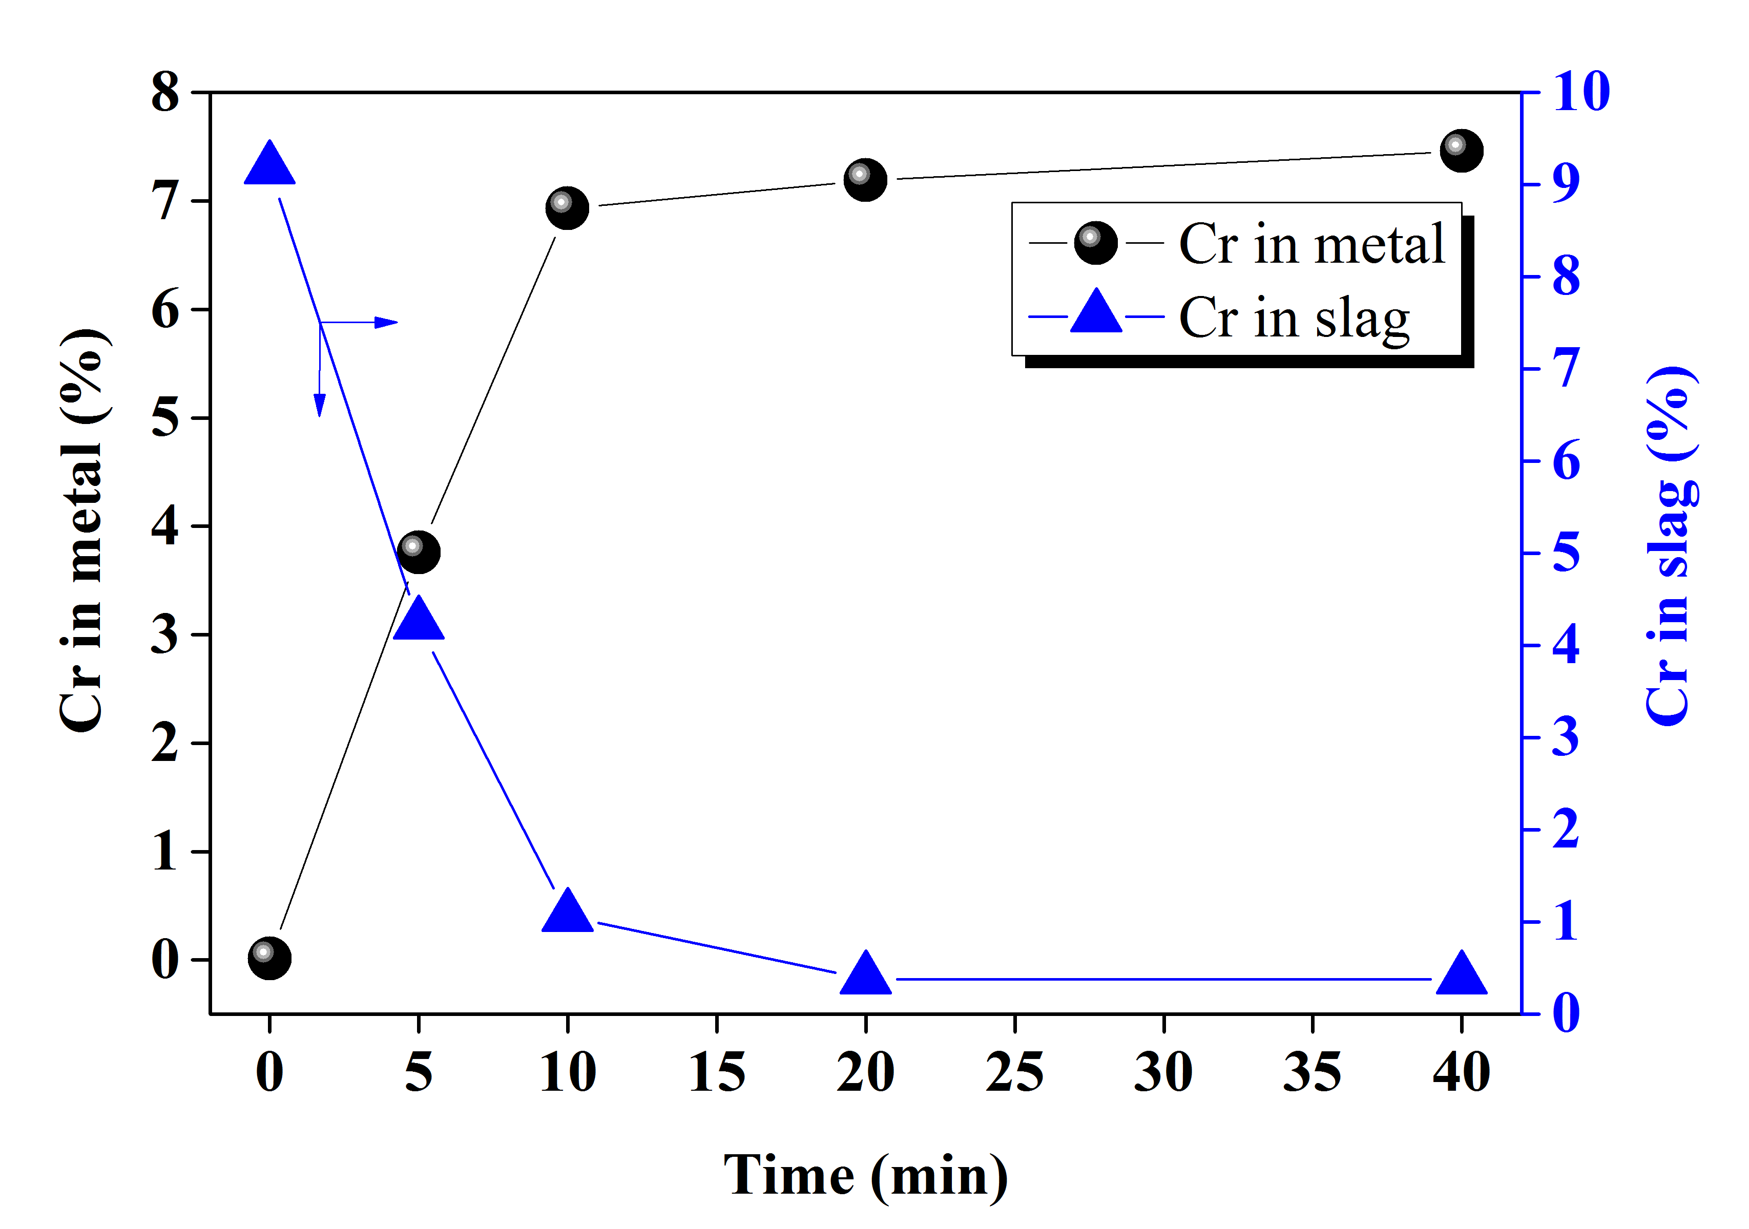
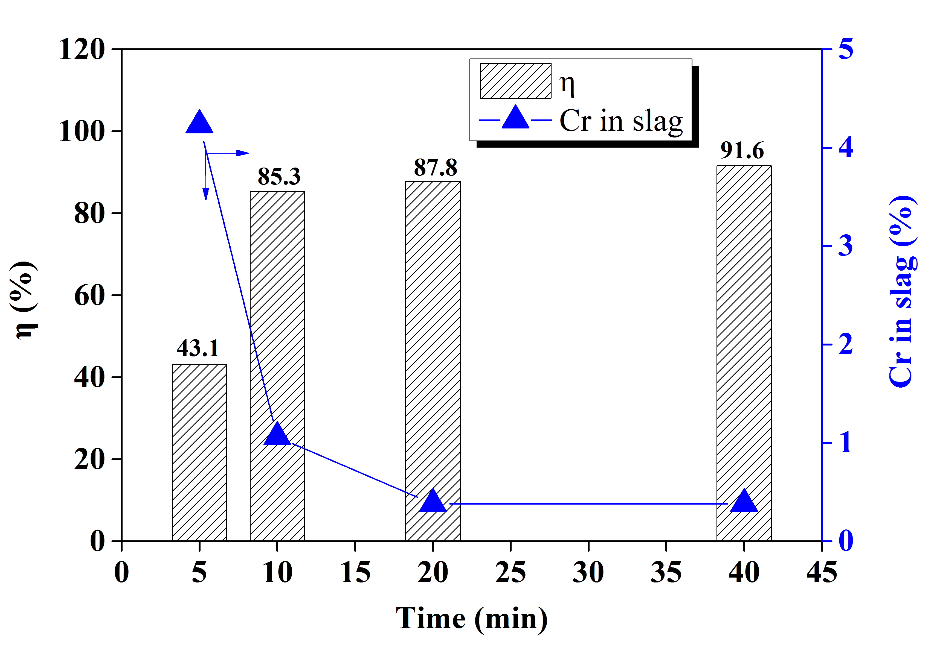
Fig.4 Time dependent of Cr in slag and metal
Fig.5 Effect of time on (%Cr) and ƞ_{Cr}
Experiment condition
20g pig iron (C: 4.61%, Si: 0.42%, Cr: 0.014%) and 20g stainless steel slag
The addition quantity of high-pure graphite is based on the oxygen combined with Fe, Cr, and Mn in the slag
A little SiO₂ (about 1g ) was added to the pellets to adjust the final basicity to 1.1
The sample was kept at 1550℃ for 5, 10, 20, 40 min to find the proper holding time

Slide 16
Table Comparison of chromium oxides reduction by different melts
Metal | Reductant | Flux | [C]_{final} % | η % | (Cr)_{slag} %
Fe-5.0C | — | — | 4.08 | 40.6 | 6.14
Fe-5.0C | nC:nO=1.0 | — | 5.07 | 80.7 | 0.55
Fe-5.0C | nC:nO=1.0,nSi:nO=0.1 | — | 5.42 | 89.7 | 0.39
Fe-5.0C | nC:nO=1.0,nAl:nO=0.1 | — | 5.39 | 88.8 | 0.42
Fe-1.9C | nC:nO=1.0 | — | 2.41 | 81.2 | 1.04
Fe-1.9C | nC:nO=1.0,nSi:nO=0.1 | — | 2.71 | 83.0 | 0.63
Fe-1.9C | nSi:nO=0.5 | — | 2.04 | 92.6 | 0.33
Fe-1.9C | nSi:nO=0.75 | — | * | * | 0.12
Fe-1.9C | nAl:nO=2:3 | — | * | * | 0.12
Fe-1.9C | nC:nO=1.0,nSi:nO=0.1 | SiO₂ | * | * | 0.59
Fe-1.9C | nC:nO=1.0,nSi:nO=0.1 | CaO | * | * | 0.88
Pig iron | nC:nO=1.0 | SiO₂ | 4.46 | 87.8 | 0.38
* The [C], [Cr] in metal has not been detected.

Slide 17
4.1 Conclusions
γ_{Cr} decreases with Increasing [%C], increasing [%Si], and decreasing [%Al] in metal phase. And, γ_{Cr} increases with increasing temperature.
Activity of CrO in CaO-SiO₂-MgO(Al₂O₃)-3%CrO increases with increasing basicity (%CaO/%SiO₂). %Al₂O₃ gives little influence on a_{CrO}, while it was helpful to increase the ratio of the liquid phase.
Thermodynamically, (%Cr) of slag greatly decreases as the [%C] of a metal increases. For the high [%Cr] and low [%C] metal melt, Si has limited reducibility for CrO in slag. Temperature has different effects on the reduction of CrO in slag and depends on the effective reductant in the melt.
The effective reduction of high Cr-containing slag must rely on self-reduction and proper addition of C, SiFe, and Al increases the η_{Cr} extensively. High [C] pool is beneficial to keep the low [Cr] in the metal, which is consistent with the calculation from Factsage equilib module.
Compared with C, SiFe and Al have stronger reducibility. Considering the economy, a little addition of SiFe or Al will promote the reduction of CrO_{x} once the C was chosen as the main reductant. The final slag composition has remarkable influence on the (Cr)_{slag} and the work will be carried out.

Slide 18


Thanks for your attention!

