Slide 1
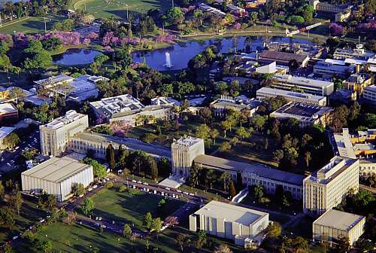

Recent experimental and modelling research on the thermodynamics and phase equilibria of multi-component oxide systems
Evgueni Jak and Peter Hayes
PYROSEARCH, Pyrometallurgy Innovation Centre, The University of Queensland,
Brisbane, Australia.

Slide 2
Introduction
Experimental Methodology
Thermodynamic Models and Databases
Applications to Industry

Slide 3
Introduction
- The slag valorisation process
RAW MATERIALS
Slags
Stoichiometric compounds
Complex wastes
How we can help!!!
PROCESS AND CHEMICAL MODIFICATION
Complex solid solutions
Amorphous (glassy) materials
Partially crystallised materials
Chemical separations
PROPERTIES TO BE ACHIEVED
High/Low reactivity
Stabilisation of hazardous elements
Low impurity levels
NEW MATERIALS
Cements
Geopolymers
Slag structural materials
Slag manufactured materials

Slide 4
INTRODUCTION - CaO-FeO-Fe₂O₃-SiO₂-Common slag chemistry Al₂O₃-MgO……
CaO
|
FeO
|
Fe₂O₃
|
SiO₂
|
Al₂O₃
|
MgO
Fe ore
Cement
production
Fe sinter
Iron and
steelmaking
slags
Structural
materials
Manufactured
materials
Non-ferrous
metallurgical
slags
Inorganic-polymer materials
Industrial wastes
Slag
valorisation

Slide 5
INTRODUCTION - Information needed
- Phases present
- Chemical compositions of the phases
- Relative fractions of the phases
- Thermodynamic activities of the chemical components
- Physico-chemical properties of chemical components (e.g. viscosity)

Slide 6
● Thermodynamic modelling
- assess existing data and plan experiments
METHODOLOGY needed for complex systems – Integrated and iterative thermodynamic modelling and experimental studies
● Experiments on low order systems
- fundamental knowledge
● Experiments on multi-component systems
- usually in support of industrial processes
● Thermodynamic modelling
- final database development

Slide 7
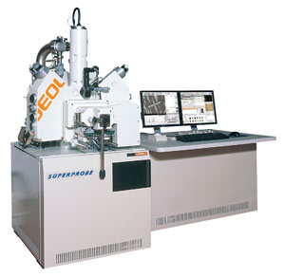
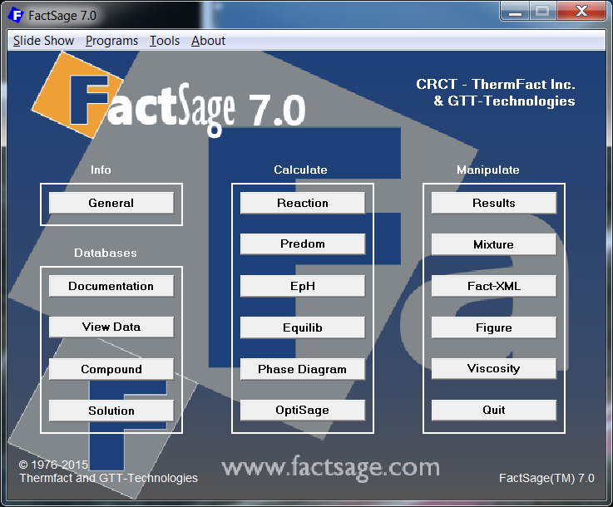
New advanced micro-analytical tools and experimental methodologies,
EPMA, LA-ICP-MS
PYROSEARCH METHODOLOGY
INTEGRATED
  EXPERIMENTAL AND
  THERMODYNAMIC MODELLING
STUDIES
New advanced computational and theoretical tools

Slide 8
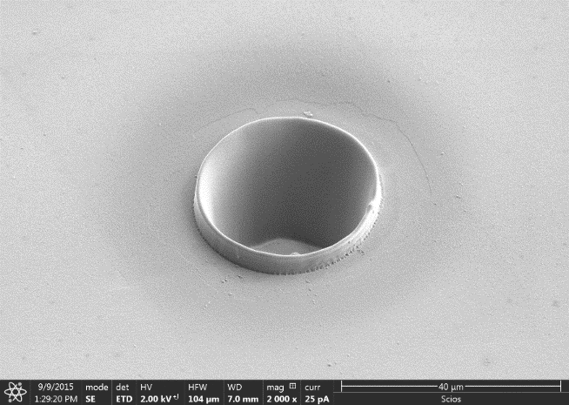
EXPERIMENTAL METHODOLOGY
– microanalysis for minor elements in multi-phase systems
Examples of Laser Ablation ICP-MS microanalysis of minor elements in slag

Slide 9
METHODOLOGY FOR ACCURATE PHASE EQUILIBRIA MEASUREMENTS
High Temperature Equilibration
>>> Quenching
>>> Electron Probe X-ray Microanalysis (EPMA)
Independent of original bulk composition/Crucible interaction/Vaporisation
  Enables metal/slag/matte/ gas equilibration
  Allows use of substrates
  Tests achievement of
  equilibria
  Enables phase analysis and identification
  Defines limits of solid and liquid solutions for thermodynamic modelling
  Applicable to multi-
  component systems

Slide 10
METHODOLOGY FOR ACCURATE PHASE EQUILIBRIA MEASUREMENTS
The lever rule applies in multi-phase space, e.g.
At T₁ the proportion of liquid at bulk composition, X
= bc/ac

Slide 11
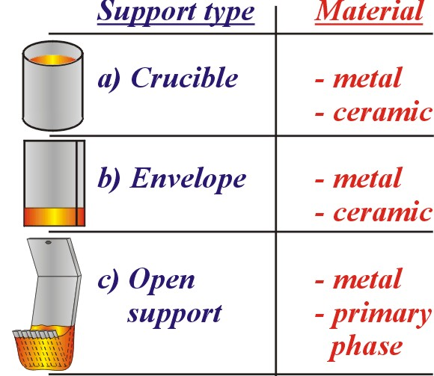
EXPERIMENTAL APPROACHES
Sample mass /Systems
Chemical Analysis Techniques
Wet chemical/
SEM-EDS
EPMA
EPMA/LA-ICP-MS
5 – 20 g/ High silica systems
Previous
0.1 – 1 g/ Low silica systems
Increasing cooling rate
10 yrs ago
Now
0.05 – 0.2 g
No silica systems
Evolution of sample support types for slag phase equilibria determination.

Slide 12
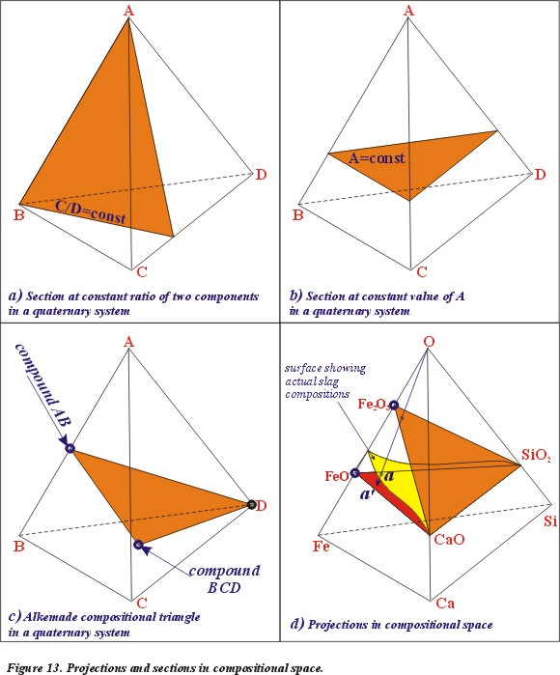
METHODOLOGY
for representation of phase equilibria –
Phase diagrams
There are many different ways to explore compositional space and to make it easier to apply thermodynamics to practice
Projections and sections in compositional space.

Slide 13
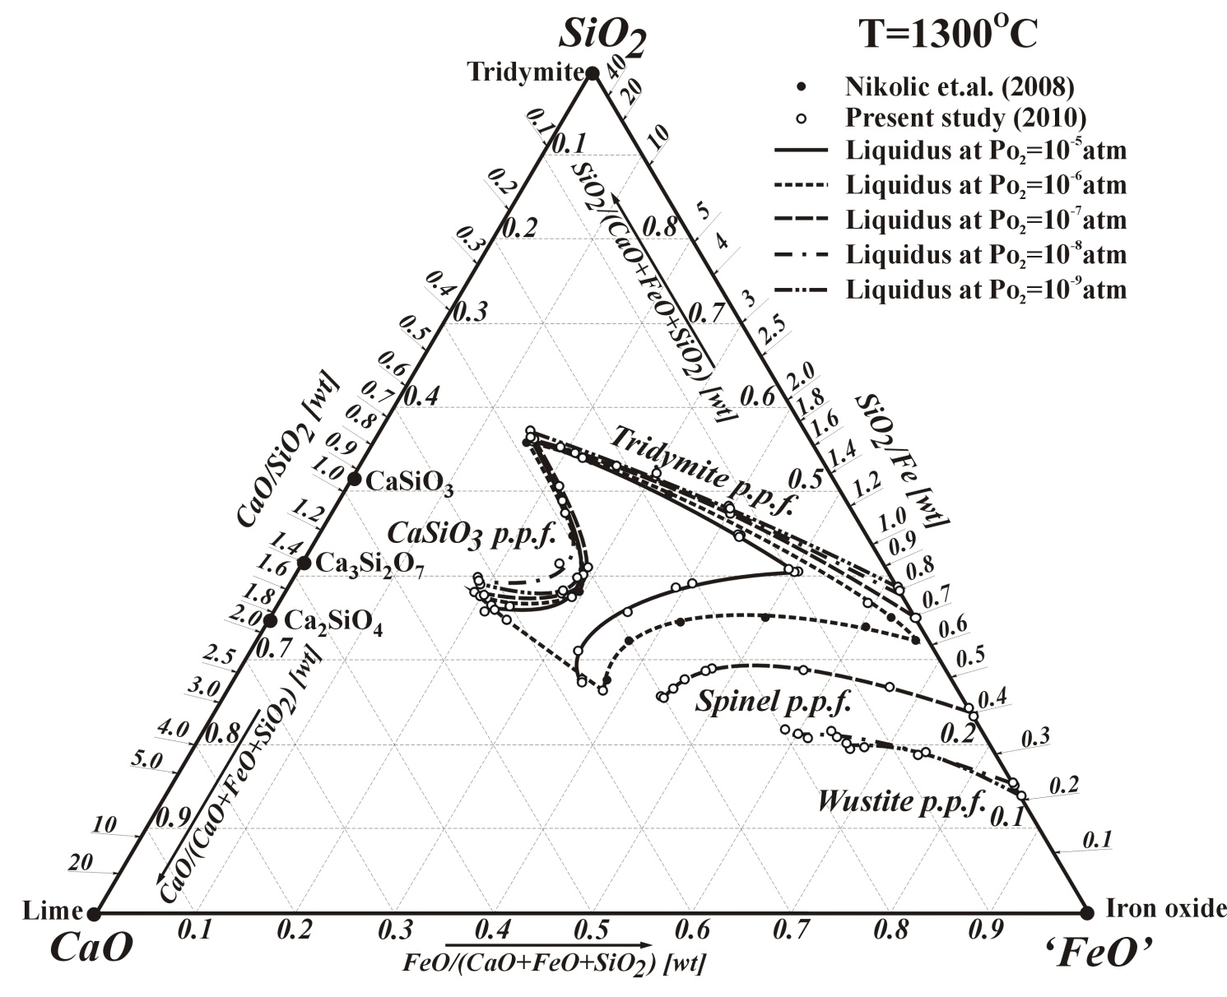
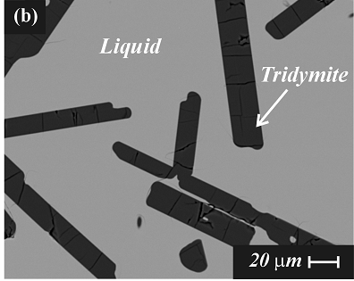
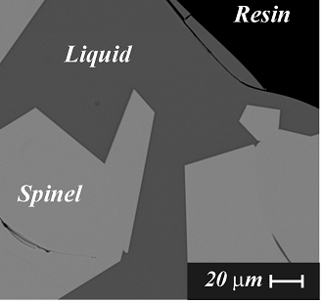
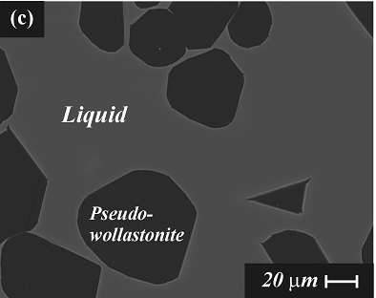
FeO_{x}-CaO-SiO₂ at fixed P_{O2}
T = 1300ºC
PO₂ 10⁻⁵
10⁻⁶
10⁻⁷
10⁻⁸
10⁻⁹
References:
(1) S. Nikolic, P.C. Hayes and E. Jak: Metall. Trans. B, 39B(2008), 179-188.
(2) T. Hidayat, P.C. Hayes and E. Jak: Metall. Mater. Trans. B, 43(2012), 14-26.
(3) T. Hidayat, P.C. Hayes and E. Jak: Metall. Mater. Trans. B, 43(2012), 27-38.

Slide 14
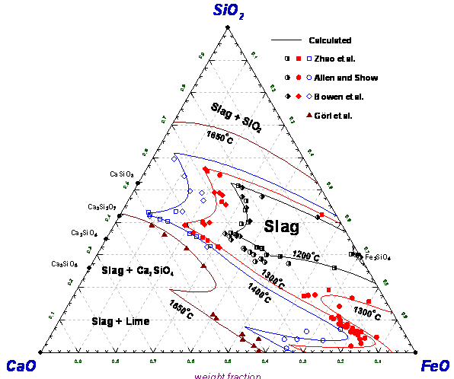
CaO-“FeO”-SiO₂ in equilibrium with metallic iron
S.A. Decterov, I.-H. Jung, E. Jak, Y.-B. Kang, P. Hayes and A.D. Pelton: Proc. of VII Int. Conf. on Molten Slags, Fluxes & Salts. SAIMM, South Africa, (2004), 839-850.
New experimental
liquid / solid tie-lines
– essential for the accurate revision of thermodynamic databases
References:
(4) B. Zhao, P. Hayes and E. Jak: Unpublished Work: Pyrometallurgy Research Centre, The University of Queensland, (2003), (5) W.C. Allen and R.B. Snow: J. Am. Ceram. Soc., 38(1955), 264-280.
(6) N.L. Bowen, J.F. Schairer and E. Psnjak: Am. J. Sci., 26(1933), 193-284.
(7) E. Görl, F. Oeters and R. Scheel: Arch. Eisenhuettenwes., 37(1966), 441-445.
(8) S.A. Decterov, I.-H. Jung, E. Jak, Y.-B. Kang, P. Hayes and A.D. Pelton: Proc. of VII Int. Conf. on Molten Slags, Fluxes & Salts. SAIMM, South Africa, 2004, 839-850.
α’-Ca₂SiO₄-Fe₂SiO₄
Solid Solution

Slide 15
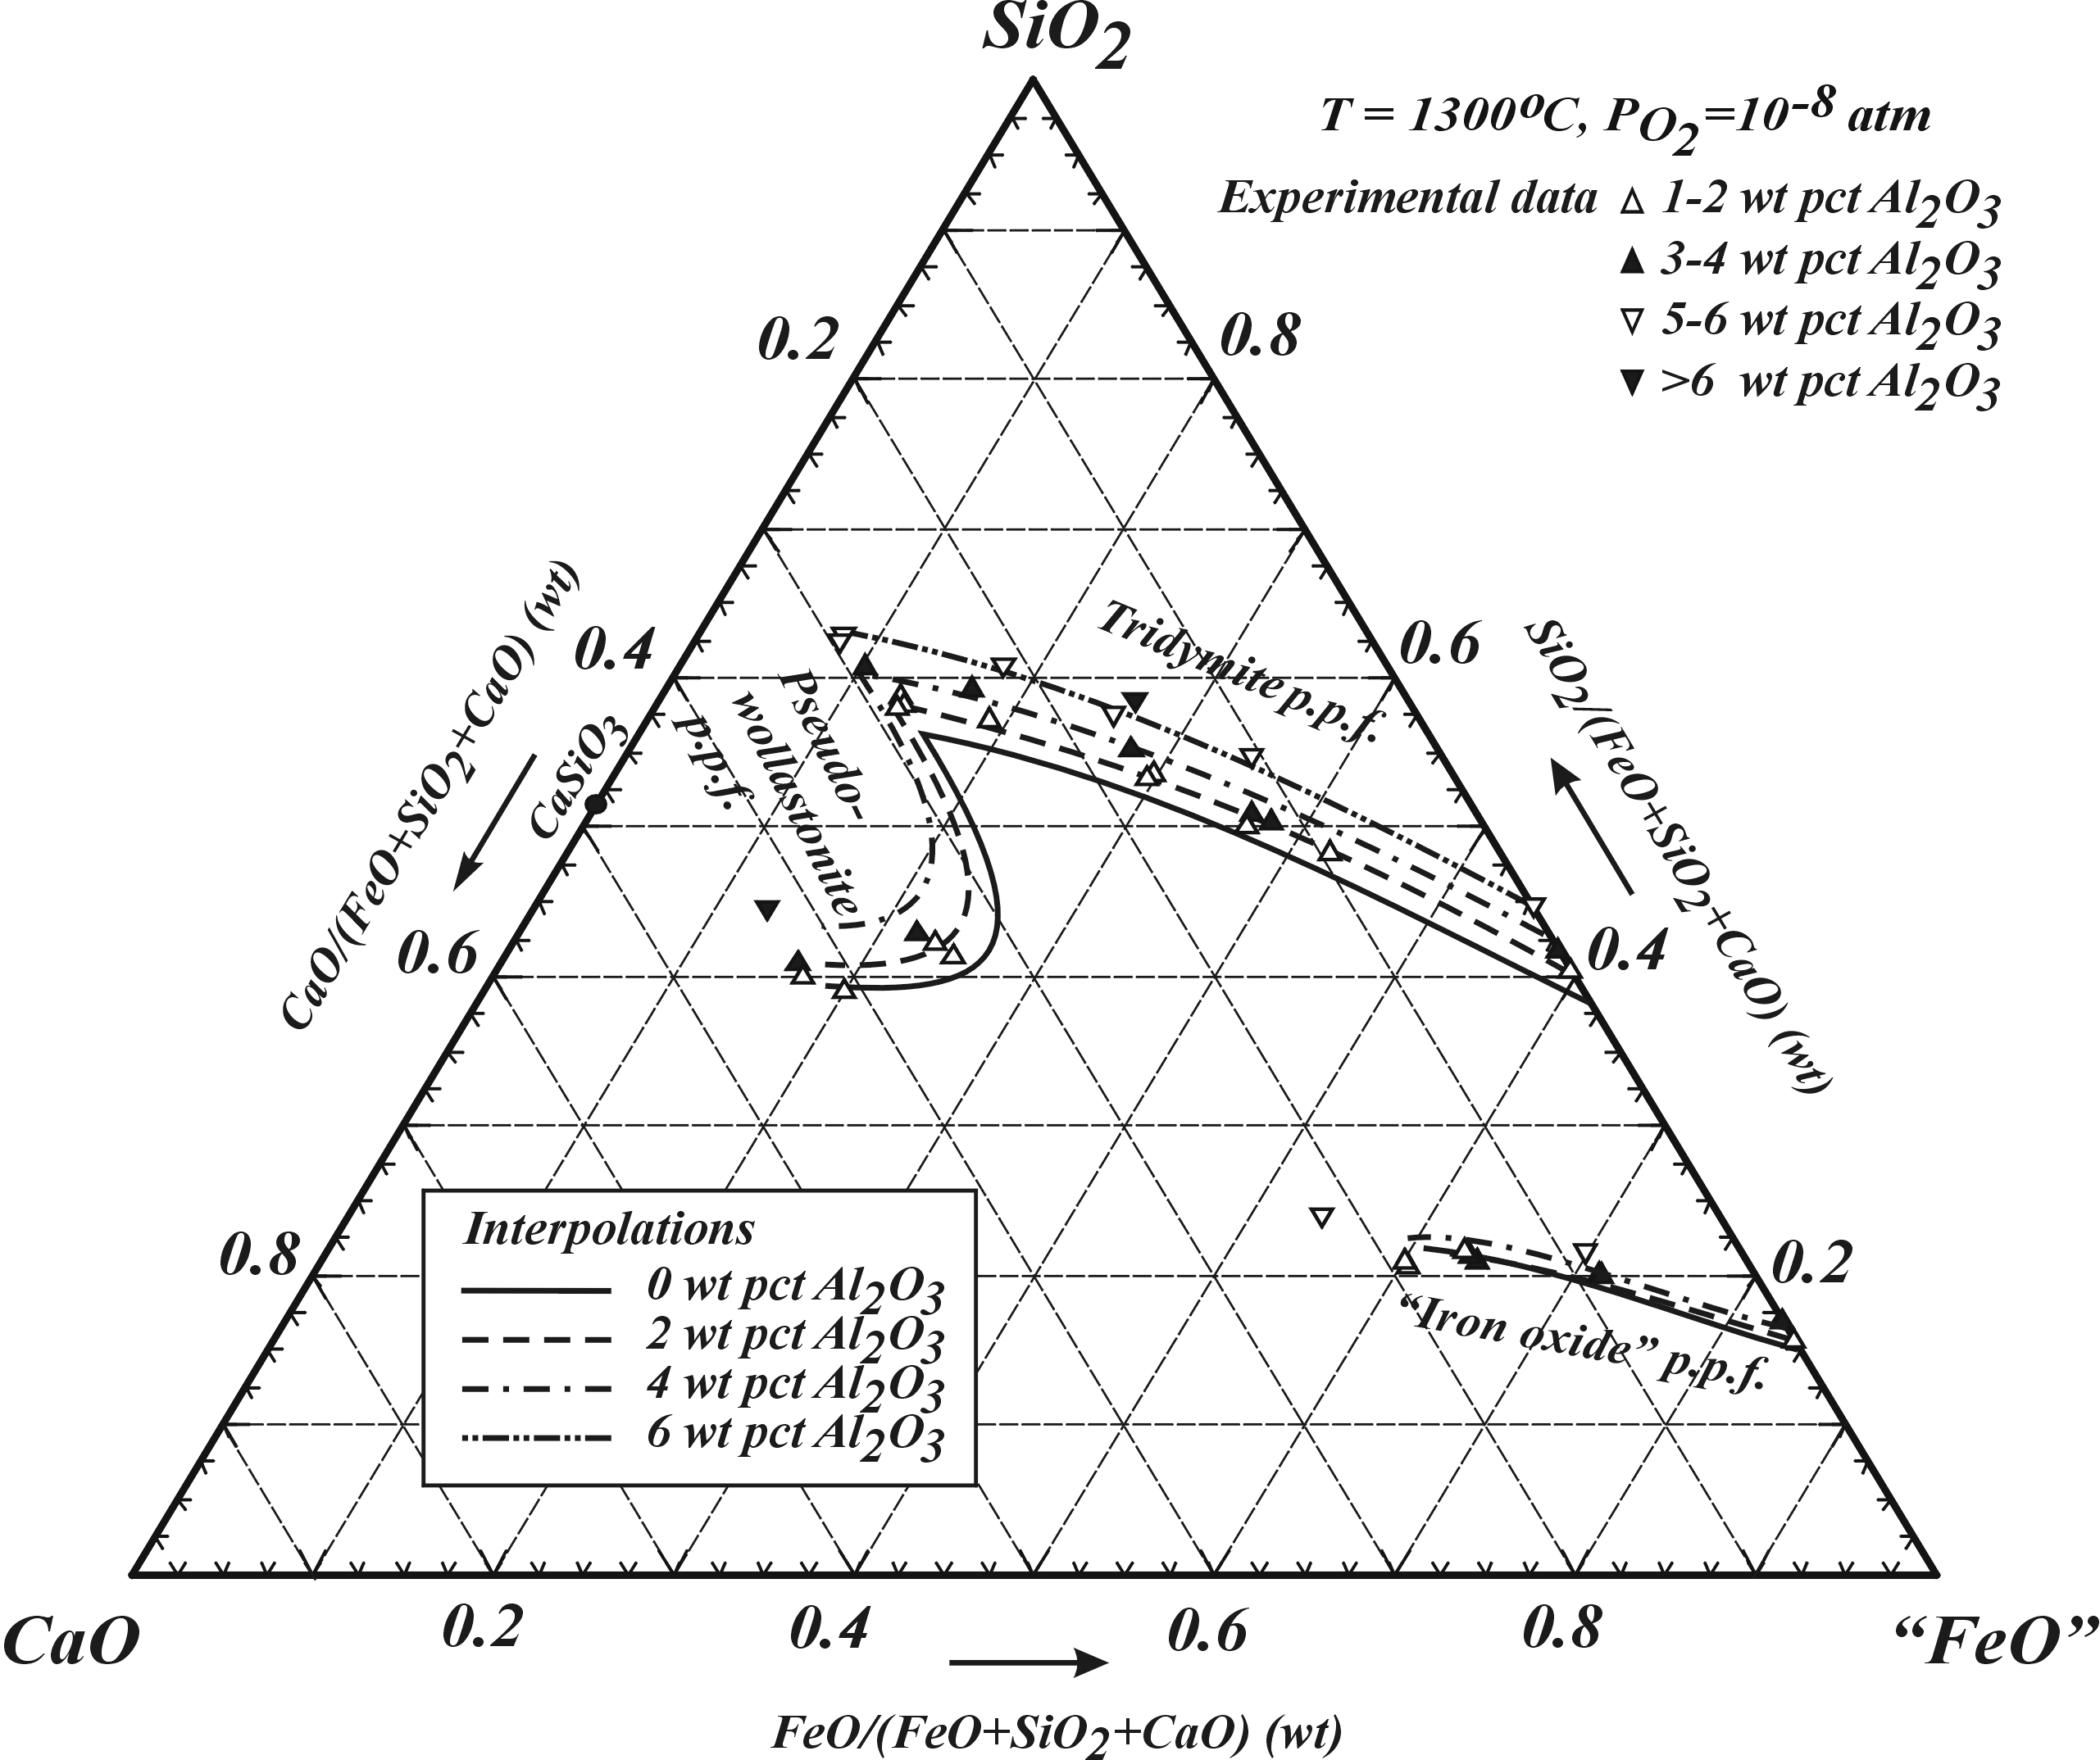
“FeO”-CaO-SiO₂ at fixed P_{O2} - effect of Al₂O₃
References:
T. Hidayat, H.M. Henao, P.C. Hayes and E. Jak: Proc. of the 7th International Copper-Cobre Conference 2010. GDMB, Hamburg, Germany, 2010, 761-778.

Slide 16
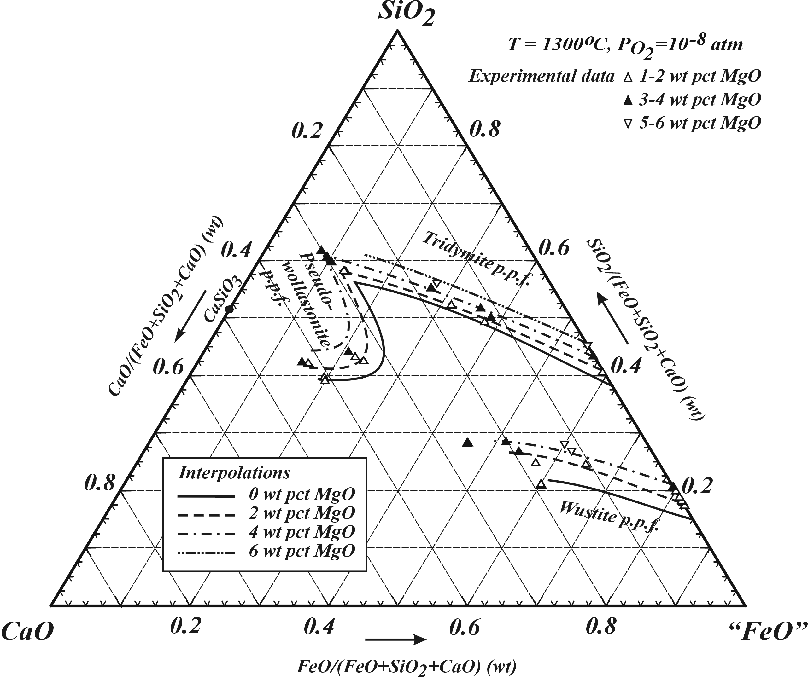
“FeO”-CaO-SiO₂ at fixed P_{O2} - effect of MgO
References:
T. Hidayat, H.M. Henao, P.C. Hayes and E. Jak: Proc. of the 7th International Copper-Cobre Conference 2010. GDMB, Hamburg, Germany, 2010, 761-778.

Slide 17
Microanalysis of multi-phase systems for complex feeds - partitioning of elements between solutions
Cu-Pb-Fe-O-S-Si system
17
Notes:
17

Slide 18
● Thermodynamic modelling
- assess existing data and plan experiments
Integrated thermodynamic modelling and experimental studies
● Experiments on low order systems
- fundamental knowledge
● Experiments on multi-component systems
- usually in support of industrial processes
● Thermodynamic modelling
- final database development

Slide 19
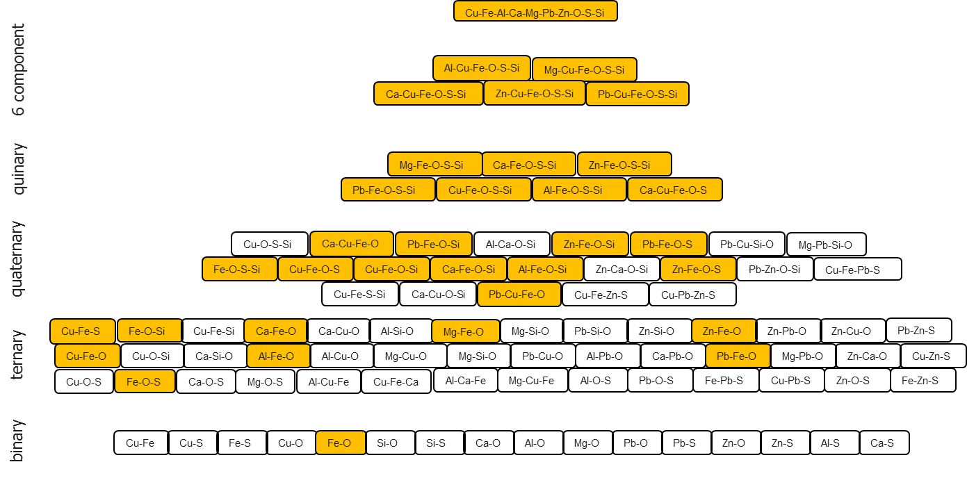
THERMODYNAMIC DATABASE DEVELOPMENT
Pyramid effect: e.g. change in Fe-O
requires re-evaluation of all these systems

Slide 20
THERMODYNAMIC DATABASE DEVELOPMENT
What does it mean when we say build a database?
Quantitatively define the relationship between
Composition and Gibbs Free Energy for each and every possible phase.

Slide 21
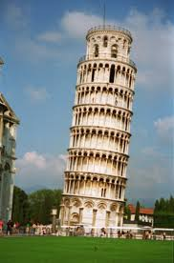
THERMODYNAMIC DATABASE DEVELOPMENT
For accurate description of a condensed phase system at least 6 types of data are needed to describe the system unambiguously, S₂₉₈ C_{p} ∆H₂₉₈ ∆H_{fusion} Liquidus, Component Activities.
For systems having extensive solid solutions then crystal structure and site occupancy of elements must also be added.
Solids data S₂₉₈ and C_{p} (then ∆H₂₉₈) are usually the most accurate – liquid data are invariably the least accurate.
Liquid
∆H_{fusion} Liquidus, Activities
S₂₉₈, Cp, ∆H₂₉₈
S₂₉₈, Cp, ∆H₂₉₈
solubilities
Its important to get the foundations right!

Slide 22
THERMODYNAMIC DATABASE DEVELOPMENT
Modern Thermodynamic Computer Platforms
contain
------------------------------------
GIBBS FREE ENERGY
MINIMISATION SOFTWARE
+
THERMODYNAMIC DATABASES
+
INPUT/OUTPUT WINDOWS - BASED

Slide 23
THERMODYNAMIC DATABASE DEVELOPMENT
FactSage thermodynamic databases describe the Gibbs Free Energies of
      Over 5000 stoichiometric compounds
      Advanced solution models
      Evaluated complex solutions
----------------------------------------------
Enabling the prediction of the thermochemical properties of Multi-component, Multi-phase equilibria for systems containing
GASES / SLAG (molten oxides) / MOLTEN SALTS (Cl, F, S, SO₃, .) / METAL ALLOYS / SOLIDS / AQUEOUS SOLUTIONS
FactSage developed by Centre for Computational Thermochemistry, (CRCT ), Ecole Polytechnique de Montreal, Canada

Slide 24
THERMODYNAMIC DATABASES DEVELOPMENT
Models provide the structure
LIQUID SLAG – RECENT MODEL IMPROVEMENTS:
- Modified Quasi-chemical Model, GUTS model
- Flexible acid / basic grouping
- Flexible maximum ordering composition
- Flexible combination of models for binaries and ternaries
SOLID SOLUTIONS:
- Compound energy formalism - 2 and 3 sub-lattice models

Slide 25
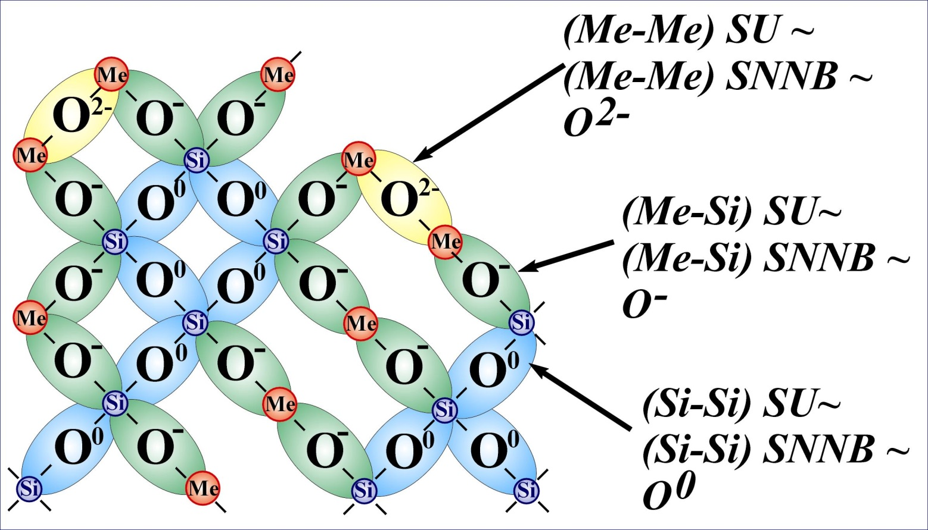
THERMODYNAMIC DATABASES - Example
Quasi-chemical model for slags and molten salts
Quasichemical Thermodynamic Model (FactSage)
SNNB – Second Nearest Neighbour Bond
(Si-O-Si) + (Me-O-Me) = 2 (Me-O-Si), Δg_{Si-Me}= ω-ηT

Slide 26
THERMODYNAMIC DATABASES - Advanced thermodynamic models / self consistent databases
Slag
Matte/Metal
Spinel
Olivine [Ca²⁺, Fe²⁺, Mg²⁺, Zn²⁺]^{M2}(Ca²⁺, Fe²⁺, Mg²⁺, Zn²⁺)^{M1}SiO₄
Melilite [Ca²⁺, Pb²⁺]₂(Fe²⁺, Zn²⁺, Al³⁺, Fe³⁺)[Al³⁺, Fe³⁺, Si⁴⁺]₂
Pyroxenes (Ca, Fe²⁺, Mg)^{M2} (Fe²⁺, Fe³⁺, Mg, Al )^{M1} (Fe³⁺, Al, Si)^{B} Si^{A} O₆
Monoxide CaO - MgO - MnO - CoO - NiO - FeO
(+ Fe₂O₃ - Al₂O₃ - ZnO - Cr₂O₃)
a-Ca₂SiO₄ a-Ca₂SiO₄ ( + Fe₂SiO₄, Mg₂SiO₄, Mn₂SiO₄)
a’-Ca₂SiO₄ a’-Ca₂SiO₄ ( + Fe₂SiO₄, Mg₂SiO₄, Mn₂SiO₄ , Pb₂SiO₄ , Zn₂SiO₄)
Wollastonite CaSiO₃ ( + FeSiO₃, MgSiO₃, MnSiO₃)
Corundum Al₂O₃ - Cr₂O₃ - Fe₂O₃
Pyroxenes (Ca, Fe²⁺, Mg)^{M2} (Fe²⁺, Fe³⁺, Mg, Al )^{M1} (Fe³⁺, Al, Si)^{B} Si^{A} O₆
Monoxide CaO - MgO - MnO - CoO - NiO - FeO
(+ Fe₂O₃ - Al₂O₃ - ZnO - Cr₂O₃)
a-Ca₂SiO₄ a-Ca₂SiO₄ ( + Fe₂SiO₄, Mg₂SiO₄, Mn₂SiO₄)
a’-Ca₂SiO₄ a’-Ca₂SiO₄ ( + Fe₂SiO₄, Mg₂SiO₄, Mn₂SiO₄ , Pb₂SiO₄ , Zn₂SiO₄)
Wollastonite CaSiO₃ ( + FeSiO₃, MgSiO₃, MnSiO₃)
Corundum Al₂O₃ - Cr₂O₃ - Fe₂O₃
.

Slide 27
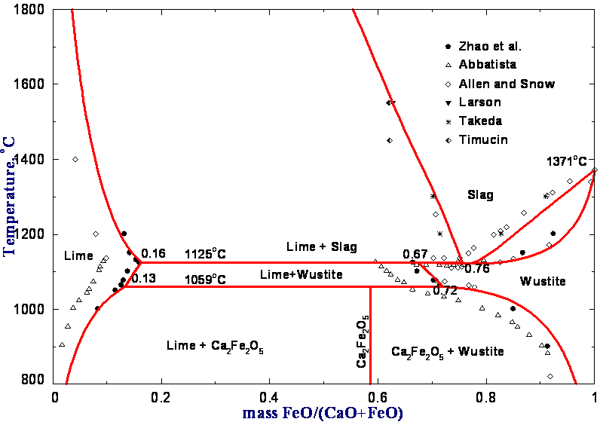
THERMODYNAMIC DATABASES – why we need to re-evaluate base systems
References:
(4) B. Zhao, P. Hayes and E. Jak: Unpublished Work: Pyrometallurgy Research Centre, The University of Queensland, (2003),
(5) W.C. Allen and R.B. Snow: J. Am. Ceram. Soc., 38(1955), 264-280.
(6) N.L. Bowen, J.F. Schairer and E. Psnjak: Am. J. Sci., 26(1933), 193-284.
(7) E. Görl, F. Oeters and R. Scheel: Arch. Eisenhwes., 37(1966), 441-445.
(8) S.A. Decterov, I.-H. Jung, E. Jak, Y.-B. Kang, P. Hayes and A.D. Pelton: Proc. VII Int. Conf. on Molten Slags, Fluxes & Salts. SAIMM (2004), 839-850.
(10) F. Abbattista, A. Burdese and M. Maja: Rev. Int. Hautes Temp. Refract., 12(1975), 337-342.
(11) H. Larson and J. Chipman: Trans. AIME, J. Met., 197(1953), 1089-1096.
(12) Y. Takeda, S. Nakazawa and A. Yazawa: Can. Metall. Q., 19(1980), 297-305.
(13) M. Timucin and A.E. Morris: Metall. Trans., 1(1970), 3193-3201.
In equilibrium with metallic iron
Recent data shows that early measurements were not always correct
α’-Ca₂SiO₄-Fe₂SiO₄
Solid Solution
S.A. Decterov, I.-H. Jung, E. Jak, Y.-B. Kang, P. Hayes and A.D. Pelton: Proc. VII Int. Conf. Molten Slags, Fluxes & Salts. SAIMM, South Africa, (2004), 839-850.

Slide 28
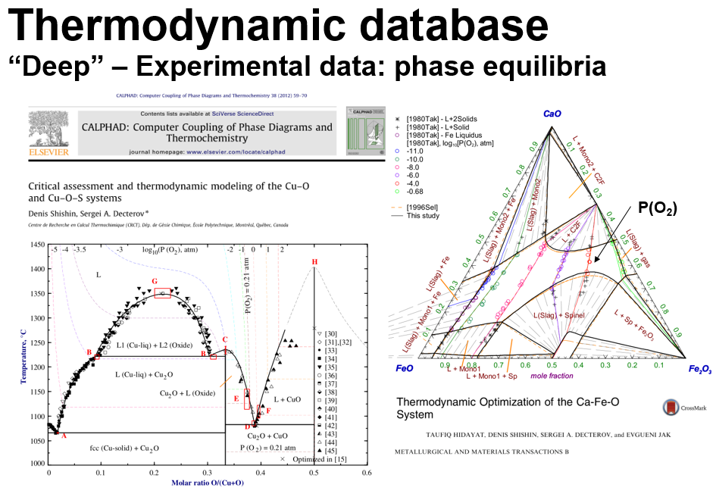
THERMODYNAMIC DATABASES– why we need to re-evaluate base systems

Slide 29
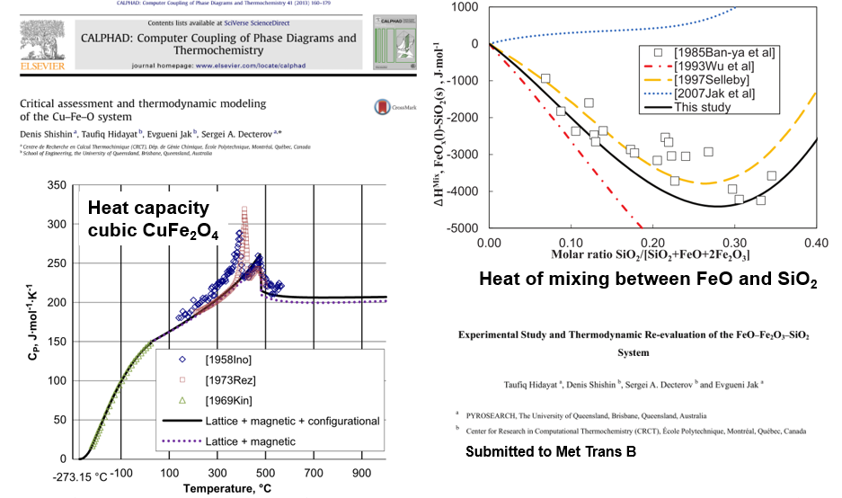
THERMODYNAMIC DATABASES– why we need to re-evaluate base systems

Slide 30
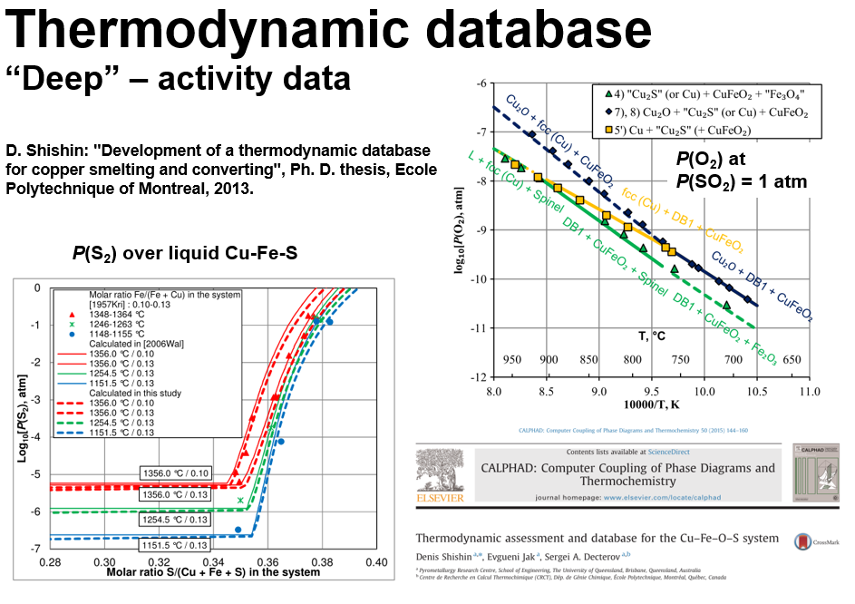
THERMODYNAMIC DATABASES – why we need to re-evaluate base systems

Slide 31
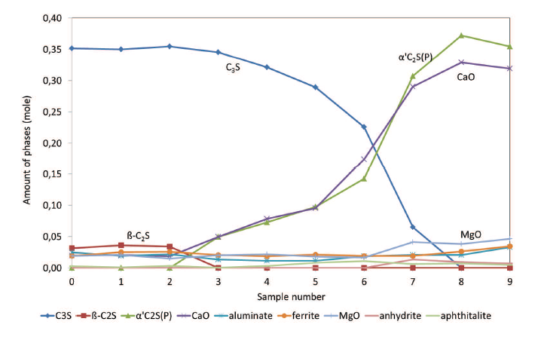
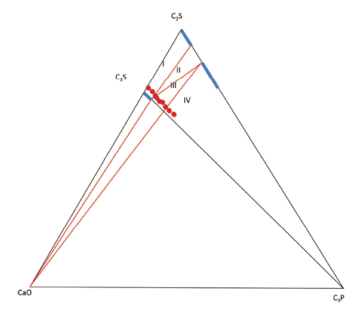
Effect of P on phase distribution in the system CaO-2CaO.SiO₂-3CaO.P₂O₅
2CaO.SiO₂
Minor elements in solid solutions can significantly change the polymorph that is stable
CaO
3CaO.P₂O₅
B. Hokfors, PhD thesis, Umea 2014, “Cementa” “Phase Chemistry in process models for cement clinker and lime production”

Slide 32
FactSage THERMODYNAMIC DATABASES
for slags developed by PYROSEARCH
(in collaboration with CRCT Ecole Polytechnique de Montreal)
PbO - ZnO- CaO - FeO -Fe₂O₃ - Al₂O₃ - SiO₂
SiO₂ - Al₂O₃ - CaO - FeO - Fe₂O₃ - MgO - Na₂O - K₂O
“Cu₂O”- S -SiO₂ - FeO - Fe₂O₃ - CaO - Al₂O₃ - MgO
Now extending these to integrated slag/ matte/ metal databases to include
Cu-S-O-FeO-Fe₂O₃-SiO₂-Al₂O₃-CaO-MgO-Pb
… As-Pb-Zn-Sn-Sb-Bi-Ag-Au … Ni, Se, Te, Pd …

Slide 33
DATABASES THE NEXT GENERATION - Integration of
experimental results, models and modelling tools
PHASE
EQUILIBRIA
EXPERIMENTS
AND
THERMODYNAMIC
MODELLING
- % Liquid
- % Solids
- Slag composition
EXPERIMENTS
AND MODELLING
OF VISCOSITIES
Liquid and
partially crystallised
slag systems
CUSTOMISED SOFTWARE
INDUSTRIAL APPLICATIONS
- Slag liquidus / fluxing / blending
- Slag viscosity / flow
    Activity / vapour pressure / enthalpy changes
    Multi-phase equilibrium predictions

Slide 34
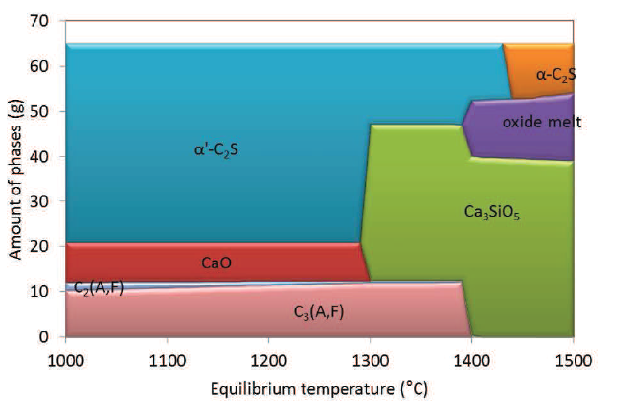
Example: Application of thermodynamics to Cement chemistry - FactSage equilibrium predictions
Proportions of phases formed under equilibrium cooling of an “idealised cement mix” in the CaO-SiO₂-Al₂O₃-Fe₂O₃ system.
B. Hokfors, PhD thesis, Umea, 2014, “Cementa”, “Phase Chemistry in process models for cement clinker and lime production”.

Slide 35
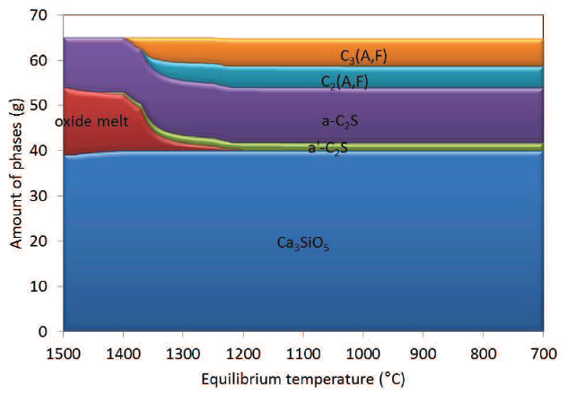
Example: Application of thermodynamics to Cement chemistry - FactSage predictions Scheil non-equilibrium cooling
Proportions of phases formed under non-equilibrium cooling of an “idealised cement mix” in the CaO-SiO₂-Al₂O₃-Fe₂O₃ system
B. Hokfors, PhD thesis, Umea 2014, “Cementa”, “Phase Chemistry in process models for cement clinker and lime production”.

Slide 36
SUMMARY
Experimental studies of phase equilibria
New experimental techniques make it possible to accurately measure
- Phase equilibria in complex oxide systems.
- Elemental partitioning between liquid and solid oxides, sulphides, alloys at controlled temperatures and compositions.
FactSage thermodynamic databases
are available for the prediction of equilibrium and metastable states in systems containing complex oxides, sulphides, alloys.
Slag Viscosities
Experimental measurement can be undertaken at controlled temperatures and compositions.
Quasi-chemical models can accurately predict slag viscosities in complex oxide systems, e.g. CaO-FeO-Fe₂O₃-SiO₂-Al₂O₃-MgO….

Slide 37
CONCLUDING STATEMENT
Modern computer platforms enable complex calculations of mass balance, energy balance, thermodynamic calculations (chemical outcomes), process modelling, simulation, optimisation and control.
Underpinning these tools are key fundamental property data on thermochemistry, physico-chemical and chemical thermodynamic properties.
We have the predictive tools but ….
to have accurate tools we need accurate and comprehensive thermodynamic databases
…. this is what we do!!

