Slide 1


Experimental Investigation and Modelling of the Viscosity of Oxide Slag Systems
M. Müller¹, S. Seebold¹, G. Wu¹, E. Yazhenskikh¹,
T. Jantzen², K. Hack²
¹Institute of Energy and Climate Research (IEK-2), Forschungszentrum Jülich GmbH
²GTT-Technologies
5th International Slag Valorisation Symposium, 3-5 April 2017, Leuven, Belgium

Slide 2
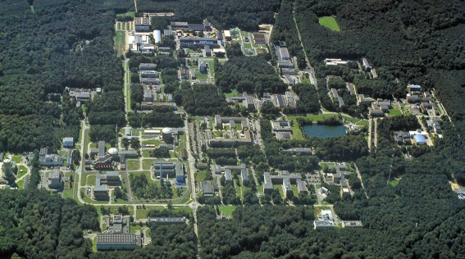
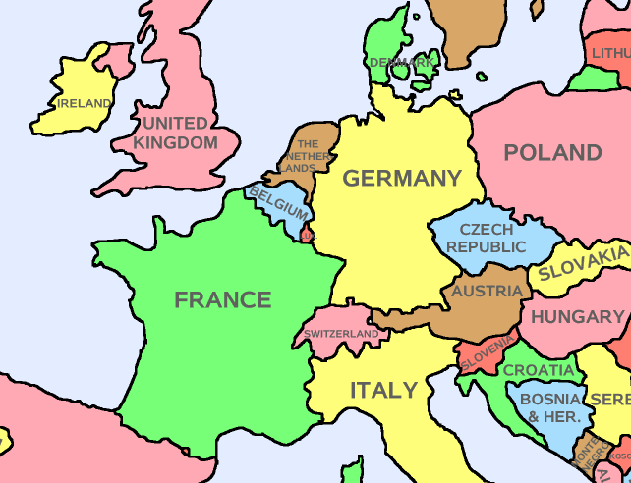

Forschungszentrum Jülich
Mitglied der Helmholtzgemeinschaft
founded 1956
5700 employees
1000 guest scientists
from >40 countries
Leuven
Key Technologies
for Tomorrow
Energy and Environment
Information and the Brain

Slide 3
Thermochemistry Group at IEK-2
Research Areas
High temperature chemistry of inorganic condensed and gaseous phases in
  Advanced power plants
  Biomass conversion
  Energy storage
  SOFC
  Membranes

Slide 4
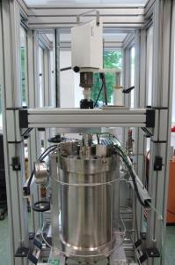
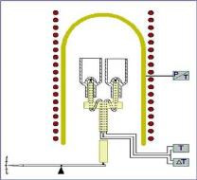
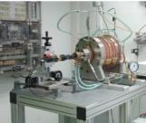
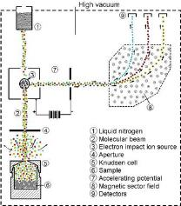
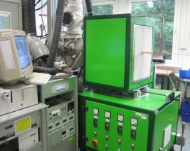
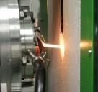
Experimental Methods for Ash/Slag and Fuel Characterisation
Thermoanalytical Methods
Thermophysical Methods
HT-HP
Microscope
and
Viscosimeter
DTA / DSC / TG
Dropcalorimeter
Knudsen-Effusion-
Mass-Spectrometry
Hot Gas Analysis
Exposure / Annealing
Analytics: SEM, TEM, XRD, HT-XRD, chem. Analysis, etc.
Molecular-Beam-Mass-Spectrometry

Slide 5
IGCC
Source: Abraham, TKIS
high efficiency (ca. 45% currently, >50% in 5 years, >55% in 12 years)
opportunity for effective CO₂ capture and storage

Slide 6
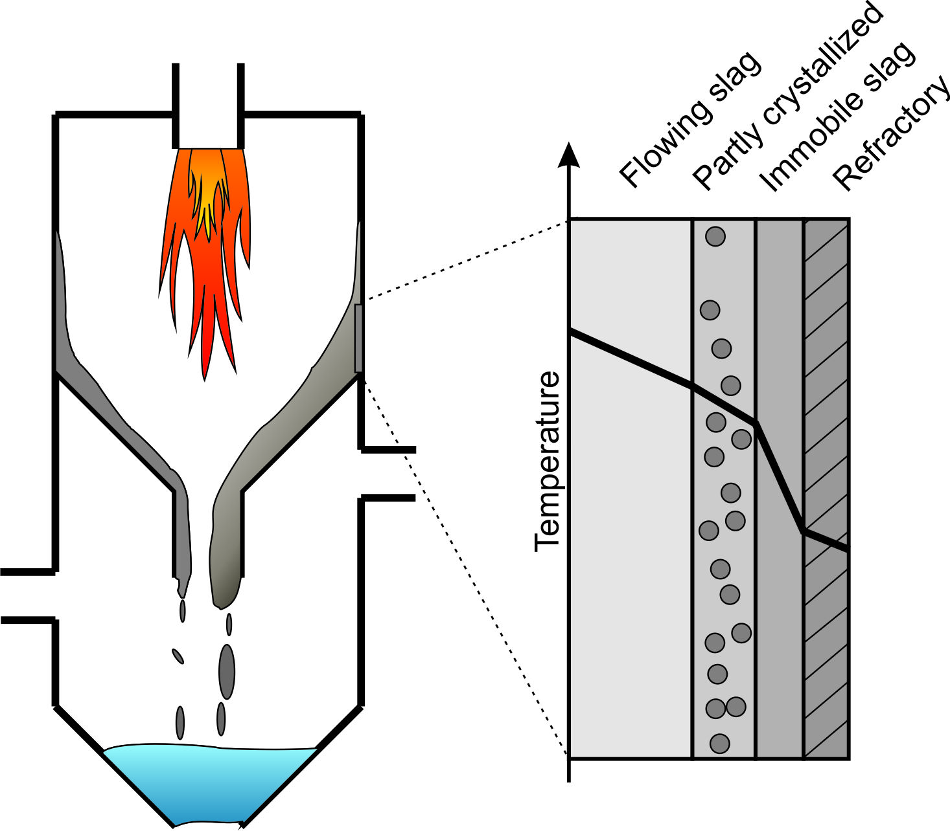
Entrained Flow Slagging Gasifiers
Thermochemistry
of slag?
Viscosity of slag?
25 Pa·s
10 Pa·s
Temperature of critical viscosity, T_{cv}

Slide 7
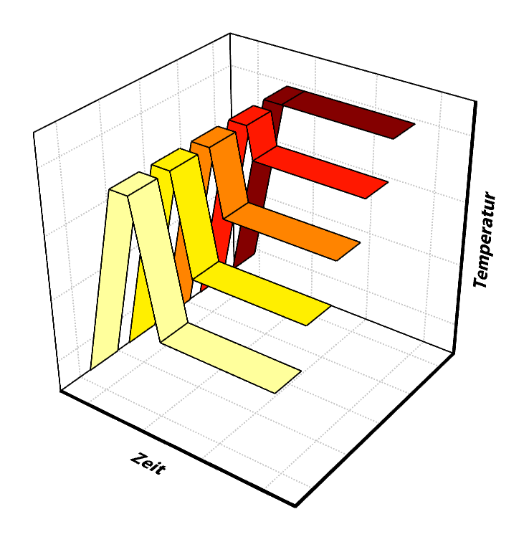
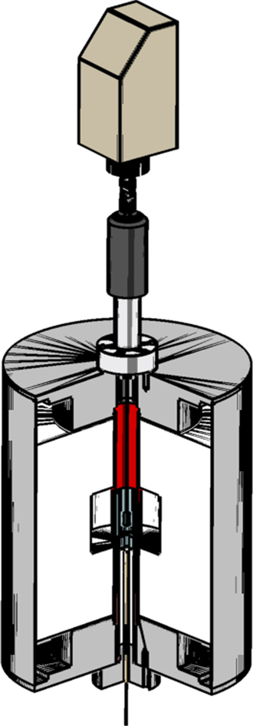
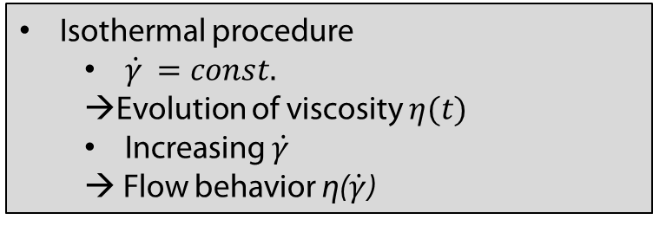
Rheometry
Isotherm:
Viscometer
Universal joint
Magnetic coupling
Crucible and
spindle
Isothermal procedure
  $\dot{γ }=const.$
  →Evolution of viscosity $η(t)$
  Increasing $\dot{γ }$
  → Flow behavior η($\dot{γ}$)
Thermocouple

Slide 8
Isothermal Measurement
Characteristic evolution of viscosity
ST-D-2
Ar/H₂
10 rpm
Supercooling effects
Increasing viscosity

Slide 9
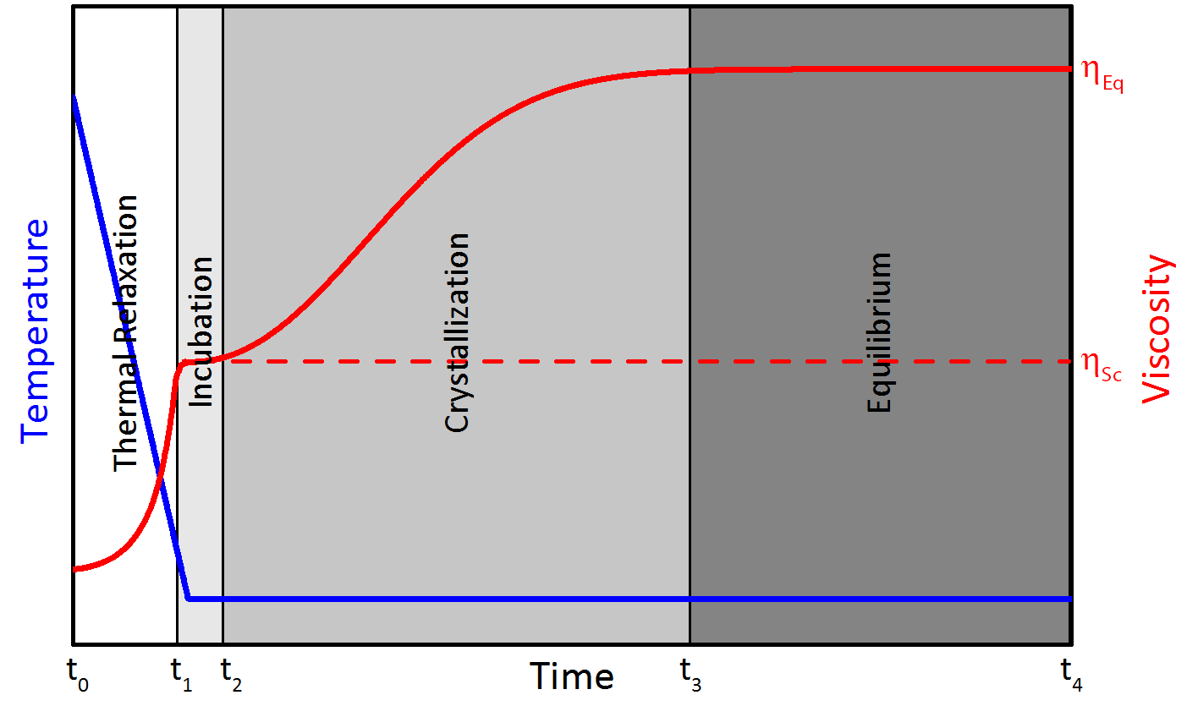
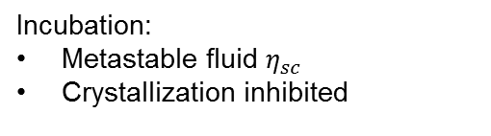
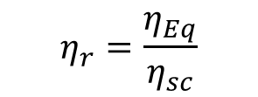
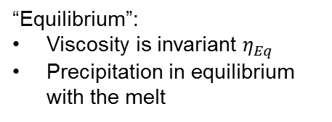
Evolution of Viscosity
Themal relaxation:
Exponentially increase of η
Incubation:
Metastable fluid $η_{sc}$
Crystallization inhibited
Crystallization:
Increase of the viscosity caused by the increase of precipitation
“Equilibrium”:
Viscosity is invariant $η_{Eq}$
Precipitation in equilibrium with the melt
Definition:
$$η_{r}=\frac{η_{Eq}}{η_{sc}}$$

Slide 10
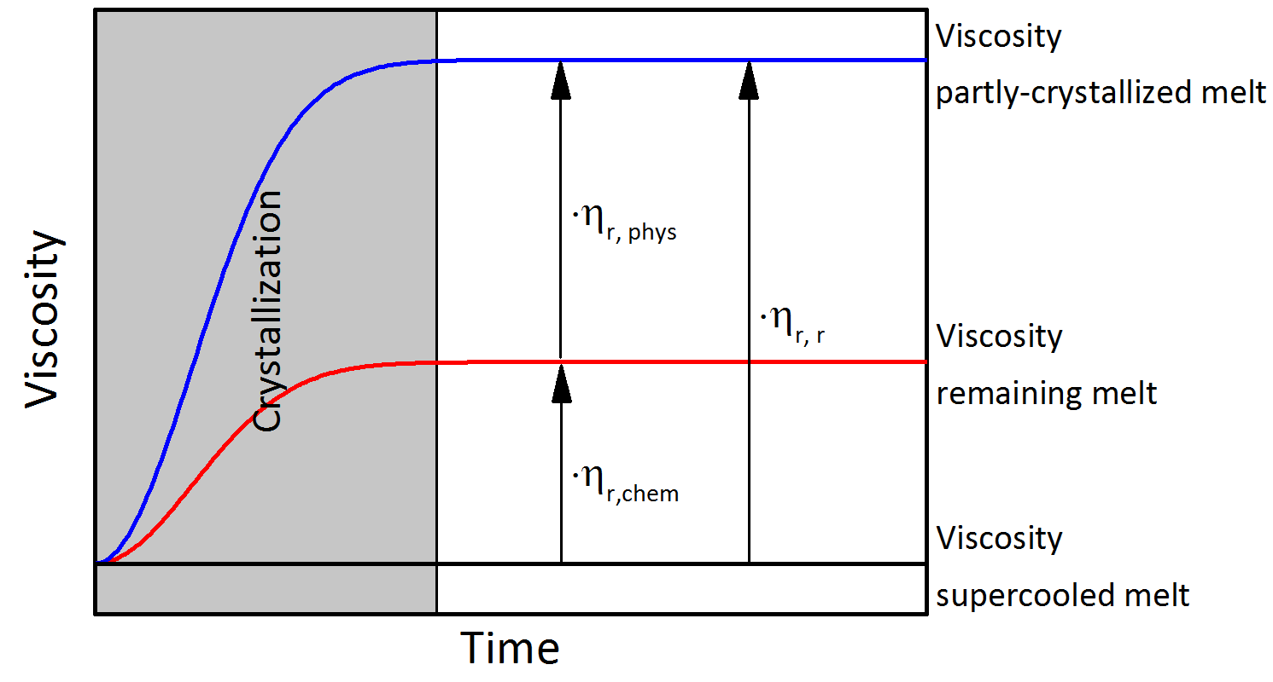
Resulting Relative Viscosity
η_{Eq} = η _{r,chem} * η _{r,phys} * η _{Sc}

Slide 11
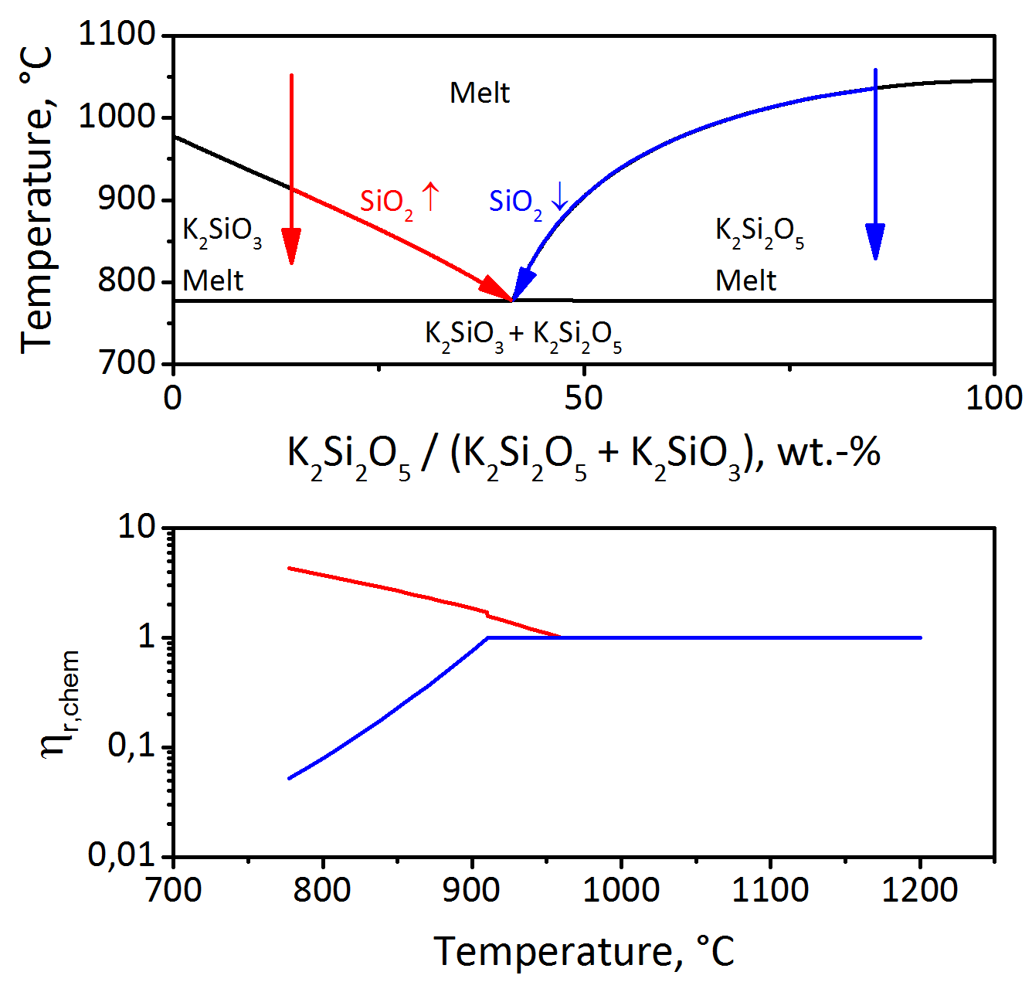
Chemical Relative Viscosity
Viscosity of continuous phase is strongly dependent on precipitations
Notes:
Viskosität der Restschmelze bezigen auf zur znterkühlten Schmelze

Slide 12
Thermodynamic Database
P₂O₅
Cr_{x}O_{y}
K₂O
MgO
Al₂O₃
CaO
Oxide database
State of the art:
Phase equilibria and thermodynamic properties are investigated using DTA/TG, DSC, KEMS etc.
2-, 3- and multicomponent systems have been thermodynamically assessed using all available experimental data
phase diagrams and other thermodynamic properties can be calculated with the obtained self-consistent datasets
ZnO
SiO₂
Me_{x}S_{y}
Na₂O
Fe_{x}O_{y}
Mn_{x}O_{y}
SO₃
+
CO₂
Aim of our work:
Determination of thermodynamic data
Development of a new data base for slag relevant oxide/sulphide systems

Slide 13

Optimisation
OptiSage in
Experimental Data
Analysis of phase diagrams and activities
Optimisation of solution parameters
ΔH_{f}²⁹⁸ and S²⁹⁸ (solid and liquid components within solutions and phases)
interaction of components within a phase
Choice of model for solid and liquid solutions
Data available for pure substances and solutions
optimisation
disagreement
compared to
experimental data
Re-assessment:
Gibbs Energy values of pure components from the FACT database needed to be replaced by values from the SGTE Pure Substance Database
agreement
New Dataset

Slide 14
Models
Solids: stoichiometric compounds
Solid solutions: sublattice approach
Liquid: non-ideal associate solution using Redlich-Kister-Muggianu polynomial
Deviation of ideal behaviour is described by formation of complex components (associates). Associates are not necessarily real ionic or molecular species.
G° = A + B*T + C T*ln(T) + D*T² + E*T³ + F/T

Slide 15
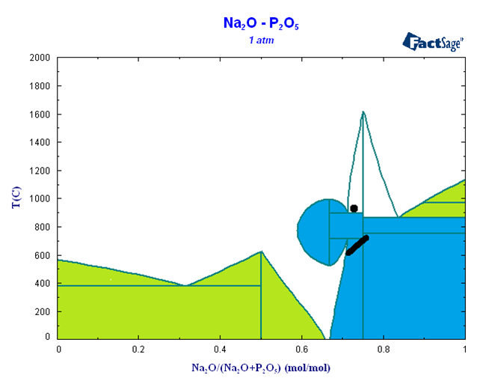
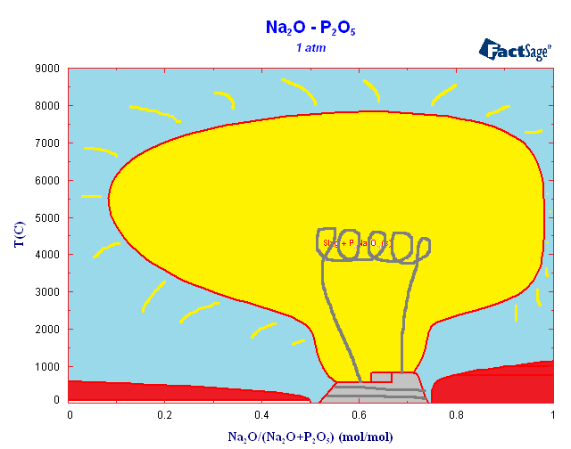
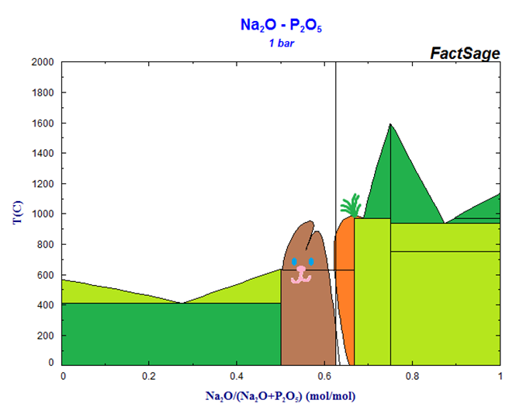
Highlights from Thermodynamic Database (before final optimisation)

Slide 16
Highlights from Thermodynamic Database
SiO₂ – NaAlO₂

Slide 17
Development of New Viscosity Model
Classical model:
Comp.
Temp.
Viscosity
The story of current model:
Comp.
Temp.
Associate
species
Viscosity
Comp.
Temp.
Associate
species
Structure
Viscosity
For FeO/Fe₂O₃ containing systems, partial pressure of oxygen is also taken into account in the current model.

Slide 18
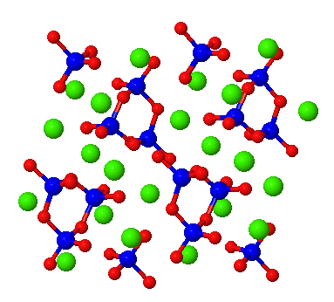
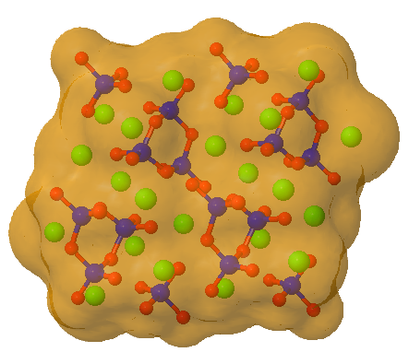
Simple Associate Based Model
CaSiO₃
Associate species model is employed to predict the slag structure, which can be presented by the relative concentrations of each associate species.

Slide 19
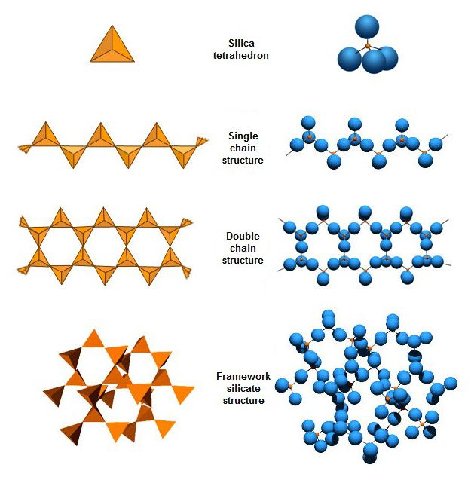
Self-Polymerization of SiO₂
S: SiO₂
S₁+S₁=S₂
S₁+S₂=S₃
… …
S₁+S_{k-1}=S_{k}
self-pol.

Slide 20

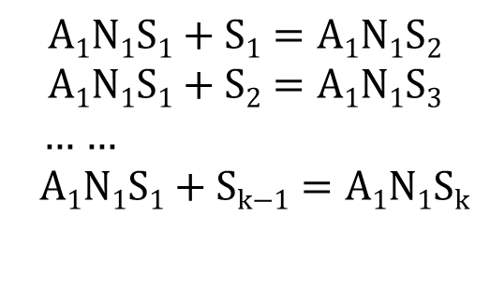
Inter-Polymerization with SiO₂
inter-pol.

Slide 21
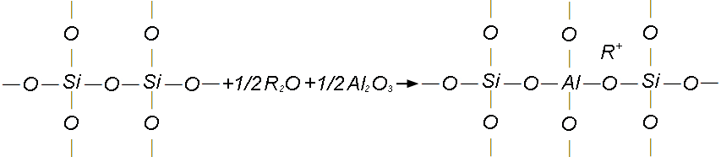
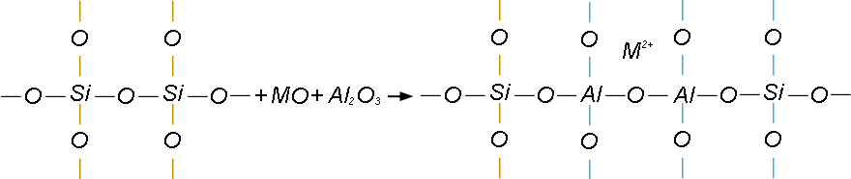
Amphoteric Effect of Al₂O₃
RAlO₂, RAlSiO₄, RAlSi₃O₈ or RAlSi₂O₆
R: Na, K
MAl₂O₄, MSi₂Al₂O₈ or M₂Al₄Si₅O₁₈
M: Ca, Mg

Slide 22
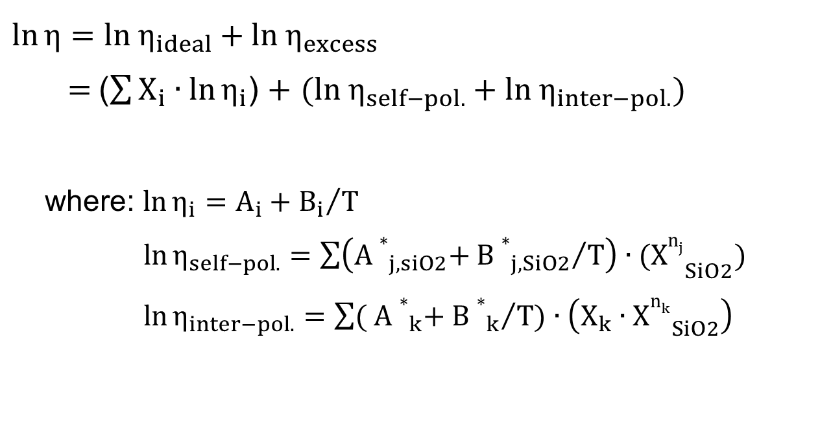
Current Viscosity Model
Arrhenius model (modified)
Si-Al-based ternary associate species
Si-based associate species
Probability
System: SiO₂-Al₂O₃-CaO-MgO-Na₂O-K₂O-FeO_{x}-(P₂O₅)

Slide 23
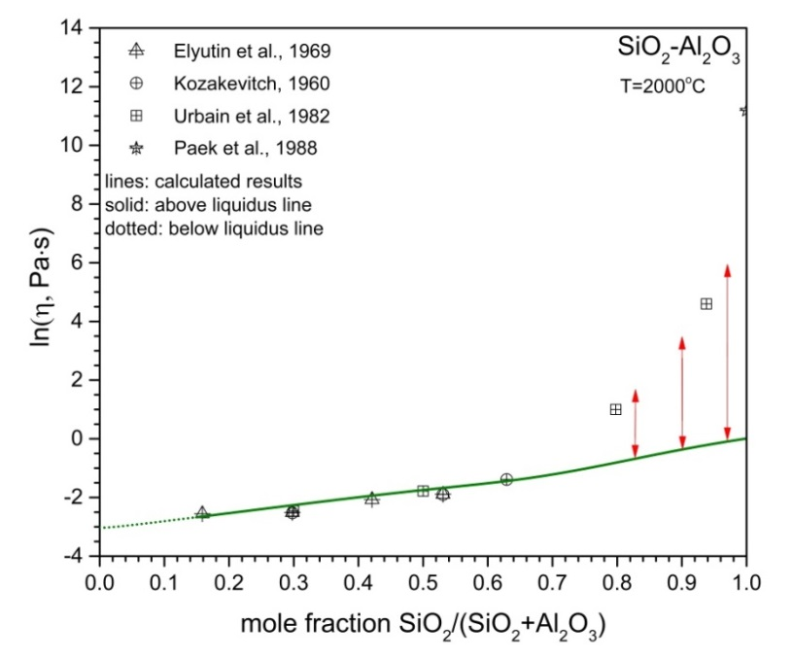
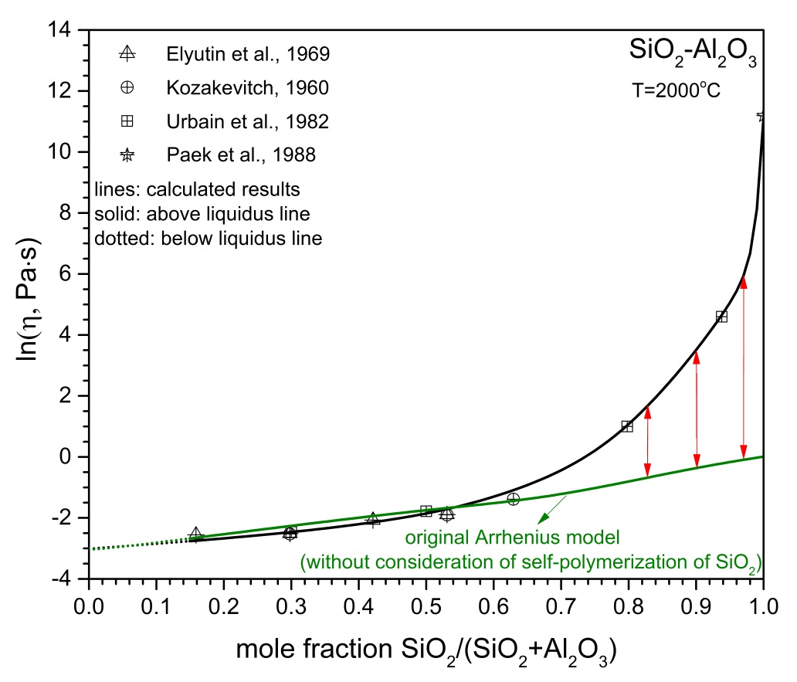
Results: Lubricant Effect
where: j=1,2.
n₁=6 and n₂=109
(SiO₂)₆ and (SiO₂)₁₀₉

Slide 24
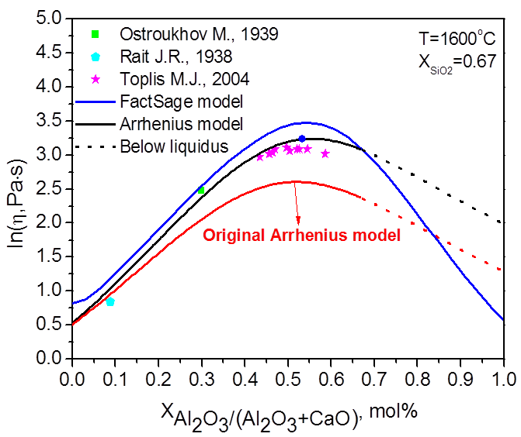
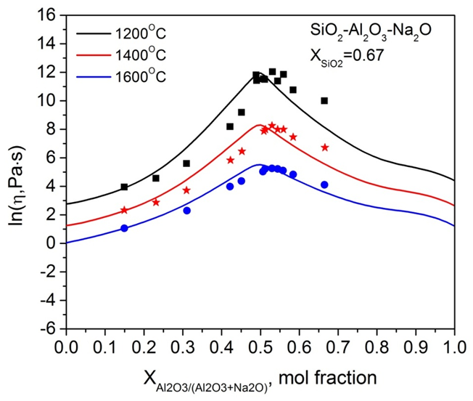
Results: Amphoteric Effect

Slide 25
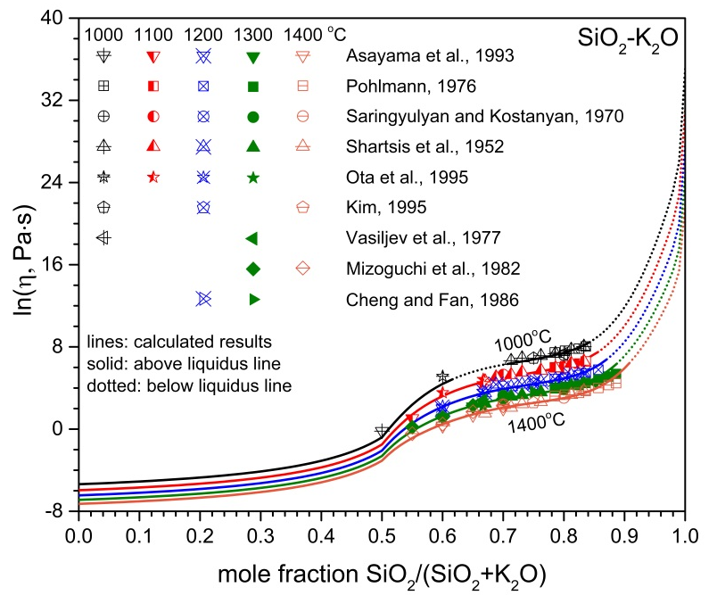
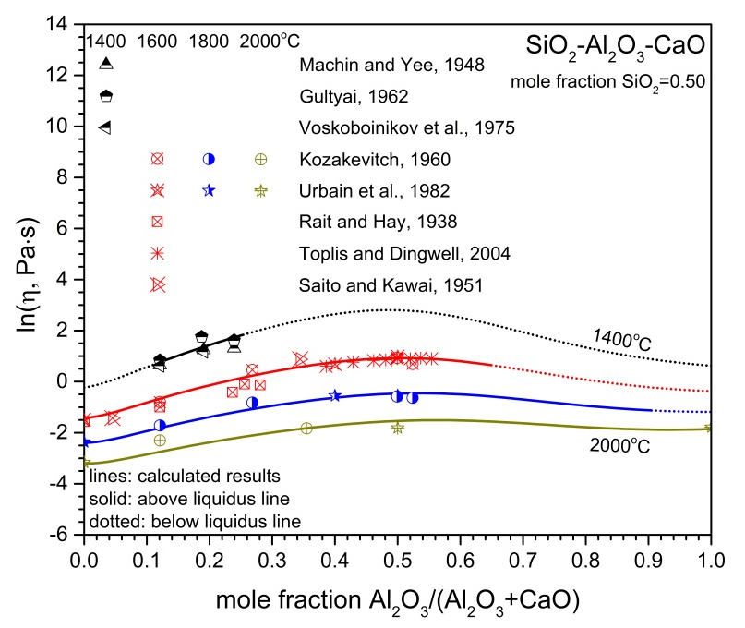
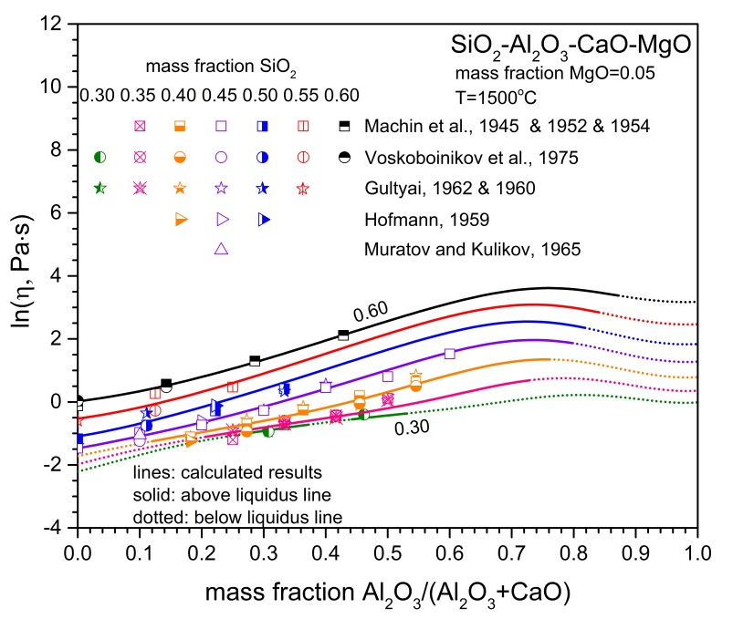
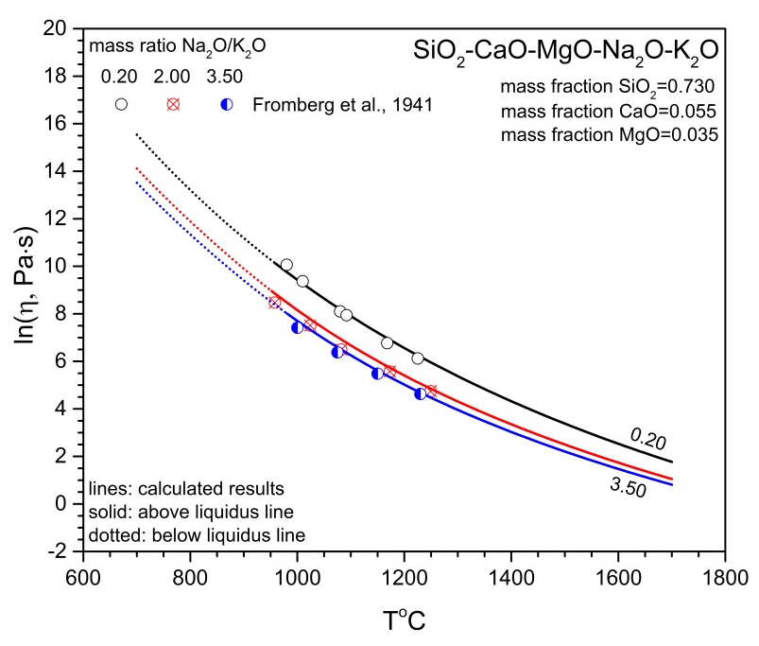
Results

Slide 26
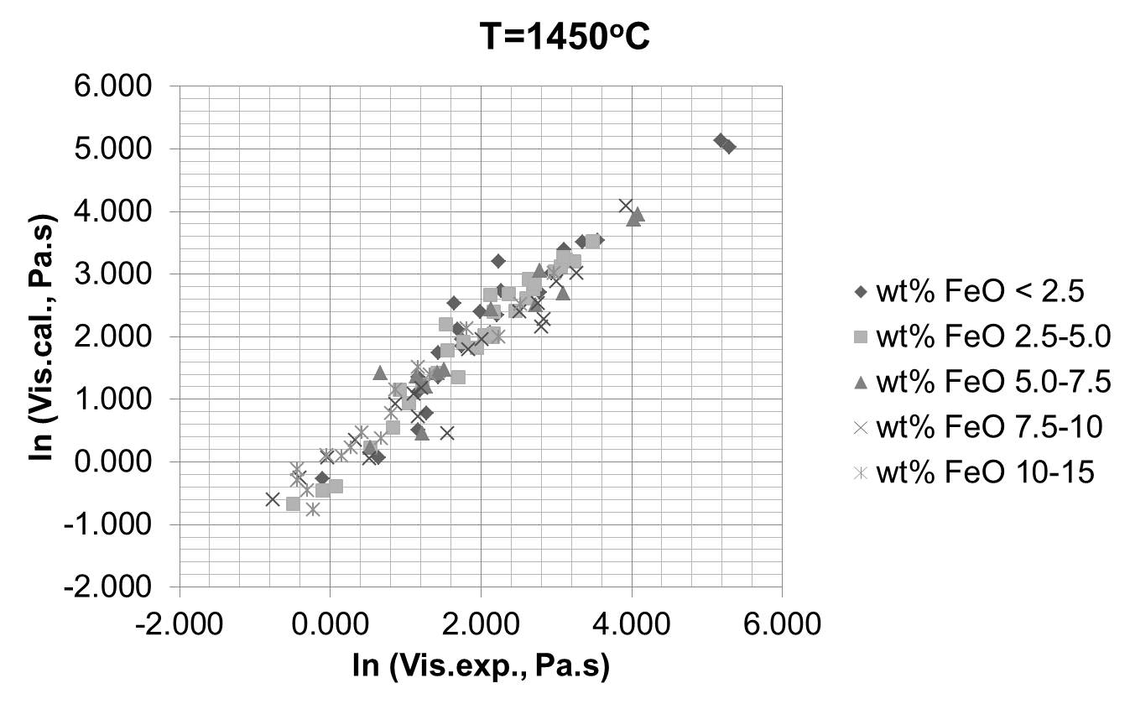
Role of Iron Oxide
SiO₂
Al₂O₃
MgO
Na₂O
K₂O
Fe₂O₃
T & P_{O2}
Dual roles
CaO
FeO
current model vs. Hurst model*
Redox reaction
*Source: H.J. Hurst, F. Novak, J.H. Patterson, Proc. V International Conference on Molten Slags, Fluxes and Salts, Sydney, Australia, 1997, pp. 873-876

Slide 27
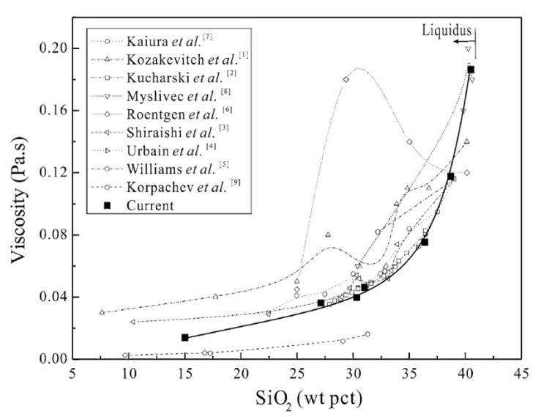
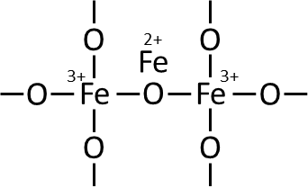
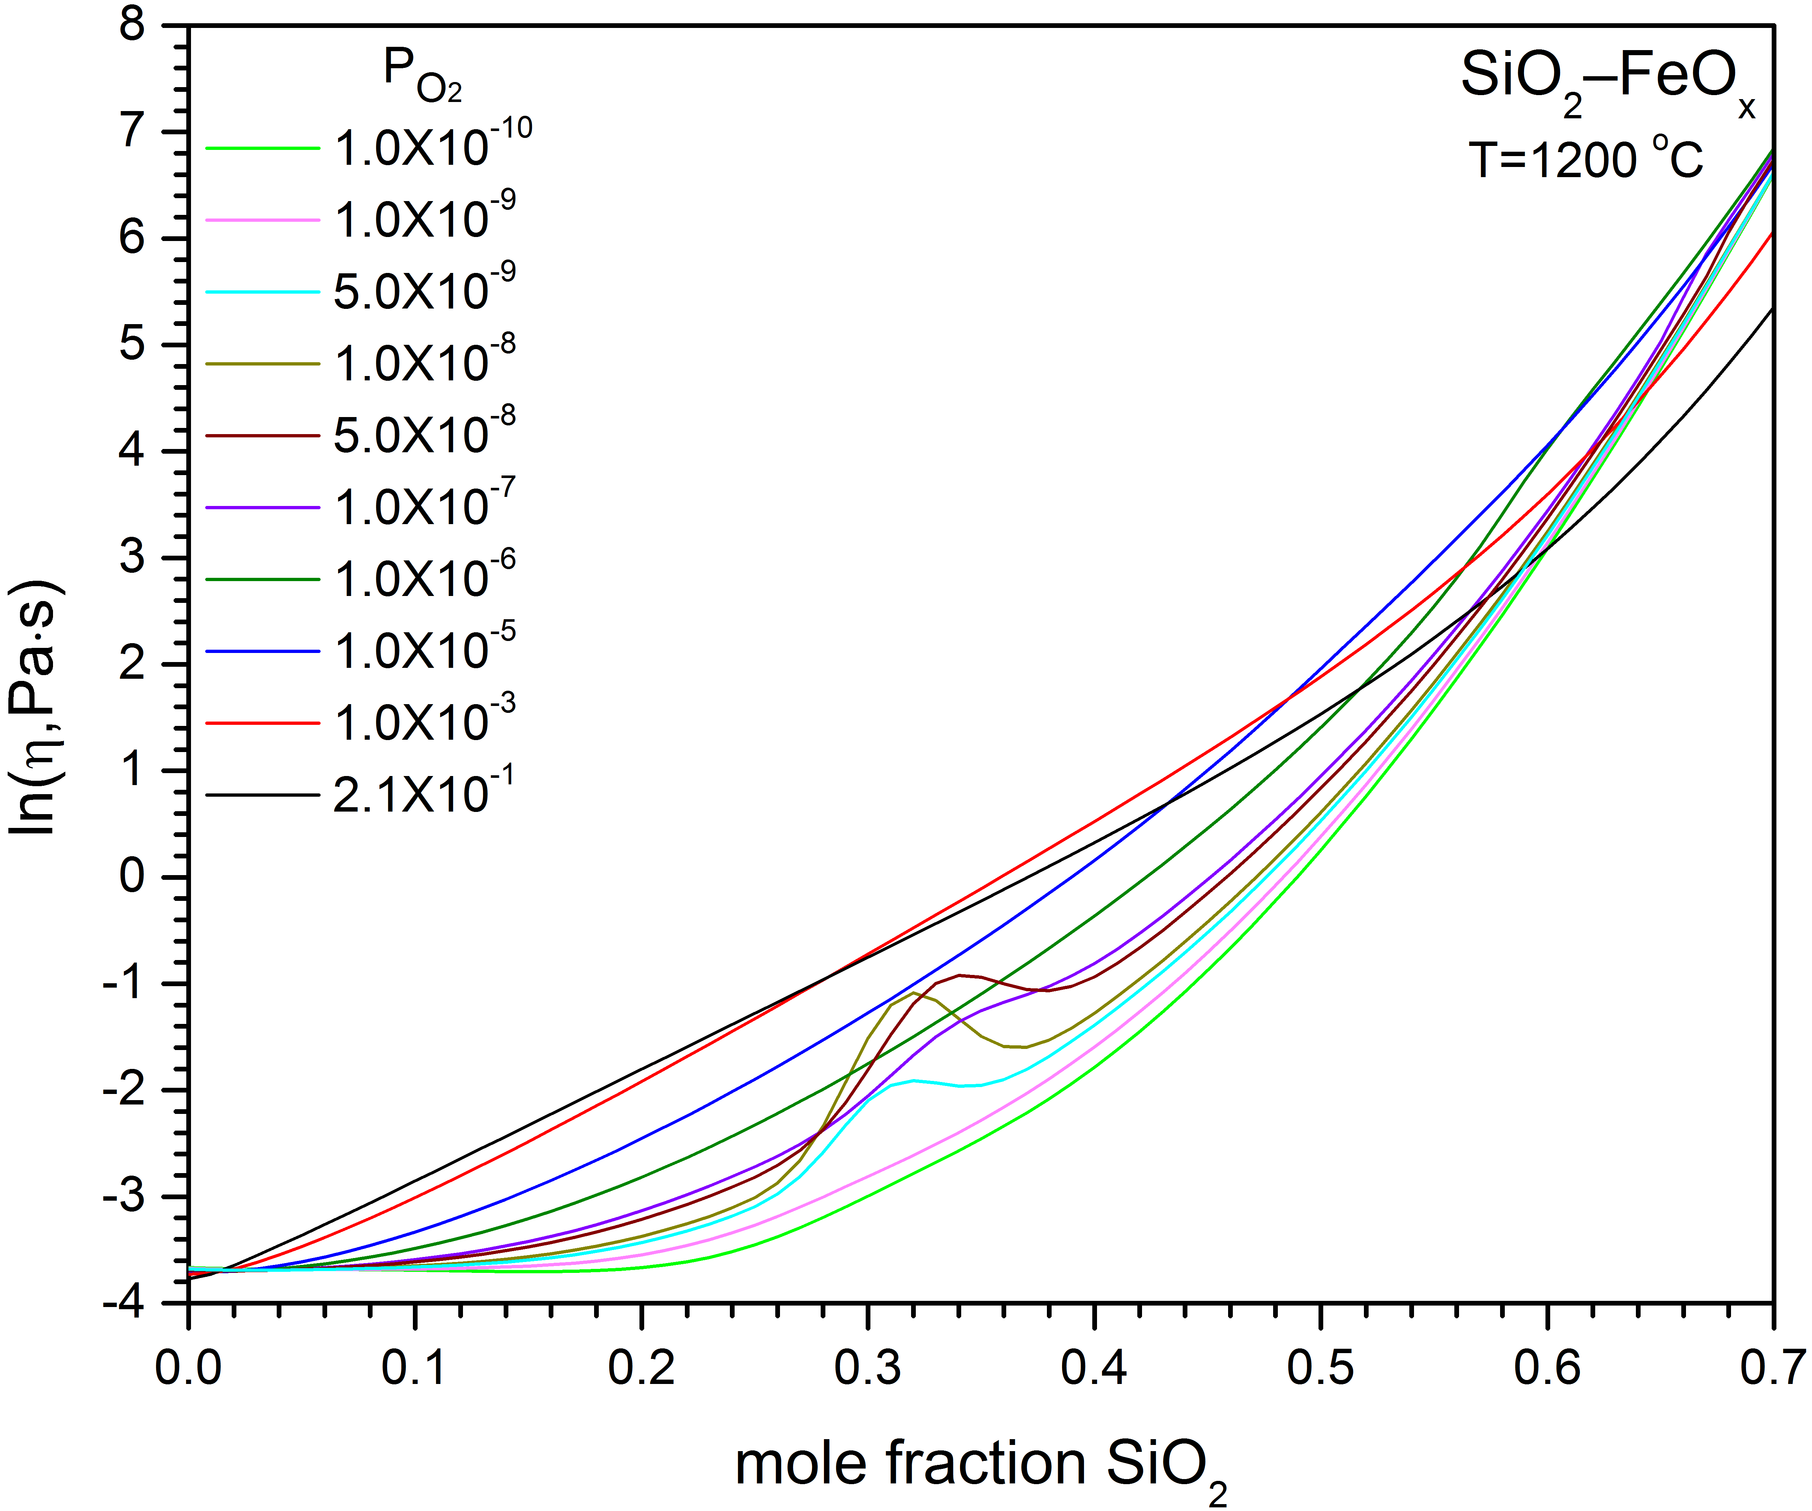
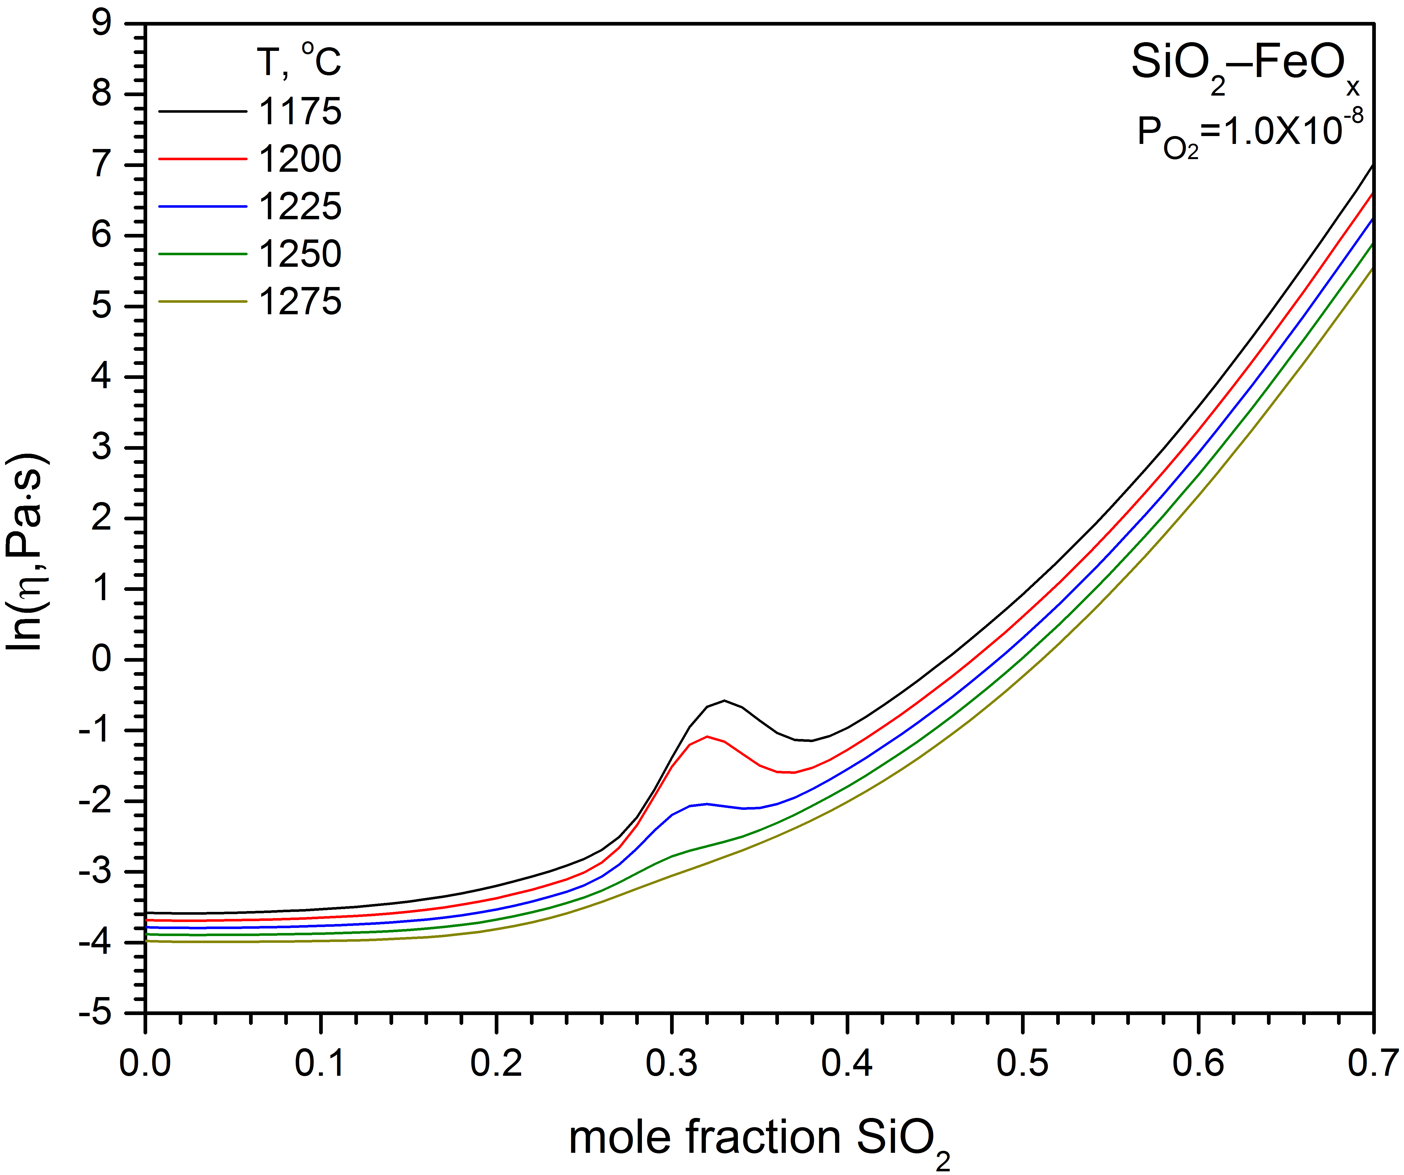
System SiO₂-FeO_{x}
Species Fe₃O₄
Source: M. Chen, S. Raghunath, B. Zhao,
Metall. Mater. Trans. B, 44 (2013) 506-515.

Slide 28
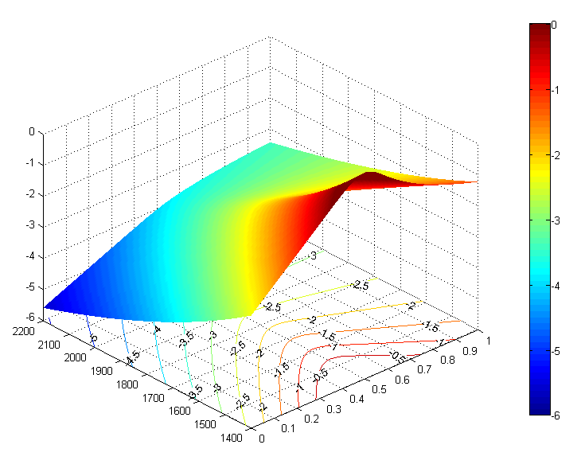
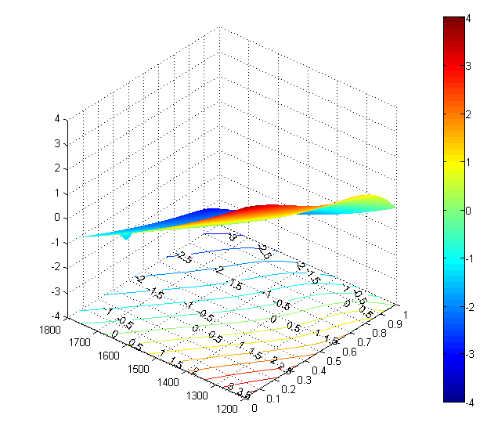


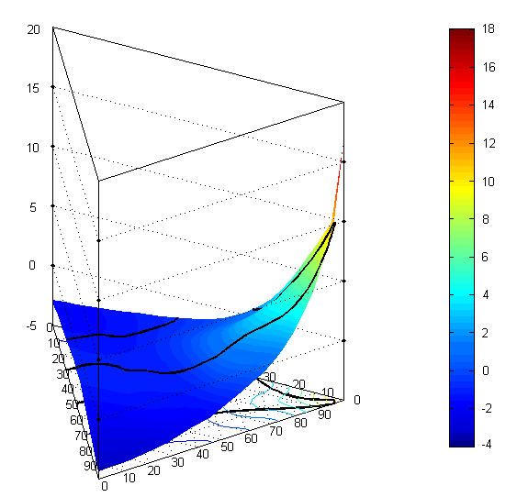

Application of the Model
Al₂O₃-CaO
Ca₂SiO₂-MgAl₂Si₂O₈
mole fraction Al₂O₃/(Al₂O₃+CaO)
mole fraction Ca₂SiO₄ /
(Ca₂SiO₄ +MgAl₂Si₂O₈)
T, ºC
T, ºC
SiO₂-Al₂O₃-CaO
T=1600ºC
fully liquid region
CaO
SiO₂
mole fraction SiO₂/(SiO₂+Al₂O₃)
Al₂O₃

Slide 29
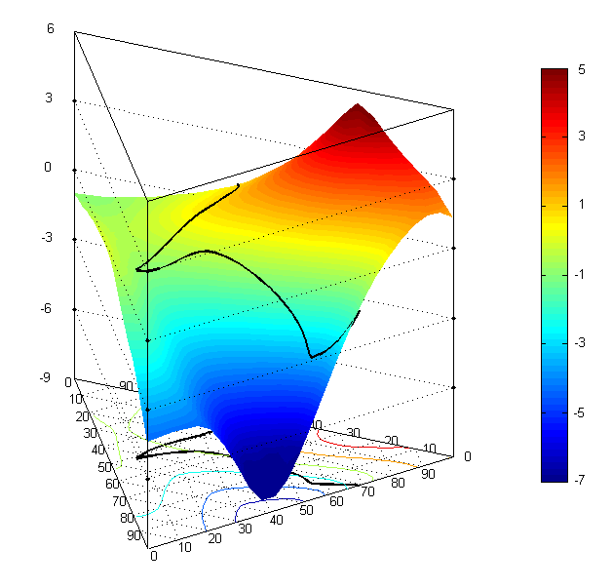
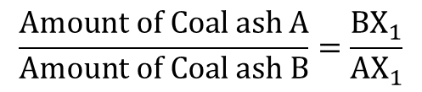
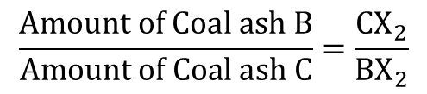

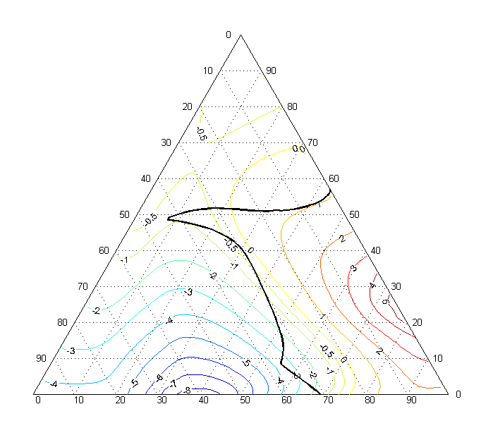
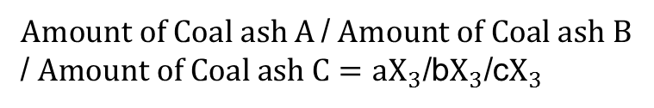
Application of the Model (2)
SiO₂-Al₂O₃-CaO-MgO-Na₂O-K₂O
molar ratio CaO/MgO=1
molar fraction Na₂O=0.1
molar fraction K₂O=0.1
T=1600ºC
Ca_{0.5}Mg_{0.5}O
Ca_{0.5}Mg_{0.5}O
A
SiO₂
X₁
mole fraction SiO₂/(SiO₂+Al₂O₃)
c
Al₂O₃
b
X₃
B
a
X₂
C
Al₂O₃
SiO₂

Slide 30
Flux Influence on Viscosity
Flux: CaO, Na₂O, Albit
Influence on solidification

Slide 31
Modelling Partially Crystallised Slag
Composition, Temperature
Equilibrium
Thermodynamic Calculation
Supercooled
Residual
Liquid
Particles
Viscosity Model
Viscosity Model
Density Model
Viscosity Model
for Suspensions
η_{Eq} = η _{Sc} * η _{r,chem} * η _{r,phys}

Slide 32
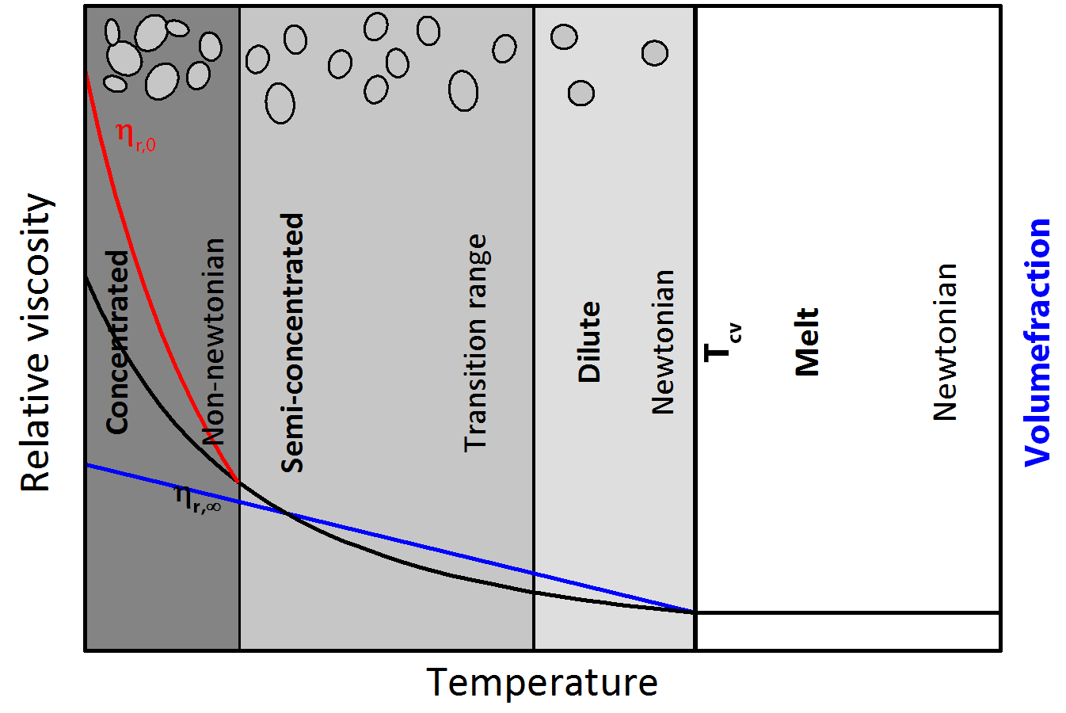



Flow Behaviour
Ostwald-de Waele:
Herschel-Bulkley:
Einstein:
$$η=K_{r}{\dot{γ}}^{n−1}$$
$η_{r}=$ ${(1−\frac{φ}{φ_{m}})}^{−Bφ_{m}}$
$η_{r}=$ $1+bφ$

Slide 33
Crystallisation Kinetics
Supercooled
Melt
Crystallisation
Equilibrium
Calculation and extrapolation of the viscosity of the supercooled slag
Johnson-Mehl-Avrami-Kolmogorov-Equation
Chemical effect
Physical effect of crystals
Volume fraction of crystals
Viscosity
Liquidus
Viscosity
Temperature
Time
Notes:
Relative Viskosität definiert als eta-app/eta-sc

Slide 34

Results

Slide 35
Summary
Experiments show a significant influence of crystallisation on slag viscosity. The apparent viscosity is time dependant.
A self-consistent thermodynamic database for the system SiO₂-Al₂O₃-Na₂O-K₂O-CaO-MgO-P₂O₅-Cr_{x}O_{y}-Mn_{x}O_{y}-Fe_{x}O_{y}-SO_{x} has been developed using the non-ideal associate species model for the liquid phase.
A new structurally-based, Arrhenius-type viscosity model has been developed for the fully liquid oxide system SiO₂-Al₂O₃-CaO-MgO-Na₂O-K₂O-FeO-Fe₂O₃ over the whole range of compositions and a broad range of temperatures.
Viscosity of partially crystallised slags can be calculated considering chemical and physical effects.
Experimental data on crystallisation are needed.

Slide 36


Alternative Use of Gasification Technology
Thank you for your attention!
Merci de votre attention!
Спасибо за внимание!
आपका ध्यान के लिए धन्यवाद!
非常感谢您的参与！
Dziękuję za uwagę!
Gracias por su atención!
Dank u voor uw aandacht!
Σας ευχαριστώ για την προσοχή σας!
Vielen Dank für Ihre Aufmerksamkeit!
Notes:
http://en.wikipedia.org/wiki/Philippe_le_Bon
http://www.5reicherts.com/skan/8-12-leuchtturm2.jpg
http://upload.wikimedia.org/wikipedia/commons/2/20/Earlyoilfield.jpg
http://images.google.de/imgres?imgurl=http://www.c-turbines.ch/img/Energie/biomasse/Holzvergaser.jpg&imgrefurl=http://www.c-turbines.ch/biomasse.html&usg=__fNteUgmwl7okZNtVxYUHZVEl7rc=&h=333&w=250&sz=18&hl=de&start=9&um=1&tbnid=WbzWfuZDUNQ4VM:&tbnh=119&tbnw=89&prev=/images%3Fq%3DHolzvergaser%26um%3D1%26hl%3Dde%26sa%3DN
http://www.ihk-nordwestfalen.de/medienservice/bindata/065_2505__Jufo_Holzvergaser.jpg (IHK-Regionalsieger Benedikt Decker im Endspurt
Jüngster Teilnehmer beim Bundesfinale „Jugend forscht“25. Mai 2005 )
http://media.motosport.ch/images/32966_holzvergaser_motorrad_titel_220.jpg
http://www.lanz-bulldog.ch/Portals/0/LiveContent/602/Images/c-holzvergaser-andi-dinkel.jpg

