Slide 1
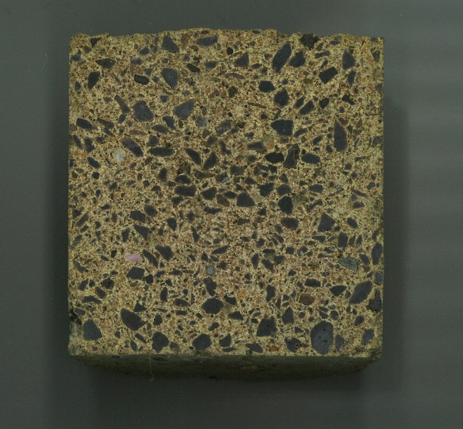
CHARACTERIZATION OF STEEL INDUSTRY SLAG SUITABILITY AS RAW MATERIAL FOR REFRACTORY CASTABLES
5th International Slag Valorisation Symposium, 3-5 April, Leuven, Belgium
Marjaana KARHU, Pertti LINTUNEN, Juha LAGERBOM, Tomi LINDROOS
VTT Technical Research Centre of Finland Ltd

Slide 2
Outline
Introduction and research goals
Materials and methods
Results
Conclusions

Slide 3
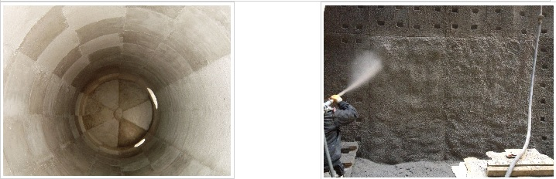

Introduction
Refractories are inorganic non-metallic materials which are used at high temperatures usually exceeding 1000 °C and they should remain chemically and physically stable at high temperatures.
Castable refractory materials are needed in all thermal energy intensive industries for example in the construction of the furnaces, kilns, incinerators or reactors.
Key aspects for more sustainable refractories development is to decrease environmental loading, such as CO₂ emissions by
  Utilization of industrial by-products
  Innovative processing routes.

Slide 4
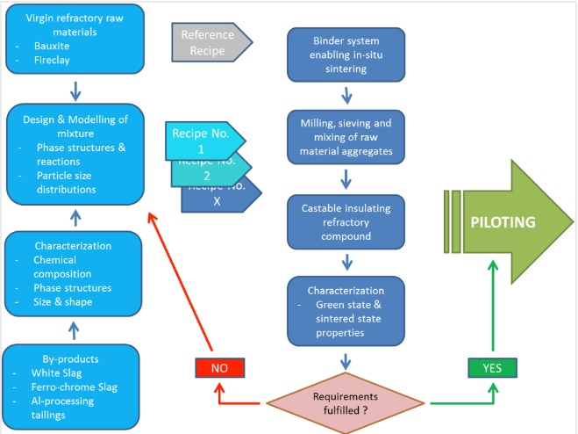
Research goals
Presented study is a first part of the research work which eventually aims to the industrial pilot scale demonstration of processing route for refractory castables based on maximal utilization of secondary raw materials.
Two main approaches to decrease energy intensity:
  Maximizing amount of by-products in raw material mixtures
  Study possibilities to taking profit of the exothermal reactions of raw materials (low energy processing), because thermal processing (high temperature firing) is the most remarkable step for energy consumption for refractories.
In the current work, high carbon ferrochrome (HCFeCr)
production by-product, FeCr slag, suitability as raw
material for refractory castables was studied.

Slide 5
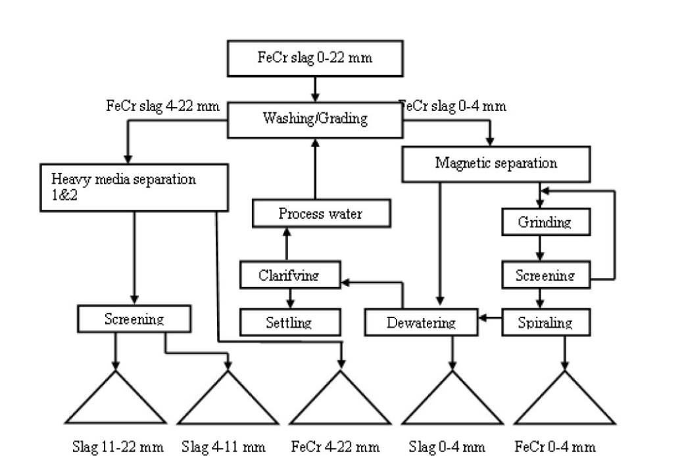
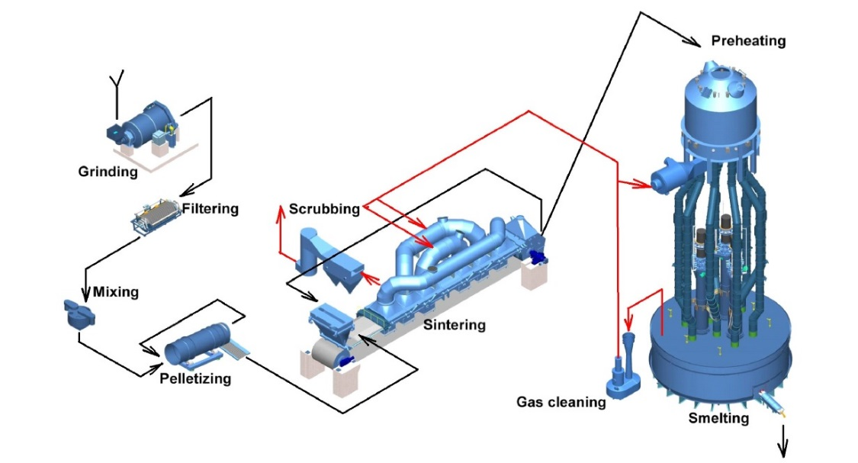
Ferrochrome slag
Almost all high carbon ferrochrome (HCFeCr) is produced in submerged electric arc furnaces.
Smelted products obtained from the smelting furnaces are the ferrochrome alloy and the ferrochrome slag (by-product).
Outokumpu Tornio Works produces 320 000 t FeCr-slag/a.
Slag products from the process are aggregates of 0-4, 4-11 and 11-22 mm.

Slide 6
Materials and Methods
FeCr slag fine aggregates (0-4 mm) was selected for characterization.
Particle size and its distribution was determined with laser diffractometry (Malvern Mastersizer).
Microstructure was investigated using a field-emission SEM (FESEM, Zeiss ULTRAplus) which is equipped with an energy dispersive spectrometer (EDS, INCA x-act silicon-drift detector (SDD), Oxford Instruments).
The identification of crystalline phases was done by using an X-ray diffractometer (XRD, Empyrean, PANalytical B.V., ALMELO, Netherlands) with Cu-Kα radiation source, and analysed using HighScore Plus software.
The thermal behaviour was studied using thermogravimetry (TGA, Netzsch STA 449 F1 Jupiter) giving a simultaneous Differential Scanning Calorimetry (DSC) signal. The measurements were made in air and in argon atmosphere with a heating rate of 10 °C/min.
Thermodynamic calculations were performed using FactSage 7.0 thermochemical software with FToxid database.

Slide 7
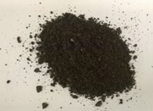
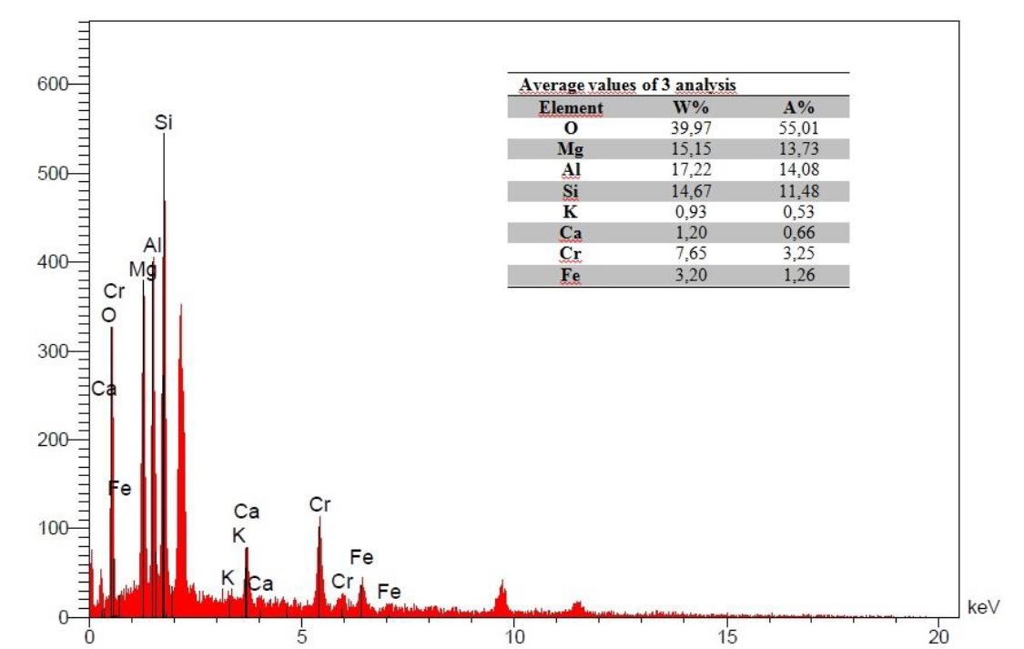
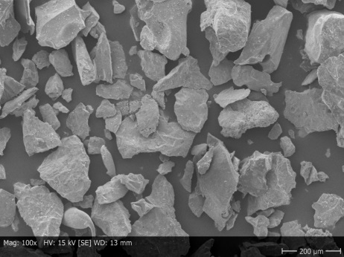
Results, chemical composition
According EDS spectrum and tabulated quantitative results the main elements in the slag are Al, Mg, Si and O, also Fe, Cr, Ca and K identified.
Typical chemical composition⁽¹⁾: 30% SiO₂, 26% Al₂O₃, 23% MgO, 8% Cr, 4% Fe and 2% CaO.
⁽¹⁾ P. Niemelä and M. Kauppi, “Production, characteristics and use of ferrochromium slags” INFACON XI, New Delhi, India (2007)

Slide 8
Results, microstructure 1/3
Mineralogy of FeCr slag show Fe-Mg-Cr-Al-spinels, forsterite (Mg₂SiO₄), Mg-Al-silicates and metal droplets as crystalline phases⁽²⁾.
With fast cooling rates, the slag is not totally crystalline and amorphous glass phase is solidifying between the crystalline phases. The amount of amorphous glass phase depends on the cooling rate being typically between 60-70% in FeCr slag.
⁽²⁾ H.T. Makkonen and P.A. Tanskanen, “Outokumpu Chrome Oy:n Ferrokromikuonan mineralogia
ja liukoisuusominaisuudet” University of Oulu Report 313, (2005)

Slide 9
Results, microstructure 2/3
Al, Cr, Mg → Spinels, (Mg)(Al,Cr)₂O₄
Cr
Mg, Si → Forsterite, Mg₂SiO₄
Si
Fe
Mg
Mg, Si → magnesium-silicate
Fe → metal droplets
Ca
Si, Ca → amorphous glass phase

Slide 10
Results, microstructure 3/3
Cr
Si
Fe
Ca
Mg

Slide 11
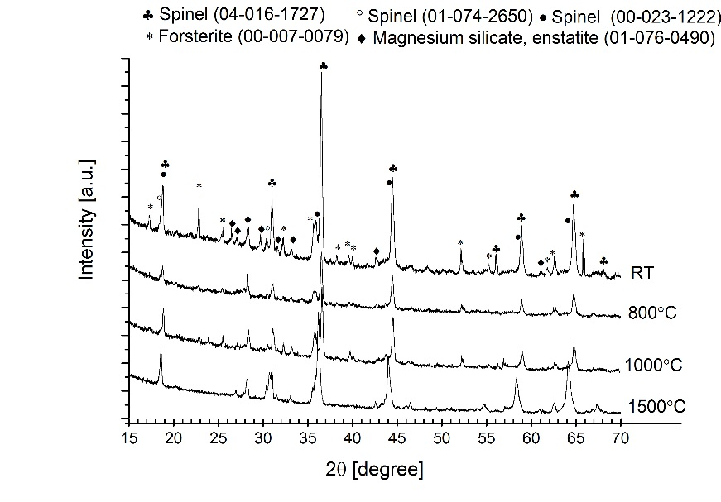
Results, XRD analysis
According to XRD analysis, the spinel phases appear as main crystalline peaks, other phases identified are magnesium silicates: forsterite and enstatite.
Slag was heat-treated at 800°C, at 1000°C and at 1500°C and cooled down with the furnace to see the difference in the phase structure.
  Spinel phases appear still as main crystalline peaks.

Slide 12
Results, microstructure after 1500°C
More homogenous aggregates after heat-treatment and cooling with the furnace

Slide 13
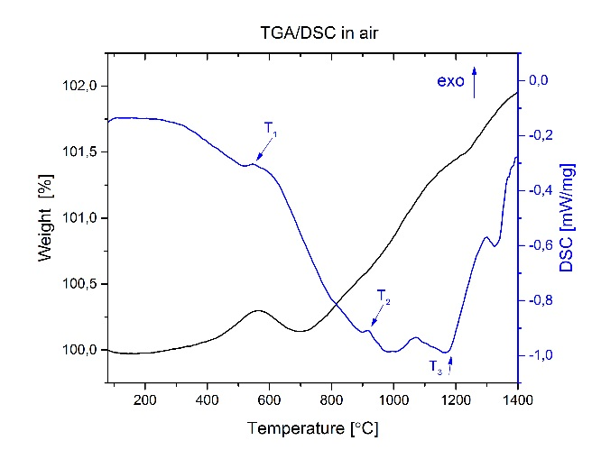
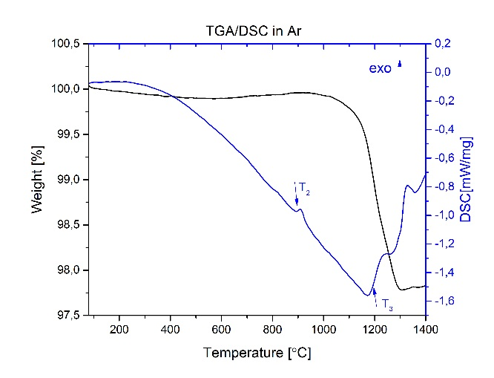
Thermal behaviour analysis
In air, the weight loss curve starts to increase after 400 °C showing also a small exothermic peak in the DSC curve (T₁). Small amount of CO₂ release is also detected connected to this transformation which indicates carbon combustion in small quantities. In air, the weight curve continues to increase relating most probably to metal droplets (Fe) oxidation.
In both atmospheres an exothermic peak is detected is DSC curve above 900°C (T₂) relating probably to crystallization of amorphous glass phase. Above 1200°C (T₃) both in air atmosphere and in argon atmosphere shows transformation which relates probably to liquid phase formation.
  FeCr slag potential option to withstand temperatures up to 1200°C.

Slide 14
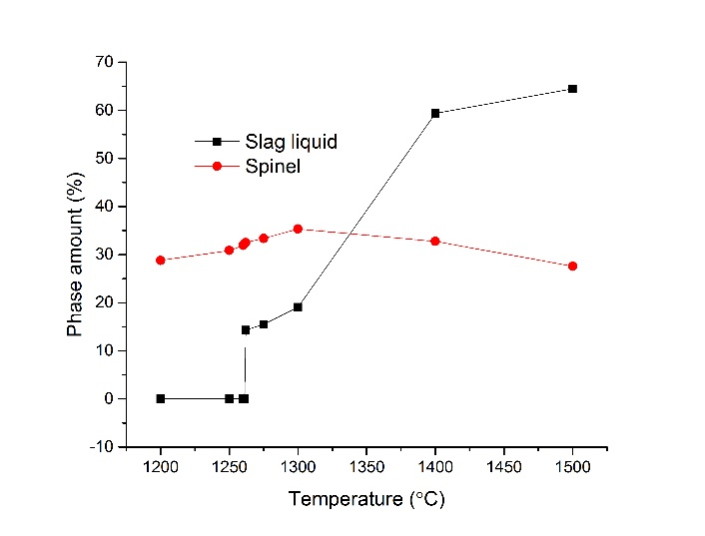
Thermodynamic calculations
FactSage simulations for main equilibrium phases and their amounts for FeCr slag.
  Spinel phases as main crystalline phase.
  Liquid slag phase is formed at a temperature between 1261-1262 °C.
    Simulation results support the characterization results presented previously.
  However, it must be noted that the non-equilibrium phase or metastable phase cannot be included to equilibrium calculations straightforward.

Slide 15
Summary and Conclusions
High carbon ferrochrome (HCFeCr) production by-product, ferrochrome (FeCr) slag, was analysed to find out its characteristic properties in order to be utilized as raw material in the manufacturing of novel refractory castables.
  Slag was analysed by laser diffractometer, SEM/EDS, XRD and thermal analysis and also performed some thermodynamic calculations (FactSage).
Characterization and simulation results indicate that ferrochrome slag will be the potential option to achieve successful properties for refractories to withstand high temperatures up to 1200 °C in gaseous atmosphere.
Presented study is a first part of the research work which eventually aims to the industrial pilot scale demonstration of processing route for refractory castables based on maximal utilization of secondary raw materials.
Next steps on research work concentrate on (i) modelling and calculations (packaging models utilized to calculate the optimal particle size distribution for castables and phase diagrams and thermodynamical calculations to estimate thermal stability) and (ii) formulation of the alternative recipes for refractory materials based on maximal utilization of secondary raw materials.

Slide 16
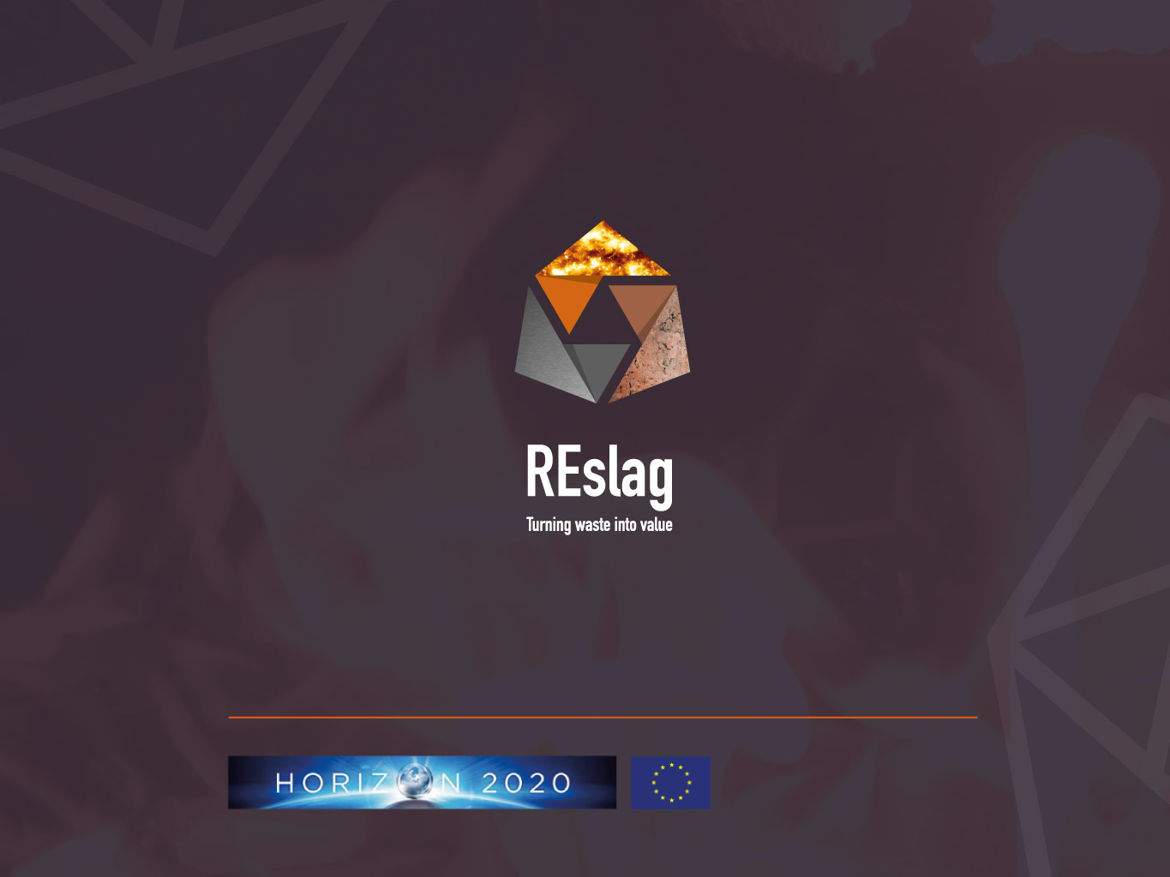


Acknowledgement
www.REslag.eu
@reslag_eu
/reslag
Funded by the European Union’s H2020 Programme Waste-1-2014. GA - 642067

Slide 17


Thank you for your attention!

