Slide 1
Electrolytic reduction of red mud in strong alkaline solution
Bin Wu
2015/04/16
Supervisor:
Prof. dr. ir. Jan Fransaer
Prof. dr. ir. Bart Blanpain

Slide 2
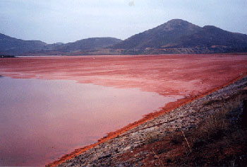
Red mud
Mineral | Formula | Quantity (wt.%)
Goethite | FeOOH | 27.75
Hematite | Fe₂O₃ | 28.36
Gibbsite | Al(OH)₃ | 11.86
Rutile | TiO₂ | 4.58
Cancrinite | Na₆Ca₂[(CO₃)₂Al₆Si₆O₂₄] ·2H₂O | 9.10
Quartz | SiO₂ | 2.36
Calcrite | CaCO₃ | 0.03
Non-quantified phases | - | 15.22
Iron-containing
phases
Impurity
phases
Environmental pollution
High alkalinity ( pH typically around 11-12)
Large amount ( 1.5 ton red mud per ton aluminum and 91 million tons in 2008) ^{[1]}
Potential resource
Iron production ^{[2]}
Rare earth elements extraction
Building materials
Element | Concentration (g/ton) | Element | Concentration (g/ton)
Sc | 121±10 | Gd | 22.0±1.9
Y | 75.7±9.6 | Tb | 3.5±0.6
La | 114±15 | Dy | 16.7±0.7
Ce | 368+68 | Ho | 3.9±0.6
Pr | 28.0±3.9 | Er | 13.5±1.8
Nd | 98.6±7.0 | Tm | 1.9±0.3
Sm | 21.3±2.3 | Yb | 14.0±1.9
Eu | 5.0±0.9 | Lu | 2.4±0.3
[1] M. Grafe, et. Al. Bauxite residue issues: III, Alkalinity and associated chemistry. 108 (1-2): 60-79, 2011
[2] M. Bruers, Iron recovery from bauxite residue by direct reduction of hematite, Master thesis

Slide 3
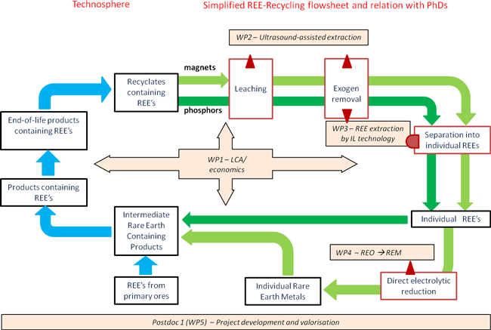
Overall flow sheet for rare earth project
The residue will be a concentrated source for rare earth extraction
Primary source for iron production

Slide 4
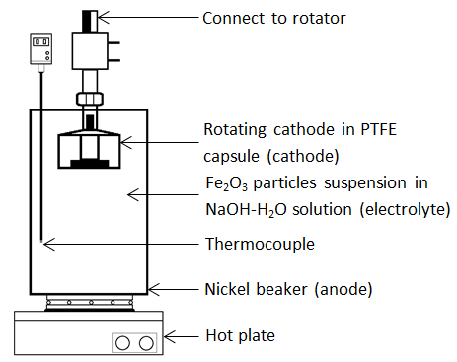
Experimental
Electrolysis at elevated temperature, i.e. 100 ℃
working electrode: copper or stainless steel
counter electrode: nickel beaker
electrolyte: 50 wt.% NaOH aqueous solution with various concentrations of hematite or goethite
Investigated parameters
Rotating speed
Hematite, goethite concentration
Inert component concentration
Constant charge for each experiment, i.e. 420 C
Notes:
Bron: Vlaamse Overheid, Departement Economie, Wetenschap en Innovatie (februari 2010), resultaten onder voorbehoud

Slide 5
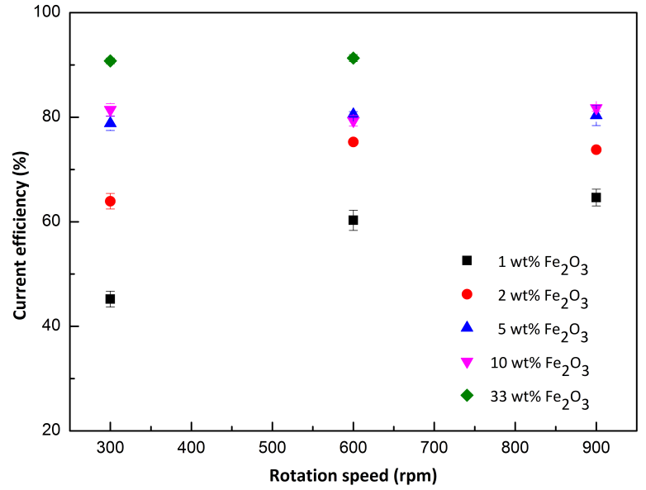
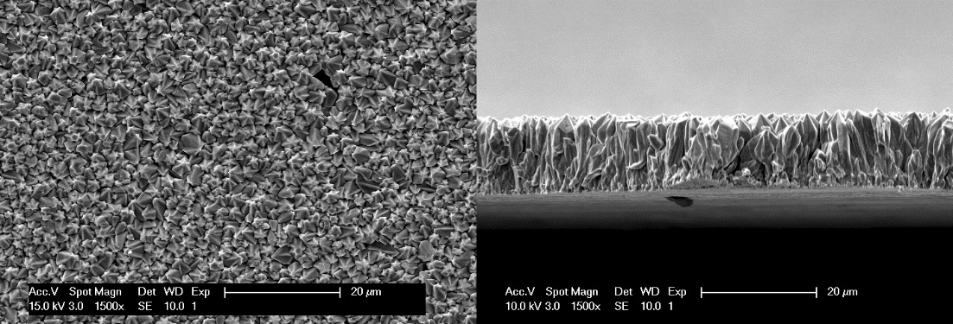
Electrolytic reduction of hematite
Hematite can be reduced electrochemically with current efficiency over 90%
Hematite concentration has significant impact on the current efficiency
Rotation speed plays important role when the hematite concentration is low

Slide 6
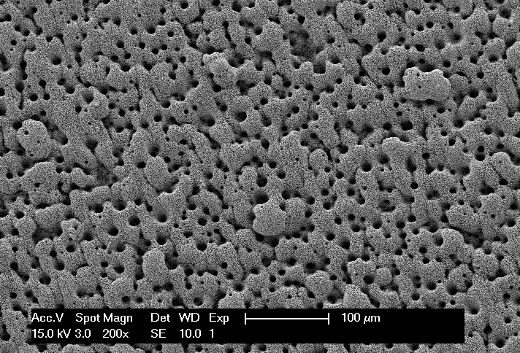
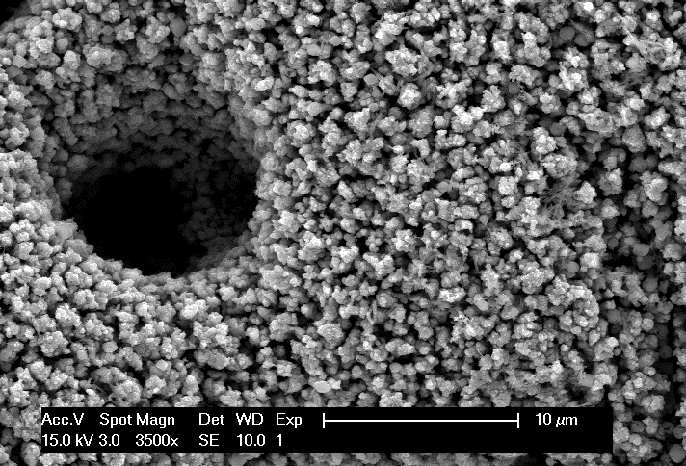
Electrolytic reduction of goethite
Goethite can also be electrochemically reduced, however with lower current efficiency than that of hematite
The iron deposit obtained from goethite reduction has dramatically different morphology than that from hematite
Notes:
Compare to data in dia 1 : 37 % of PhDs = non-Belgian; 35% of postdocs

Slide 7
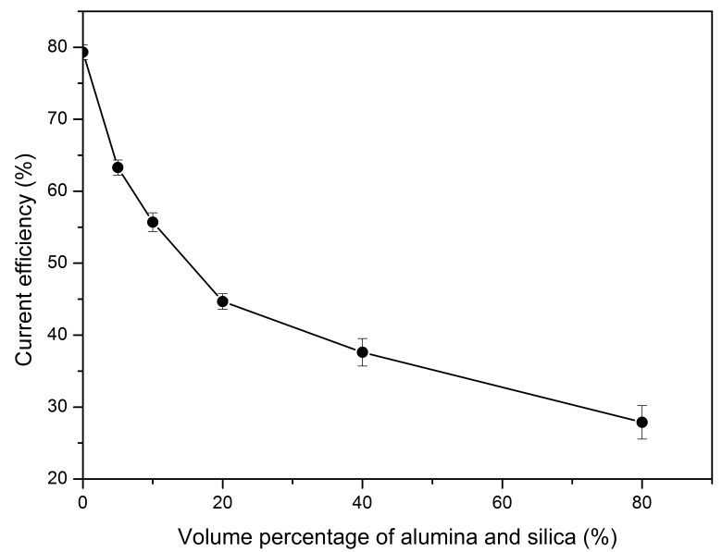
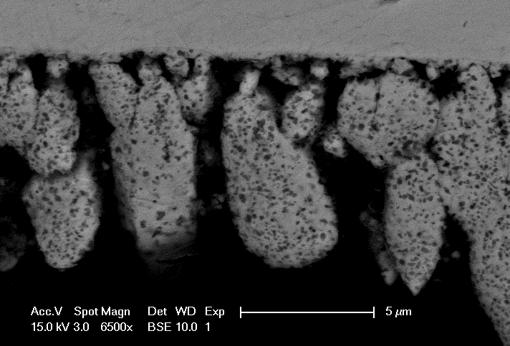
Influence of SiO₂ and Al₂O₃
SiO₂ and Al₂O₃ sharply reduced the current efficiency for hematite reduction
Al₂O₃ particles are found incorporated in the obtained iron film
Notes:
Attention: not only KU Leuven, but total number of applications at FWO (incl other univs and…)
For KU Leuven 2011: 116 appl/ 79 awards
2008: slaagkans 90%
2011 slaagkans nog steeds 65,4 %
Vrij gelijkmatige verdeling over domeinen heen.

Slide 8
Thank you for your attention !

