Slide 1
Welcome to the 4th International Slag Valorisation Symposium
Dr. Ir. Annelies Malfliet and Dr. Ir. Yiannis Pontikes

Slide 2
International Slag Valorisation Symposium
Scope: Valorisation of residues from high-temperature processes
Aim of the Slag Valorisation Symposium
Contribute towards near zero waste processing and closed material loops
Offer to researcher and industrial actors the opportunity to share knowledge and discuss the challenges and opportunities in the field of slag valorisation
Organized for the 4th time in Leuven (2009-2011-2013-2015), by

Slide 3
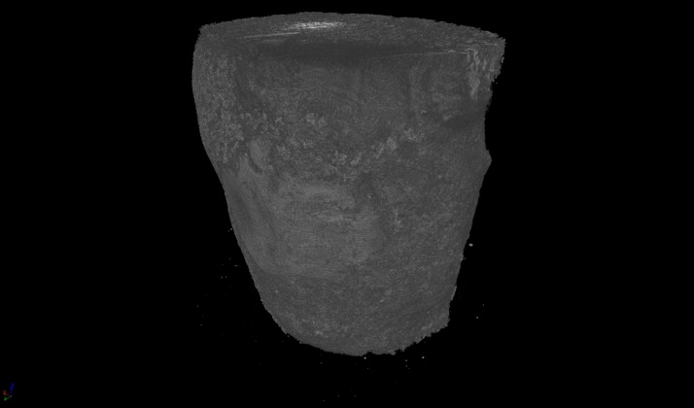

Slide 4
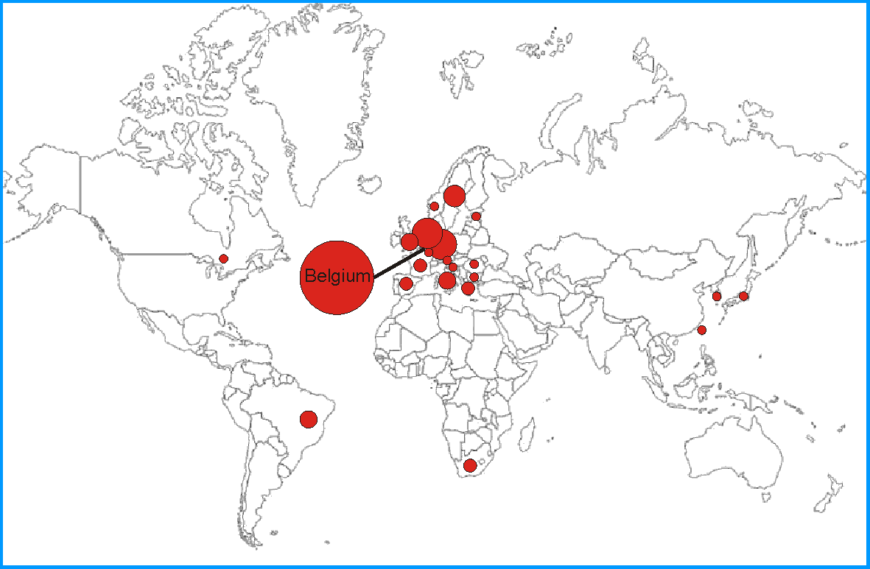
The 4th Slag Valorisation Symposium
8 Invited speakers from academia and industry
20 Oral presentations
19 Poster presentations
139 participants

Slide 5
4th Slag Valorisation Symposium
4th edition has Zero Waste as subtheme
4 topics
Thu 16 April AM | Hot Stage Slag Engineering for Higher Added Value Applications and Energy
Thu 16 April PM | Base and Critical Metal Recovery
Fri 17 April AM | Innovative/Low-Carbon Building Applications
Fri 17 April PM | Non-Traditional Slag Valorization Processes and Products

Slide 6
Thursday 16 April
09:00 | A Welcome Opening by the hosts: Annelies Malfliet, Yiannis Pontikes and Martine Wevers
Theme | Hot Stage Slag Engineering For Higher Added Value Applications And Energy Recuperation
09:20 | Keynote Lecture Takahiro MIKI - "Solidification of metallurgical slags for higher added value applications” Tohoku University (Japan)
10:00 | Keynote Lecture Daniel MICHELS and Horst KAPPES - "Dry slag granulation and energy recovery” Paul Wurth (Luxembourg)
10:40 | Coffee Break - Poster Session
11:10 | Sander ARNOUT, Els NAGELS - "The InsPyro-spark calculation toolbox for slag engineering properties”
11:30 | Mikael LINDVALL1, Lars-Olov NORDBERG1, Anders STENBERG2, Diana ORRLING2 - "Swerea MEFOS experiences on dry blast furnace slag granulation”
11:50 | Jaehong LEE, Joon Seok OH , Joonho LEE -"Kinetics of reduction of electric arc furnace oxidizing slag by Al alloy“
12:10 | Susanne SCHÜLER1, Hans-Peter MARKUS2, David ALGERMISSEN3, Dirk MUDERSBACH3 -"Electric arc furnace slag engineering during production, treatment, solidification and processing”
12:30 | Lunch
13:20 | Joao B. FERREIRA NETO, Joao O. G. FARIA, Catia FREDERICCI, Fabiano F. CHOTOLI, Andre N. L. SILVA, Bruno B. FERRARO, Tiago R. RIBEIRO, Antonio MALYNOWSKYJ, Valdecir A. QUARCIONI, Andre A. LOTTO - "Modification of molten steelmaking slag for cement application”
13:40 | Alessandra PRIMAVERA1, Laura PONTONI1, Davide MOMBELLI2, Silvia BARELLA2, Carlo MAPELLI2 - "EAF slag treatment for inert materials production”
14:00 | Karl BUTTIENS1, Joel LEROY1, Patrick NEGRO1, Jean-Sébastien THOMAS†2, Yann DE LASSAT3 - "The carbon cost of slag production in the blast furnace”
14:20 | Intensified Poster Presentation Session
14:50 | Coffee Break - Poster Session
Theme | Base And Critical Metal Recovery
15:20 | Keynote Lecture Helmut ANTREKOWITSCH → Christoph PICHLER -"New development in metal recovery from secondary resources” University Leoben (Austria)
16:00 | Keynote Lecture Mathias CHINTINNE -"Combined metal and slag valorisation at Metallo-Chimique” Metallo-Chimique (Belgium)
16:40 | Qingwei QIN1, Fan BI1, Jianhong YANG1, Guangqiang LI1, Guangdong LIAO2, Xiaoliang SU2 -"Comprehensive utilization of copper converter slags by hybrid beneficiation technology and industrial application”
17:00 | Chenna Rao BORRA, Bart BLANPAIN, Yiannis PONTIKES, Koen BINNEMANS , Tom VAN GERVEN -"Smelting reduction of iron oxides from bauxite residue in view of improved rare earths leaching”
17:20 | End of Thursday sessions
17:20 | Installation: perception or reality?
18:30 | Visit to Beguinage
19:30 | Symposium dinner

Slide 7
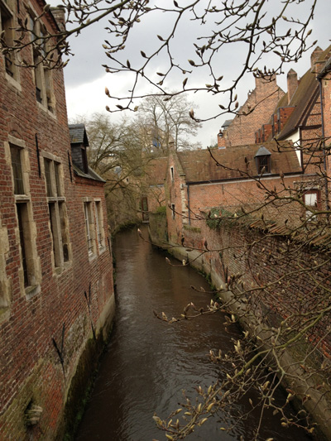
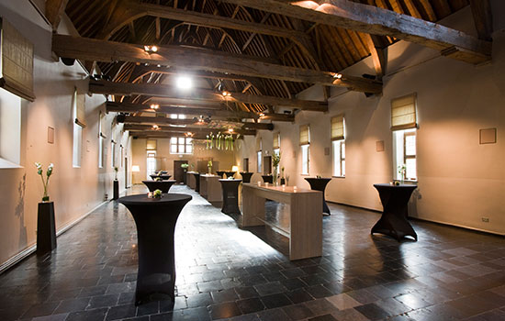
Social events
Visit to Beguinage Thursday 16 April at 18:30
Symposium dinner at Faculty Club Thursday 16 April at 19:30
For the details, the participants are referred to the SVS website, the infobrochure or to the registration desk

Slide 8
Friday 17 April
Theme | Innovative/Low-Carbon Building Applications
09:00 | Keynote Lecture John L. PROVIS1, Razie HANAFI1, Pablo GARCÍA-TRIÑANES2 - "Valorisation of wastes by alkali-activation - progress, opportunities and pitfalls" 1University of Sheffield (United Kingdom), 2University of Surrey (United Kingdom)
09:40 | Keynote Lecture Gert VAN DER WEGEN - "Turning residues into business opportunities: some examples" SGS Intron B.V. (The Netherlands)
10:20 | Coffee Break - Poster Session
10:50 | Youva Raj TYAGI, Peter VAN BAKEL - "Production of value added light-weight, eco-friendly green concrete through MGX Technology“
11:10 | Chih-Ta TSAI, Wei-Sheng CHEN, Juu-En CHANG -"Cold-pressing technique - A new approach to recycle stainless steel reductive slag as coarse aggregate“
11:30 | Flora FALESCHINI, Katya BRUNELLI, Manuele DABALÀ, Carlo PELLEGRINO -"High performances concrete with EAF slag as coarse aggregates“
11:50 | Raffaele VINAI, Ali RAFEET, Marios SOUTSOS, Wei SHA -"Slag valorisation in construction materials: Mechanical properties and rheology of alkali activated concrete containing GGBS“
12:10 | Frank KAUßEN1, Jörn BÖHLKE2, Christoph KEMPER1, Bernd FRIEDRICH1 -"Conditioning of lead and zinc slags in pilot scale SAF for further utilization"
12:30 | Lunch
Theme | Non-Traditional Slag Valorization Processes And Products
13:20 | Keynote Lecture Enrico BERNARDO, Mauro MARANGONI, Ines PONSOT - "Reuse of inorganic waste in monolithic and cellular glass-based materials for structural and functional applications" University of Padova (Italy)
14:00 | Keynote Lecture Justin HARGREAVES - "Catalytic applications of large scale metal processing wastes" University of Glasgow (United Kingdom)
14:40 | Intensified Poster Presentation Session
15:10 | Coffee Break - Poster Session
15:40 | Dimitra ZAHARAKI, Antigoni VLACHOU, Kostas KOMNITSAS - "Co-utilization of slags with construction wastes or red mud for geopolymer production“
16:00 | T. VELEA1, I. ANGER1, F. STOCIU1, E. GAMENT2, M. MIHALACHE3, L. ILIE3, L. POPESCU4, Fl. ZAMAN4, L. MARA1, V. PREDICA1 - "Non-traditional slag valorization for agriculture"
16:20 | Wouter SCHROEYERS, Tom CROYMANS-PLAGHKI , Sonja SCHREURS - "Towards a holistic approach for risk assessment when reusing slag with enhanced NORM content in building materials"
16:40 | Andrea DI MARIA, Muhammad SALMAN, Karel VAN ACKER, Maarten DUBOIS - "Producing bricks from stainless steel slags: An Environmental evaluation based on life cycle analysis"
17:00 | Lieven MACHIELS1, Lukas ARNOUT1, Els NAGELS2, Sander ARNOUT2, Bart BLANPAIN1, Yiannis PONTIKES1 - "Properties of inorganic polymer cement from ferric and ferrous vitrified residues of plasma gasification"
17:20 | Björn DEBECKER -"Funding opportunities under the EC- Research Fund for Coal and Steel Programme"
17:40 | Closing session
17:50 | End of Friday Sessions

Slide 9
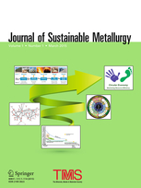
Conference proceedings
The papers presented in this Symposium are collected in the Symposium book and on USB stick
After the Symposium, the book can also be ordered through the SVS website
Selected papers for Journal of Sustainable Metallurgy

Slide 10
Acknowledgements
For the financial and media support
Scientific Committee and chair persons
For the organisation:
Conference Coordinator: Rabab Nasser
Staff from the department of Materials Engineering and the research group High Temperature Processes and Industrial Ecology

Slide 11
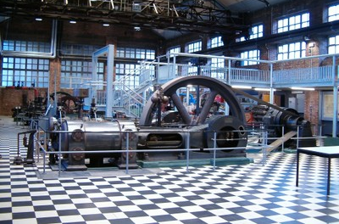
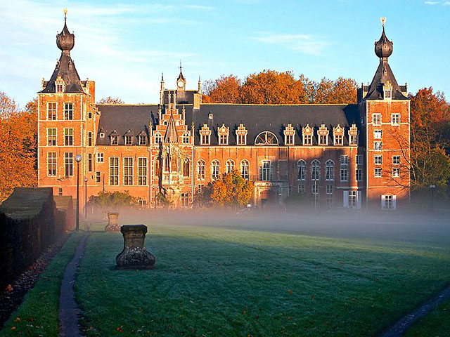
Thanks for the attention

