Slide 1


Slag valorisation in construction materials: mechanical properties and rheology of alkali activated concrete containing ggbs
Dr. Raffaele VINAI
Mr. Ali RAFEET
Prof. Marios SOUTSOS
Prof. Wei SHA
School of Planning, Architecture and Civil Engineering
Queen’s University Belfast, United Kingdom

Slide 2

Plan of the presentation
4th International Slag Valorisation Symposium | Leuven | 15-17/04/2015
Framework of the research carried out at QUB
Background
Materials and methods
Results and discussion
  Strength development
  Workability
  Non destructive tests
  Elastic modulus
Conclusions
Future developments
Acknowledgements

Slide 3
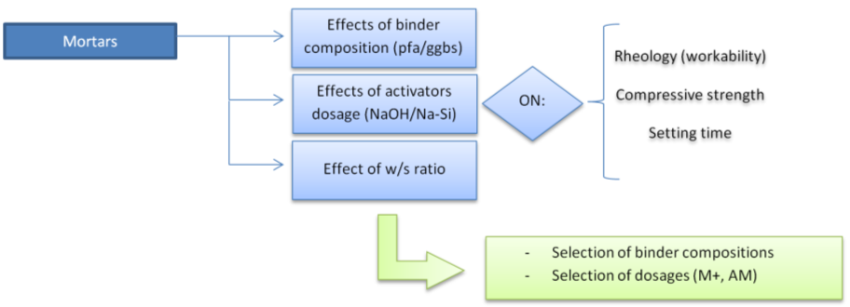
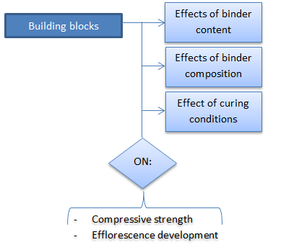
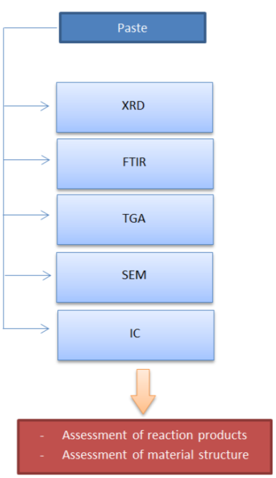
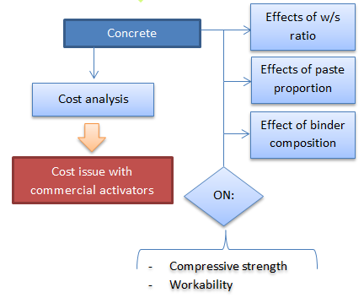
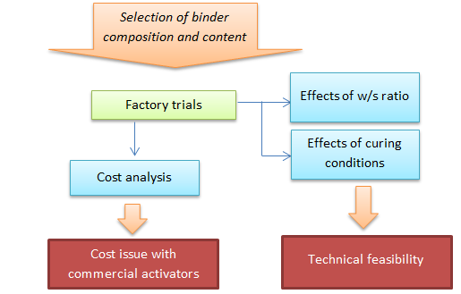
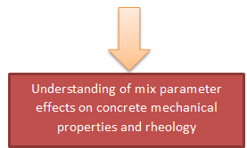
Research at QUB
4th International Slag Valorisation Symposium | Leuven | 15-17/04/2015

Slide 4

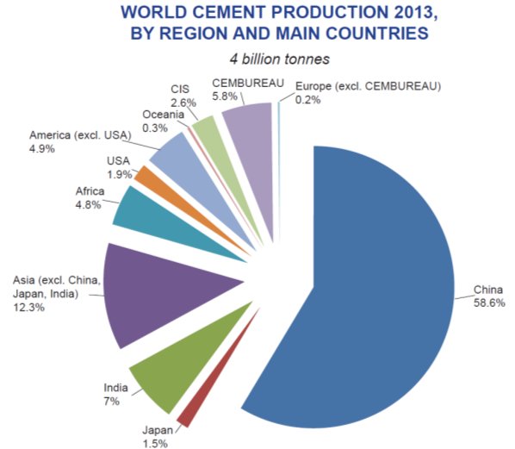
Background
4th International Slag Valorisation Symposium | Leuven | 15-17/04/2015
Building sector has the potential for absorbing the high volume of slag produced by iron and steel-making industry!
It represents in EU28 about 8.8% of GDP
It represents 29% of industrial employment
It had a turnover of 92.5 billion € in 2013
1,200 billion € as construction output in EU28
Source: CEMBUREAU website

Slide 5
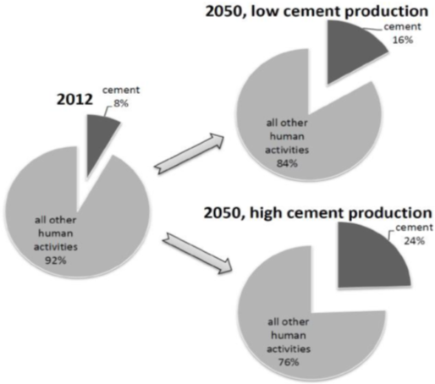

Background
4th International Slag Valorisation Symposium | Leuven | 15-17/04/2015
Alkali activated concrete vs Conventional concrete
Recycling waste or using by-product materials the CO₂ emission is reduced! On average, the production of 1 m³ of alkali activated concrete has a CO₂ emission of less than 50 kg.
For producing 1 ton of cement about 0.8 - 1 t of CO₂ is emitted! On average, the production of 1 m³ of concrete has a CO₂ emission of 400 kg.
Alkali activated concrete is a novel building material under development that allows a wide range of applications and high technological properties.
World’s current CO₂ emissions form cement industry is around 8% of world's total CO₂ emissions
(source: Provis et al. 2014)

Slide 6
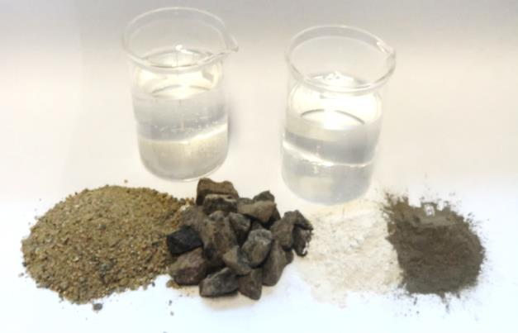
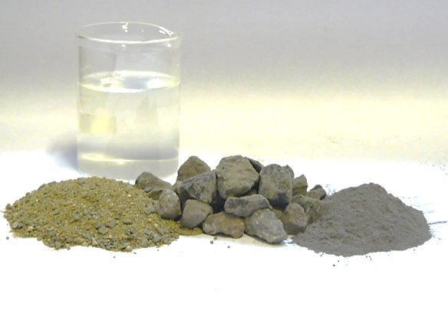
Background
4th International Slag Valorisation Symposium | Leuven | 15-17/04/2015
Alkali activated concrete vs Conventional concrete
Chemical activators
“Activator” - water
“Precursor” materials (binder)
Aggregates
Aggregates
Portland cement (binder)

Slide 7
Aim and objectives
4th International Slag Valorisation Symposium | Leuven | 15-17/04/2015
The objective of this study was to analyse the effects of binder content, paste content and water to solid ratio on mechanical and rheological properties of the concrete.
Materials and methods
Precursor materials:
pulverised fuel ash (pfa) 60%; ground granulated blast furnace slag (ggbs) 40%.
Chemical activators:
NaOH solution prepared at 30% w/w from solid (99% purity).
Sodium Silicate solution with SiO₂ : Na₂O ratio = 2:1 (Na₂O 12.8%, SiO₂ 25.5%, water 61.7%).
Alkali dosage (M+): Alkali modulus (AM):
Water/solids ratio

Slide 8
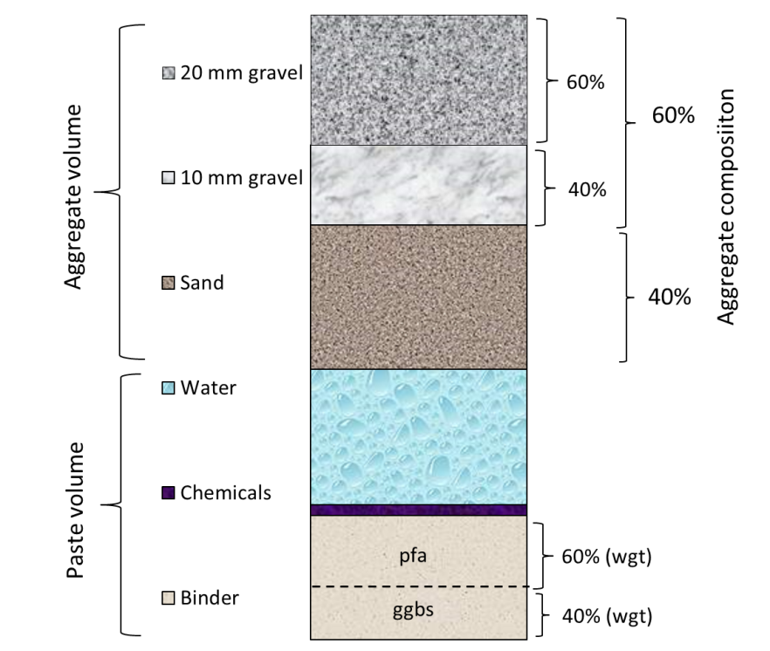
Materials and methods
4th International Slag Valorisation Symposium | Leuven | 15-17/04/2015
10 mixes (C1 – C10)
Pfa/ggbs ratio 60%/40% (in weight)
M+ = 7.5, AM = 1.25.
9 cubes (100 mm) for testing at 1, 7, and 28 days
C1: 15 cubes for testing at 1, 7, 28, 56 and 90 days, plus 3 cylinders (diam. 100 mm, h. 200 mm) for E_{mod,28d}
3 cubes of C1 used for UPV
Curing carried out in plastic boxes (>90% relative humidity) kept at 20 ˚C.

Slide 9
Materials and methods
4th International Slag Valorisation Symposium | Leuven | 15-17/04/2015
 |  | Binder proportion
 |  | 500 kg/m³ | 450 kg/m³ | 400 kg/m³ | 350 kg/m³
w/s | 0,30 | (C2) 38.1%
 | 0,34 |  | (C8) 36.4% | (C9) 32.4%
 | 0,37 | (C1) 43.9% | (C3) 37.8% | (C4) 33.3% | (C5) 29.4%
 | 0,40 |  |  | (C7) 34.9% | (C6) 30.4%
 | 0,45 |  |  |  | (C10) 32.4%
% refer to the paste content
According to the approach followed in recent literature papers:
w/s ratio varied from 0.30 to 0.45
Binder content varied from 350 to 500 kg/m³

Slide 10
Materials and methods
4th International Slag Valorisation Symposium | Leuven | 15-17/04/2015
 |  | Binder proportion
 |  | 500 kg/m³ | 450 kg/m³ | 400 kg/m³ | 350 kg/m³
w/s | 0,30 | (C2) 38.1%
 | 0,34 |  | (C8) 36.4% | (C9) 32.4%
 | 0,37 | (C1) 43.9% | (C3) 37.8% | (C4) 33.3% | (C5) 29.4%
 | 0,40 |  |  | (C7) 34.9% | (C6) 30.4%
 | 0,45 |  |  |  | (C10) 32.4%
% refer to the paste content
Not all the mixes were successful:
C2 set in the mixer
C5 was too dry and only 6 cubes were cast
C9 was too dry and no cubes were cast

Slide 11
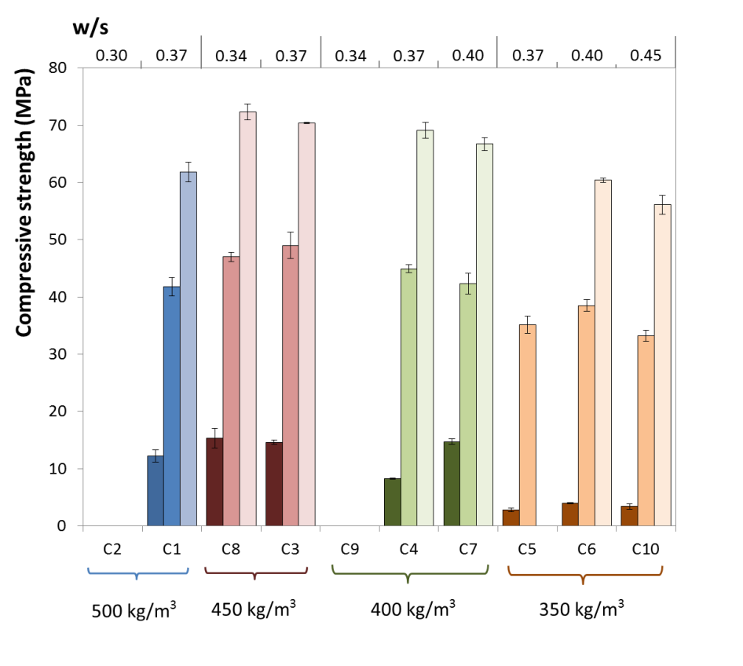
Results & discussion (1) Strength development
4th International Slag Valorisation Symposium | Leuven | 15-17/04/2015
Binder content vs. UCS
C1 showed a reduction in UCS => segregation effects
Mixes with low w/s ratios showed very fast setting
Some mixes were too dry (only 6 cubes cast for C5, no cube for C9)
Increase of binder from 350 to 450 kg/m³ resulted in a strength increase of 13 MPa.
60 MPa UCS achieved even with lowest binder content

Slide 12
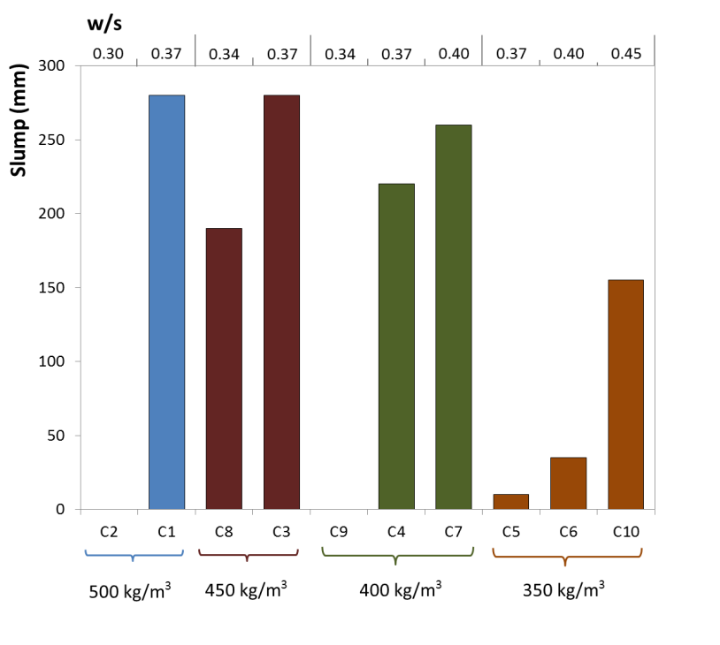
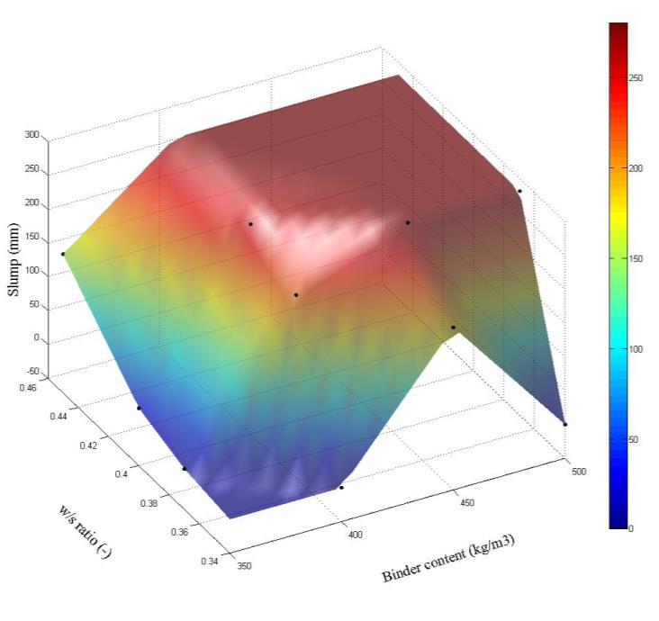
Results & discussion (2) Workability
4th International Slag Valorisation Symposium | Leuven | 15-17/04/2015
With binder contents higher than 350 kg/m³, slump was usually higher than 190 mm. When low binder content was utilised (350 kg/m³) slump values lower than 50 mm were recorded for w/s ratios up to 0.40 (C6).

Slide 13
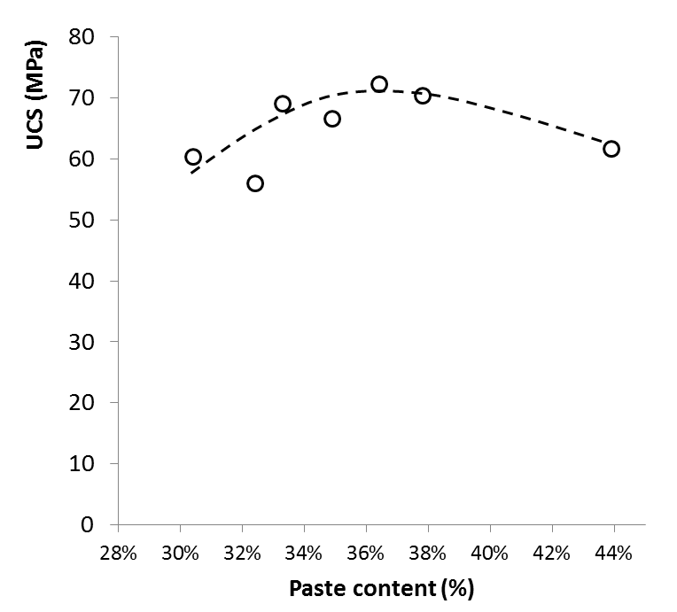
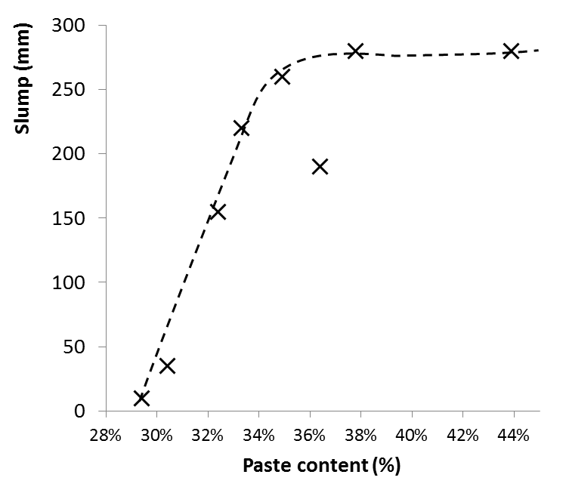
Results & discussion (3) Paste content approach
4th International Slag Valorisation Symposium | Leuven | 15-17/04/2015
Control of the workability
Paste content
range 30% - 33%
Detailed investigation in this range!
Control of the UCS

Slide 14
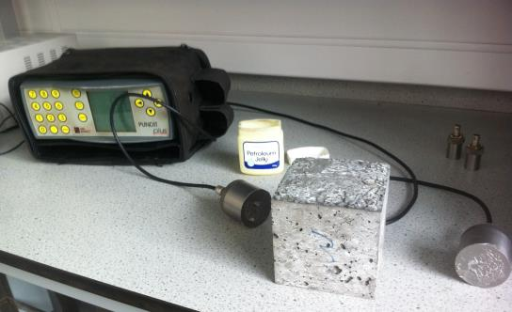
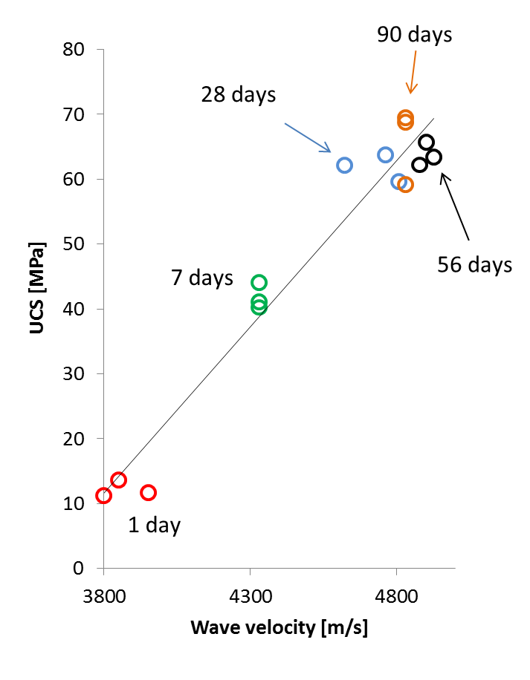
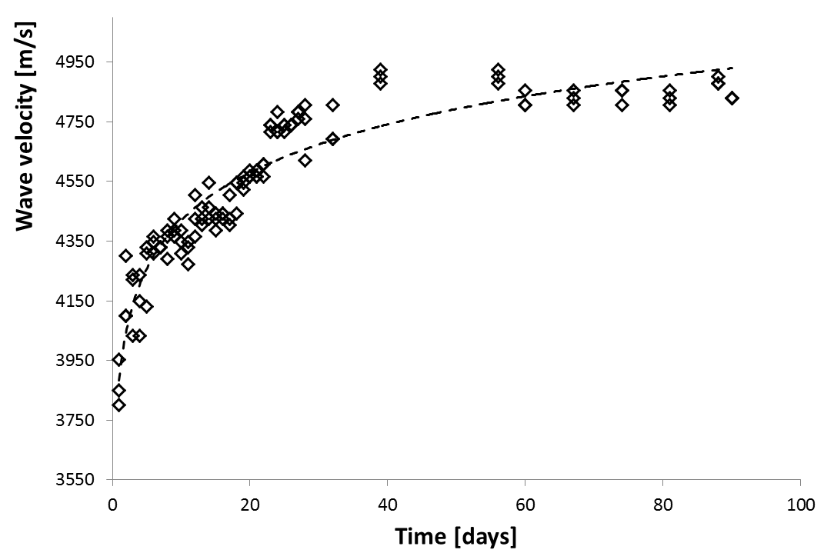
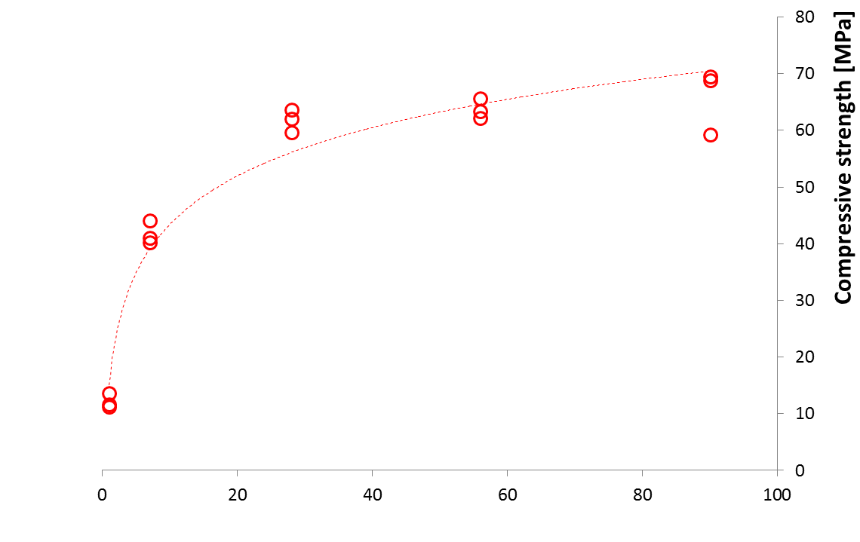
Results & discussion (4) UPV
4th International Slag Valorisation Symposium | Leuven | 15-17/04/2015
Readings on daily base until 28 days
Readings on weekly base from 28 to 90 days
Observed a linear relationship with UCS but…

Slide 15
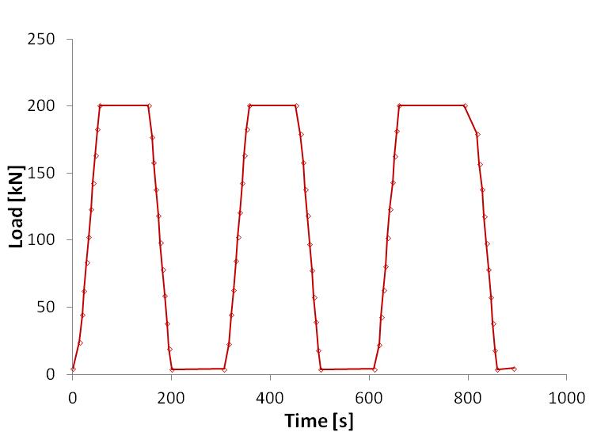
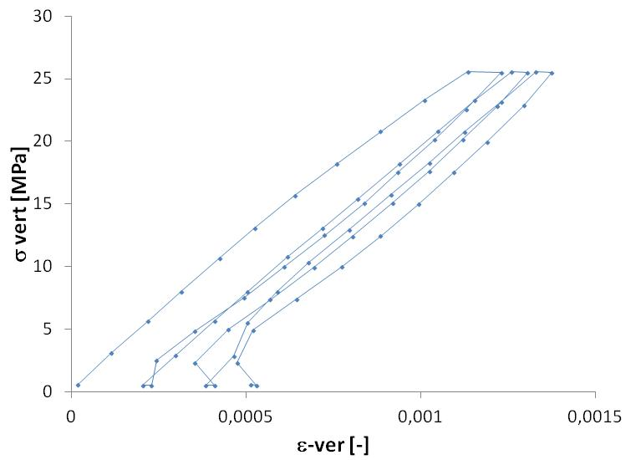
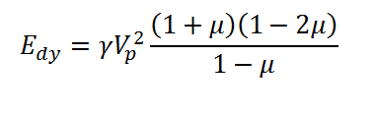
Results & discussion (5) Elastic modulus
4th International Slag Valorisation Symposium | Leuven | 15-17/04/2015
C1 mix: 2 LVDT transducers mounted on the opposite sides of samples, with a measurement base of 100 mm. Procedure described in BS 1881-121:1983
Sample | E_{sec} (GPa)
C1 – 1 | 25.46
C1 – 2 | 26.56
C1 – 3 | 24.74
From theory of elasticity (UPV vs. E_{dy})
= 48 – 50 GPa

Slide 16
Conclusions
4th International Slag Valorisation Symposium | Leuven | 15-17/04/2015
high binder content led to higher strength but did not allow the control of workability of the mix. Reduction of paste volume has an effect on the strength development (about 13 MPa) but high strengths can still be obtained (>60 MPa);
w/s ratio plays a role in the setting time and therefore a minimum w/s ratio exists for each binder blend that allows a reasonable setting time (i.e. greater than 60 min) that should not be exceeded. W/s ratio does not affect dramatically the strength development except in the case of very high values (≥ 0.40);
UPV measurements showed a relationship with strength, and is a useful tool for estimating the evolution of mechanical parameters of geopolymer concrete;
static elastic modulus measured at 28 days for one sample with very high paste content was around 25 GPa, similar to PC concretes. Mixes with lower paste content would exhibit higher stiffness.

Slide 17
Future developments
4th International Slag Valorisation Symposium | Leuven | 15-17/04/2015
Investigation of strength development and workability behaviour for concrete with paste content in the range 30% - 33%;
Extension of the methodology on different pfa/ggbs binder blends;
Development of a preliminary mix design guidelines controlling (a) compressive strength requirements; (b) workability requirements; (c) setting time requirements.

Slide 18
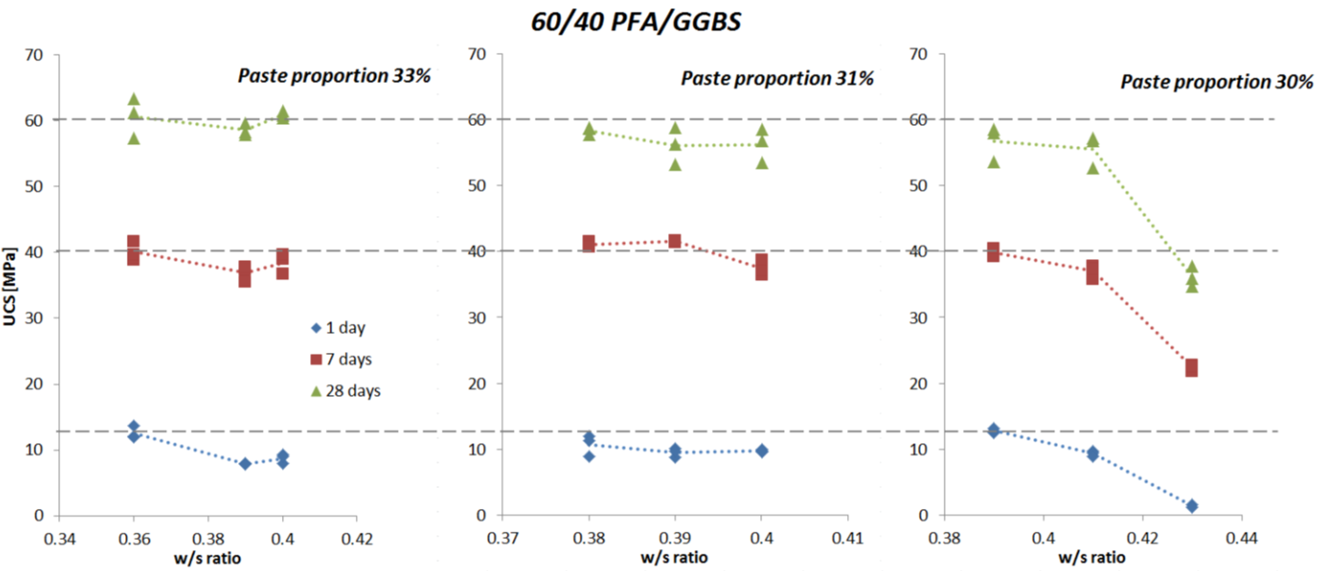
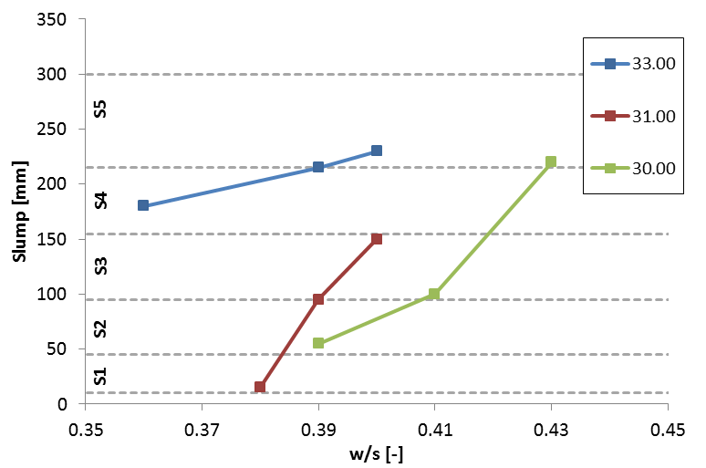
4th International Slag Valorisation Symposium | Leuven | 15-17/04/2015

Slide 19

Acknowledgement
4th International Slag Valorisation Symposium | Leuven | 15-17/04/2015
http://www.sus-con.eu/home
Geopolymer Research at Queen's University, Belfast:
http://blogs.qub.ac.uk/geopolymer/

Slide 20
Slag valorisation in construction materials: mechanical properties and rheology of alkali activated concrete containing ggbs
Dr. Raffaele VINAI
Mr. Ali RAFEET
Prof. Marios SOUTSOS
Prof. Wei SHA
School of Planning, Architecture and Civil Engineering
Queen’s University Belfast, United Kingdom

