Slide 1
Turning residues into business opportunities: some examples
Gert van der Wegen
SGS INTRON

Slide 2
Introduction
Sustainable society: recycling, reuse or recovery of materials and energy from wastes
Europe has very limited primary resources economical importance EU policy: ‘recycling society’
Waste Framework Directive: recycle 50% of municipal waste and 70% of construction & demolition waste by 2020!
Waste treatment = new industry (jobs + technology)
Wastes can be turned into profits: 3 examples based on Dutch experiences

Slide 3
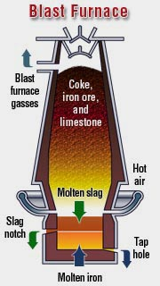
Blastfurnace slag
By-product of iron production in blast-
furnace (1500ºC)
Molten slag on top of molten iron
Rapid cooling of molten slag through
high-pressure water jets granulated
blastfurnace slag (up to 5 mm grains;
amorphous structure)
Drying and grinding (450 m²/kg)
ground granulated blastfurnace slag
(GGBS)

Slide 4
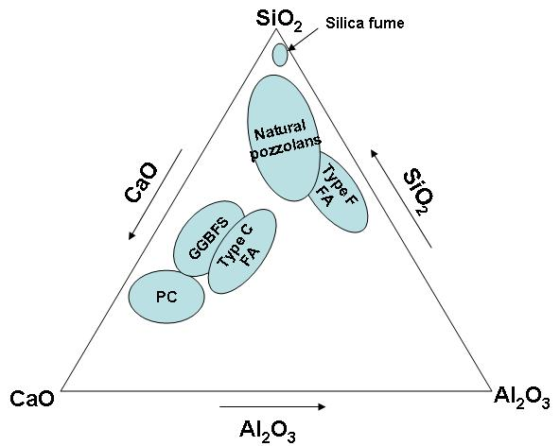
Composition
PC = Portland cement
FA = fly ash (from powder coal)
Latent hydraulic (activator needed)
Constituent(%) | PC | GGBS | FA
CaO | 65 | 40 | 4
SiO₂ | 20 | 35 | 59
Al₂O₃ | 5 | 10 | 22
MgO | 2 | 8 | 2
Fe₂O₃ | 3 | 0 | 8

Slide 5
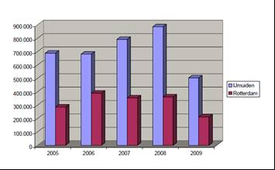
Production and use as binder
First application: lime activated GGBS in 1865
In 1880 with PC as activator (Europe, USA)
Netherlands: 1930 CEMIJ (Hoogovens/Tata Steel); ENCI Rotterdam and Maastricht
Netherlands:
total cement = 5 Mton/y
of which 55% CEM lll
(highest % worldwide)
1.7 Mton/y GGBS

Slide 6
Production and use as binder
Worldwide production of BFS = 400 Mton/y
Europe = 30 Mton/y; 80% is granulated (= 24 Mton/y GBS); about 80% of GBS is used in cement or concrete (= 20 Mton GGBS per year)
In cement GGBS is fully considered as binder (EN 197)
Cement type |  | Clinker | GBS | Fly ash
Portland cement | CEM l | 100 | 0 | 0
Portland fly ash cement | CEM ll/A-V | 80-94 | 0 | 6-20
 | CEM ll/B-V | 65-79 | 0 | 21-35
Portland blastfurnace slag cement | CEM lll/A | 35-64 | 36-65 | 0
 | CEM lll/B | 20-34 | 66-80 | 0
Composite cement | CEM V/A | 40-64 | 18-30 | 18-30
 | CEM V/B | 20-38 | 31-50 | 31-50

Slide 7
Production and use as binder
GGBS applied at ready-mixed concrete plant = type ll addition: only partially (k-value) considered as binder
GGBS k-value = 0.6 (under discussion)
Based on principle of equivalent concrete performance it is possible to obtain k=1 for specific combinations of GGBS and CEM l (NL since 2003 and B since 2013): ‘attest’
In NL also possible for ternary systems: CEM l – GGBS – FA
This combination is well suited for optimization of durability, sustainability and economics

Slide 8
Distinctive properties
Compared to CEM l cement CEM lll:
Has higher resistance to chloride ingress, alkali-silica reaction, sulphate attack, chemical degradation
Is more sustainable (lower environmental impact)
Has lower heat of hydration (lower risk of cracking)
However, is more sensitive to curing conditions of concrete
Develops strength slower at early ages and at low temperatures
Has less resistance to carbonation and freeze-thaw with DC

Slide 9
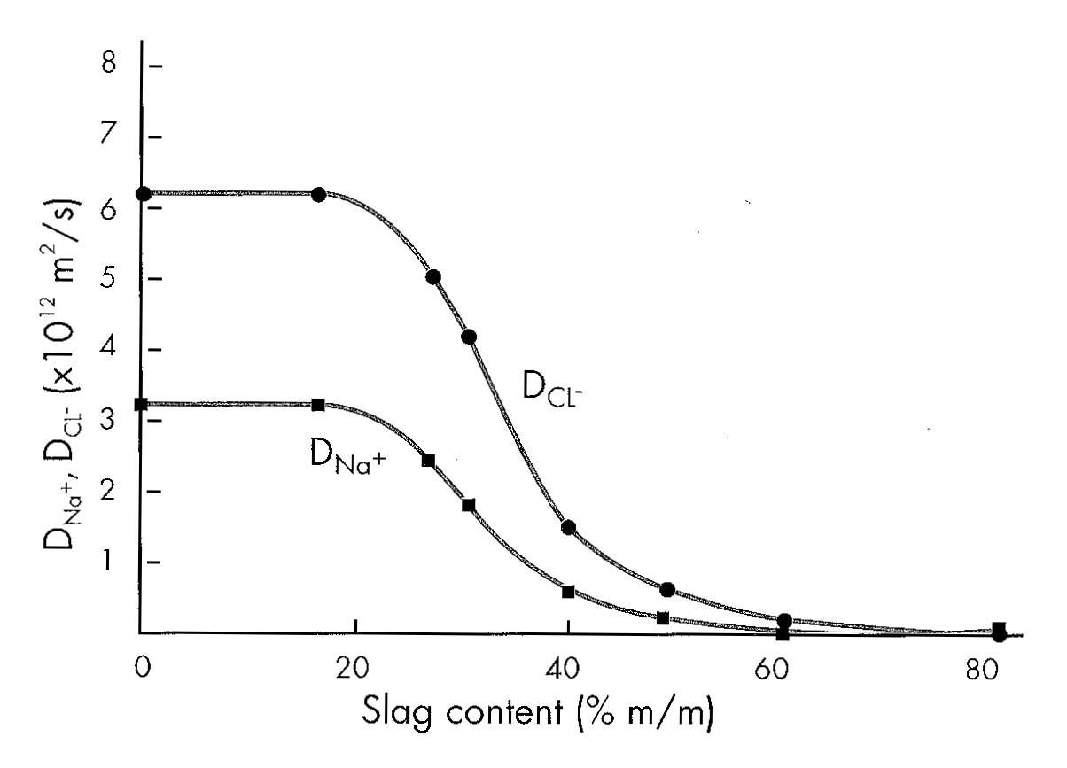
Distinctive properties
Denser microstructure (more gel less capillary pores) when properly cured: lower diffusivity and permeability

Slide 10
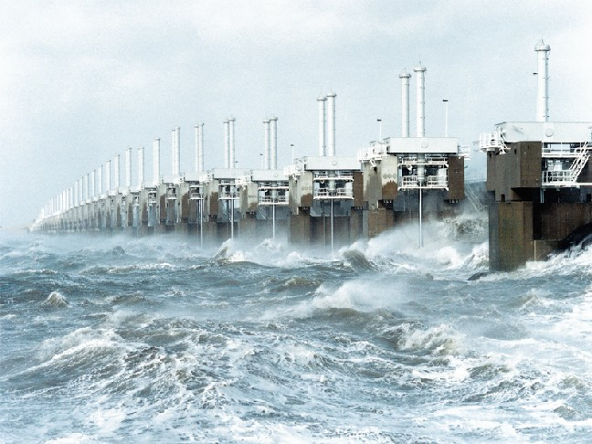
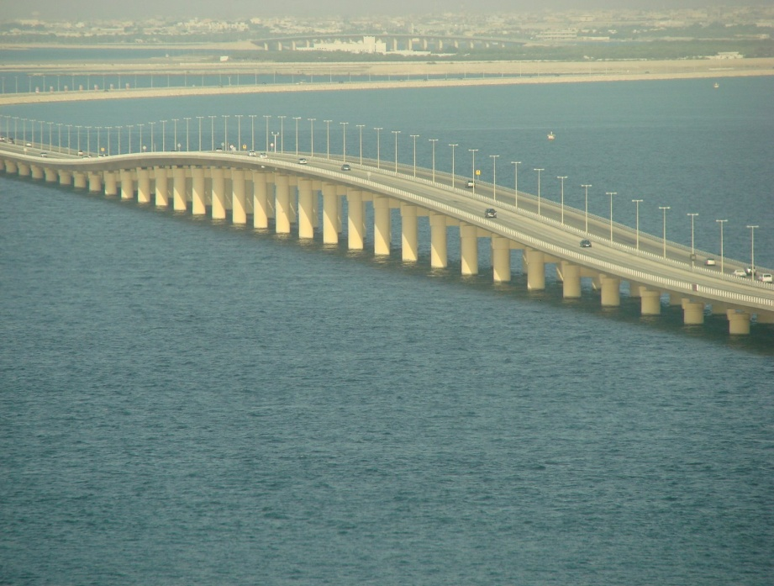
Distinctive properties
Excellent performance in marine and aggressive environ-ments. E.g. Eastern Scheldt barrier (NL; design service life of 200 years) and King Fahad Causeway (Bahrain – KSA; design service life 70 150 years)

Slide 11
Sustainability
Environmental impact of CEM lll concrete is about 60% lower compared to same concrete with CEM l cement
(emission of green house gases = EGHG):
* average of Dutch CEM lll/A and CEM lll/B
Concrete (kg/m³) | CEM l (ref) | CEM lll*
CEM l | 300 | 0
CEM lll | 0 | 300
Water | 165 | 165
River sand | 616 | 610
River gravel | 1232 | 1220
EGHG (kg CO₂-eq) | 287 (100%) | 116 (40%)

Slide 12
Economics
CEM lll somewhat lower in price than CEM l cement (in NL) due to price of GGBS is lower than costs for producing and grinding clinker
Use of GGBS as type ll addition within ‘attest’ (i.e. fully considered as binder (k=1)), needs initials tests to proof equivalent performance of the specific combination.
Market price of GGBS in such high valued applications is about ¾ of cement price (depending on specific market conditions)
Very lucrative, even with the costs for initial performance testing and quality assurance

Slide 13
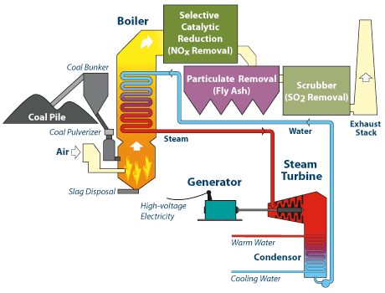
Powder coal fly ash
By-product of pulverised coal fired power plants (1200ºC)
Separated from flue gas by electrostatic precipitators or cyclones and stored in silos

Slide 14
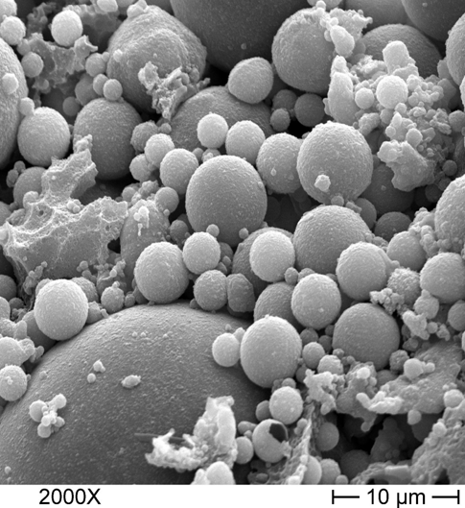
Powder coal fly ash
After combustion fly ash particles
are in molten state
When leaving the furnace very
rapid cool down amorphous
and spherical particles
Pozzolanic (type F; low Ca) or
even self-cementing (type C;
high Ca) properties
Focus on type F fly ash

Slide 15
Composition
PC = Portland cement
FA = fly ash (from powder coal)
Pozzolanic: needs activator like
cement, lime, …
Constituent(%) | PC | GGBS | FA
CaO | 65 | 40 | 4
SiO₂ | 20 | 35 | 59
Al₂O₃ | 5 | 10 | 22
MgO | 2 | 8 | 2
Fe₂O₃ | 3 | 0 | 8

Slide 16
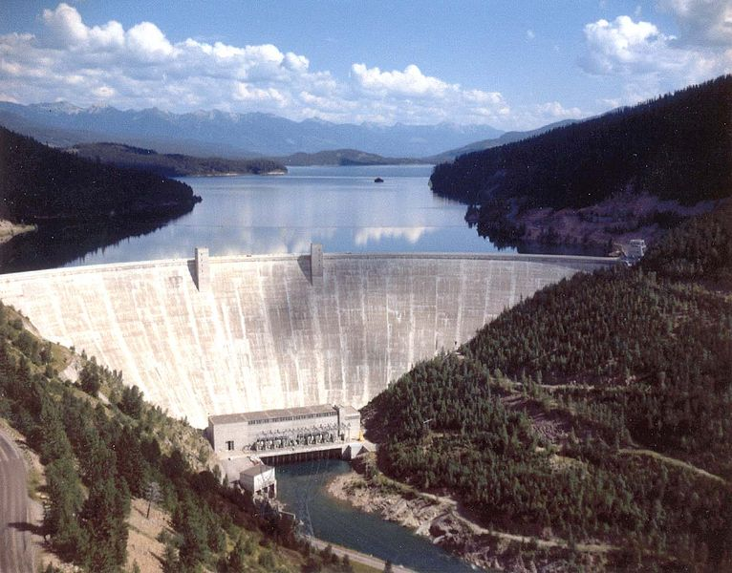
Production and use as binder
Successfully used in concrete for over 70 years now
Started as a filler, but pozzolanic nature was swiftly noticed
Hungry Horse Dam (USA 1948)
3 Mm³ of concrete
35% of CEM l replaced by FA
(reduce heat of hydration)

Slide 17
Production and use as binder
Mid 70’s strong increase of electricity production by firing powder coal large amounts of fly ash
Early 80’s cement industry started production of Portland fly ash cement (fly ash fully considered as binder)
Fly ash used as addition type ll (added at the ready-mixed concrete plant): k-value concept (k = 0.2 – 0.4)
Based on principle of equivalent performance the attestation of specific combinations of fly ash and cement was develop-ed in NL in 1992, considering the fly ash fully as a binder (k=1), similar to Portland fly ash cement (CEM ll/B-V)
A similar system will be introduced in Belgium this year

Slide 18
Production and use as binder
Worldwide production of fly ash is more than 400 Mton/y
Most of it is landfilled; only small part is used for high end purposes such as binder in concrete
In Europe about 30 Mton/y of fly ash is produced of which only 8% is disposed off. About 30% is applied in cement or concrete
In NL about 1 Mton/y of fly ash is produced, which is almost entirely used in cement and concrete. Actually, fly ash is sometimes imported from abroad due to a shortage
In Belgium about 0.5 Mton of fly ash is produced each year

Slide 19
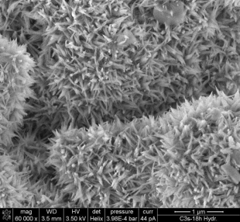
Distinctive properties
First few weeks the contribution of fly ash is limited to its physical properties:
  filler effect due to its fineness
  lower water demand due to spherical shape
Chemical contribution = pozzolanic reaction = formation of cementitious hydrates, occurs at later age
Denser structure (capillary gel pores)
after 1 year about the same as CEM lll/B

Slide 20
Distinctive properties
Chloride diffusion coefficient as function of time
Carbonation and freeze-thaw resistance is even much better

Slide 21
Sustainability
Environmental impact of concrete with fly ash as part of binder is 33% lower compared to same concrete with CEM l cement
(EGHG = emission of green house gases)
Concrete (kg/m³) | CEM l (ref) | CEM lll | CEM l-FA
CEM l | 300 | 0 | 200
CEM lll | 0 | 300 | 0
Fly ash | 0 | 0 | 100
Water | 165 | 165 | 165
River sand | 616 | 610 | 610
River gravel | 1232 | 1220 | 1220
EGHG (kg CO₂-eq) | 287 (100%) | 116 (40%) | 193 (67%)

Slide 22
Economics
Fly ash can partly replace cement (k-value 0.2 – 0.4) positive but limited economic value
Use of fly ash as type ll addition within ‘attest’ (i.e. fully considered as binder (k=1)), needs initials tests to proof equivalent performance of the specific combination.
Market price of fly ash in such high valued applications is about ½ of cement price (depending on specific market conditions)
Very lucrative, even with the costs for initial performance testing and quality assurance

Slide 23
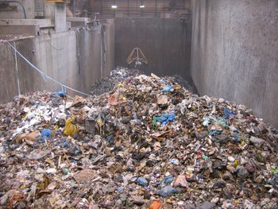
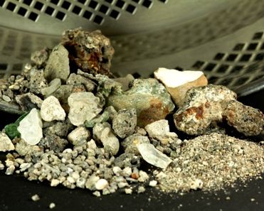
Municipal incinerator bottom ash
EU 350 Mton/y household waste:
40% recycled; 25% incinerated;
35% landfilled
Incinerated because recovery of energy
and reduction of waste volume
Municipal incinerator bottom ash (MIBA)
NL: 15 Mton/y municipal waste
7 Mton/y incinerated
2 Mton/y MIBA

Slide 24
Treatment and applications
Standard treatment raw bottom ash: sieving, separation of ferrous (magnetic) and non-ferrous (Eddy current), hand-picking
Embankments (noise barriers) and (un)bound base courses for roads
These applications are discouraged in NL because of environmental issues
Looking for alternatives with more added value upgrading quality of MIBA

Slide 25
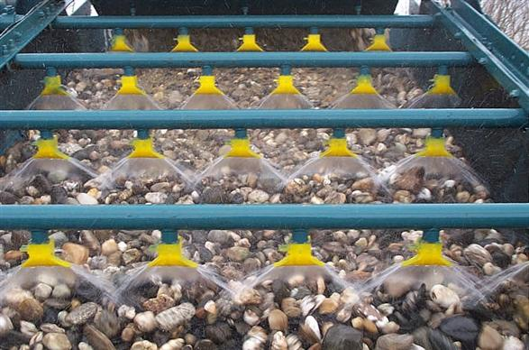
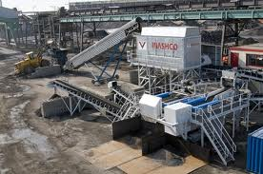
Upgrading quality
Wet process: similar to traditional washing of polluted soil
  Fractions: 40-4 mm, 4-0.1 mm and residue
  Additional recovery of (non)ferrous from
  fractions 40-4 and 4-0.1
  Residue contains very fine and low
  density particles
Dry process: called ADR technology
  Developed by TU Delft (patented)
  Based on ballistic principles
  Higher recovery of (non)ferrous
  Separation of porous particles

Slide 26
Aggregate for concrete
Wet process:
  Effectively removes undesired constituents like Cl, SO₄, Na, K
  In general meets basic requirements for application in concrete
Dry process:
  Higher contents of Cl, SO₄, Na, K; can be a problem for application in reinforced or prestressed concrete
For structural concrete the particle density should be
> 2100 kg/m³
Upgraded MIBA can replace 20 %V/V of fine and coarse aggregate in concrete. Up to 40 %V/V in concrete paving blocks and flags

Slide 27
Aggregate for concrete
At same compressive strength other structural properties (tensile strength, E-mod, …) are similar to concrete with no replacement in aggregates
Shrinkage and creep are increased when replacing 20% V/V of fine and coarse aggregate
Durability (carbonation, freeze-thaw, ASR) is similar to concrete without MIBA, except for chloride ingress (50% higher)

Slide 28
Sustainability
Environmental impact of concrete with 40% replacement of river gravel and sand by MIBA is 4% lower compared to same concrete with only river gravel and sand
(EGHG = emission of green house gases)
Concrete (kg/m³) | CEM l (ref) | CEM lll | CEM l-FA | MIBA
CEM l | 300 | 0 | 200 | 300
CEM lll | 0 | 300 | 0 | 0
Fly ash | 0 | 0 | 100 | 0
Water | 165 | 165 | 165 | 165+24
River sand | 616 | 610 | 610 | 370
River gravel | 1232 | 1220 | 1220 | 732
MIBA | 0 | 0 | 0 | 608
EGHG (kg CO₂-eq) | 287 (100%) | 116 (40%) | 193 (67%) | 274 (96%)

Slide 29
Economics
Taxes on landfilling MIBA can be very high (up to € 80/ton in EU)
Although only a few % of MIBA is metals, their high market value is sufficient to cover the costs of the upgrading process
Use of (unbound) MIBA in embankments and road construc-tions requires additional measures to prevent leaching
negative price for MIBA of about –10 €/ton
Applied as aggregate in concrete a market price of about ½ the price of river sand is obtained
Concrete paving block and flags with up to 40% MIBA are produced nowadays

Slide 30
Conclusions
The 3 examples described clearly demonstrate that mineral residues can be turned into valuable raw materials for the concrete industry
Some of such residues (GGBS and FA) even improve the performance of concrete significantly. Not only from a materials but also from a sustainability and economic point of view
Residues of lesser quality need to be upgraded before application, but can still be of interest

