Slide 1
Production of durable “Spijkerbed”
(Hanging concrete)
Prof. Dr. Youva Raj Tyagi
Peter van Bakel
Notes:
1

Slide 2
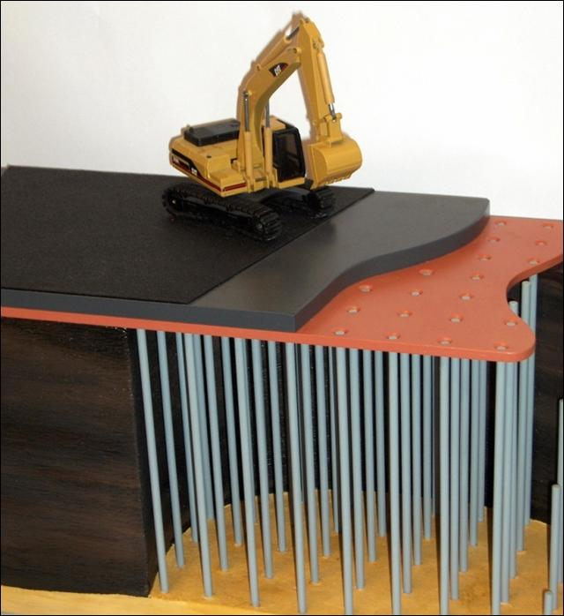

Slide 3
Zero Waste
Environmental Protection in a real way !!

Slide 4
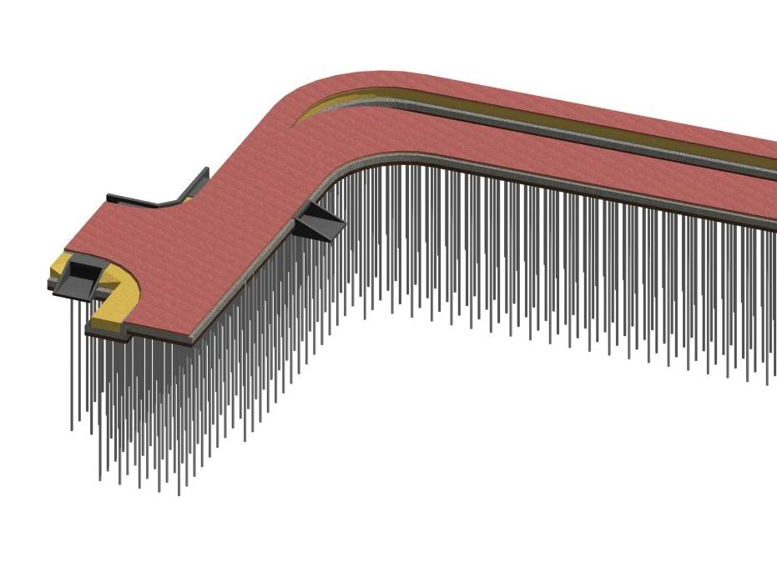
“Spijkerbed”
deck plate
high speed poles
working floor

Slide 5
Innovation in Green Concrete
Using contaminated waste
CO₂ reduction
Low cost due to use of:
Waste
No reinforcement
Less cement

Slide 6
Innovation in Green Concrete
Using contaminated waste
CO₂ reduction
Low cost due to use of:
Waste
No reinforcement
Less cement

Slide 7
Results
Deck Plate
CS (N/mm2): 25,6;
Density: 2138 kg/m3;
Ultra sound: 3,900 to 4,116 m/sec;
Working Floor
CS (N/mm2):5,8;
Density: 1845 kg/m3;
Ultrasound: 2315 to 2620 m/sec

Slide 8
Leaching Tests
NEN-EN12457; DT NEN 7375
Passes both for Working Floor and Deck Plate

Slide 9
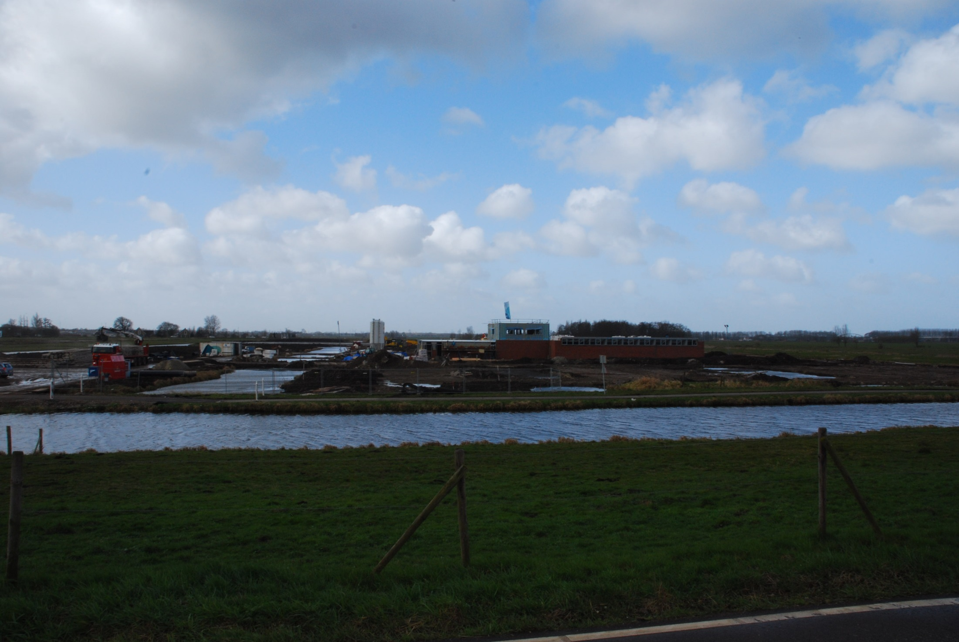
“Spijkerbed”
deck plate
high speed poles
working floor

Slide 10
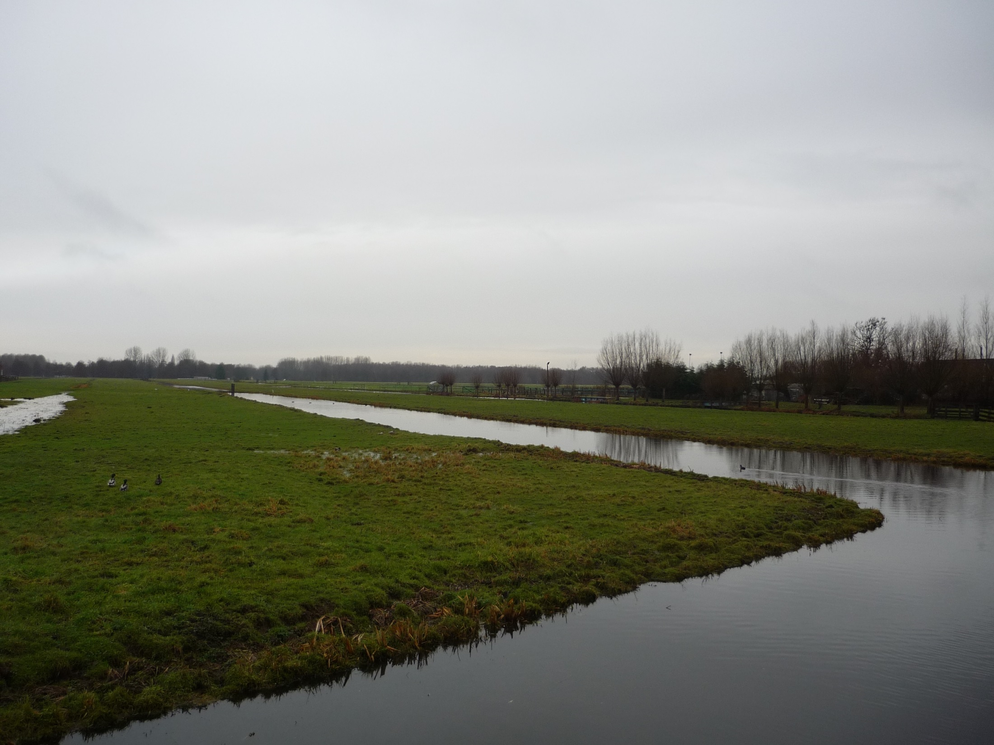
“Spijkerbed”
deck plate
high speed poles
working floor

Slide 11
Basic information
Area: 2300 m2-Thickness 500mm (Lower Deck Plate);
Area:2650 m2, Thickness 500 mm (Higher Deck Plate);
All toxic waste;
DT NEN 7375 : Metal and Non Metal ions passes;
No reinforcement;
Less cement;
CO2 saving due to low cement and no reinforcement;
Cost saving;
Eco-friendly green concrete.

Slide 12
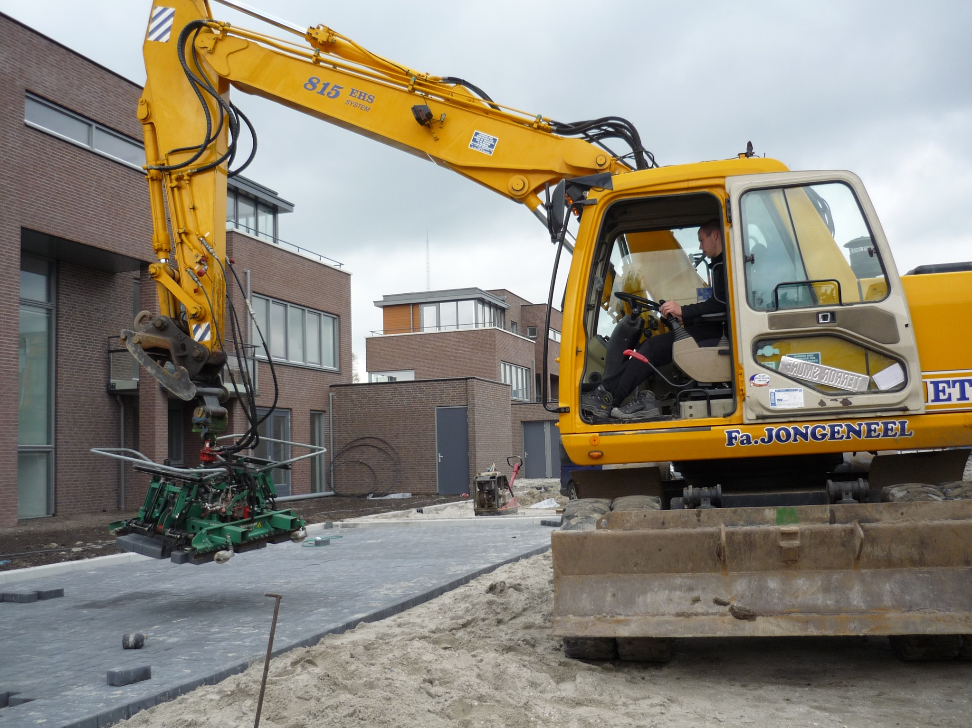

Slide 13
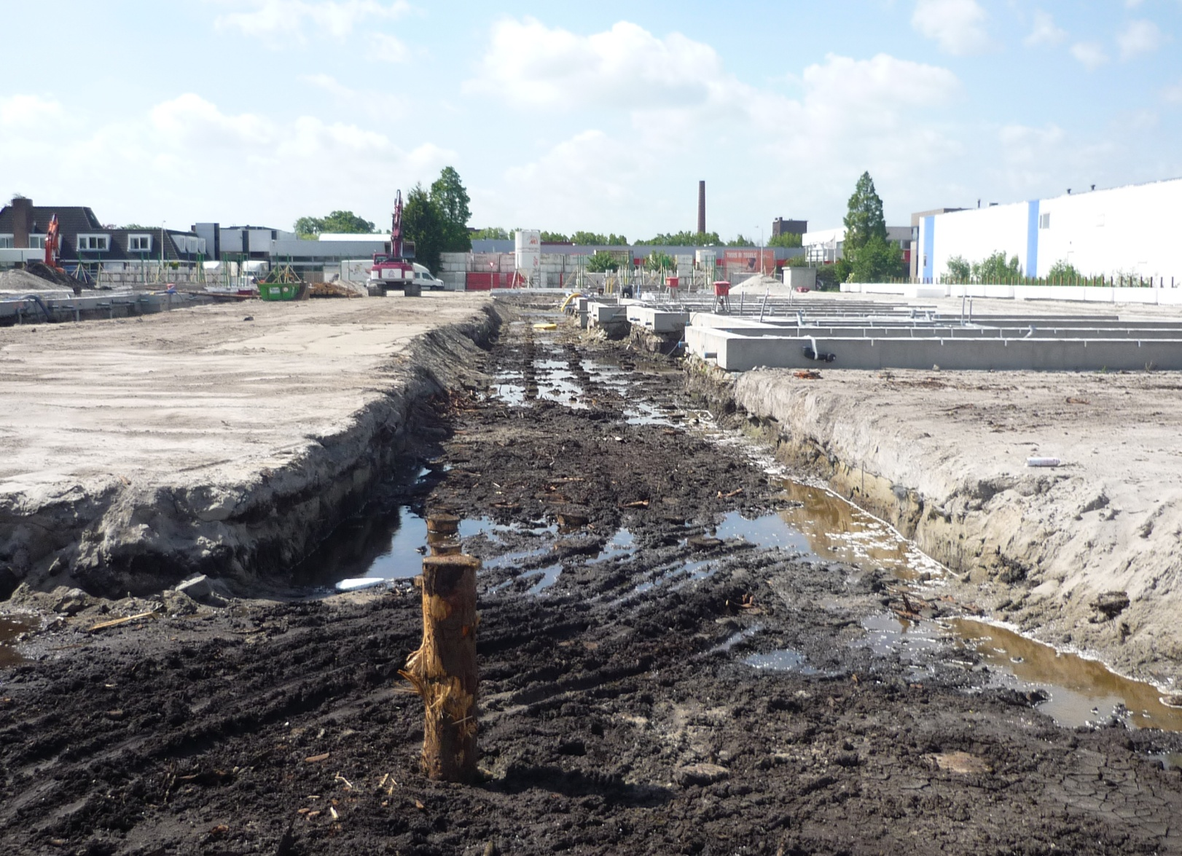
Working floor and water level

Slide 14
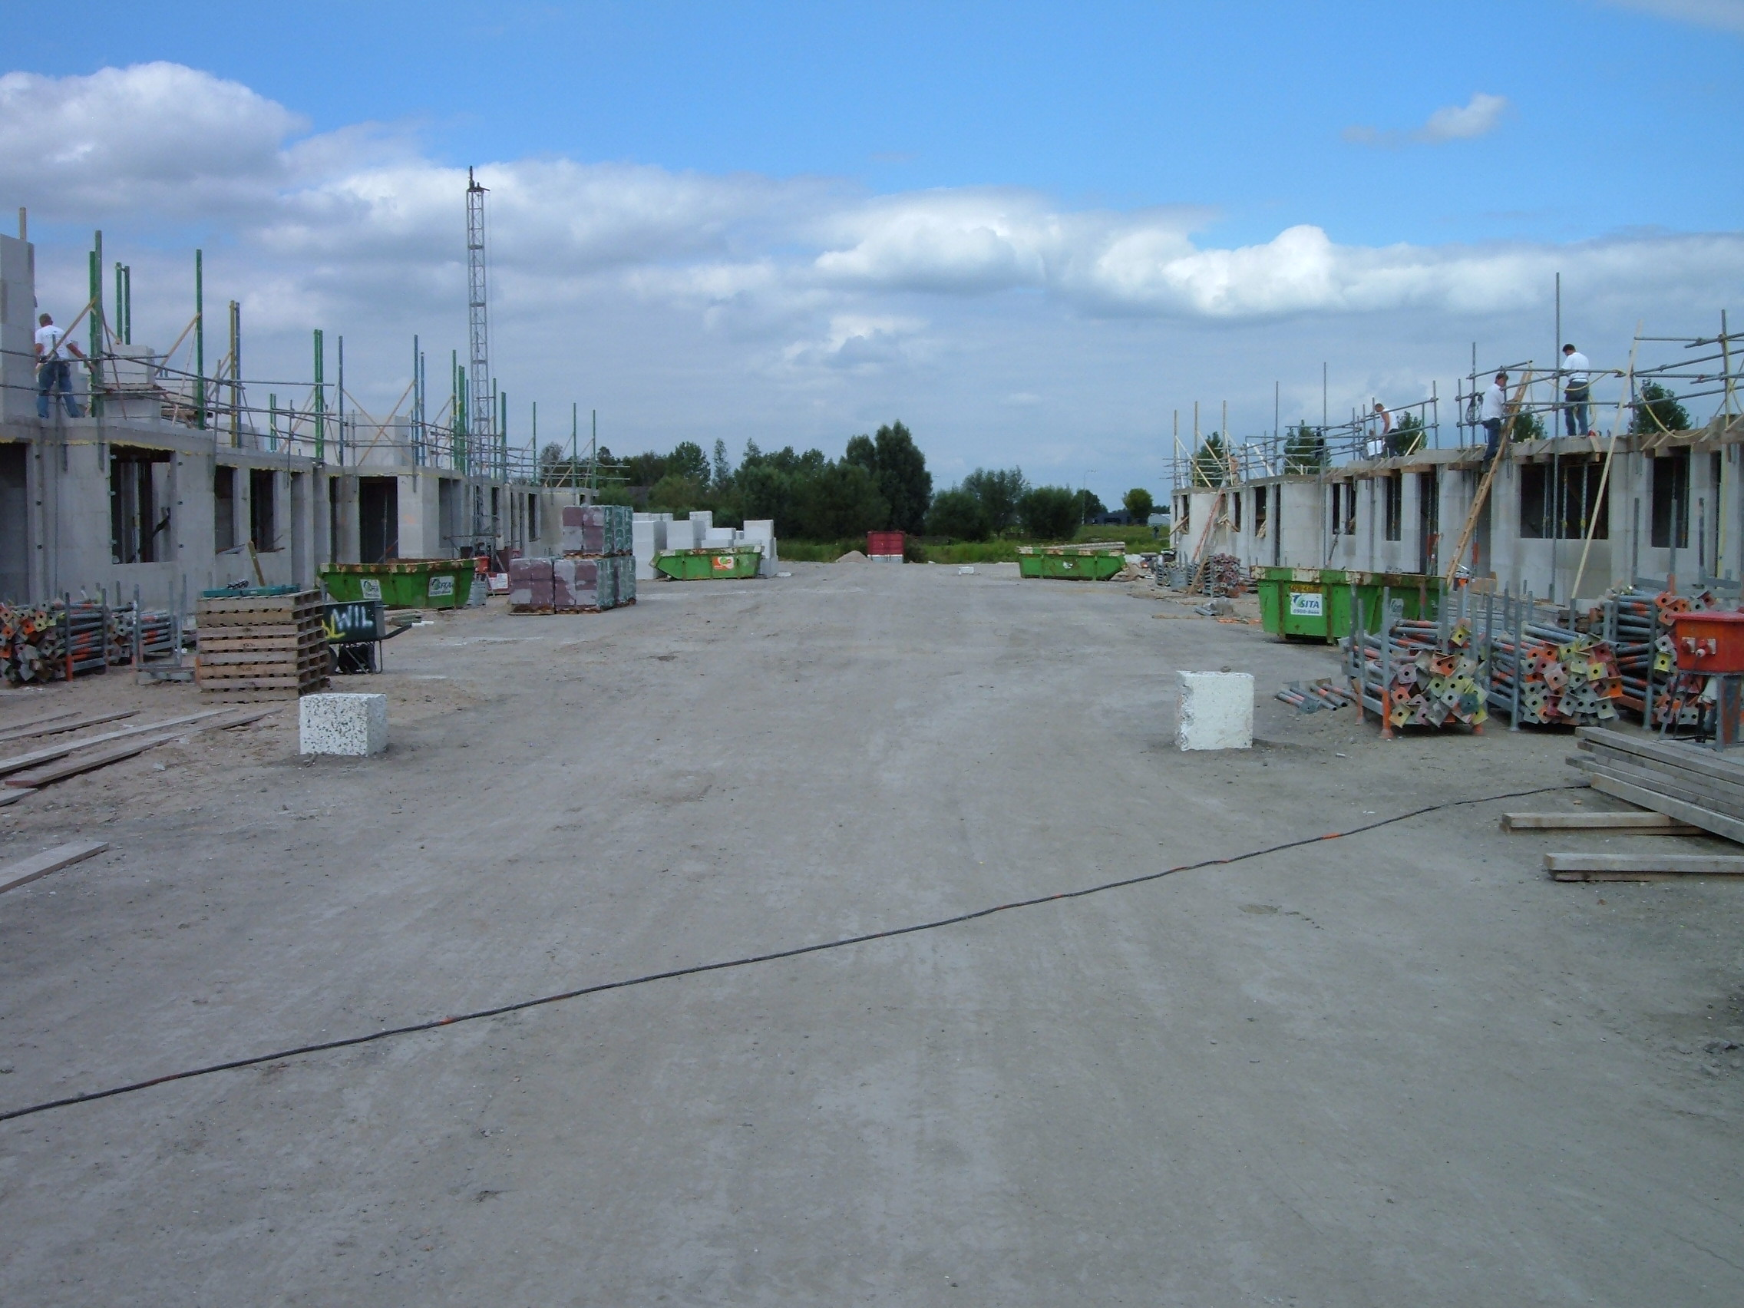
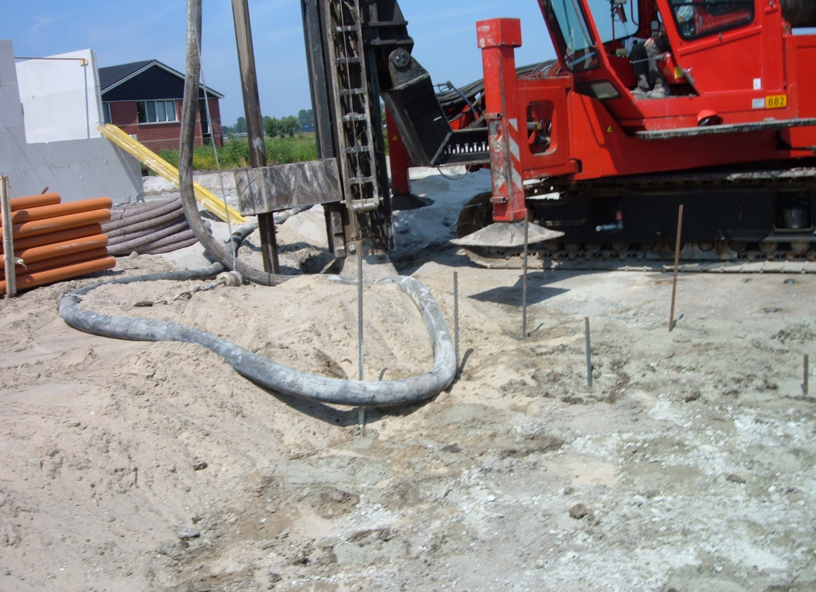
Location and distribution of High Speed Poles

Slide 15
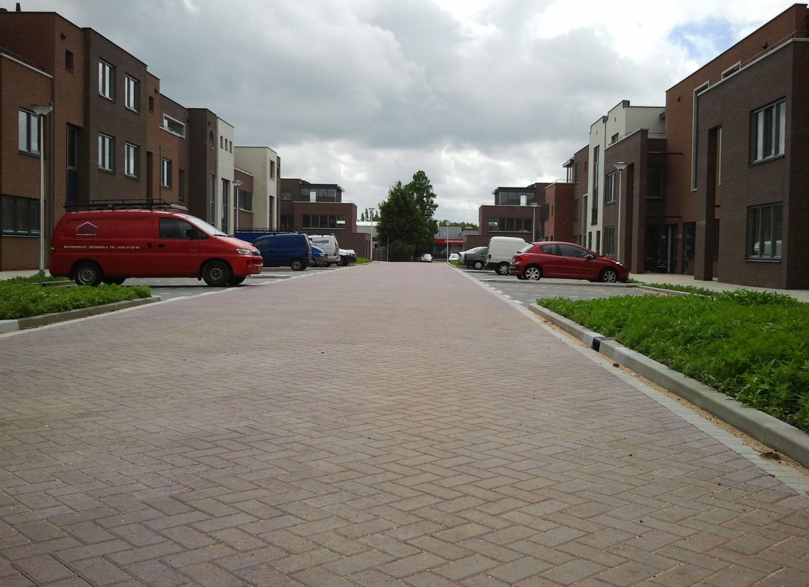
View of completed “Spijkerbed” project

Slide 16
Conclusions
CS/BS, density and other related parameters are
qualifying
100% toxic waste is used
Cement was reduced more than 40%
The leaching profile of 15 cations and 4 anions
passed the diffusion test (NEN 7375)
This leads to environment protection as CO₂
emissions are reduced due to cement and steel and
(hazardous) waste reduction

Slide 17
Innovation in Green Concrete
Prof. Dr Youva Tyagi
Peter van Bakel
MGX Research Centre
www.mgxgroup.eu

