Slide 1


Production of value added light-weight , eco-friendly green concrete
Prof. Dr. Youva Raj Tyagi
Peter van Bakel
Notes:
1

Slide 2
Agenda
Introduction
Preparing concrete from CWW/EPS
Results
Conclusions
Questions

Slide 3
Zero waste
Future Technologies
Waste wood and EPS based concrete
Mecalithe

Slide 4
Available options
Landfill;
Thermal/Burning;
Re-cycling;
Bioremediation;
Others non-viable.

Slide 5
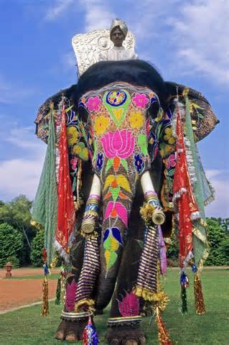

What is the difference
Synthetic or semi-synthetic organic polymer.
10,000.00 kgs – 100 years
1,000.00 kgs -1000 years

Slide 6
Introduction
Production of light-weight, eco-friendly concrete
Use of waste wood (WW) or (waste) expanded
polystyrene (EPS) as aggregates
Light weight:
  EPS: 785 – 876 kg/m³
  Waste wood: 1,250 kg/m³
Aggregates are free or bring money
Patented formulation of Mecalithe®
Helps reducing CO₂ emission

Slide 7
CO₂ Emissions
Global average temperature:>0,7ºC (last century)
Global warming in 2001 – 2010 was 2ºC;
Worldwide CO₂ emission (burning fossil fuels) was
36,131 million tonnes in 2013;
If 1 ton of wood (10% water) is burnt it will produce
approx. 1.5 ton CO_{2;}
By re-use of the wood this amount of CO₂ emission will be saved;
The amount of cement can be less, causing another
reduction of CO₂ emissions.

Slide 8
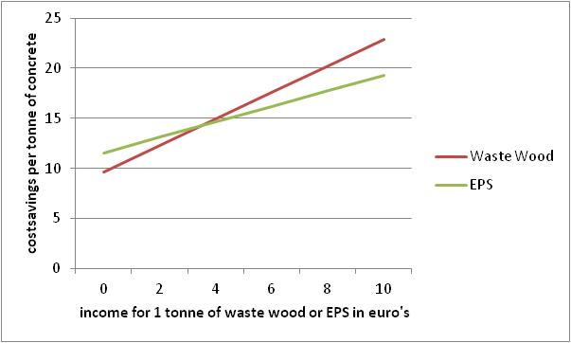
Cost savings in euro’s per m³ concrete

Slide 9
Differences in recipes (in kg per m³)
 | traditional | Houton | EPS
Cement | 350 | 200 | 200
Sand | 800
Gravel | 1,000
Mecalithe® |  | 5 | 4
Lime |  | 35 | 4
Waste Wood |  | 1,320
EPS |  |  | 770

Slide 10
Typical procedure for preparing concrete from CWW and EPS
Make is suitable recipe based upon research findings as a definition;
Place CWW or EPS (or with sand) in a mixing unit;
Mecalithe powder is added in stages at a fixed rate;
EPS may have static charge so this need to be neutralised chemically;
Finally, cement and water is added;
CWW has water absorption as high as 26% or around;
Temp, internal water, size and quantities of Mecalithe all matters.

Slide 11
Results and Discussions
Sound Absorption/Fire resistance with WWC concrete
Indicative tests according to NEN 5077 at TU Eindhoven indicate high potentials of sound absorption with WWC;
Fire tests according to NEN 6064/65/68 shows that both WWC and EPS based concrete are potentially resistant to fire;
Does not burn but glow and stops immediately;
Fire resistance provides excellent opportunities for their application in building industry;
A combination of fire resistance and sound absorption makes it even more useful for building industry;
Eco-friendly concrete, as also absorbs other radiations.

Slide 12
Results and Discussions
CS/BS (N/mm2) -Stability
High BS (N/mm2) of 4-5 can be achieved;
High CS (N/mm2) of 15 or high can be achieved with WWC;
CS (N/mm2) 8-10 can be achieved with EPS based concrete;
Freeze-Thaw with and with-out salt has indicated a remarkable stability;

Slide 13
Application – why use light weight concrete?
Waste wood/EPS concrete
  Non-bearing panels
    Easy to handle – light, easy transportaion
    Sound absorption is better
    Resistant to fire
    It does not burn but glow and the fire stops immediately
  Can be used on unstable ground
  Floating concrete (EPS);
  Eartquake zones;
  Eco-friendly absorbs harmful radiations

Slide 14
Results
Excellent performance to sensitive Freeze-Thaw tests
EPS concrete is floating
Nails can be screwed in waste wood concrete
Sound absorption of waste wood concrete is better
EPS and waste wood concrete is resistant to fire
It does not burn but glow and the fire stops
immediately

Slide 15
Results – CS of concrete with WW and sand

Slide 16
Results – concrete with diff. amounts of CEM I

Slide 17
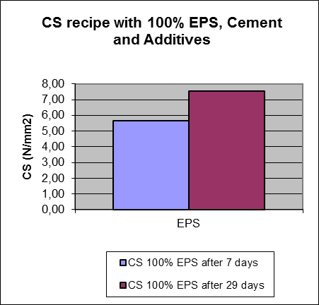
Results – CS of concrete with 100% EPS

Slide 18
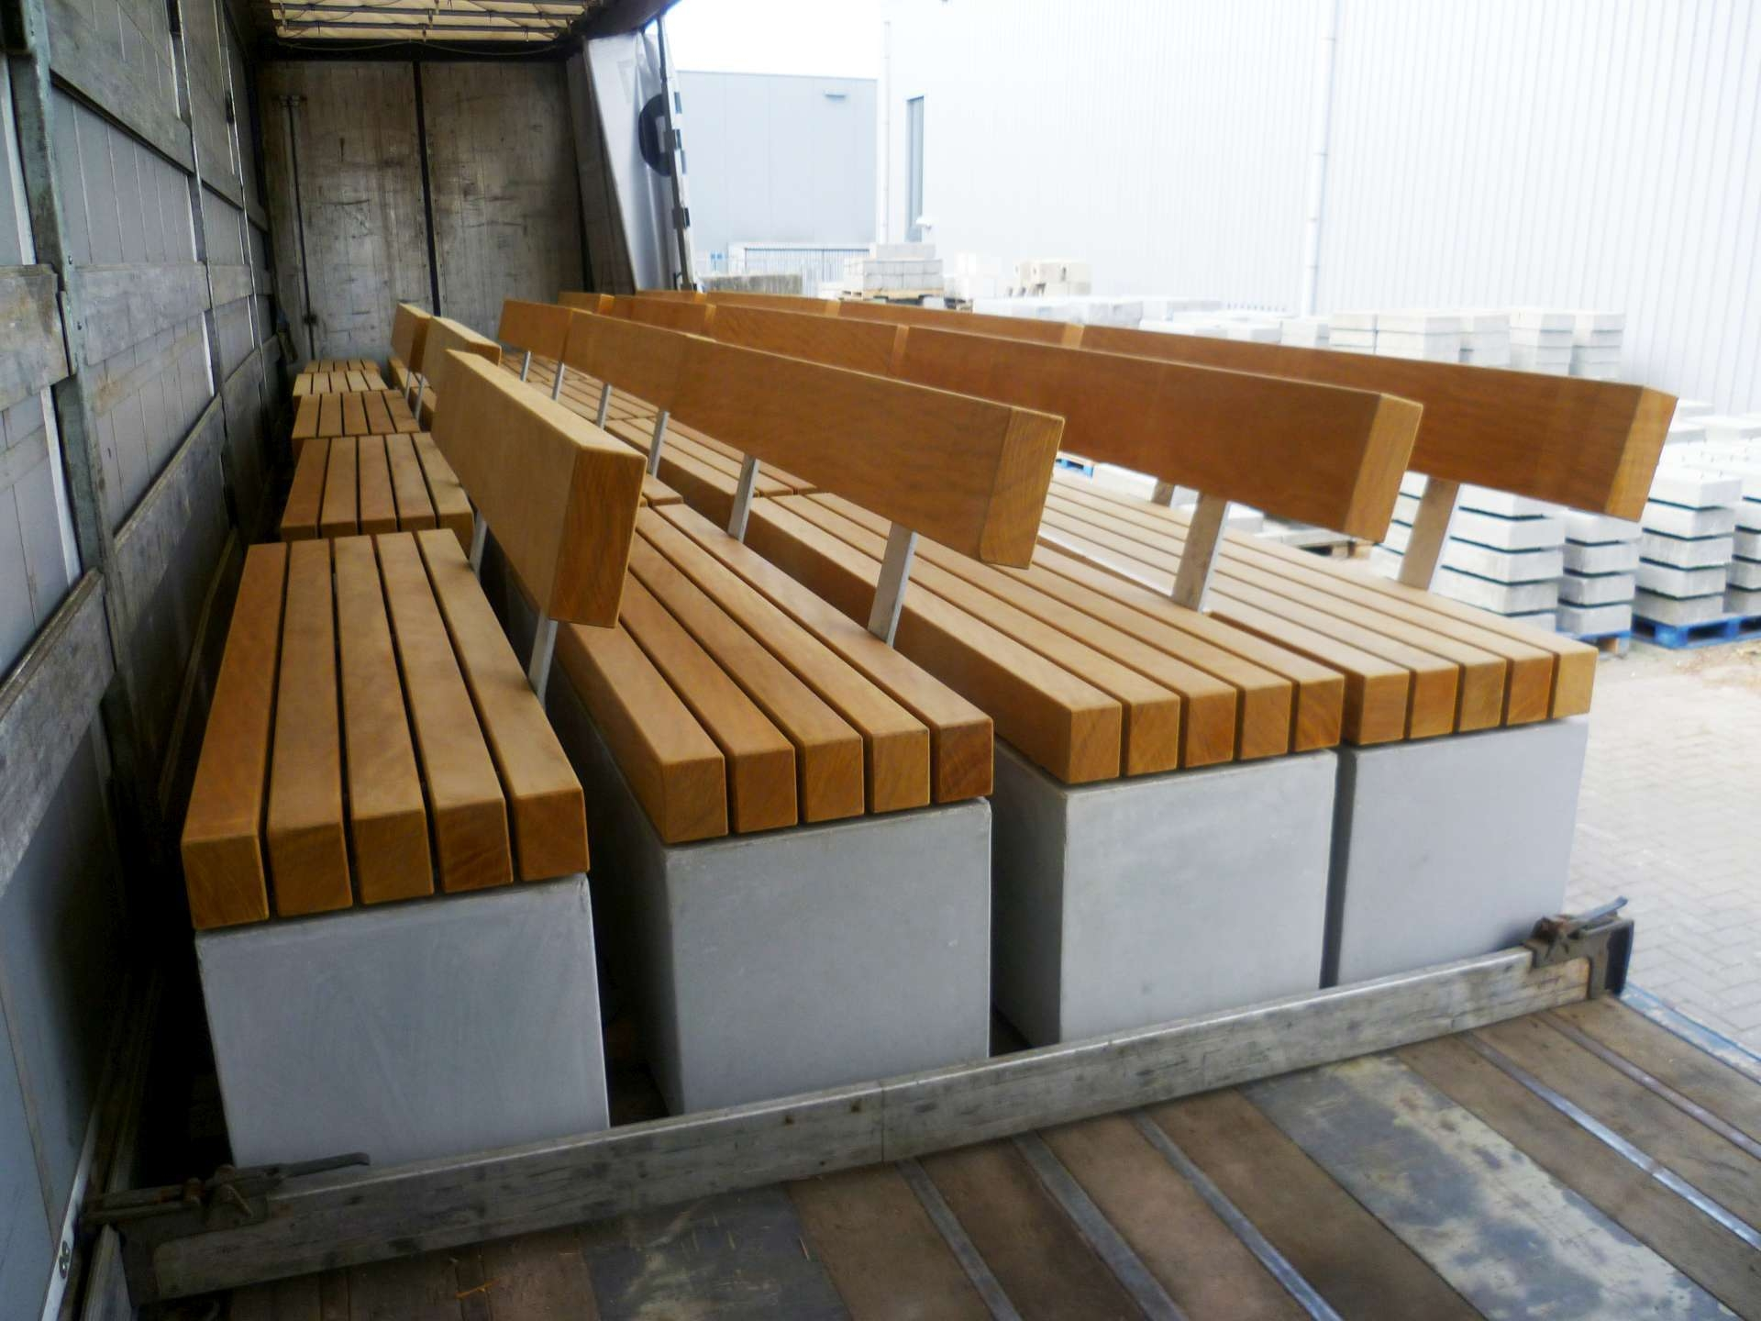
100% Waste Wood (Commercialisation of research findings)

Slide 19
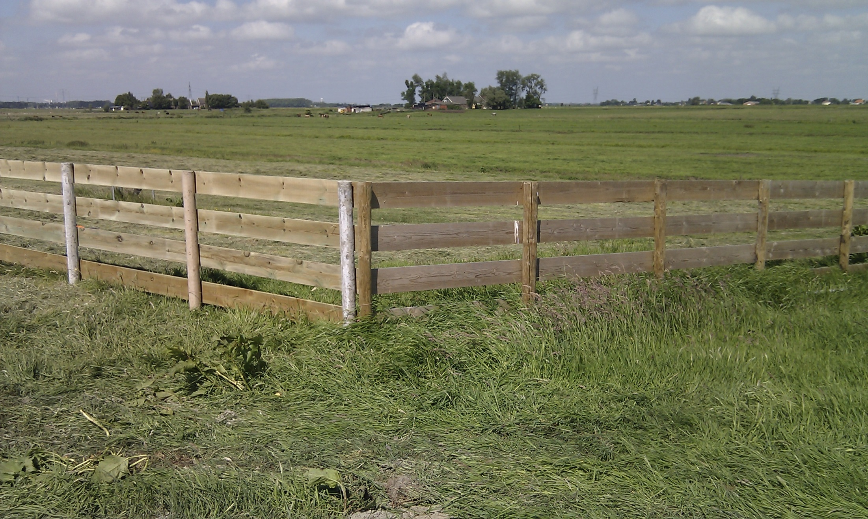
Wooden Poles (Innovation Award)

Slide 20
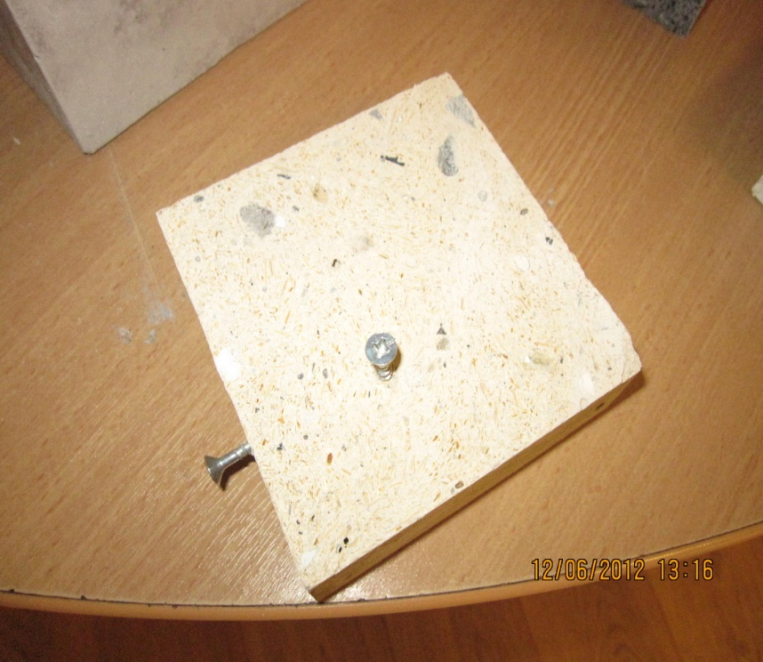
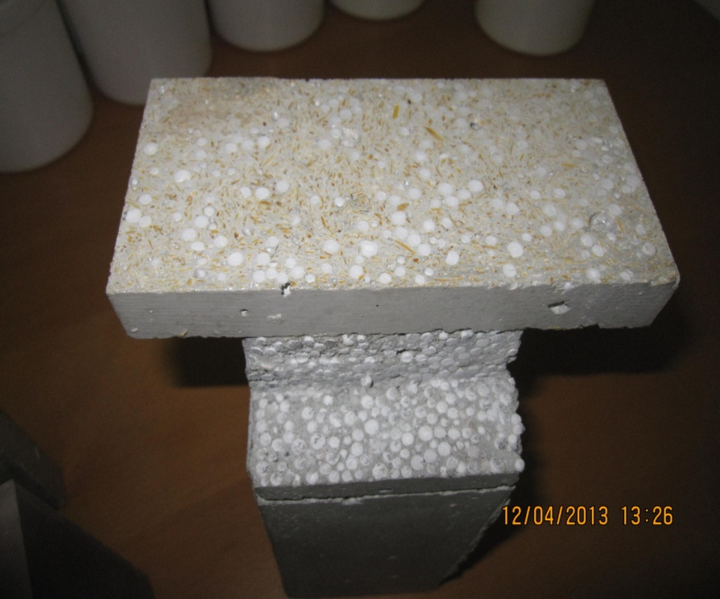
Results – waste wood and EPS concrete
waste wood concrete
EPS concrete

Slide 21
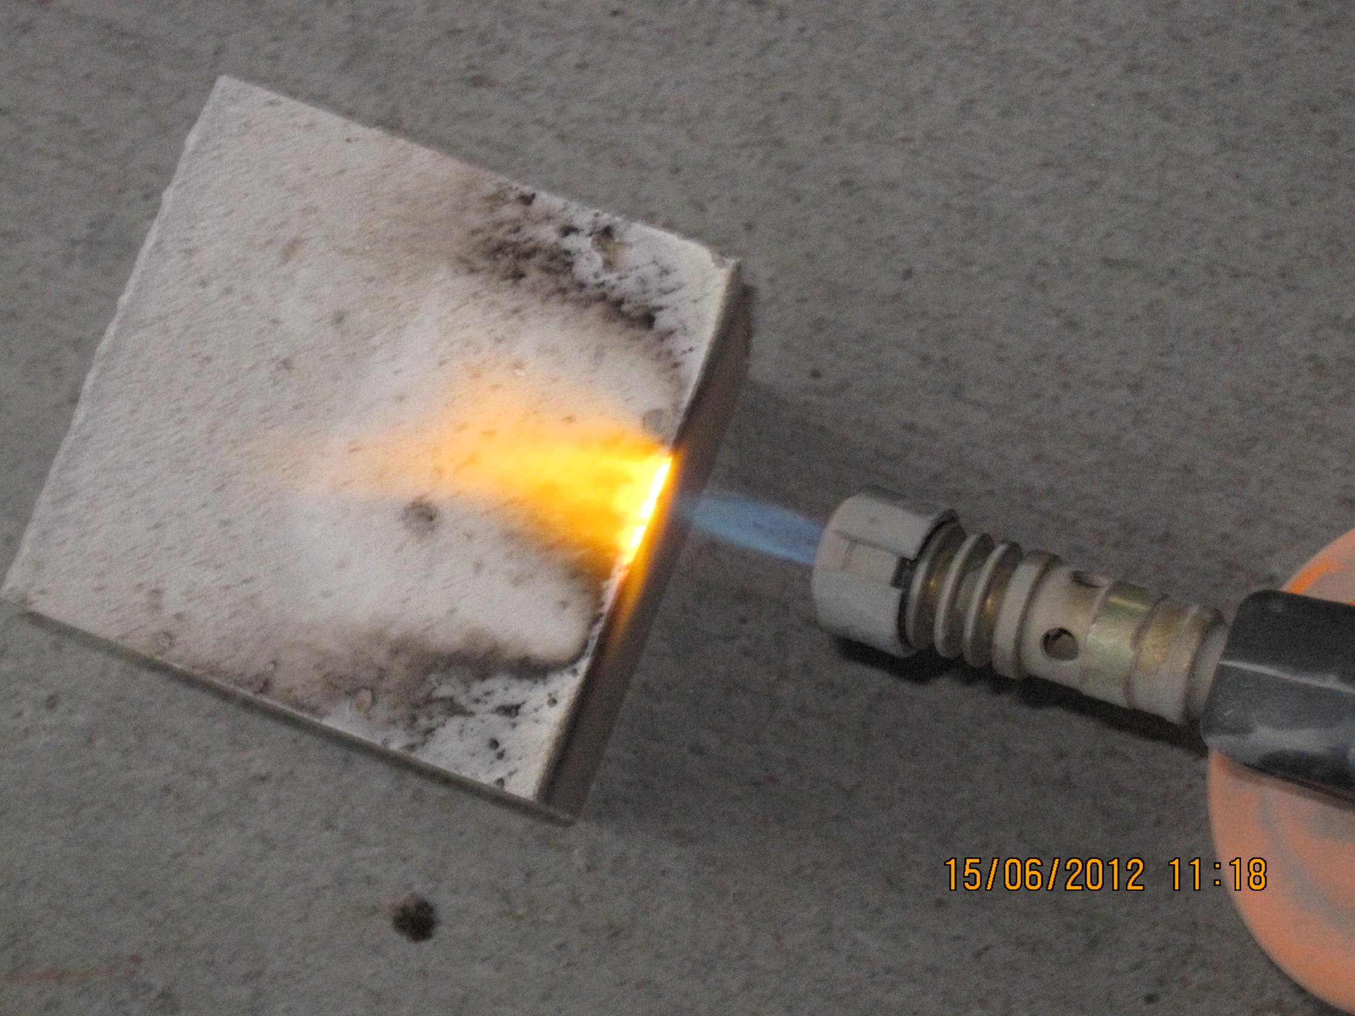
Results: Waste wood transformed chemically into a fire resistant concrete matrix under the influence of Mecalithe

Slide 22
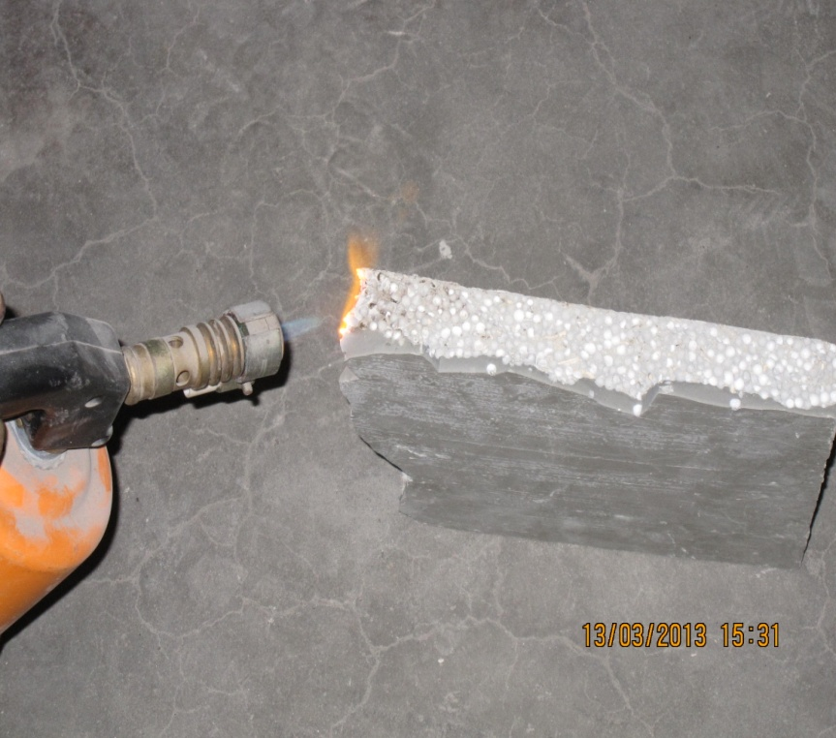
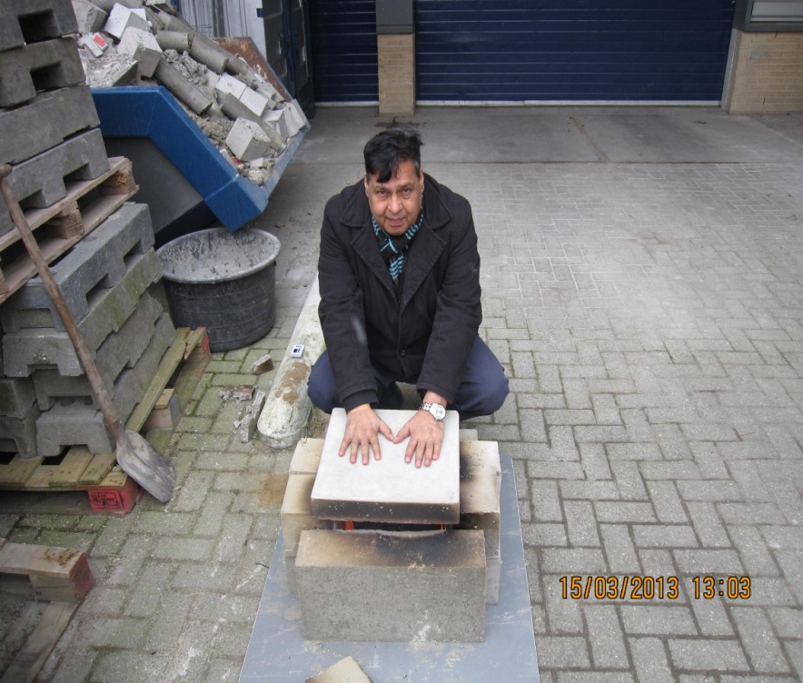
Results – fire resistance and isolation

Slide 23
Conclusions
It is possible to produce light-weight eco-friendly
green concrete with 100% waste wood or EPS
This has fire resistance qualities, aborbs sound and
shows excellent performance to the freeze-thaw test
Applications (examples):
  constructions in earthquake sensitive areas
  non-bearing light weight sound absorbent panels in modern
  buildings, high ways, recording rooms, poles
  decorative concrete with different colours
Has reduced costs and helps reducing CO₂

Slide 24
Questions?
Prof. Dr Youva Tyagi
Peter van Bakel
MGX Research Centre
www.mgxgroup.eu

