Slide 1
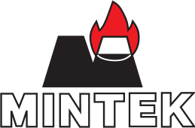
SLAG JEWELLERY
A non-traditional slag valorization process
Date 17 April 2015
Author Dr Joalet D Steenkamp
Designation Chief Engineer Pyrometallurgy Division

Slide 2
Introduction
PhD graduation day:
April 14th, 2015
Title of thesis:
Chemical wear of carbon-based refractory materials in a silicomanganese furnace tap-hole
Closure, emotionally ➔ slag jewellery design based on:
We delight in the beauty of the butterfly, but rarely admit the changes it has gone through to achieve that beauty
Maya Angelou (1928 – 2014)

Slide 3
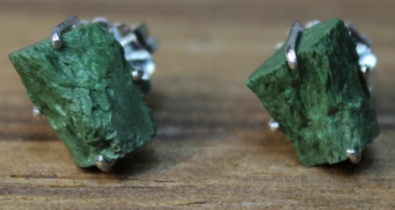
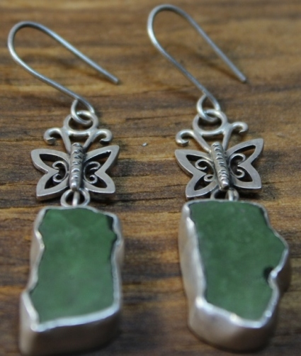
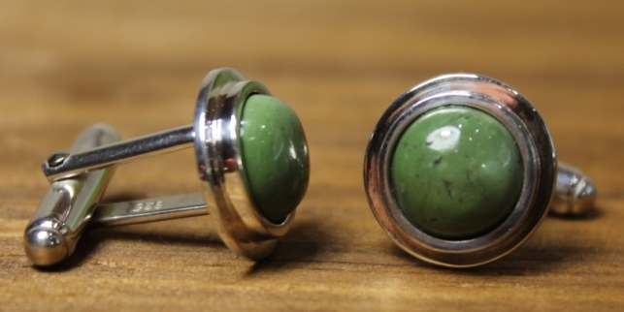
Slag Jewellery
€53
€23
€39 + €42 = €81

Slide 4
Conclusion
Making jewellery from slag adds value, both emotionally and financially, to a waste product.
Learn from diamond industry¹:
End 1930’s: De Beers aggressive marketing campaign in USA equating love to diamonds.
1947: Classic slogan ‘A Diamond is Forever’ launched.
Today: World-wide idea that size of diamond in engagement ring shows how much man love fiancée.
By adding emotional value to their product De Beers added tremendous financial value too.
¹www.americangemsociety.org/the-history-of-the-diamond-as-an-engagement-ring

Slide 5
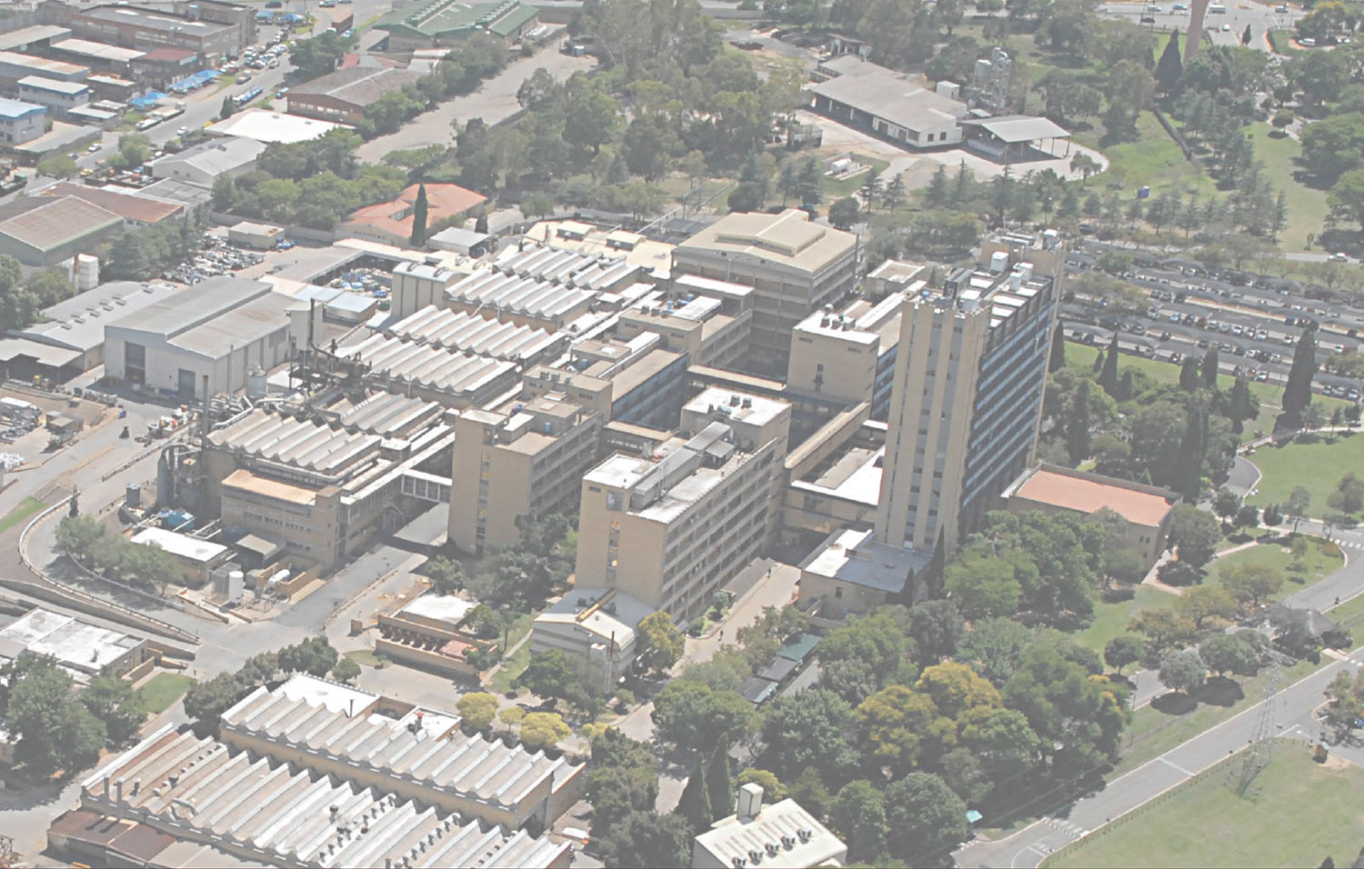
Thank you
JoaletS@mintek.co.za

