Slide 1
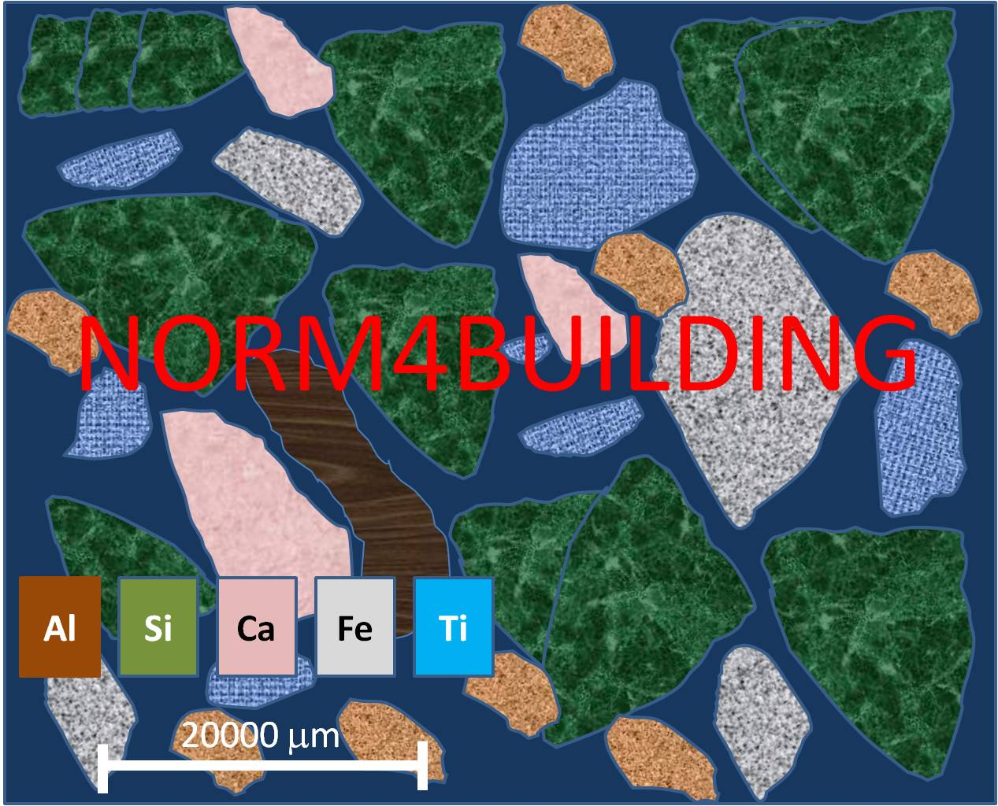

Towards a holistic approach for risk assessment when reusing slag with enhanced NORM content in building materials
.
Leuven 17/04/2015
Wouter SCHROEYERS, Tom CROYMANS-PLAGHKI, Sonja SCHREURS
NuTeC, UHasselt, Belgium
Transport and Urban Development (TUD)

Slide 2
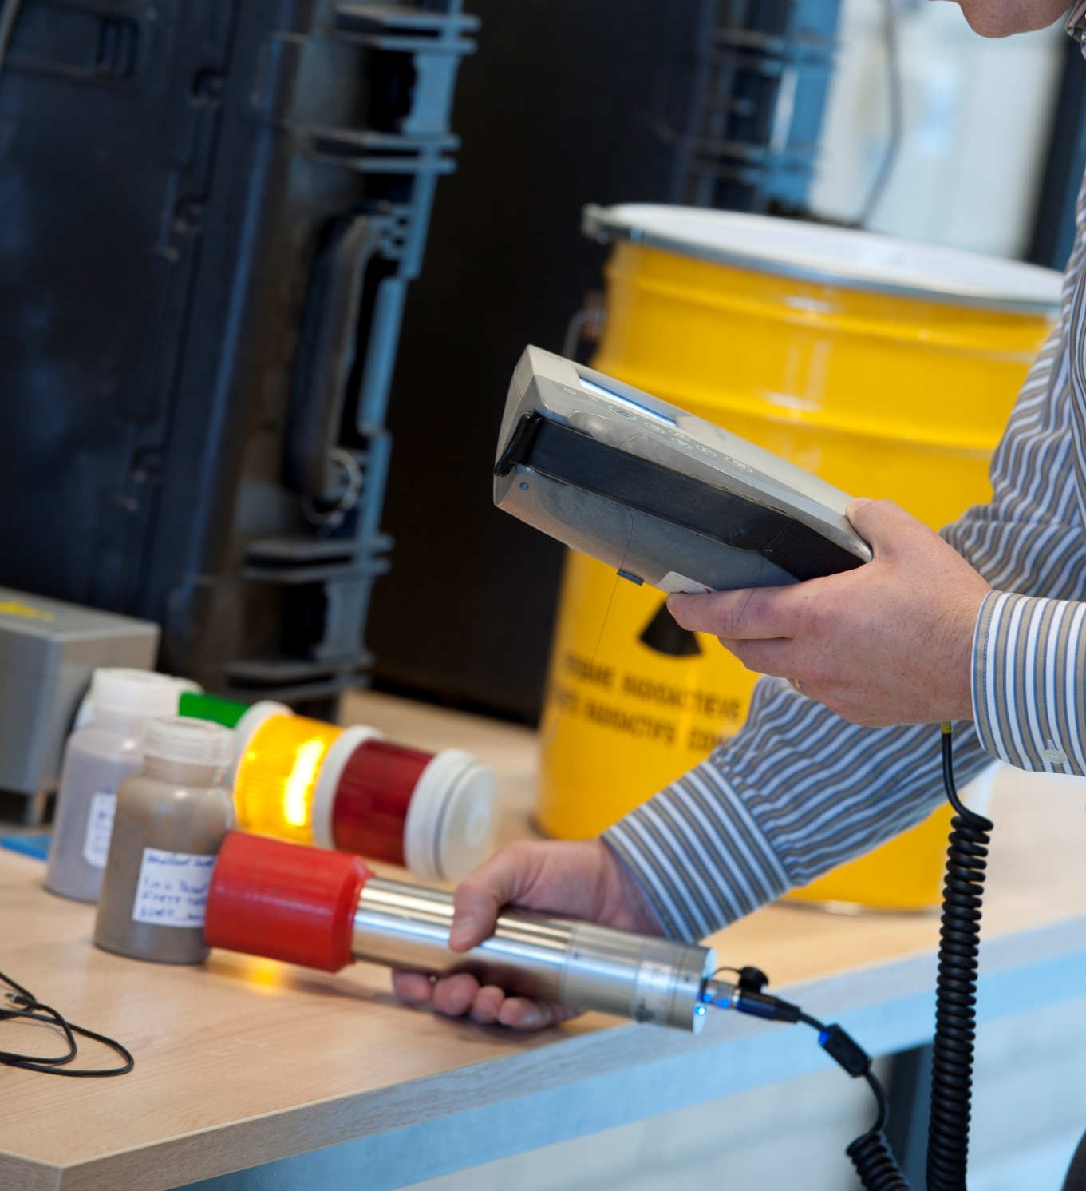
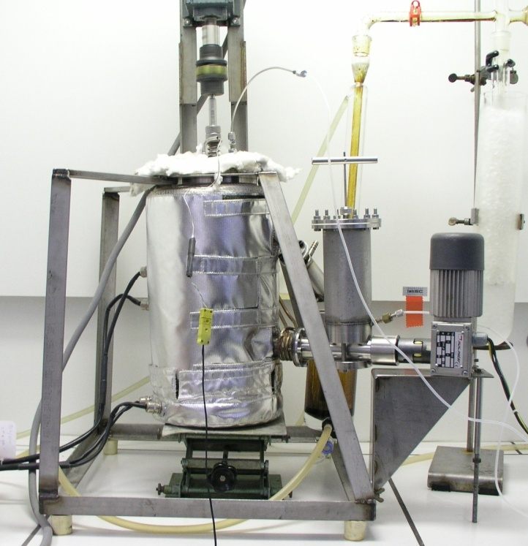
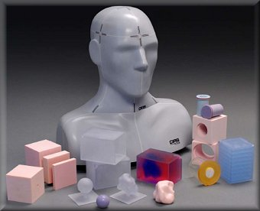
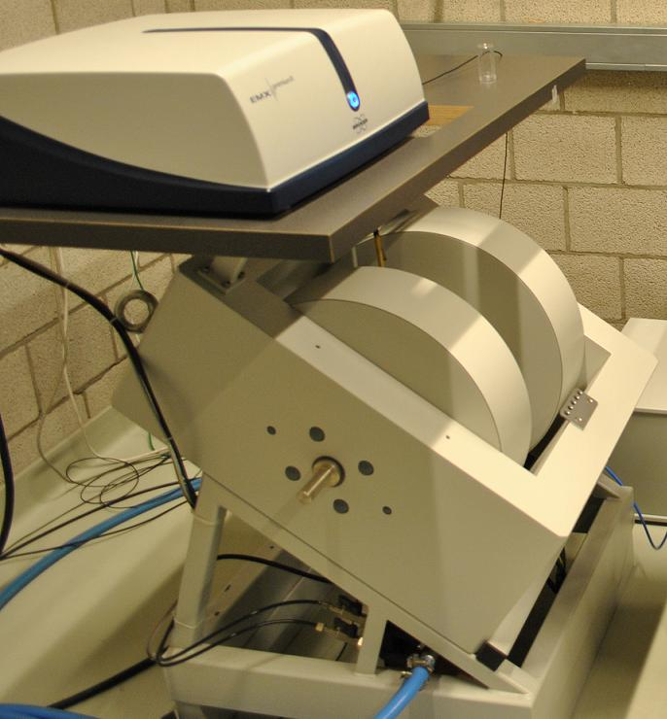
NuTeC
Nuclear Technological Center (NuTeC, www.nutec.be)
Center of Environmental Studies (CMK, www.uhasselt.be/cmk)
Industrial Sciences: “Nuclear and environmental Engineering”
    Environmental Technology-Radiochemistry
    Medical Nuclear Technology
Application and development of nuclear measurement methods
Environmental and energy related research (pyrolysis)
EMR dosimetry

Slide 3
Reusing slag with enhanced NORM content in building materials
Taking into account NORM in the risk assessment?
Scientific approach NORM4Building network
Collaboration opportunities

Slide 4
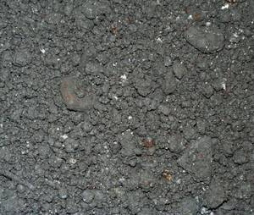
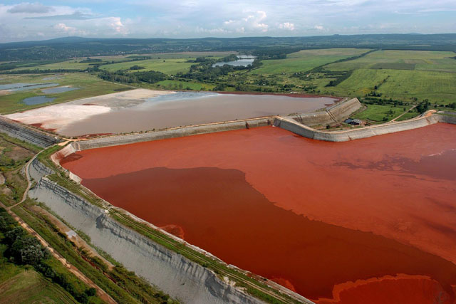
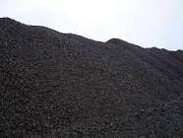
Hazard identification - constituents of interest
Evaluating the reuse of slag in construction materials:
Chemical and physical properties
  Leaching of metals: vanadium, chromium (VI), manganese,…
  Species influencing indoor air quality (volatile organic compounds,…)
  …
During use (residential or non-residential)? After the End-of-Life?
Radiological issues???
Ore: ‘Naturally Occurring Radioactive Materials’ (NORM)
Residues with enhanced concentrations of NORM
Processing
Fly ash
Red mud
Cu slag

Slide 5
Metal processing: how radionuclides (U-238 decay chain) can behave during smelting?
slag
gas
flue dust
metal phase
(similar for decay chain of Th-232)

Slide 6
NORM processing industries (New Euratom-Basic Safety Standards (BSS), December 2013)
extraction of rare earths from monazite;
production of thorium compounds and manufacture of thorium-containing products;
processing of niobium/tantalum ore;
oil and gas production;
geothermal energy production;
TiO₂ pigment production;
thermal phosphorus production;
zircon and zirconium industry;
production of phosphate fertilisers;
cement production, maintenance of clinker ovens;
coal-fired power plants, maintenance of boilers;
phosphoric acid production;
primary iron production;
tin/lead/copper smelting;
ground water filtration facilities;
mining of ores other than uranium ore.
Including relevant secondary processes
Member States can add other relevant activities
Notes:
13

Slide 7
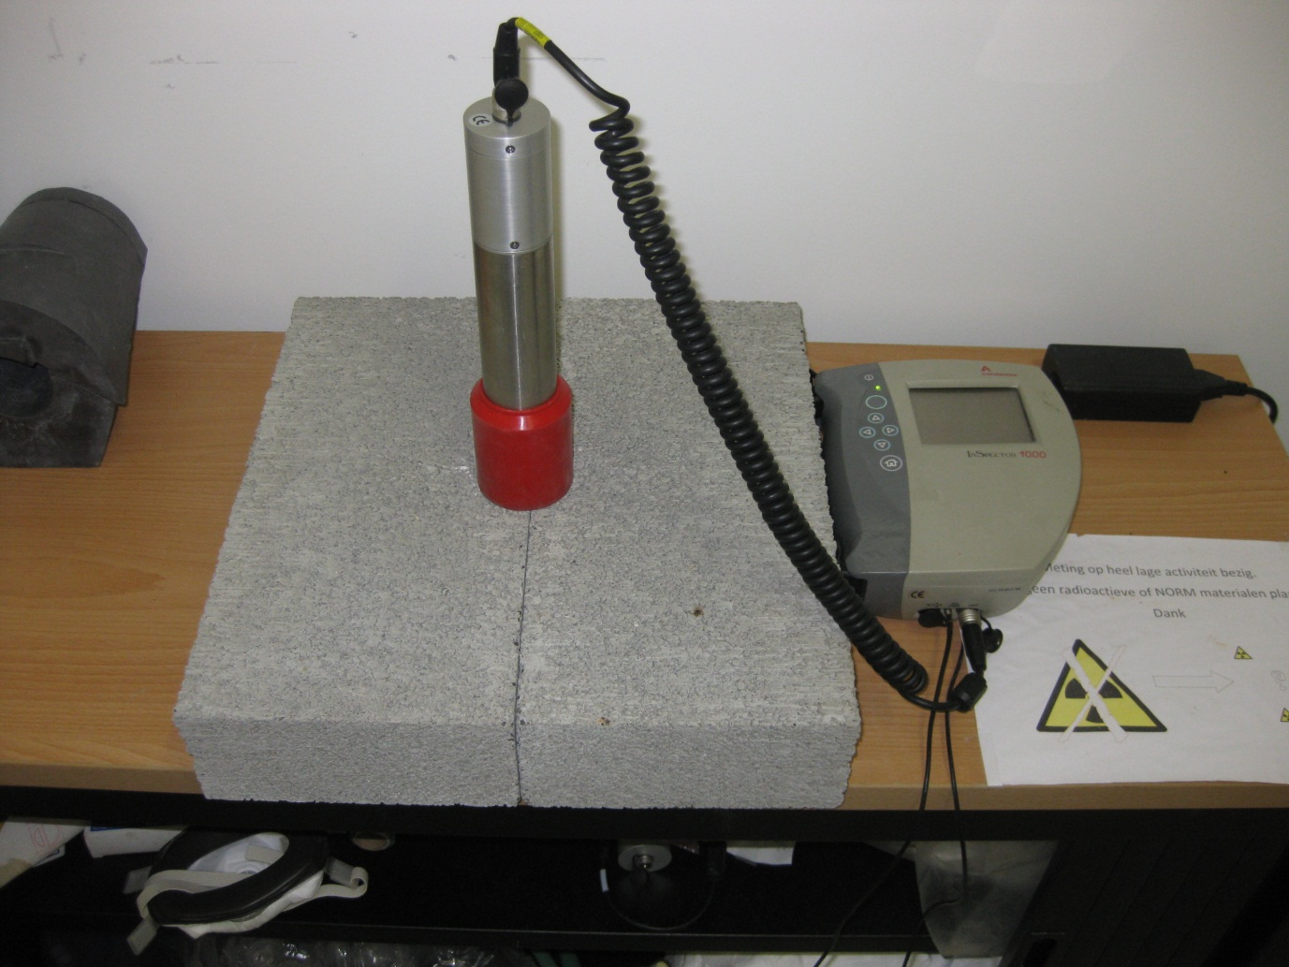
Reuse of NORM in building materials
(New Euratom-BSS in addition to CPR)
C in Bq/kg
Index ≤ 1?
Materials including by-products or residues from NORM processing industries:
  fly ash,
  phosphogypsum,
  phosphorous slag
  tin slag
  copper slag
  red mud
  residues from steel production
No?
(Gamma) Dose estimate < 1 mSv/year
"Declaration of performance"
CE marking + classification
to be made available to the consumers

Slide 8
EU drinking water directive
Heavy metals leaching from construction materials relative to the European drinking water directive 98/83/EC
Leaching behaviour of natural occurring radionuclides relative to the council directive2013/51/EURATOM?

Slide 9
Reusing slag with enhanced NORM content in building materials
Taking into account NORM in the risk assessment?
Scientific approach NORM4Building network
Collaboration opportunities

Slide 10
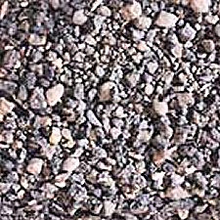
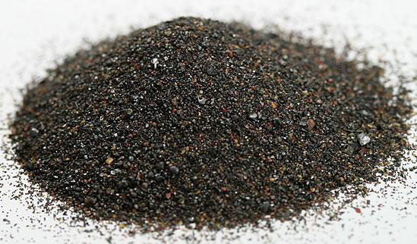
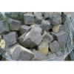
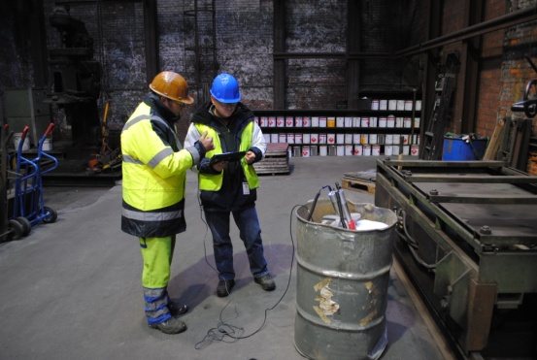
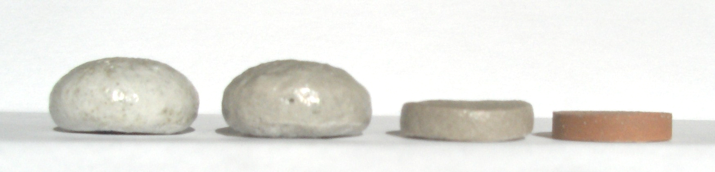
Using NORM for building materials?
Fly ash
Phosphogypsum
Metal slag
Red mud
Ceramics
Concrete
Cement
Suitable chemical and physical properties?
  (Pre)treatment of residues?
Gamma exposure towards occupants?
Indoor air quality?
  Radiological and chemical noxes?
End-of-life considerations?
  Leachability?
A need to check under what conditions materials can be used and where!
Focus on reuse of residues in
Ceramic
Cement Geopolymers
Concrete

Slide 11
Main objective ‘NORM4BUILDING’
Exchange of multidisciplinary knowledge and experiences (radiological, technical, economical, legislative, ecological, …)
  Stimulate the
  reuse of NORM residues in new tailor-made sustainable building materials
  while
  considering exposure to external gamma radiation and the resulting indoor air quality.

Slide 12
Scientific focus working groups
Working Group 1
Studying state of the art in the reuse of NORM residues in building materials
Development of a data base with good practices
Working Group 2
Develop new options for tailor-made building materials to incorporate NORM residues.
Working Group 3
Improve measurement capacity for NORM containing building materials
Standardization of measurement protocols and development of (pre-)standards.
Working Group 4
Improving dosimetric models for a number of building scenarios.
Investigating the influence of different legislative radioprotection scenarios.

Slide 13
Working Group 1
‘Data base with good practices’
Norm4Building Database
Evaluation of practices
Criteria for evaluation of practices were set.
Gathering information on NORMs currently used for building materials
Including representative national surveys
Output
Information per entry
General information:
  By-product name; Industrial sector
  Country
  Total amount of by-product [Mt], Number of surveyed samples
  References
Chemical features
Radiological features
  Activity concentration (terrestrial isotopes: Ra-226; Th-232, K-40)
  Activity concentration index
  Emanation and exhalation features
Collaboration with industry to evaluate the application in building materials (WG 2)
Cost-benefit and SWOT analysis
Updating ‘Activity Concentration Index’ database
Update information for the European Waste Catalogue
Dissemination plan
Impact:
-NORM aspects are taken into account for reuse
-’Good practices database’ as guideline for reuse for industry

Slide 14
Working Group 2
‘Options for new tailor-made building materials’
(Product)
Residue
(Virgin raw materials)
Residue
Building Material
Industry
Working Group 1
Working Group 2
Study new develop options
Radiological content linked to…
Analytical model with relation between % of virgin raw materials substituted and radiological content
Recommendations on use secondary raw materials in geopolymers considering the radiological content.
Pretreatment of the raw materials
Development and application of the building material
Effect of inherent and engineered properties

Slide 15
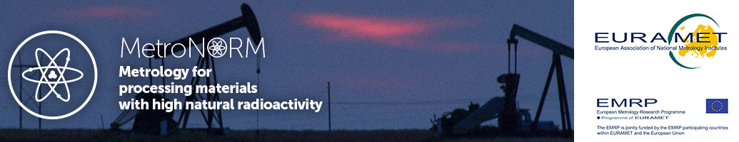
Working Group 3
‘Improve measurement capacity and standardisation’
Validated (in-situ) measurement protocols for
Towards standardisation
Activity Concentration Index
Radon (possibly thoron) emanation and exhalation rate
Intercomparisons using several measurements protocols and instruments
Towards certification
Proposal for a calibration procedure
Steps in the development of standard materials
Factsheet for unified certification procedure of construction materials.

Slide 16
Working Group 4
‘Improving dosimetrical models’
Improved (more realistic) dosimetrical models
Evaluation of implementation on market.
For use of NORMs in
Cement
Concrete
Ceramics
Specific focus on use of NORMs in geopolymers.
Evaluation of legislation
Round table discussions with all stakeholders
End-of-Life?
  Leachability
Impact EU-BSS
Comparison of alternative national legislative scenarios

Slide 17
Towards a more realistic assessment of the radiological impact when using NORM in building materials?
Technical properties of building materials (Density, thickness,…) ➔ more realistic modeling
  Gamma dose estimation
  Radon dose estimation
  Leachability modelling of radiological and chemical impact

Slide 18
Reusing slag with enhanced NORM content in building materials
Taking into account NORM in the risk assessment?
Scientific approach NORM4Building network
Collaboration opportunities

Slide 19
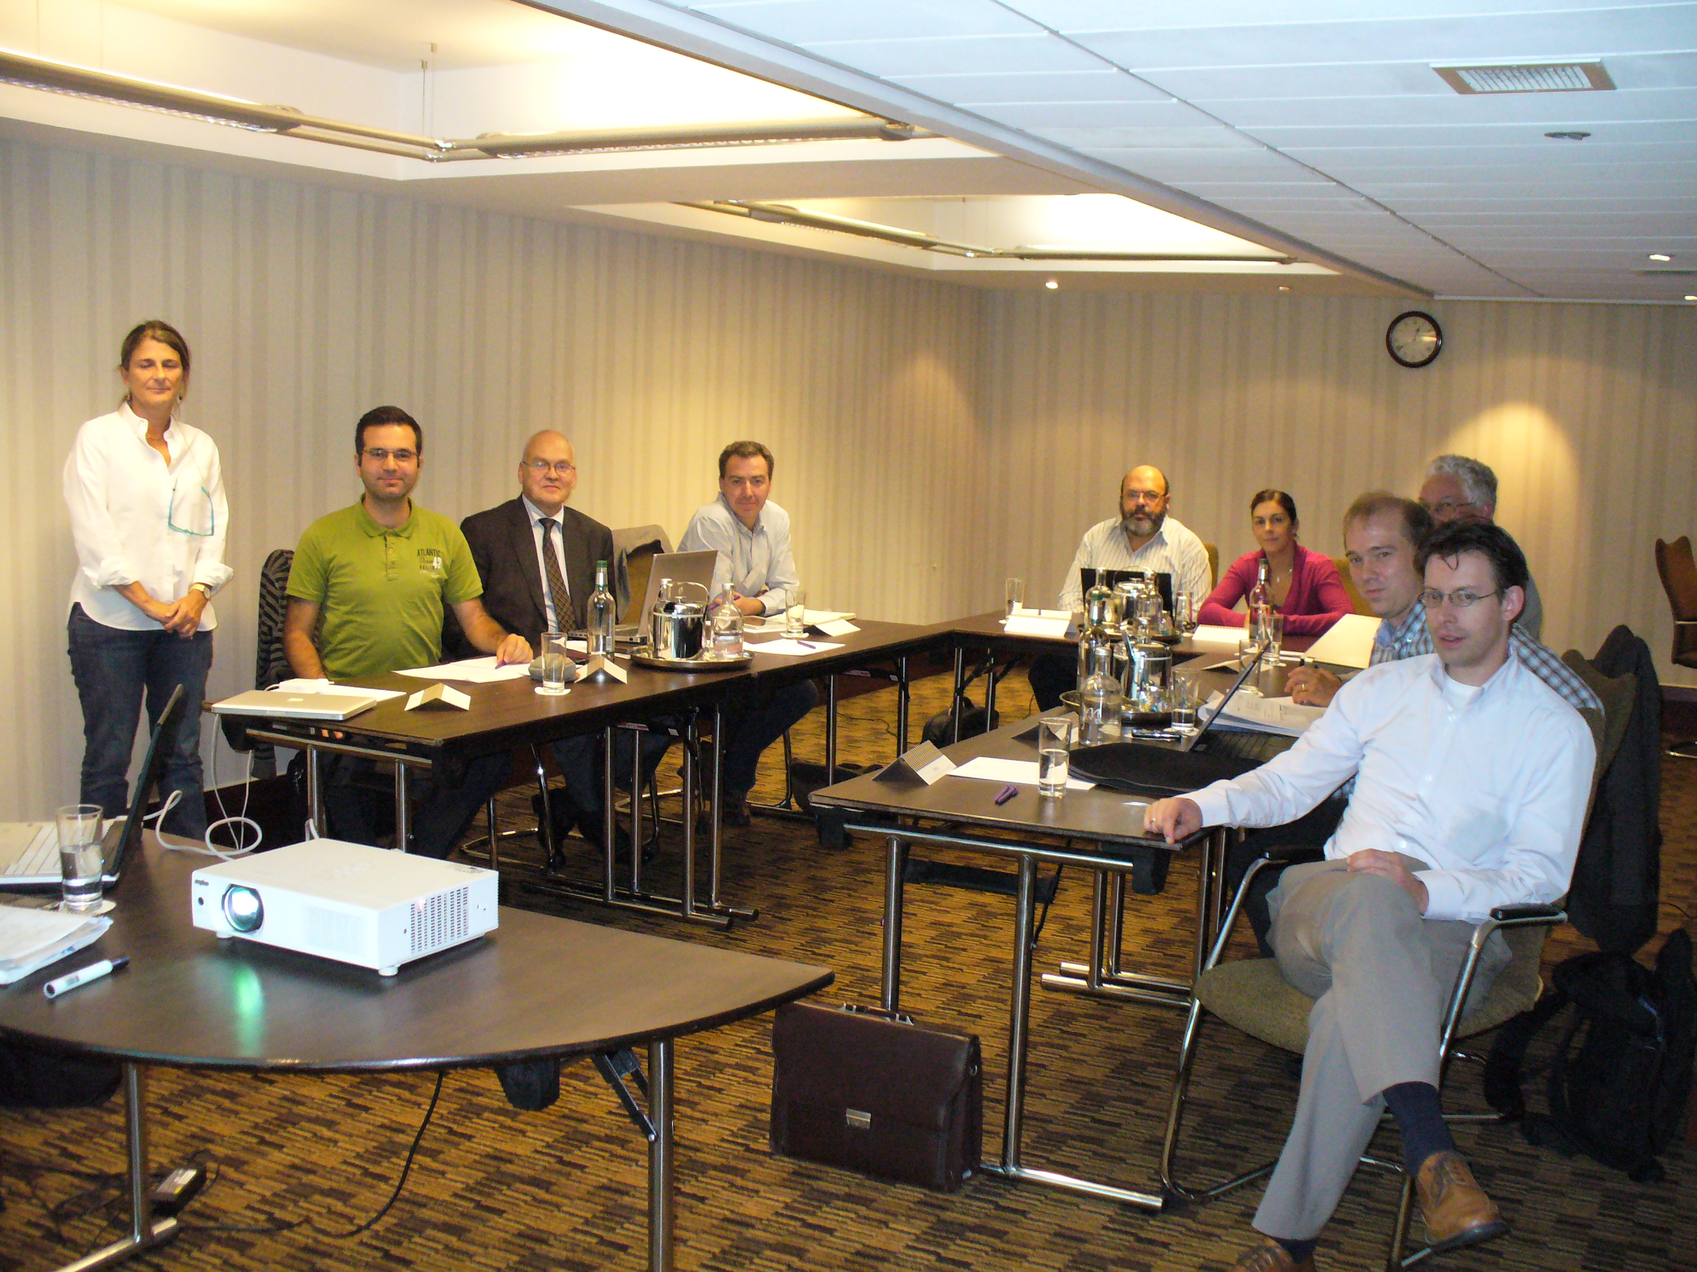
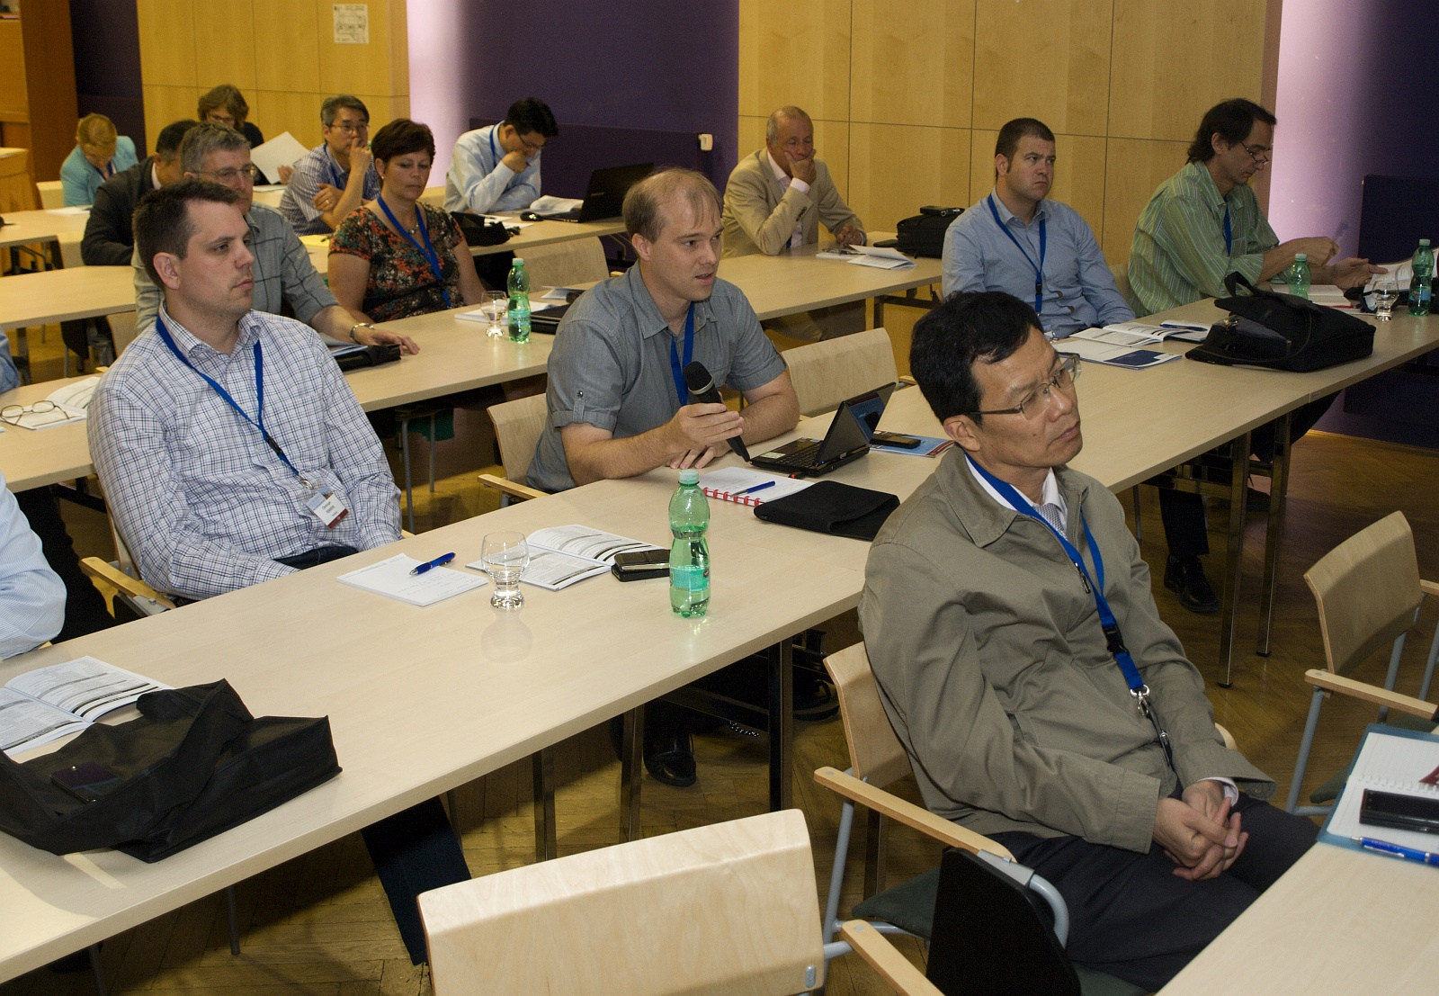
COST - network
(Research and Technological development Framework Program)
ORGANIZATION OF MEETINGS:
  12-13/02/2014 Israel, Dead Sea Hotel
    Linked to INS conference
  16-17/06/2014 Czech Republic, Prague
    Linked to EU-NORM 2 symposium
  17-18/09/2014 UK, Sheffield
    Linked to 34th Annual Cement and Concrete Science Conference
  11-12/06/2015 Austria, Vienna (upcoming)
    Linked to the ICRM symposium
  8-9/10/2015 Belgium Leuven (upcoming)
    Round table with industry and legislators
SHORT-TERM SCIENTIFIC MISSIONS
TRAINING SCHOOLS
PUBLICATIONS and DISSEMINATION
www.norm4building.org

Slide 20
Collaboration with industry
  Participation in round table discussion
  Workshops specifically for training of participants from industry
  Industrial partners get access to database of good practices
  Development of research and innovation projects to find reuse options of NORM residues of industrial partners

Slide 21











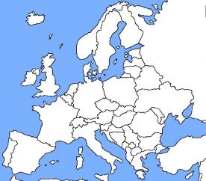































Current status: 98 Experts from 25 countries
Interested?
www.norm4building.org
Contact:
COST@uhasselt.be
Upcoming event:
  8-9/10/2015 Workshop - round table (after bauxite valorization symposium in Leuven)

