Slide 1
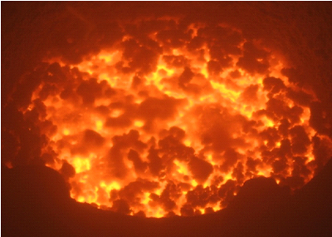
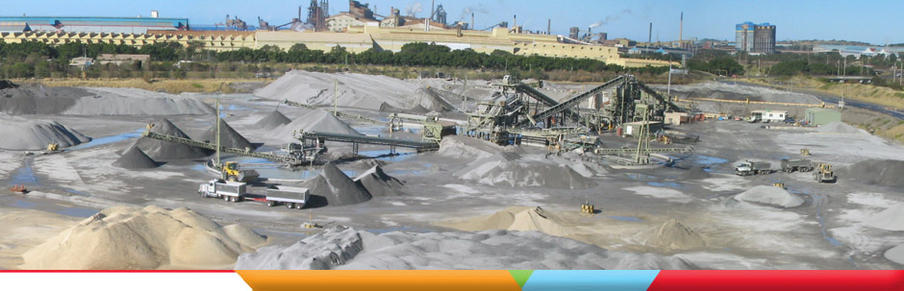
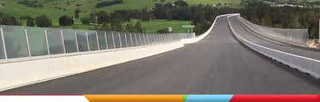


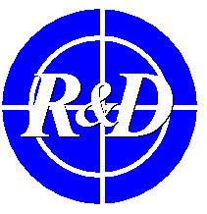
DANIELI
THE RELIABLE & INNOVATIVE
PARTNER IN THE METALS INDUSTRY
EAF SLAG TREATMENT
FOR INERT MATERIALS
PRODUCTION
SLAG VALORIZATION SYMPOSIUM
April 15-17, 2015
Leuven, Belgium
Alessandra Primavera
Executive Manager
Danieli R&D dept.
Research Center
According to law DANIELI & C. S.p.A. considers this document to be a company secret and therefore prohibits any person to reproduce it or
make it known in whole or in part to the other parties or to competitors without specific written authorization of DANIELI & C. management.

Slide 2

Index
Is the EAF slag a by-product or a waste?
Slag composition
Danieli’s technology for slags inertization
Laboratory tests
Industrial pilot tests
Industrial application
Conclusions
2

Slide 3
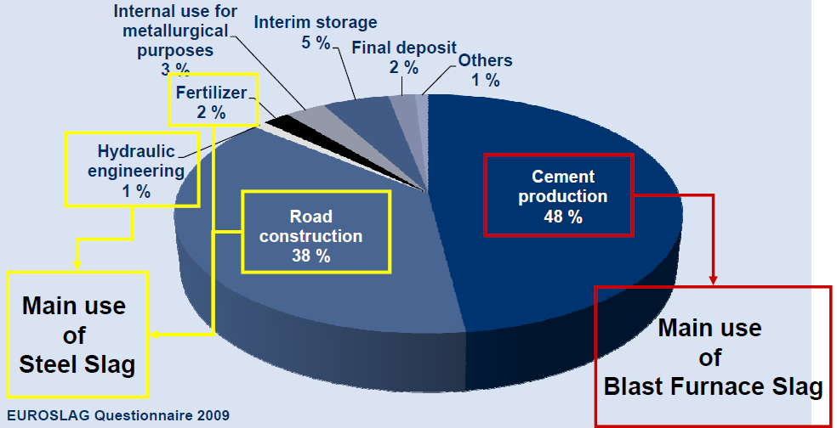
Is the EAF slag a product or a waste?
The European steel and slag industry considers slag as a by-product that can be
used for construction products (e.g. roads), in case of fulfillment of the
European harmonized Standards:
1. Mechanical resistance and stability
2. Safety in case of fire
3. Hygiene, health and the environment
4. Safety in use
5. Protection against noise
6. Energy economy and heat retention
1-3-4 are the most
important ER for
road building materials
3

Slide 4
Slag composition
Other oxides could occasionally be present (like Ba and V oxides) in function of the scrap and additives composition
Sometimes Ba, Cr and V can be responsible of the elution issues arisen during the slag analysis
4

Slide 5
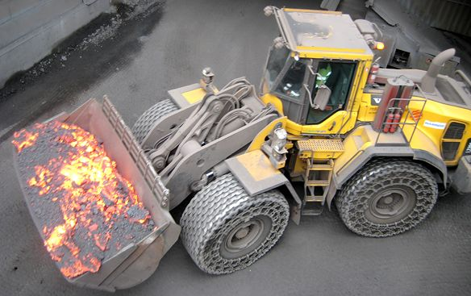
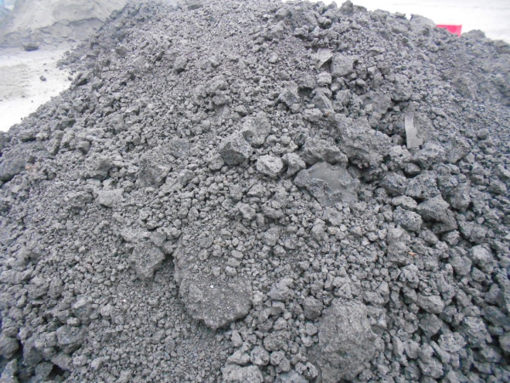
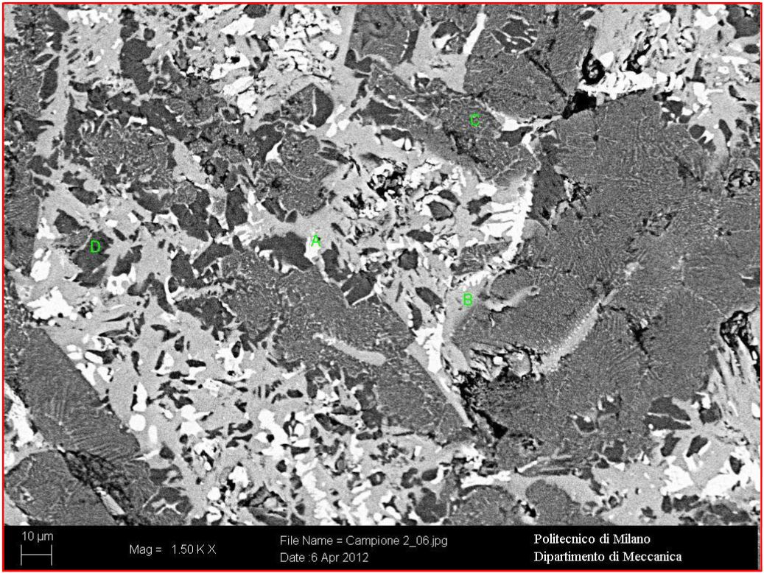
Slag composition
Mg-Wustite
(Mg, Fe)O
Hatrurite
3CaO · SiO₂
Larnite
2CaO · SiO₂
Brownmillerite
2CaO · Al₂O₃ · 2FeO
5

Slide 6
Slag composition
Mg-Wustite
(Mg, Fe)O
6.5% V₂O₅
4.0% BaO
0.5% Cr₂O₃
Hatrurite
3CaO · SiO₂
6.5% V₂O₅
4.0% BaO
0.5% Cr₂O₃
 | Unit | Limit concentrations
Asbestos | μg/l | 30000
As | μg/l | 50
Ba | μg/l | 1000
Be | μg/l | 10
Cd | μg/l | 5
Co | μg/l | 250
Total Cr | μg/l | 50
Hg | μg/l | 1
Ni | μg/l | 10
Pb | μg/l | 50
Cu | μg/l | 50
Se | μg/l | 10
V | μg/l | 250
Zn | μg/l | 3000
COD | mg/l | 30
PH |  | 5.5÷12.0
Brownmillerite
2CaO · Al₂O₃ · 2FeO
100% TiO₂
99.5% Cr₂O₃
47.5% BaO
32% V₂O₅
Larnite
2CaO · SiO₂
100% Sb₂O₃
45% V₂O₅
27.5% BaO
Calcium-silicates, as Larnite and
Hatrurite, are soluble in water.
This phenomenon is, sometimes, responsible
for the Cr, V and Ba eluitions over the limits.
Reference: DM 186/06 ALL. 3
6

Slide 7

Danieli’s technology for slags inertization
For final use, slag must be inert: no elution of Ba, Cr or V over limits
Danieli has developed a patent-pending process of inertization
It consists in the alteration of the chemical composition of EAF slag at high temperature adding a mix of oxides (high content in SiO₂)
The process produces inert slag with ideal chemical, physical and mechanical properties which fulfill legal and technical requirements
7

Slide 8
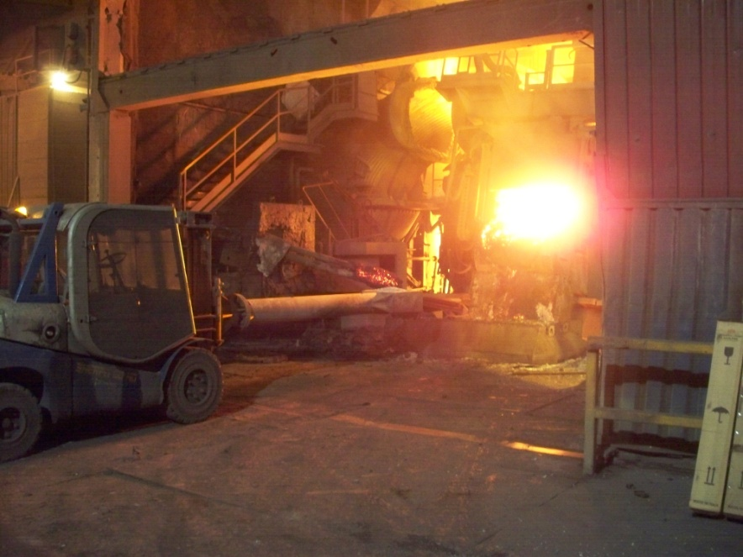
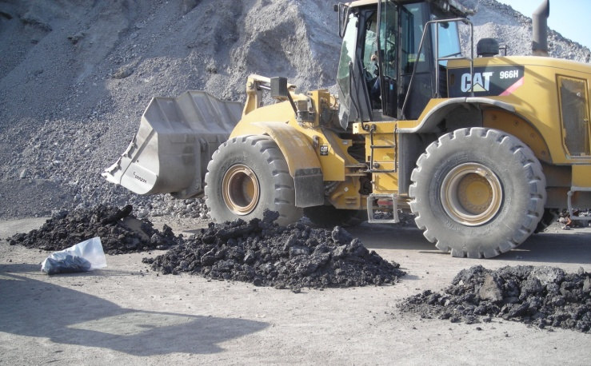
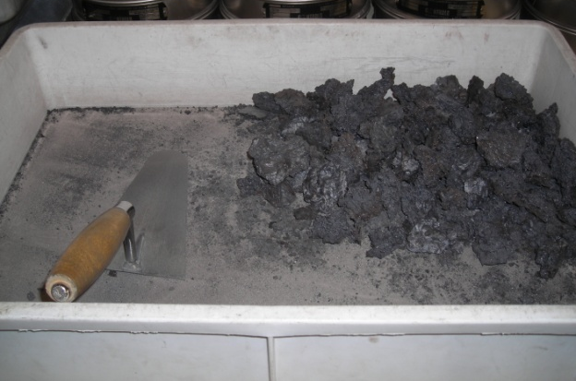
Danieli’s technology for slags inertization
Technology development:
  Laboratory test in collaboration with
  Politecnico di Milano
  Pilot test in the steelmaking plant
Goals:
Decrease of slag liquidus temperature and migration of Cr³⁺ cation into stable phases.
Inertization of Ba²⁺ cation through vetrification of phases.
Decrease of basicity of slag (pH <) and free lime content.
8

Slide 9
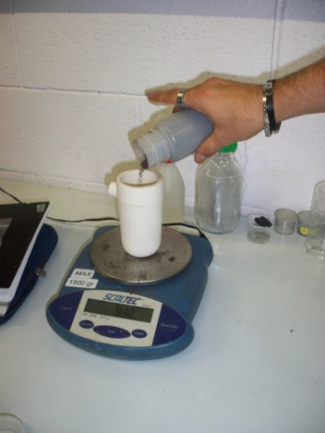
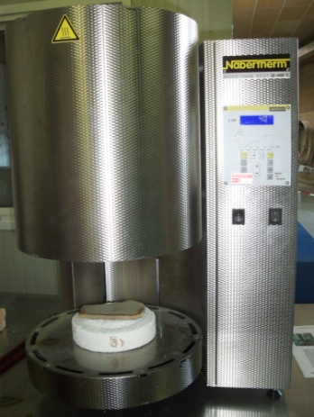
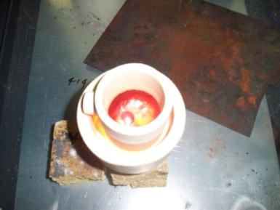
Laboratory tests
In collaboration with the Politecnico di Milano
EAF slag from an industrial plant
Test results show the feasibility of the process: the treatment with the mix of oxides (containing mainly SiO₂) allows the decrease of hazardous elements leaching (Ba, Cr and V below the limits), obtaining an inert by-product
9

Slide 10
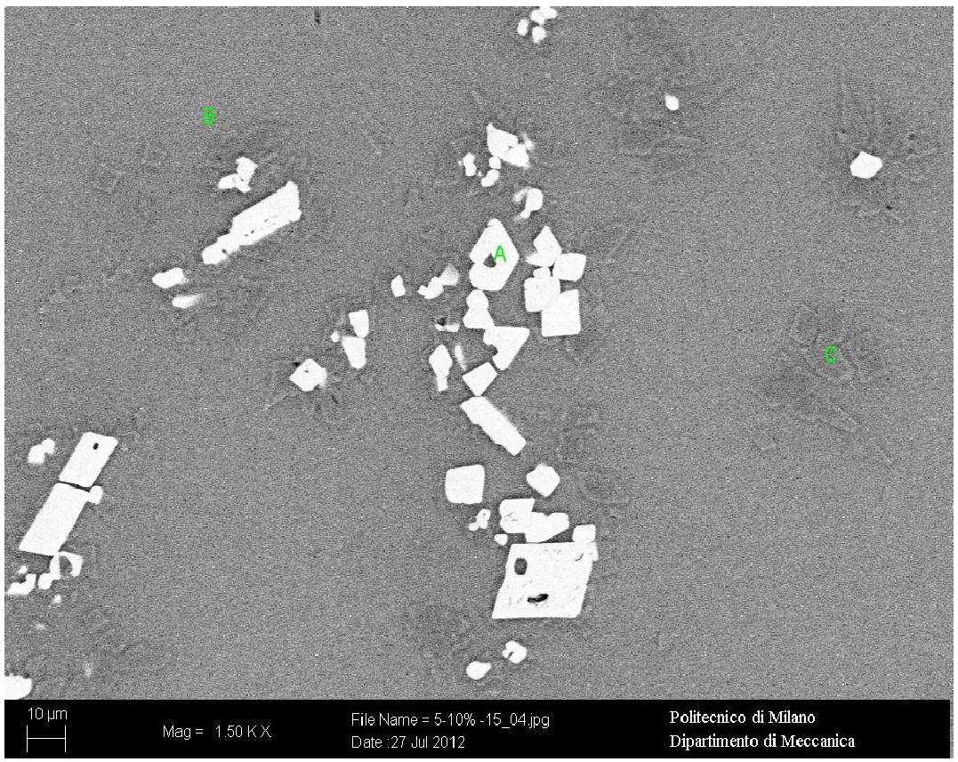
Laboratory tests
Treated slag in laboratory tests
Mg-Cr-Spinel
MgCr₂O₄
99.1% Cr₂O₃
50.5% BaO
34.35% V₂O₅
Glass phase
CaO · SiO₂
50.35% V₂O₅
36.5% TiO₂
32.0% BaO
0.3% Cr₂O₃
Glass phase
CaO · SiO₂
63.5% TiO2
17.5% BaO
15.3% V₂O₅
0.6% Cr₂O₃
Larnite, Hatrurite converted into glass phases (both amorphus and crystalline phases like pseudowollastonite and wollastonite)
Mg-Wustite + Cr forms Mg-Cr-Spinel stable phase.
Reduction of Free CaO (< 0.1g/100g)
10

Slide 11
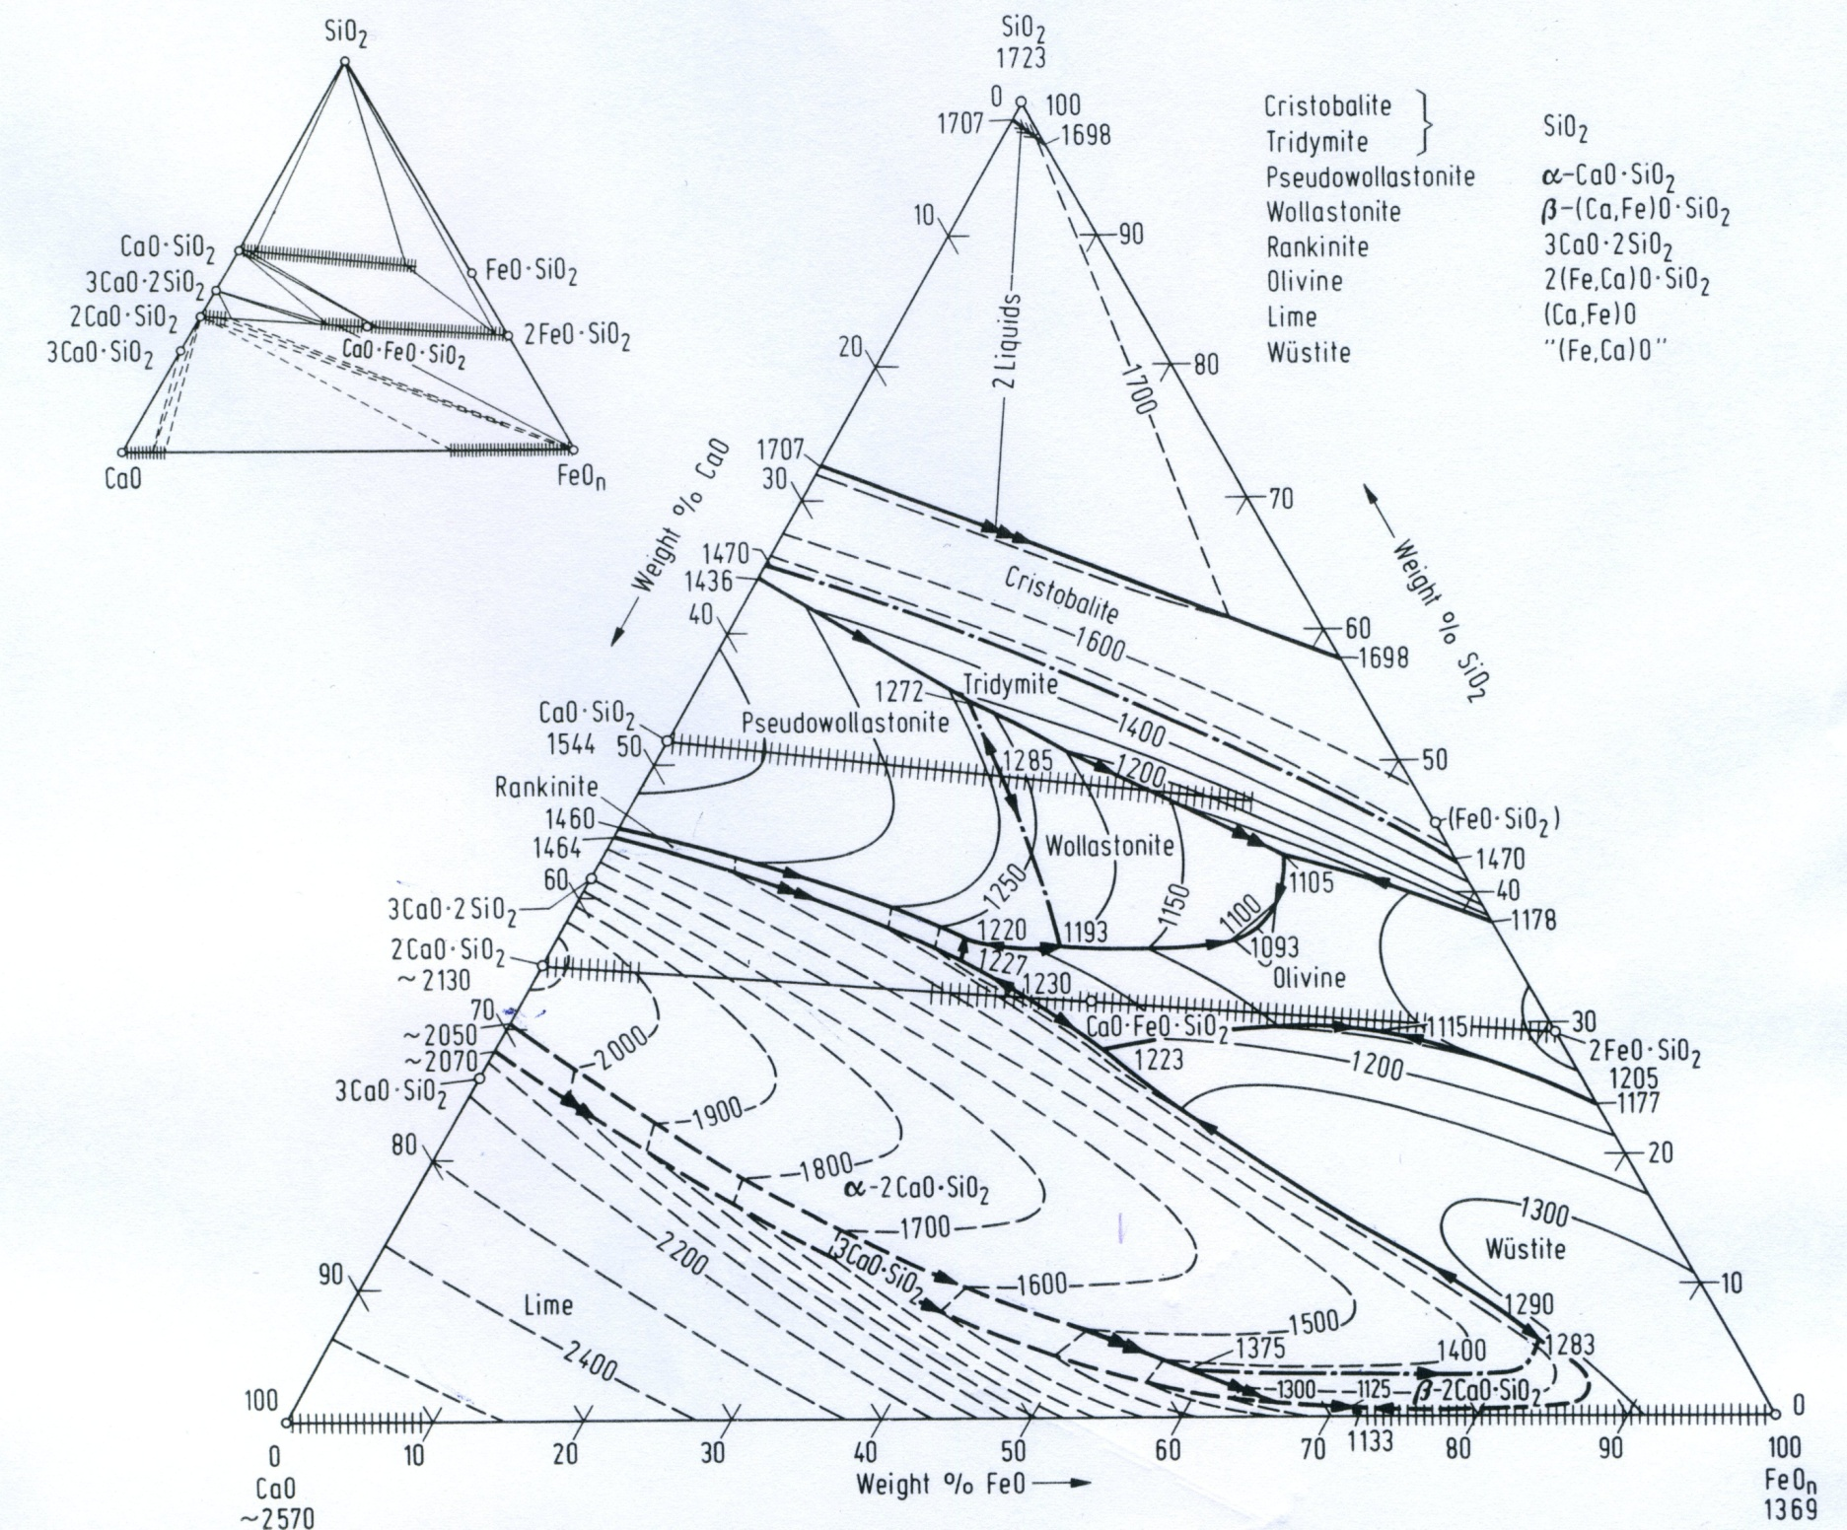
Laboratory tests
Before the slag treatment the leaching analysis
of Cr was over the limit (61.8 μg/l)
 | Limit [μg/l] | Treated slag #1 | Treated slag #2 | Detection limit (DL) [μg/l]
Ba | 1000 | 90 | 82 | 1
Cr | 50 | 26 | 19 | 0.1
V | 250 | 3.4 | <DL | 0.2
pH | 5.5 < > 12 | 9.6 | 9.1
PSEUDO-
WOLLASTONITE
WOLLASTONITE
The Chrome inertization has been verified.
Similar behaviour has been also tested
for the Barium.
So far no problem with Vanadium
elution has been found but the conditions applied are
efficient for V too .
LARNITE
HATRURITE
11

Slide 12
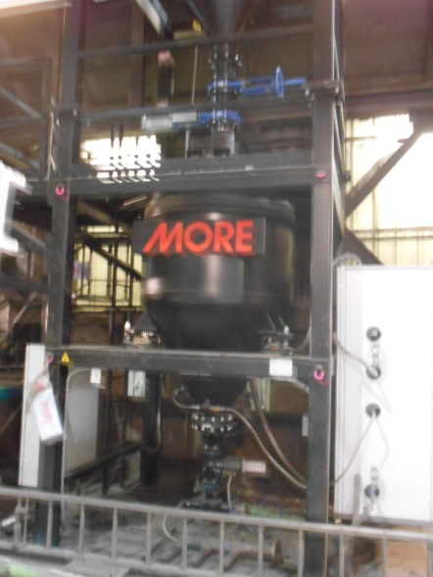
Industrial pilot tests
Mixed oxides injection system during the slag tapping phase, using a pneumatic transport.
Injection of oxides of grain size > 1 mm.
High pressure dispenser for the oxides storage before the pneumatic transport
and injection into the liquid slag
Parameters | Value
Air flow rate [Nm³/h] | 150 ÷300
Dispenser internal pressure [bar] | 2 ÷4
Air pressure [bar] | 0 ÷ 3.5
Additive flow [kg/min] | 0 ÷ 140
Injection temperature > 1600°C
12

Slide 13
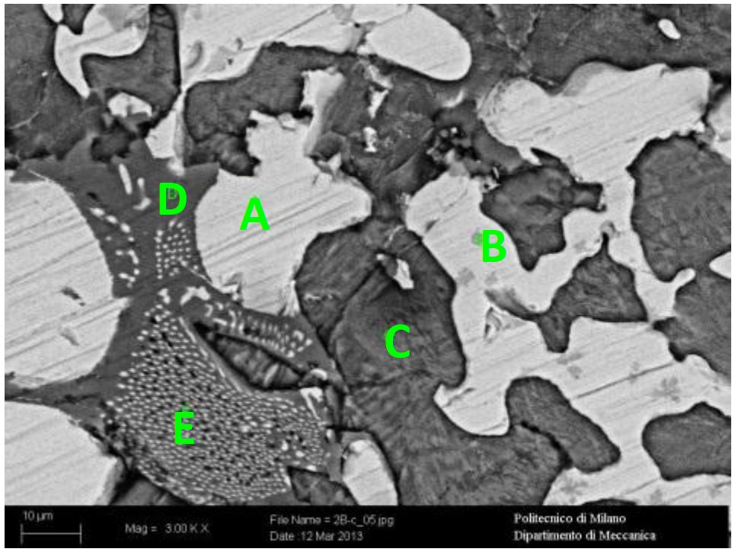
Industrial pilot tests
Treated slag in industrial pilot tests
Mg-Wustite
(Mg, Fe)O
8.0% BaO
8.0% Cr₂O₃
3.0% V₂O₅
Mg-Cr-Spinel
MgCr₂O₄
100% TiO₂
92.0% V₂O₅
89.0% Cr₂O₃
15.0% BaO
1.0% Sb₂O₃
Gehlenite
2CaO · SiO₂ · Al₂O₃
72.0% Sb₂O₃
51.0% BaO
5.0% V₂O₅
3.0% Cr₂O₃
Larnite
2CaO · SiO₂
27.0% Sb₂O₃
26.0% BaO
13

Slide 14
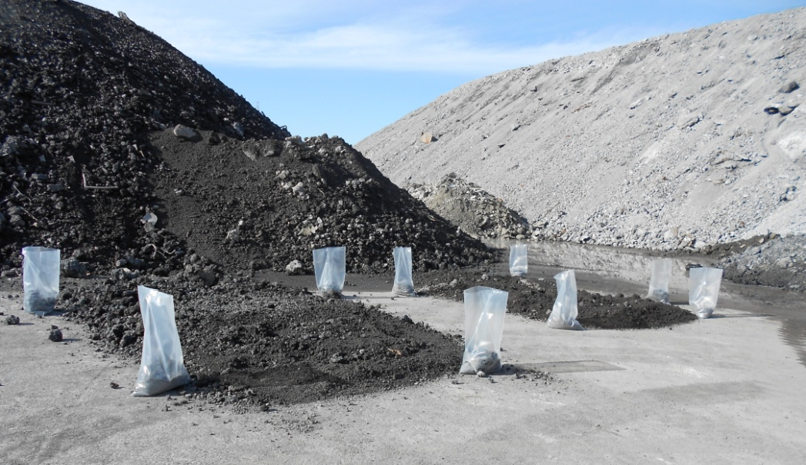
Industrial pilot tests
 | Limit [μg/l] | Treated slag
Ba | 1000 | 300
Cr | 50 | 34
V | 250 | 53
pH | 5.5 < > 12 | 11.7
Formation of stable phases (Mg-Cr-Spinel and Gehlenite surrounded by a glass phase) that avoid elution of hazard elements
Free CaO: 0.4g/100g
14

Slide 15
Industrial pilot tests
Mechanical characterization of the treated slag
Los Angeles Test
Grain Size: 31.5/50 mm
Good mechanical properties of the slag
Test | Los Angeles number
Treated Slag # 1 | 25
Treated Slag # 2 | 27
Matured Slag | 25
Fresh Slag | 28
Reference: UNI EN 1097-2
15

Slide 16
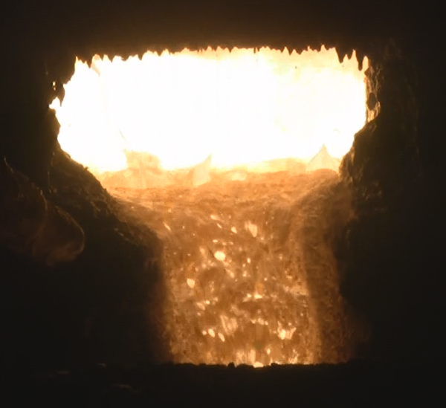
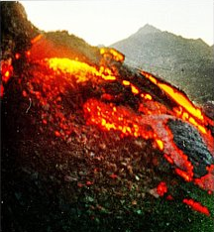
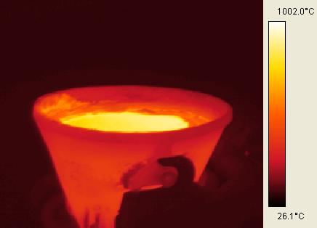
Scenario for the industrial applications
Slag
Mix of oxides
Operating floor
Slag pot
16

Slide 17

Conclusions
With Danieli’s technology for slag inertization it is possible to obtain:
  Use of a safe, not expensive and easy to manage technology of EAF slag treatment.
  Production of an inert product for a wide range of slag compositions and applications.
  Production of a valuable by-product
17

Slide 18
Thank you for your attention!
18

