Slide 1
Processing of Fe-rich slag-based inorganic polymers towards higher heat resistance Silviana ONISEI¹, Annelies MALFLIET¹, Delia GUTIÉRREZ-CAMPOS², Bart BLANPAIN¹, Yiannis PONTIKES¹ 1 KU Leuven, Department of Materials Engineering, 3001 Heverlee, Belgium 2 Universidad Simón Bolívar, Departamento de Ciencia de los Materiales, Caracas 1080, Venezuela

Slide 2
PURPOSE OF THE WORK
When concrete is subjected to temperatures higher than 300°C, severe spalling occurs, causing serious damage to concrete structures
As inorganic polymer is effectively a glass, unlike OPC which is a hydrate, resistance to heat and specifically to fire is greatly improved
An iron rich slag-based inorganic polymer material is studied for its potential to be used in heat resistant applications
Notes:
To go beyond comparison with OPC; inorg polymers are new materials

Slide 3
Notes:
composition

Slide 4
Notes:
(Refractory)

Slide 5
Notes:
New phases forming when temp exceeds 500 C
decomposition

Slide 6
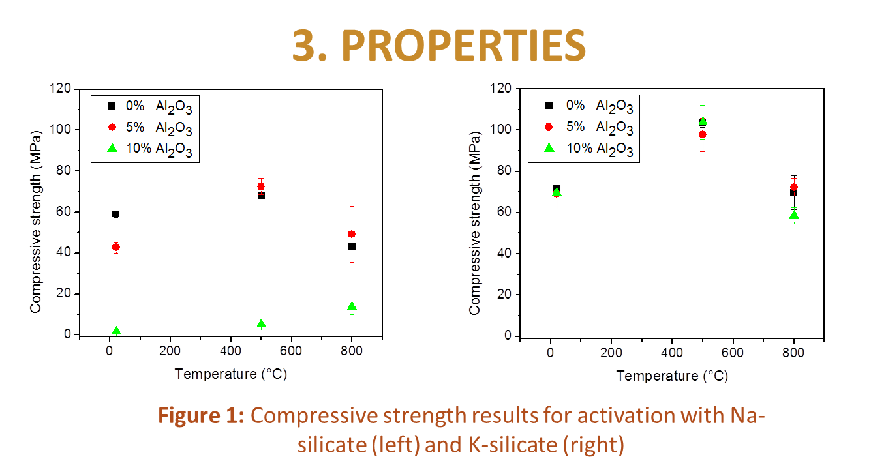

Slide 7
Notes:
Effectively a glass-ceramic

Slide 8
CONCLUSION
At room temperature compressive strength was approximatively 60 MPa when activation was with Na-silicate and approximatively 70 MPa when activation was with K-silicate
The addition of Al₂O₃ in the Na-silicate compositions lead to a decrease in compressive strength, however, in the case of K-silicate formulations and the same curing/firing temperature, the impact was rather small
The highest compressive strength obtained exceeded 100 MPa and was obtained for activation with K-silicate and firing at 500 °C

