Slide 1
Valorisation of stainless steel slag by selective Cr recovery and carbonation of the matrix material
E.Kim^{1,2}, J.Spooren¹, K.Broos¹, L.Horckmans¹, P.Nielsen¹, M.Quaghebeur¹
¹Flemish Institute for Technological Research, VITO
²Department of Bioengineering, University of Antwerpen

Slide 2
Goals
selectively recover Cr from a low grade (secondary) ore by hydrometallurgical method
safely reuse the matrix material after removal of Cr

Slide 3
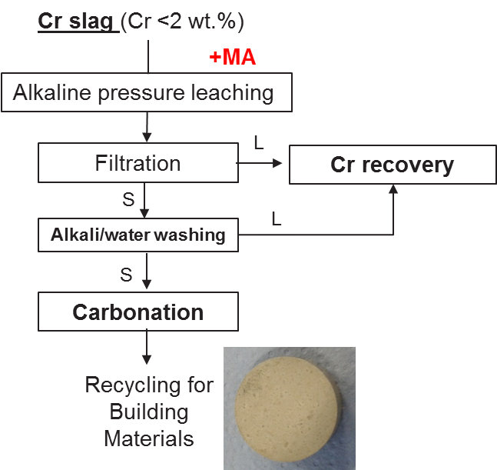
Proposed process flow
1
2
3
25mm(D)x11mm(H)
Compress strength: 38MPa

Slide 4
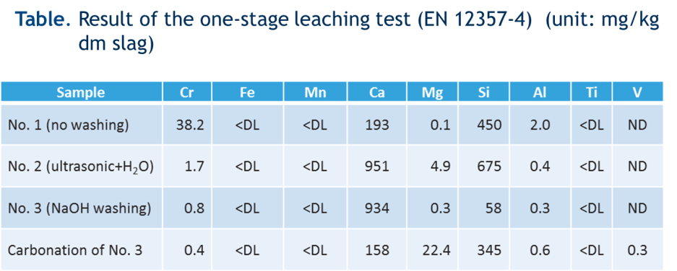
Carbonation of the residue

Slide 5
Conclusions
The leaching efficiency of Cr under alkaline oxidizing conditions increased with temperature and MA time.
Optimal reaction condition: 240 °C, 6hr, MA 30min, 1M NaOH, 8.4 bar pO₂.
After Cr leaching by APL and MA the matrix material can be used after a subsequent washing step for the production of building materials through a carbonation step.

