Slide 1


Electric arc furnace slag engineering during production, treatment, solidification and processing
D. Mudersbach², S. Schüler¹,
D. Algermissen², H.P. Markus³,
¹⁾ Max Aicher Umwelt GmbH
²⁾ FEhS-Institut für Baustoff-Forschung e.V.
³⁾ Lech-Stahlwerke GmbH

Slide 2
Usage of EAF Slag of 2013
Source: Statistische Erhebungen von 07/2014
des Fachverband Eisenhüttenschlacken e.V.

Slide 3
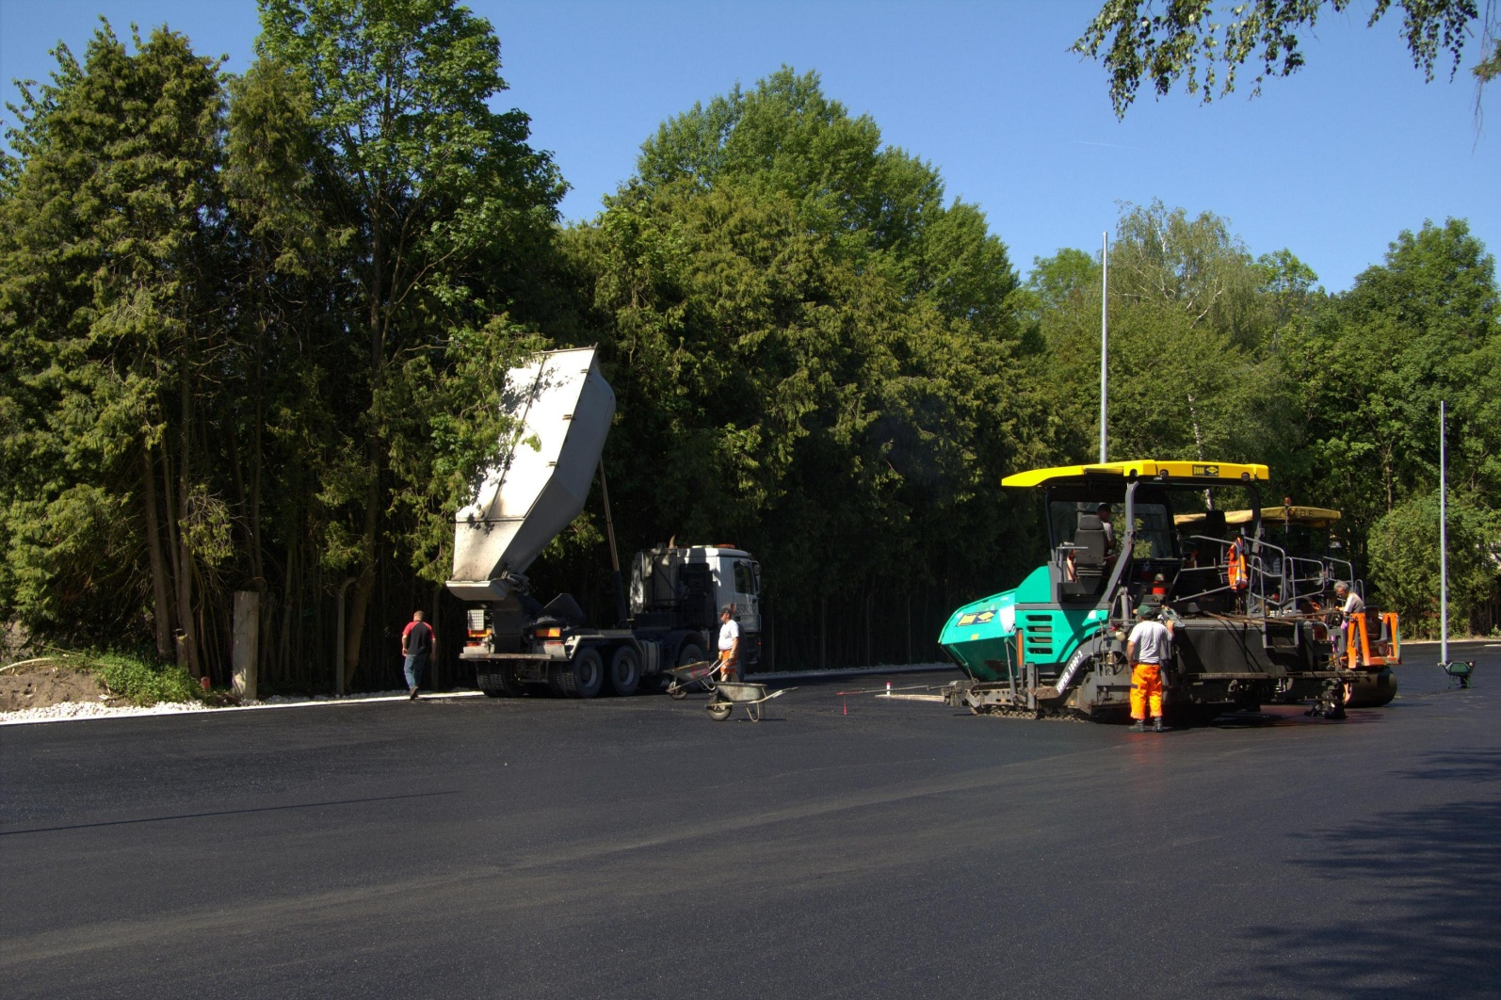
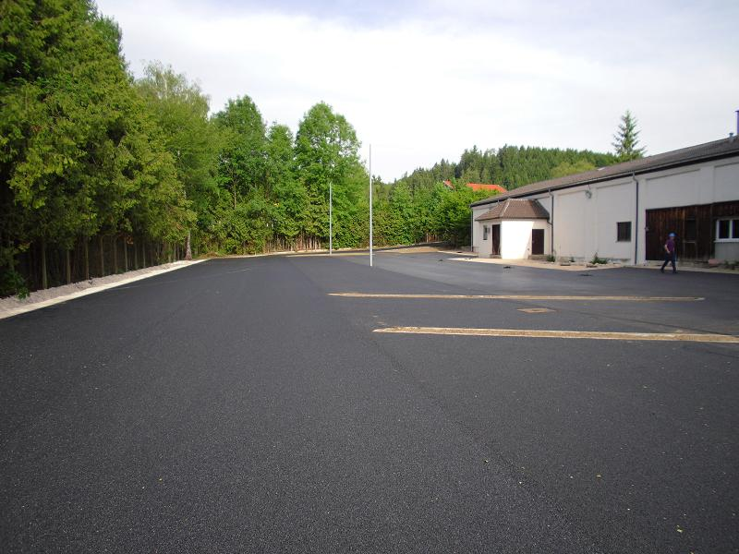
Joint project:
Leiser
Straßenverkehr 3

Slide 4
current german regulations: TL-Gestein-StB / LAGA TR 20
class | el. conducitvity | pH-value | chromium | molybdenum | vanadium | fluoride
 | [µS/cm] |  | [mg/l] | [mg/l] | [mg/l] | [mg/l]
SWS-1 / Z 1.1 | 1.500 | 10,0 - 12,5 | 0,030 | - | 0,050 | 0,75
SWS-2 / Z 1.2 | 1.500 | 10,0 - 12,5 | 0,075 | - | 0,100 | 2,0
SWS-3 / Z 2 | 1.500 | 10,0 - 12,5 | 0,100 | - | 0,250 | 2,0
Leaching test: shaking 10:1
prospective german regulations: Ersatzbaustoffverordnung
class | el. conducitvity | pH-value | chromium | molybdenum | vanadium | fluoride
 | [µS/cm] |  | [mg/l] | [mg/l] | [mg/l] | [mg/l]
SWS-1 | 10.000 | 12,0 | 0,110 | 0,055 | 0,180 | 1,1
SWS-2 | 10.000 | 13,0 | 0,190 | 0,200 | 0,220 | 2,0
SWS-3 | 10.000 | 13,0 | 0,250 | 1,000 | 1,000 | 4,0
Leaching test: shaking 2:1 / column 2:1
Higher leaching of regulated parameters
No experience with influencing parameters of molybdenum

Slide 5
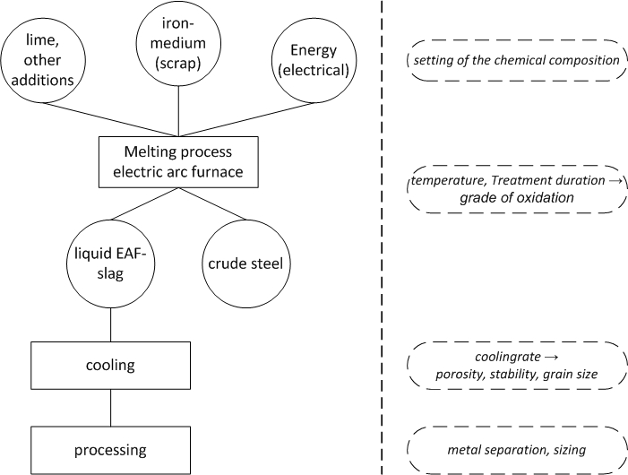
Influence of EAF Slag before/while/after metallurgical process

Slide 6
SOLIDIFICATION

Slide 7
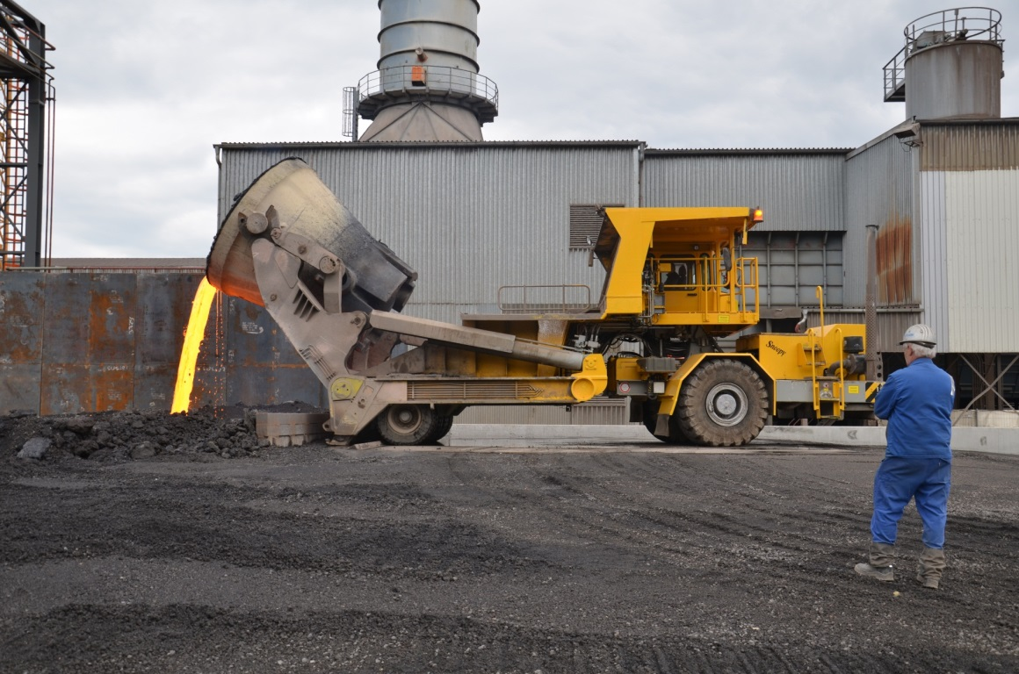
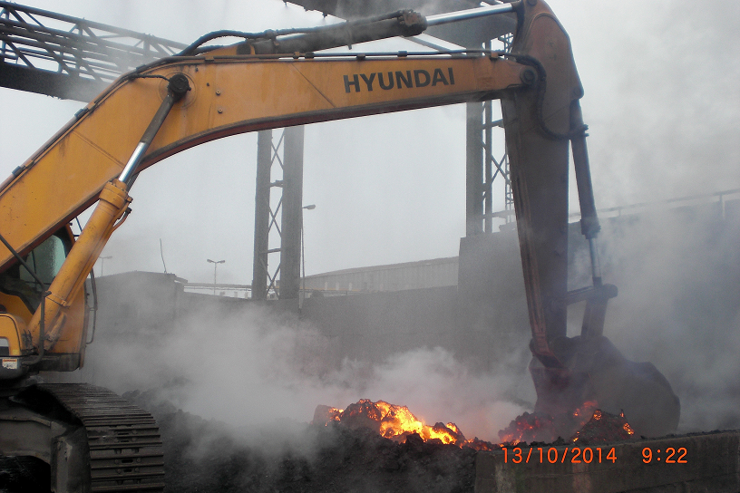
Slagyard
Lech-Stahlwerke

Slide 8
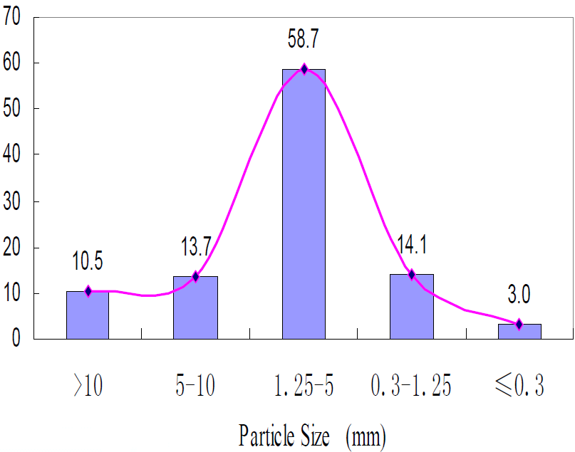
BSSF - treatment
→ low demand of small grain sizes
→ low gain

Slide 9
OPERATIONAL TESTS

Slide 10
 | Crudesteel EAF sample
Steel grade | C | Si | Mn | P | S | Cr | Mo | Ni | Cu | Sn | Al | V | B | Ti | Nb | N₂ | Pb | Zn | W
38MNV S5 (+50kg FeV) | 9 | 1 | 13 | 2 | 15 | 11 | 2 | 4 | 5 | 4 | 271 | 0 | 1 | 1 | 1 | 64 | 0 | 399 | 0
38MNV S5 (+50kg FeV) | 26 | 1 | 23 | 8 | 28 | 19 | 3 | 9 | 10 | 11 | 343 | 0 | 1 | 1 | 1 | 70 | 1 | 149 | 0
38MNV S5 (+50kg FeV) | 11 | 0 | 19 | 5 | 20 | 20 | 3 | 9 | 15 | 8 | 274 | 0 | 1 | 1 | 1 | 68 | 0 | 60 | 0
20MNCR S5 (+800kg FeCr) | 10 | 1 | 15 | 5 | 20 | 17 | 4 | 10 | 12 | 8 | 241 | 0 | 1 | 1 | 1 | 70 | 6 | 142 | 0
20MNCR S5 (+1t FeCr) | 10 | 1 | 17 | 6 | 30 | 25 | 4 | 12 | 12 | 8 | 323 | 0 | 1 | 1 | 1 | 79 | 0 | 82 | 0
27MNCR5 (+1,5t FeCr) | 9 | 0 | 16 | 3 | 22 | 31 | 4 | 11 | 15 | 9 | 243 | 0 | 1 | 1 | 1 | 71 | 0 | 144 | 0
27MNCR5 (+1,5t FeCr) | 9 | 0 | 15 | 3 | 26 | 26 | 4 | 10 | 17 | 10 | 278 | 0 | 1 | 1 | 1 | 71 | 1 | 153 | 0
25MOCR4 (+350kg FeMo) | 9 | 0 | 19 | 4 | 22 | 22 | 23 | 11 | 13 | 9 | 350 | 0 | 1 | 1 | 1 | 65 | 0 | 84 | 1
25MOCR4 (+350kg FeMo) | 10 | 1 | 16 | 2 | 16 | 11 | 22 | 8 | 10 | 7 | 338 | 0 | 1 | 1 | 1 | 59 | 1 | 224 | 0
25MOCR4 (+350kg FeMo) | 9 | 1 | 17 | 3 | 16 | 10 | 25 | 8 | 9 | 6 | 235 | 0 | 1 | 1 | 1 | 66 | 1 | 273 | 0
Source: Operational tests LSW/MAH: H.P. Markus, S. Schüler

Slide 11
VANADIUM
LEACHING

Slide 12
Vanadium leaching
> 90% operational tests
S4-test

Slide 14
CHROMUIM LEACHING

Slide 15
Chromium Leaching

Slide 16
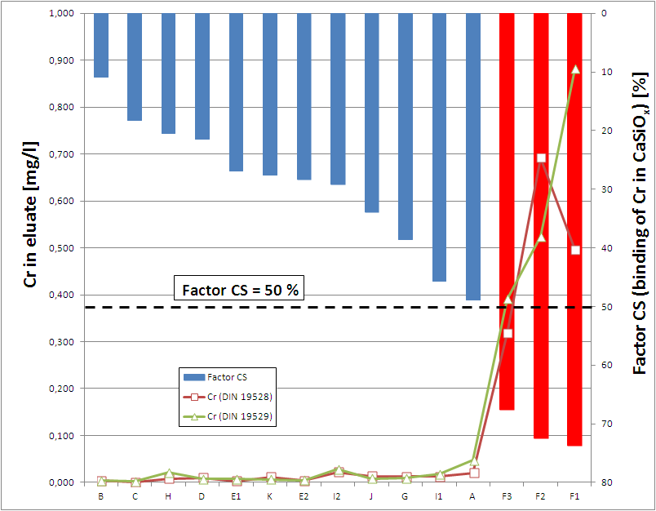
Chromium Leaching
EAF Slags from 11 different Electricsteel plants
high Factor CS
high Cr in
calciumsilicates
high Cr-leaching
Leaching tests:
column 2:1 (DIN 19528)
shaking 2:1 (DIN 19529)
16
Notes:
16

Slide 17
Mutual reactions by conditioning
 |  | Original state | adding alumina | adding alumina + lime | defined dose of alumina + lime
Adding | Alumina
 | Lime
Leaching | Chromium
 | Vanadium
 | el. Conductivity
Source: Operational tests BST: Th. Taube

Slide 18
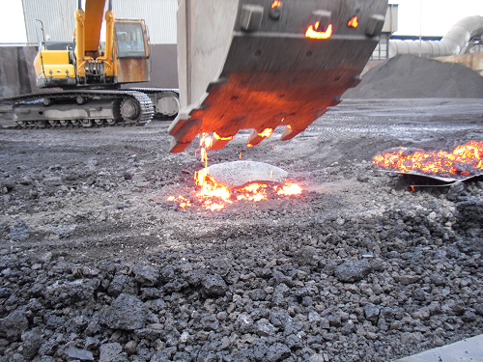
Chromium leaching
„shell“
Liquid slag
Chromium leaching by S4-test
Conditioning | „Shell“ | „Liquid“
Reference sample | Ref | -59,2%
+ 500 kg Alumina |  | -42,1%
Source: Operational tests LSW/MAH: H.P. Markus, S. Schüler

Slide 19
ALTERNATIVE PRODUCTION

Slide 20
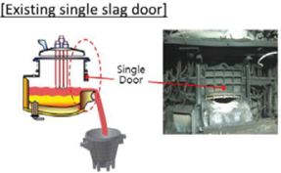
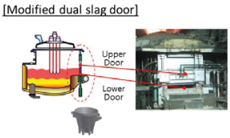
Slag flows eary in the process to the slagpot
Slag is „holding back“ a longer time
No „fully unreduced“ slag flows to the slagpot
Source:
I. Sohn, J.I. Hwang, H.S. Kim, J.S. Choi, Y.S. Jeong, H.C. Lee:
Development of ECO Slag Processing Technology for Iron Recovery and Value-Added Products in Steelmaking

Slide 21
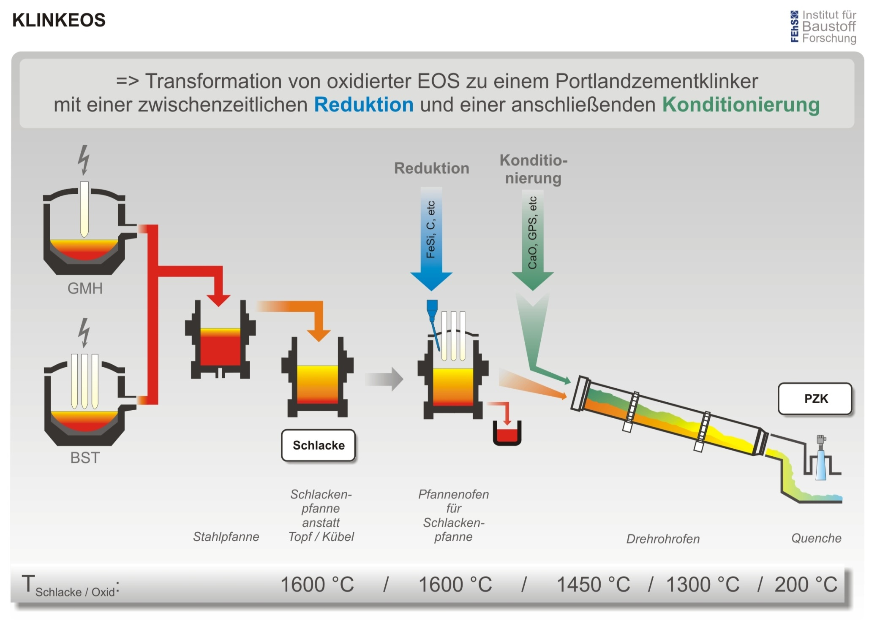
in Entwicklung:
laufendes DBU- Forschungsvorhaben
mit HEEPP, Rheinberg
Source: DBU research project KLINKEOS

Slide 22
ALTERNATIVE SOLIDIFICATION

Slide 23
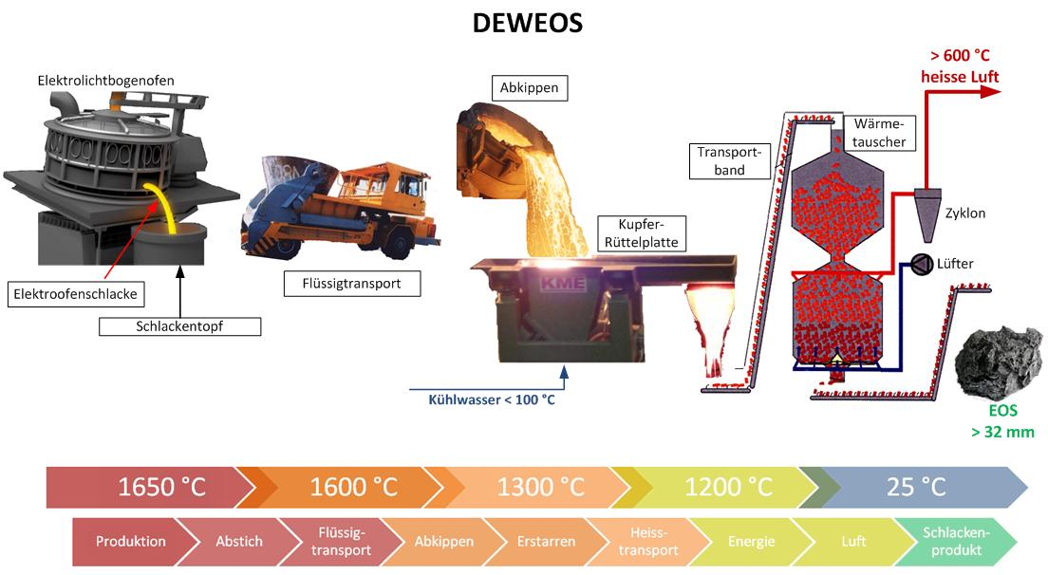
Source: BMWi research project DEWEOS

Slide 24
WATER TREATMENT

Slide 25
RFCS research project SLACON
Work is part of a European research project
Project aim is improvement of slag quality defined by eluate tests
Slag production in electric arc furnace
Process development for improved slag quality
Slag
Slag processing:
cooling, washing, sizing
Water
Slag
Adsorption treatment
for water recyling
Eluate
test
Process development for water treatment and recyling
Slag for utilisation in the construction industry

Slide 26
Investigation of water treatment for recycling
For water recycling, leached elements (Vanadium, Molybdenum, Fluoride) have to be removed selectively from water from slag processing
Slag processing water is highly alkaline, with high total ion concentration (conductivity > 1 mS/cm)
Laboratory tests
Precipitation with Fe₂(SO₄)₃
Adsorption on iron hydroxide based adsorbent
On-site tests
In on-site tests of adsorption more than 80 m³ of water have been treated
Very low residual concentrations have been obtained, V: 1 µg/l, Mo: 2 µg/l
Recycling of used adsorbent to EAF is investigated

Slide 27
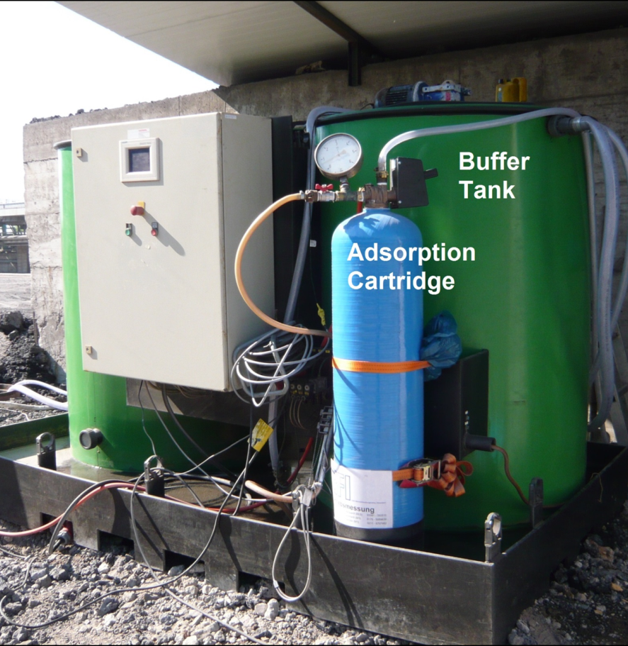
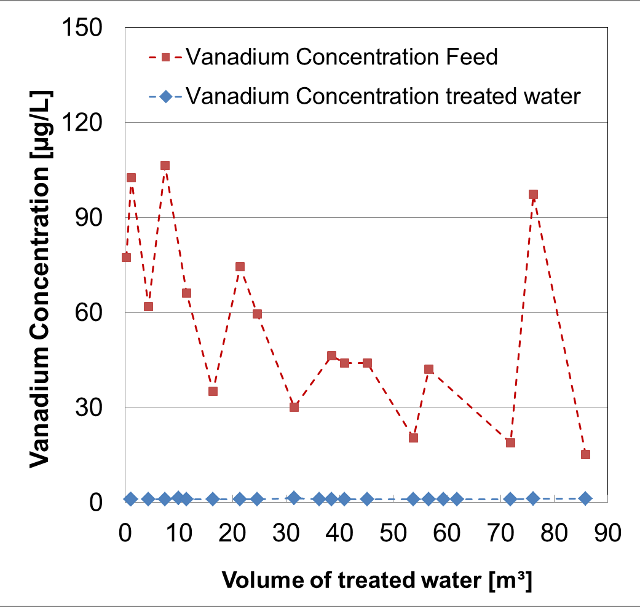
On-site tests of adsorption treatment for water recycling
BFI equipment for on-site tests Vanadium removal during on-site tests

Slide 28



Acknowledgments
The authors would like to thank the Projektträger Jülich, Department Energy Technologies (PTJ-ERG) and the German Federal Ministry of Economics and Technology (BMWi) for the financial support for the research project “DEWEOS”.
We would also like to thank the Deutsche Bundesstiftung Umwelt (DBU) for the financial support for the research project “KLINKEOS” and the Research Fund for Coal & Steel (RFCS) for the financial support for the European research project “SLACON”.

Slide 29

Contact
s.schueler@max-aicher.de
hans-peter.markus@lech-stahlwerke.de
d.algermissen@fehs.de
d.mudersbach@fehs.de
barbara.wendler@bfi.de
matthias.kozariszczuk@bfi.de
For more information and discussion you are welcome at the BFI poster !

