Slide 1
Solidification of metallurgical slags for higher added value applications
- Separation of FeO and P₂O₅ from steelmaking slags by solid phase precipitation -
Takahiro MIKI, Tohoku University (Japan)

Slide 2
Annual Worldwide Metal Production
Minerals Commodity Summaries (2014)
Fe : 1606.9 million tonnes
Al : 47.3 million tonnes
Cu: 17.9 million tonnes
Zn: 13.5 million tonnes
Pb: 5.4 million tonnes
Production amount of Fe is very large

Slide 3
Production of steel
Worldsteel (2014)
Countries
Region

Slide 4
Slag and Steel production in Japan
Nippon Slag Association(FY 2013)
・Annual production
Hot metal(HM): 83.8 million tonnes/yr
Steel : 111.5 million tonnes/yr
Blast furnace(BF) slag : 24.6 million tonnes/yr
Steelmaking slag : 14.4 million tonnes/yr
・Slag production per t-HM and t-steel
Blast furnace slag : 294kg-slag/t-HM
Steelmaking slag : 129kg-slag/t-steel

Slide 5
BOF steel production process
Iron ore
De-S Slag
De-P Slag
De-Si Slag
De-P Slag
CaO
Product
Coke
De-C Slag
BF slag
De-Si,P Slag
Beside this process, there is EAF steel production process using steel scraps as an iron source.

Slide 6
Blast furnace(BF) slag usage in Japan
Cement – 72%
Road Building – 15%
Concrete Aggregate – 9%
Others – 2%
Typical Composition of BF slag
42mass%CaO-34mass%SiO₂-13mass%Al₂O₃-7mass%MgO
mass%FeO<0.5, mass%P₂O₅<0.1
BF slag has established a stable position for cement industry

Slide 7
Steelmaking slag
Typical Composition of Steelmaking slag
46mass%CaO-17.4mass%FeO-11mass%SiO₂-6mass%MgO
-1.7mass%P₂O₅
■ Civil
The FeO and P₂O₅ in the slag is wasted in such applications.
■ Road
14.4 million ton/yr
■ Recycling
■ Soil improvement
■ Cement
■ Land fill
These materials need to be put to better use.
■ Fertilizer
■ Other
Uses of steelmaking slag in Japan.

Slide 8
Phosphorus in steelmaking slag
Blast Furnace
Dephosphorization
Converter
Molten iron
De-P
Steel products
Iron ore
(Si,P,S,C)
CaO
Si
P
S
Coal
Slag
De-P slag
Slag
Slag
Raw materials
BF slag
Steelmaking slag
Flow chart of steelmaking process

Slide 9
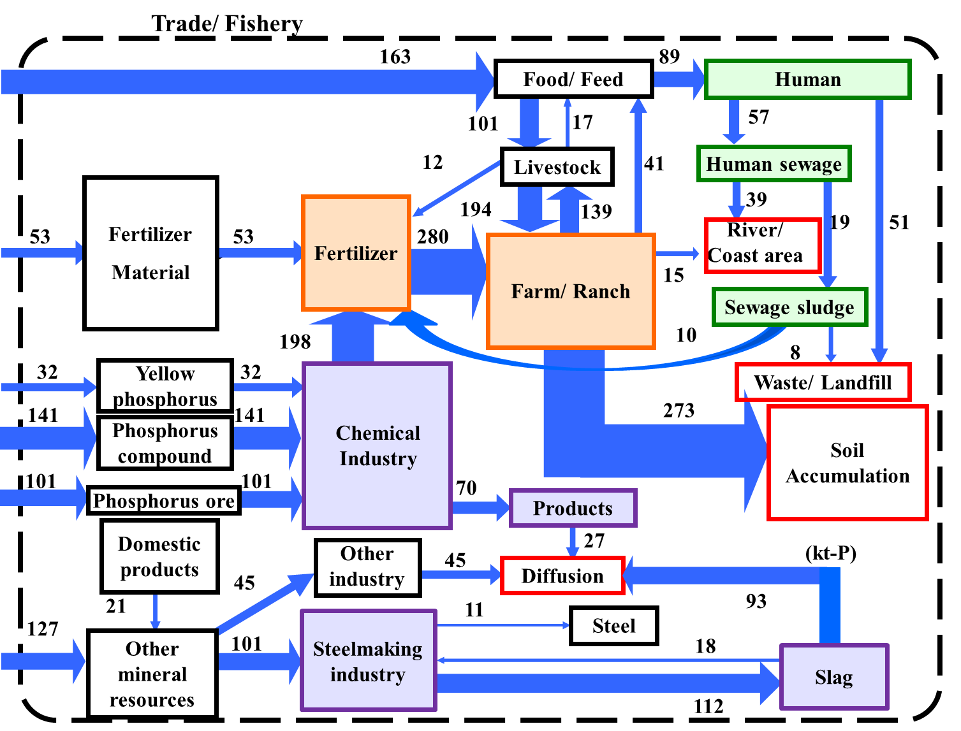
Phosphorus flow in Japan
Matsubae et al. Chemosphere (2011)

Slide 10
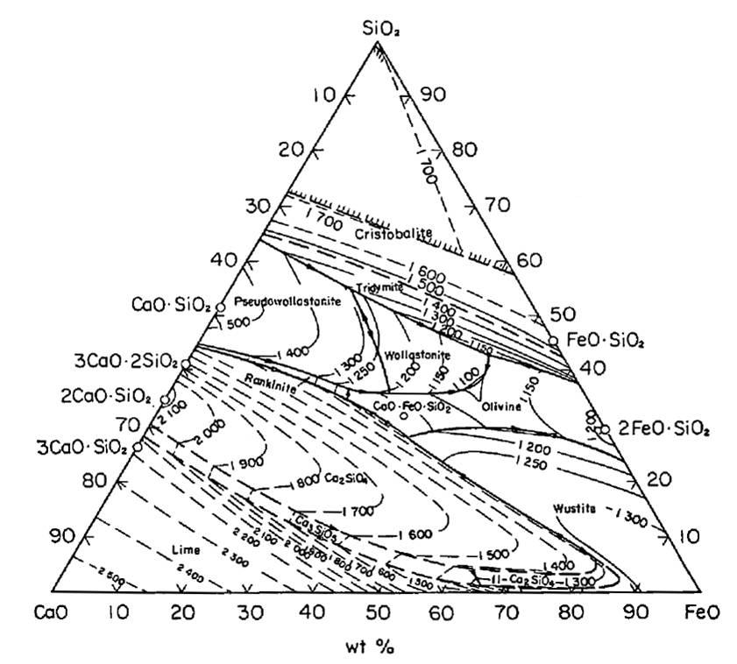

Background
Compositions of Basic Oxygen Furnace(BOF) and Electric Arc Furnace(EAF) slag.
Steelmaking slag
 | CaO | SiO₂ | T-Fe | MgO | Al₂O₃ | S | P₂O₅ | MnO
BOF | 45.8 | 11 | 17.4 | 6.5 | 1.9 | 0.06 | 1.7 | 5.3
EAF | 22.8 | 12.1 | 29.5 | 4.8 | 6.8 | 0.2 | 0.3 | 7.9
 | CaO | SiO₂ | T-Fe | MgO | Al₂O₃ | S | P₂O₅ | MnO
BOF | 45.8 | 11 | 17.4 | 6.5 | 1.9 | 0.06 | 1.7 | 5.3
EAF | 22.8 | 12.1 | 29.5 | 4.8 | 6.8 | 0.2 | 0.3 | 7.9
BOF(Basic Oxygen Furnace) slag
EAF(Electric Arc Furnace) slag
Main components： CaO-FeO-SiO₂
Nippon Slag Association.
2CaO･SiO₂
CaO – FeO – SiO₂ ternary system.

Slide 11
Background
Compositions of Basic Oxygen Furnace(BOF) and Electric Arc Furnace(EAF) slag.
Steelmaking slag
 | CaO | SiO₂ | T-Fe | MgO | Al₂O₃ | S | P₂O₅ | MnO
BOF | 45.8 | 11 | 17.4 | 6.5 | 1.9 | 0.06 | 1.7 | 5.3
EAF | 22.8 | 12.1 | 29.5 | 4.8 | 6.8 | 0.2 | 0.3 | 7.9
BOF(Basic Oxygen Furnace) slag
EAF(Electric Arc Furnace) slag
Main components： CaO-FeO-SiO₂
Nippon Slag Association.
Solidification model
FeO
P₂O₅
P₂O₅
FeO
FeO
FeO
FeO
FeO
P₂O₅
P₂O₅
FeO
FeO
FeO
P₂O₅
P₂O₅
P₂O₅
FeO
Molten slag(including FeO and P₂O₅)
Liquid slag(FeO rich)
2CaO・SiO₂ (P₂O₅ rich)
P₂O₅ tends to distribute in 2CaO･SiO₂

Slide 12
Background
Compositions of Basic Oxygen Furnace(BOF) and Electric Arc Furnace(EAF) slag.
Steelmaking slag
 | CaO | SiO₂ | T-Fe | MgO | Al₂O₃ | S | P₂O₅ | MnO
BOF | 45.8 | 11 | 17.4 | 6.5 | 1.9 | 0.06 | 1.7 | 5.3
EAF | 22.8 | 12.1 | 29.5 | 4.8 | 6.8 | 0.2 | 0.3 | 7.9
BOF(Basic Oxygen Furnace) slag
EAF(Electric Arc Furnace) slag
Main components： CaO-FeO-SiO₂
Nippon Slag Association.
Solidification model
FeO
FeO
FeO
P₂O₅
P₂O₅
P₂O₅
FeO
P₂O₅
FeO
FeO
FeO
P₂O₅
FeO
FeO
P₂O₅
FeO
P₂O₅
Liquid slag(FeO rich)
2CaO・SiO₂ (P₂O₅ rich)
P₂O₅ tends to distribute in 2CaO･SiO₂

Slide 13
Background
Compositions of Basic Oxygen Furnace(BOF) and Electric Arc Furnace(EAF) slag.
Steelmaking slag
 | CaO | SiO₂ | T-Fe | MgO | Al₂O₃ | S | P₂O₅ | MnO
BOF | 45.8 | 11 | 17.4 | 6.5 | 1.9 | 0.06 | 1.7 | 5.3
EAF | 22.8 | 12.1 | 29.5 | 4.8 | 6.8 | 0.2 | 0.3 | 7.9
BOF(Basic Oxygen Furnace) slag
EAF(Electric Arc Furnace) slag
Main components： CaO-FeO-SiO₂
Nippon Slag Association.
Solidification model
If these are able to be separated,
they can be used more effectively.
FeO
FeO
FeO
P₂O₅
P₂O₅
FeO
FeO
P₂O₅
P₂O₅
FeO
P₂O₅
FeO
P₂O₅
P₂O₅
FeO
FeO
FeO
FeO
FeO
P₂O₅
P₂O₅
FeO
FeO
P₂O₅
FeO
FeO
P₂O₅
FeO
FeO
P₂O₅
P₂O₅
FeO
P₂O₅
P₂O₅ rich 2CaO・SiO₂
FeO rich liquid slag
For example :
Fertilizer and chemical industry
Reuse as an iron-making material

Slide 14
Background
The purpose of this study
Investigate the possibilities of separating the 2CaO･SiO₂ solid phase from the liquid phase of steelmaking slag.
Separation
FeO
FeO
FeO
P₂O₅
P₂O₅
FeO
FeO
P₂O₅
P₂O₅
FeO
P₂O₅
FeO
P₂O₅
P₂O₅
FeO
FeO
FeO
FeO
FeO
P₂O₅
P₂O₅
FeO
FeO
P₂O₅
FeO
FeO
P₂O₅
FeO
FeO
P₂O₅
P₂O₅
FeO
P₂O₅
P₂O₅ rich 2CaO・SiO₂
FeO rich liquid slag

Slide 15
Experiment A : floatation of 2CaO・SiO₂
Separation of FeO-rich liquid and P₂O₅-rich 2CaO･SiO₂
by density difference between liquid slag and 2CaO･SiO₂
Experiment B：Addition of sintered CaO to slag.
Separation of the FeO-rich liquid and P₂O₅-rich 2CaO･SiO₂ by absorption of FeO-rich liquid to sintered CaO.

Slide 16

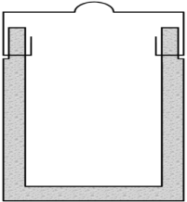


Apparatus and Procedure
Experiments
Gas inlet
Cooling water
slag
(8 g)
MgO crucible
Cooling water
Experimental condition
Sample slag(8 g)
Composition：45.8 mass%CaO – 43.1 mass%FeO
– 8.1 mass%SiO₂ – 3.0 mass%P₂O₅
Crucible：MgO crucible
Atmosphre：Ar(100 ml/min)
Experimental temperature：1523、1573、1623、1673 K
Holding time：4 hours
Gas outlet

Slide 17
Procedure and principles.
melting
1823 K
solid-liquid coexistance
1 hour
1673 K
1623 K
v
Experimental
temperature
v
1573 K
v
1523 K
v
4 hours
quench
v
200 K/hour
v
v
Experimental condition
Sample slag(8 g)
Composition：45.8 mass%CaO – 43.1 mass%FeO
– 8.1 mass%SiO₂ – 3.0 mass%P₂O₅
Crucible：MgO crucible
Atmosphre：Ar(100 ml/min)
Experimental temperature：1523、1573、1623、1673 K
Holding time：4 hours

Slide 18
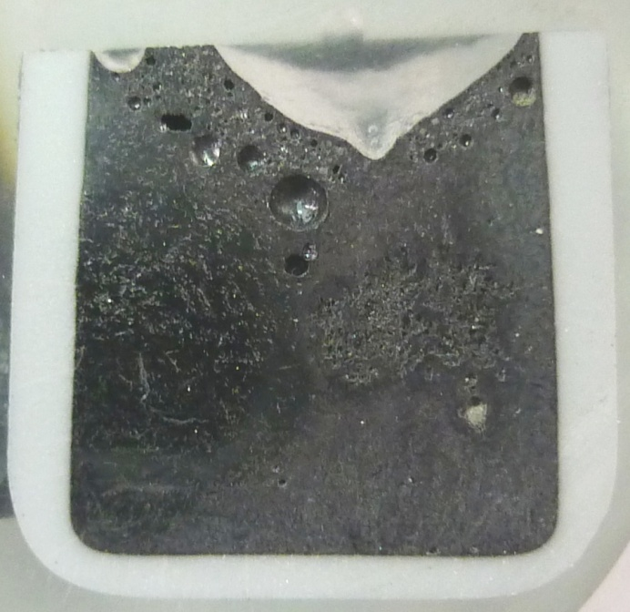
melting
1823 K
solid-liquid coexistance
1 hour
1673 K
1623 K
1573 K
1523 K
4 hours
200 K/hour
quench
1623 K
10 mm
Photo of the vertical section of the sample at 1623 K.
Experimental condition
Sample slag(8 g)
Composition：45.8 mass%CaO – 43.1 mass%FeO
– 8.1 mass%SiO₂ – 3.0 mass%P₂O₅
Crucible：MgO crucible
Atmosphre：Ar(100 ml/min)
Experimental temperature：1523、1573、1623、1673 K
Holding time：4 hours
SEM-EDS analysis

Slide 19
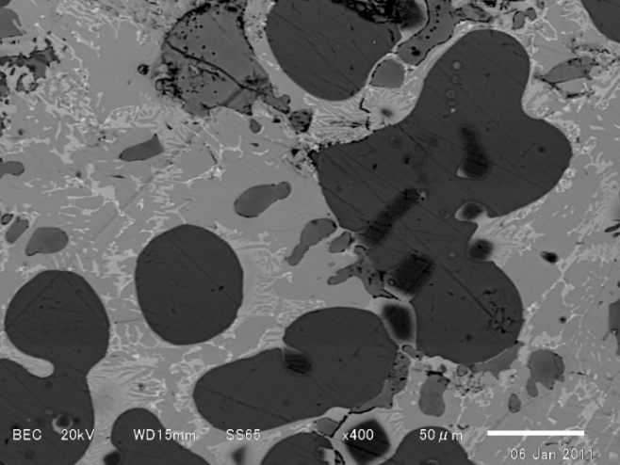
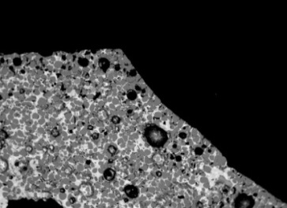
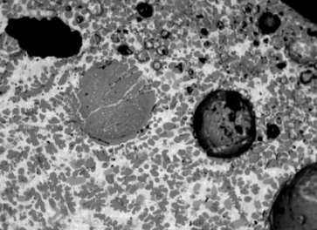
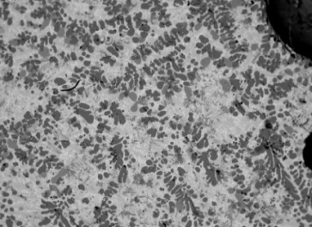
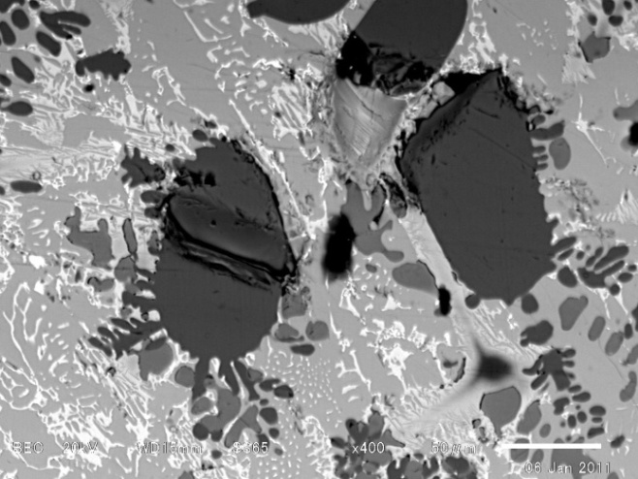

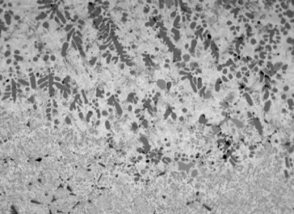
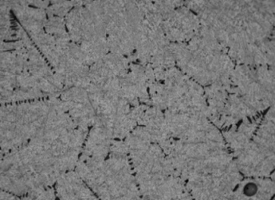
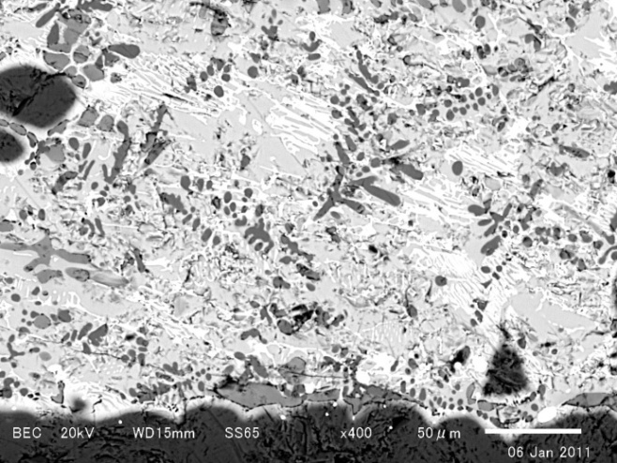
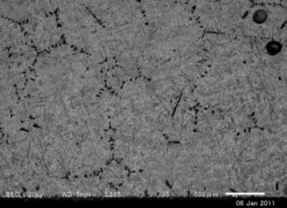
SEM images of the sample of 1623 K
1623 K
50 μm
50 μm
500 μm
50 μm

Slide 20

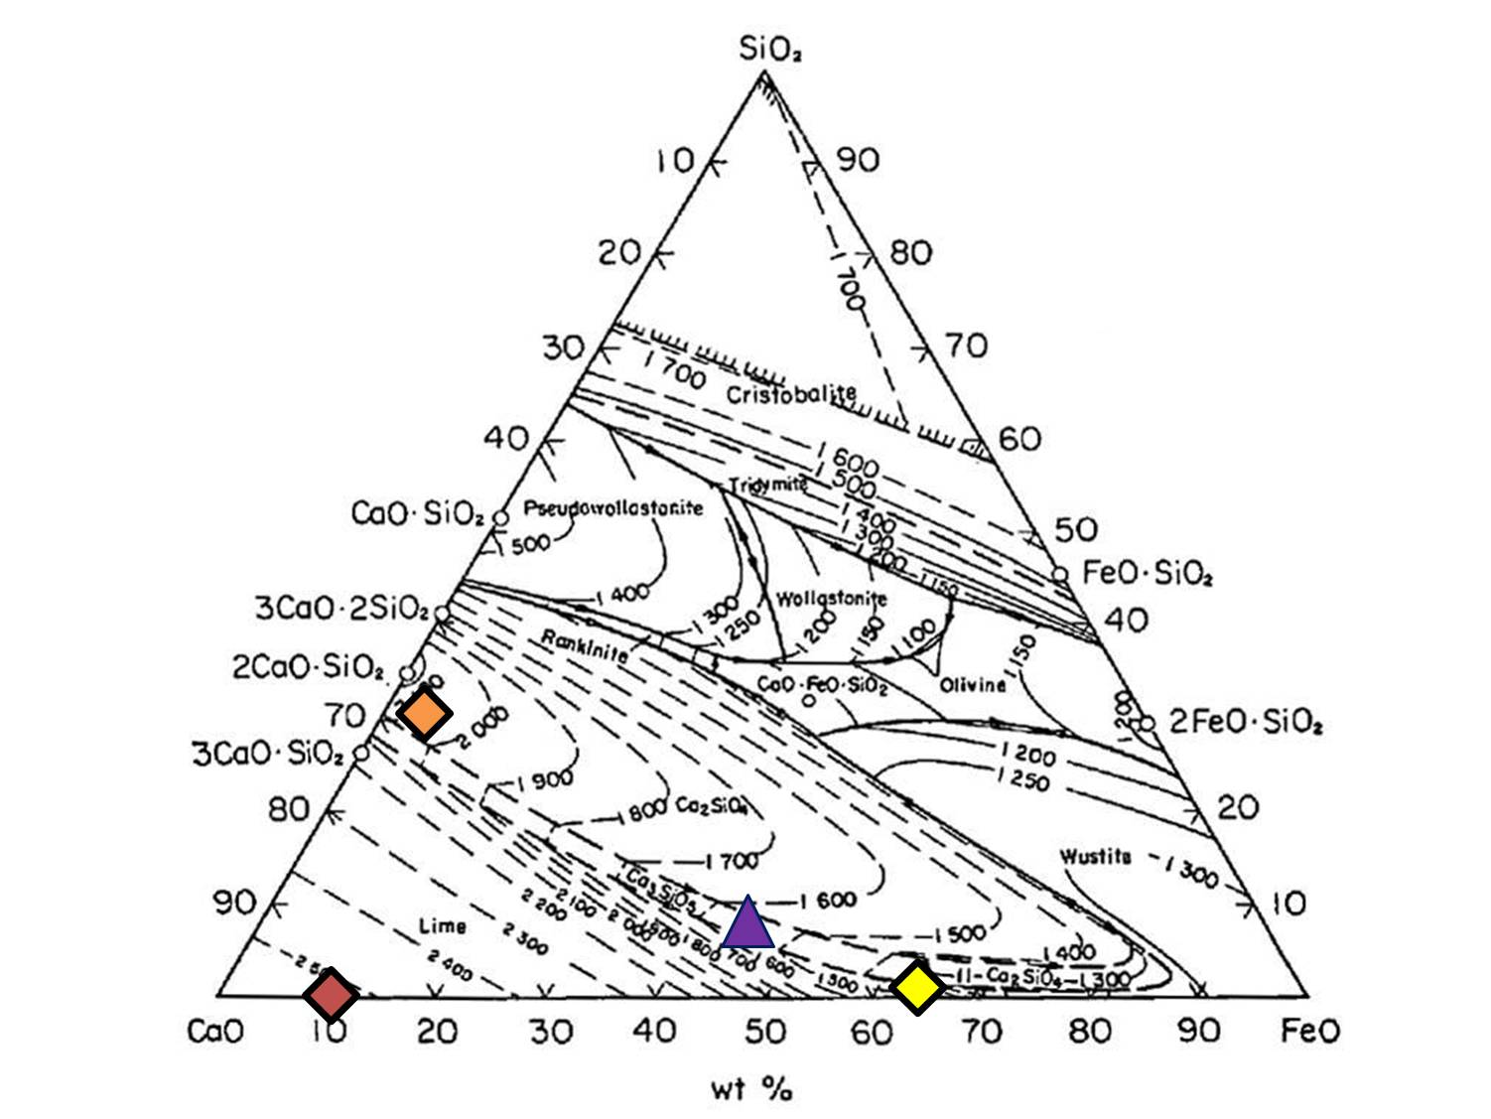
Composition of Phases
Composition of each phase
Temp.1623 K | Composition (mass%)
Phase | CaO | FeO | SiO₂ | MgO | P₂O₅
Initial | 45.8 | 43.1 | 8.1 | 0 | 3.0
CaO | 88.5 | 10.1 | 0.2 | 1.2 | 0.0
2CaO･SiO₂ | 59.7 | 3.2 | 27.9 | 0.1 | 9.1
Liquid | 34.7 | 62.7 | 1.0 | 1.3 | 0.3
(Mg,Fe)O | 1.6 | 27.6 | 0.2 | 70.5 | 0.1
2CaO･SiO₂
CaO
Liquid
▲Initial
◆CaO
◆2CaO･SiO₂
◆Liquid
(Mg,Fe)O
50 µm
Observed phases
- CaO solid.
2CaO･SiO₂ solid.
(Mg,Fe)O solid.
Liquid.

Slide 21
Composition of Phases
Composition of each phase
Temp.1623 K | Composition (mass%)
Phase | CaO | FeO | SiO₂ | MgO | P₂O₅
Initial | 45.8 | 43.1 | 8.1 | 0 | 3.0
CaO | 88.5 | 10.1 | 0.2 | 1.2 | 0.0
2CaO･SiO₂ | 59.7 | 3.2 | 27.9 | 0.1 | 9.1
Liquid | 34.7 | 62.7 | 1.0 | 1.3 | 0.3
(Mg,Fe)O | 1.6 | 27.6 | 0.2 | 70.5 | 0.1
2CaO･SiO₂
CaO
Liquid
▲Initial
◆CaO
◆2CaO･SiO₂
◆Liquid
(Mg,Fe)O
50 µm
・This result is good agreement with the phase diagram.
・FeO was concentrated in liquid phase
・P₂O₅ was clearly distributed in 2CaO･SiO₂

Slide 22
Composition of Phases
Composition of each phase
Temp.1623 K | Composition (mass%)
Phase | CaO | FeO | SiO₂ | MgO | P₂O₅
Initial | 45.8 | 43.1 | 8.1 | 0 | 3.0
CaO | 88.5 | 10.1 | 0.2 | 1.2 | 0.0
2CaO･SiO₂ | 59.7 | 3.2 | 27.9 | 0.1 | 9.1
Liquid | 34.7 | 62.7 | 1.0 | 1.3 | 0.3
(Mg,Fe)O | 1.6 | 27.6 | 0.2 | 70.5 | 0.1
2CaO･SiO₂
CaO
Liquid
▲Initial
◆CaO
◆2CaO･SiO₂
◆Liquid
(Mg,Fe)O
50 µm
These 4 phases were also observed in the other areas of sample.

Slide 23
SEM images of one sample
2CaO･SiO₂
CaO
Be concentrated
(Mg,Fe)O
50 μm
Liquid
Solid phase
50 μm
Very little
1 mm
50 μm

Slide 24

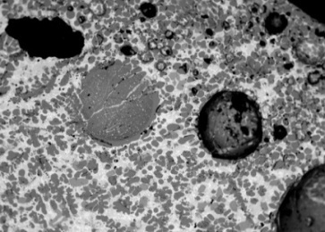
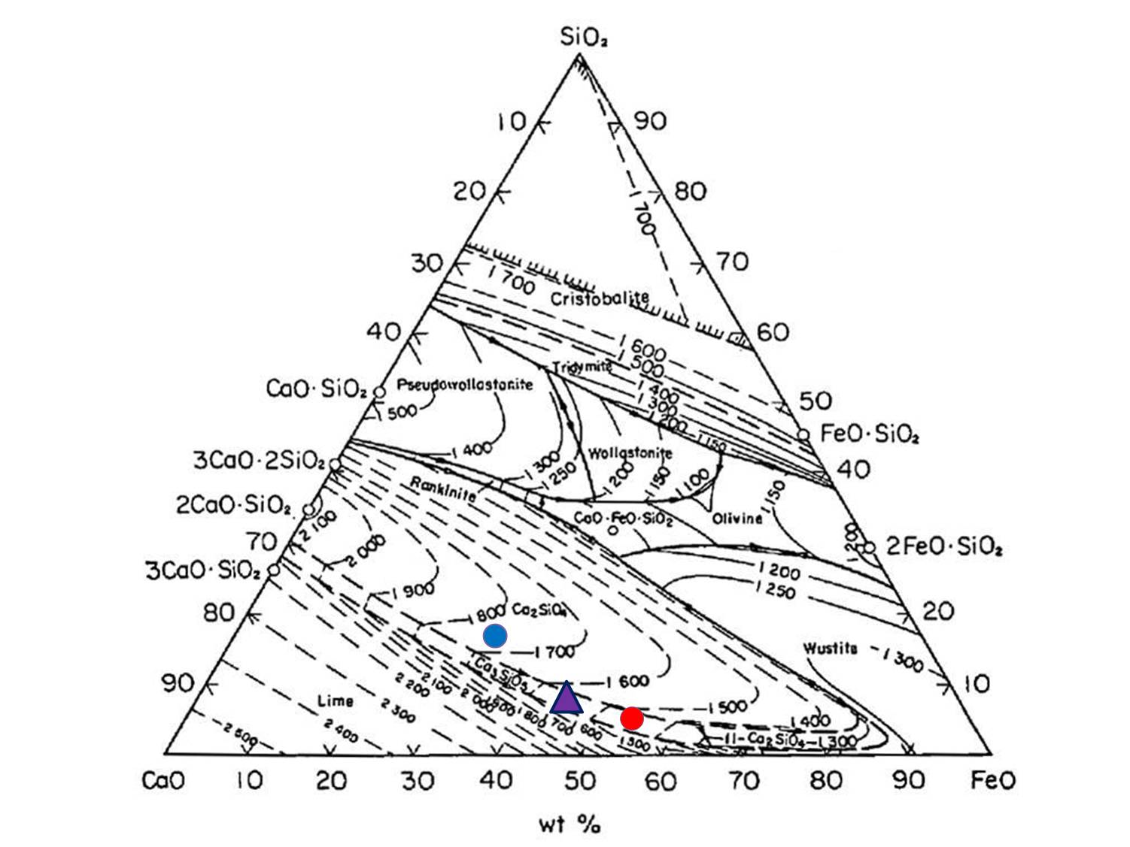

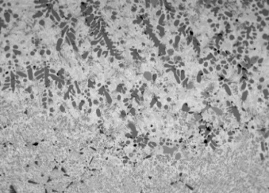


Composition by area.
Compositions of each areas.
Results
Temp.1623 K | Composition (mass%)
Area | CaO | FeO | SiO₂ | MgO | P₂O₅
Initial slag | 45.8 | 43.1 | 8.1 | 0 | 3.0
Upper area | 47.4 | 28.9 | 15.6 | 3.7 | 4.4
Lower area | 38.5 | 50.8 | 4.9 | 4.5 | 1.3
▲ Initial
● Upper
● Lower
500 μm

Slide 25
Composition by area.
Results
Temp.1623 K | Composition (mass%)
Area | CaO | FeO | SiO₂ | MgO | P₂O₅
Initial slag | 45.8 | 43.1 | 8.1 | 0 | 3.0
Upper area | 47.4 | 28.9 | 15.6 | 3.7 | 4.4
Lower area | 38.5 | 50.8 | 4.9 | 4.5 | 1.3
▲ Initial
● Upper
● Lower
500 μm

Slide 26
The results for the other temperatures.
No clear temperature dependence was observed.
FeO and P₂O₅ mass ratio
 | 1523 K | 1573 K | 1623 K | 1673 K
 | 0.67 | 0.61 | 0.57 | 0.62
 | 2.4 | 3.6 | 3.4 | 2.2

Slide 27
Brief summary of experiment A
The floatation method had serious limitations because it was not possible to successfully retrieve the FeO or P₂O₅.
Even though the sample changed quite dramatically in appearance, analysis showed little change in the composition from top to bottom

Slide 28
Experiment A : floatation of 2CaO・SiO₂
Separation of FeO-rich liquid and P₂O₅-rich 2CaO･SiO₂
by density difference between liquid slag and 2CaO･SiO₂
Experiment B：Addition of sintered CaO to slag
Separation of the FeO-rich liquid and P₂O₅-rich 2CaO･SiO₂ by absorption of FeO-rich liquid to sintered CaO.

Slide 29



Silicon rubber seal
CaO crucible：1.58 g (sintered at 1773K)
Slag：0.680 g, 0.165g
Sample held at 1623K for 4hrs
Gas inlet
slag
(0.165g or 0.680 g)
1823 K
CaO crucible
(1.58g)
1 hour
MgO crucible
200 K/hour
200 K/hour
Cooling water
Gas outlet

Slide 30
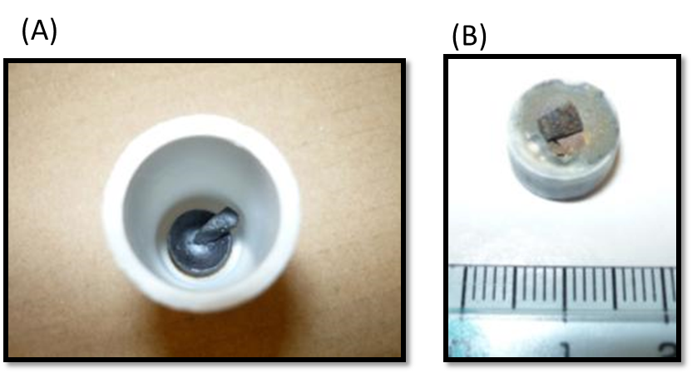
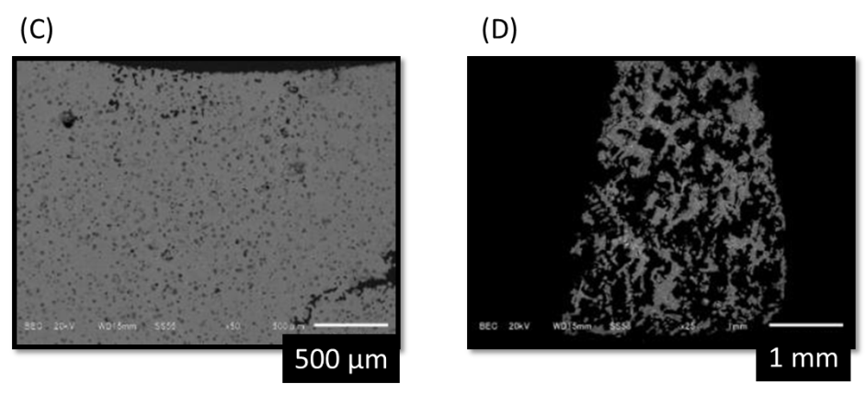
slag
0.680 g
slag
0.165g
Easily separated
CaO crucible
Remained slag

Slide 31
0.11g of liquid phase was absorbed in CaO crucible
73% of P₂O₅ and 92% of FeO were recovered

Slide 32
Procedure
Silicon rubber seal
Preparation of sintered CaO
Sintered CaO ball
Calcinated
at 1473 K
Gas inlet
CaCO₃
CaO
Sintered CaO
Pressed into tablet shape (10 MPa)
Sintered 12 hours at 1773 K
Experimental condition
Sintered CaO：0.74 g
Slag：0.15 g
Compositions：45.8 mass%CaO – 43.1%FeO
– 8.1 mass%SiO₂ – 3.0 mass%P₂O₅
Crucible：MgO crucible
Atmosphere：Ar(100 ml/min)
Holding time：1 hour
Cooling water
Gas outlet
same as experiment A

Slide 33
Procedure
Experiments
Silicon rubber seal
Sintered CaO ball
Gas inlet
slag
(0.15 g)
Experimental condition
MgO crucible
Sintered CaO：0.74 g
Slag：0.15 g
Compositions：45.8 mass%CaO – 43.1%FeO
– 8.1 mass%SiO₂ – 3.0 mass%P₂O₅
Crucible：MgO crucible
Atmosphere：Ar(100 ml/min)
Holding time：1 hour
Cooling water
Gas outlet
same as experiment A

Slide 34

Procedure and Principle
Experiments
1823 K
Addition of CaO
Sintered CaO ball
1773 K
1 hour
1 hour
15 min
200 K/hour
Absorption
Experimental condition
Sintered CaO：0.74 g
Slag：0.15 g
Compositions：45.8 mass%CaO – 43.1%FeO
– 8.1 mass%SiO₂ – 3.0 mass%P₂O₅
Crucible：MgO crucible
Atmosphere：Ar(100 ml/min)
Holding time：1 hour
2CaO・SiO₂
Slag tablet
same as experiment A

Slide 35
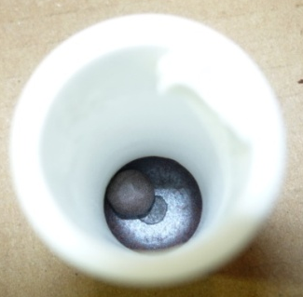
Results. (i)
Sintered CaO
Slag
Photo image taken from top of the crucible.
SEM-EDS analysis

Slide 36
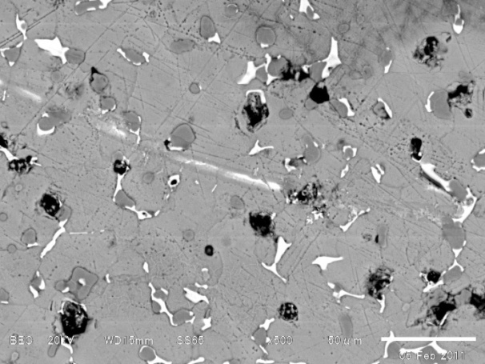
SEM observation of ball.
CaO
Results
2CaO･SiO₂
Liquid
50 μm
Observed phase
・CaO
・2CaO・SiO₂
・Liquid
SEM image of sintered CaO
Located in the CaO voids
2CaO・SiO₂ was precipitated from liquid phase during cooling to R.T.

Slide 37
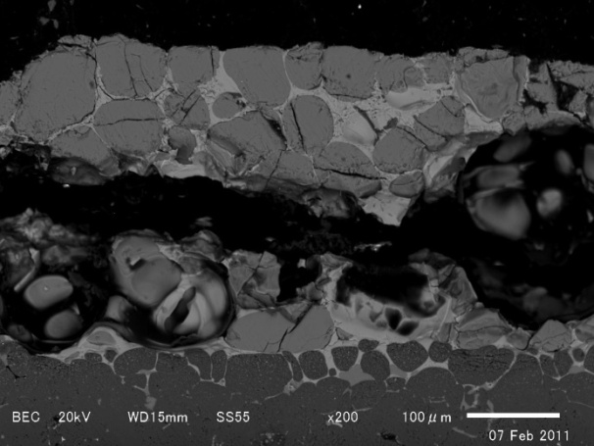
SEM observation of slag.
Results
2CaO･SiO₂
Liquid
MgO Crucible
100 μm
SEM image of separated slag
Observed phases
・2CaO･SiO₂
・Liquid―(in the 2CaO･SiO₂ voids)
Most of the liquid was absorbed to sintered CaO ball.

Slide 38
Change in composition
 | Composition (mass%)
 | CaO | FeO | SiO₂ | MgO | P₂O₅
Initial slag | 45.8 | 43.1 | 8.1 | 0 | 3.0
Separated slag | 56.7 | 10.1 | 25.1 | 1.7 | 6.4
Sintered CaO | 90.7 | 5.3 | 2.4 | 1.1 | 0.5
FeO composition was 1/4 of initial slag
P₂O₅ composition was twice of initial slag.
P₂O₅
FeO
43.1mass%
6.4 mass%
x2
3.0 mass%
10.1mass%
87% of P₂O₅ and 90% of FeO were recovered

Slide 39
Comparison of both methods.
 | Composition (mass%)
 | CaO | FeO | SiO₂ | MgO | P₂O₅
Initial slag | 45.8 | 43.1 | 8.1 | 0 | 3.0
Separated slag | 56.7 | 10.1 | 25.1 | 1.7 | 6.4
Sintered CaO | 90.7 | 5.3 | 2.4 | 1.1 | 0.5
▲Initial slag
◆Separated slag
◆Sintered CaO
◆
▲
◆

Slide 40
Comparison of experiment .
 | Composition (mass%)
 | CaO | FeO | SiO₂ | MgO | P₂O₅
Initial slag | 45.8 | 43.1 | 8.1 | 0 | 3.0
Separated slag | 56.7 | 10.1 | 25.1 | 1.7 | 6.4
Sintered CaO | 90.7 | 5.3 | 2.4 | 1.1 | 0.5
At 1623 K | composition (mass%)
area | CaO | FeO | SiO₂ | MgO | P₂O₅
Initial slag | 45.8 | 43.1 | 8.1 | 0 | 3.0
Upper area | 47.4 | 28.9 | 15.6 | 3.7 | 4.4
Lower area | 38.5 | 50.8 | 4.9 | 4.5 | 1.3
▲Initial slag
◆Separated slag
◆Sintered CaO
●Experiment A
Experiment B separated slag
Experiment A upper area
Experiment B was more successful than experiment A
◆
▲
◆

Slide 41
Summary
In this study, two possible methods for the separation of 2CaO･SiO₂ and the liquid phase of steelmaking slag with the aim of finding the best way to recover valuable FeO and P₂O₅ are investigated.
The floatation method had serious limitations because it was not possible to successfully retrieve the FeO or P₂O₅. Even though the sample changed quite dramatically in appearance, analysis showed little change in the composition from top to bottom.
The addition of sintered CaO allowed for the successful separation of both FeO and P₂O₅ from steelmaking slag. This technique has the potential to be applied by industry so that valuable resources can be retrieved from slag and reused.

Slide 42
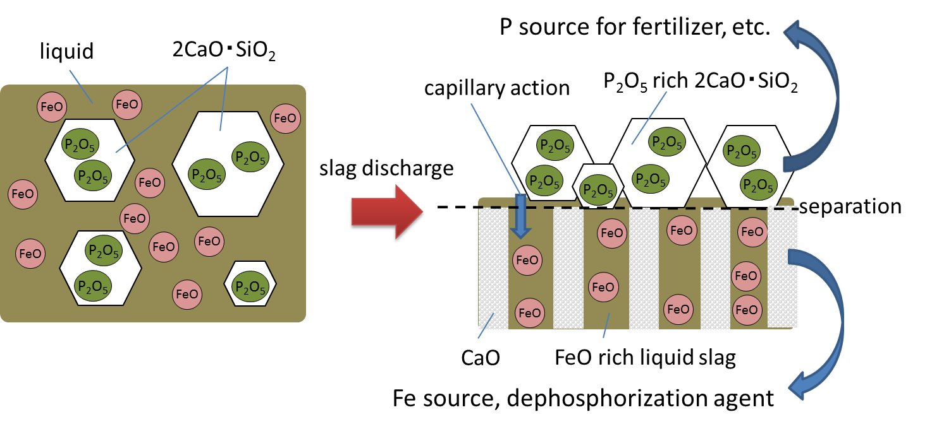
On site separation of FeO and P₂O₅ by use of Capillary effect

Slide 43
Separation using capillary effect
Molten slag
P₂O₅ containing 2CaO・SiO₂
Absorber
Converter
Absorber
+ Fe rich liquid
Capillary effect
Molten steel
P source for fertilizer
P₂O₅ containing 2CaO・SiO₂
P₂O₅ enriched 2CaO・SiO₂
Fe source for blast furnace
Absorber+ Fe rich liquid
Absorber+ Fe rich liquid

Slide 44
Other possible ways to separate FeO and P₂O₅
Magnetic Separation
Magnetic Separation of Phosphorus Enriched Phase from Multiphase Dephosphorization Slag : Hironari Kubo, Kazuyo Matsubae-Yokoyama, Tetsuya Nagasaka, ISIJ International, 50 (2010), 59-64.
Dissolution into Aqueous Solution
Dissolution Behavior of Dicalcium Silicate and Tricalcium Phosphate Solid Solution and other Phases of Steelmaking Slag in an Aqueous Solution : Takuya Teratoko, Nobuhiro Maruoka, Hiroyuki Shibata, Shin-ya Kitamura, High Temperature Materials and Processes, 31(2012), 329–338.

Slide 45
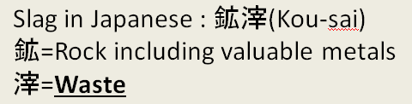
Meaning of Slag
Slag : Glass-like by-product left over after a desired metal has been separated from its raw ore
Slag is By-product, not Waste!

Slide 46

Thank you for your kind attention!

