Slide 1
Properties of inorganic polymer cement from ferric and ferrous vitrified residues of plasma gasification
Lieven Machiels¹, Lukas Arnout¹, Els Nagels², Sander Arnout², Bart Blanpain¹, Yiannis Pontikes¹
¹ Research group of High Temperature Processes & Industrial Ecology, Dept. of Materials Engineering, KU Leuven
² Inspyro NV
Slag Valorisation Symposium, April 17, 2015

Slide 2
Can waste become the cement of the future?

Slide 3

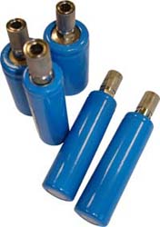
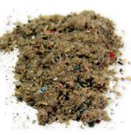
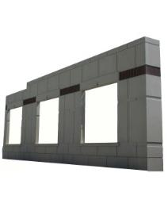
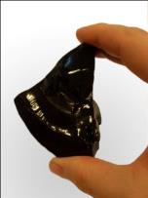
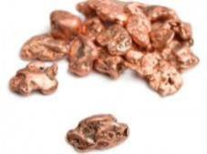
Plasma gasification of MSW for hydrogen production
Refuse Derived Fuel
Cement in construction applications

Slide 4
Inorganic polymer cement from plasma gasification slags
= Low carbon footprint
= Easy in use in existing installations running on OPC
= No big investments required
= Competitive price with OPC
= Broad range of applications
= Building products with improved properties
Pontikes et al., 2013. Applied clay Science, 73, 93-102;
Machiels et al., 2014. Waste Biomass Valorisation, 5, 411-428;
Danthurebandara et al., 215, in press. Journal of Cleaner Production.

Slide 5
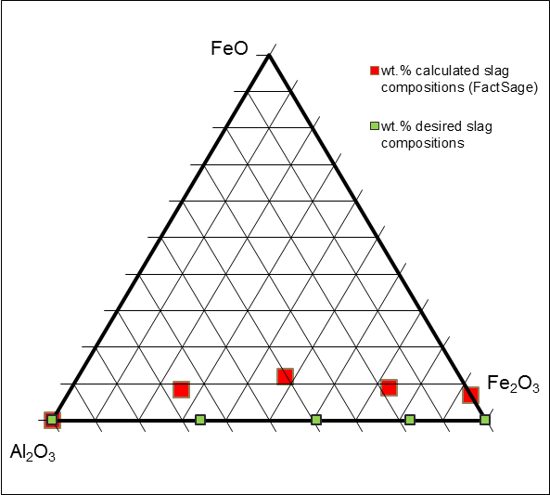
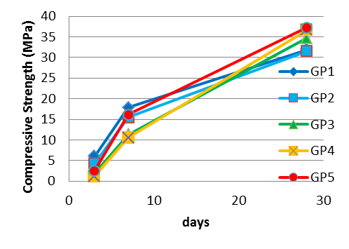
Research for cement development: Al or Fe?
Composition of refuse derived fuel vs. traditional raw materials?
“Traditional inorganic polymers are Si-Al based”
Al content is commonly low
But.. considerable amounts of Fe are present, 20% Fe₂O₃ is common
Research on role of Fe in inorganic polymers
GP1
GP2
GP3
GP4
GP5

Slide 6
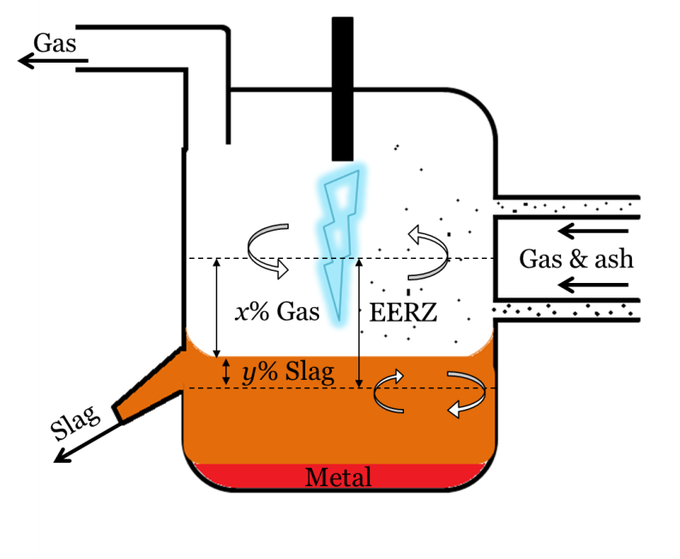
Research for cement development: Fe³⁺ or Fe²⁺
Influence of a varying pO₂ in the liquid slag system (Fe²⁺ ⬄ Fe³⁺ ) on properties of inorganic polymer cement
Depending on:
  feed oxidation state
  degree of reduction in process
  degree of gas-slag-metal equilibrium
Yan et al., 2014. Mineral Processing and Extractive Metallurgy.

Slide 7
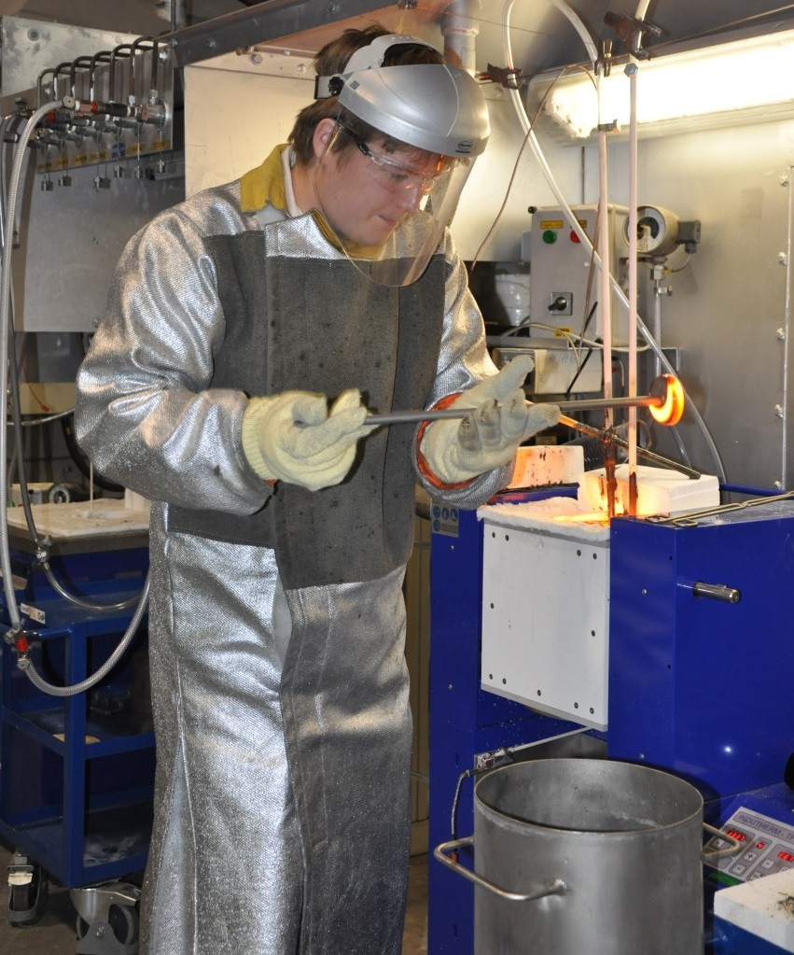
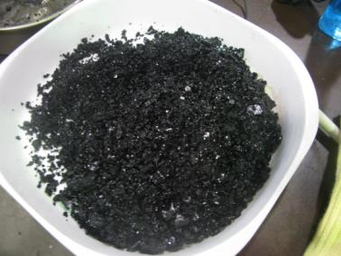
Research for cement development: Fe³⁺ vs. Fe²⁺
Production of two identical slag compositions on lab scale, ~20% FeO
in equilibrium with air, “oxidized slag”, mainly Fe³⁺
in equilibrium with (68% CO – 32% CO₂), “reduced slag”, mainly Fe²⁺

Slide 8
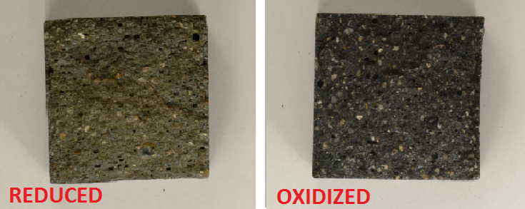
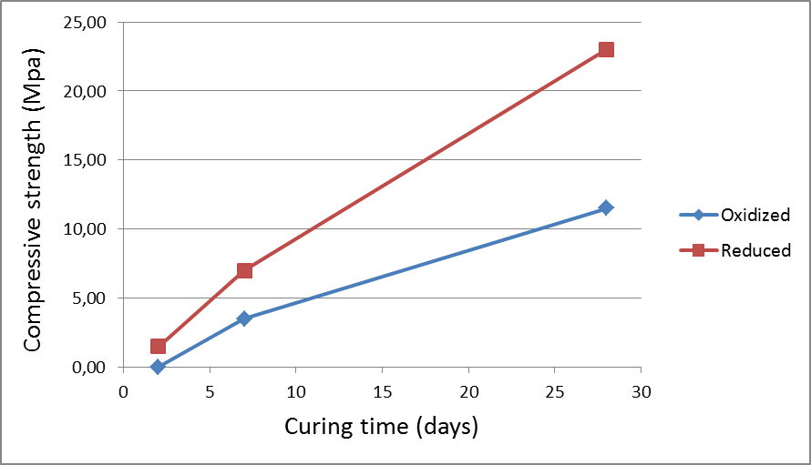
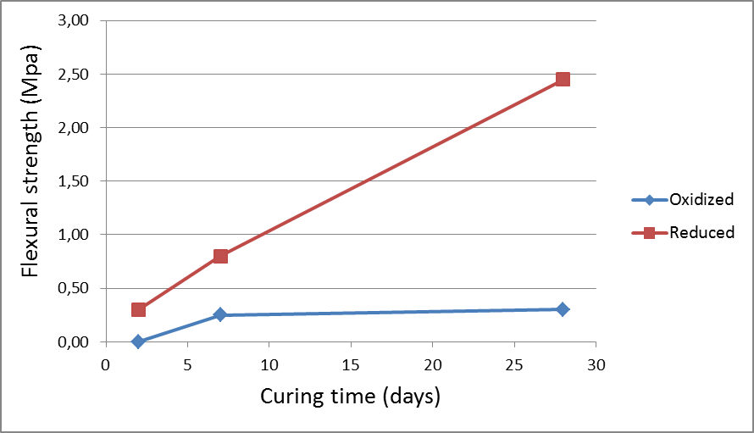
Research for cement development: Fe³⁺ vs. Fe²⁺
Fe²⁺ in slag
Fe³⁺ in slag
Next step: How Fe is incorporated in inorganic polymer network?

Slide 9
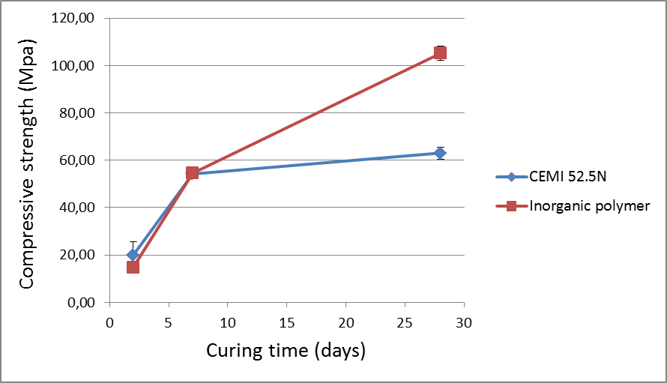
Research for cement development: lab scale
Example: Castable inorganic polymer cement
Properties similar to CEMI 52.5N cement
Ratio water(glass) solution/slag: 0.5
Room temperature curing 20°C

Slide 10
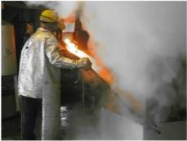
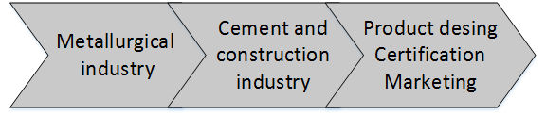
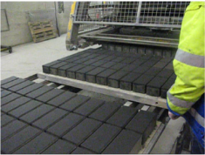
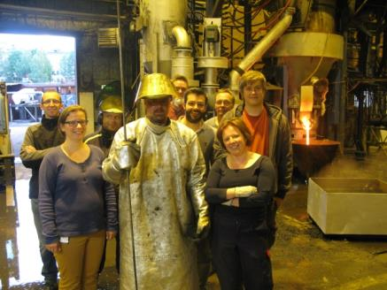
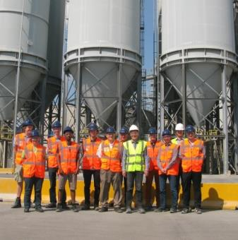
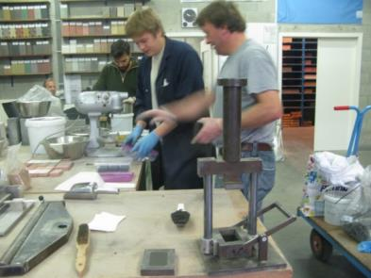
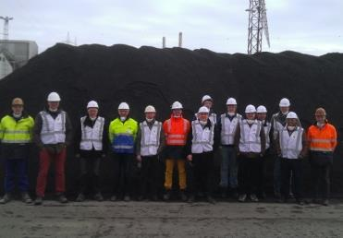
From the lab to the market
Joint R&D with partners from the whole value chain

Slide 11
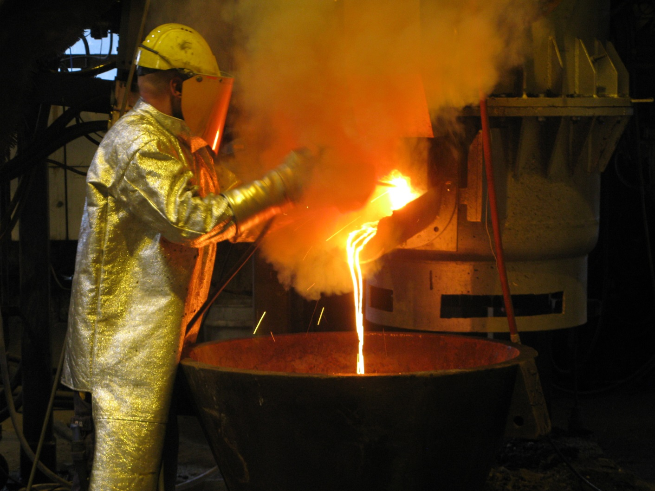
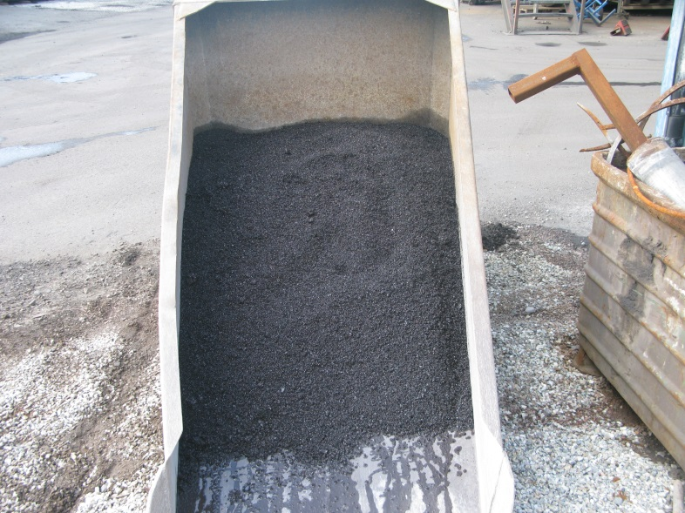
Pilot tests for slag production

Slide 12
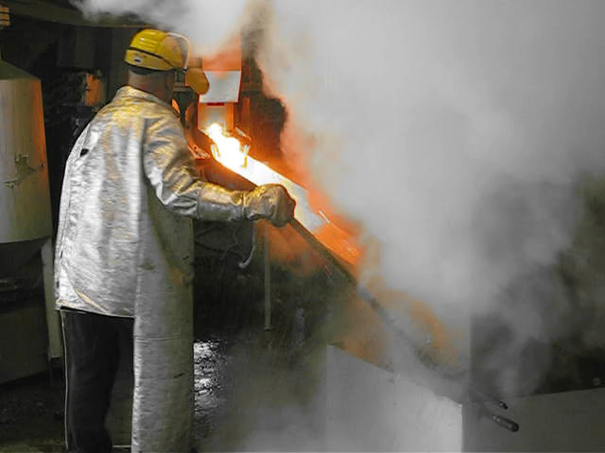
Pilot tests for slag production - granulation

Slide 13

Industrial paver production - first trial

Slide 14
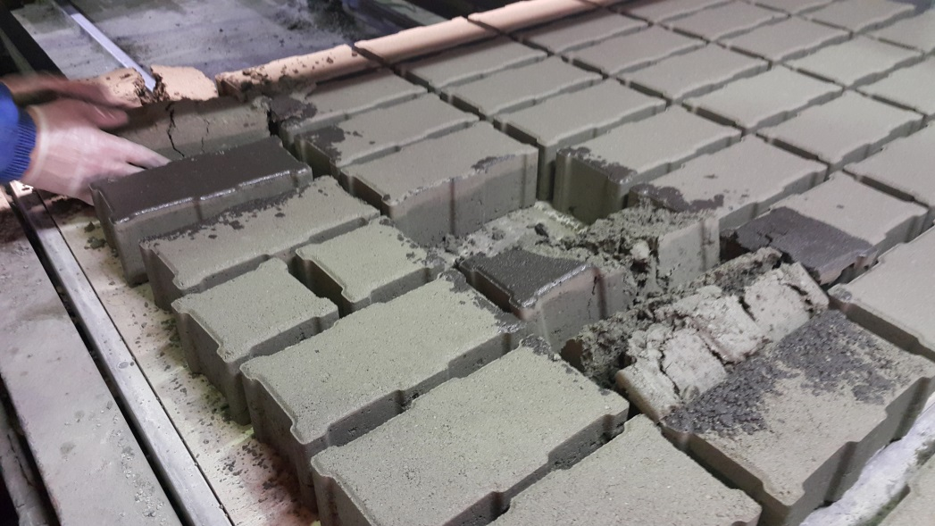
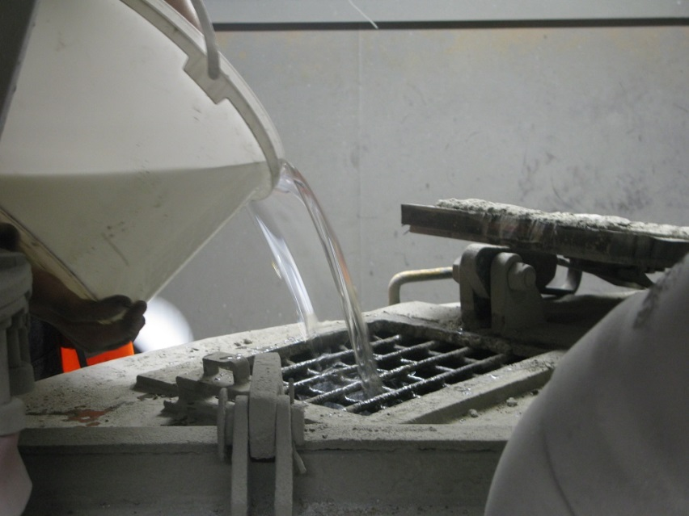
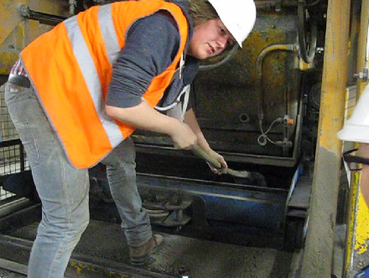
Industrial paver production

Slide 15
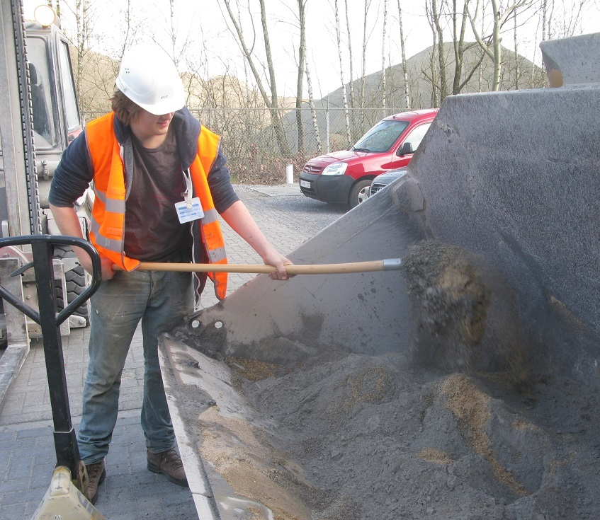
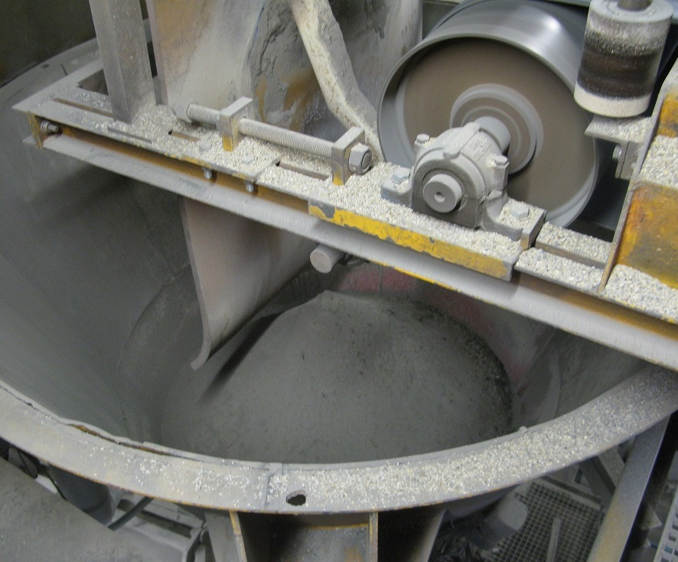
Industrial paver production- first full scale trial

Slide 16
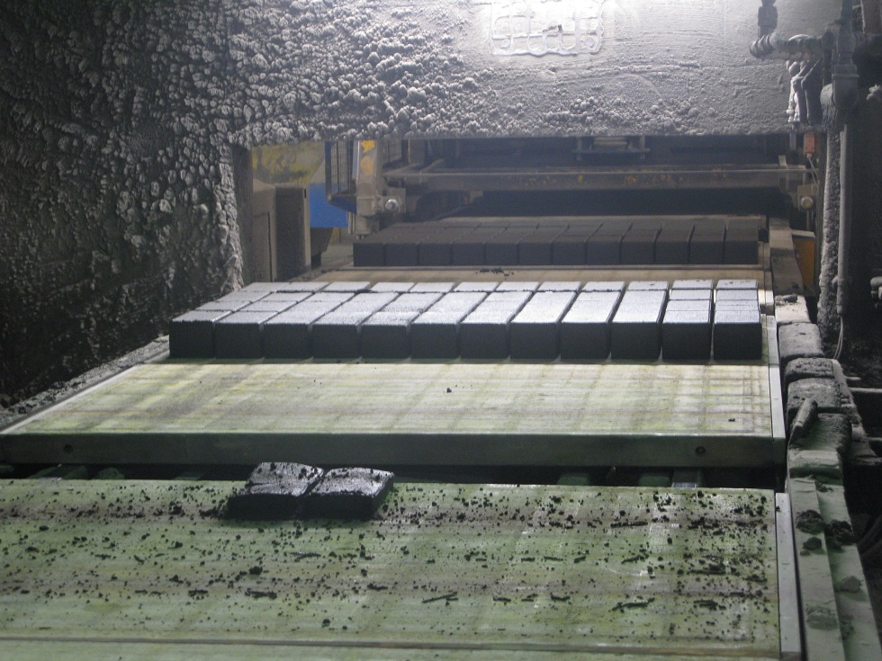
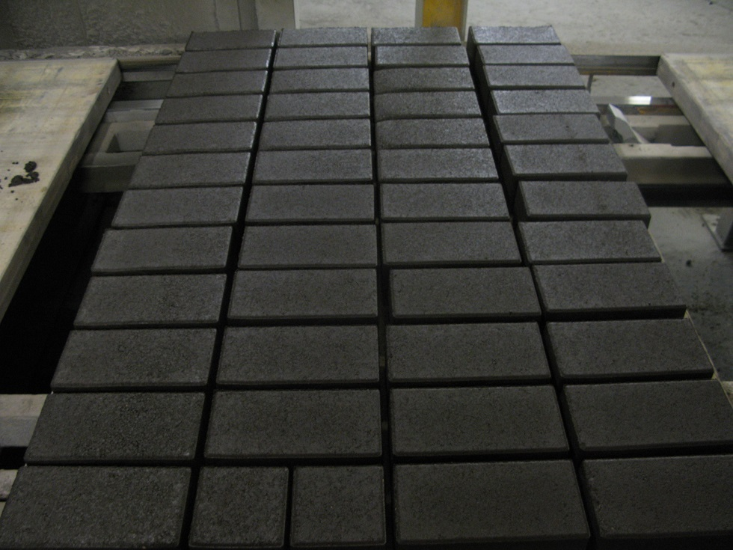
Industrial paver production- first full scale trial

Slide 17
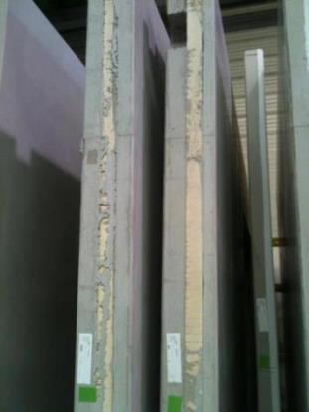
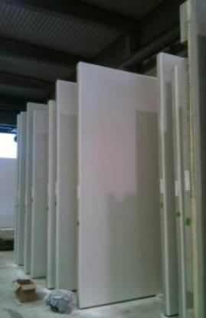
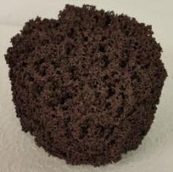
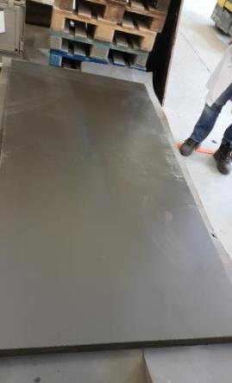
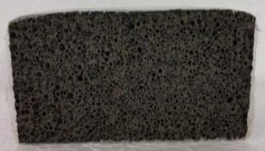
The future: high added value products
Original from OPC and PU
Ambition: building a house!
Pavement stones
Tiles
Roofing tiles
Bricks
Walls
Foundation
Insulation panels
Architectural concrete
…
Geopolymer based
Example: replacement of polyurethane by foamed geopolymer cement in sandwich walls

Slide 18
Contact
Dr. Lieven Machiels
Email: Lieven.machiels@mtm.kuleuven.be
Mobile: +32494918649
Publications: https://lirias.kuleuven.be/cv?u=U0050557
Research group of High Temperature Processes & Industrial Ecology
Department of Materials Engineering
KU Leuven
Group website:
http://www.mtm.kuleuven.be/Onderzoek/Semper/Hitemp

Slide 19
Extra slides

Slide 20
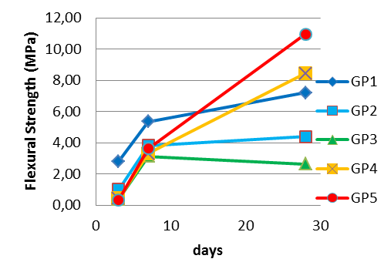
Research for cement development: Al or Fe?
GP1
GP2
GP3
GP4
GP5
Goetschalckx, et al., Geopolymer conference Hernstein, Austria, May 25-29, 2015.

Slide 21
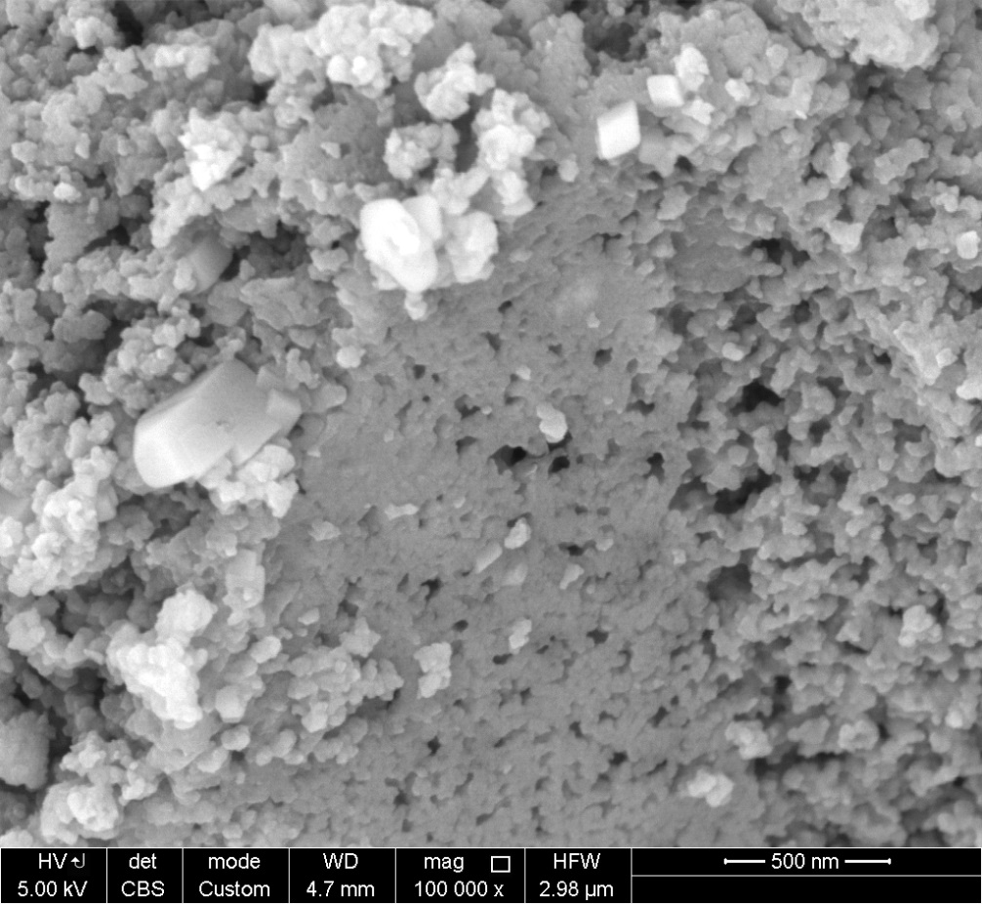
GP1: nanospheres + nanopores
Different behaviour during drying/shrinkage, low permeability inorganic polymers more subject to cracking?
GP3: very dense structure
Goetschalckx, et al., Geopolymer conference Hernstein, Austria, May 25-29, 2015.
21

