Slide 1


Dimitra ZAHARAKI, Antigoni VLACHOU, Kostas KOMNITSAS
School of Mineral Resources Engineering,
Technical University of Crete, 73100, Chania, Greece
CO-UTILIZATION OF SLAGS WITH CONSTRUCTION WASTES OR RED MUD FOR GEOPOLYMER PRODUCTION

Slide 2
Objective
Investigation of the co-geopolymerization potential of ferronickel slags with construction/demolition wastes or red mud
Contents
Geopolymerization
Materials and experimental methodology
Compressive strength of geopolymers
XRD and FTIR analyses
Conclusions

Slide 3
Geopolymer or inorganic polymer
Geopolymers are inorganic materials formed by the alkali activation of aluminosilicates at relatively low temperatures
Partially or fully amorphous polymeric structures consisting of Si-O-Al bonds
The tetrahedral AlO₄ and SiO₄ units are built in three dimensional structures

Slide 4


Geopolymer or inorganic polymer
The structure and mechanical properties of geopolymers are affected by several parameters such as chemical composition and particle size of the raw materials
Various wastes such as fly ash and slag have been extensively investigated as potential raw materials for the synthesis of geopolymers
Geopolymerisation of other wastes and especially construction and demolition wastes (CDW) still remains a great challenge
Activating solution
[ΚΟΗ or ΝaOH and Na₂SiO₃]
Raw materials
[aluminosilicate materials or industrial by-products]

Slide 5
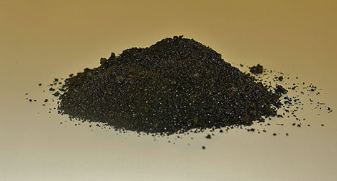
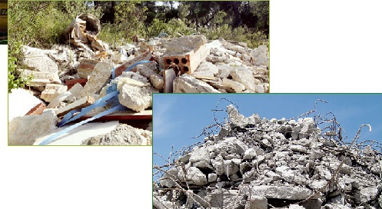
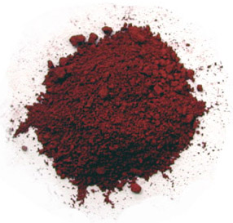
Materials
Electric arc furnace slag from the “LARCO S.A” ferronickel plant, Greece
CDW (tiles, bricks and concrete)
Red mud from “Aluminium of Greece”

Slide 6
Materials
All materials were dried and pulverized using a FRITSCH-BICO pulveriser (slag: <120 μm and d₅₀ 12 μm, tiles: <140 μm and d₅₀ 14 μm, bricks: <140 μm and d₅₀ 6.6 μm, concrete: <190 μm and d₅₀ 10 μm, red mud: <76 μm and d₅₀ 4 μm)
Table 1: Chemical composition (%) of raw materials
Material | Fe₂O₃ | SiO₂ | Al₂O₃ | CaO | Na₂O | K₂O | MgO | TiO₂ | LOI | SUM
Slag (S) | 43.83 | 36.74 | 9.32 | 3.73 | - | - | 2.76 | - | - | 96.4*
Concrete (C) | 0.75 | 5.81 | 1.49 | 65.42 | 0.57 | 1.26 | 4.21 | 0.03 | 21.59 | 101.1
Bricks (B) | 6.00 | 57.79 | 14.95 | 8.79 | 1.03 | 2.80 | 4.75 | 0.85 | 1.89 | 98.9
Tiles (T) | 5.39 | 70.54 | 9.80 | 8.78 | - | 1.37 | 4.46 | 0.77 | - | 101.1
Red mud (R) | 41.65 | 9.28 | 15.83 | 10.53 | 2.26 | 0.21 | - | 4.73 | 16.77 | 101.3
LOI: Loss on ignition after heating the material at 1050 ºC for 4 h, *Cr₂O₃: 2.82 %

Slide 7
Experimental methodology
The activating solution consists of NaOH or KOH anhydrous pellets, distilled water and sodium silicate solution
Raw materials were then mixed with the activating solution (8-10 M NaOH or KOH)
The specimens produced (5 cm edge) were heated at 80 °C in a laboratory oven for 7 days and then subjected to compressive strength testing using an MTS 1600 load frame
X-ray diffraction (XRD) of the final products using a Bruker D8 Advance diffractometer
Fourier transform infrared spectroscopy (FTIR) on KBr pellets using a Perkin–Elmer Spectrum 1000 spectrometer

Slide 8
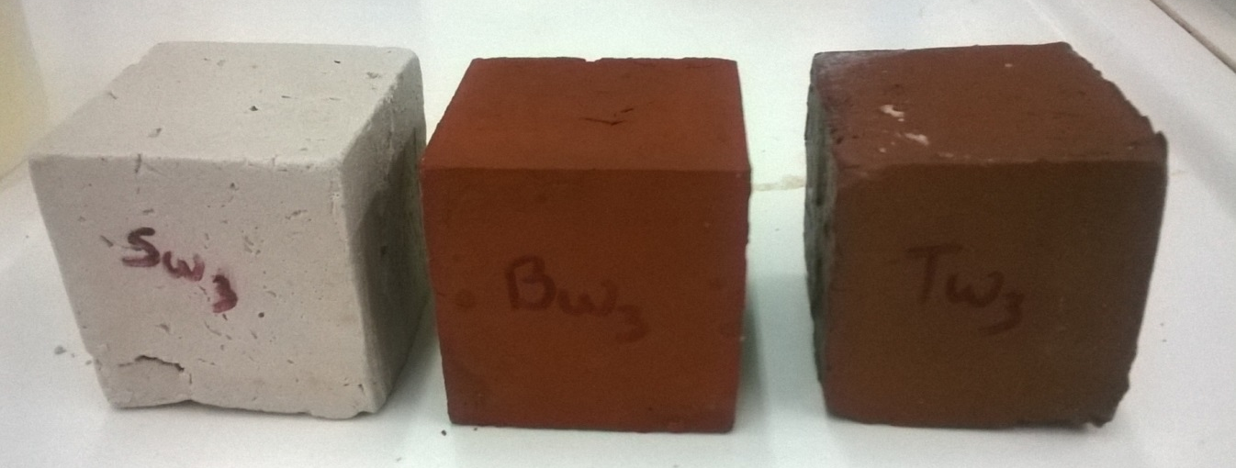
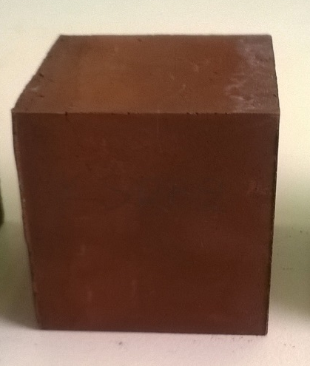
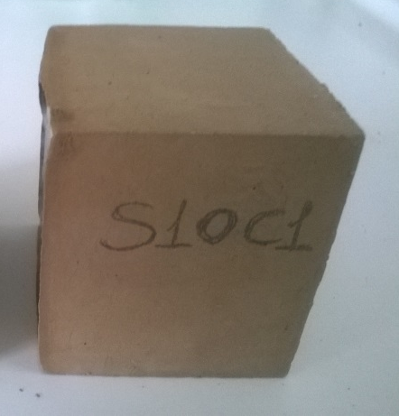
5 cm
5 cm
5 cm
Geopolymers from concrete, bricks and tiles (left to right)
Slag-red mud geopolymer
Slag-CDW geopolymer

Slide 9
Results and discussion

Slide 10
Figure 1: Compressive strength of geopolymers prepared by mixing slag with (a) CDW (eg. 50-20-20-10: % w/w 50 S-20 T-20 B-10 C) and (b) red mud (eg. 90-10: % w/w 90 S-10 R)
Slag-CDW geopolymers prepared with 10 M NaOH acquired higher compressive strength
The percentage of each CDW component in the initial mixture affects the compressive strength at 10 M NaOH
The compressive strength decreases gradually with increasing red mud %

Slide 11
Table 2: Molar ratios of oxides
 | S | T | B | C | R | Geopo-lymer 50-10-10-30 | Geopo-lymer 25-30-30-15 | Geopo-lymer 50S-50R
SiO₂/Al₂O₃ | 7.33 | 12.67 | 6.84 | 9.86 | 1.33 | 8.26 | 8.86 | 3.53
H₂O/(Na₂O+K₂O) | 8.30 | 9.03 | 8.32 | 6.62 | 8.11 | 6.96 | 6.10 | 6.66
SiO₂/(Al₂O₃+CaO) | 4.03 | 4.81 | 3.30 | 0.12 | 0.60 | 1.18 | 2.21 | 1.70
Strength, MPa | 76.1 | 57.8 | 39.4 | 7.8 | 2.5 | 59.2 | 78.4 | 38
S: slag, T: tiles, B: brick, C: concrete, R: red mud, eg. 50-10-10-30: % w/w 50 S-10 T-10 B-30 C

Slide 12
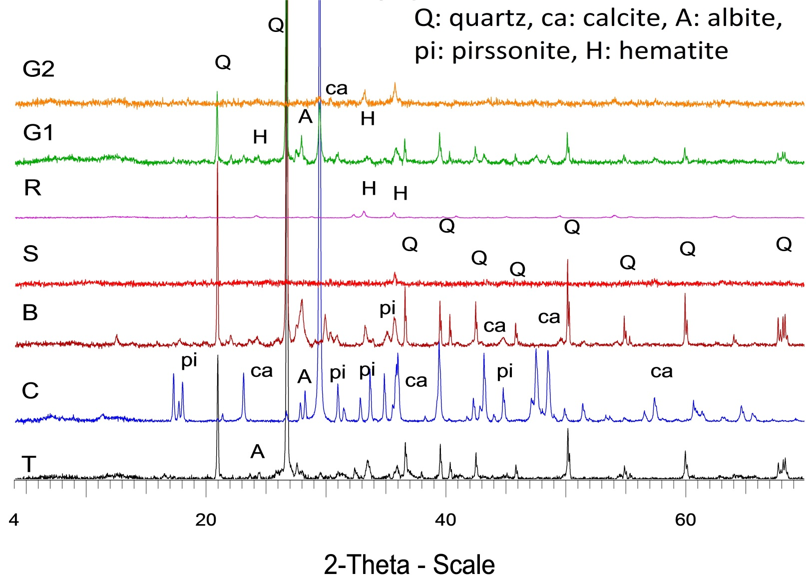
Figure 2: XRD patterns of geopolymers synthesized from slag, CDW and red mud (T: tiles, C: concrete, B: bricks, S: slag, R: red mud, G1:25-30-30-15% w/w S-T-B-C, G2: 50-50% w/w S-R)

Slide 13
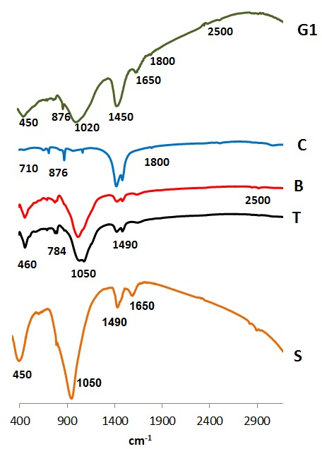
Figure 3: FTIR spectra of selected geopolymers (T: tiles, C: concrete, B: bricks, S: slag, G1:25-30-30-15% w/w S-T-B-C)

Slide 14
Conclusion
Slag can be successfully co-utilized with various by-products/wastes such as CDW and red mud
Production of geopolymers with compressive strength between 37 and 80 MPa using 10 M NaOH or KOH as alkali activator
The presence of the major fingerprints of the aluminosilicate geopolymeric matrix was revealed by XRD and FTIR analysis

Slide 15
Thank you
Technical University of Crete
School of Mineral Resources Engineering
Research unit “Management of Mining/Metallurgical Wastes and Rehabilitation of Contaminated Soils” http://www.mred.tuc.gr/3020.html
Acknowledgements
The present study has been co-funded by the European Commission (European Regional Development Fund) and by national funds through the Operational Programme “Competitiveness and Entrepreneurship” (OPCE ΙΙ 2007 - 2013), National Strategic Reference Framework – Research funded project: “Recycling of quarry dust and construction and demolition wastes for the production of novel ecological building elements”, DURECOBEL 11SYN_8_584, in the framework of the Action COOPERATION 2011– Partnerships of Production and Research Institutions in Focused Research and Technology Sectors.
Project website: http://www.durecobel.gr/

