Slide 1
Influence of chemistry of vitrified residues on the properties of blended inorganic polymers with calcined kaolinitic clay
E. François^{1,2}, J. Elsen¹, Y. Pontikes² & L. Machiels²
¹KU Leuven, Department of Earth and Environmental Sciences, 3001, Leuven, Belgium
²KU Leuven, Department of Materials Engineering, 3001, Leuven, Belgium

Slide 2
GOAL
Replace GGBFS in a GGBFS-metakaolin based inorganic polymer (IP) by alternative glassy precursors:
Limited availability and high price of GGBFS
Designing glass chemistry to have optimal properties
Three different glass chemistries:
 | GGBFS | GGBFS-glass | Mg-glass | K-glass
SiO₂ | 36.0 | 34.0 | 27.1 | 28.2
Al₂O₃ | 14.5 | 10.4 | 13.4 | 8.9
Fe₂O₃ | 0.4 | 14.2 | 14.1 | 13.7
CaO | 39.9 | 32.3 | 31.7 | 30.5
MgO | 6.9 | 1.7 | 8.1 | 2.3
K₂O | 0.7 | 0.8 | 0.6 | 8.5
Na₂O | 0.2 | 2.4 | 3.6 | 4.8
Others | 1.6 | 4.4 | 1.3 | 3.2

Slide 3
Reactivity
Based on:
Particle size distribution
Specific surface area
Amorphous content
Chemical composition
$$\frac{CaO+MgO+K_{2}O+{Na}_{2}O}{SiO_{2}+{Al}_{2}O_{3}}$$
Similar for the glasses
GGBFS-glass | Mg-glass | K-glass
0.84 | 1.09 | 1.24

Slide 4
Results and conclusion

Slide 5
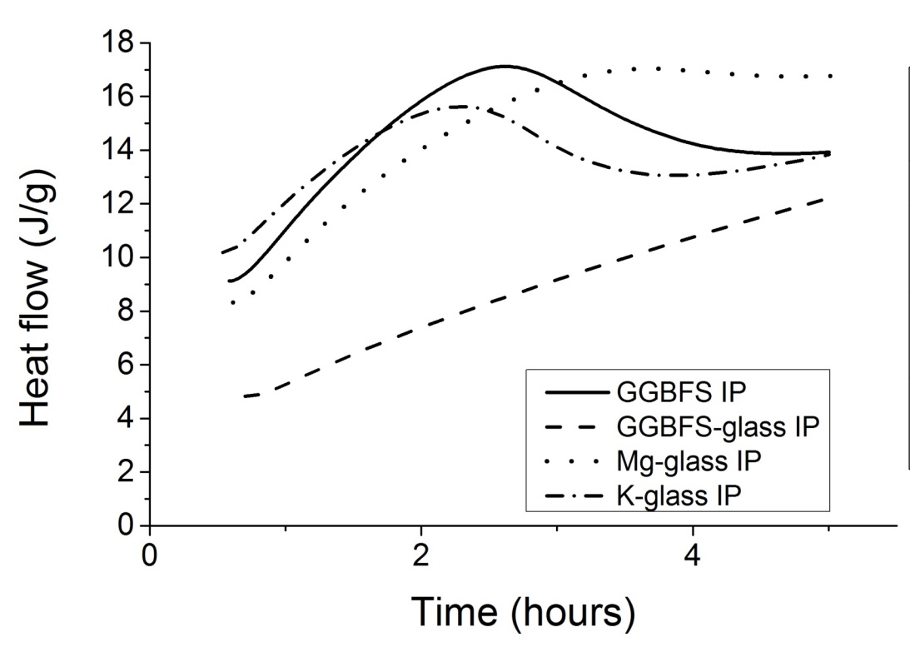
First hours
Setting time measured with vicat testing apparatus
 | Initial setting time (hours)
GGBFS | 1.2
GGBFS-glass | 2.6
Mg-glass | 1.2
K-glass | 0.8
Heat flow over time obtained with calorimetry
GGBFS-glass | Mg-glass | K-glass
0.84 | 1.09 | 1.24

Slide 6
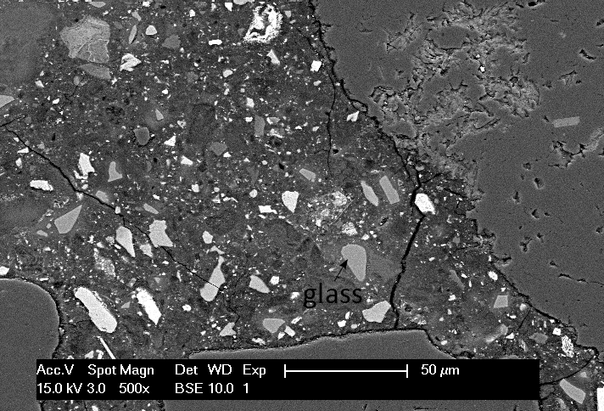
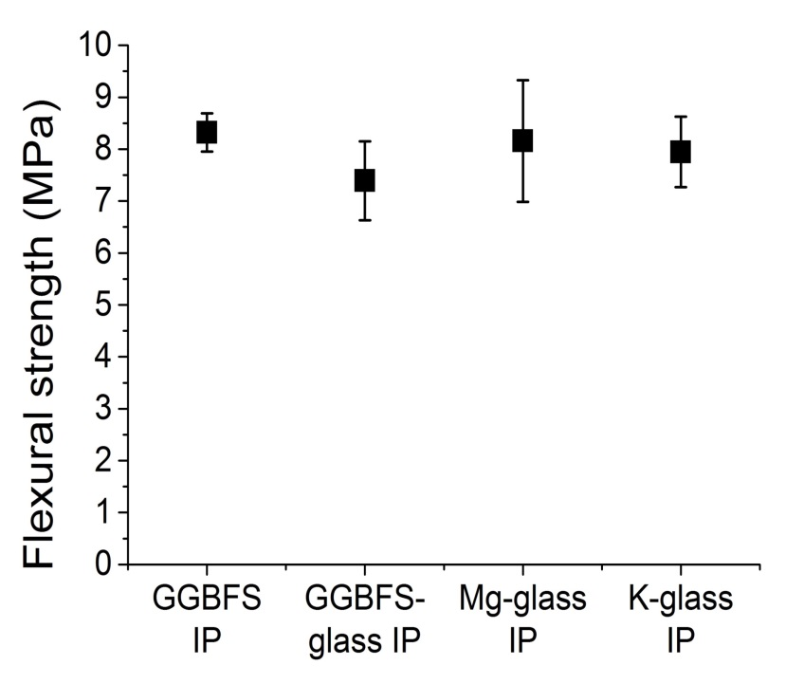
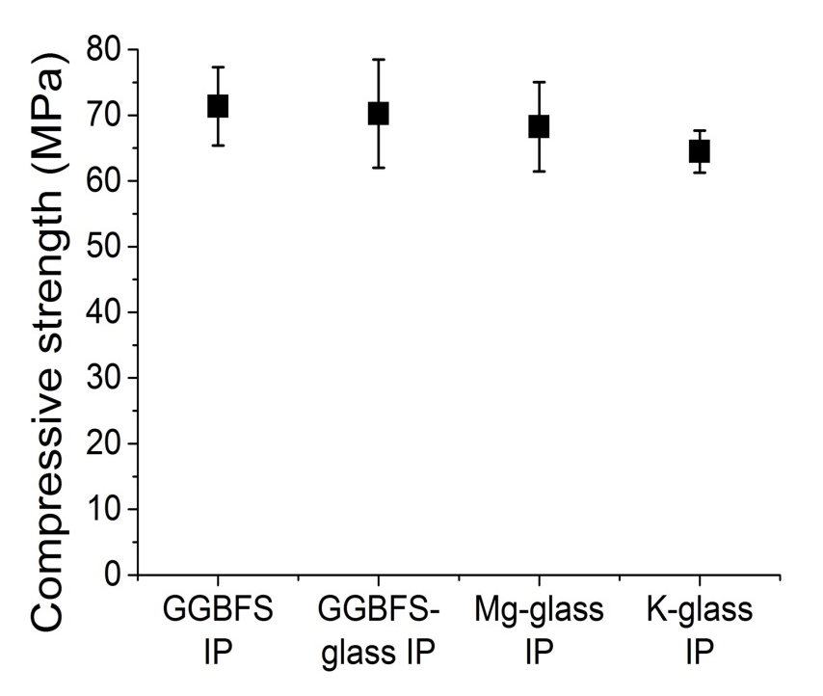
After several days of curing
Flexural strengths at 28 days
Compressive strengths at 33 days
BSE image of a representative inorganic polymer sample

Slide 7
Conclusion
During first hours: chemical composition has strong influence on IP properties
Glass with highest network-modifying to network-forming cations ratio reacts the fastest
After several days similar microstructures are observed and equal flexural and compressive strengths are obtained
Glass chemistry can be controlled to modify the setting time (0.8 to 2.6 hours) without affecting the final properties (strength, microstructure)

Slide 8
Thank you for your attention

