Slide 1

Modification of molten steelmaking slag for cement application
Joao B. FERREIRA NETO¹, Joao O. G. FARIA¹, Catia FREDERICCI¹, Fabiano F. CHOTOLI², Andre N. L. SILVA¹, Bruno B. FERRARO¹, Tiago R. RIBEIRO^{1,} Antonio MALYNOWSKYJ¹, Valdecir A. QUARCIONI², Andre A. LOTTO¹
¹ Laboratory of Metallurgical Processes, Institute for Technological Research (IPT), Sao Paulo – SP, Brazil
² Laboratory of Civil Construction Materials, Institute for Technological Research (IPT), Sao Paulo – SP, Brazil
4th International Slag Valorisation Symposium | Leuven | 15-17/04/2015

Slide 2
OUTLINE
Availability of BF slag in Brazil and use of SS slag as alternative for cement industry in Brazil
Effect of cooling rate and chemical composition on slags crystallization
Conclusions
4th International Slag Valorisation Symposium | Leuven | 15-17/04/2015
dis

Slide 3

Blast Furnace slag X Steel Slag → Cement Industry in Brazil
Near future scenario: There will be a lack of BF slag to supply the demand of cement manufacturing in Brazil
The steel production in Brazil has been around 32-34 millions t/y for last ten years. There is not any expectation of increasing X growth of construction industry in Brazil
Steel slag could be an alternative as cement mineral admixture, partially substituting the BF slag
Production of crude steel in Brazil (x1.000 t)
conc

Slide 4
26,6 MT steel x 120 kg SSlag/t steel
=
3,2 Mt of Steel Slag (BOF)
(~4 millions t of BF slag)
Crude Steel production in Brazil
Source: Instituto Aço Brasil
4th International Slag Valorisation Symposium | Leuven | 15-17/04/2015
T a

Slide 5
Objective: Development of autogenous process of liquid Steel Slag modification aiming its application as raw material in the portland cement manufacturing, partially substituting the BF slag
 | BF Slag | Steel Slag (Brazil)
CaO (%) | 41-44 | 36-46
MgO (%) | 6-7 | 5-12
SiO₂ (%) | 35-40 | 10-16
Al₂O₃ (%) | 10-13 | 1-4
FeO (%) | < 1,8 | 14-22
Fe₂O₃ (%) | - | 13,6
S (total) | 0,8-1,1 | 0,1-0,3
P₂O₅ (%) | - | 1,0-2,5
Basicity (CaO+MgO)/SiO₂ | 1,2-1,4 | > 3,0
Technological barriers to be overcome:
    - Chemical composition modification (decreasing of free CaO and MgO, Fe₂O₃/FeO and Fe)
    Transformation of mineralogical phases (appropriate phases with hydraulic activity for cement production
    Low cost by-products/residues must be used as transforming agents
    Use of heat content in SSlag for modification process
4th International Slag Valorisation Symposium | Leuven | 15-17/04/2015

Slide 6

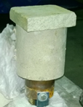
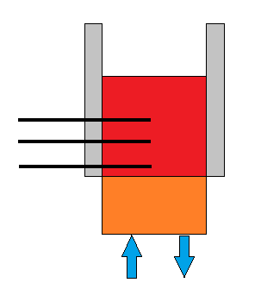
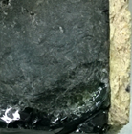
Effect of cooling rate and chemical composition on slags crystallization
Lab Scale (1 kg modified slag)
MgO crucible
SS slag + modyfing agents
Ceramic mold
Slag
TC 3
TC 2
TC 1
Cu Chilled plate
Water in
Water out
Slag
4th International Slag Valorisation Symposium | Leuven | 15-17/04/2015
SS rem ch
Glassy layer

Slide 7
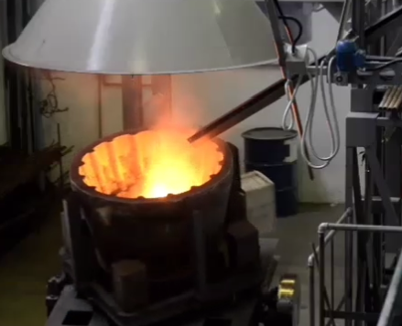
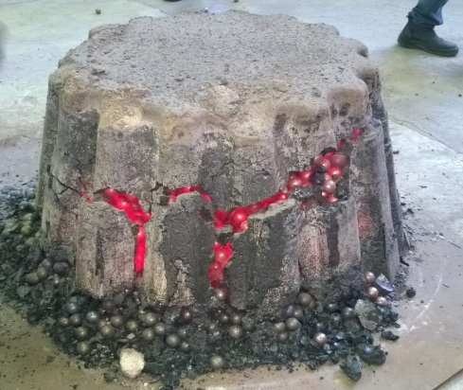
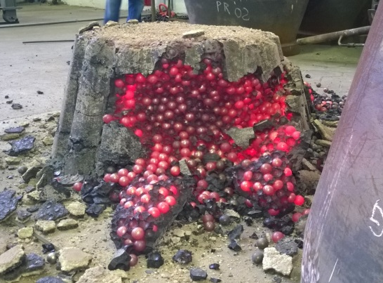
Effect of cooling rate and chemical composition on slags crystallization
Lab Scale (1 kg modified slag)
Pilot Scale (300 kg modified slag)
MgO crucible
SS slag + modyfing agents
Ceramic mold
SS slag + modyfing agents
Slag
TC 3
TC 2
TC 1
Cu Chilled plate
Water in
Water out
Slag
4th International Slag Valorisation Symposium | Leuven | 15-17/04/2015
Glassy layer

Slide 8
XRF
Modified Steel Slags
4th International Slag Valorisation Symposium | Leuven | 15-17/04/2015

Slide 9
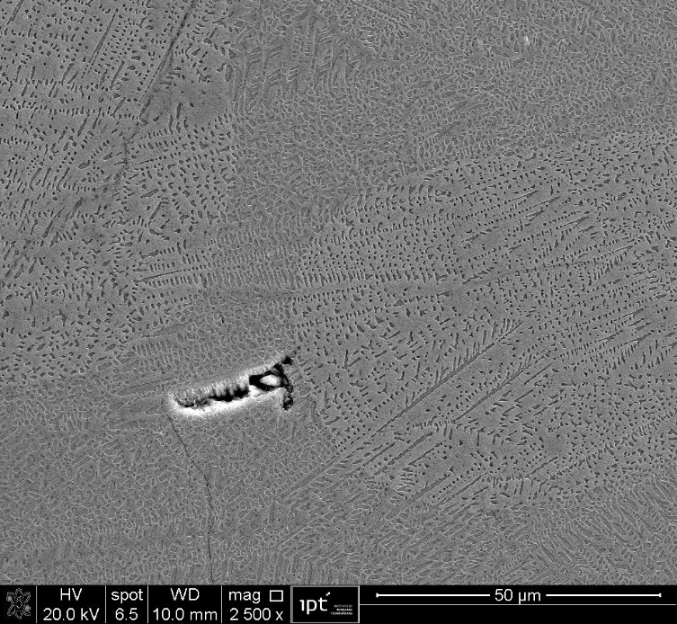
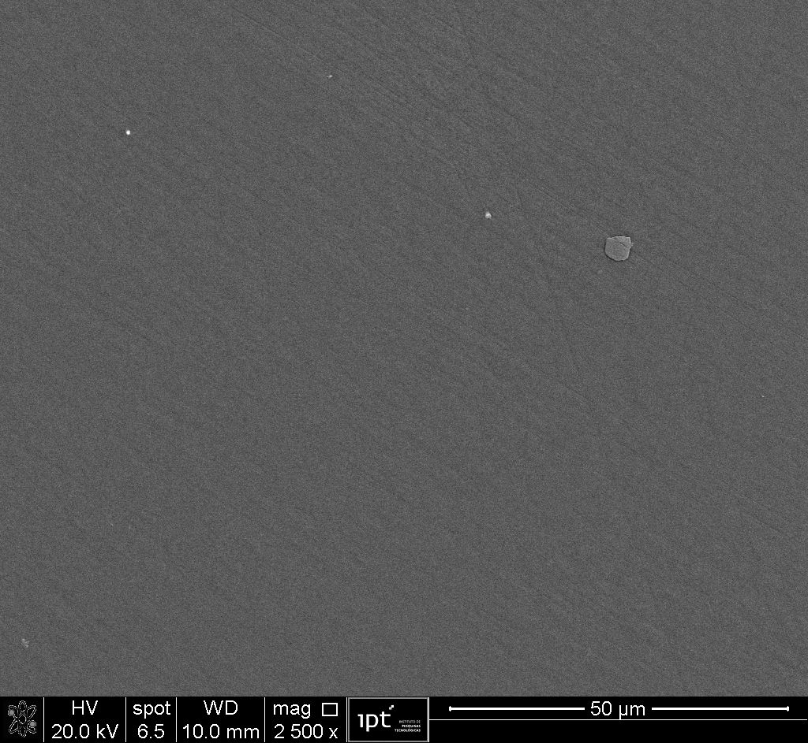
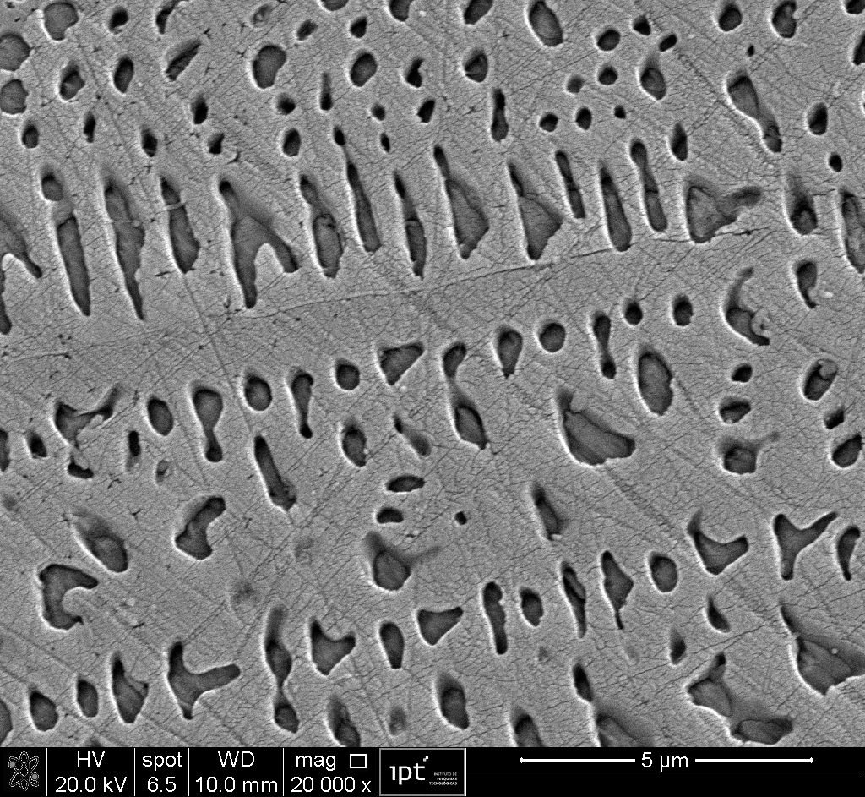
Blast Furnace Slag
XRF
XRD (Rietveld)
Slag
Cu Chilled plate
Water in
Water out
Obs: Slag remelted in graphite crucible
Merwinite, Akermanite, Melilite (solid solution between Akermanite and Gehlenite)
Typically found in BF slag cooled slowly
4th International Slag Valorisation Symposium | Leuven | 15-17/04/2015

Slide 10
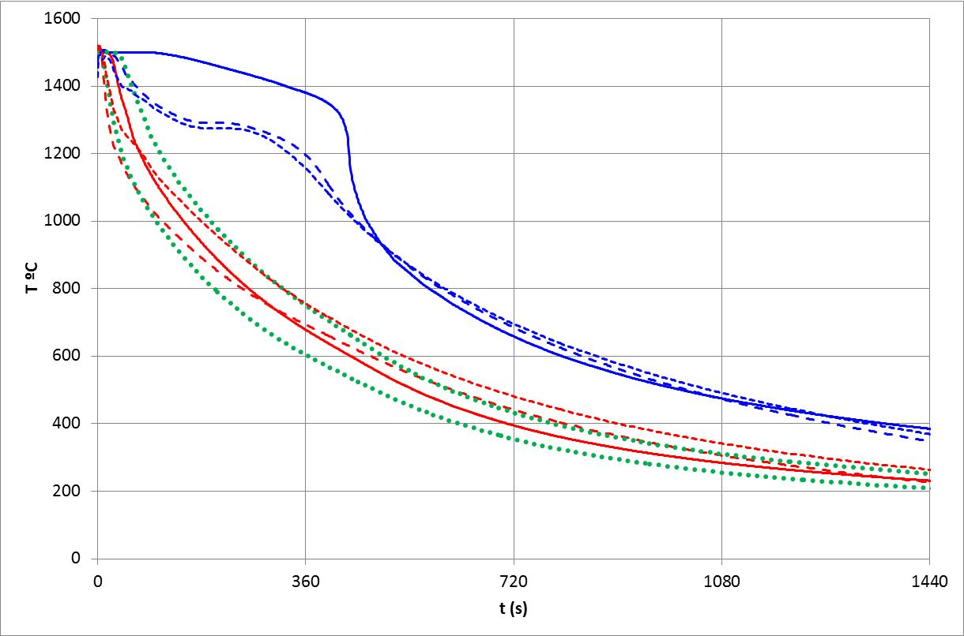
Cooling curves (experimental x Heat Transferring model)
HT Model
20 mm
Ceramic mold
TC2 – 20 mm
HT Model 3,5 mm
Slag
TC 2
TC1 – 3,5 mm
TC 1
HT Model
2 mm
HT Model
5 mm
Cu Chilled plate
Water in
Water out
under cooling rates faster than 4°C/s it would be possible to predict more than 95% of amorphous phase in BF slag
4th International Slag Valorisation Symposium | Leuven | 15-17/04/2015

Slide 11
Steel Slag
XRF
XRD
only 11,8% of amorphous phase even close to chilled plate
basicity Fe_{x}O_{y} (can act as nuclei for crystallization)
Crystalline phases typically found in steel slags: brownmillerite, larnite, RO phase (solid solution among FeO, MnO, MgO and CaO) and lime
Increasing of brownmillerite under slower cooling, since the calcium ferrite, or brownmillerite – Ca₂(Al,Fe)₂O₅) is one of the last phases to crystallize
Lime content (3,2 - 4,2%) too high in order to prevent volume soundness
4th International Slag Valorisation Symposium | Leuven | 15-17/04/2015

Slide 12
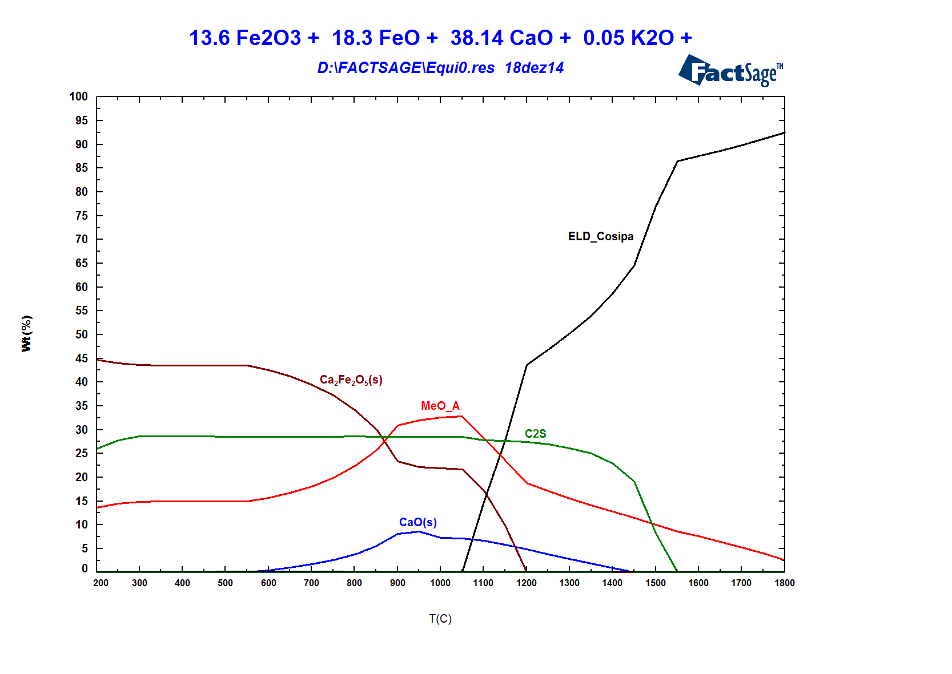
Steel Slag
XRD
Simulation of cooling
liq
liq
In ra

Slide 13
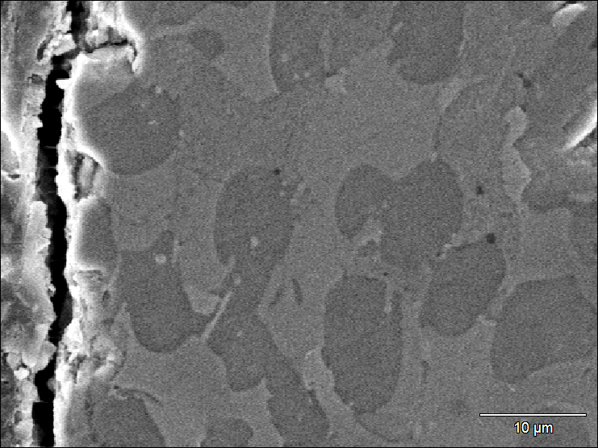
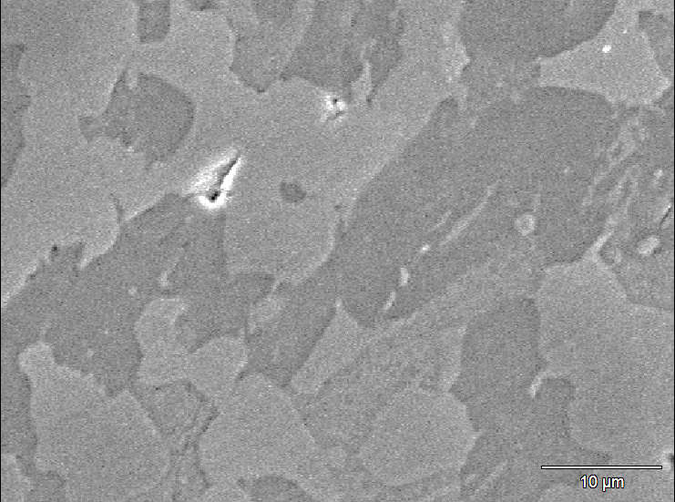
Steel Slag
RO
BM
C₂S
RO
BM
C₂S
BM
C₂S
RO
C₂S
(*) Fe as FeO
RO phase:
RO
RO
RO
RO/CaO
RO/CaO
CaO (wt %) | MgO (wt %) | FeO (wt %) | MnO (wt %)
7,5 | 25,4 | 54,1 | 13
RO calculated by mass balance (XRD Rietveld and XRF)
RO
MgO/FeO (at %): – 0,6 and 1,6
MgO/FeO
Volume Soundness

Slide 14
Modified Steel Slag (SS-M1)
XRF
XRD
Amorphous phase (did not change with the distance from the mold bottom) - Basicity (1,4) compared to the steel slag (B = 3,8)
RO (Fe_{x}O_{y} reduction - modifying agents and partially transferring of MgO from RO phase to the merwinite)
MgO stabilized as Merwinite
Free lime eliminated
4th International Slag Valorisation Symposium | Leuven | 15-17/04/2015

Slide 15
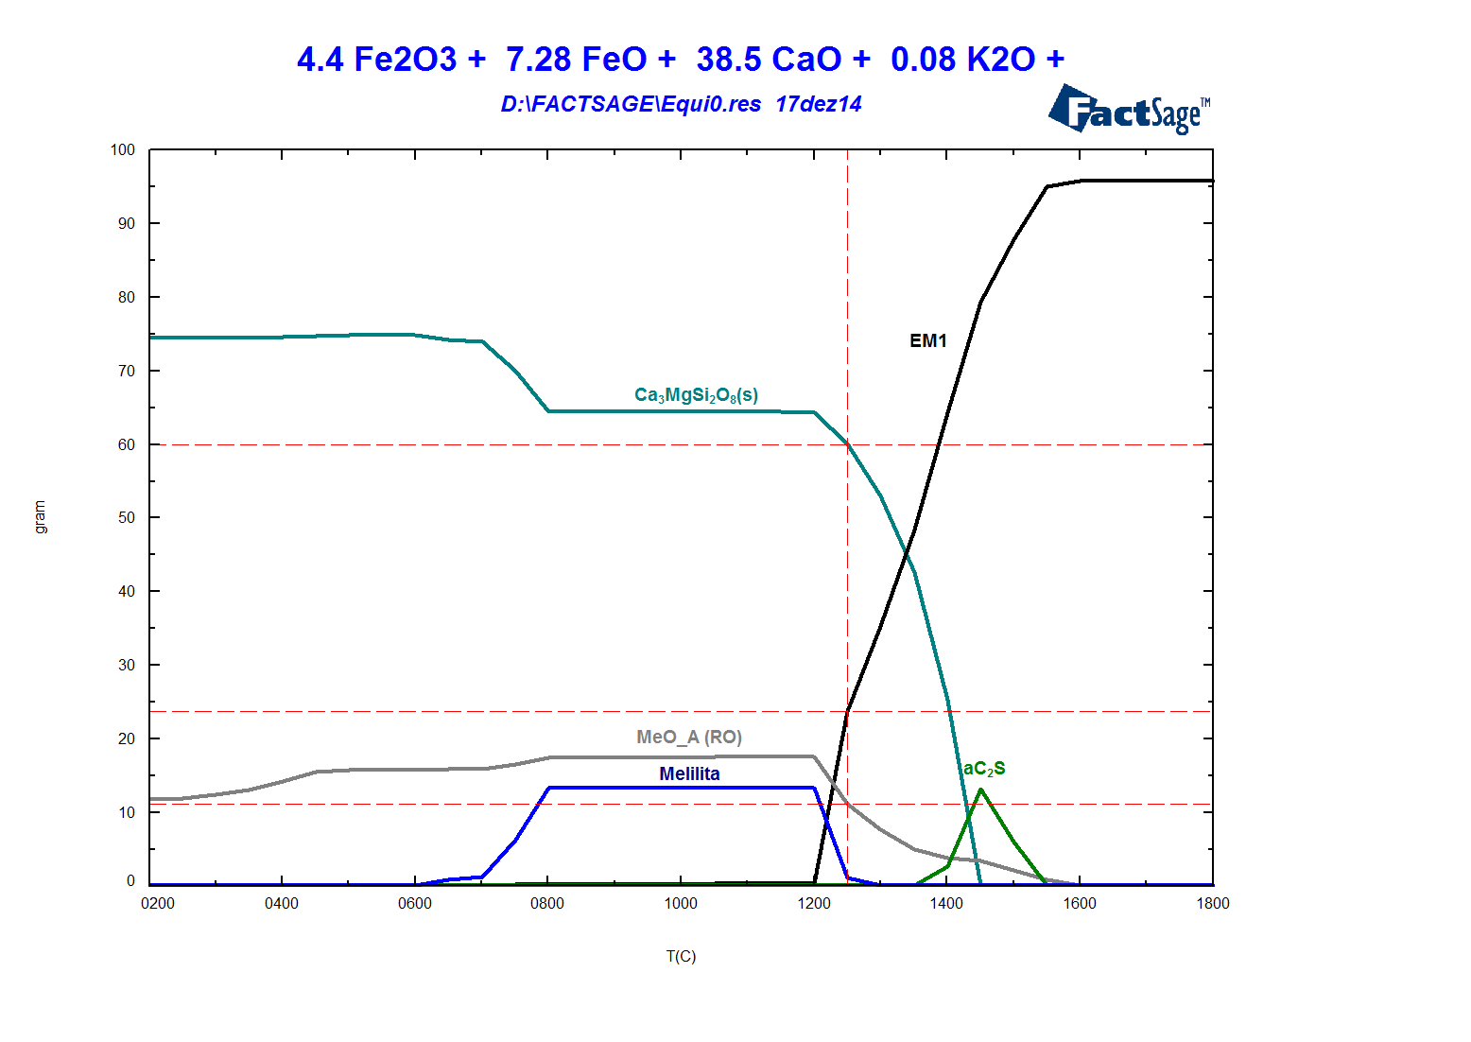
Modified Steel Slag (SS-M1)
Simulation of cooling
liq
4th International Slag Valorisation Symposium | Leuven | 15-17/04/2015

Slide 16
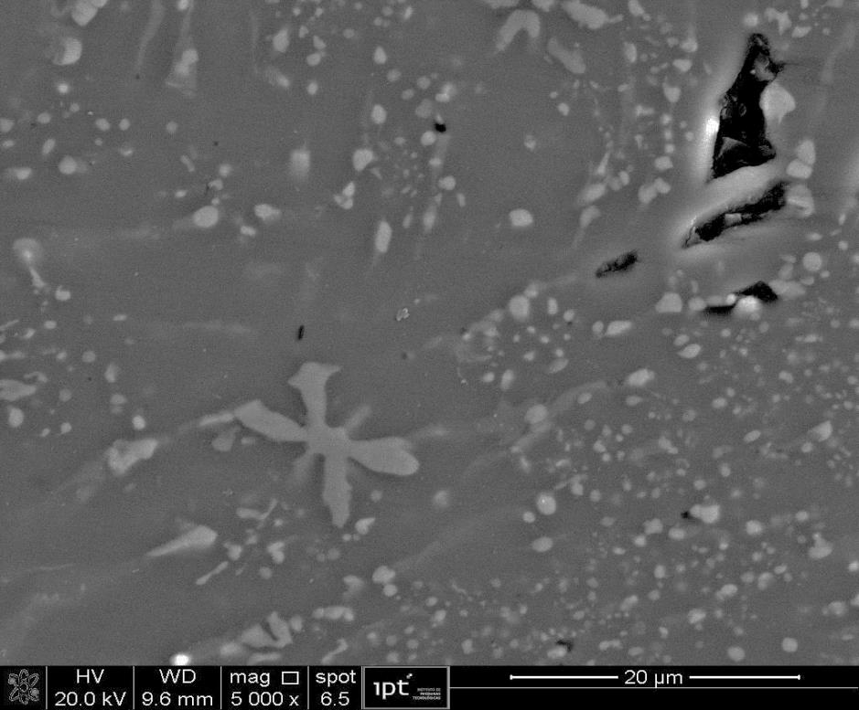
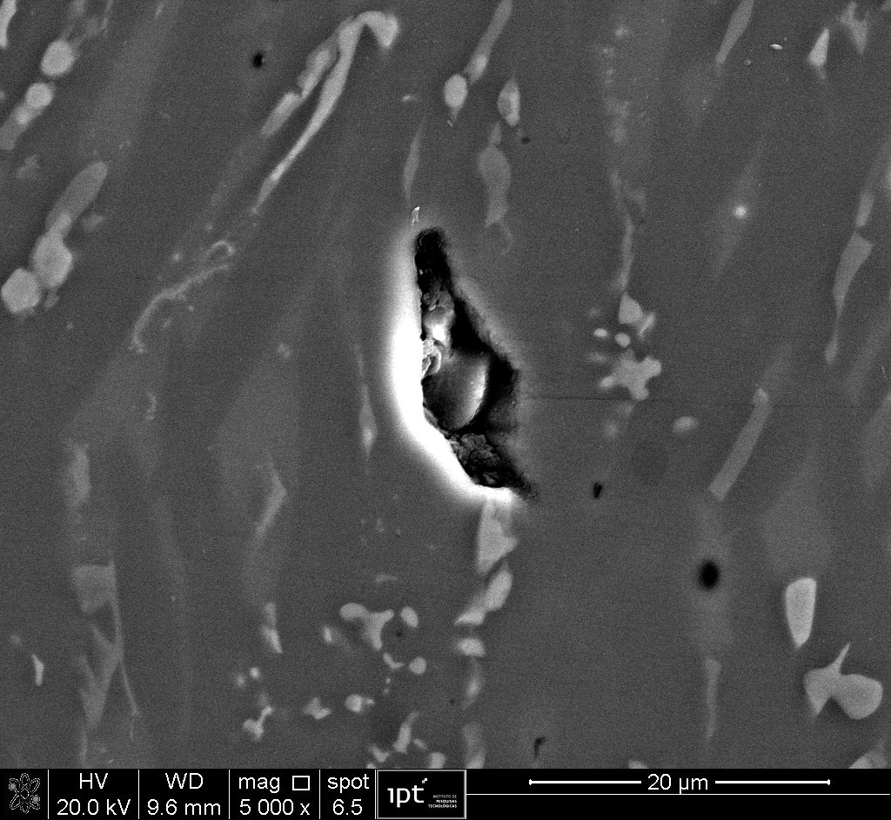
Modified Steel Slag (SS-M1)
Merwinite
glassy phase
RO
RO phase:
(*) Fe as Fe₂O₃
CaO |  | MgO |  | FeO |  | MnO
wt (%) | at (%) | wt (%) | at (%) | wt (%) | at (%) | wt (%) | at (%)
1,3 | 1,5 | 16,5 | 25,9 | 66,1 | 58,2 | 16,1 | 14,4
2 | 2,3 | 12,8 | 20,6 | 67,9 | 61,3 | 17,2 | 15,7
1,5 | 1,7 | 15,7 | 24,8 | 66,8 | 59,2 | 16 | 14,4
1,8 | 2,1 | 11,5 | 18,7 | 67,3 | 61,3 | 19,4 | 17,9
1,9 | 2 | 26,6 | 39 | 57,8 | 47,6 | 13,7 | 11,4
1,8 | 2,2 | 7 | 11,7 | 73,2 | 68,7 | 18 | 17,2
1,5 | 1,8 | 9,5 | 15,6 | 71,3 | 65,8 | 18 | 16,8
1,7 | 2 | 12,6 | 20,3 | 67,6 | 61,1 | 18,2 | 16,7
2,4 | 2,8 | 10,4 | 17 | 71,2 | 65,3 | 15,9 | 14,8
1 | 1,1 | 16,9 | 26,5 | 66,9 | 58,8 | 15,3 | 13,6
1,3 | 1,3 | 29,5 | 42,6 | 53 | 42,9 | 16,1 | 13,2
glassy phase
RO
Merwinite
MgO/FeO
MgO/FeO (at %): – 0,2 and 0,45
Could prevent volume soundness

Slide 17
Modified Steel Slag (SS-M2)
XRF
XRD
basicity and Fe²⁺ and Fe³⁺ compared to slag SS-M1 and Al₂O₃ (%) 11,5%
Stabilization of the glassy phase (close to the chilled plate) - similar to the BF slag (
Basicity and Al₂O₃
RO phase eliminated, MgO stabilized in phases with lower CaO/SiO₂ ratio than merwinite (3CaO.MgO.2SiO₂), such as monticellite (CaO.MgO.SiO₂) and akermanite (2CaO.MgO.2SiO₂)
Gehlenite formed in slag SS-M2 ( Al₂O₃)
4th International Slag Valorisation Symposium | Leuven | 15-17/04/2015

Slide 18
Amorphous (%) X Distance from Chilled Plate
> 4°C/s (> 95% amorphous)
Amorphous layer (SS-M2)
BF
(SS-M2)
SS-M1
ss
SS–M2 similar to BF slag (> 4°C – HT model - > 95% amorphous phase)
SS – no glassy even under high cooling rates
SS-M1 lower quantity of amorphous than BF or SS-M2 and independent from cooling rate

Slide 19
Modified Steel Slag (SS-M3) – 300 kg (reproduction of SS-M1 – larger scale)
XRF
XRD
NC. Natural cooling. SB. Cooling by steel balls
No significant differences between SS-M1 and SS-M3
Amorphous phase similar of SS-M1 and unaffected by cooling rate conditions (by NC or SB)
RO compared to the SS slag
MgO stabilized as XCaO.YSiO₂.ZMgO: Merwinite, Akermanite and Monticellite
Free lime eliminated
4th International Slag Valorisation Symposium | Leuven | 15-17/04/2015

Slide 20
Modified Steel Slag (SS-M4) – 300 kg ( B (%CaO/%SiO₂) Fe_{x}O_{y} reduction)
XRF
XRD
NC. Natural cooling. SB. Cooling by steel balls. WQ. Water quenching
Cooling rate (water quenching) amorphous
RO eliminated
MgO stabilized as XCaO.YSiO₂.ZMgO: Merwinite, Akermanite and Monticellite
Free lime eliminated
4th International Slag Valorisation Symposium | Leuven | 15-17/04/2015

Slide 21
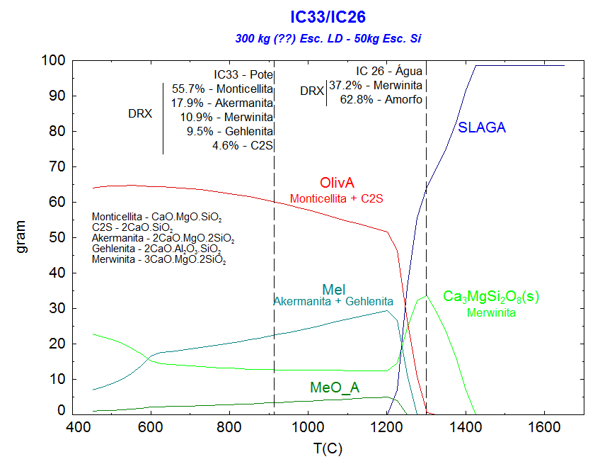
Modified Steel Slag (SS-M4)
NC. Natural cooling
WQ. Water quenching
Simulation of cooling
NC. Natural cooling. SB. Cooling by steel balls. WQ. Water quenching
FactSage™ predicts a decreasing of merwinite phase and an increasing of monticellite phase under slowly cooling (natural cooling), behavior also observed in slag SS-M3
4th International Slag Valorisation Symposium | Leuven | 15-17/04/2015

Slide 22
Modified Steel Slag (SS-M5) – 300 kg ( B (%CaO/%SiO₂), Fe_{x}O_{y} reduction, Al₂O₃ )
XRF
XRD
b. Cooling by steel balls
Larnite (hydraulic activity)
Al₂O₃ in Gehlenite
MgO stabilized as Merwinite and RO
Free lime eliminated
4th International Slag Valorisation Symposium | Leuven | 15-17/04/2015

Slide 23
75% of ordinary Portland cement and 25% of slag SS-M4 and SS-M5
- No volume soundness (under cold or hot water) – ISO EN 196-3
- Autoclave test (ASTM C 151): Expansion 10X lower (0,04% - M4 or 0,07% - M5) than 75% cement and 25% SS slag (0,44%)
Slag can be considered stabilized
Accumulated Heat (72 h) of cement sample with 25% SS-M5: 314 J/g > 299 J/g (75% cement and 25% BF slag)
Specified Strengths
Standard NBR 11578 (similar to EN 197-1)
Compressive Strength
4th International Slag Valorisation Symposium | Leuven | 15-17/04/2015

Slide 24
Conclusions
Only under cooling rates higher than 4°C/s was possible to achieve more than 95% of glassy phase in blast furnace slag.
The crystalline fraction of BF slag showed phases: akermanite, merwinite and melilite, which are typically found in BF slags cooled under slow rates.
The SSlag was mostly crystalline, even under fast cooling, showing phases typically found in this type of slag: brownmillerite, larnite, RO phase and lime. It also showed an increasing of brownmillerite under slower cooling, since the calcium ferrite or brownmillerite is one of the last phases to crystallize.
Higher silica and alumina and lower iron oxides in modified slags contributed to the glassy phase formation under fast cooling. Furthermore, the amount of RO phase decreased as consequence of iron oxides reduction as well as MgO stabilization in merwinite, monticellite and arkemanite.
MgO/FeO ratio of RO phase in modified slags are lower than MgO/FeO ratio of RO phase in SSlag, decreasing a possible expansion effect of RO phase.
4th International Slag Valorisation Symposium | Leuven | 15-17/04/2015

Slide 25
Conclusions
The stabilization of modified slags was demonstrated by volume soundness test carried out under cold and hot water, which did not show any expansion, or by low expansion (0,04 and 0,07%) observed in tests carried out in autoclave (ASTM C 151) with cement samples produced by a mixture between 75% of ordinary cement and 25% of modified slags.
The cement produced with this mixture generated an accumulated heat of 314 J/g in 72h, while the same mixture based on BF slag resulted in 299 J/g. The compressive strength in 3, 7 and 28 days were 29,9 MPa; 37,7 MPa and 41 MPa, respectively, values higher than minimum specified in the same ages according to standard NBR 11578.
4th International Slag Valorisation Symposium | Leuven | 15-17/04/2015

Slide 26
Thank you!
Contact:
João Batista Ferreira Neto
Laboratory of Metallurgical Processes
Institute for Technological Research - IPT
Sao Paulo - Brazil
Tel.: +55 11 3767.4244
jbfn@ipt.br
4th International Slag Valorisation Symposium | Leuven | 15-17/04/2015

Slide 28
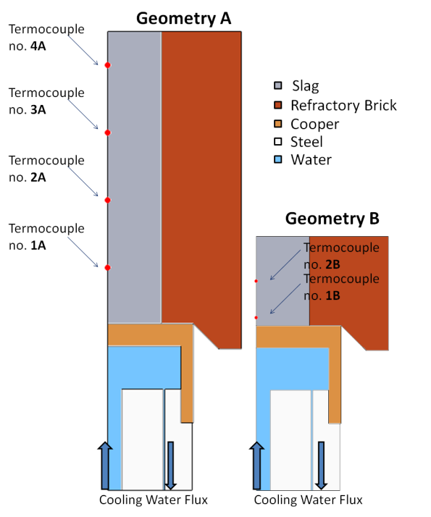
Heat transferring CFD model
Developed in COMSOL Multiphysics^{tm} software;
It was considered a 2D axisymmetric geometry for the assembly;
The mesh element size was less than 1 mm;
The physical properties of the slag was estimated according with Mills et al (2011)^{[1]};
Boundary conditions:
  There is heat loss by radiation in the top of the geometry and by natural convection in the extern walls;
  At initial time, the temperature of the slag was set to 1500 – 1600 °C depending on the slag condition. The temperature of the mold and cooper plate was set to 600 °C.
The contact between the slag and the cooper plate was adjusted for heat transferring, considering a convection coefficient of 200 W/m²°C. This coeficient was obtained by comparision with experimental data;
Fig A . Ceramic mold fixed over a copper plate cooled by water
[1] K. Mills, L. Yuan and R. Jones, "Estimating the physical properties of slags," The Journal of The Southern African Institute of Mining and Metallurgy, vol. 111, pp. 649-658, 2011

Slide 29
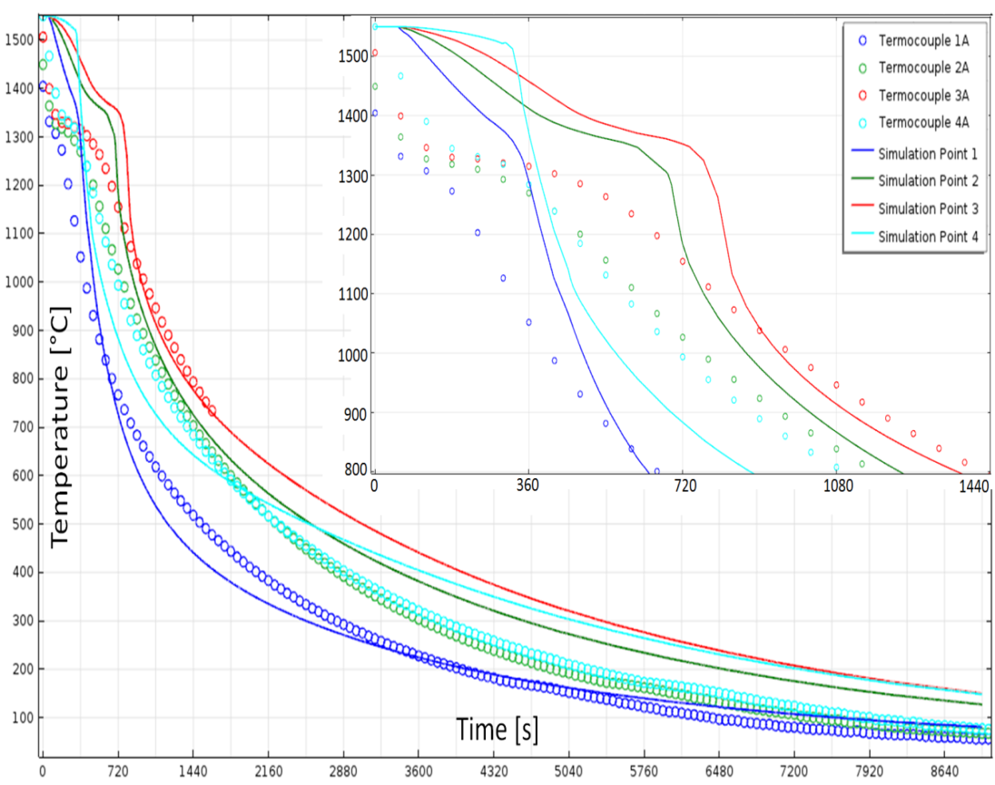
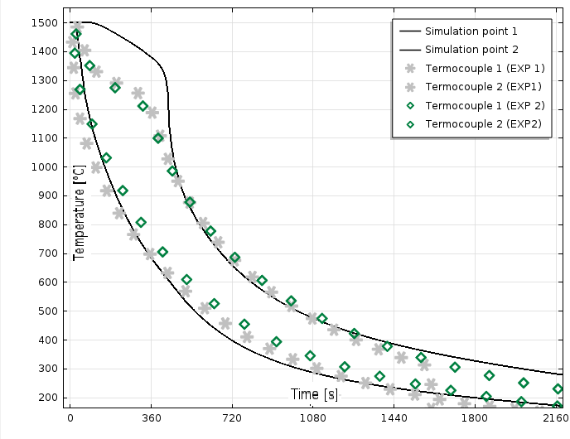
Heat transferring model
Fig B . Model simulation and experimental data for BF slag for geometry A.
Fig C . Model simulation and experimental data for BF slag for geometry B.

Slide 31
BF Slag

Slide 32
SS Slag

Slide 33
Modified Steel Slag (SS-M1)

Slide 34
Modified Steel Slag (SS-M2)

