Slide 1
Solid-phase characterization of blasted copper slag in relation to the potential release of toxic elements
Tran Thi Thu Dung^{1,3}, Valérie Cappuyns^{1, 2}, Elvira Vassilieva¹, Asefeh Golreihan¹, Nguyen Ky Phung⁴, Rudy Swennen¹
¹Department of Earth and Environmental Sciences, KU Leuven, 3001 Leuven, Belgium
² Center for Economics and Corporate sustainability (CEDON), KU Leuven, 1000 Brussels, Belgium
³ Faculty of Environment, VNUH-HCMUS, Ho Chi Minh City, Vietnam
⁴Department of Science and Technology, Ho Chi Minh City, Vietnam
15-17 April 2015, Leuven, Belgium

Slide 2
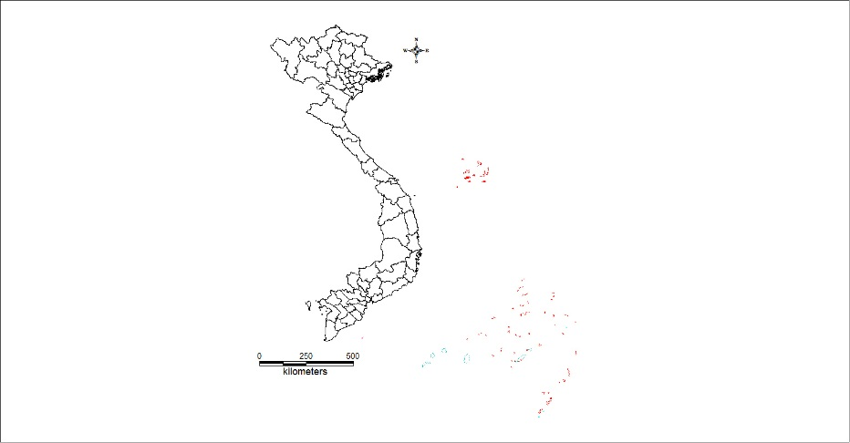
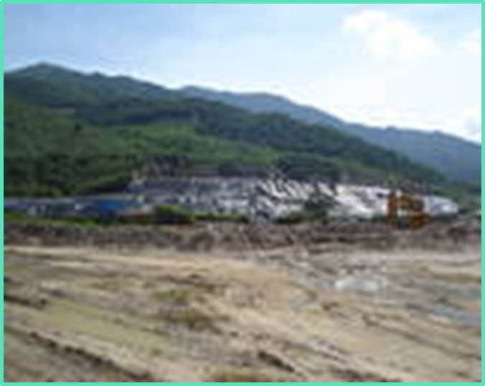
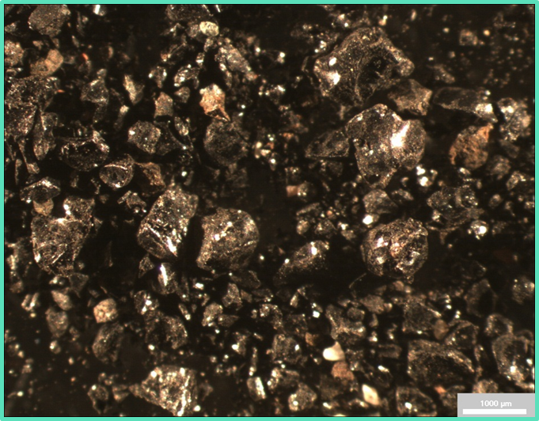
Introduction-Objectives Background
The slag in the present study has been used as a blasting agent in a shipyard located in South-Central Vietnam
Dump site
Blasted copper slag sample
Investigate the relationship between the occurrence and the potential mobility of toxic elements.
Examine the pH conditions under which the toxic elements may be mobilized.

Slide 3
Methodology
Solid-phase characterization
X-ray diffraction (XRD)
Field Emission Gun Electron Probe Micro Analysis (FEG-EPMA)
The influence of pH on release of toxic elements
Batch extractions (24 h) with different concentrations of HNO₃
pH_{stat} (pH = 10, 96 h) experiment

Slide 4
