Slide 1
Funding opportunities under the EC- RFCS Programme
Bjorn Debecker
European Commission
DG Research and Innovation
Research Fund for Coal and Steel
Slag Valorisation Symposium
17/4/2015 Leuven

Slide 2
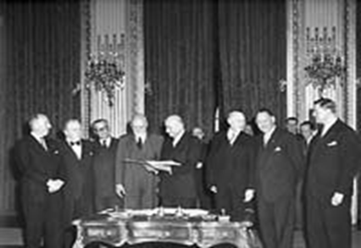
History of the RFCS Programme
From the past … European Coal and Steel Community (ECSC)
  1952: ECSC Treaty of Paris (validity 50 years, expired in 2002)
  Levy from coal and steel production
  Assets left : ~ 1.6 billion €

Slide 3
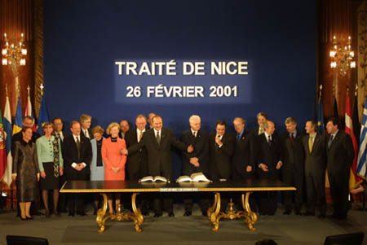
History of the RFCS Programme
… to the present: Research Fund for Coal and Steel (RFCS):
  2001 - Treaty of Nice: Decision to transfer the ECSC assets (originally paid by industry) to the European Community and utilise the interests generated by these assets (now ~ 2,0 billion €) to co-finance research in coal and steel
  Creation of the RFCS: 1 February 2003

Slide 4
The RFCS Programme
A research fund with a budget of ~ 50 M€ / year, no taxpayer money
Promoting industrial research in the field of Coal and Steel
Yearly call with deadline 15 September for proposals for
  Research projects (60% funding)
  Pilot & Demonstration projects (50% funding)
  Accompanying measures (60 - 100% funding)
Outside the FP/H2020 … yet closely co-ordinated & complementary

Slide 5
RFCS Facts & Figures
Approx. 350 Grant Agreements running at any one time
563 M€ funding in Coal and Steel research since 2003 ≈ 940 M€ total spending
Mixture of industry, academia and research centres
Technical, innovative projects, well defined objectives
Can be complimentary to other funding (e.g. national funding)
Coal
27.2%
Steel
72.8%
RFCS funding allocation

Slide 6
Management of the Programme
3 levels assisting the Commission
Coal and Steel Committee
(COSCO)
28 Member state representatives:
give opinion on
projects to be funded, etc.
Commission:
DG RTD, Dir D, Unit D4
Representatives from stakeholders:
give advice on the overall programme managament
Coal and Steel Advisory Groups (CAG/SAG)
Technical experts: give advice on
project monitoring
Technical Groups (TGC/TGS)

Slide 7

Who can participate?
Simple rules
Any legal entity established in the EU28 Member States
Partners outside EU28 are entitled to participate but without receiving financial contribution
Typical projects
Focused on industrial participation
Dedicated and manageable consortium (5/8 partners)
Average funding 1 – 2 M€ per project
Duration typically 3 – 4 years

Slide 8
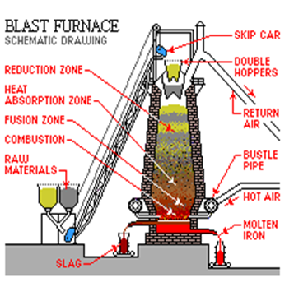
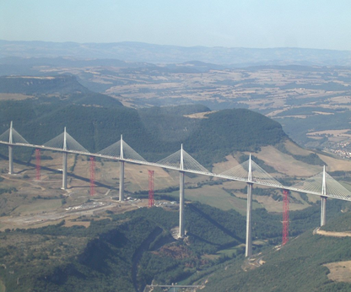

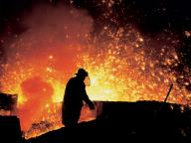
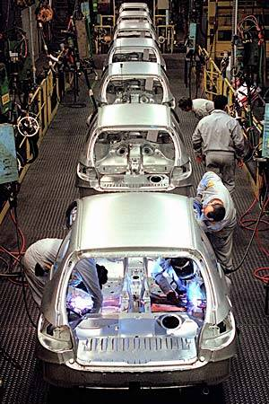
STEEL: Programme Research Objectives
New and improved
steelmaking and finishing
techniques
Programme objectives established in the RFCS Legal Basis, coming from EC Council Decision
"..reducing emissions, energy consumption and the environmental impact
as well as enhancing the use of raw materials
and the conservation of resources shall form an integral part of the improvements sought."
Conservation of resources
and improvement of
working conditions
Research on
the utilisation
of steel

Slide 9

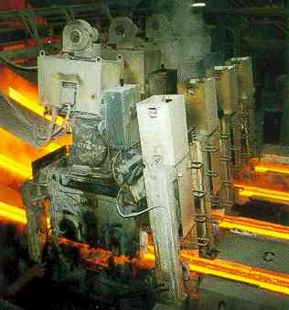
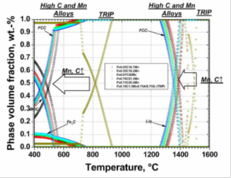
STEEL Technical Groups
TGS 1 Ore agglomeration and iron making
TGS 2 Steelmaking processes
TGS 3 Casting
TGS 4 Hot and cold rolling processes
TGS 5 Finishing and coating
TGS 6 Physical metallurgy and design of new generic steel grades
TGS 7 Steel products and applications for automobiles, packaging home appliances
TGS 8 Steel products and applications for building, construction and industry
TGS 9 Factory-wide control, social and environmental issues
Notes:
Taking a look at the technical groups defined in the legal basis of the Programme you can see that the scope for reserch topics is very wide, from steelmaking to casting and rolling
New steel grades, applications, including appliances, and social and environmentel issues. Both emissions and working conditions

Slide 10
Annual Research Priorities
The long-term strategy of the RFCS is based on annualy updated priorities identified by stakeholder platforms (ESTEP,…)
Proposals adressing an annual research priority receive 1 extra point in evaluations
9 Annual Steel Priorities in 2015, among which:
3. New or improved resource efficient processes to transform low quality primary raw materials or secondary raw materials (e.g. slag, dust, scale, sludge, low quality scrap) into valuable products
4. Solutions directly aiming at minimizing the ecological footprint of the Steel Works with respect to one of the following issues: air, water, soil, biodiversity and CO2 emissions

Slide 11
RFCS Slag Valorisation projects
RFSR-CT-2013-00032 PSP-BOF Removal of Phosphorus from BOF-slag (to separate useable slag substances)
RFSR-CT-2012-00006 SLACON Control of slag quality for utilisation in the construction industry (cf. presentation D. Mudersbach; poster B. Wendler)
RFSR-CT-2011-00037 SLAGFERTILISER Impact of long-term application of blast furnace and steel slags as liming materials on soil fertility, crop yields and plant health
RFSP-CT-2009-00028 SLASORB Using slag as sorbent to remove phosphorus from wastewater

Slide 12
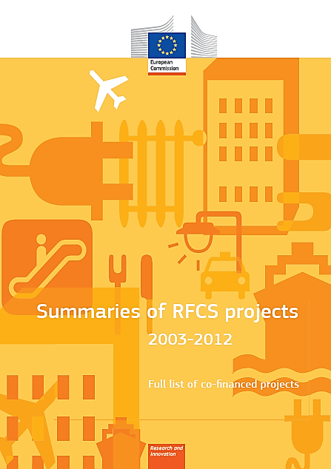
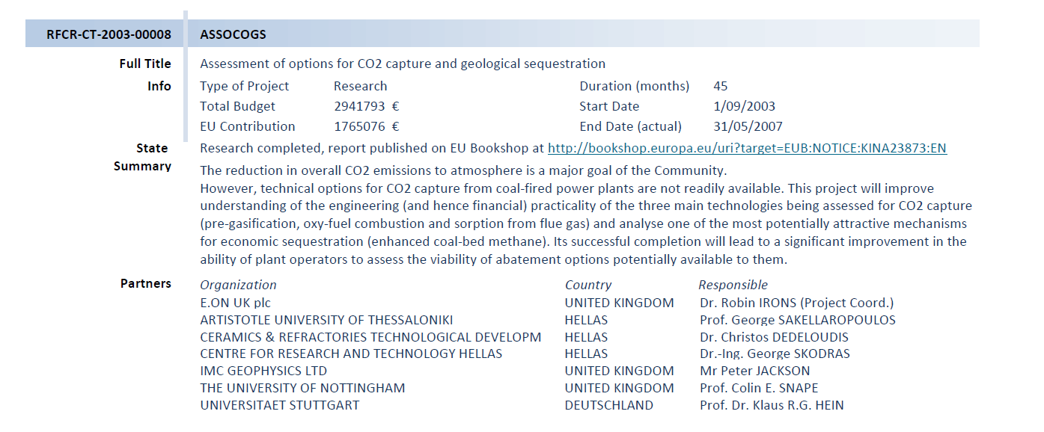
Past & ongoing RFCS projects
Online RFCS projects synopsis
(comprehensive overview on all RFCS projects)

Slide 13
Programme timeline (yearly)
budget cut-off
Ranking
CAG/SAG
COSCO
Commission
Implementing
Decision
Call deadline
GA preparation
Evaluations
PROJECT
START
Proposals
received
Eligibility
check
Above
threshold
First Main
list
Final List
15/3
usually
1/7
15/9

Slide 14
Project timeline
First prefinancing (40%)
Second prefinancing (40%, under conditions)
Balance payment (20%, under conditions)
PROJECT
START
TG advice on report approval
PROJECT
END
TG advice on report approval
First Annual report
Mid term report
n Annual Reports
Draft Final Report
Publishable Report
Technical Group Monitoring (Yearly meetings, continuous assistance)

Slide 15
Proposals received
Steel Evaluations 2013:
187 proposals submitted
→32 proposals funded
Trends per year since 2003

Slide 16
How can you take part?
By submitting a proposal
      2015 deadline is 15/9
      Updated 2015 Infopack to be published in June
    As an expert evaluator
      Help us evaluate proposals.
      Register on the expert web site
      Next Steel Evaluations in Brussels, Nov 2015

Slide 17
Web Links
RFCS website
http://cordis.europa.eu/coal-steel-rtd/
Register as Technical Expert
http://ec.europa.eu/research/participants/portal/desktop/en/experts/index.html

Slide 18
Thank you for your attention !
Questions?

