Slide 1
The Metallo Slag Cleaning Challenge:
Combined metal and slag valorisation
Mathias Chintinne
16 April 2015

Slide 2
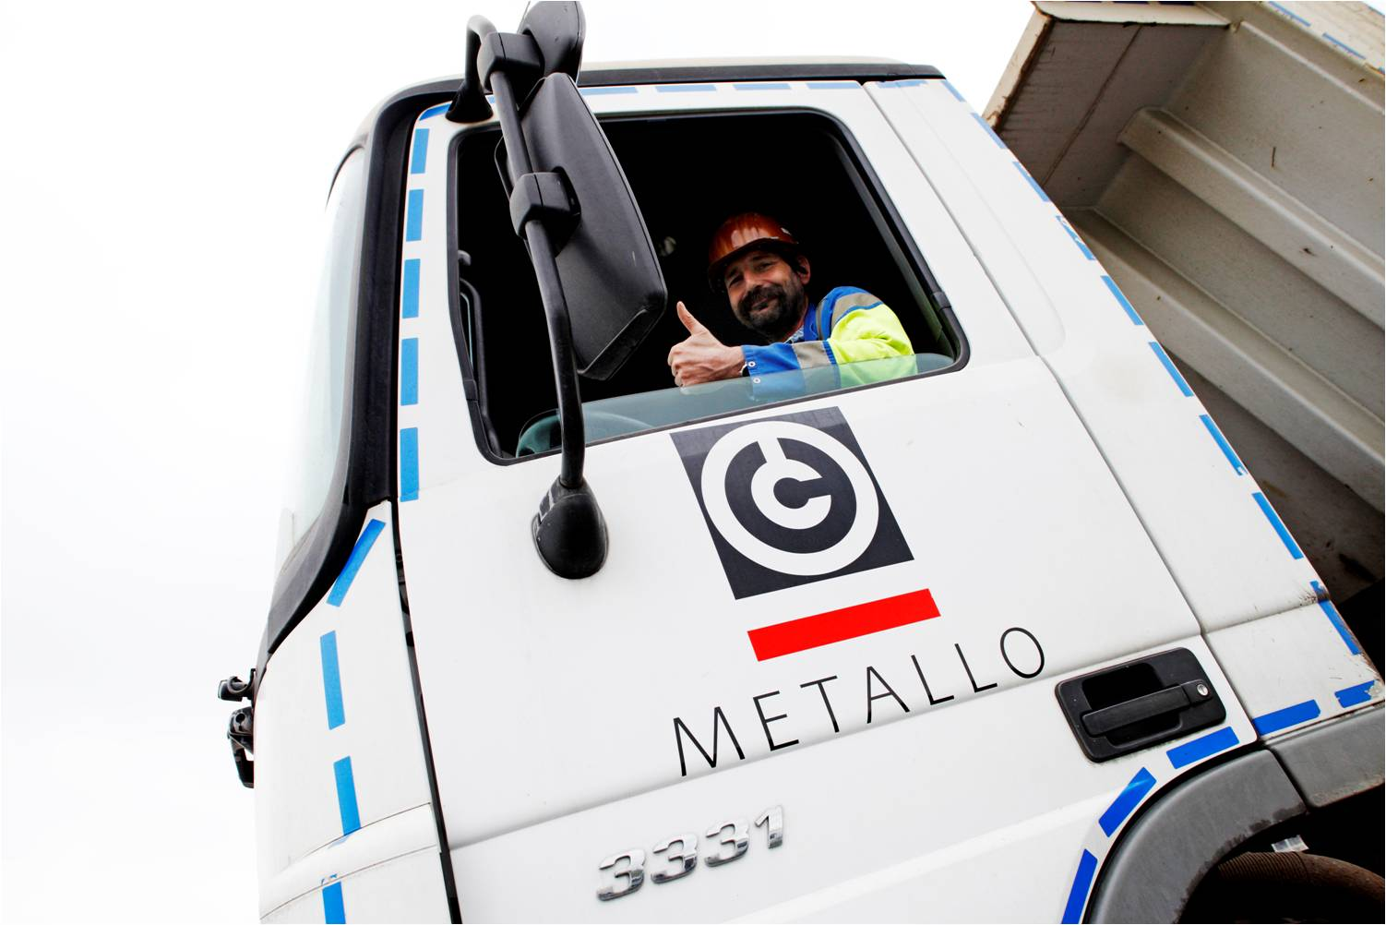
Exploring
Metallo-Chimique

Slide 3
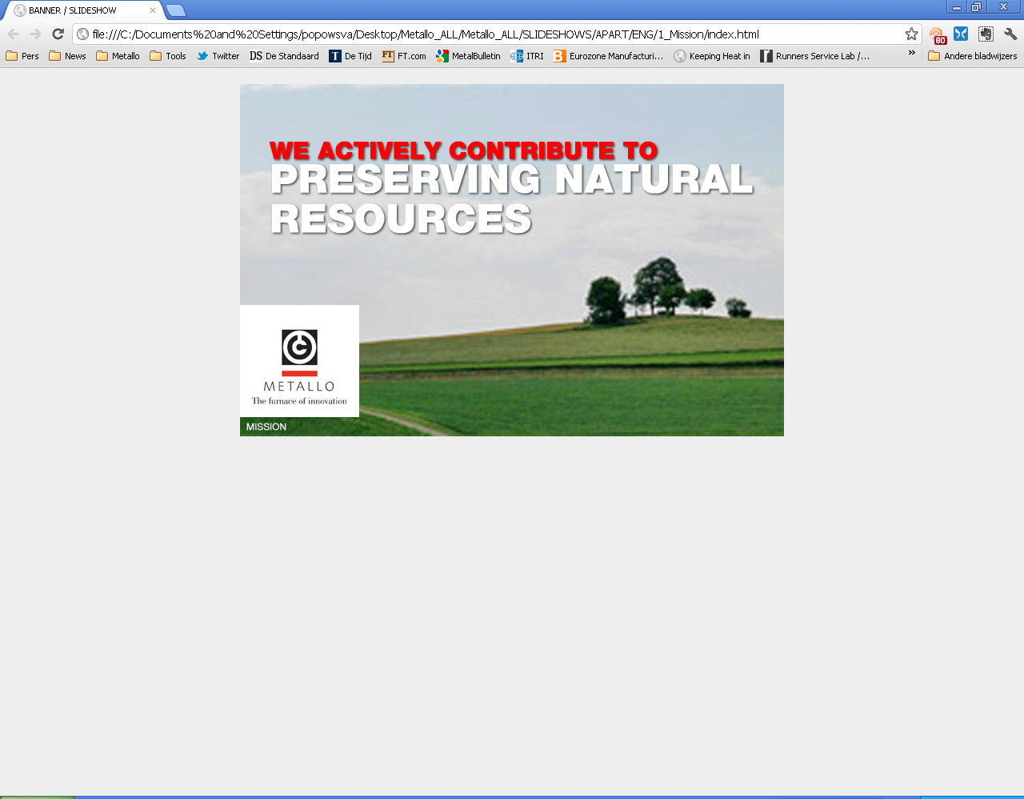
Key Features
As a recycling company, Metallo valorizes complex non-ferrous materials, returning metals back into the value chain.
Almost 100 years tradition
Metals of interest: copper, tin, lead, nickel, zinc
The world’s largest tin recycler
Unique and innovative processes
Caring for the environment

Slide 4
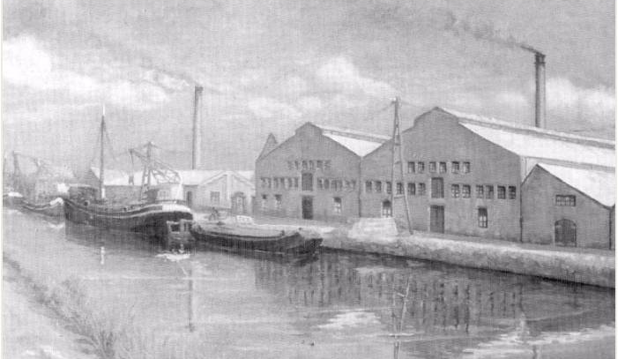
A company with a history

Slide 5
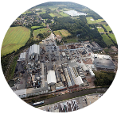
A company with a history
  1970’s:
    switch towards treatment of exclusively secondary raw materials & installation of TBRC-furnace
  2010:
    Installation of a new tankhouse
  2012:
  Installation of additional lead-tin vacuum furnaces & casting wheel
  1986:
  Acquisition of Ercosa (Former Elmet) in Bilbao, focusing on the production of ‘black copper’.
  1950’s:
    Modernizing of the foundry & installation of a tankhouse
  2013:
  TowerBrook Capital Partners (PE) & Installation of a new lab
  1919:
    Creation of “La Metallo-Chimique“ after WWI
  1960’s:
    First introduction to copper recycling
  2007:
    Capital Partner Groupe Alpha (PE), stepping out of a family era
  1920’s:
    Production rises up to 600 tons of copper sulphate monthly
  2000:
    Focus on the treatment of low grade & complex scrap
  1983:
    1st Vacuum Furnace for pure Pb Sn production

Slide 6
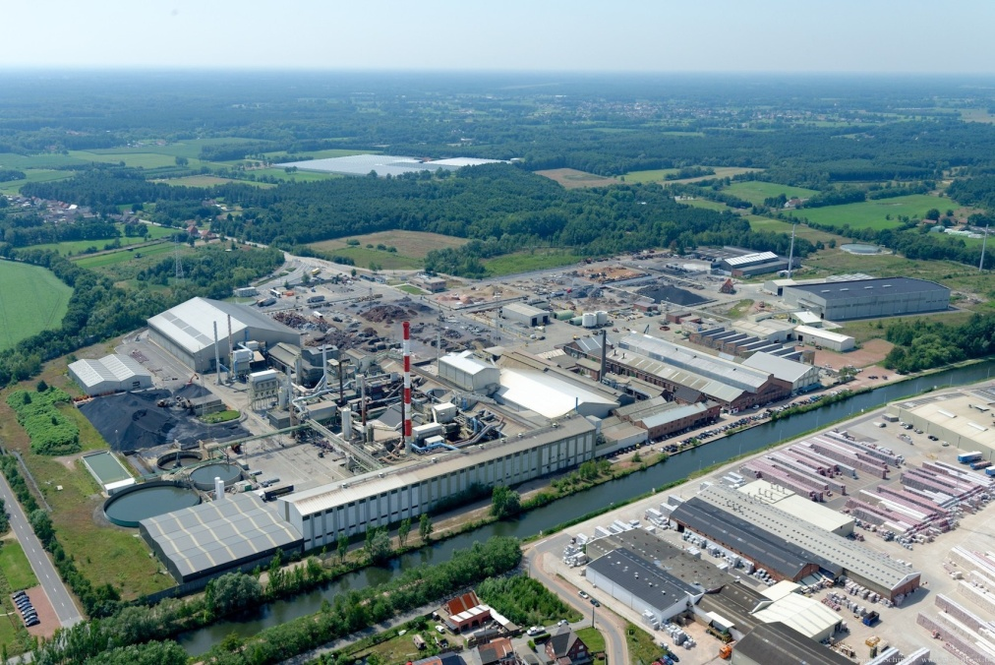
A company with a history

Slide 7
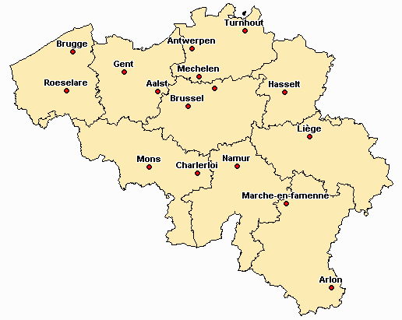
The Metallum Holding
Metallum Holdings 3 B.V. (Amsterdam, The Netherlands)
Metallum Group AG and Affiliates Regensdorf (Switzerland)
Metallum Group Holding N.V.
(Beerse, Belgium)
Recycling &
Preprocessing
Metallo-Chimique N.V.
Beerse (Belgium)
Recycling & Refining
Elmet S.L.U.
(Berango, Spain)
CMR International N.V.
(Antwerp, Belgium)
Beerse
(Belgium)
Berango
(Spain)

Slide 8
Vision and mission
Be the global recycler of choice …
  Preferred partner to process complex materials
  Caring for the environment and minimizing waste
2. … valorizing to the maximum, a variety of metals as an answer to increasing metal scarcity
  We valorize non-ferrous metals and bring them back in the value chain
  Our refining processes are unique, innovative and sustainable
  We actively contribute to preserve natural resources

Slide 9
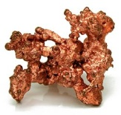
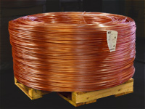
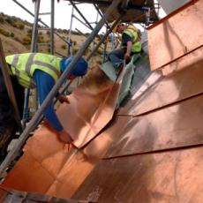
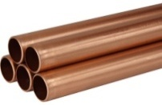

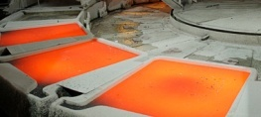
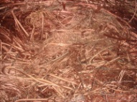
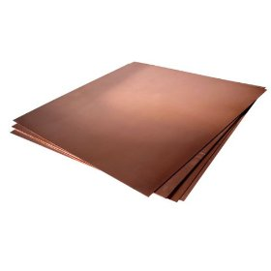
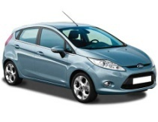
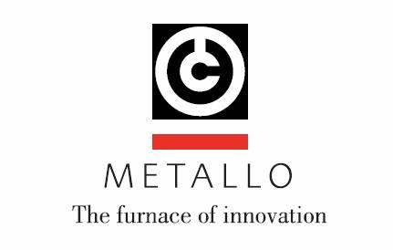
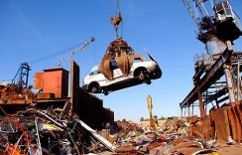
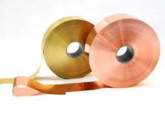
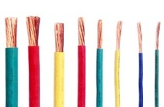
Position in the metal value chain
Raw material supplier
Product
refiner
Semi-finished goods manuf.
End product manuf.
End
customer
Waste
manager
Mining
(ore supplier)
Primary refiner
Semi fabricator
Waste mgmt companies / Small merchants
Construction
Electronic products
Recycler (scrap supplier)
Industrial machinery
Secondary refiner
Transport
Consumer products
New scrap
Old scrap

Slide 10
Metallo in Numbers
1.3 Billion EUR of revenue in 2012 (Group figure)
400.000 tons of input materials
200.000 tons of output products
200.000 tons of slag product
More than 400 FTE’s at Metallo-Chimique, Beerse
Over 20% growth in workforce despite European crisis climate.

Slide 11
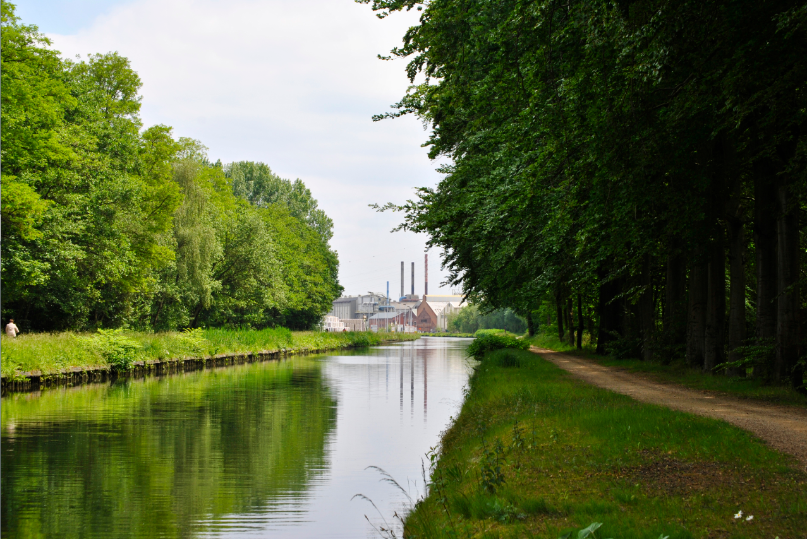
Metallo
Zero-waste
Process

Slide 12
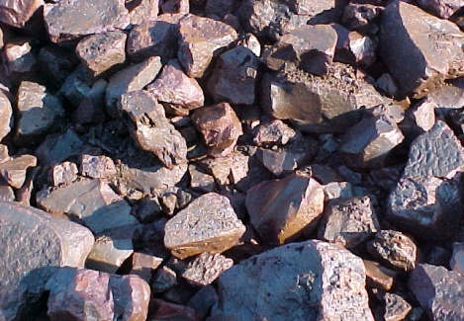
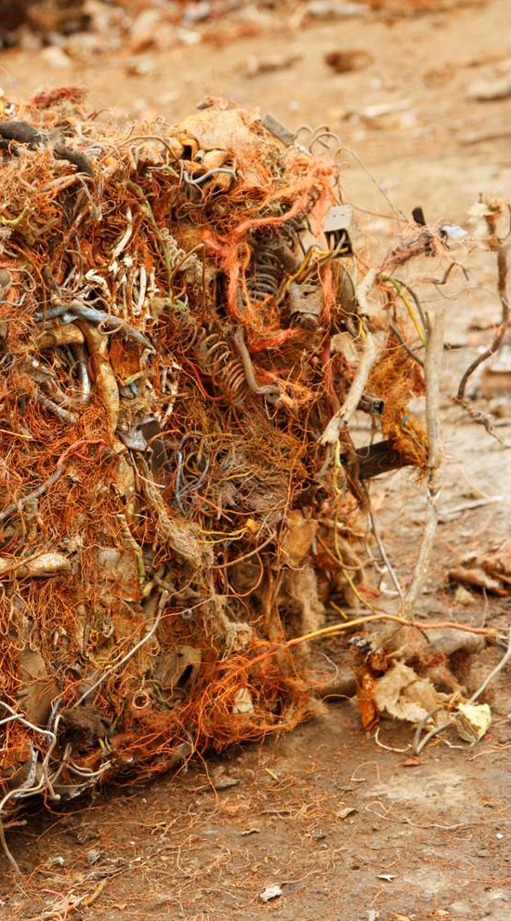
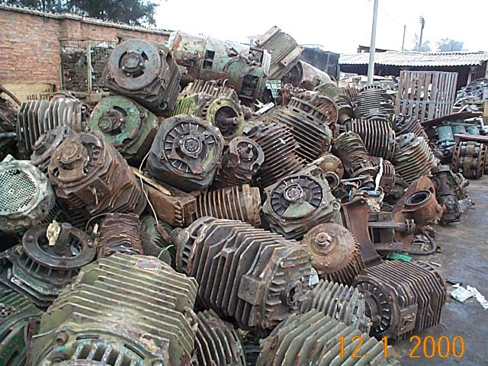
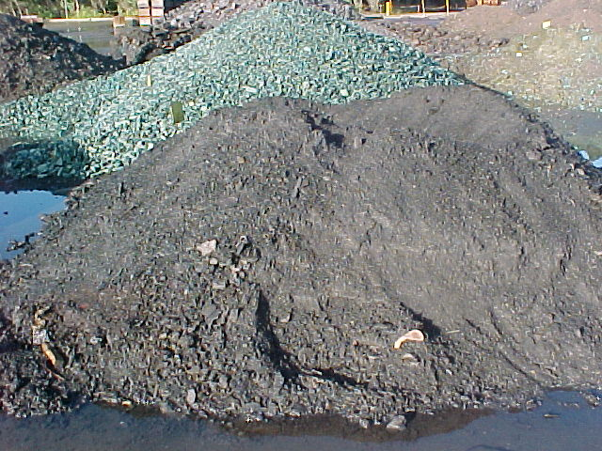
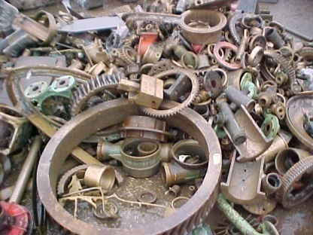
Raw materials: complex & non-ferrous

Slide 13
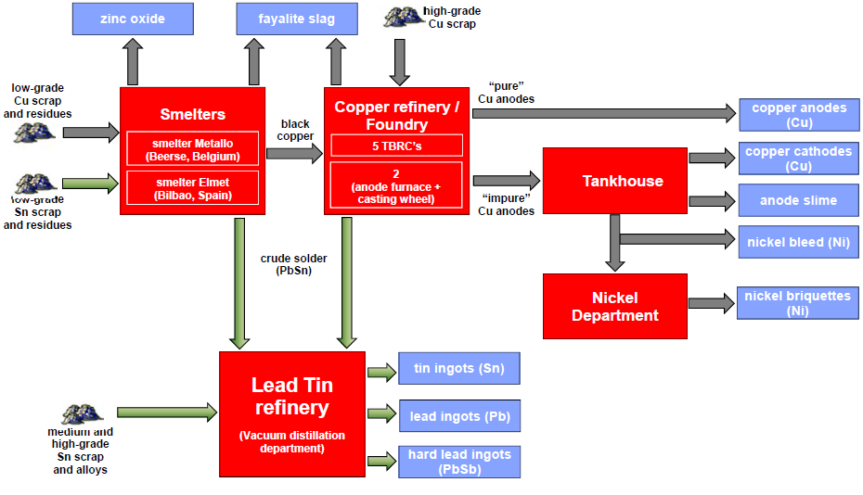
The Metallo Zero-Waste Process
Notes:
Smelting:
The smelters treat all secondary raw materials with a relative low copper, tin or lead content through reduction. This reaction produces metal called black copper which is still an impure copper containing +/- 80% Cu and taking along Sn, Pb, Ni and its accompanying elements.
2) Converting:
The liquid or granulated black copper along with other cold charges of copper scraps and alloyed materials is fed into the convertor furnaces. In this phase the copper is separated from moth other metal components before being cast into anode moulds.
3) Distillation:
The tin department treats the crude solder alloy coming from the foundry, and all other types of tin bearing materials. In the first stage of this process, the greater part of the lead in the alloys is evaporated into a soft lead and cast into 25 kg ingots. The remaining lead is removed to produce pure tin ingots with a lead content below 100 ppm, possibly even down to 50 or below 25 ppm of lead.
4) Refining by electrolysis:
The copper anodes produced in the foundry are refined into copper cathodes by means of electrolysis. The nickel units left in the anodes find themselves back in the electrolyte and are converted into nickel briquettes at the nickel department.

Slide 14
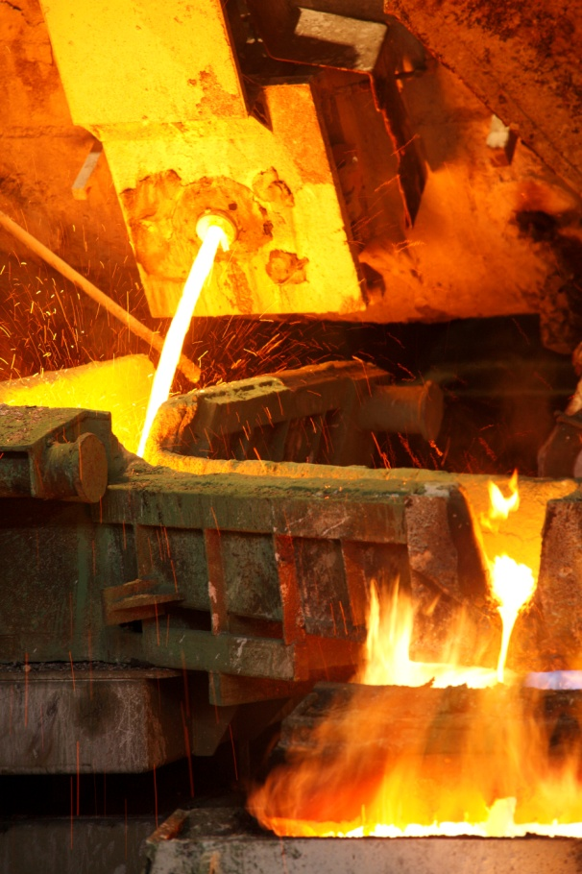
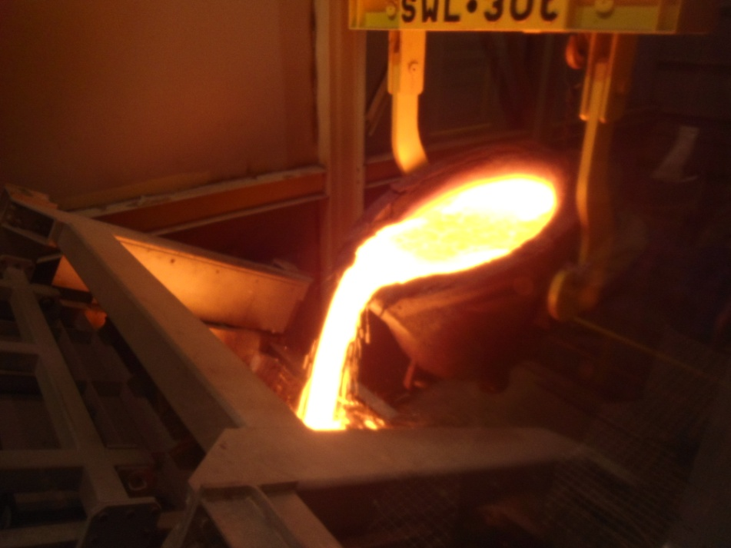
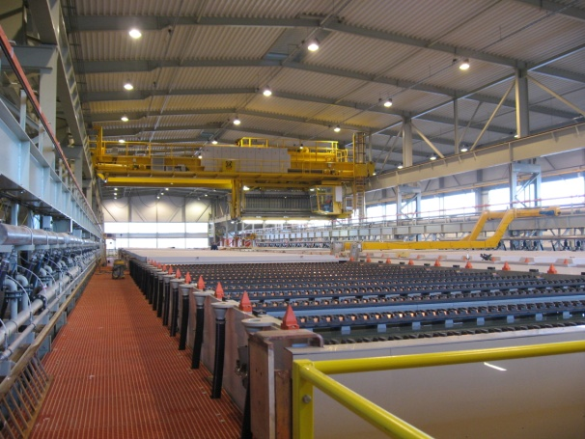
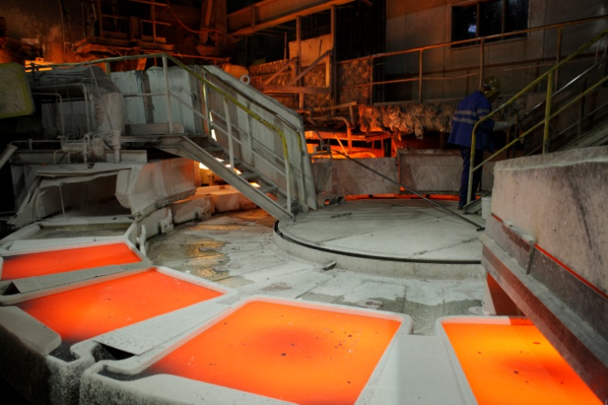
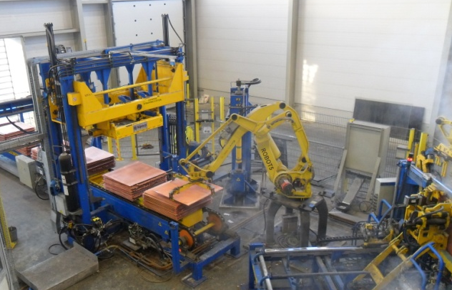
Process: pyro-, hydro- and electrometallurgy

Slide 15
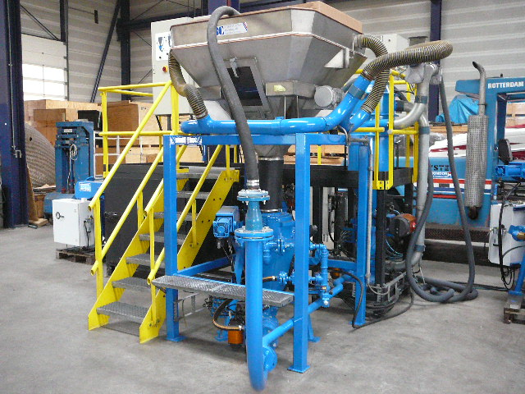
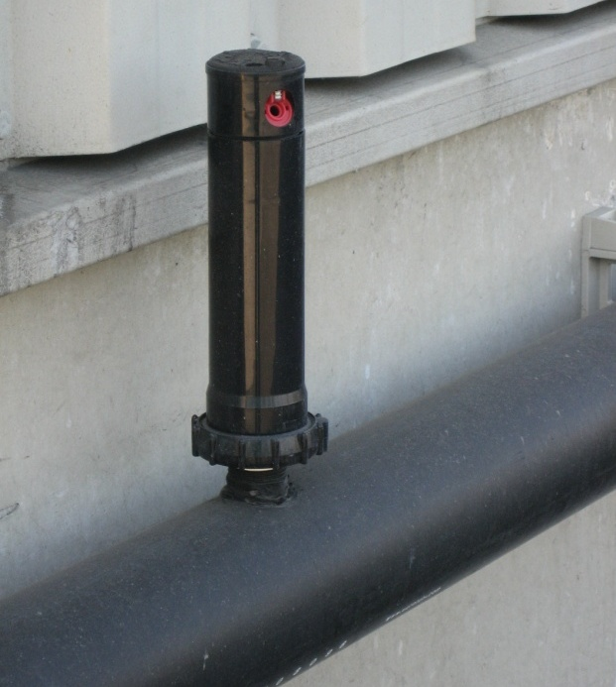
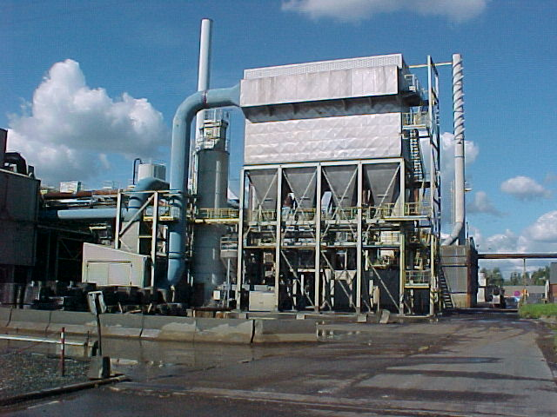
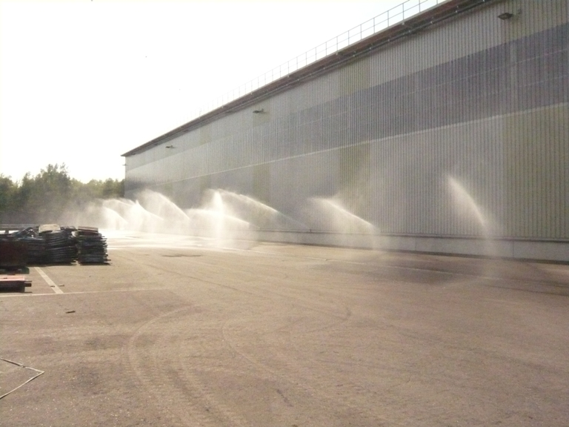
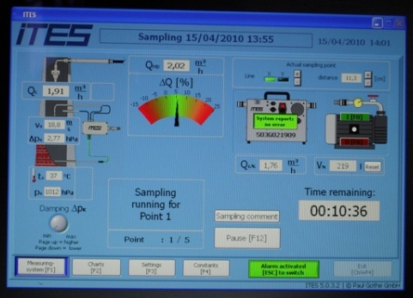
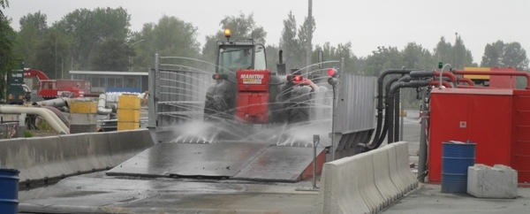
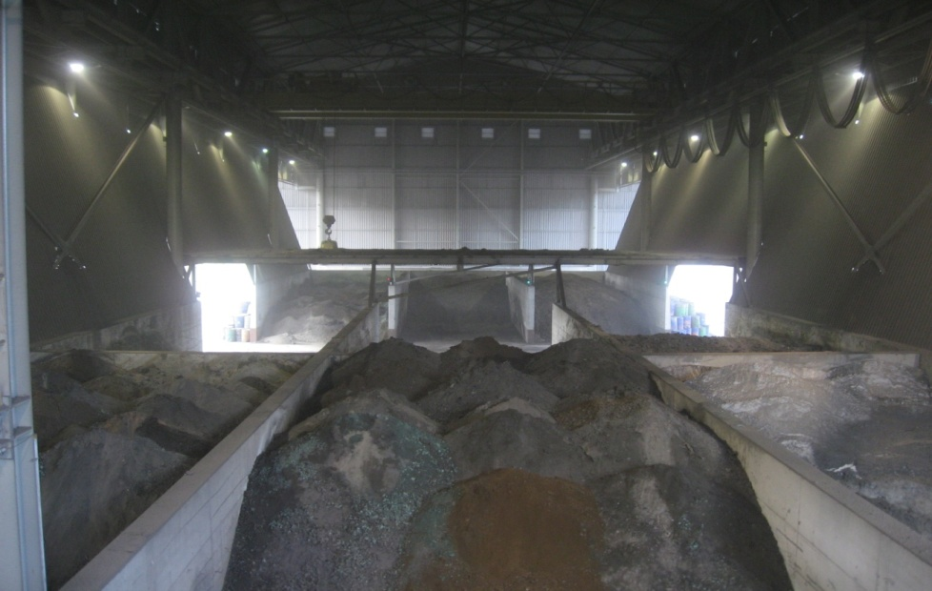
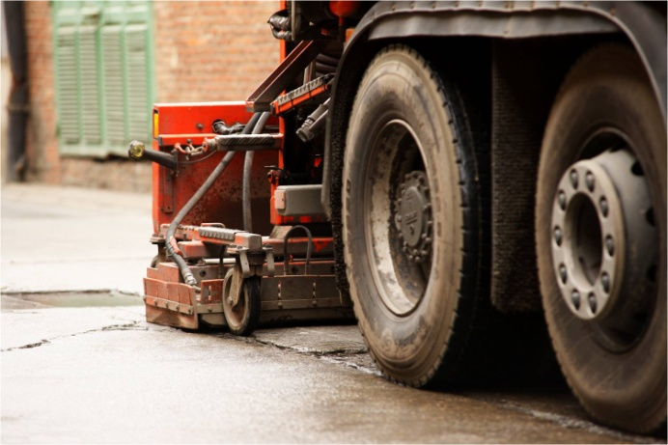
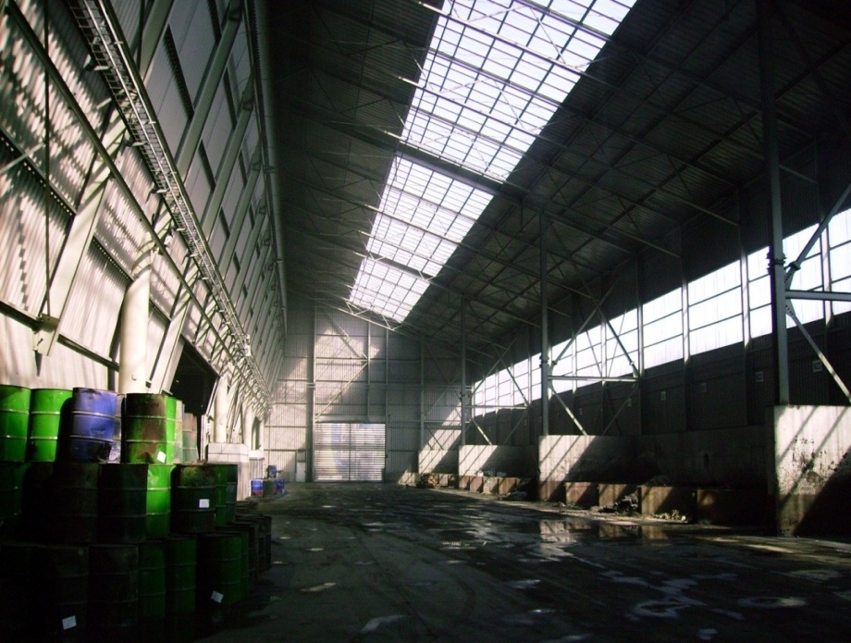
Environmental Measures
Cutting edge technology in exhaust filter installations
Spraying installations to bring down floating dust
Emission Measurement & control
Cleaning vehicles, terrains & surrounding roads
High investments in covering raw material
stock to minimize dust

Slide 16
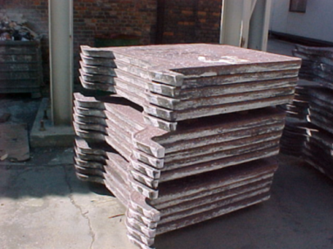
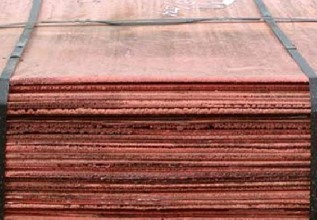
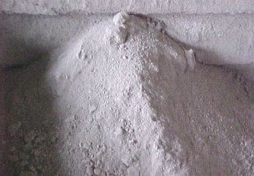
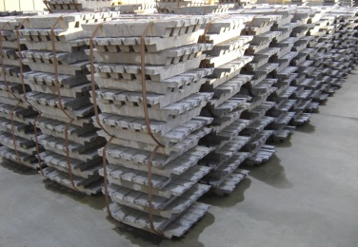
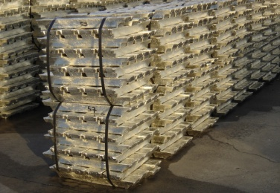
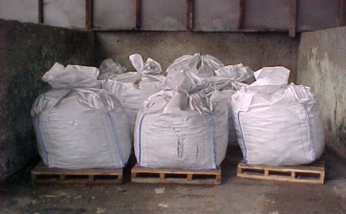
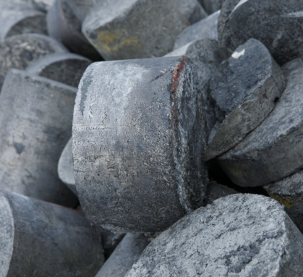
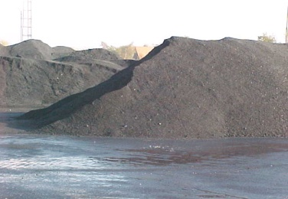
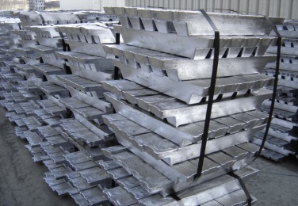
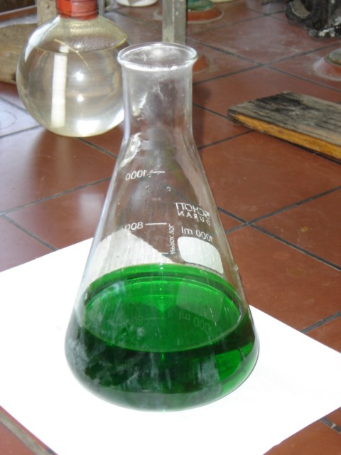
Products
Copper anodes
+/- 120.000 t/y
    Quality: 99 % Cu
Copper cathodes
+/- 25.000 t/y
    Quality: 99,98 % Cu
Pure Lead ingots
+/- 25.000 t/y
    Quality: 99%
Pure Tin ingots
+/- 11.000 t/y
    Quality: 99.96% Sn
ZnO-dust
2.500 ton/year
Anode slimes
2.000 t/y
Pure Nickel briquets
+/- 150 t/y
Quality: 90% Ni
Metamix
160.000 t/y
Hard lead
6.000 t/y
Bleed
15.000 t/y
    Quality: 5% Ni

Slide 17
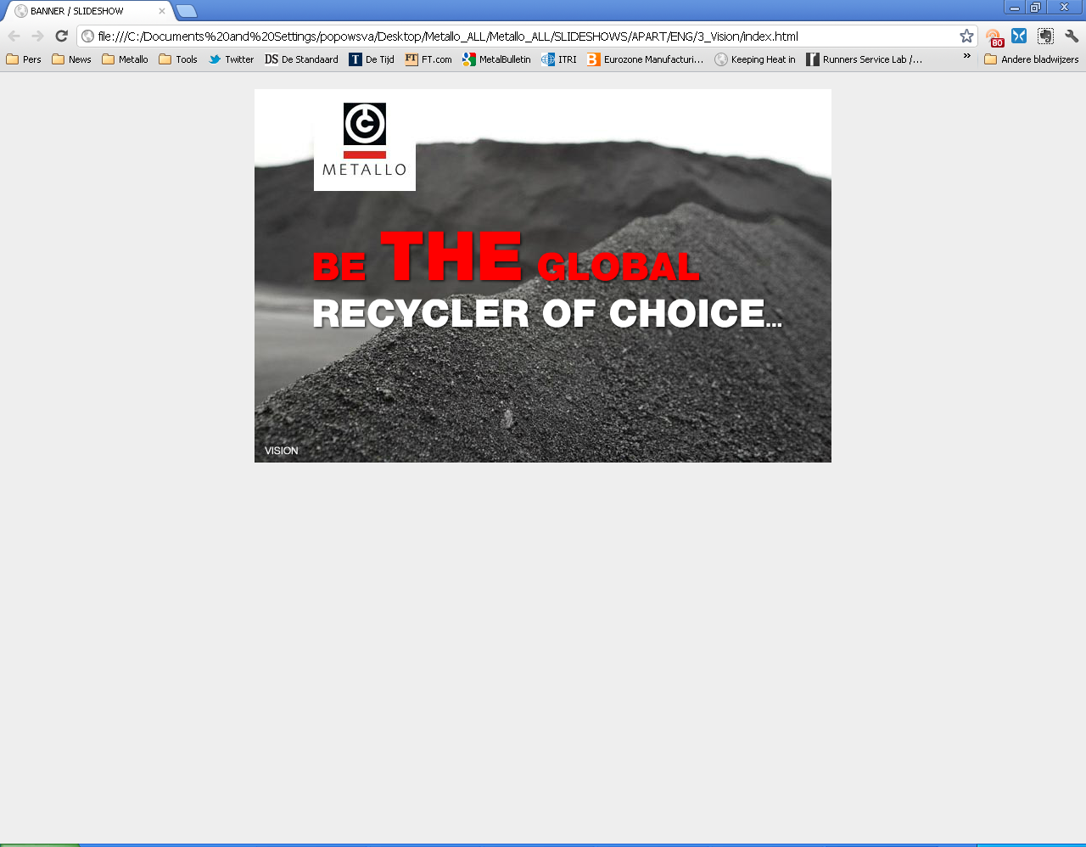
Metallo
Slag-cleaning
Challenge

Slide 18



Metallo vision:
maximum metal valorisation
Returning maximum value in the value chain:
  as pure metals
  as high-value concentrates
Unique processes, developed for maximum metal recuperation
Orange press equivalence:
  Orange = raw material
  Juice = metal
  Peel = by-product slag

Slide 19

Metal recovery from scrap: economics
Uneconomic
End point:
Metamix®

Slide 20


Metallo slag today: Metamix®
Co-product from Smelters and Refining furnaces
Annual production: 160 000 tonnes
From a metal valorisation perspective, Metamix is a depleted resource. The metal content is low. There is not enough “juice” left in the “peel”.
Did you know ? orange peel is a great product:
  Insect repellent
  Firestarter
  Skin care product
  Stain remover

Slide 21
Metamix: a depleted resource ?
Shiny black, dense and hard → attractive properties
Slag valorisation projects with KUL confirm many promising technical advantages in the use of Metallo slag
But… Zn content = 5%
  Too high for most interesting applications, due to leaching of Zn
  Too low for metal valorisation
Conclusion: Zn recovery necessary for combined metal and slag valorisation

Slide 22
Metamix®: extra valorisation ?
?
Zinc concentrate
Metamix
Clean Slag

Slide 23
Slag Cleaning Operation
Zinc
Fumer
Zn-concentrate
High-value
Product
Smelter
Metamix®
Low-value
product
Leach-stable slag
High-value
product
Process = “Zinc fuming”
  Zinc is evaporated from the slag, and concentrated as filter dust
  The remaining slag has low zinc content, and is leach-stable
Typical features of such processes:
  Molten slag, reducing conditions, evaporation → energy-demanding
  Extensive gas cleaning (cooling and filtering) → high investment cost

Slide 24



Metallo takes the challenge !
De Tijd Online: Gazet van Antwerpen:
30/01/2015

Slide 25
But… profitability is the challenge
Metallo will only treat Smelter slag (80 000 t/y) in the new slag cleaning operation. Slag from refining furnace is uneconomical to treat, because of low zinc content.
There is a need for high-value applications for slag, to make slag cleaning economical for the majority of the non-ferrous slags.
Remaining challenge: transform the good technical developments into substantial market value

Slide 26

Thank you and welcome to visit our display !

