Slide 1
The InsPyro-Spark calculation toolbox for slag engineering properties
Sander Arnout, Els Nagels

Slide 2
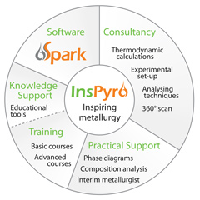
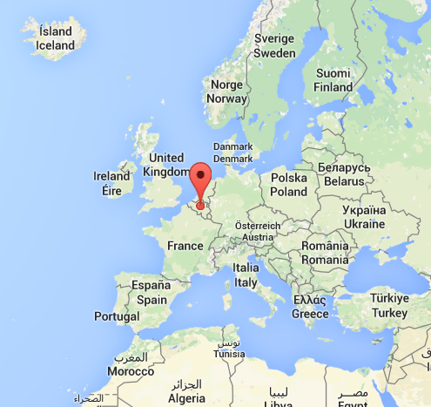
Introduction: InsPyro
KU Leuven spin-off (2009)
Founded and run by PhD’s
B2B consultancy company
Process development & improvement through:
  Modelling and literature
  Experiments
  Characterization
  Industrial experience
Industries:
  Recycling incl. batteries and residues
  Non-ferrous metallurgy (lead-zinc)
  Steel, cast iron and ferro-alloys
www.inspyro.be

Slide 3
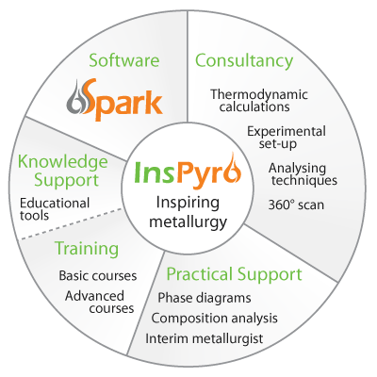
Mission: « Inspiring Metallurgy »
  InsPyro improves existing high-temperature processes
  develops new sustainable processes
  Full circle approach:

Slide 4
InsPyro’s knowledge centered approach
Operating framework
Understanding
the science
of a process
Experience: Knowledge on how to run a process
Accelerated learning by merging all types of knowledge into tools
Useful to run a process
Scientific approach
Controlling depends on model
Changes are based on physics
Mechanisms are main driver
Transferrable
Essential to run a process
Learning by doing
Controlling depends on individual
Changes by trial and error
Mechanisms unclear
Experience transfer is difficult
Notes:
Knowledge in the heads of people is the most readily applicable, but the most volatile:
People leave, retire, are on holiday
Intuition and feelings may be working most of the time, but may never be thoroughly checked/understood
Need to develop concepts which are more easily transferable:
Define rule of thumb based on mechanisms
Actual process model can be useful for complex interactions
Summaries, concepts, hypotheses can already be much more tangible than feelings, and can be validated
Provide a basis for decision making, experimenting, education of operators

Slide 5
Tools for slag processing
Calculation possibilities are ample:
  Phase formation as a function of temperature
  The expected minerals in the slag after cooling
  Viscosity of the slag
  Liquidus and solidus temperature
  Phase fractions at high temperature
  Sulphur capacity
  Impurity activities
Slag
Valorization
Metal process

Slide 6
Basic slag properties

Slide 7
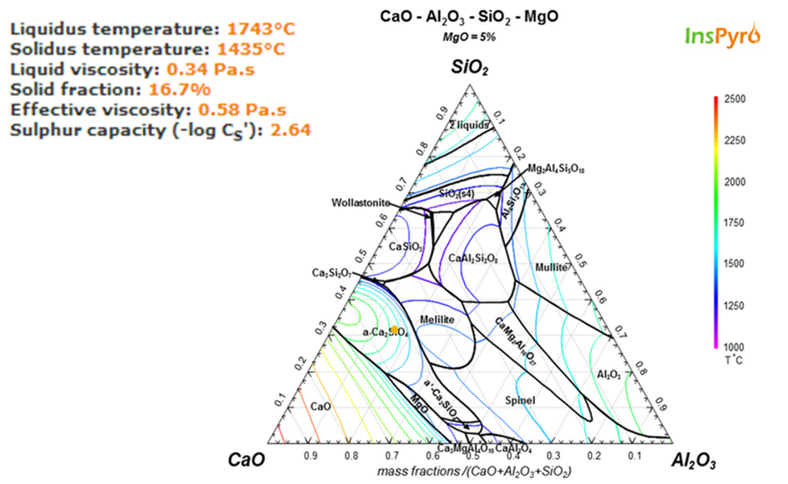
Slag properties and phase diagram

Slide 8
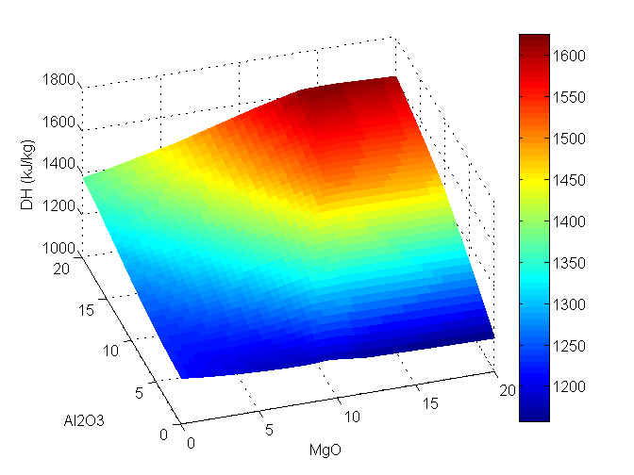
Heat recovery from slag
Enthalpy as a function of composition (1600 to 800°C)

Slide 9
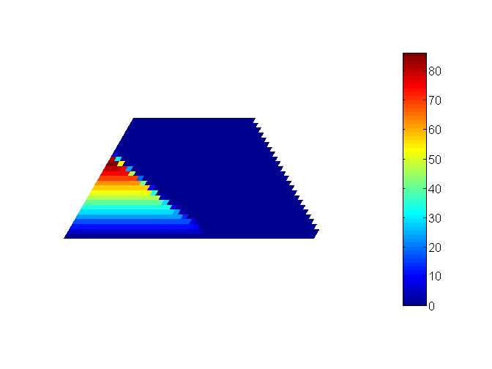
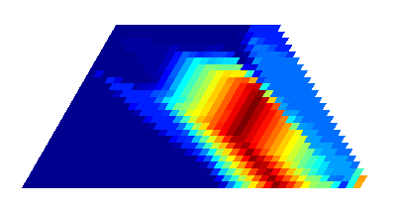
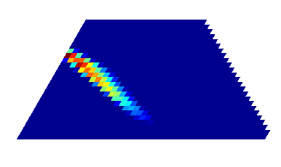
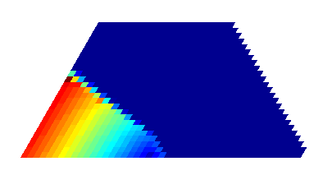
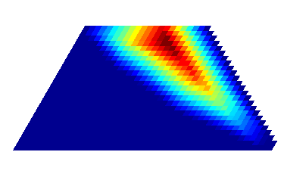
Slag mineralogy maps
Avoid problematic phases and improve desired ones
max
0
C₂S
spinel
SiO₂
+8% MgO
+2% FeO_{x}
CaO Al₂O₃
bredigite
MgO
anorthite
Notes:
Mechanical behaviour or stability in leaching tests

Slide 10
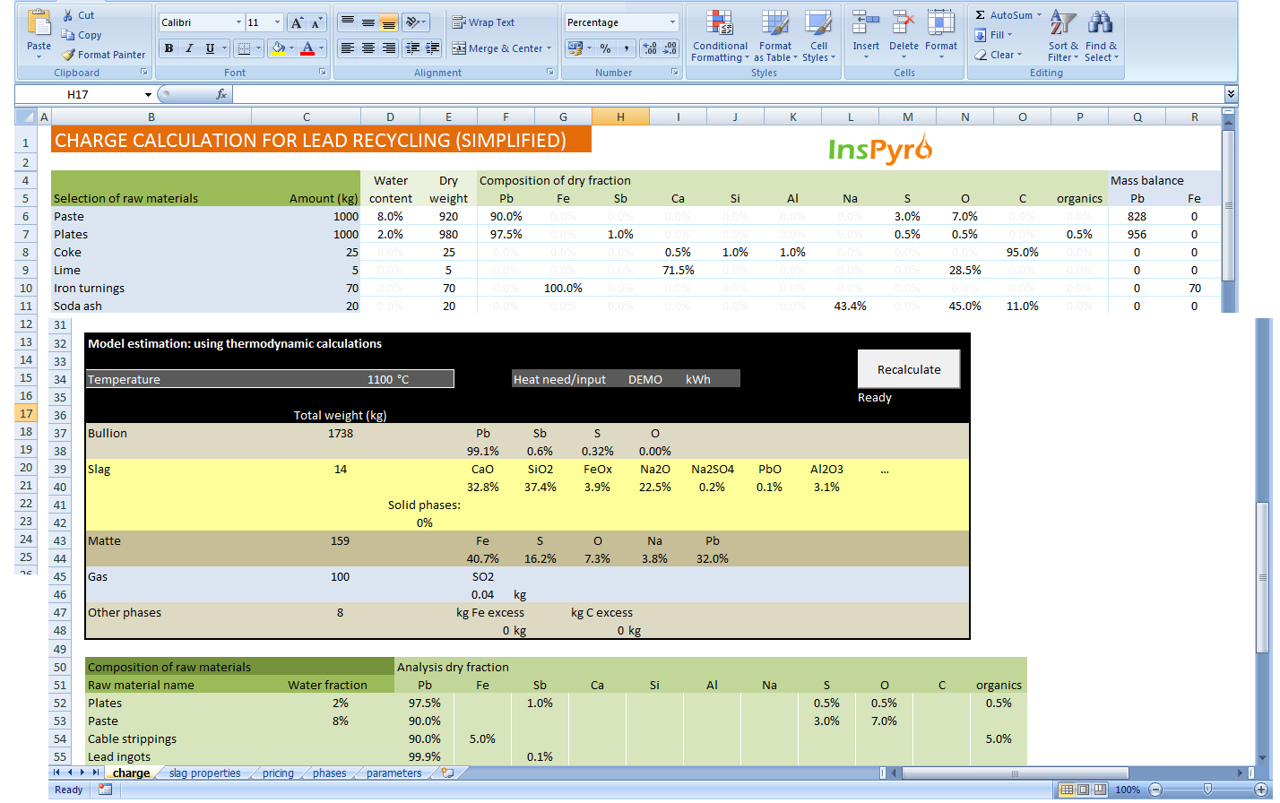
Integrated in charge calculation

Slide 11
Using Spark to guide a process
Batch-wise hot-stage slag processing:
  Calculate necessary fluxes to reach specs
    Several application options may be available: aggregates, reprocessing, fines agglomeration...
  Decide which application route to use based on cost
Continuous waste melting process:
  Check slag properties based on mass balance
  Adjust mixing ratios or select fluxes
  More flexible adjustment than simple slag composition rules
Slag needs procedure that guarantees quality!
Notes:
Waste melting is slagmaking: slag as the main volume product, quality control becomes important

Slide 12
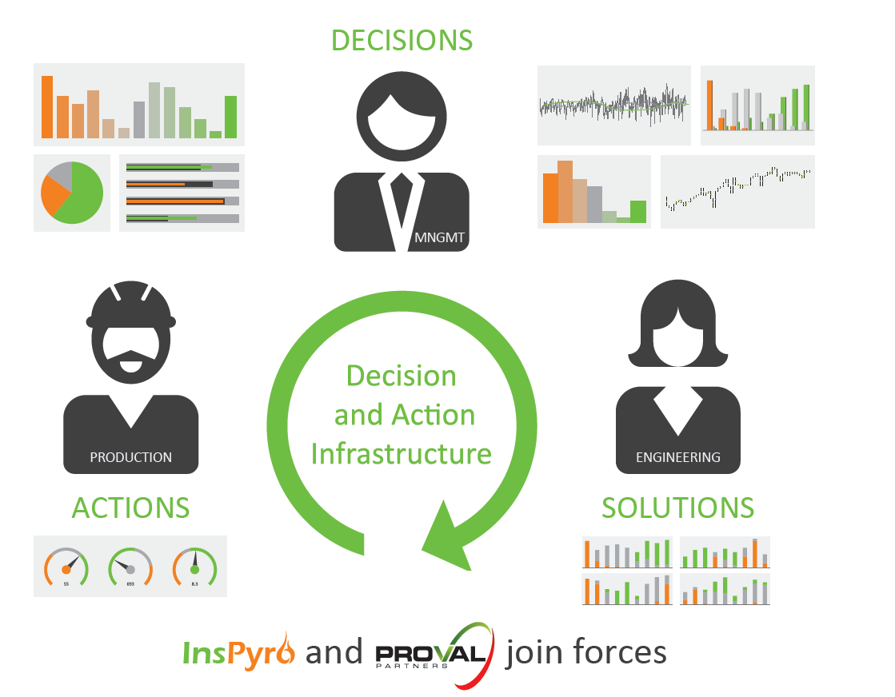
From insight to decisions (InsPyro-Proval)

Slide 13
Larger software framework
Flowsheet modelling
Plant & Data
Main process model
Models for side processes:
pre-treatment
gas treatment
Plant data history: correlations classification
Slag properties module
Feasibility calculations
Best setting selection
Best mngmt decision

Slide 14
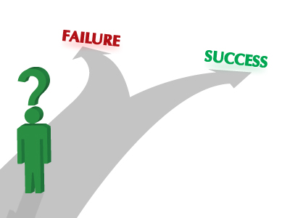
Feasibility studies
Economic feasibility needs to make assumption on technical performance
Derisking: limit risk to invest
  In industrial trials with new materials
  In new process steps
  In lab tests or upscaling
Gathering just enough information
to take a desicion, at lowest cost
Models allow for ball park estimation of
  yields
  energy need
  chemical needs
  product quality
in limited time

Slide 15
InsPyro’s approach for feasibility
Model the process
  Mass and energy balance
  Thermodynamic equilibrium gives a fast guideline
  But don’t believe modelling alone:
Incorporate knowledge of existing processes to understand limits
  E.g. theoretically, carbon can reduce Ni in slag to ppm level
  In practice this is limited due to small metal/matte droplets staying in the slag + imperfect reduction
  Most Ni smelters leave >0.2% Ni in the slag
  Would the slag/waste process be much different?

Slide 16
Conclusions
InsPyro develops models as an operating framework
  To understand the process
  To validate hypotheses
  To define optimisation opportunities
For slag treatment processes, models are essential to estimate feasibility:
  Remolten slag quality (mineralogy and heavy metal content)
  Metal yields (income)
  Needed additives and reductants (cost)
Validate the model as much as possible with operational data, selected sampling, dedicated tests

Slide 17
