Slide 1
The impact of curing conditions on Heavy metal immobilisation of Fe-rich inorganic polymers
Lukas Arnout, Lieven Machiels, Valérie Cappuyns, Peter Tom Jones,
Bart Blanpain, Yiannis Pontikes

Slide 2
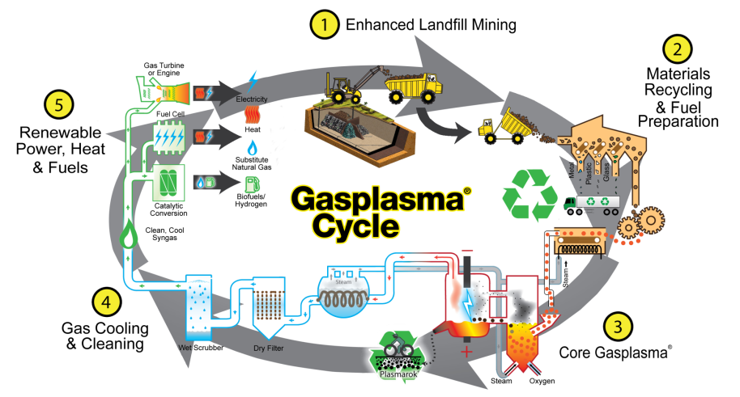
Closing the Circle Project

Slide 3
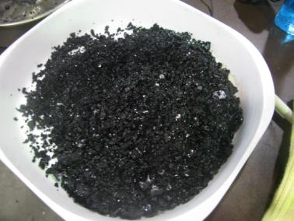
wt% | SiO₂ | FeO | CaO | Al₂O₃ | MnO | K₂O | MgO | TiO₂ | Na₂O | ZnO | CuO | Cr₂O₃ | PbO | NiO
HM | 36.2 | 29.2 | 12.4 | 8.2 | 1.7 | 0.6 | 2.2 | 1.0 | 1.1 | 1.2 | 1.2 | 1.6 | 0.6 | 1.5
RA | 38.2 | 30.4 | 14.0 | 8.5 | 1.8 | 1.2 | 1.8 | 1.0 | 0.5 | Bdl | 1.0 | 0.4 | bdl | bdl
Table 1: XRF analysis of the glasses
bdl = below detection limit
Sample | solution/glass | glass/sand | curing conditions
HM20 | 0.45 | 1/3 | 28 days at 20°C
HM60 | 0.45 | 1/3 | 24 hours at 60°C + 27 days at 20°C
HM120 | 0.45 | 1/3 | 24 hours at 120°C + 27 days at 20°C
HM180 | 0.45 | 1/3 | 24hours at 180°C + 27 days at 20°C
Table 2: Processing and curing conditions of inorganic polymer samples

Slide 4
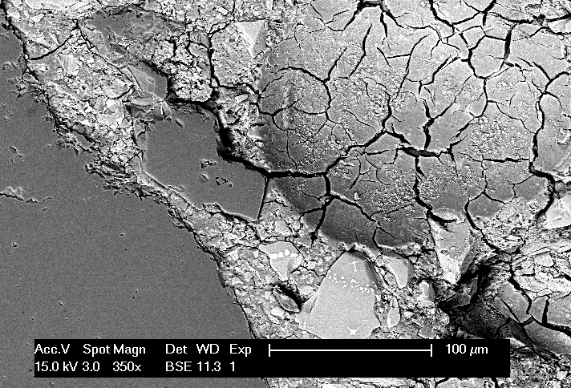
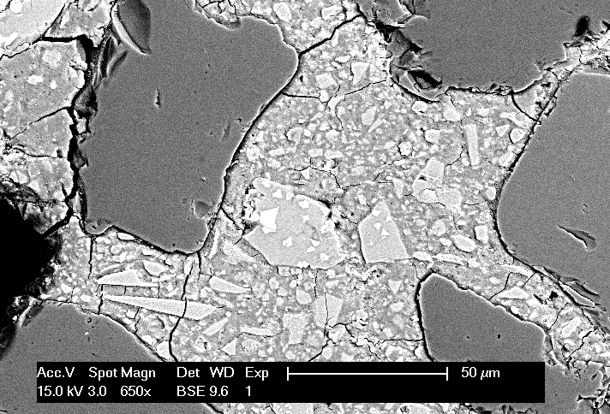
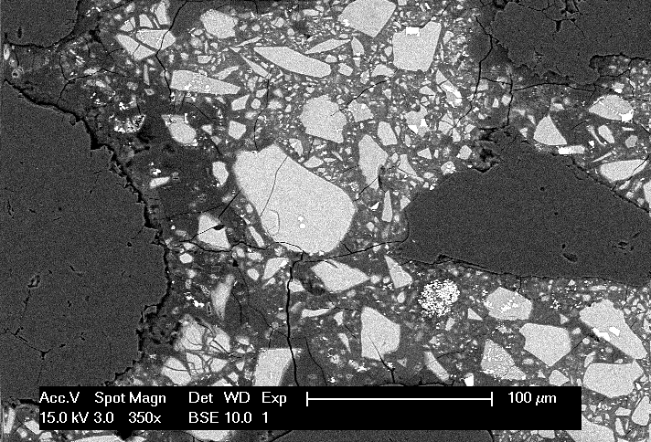
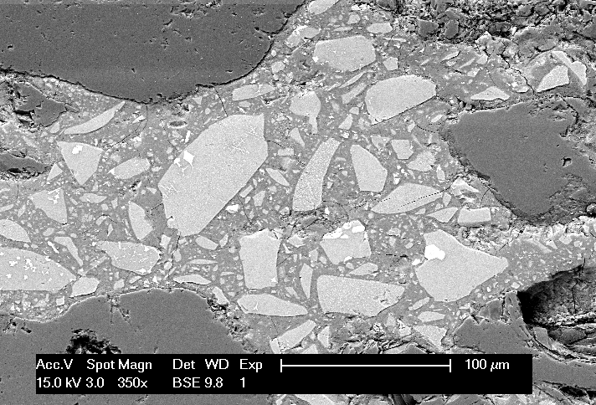
 | MPa
HM20 | 65 ± 3.2
HM60 | 106 ± 6.6
HM120 | 119 ± 3.7
HM180 | 138 ± 2.8
Table 4: Compressive strength at 28 days
HM20
HM60
HM120
HM180
Figure 2: SEM-BSE images of polished sections of samples: (a) HM20 with a lot of cracks, (b) and (c) respectively HM60 and HM120 with less cracks and (d) HM180 without cracks

Slide 5
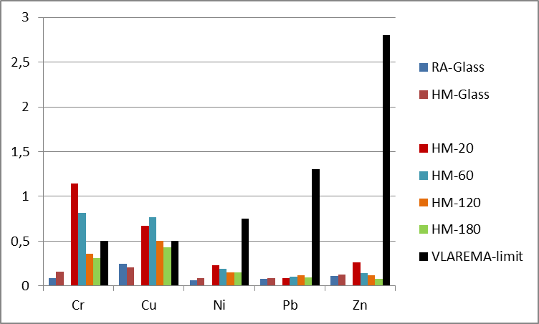
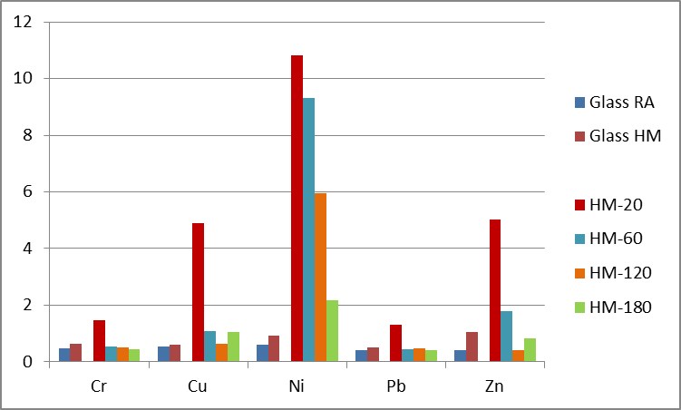
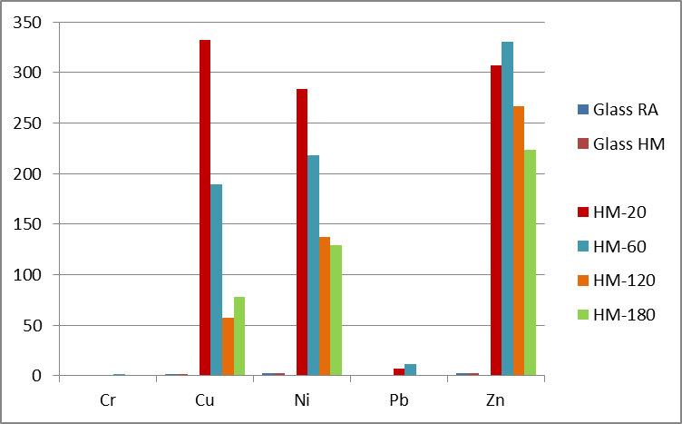
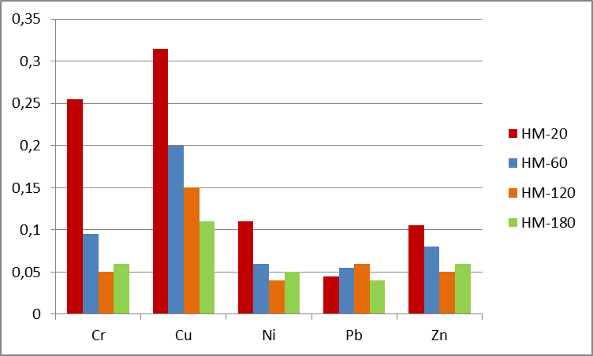
Grounded, 24h at natural pH
Grounded, 3h at pH 7
Grounded, 3h at pH 4
Monolith, 7 days at natural pH
Values in mg/kg.ds

Slide 6
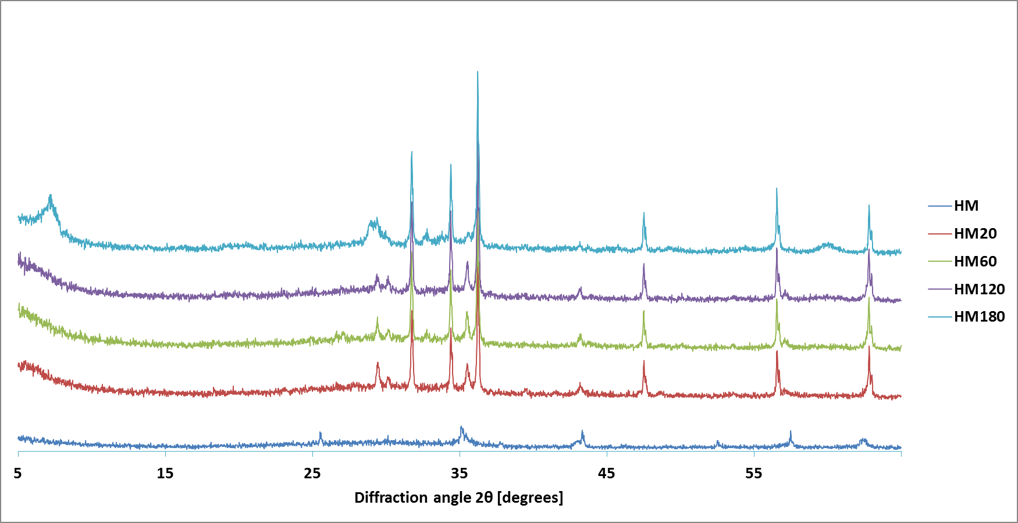
Smectite clay
XRD pattern of the inorganic polymer pastes

