Slide 1
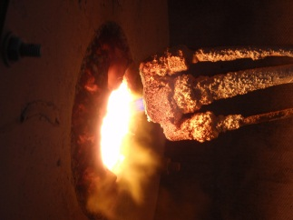
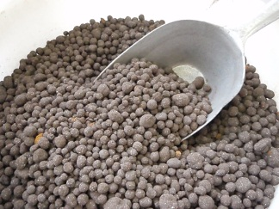
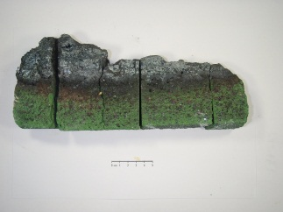
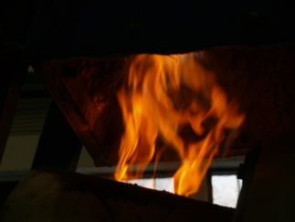
NEW DEVELOPMENT IN METAL RECOVERY FROM SECONDARY RESOURCES
Christoph Pichler
Helmut Antrekowitsch

Slide 2
Current Investigations
Waelz slag / steel mill dust
recycling of dumped slags from
lead production
slags from the copper industry
desulpurization slag
Basic Oxygen Furnace slag
slags from the ferroalloy production

Slide 3
Waelz process

Slide 4
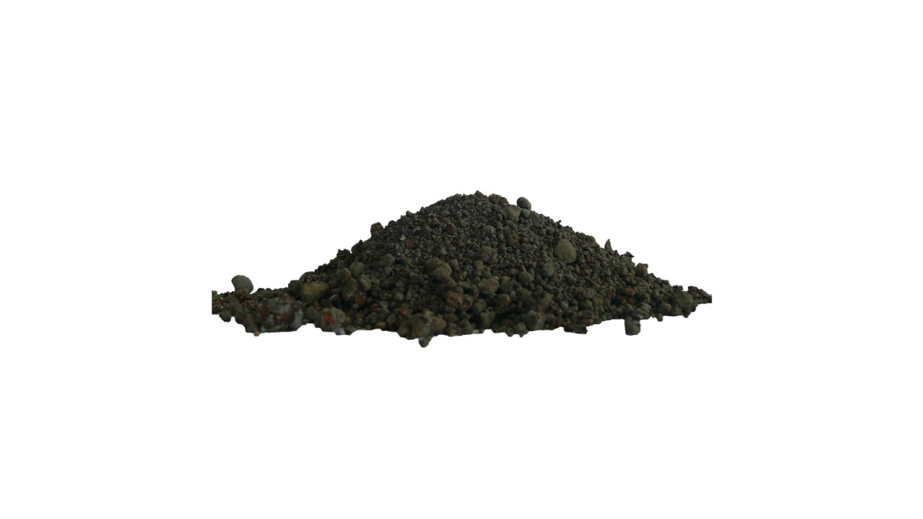
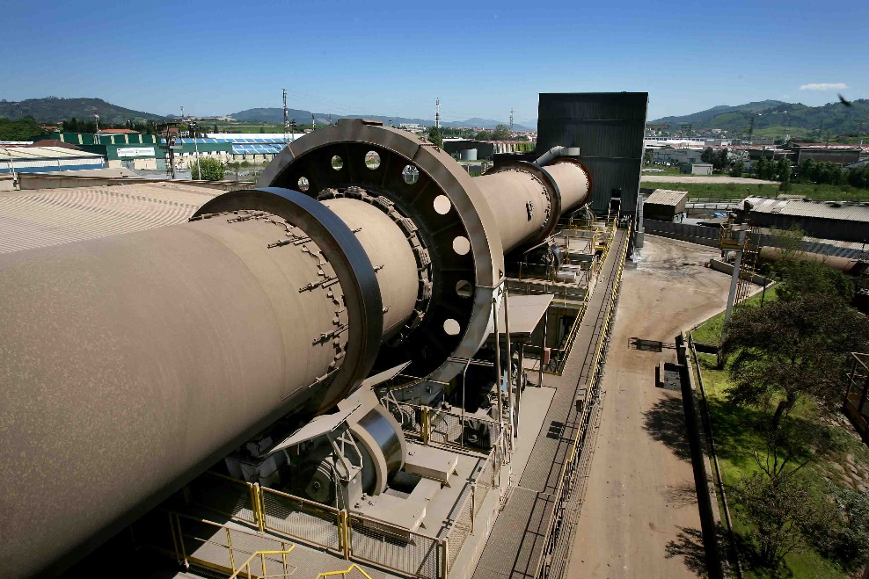
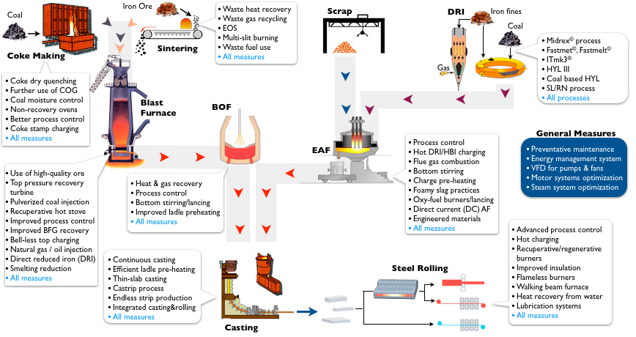
Procedural Principle
product
residue
Notes:
Es ist kein Standardaggregat
Reaktorlänge 250mm

Slide 5
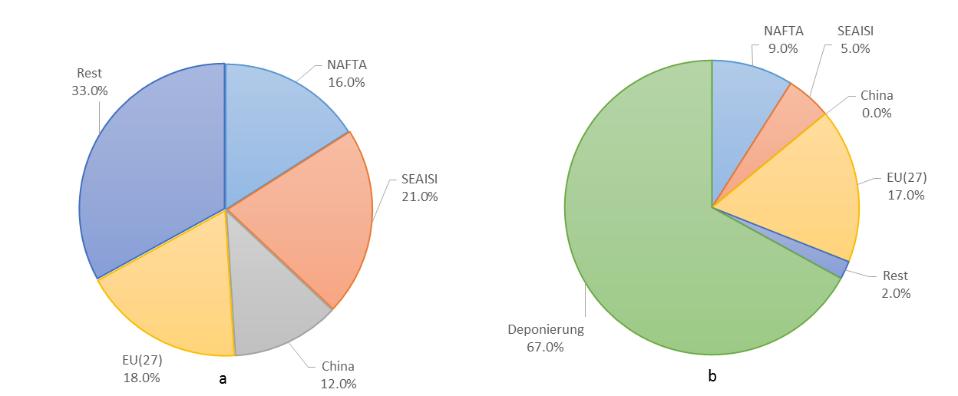
Electric Arc Furnace Dust
Amount of Electric Arc Furnace Dust (EAFD): 9.5 mil. t/a
LANDFILL
67 %
Landfill ≈ 6.4 mil. t
∅ Zn-concentration = 20 % → Zn-loss = 1.3 mil. t
Notes:
In the metallurgy a lot of slags occur. You can split them in slags from the Ferrous and Nonferrous industry, but the amount of slags out of the steel industry are the importantiliest. „Schlacken kurz erklären“
Residues out of the iron and steel industrie are used to recycle some Nonferrous metals out of them. During this processes also a lot of slag get produced. For this also some possibilities for an additional use is needed.
HOS: 250 kg/t RE
LDS: 120 kg/tRS
Menge Slag/t RE RS ENT-S

Slide 6
Possibilities for Waelz slag
Different treatments to recover the still containing valuable metals in the slag and produce an inert residue!
To avoid Waelz slag through a new process concept for the Recycling of steel mill dust!

Slide 7
Possibilities for Waelz slag
Different treatments to recover the still containing valuable metals in the slag and produce an inert residue!
To avoid Waelz slag through a new process concept for the Recycling of steel mill dust!

Slide 8
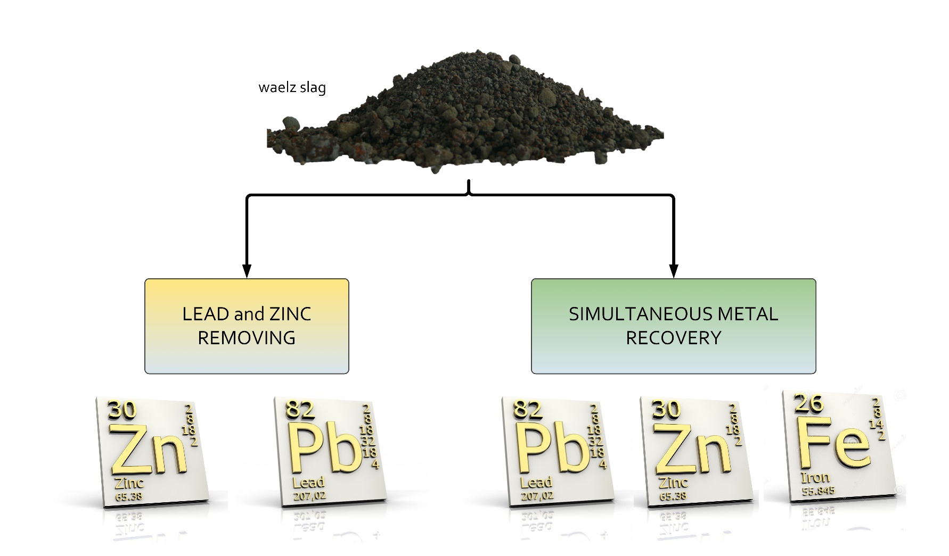
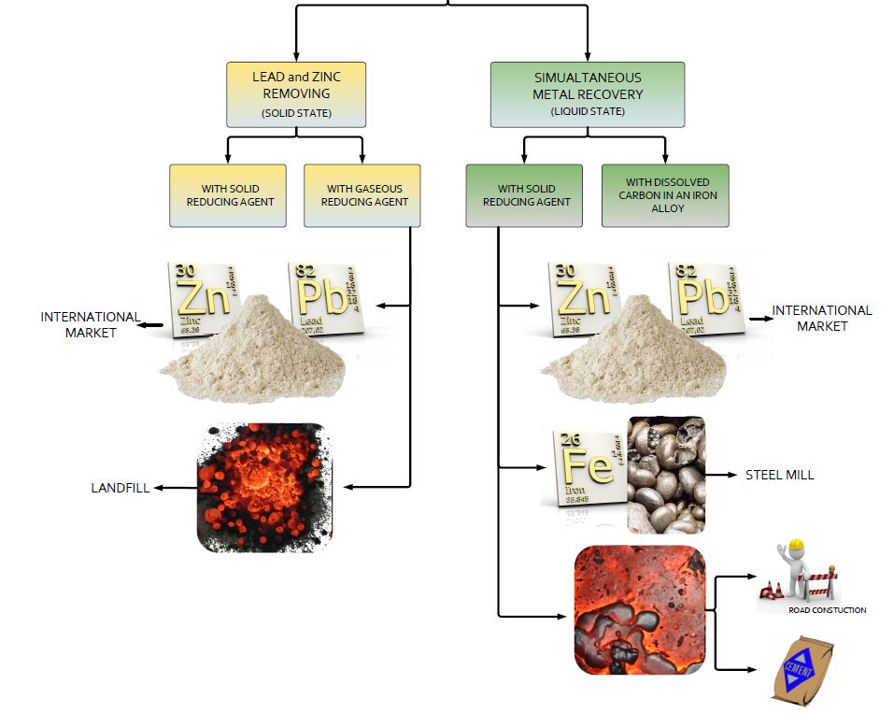
Overview of possible Strategies
Notes:
In the metallurgy a lot of slags occur. You can split them in slags from the Ferrous and Nonferrous industry, but the amount of slags out of the steel industry are the importantiliest. „Schlacken kurz erklären“
Residues out of the iron and steel industrie are used to recycle some Nonferrous metals out of them. During this processes also a lot of slag get produced. For this also some possibilities for an additional use is needed.
HOS: 250 kg/t RE
LDS: 120 kg/tRS
Menge Slag/t RE RS ENT-S

Slide 9
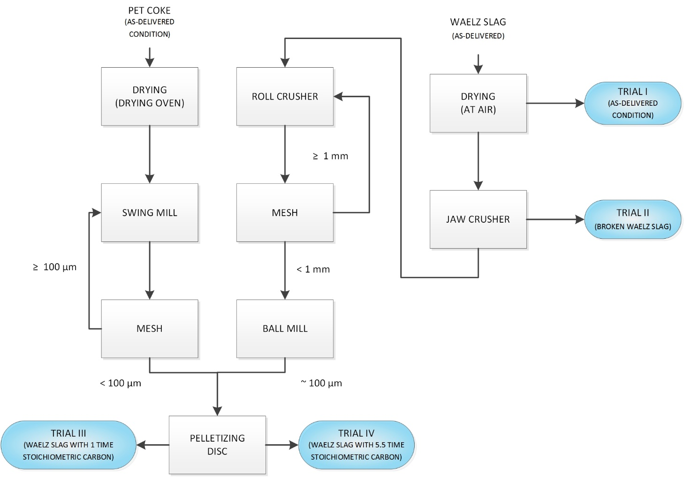
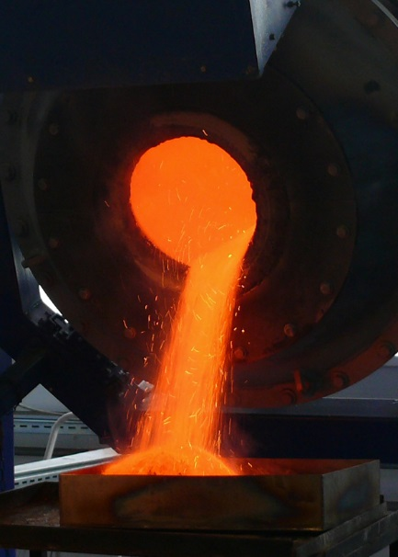
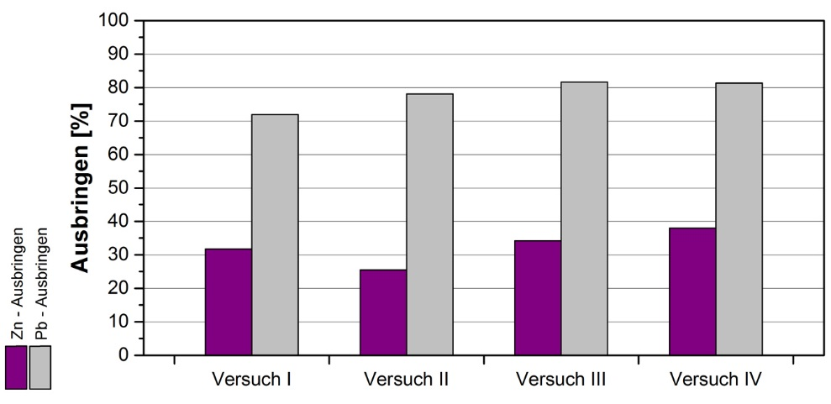
With a solid Reducing Agent
yield [%]
Pb-yield [%]
Zn-yield [%]
trial I
trial II
trial III
trial IV

Slide 10
With a gaseous Reducing Agent I

Slide 11
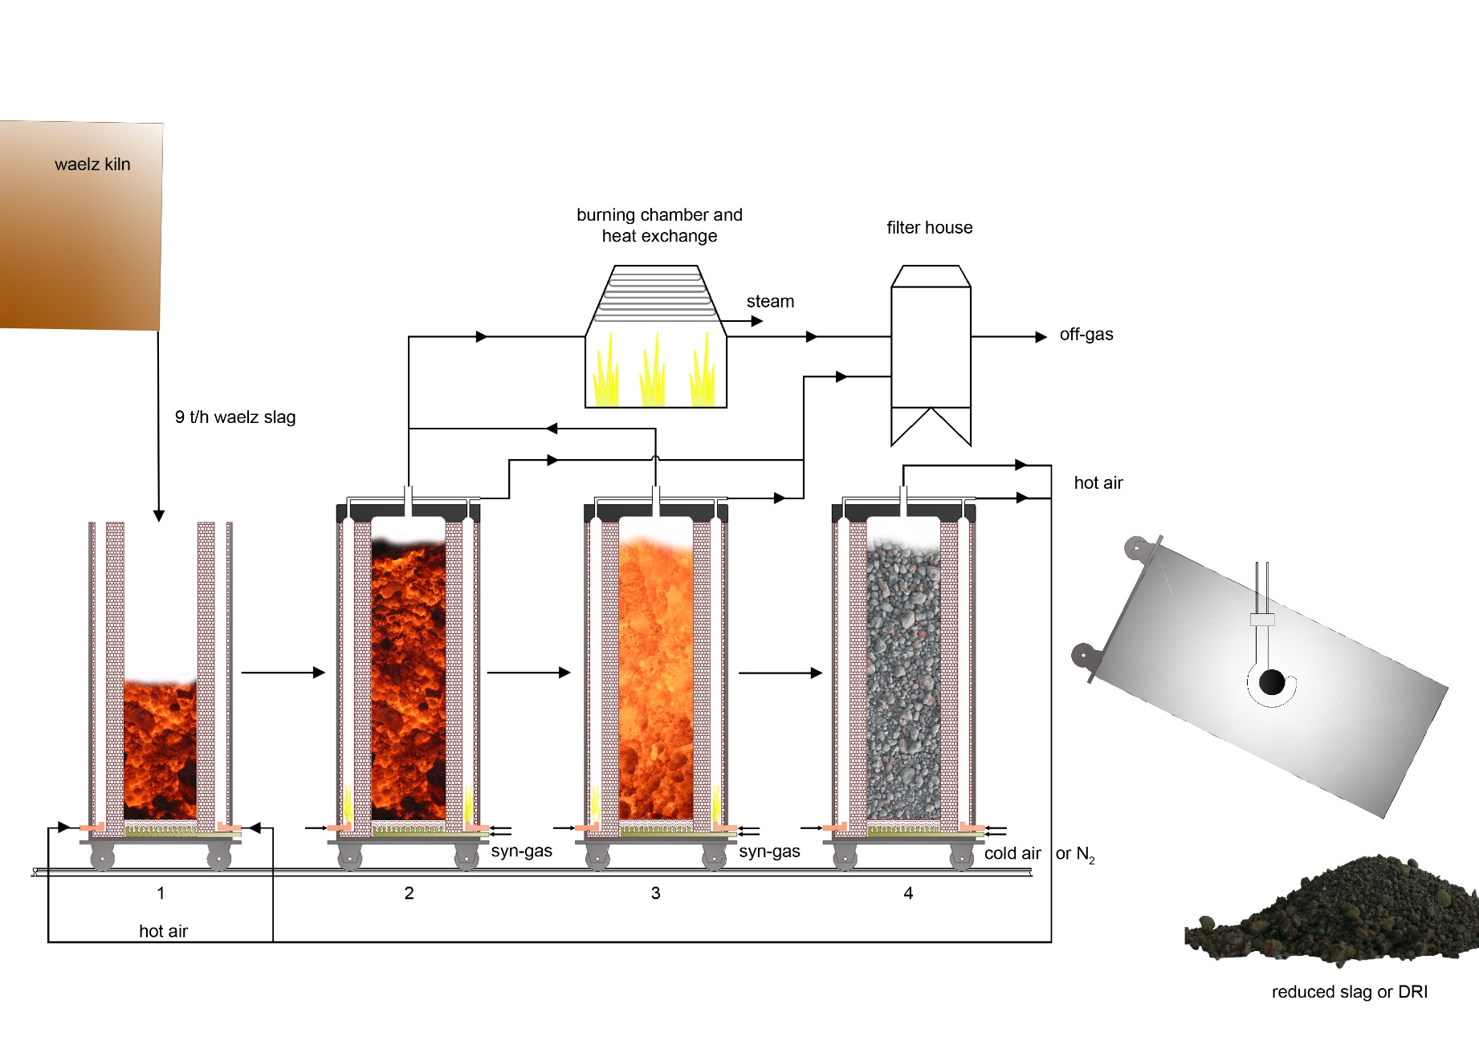
With a gaseous Reducing Agent II

Slide 12
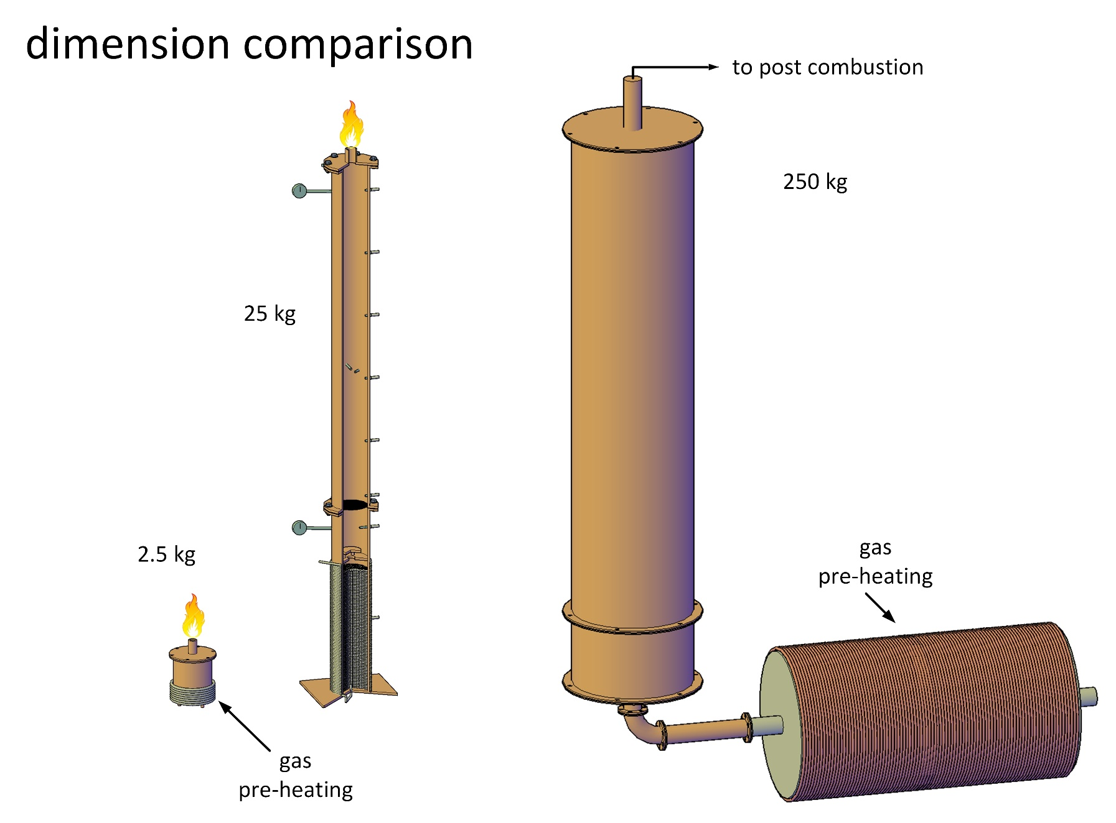
With a gaseous Reducing Agent III

Slide 13
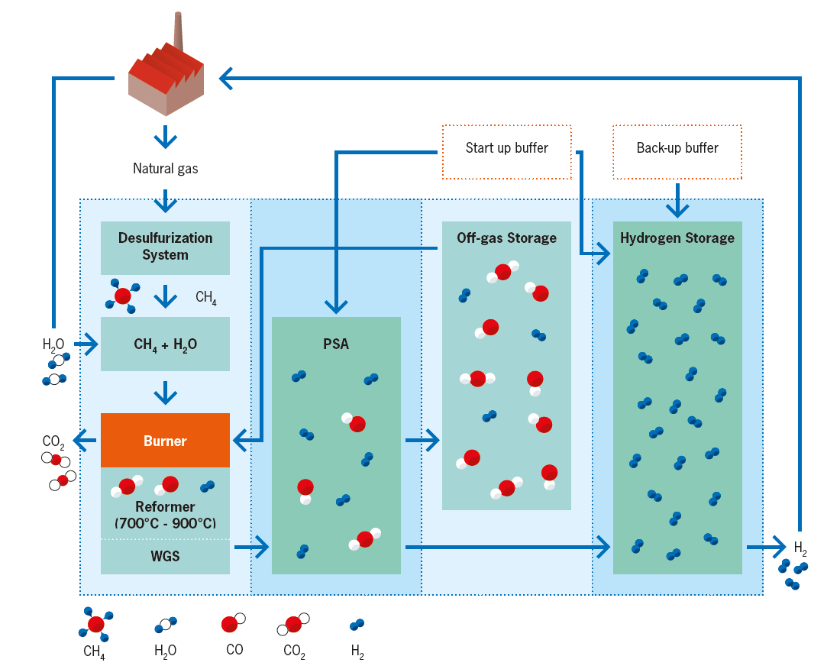
With a gaseous Reducing Agent IV
Reforming of pyrolysis gas

Slide 14
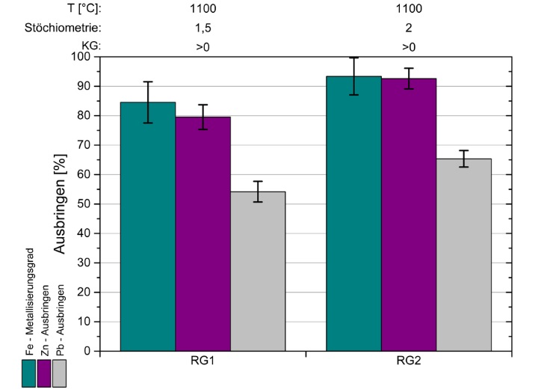
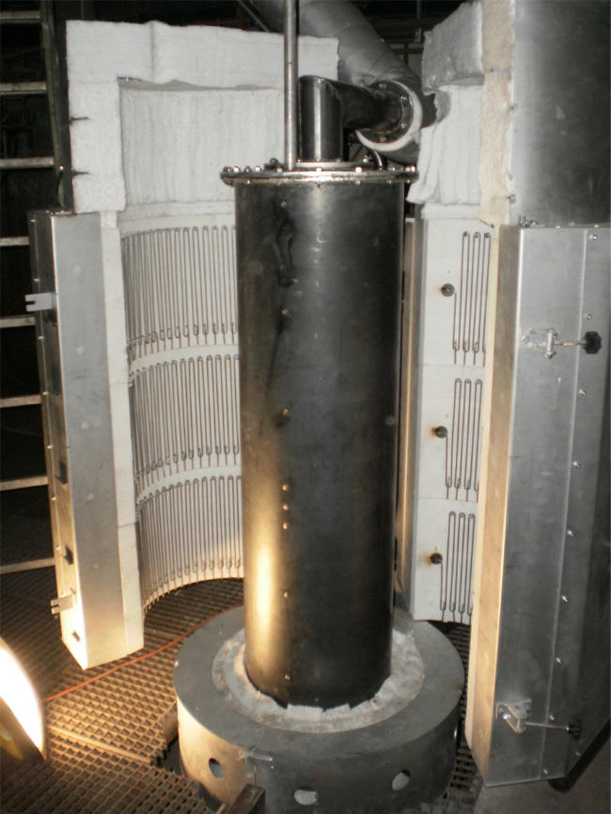
With a gaseous Reducing Agent V
T [°C]:
stochiometry:
grain size:
yield [%]
Pb-yield [%]
Zn-yield [%]
Fe-metallization [%]

Slide 15
Possibilities for Waelz slag
Different treatments to recover the still containing valuable metals in the slag and produce an inert residue!
To avoid Waelz slag through a new process concept for the Recycling of steel mill dust!

Slide 16
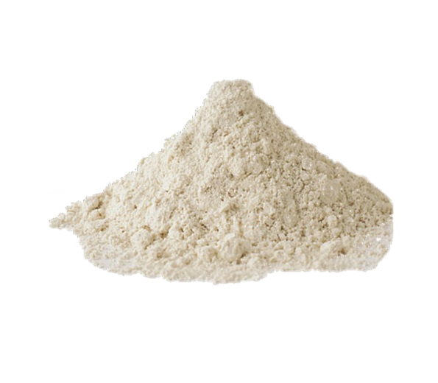
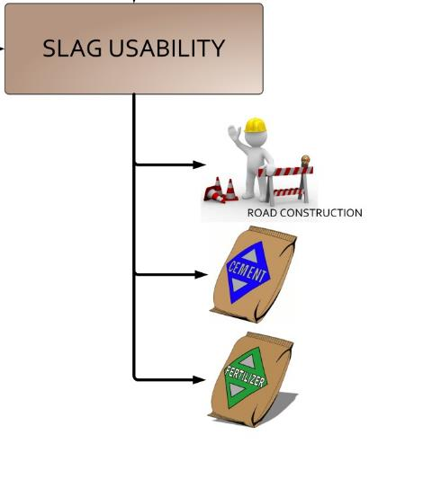
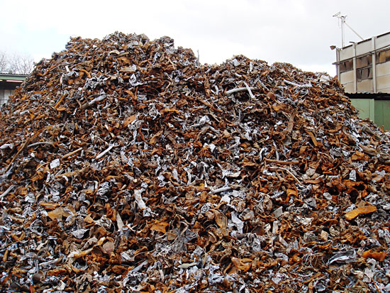
The 2^{s}DR process
filter dust
scrap
Notes:
A basic idea which we are very interested on is the iron bath technology. Similar to the PIZO-process, the residues are charged on a liquid iron bath. A main problem is in course of such processes is the refractory lining. Therefore we have a new cooperation with RHI to investigate this problems. A further important point is to use the post combustion energy in the reducing step before to save energy.
Another idea is to use a gas fired facility for the treatment, because in Western European countries this energy may be cheaper in contrast to electrical power.

Slide 17
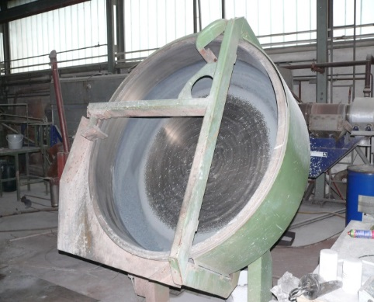
Overview “2sDR” Process
EAFD / BOFD
STEP
CLINKERING
2. STEP
REDUCTION

Slide 18
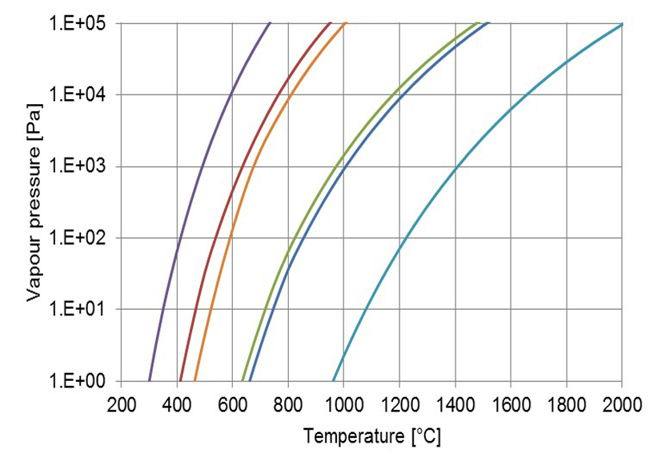
The first step CLINKERING

Slide 19
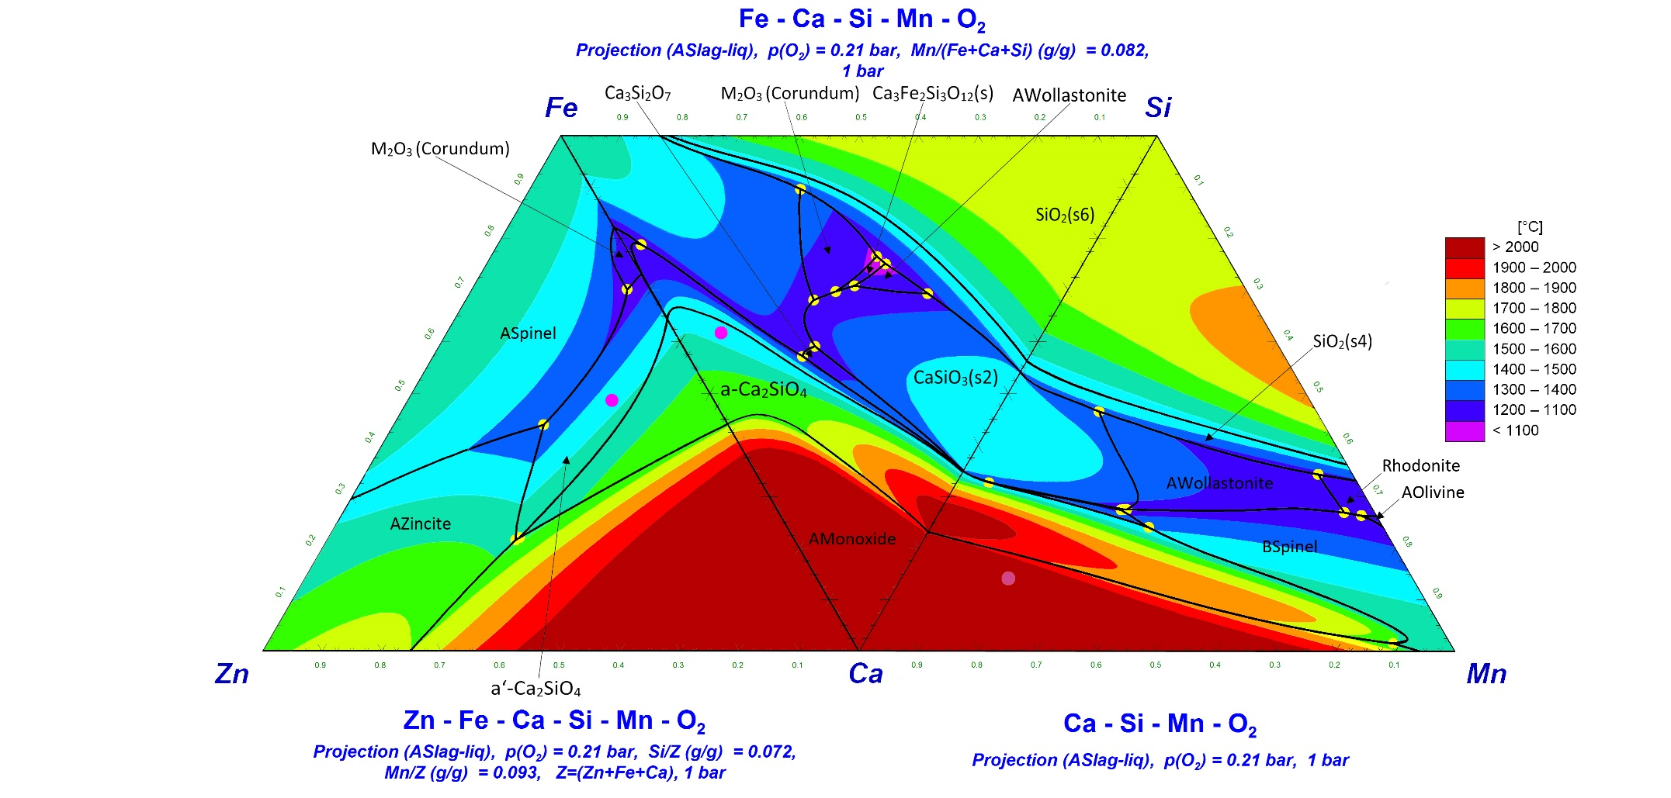
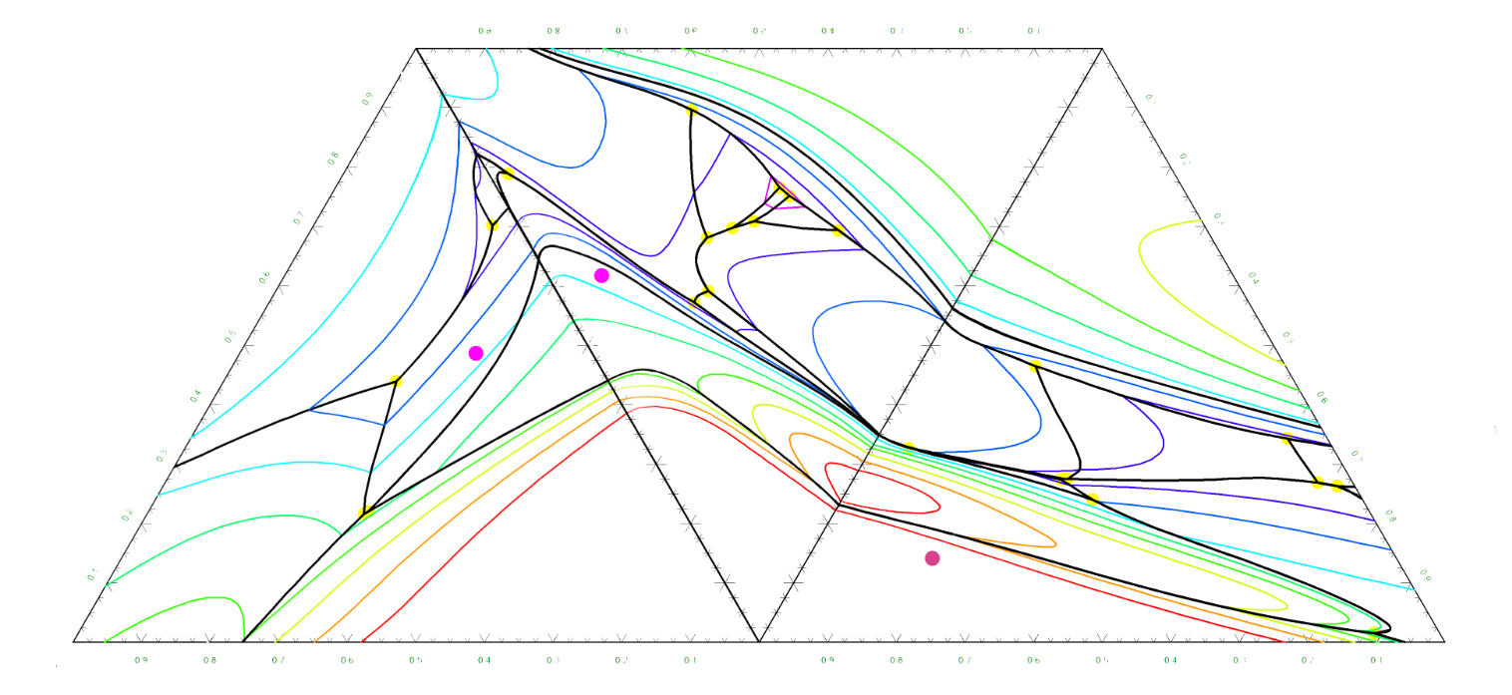
Thermodynamic Process-Simulation with FactSage (Reduction Step)
FeO_{x} (Fe)
SiO₂ (Si)
2. Process-Step
1. Process-Step
ZnO (Zn)
CaO (Ca)
MnO (Mn)

Slide 20
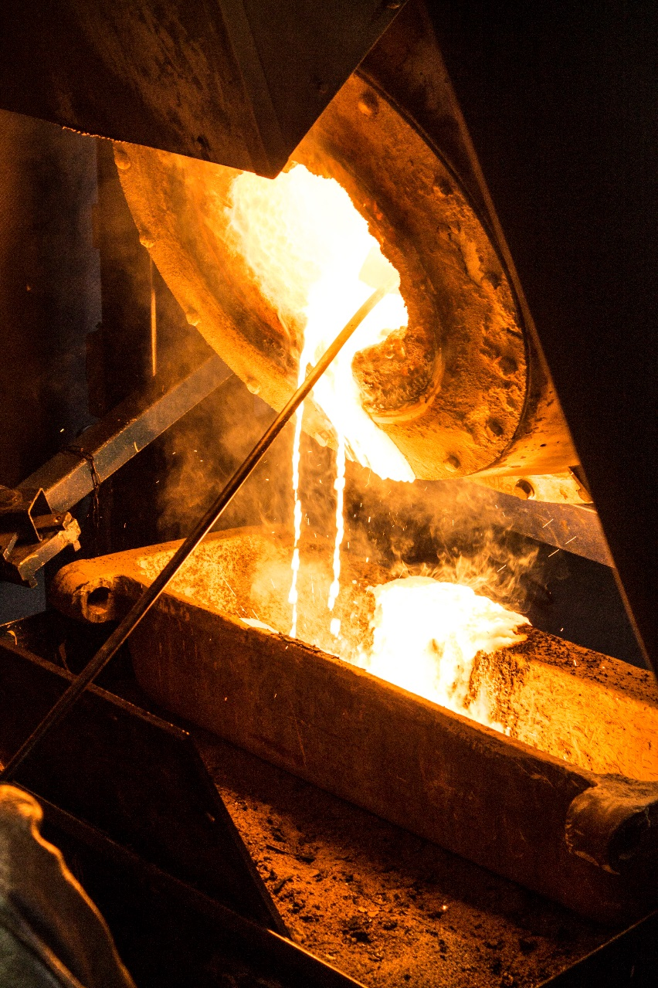
Technical Scale TRIALS
Notes:
A basic idea which we are very interested on is the iron bath technology. Similar to the PIZO-process, the residues are charged on a liquid iron bath. A main problem is in course of such processes is the refractory lining. Therefore we have a new cooperation with RHI to investigate this problems. A further important point is to use the post combustion energy in the reducing step before to save energy.
Another idea is to use a gas fired facility for the treatment, because in Western European countries this energy may be cheaper in contrast to electrical power.

Slide 21
Recycling of dumped slags from the primary lead production

Slide 22
Overview
Railly&Hill Metal Recovery Inc.
Huge volumes of dumped slags over the past 150 years originating from lead production. Many of those slags were not pre-treated and still contain high volumes of recoverable metals.
Recoverable materials: Zinc Oxide, Lead, but also rare metals - e.g. Ag, In, Ga - if present
Reason for recycling:
  Decontamination of dump site
  Zinc values up to 15.1 % due to missing zinc fuming in primary lead winning route
  Lead values up to 7.1 %
  Other valuable metals such as Ag, Ge, and In possible to recover
  Simple process for metal recovery available
  Treated slag might be suitable for road construction, sand blasting or cement industry

Slide 23
Recycling of dumped slags from lead production I
Railly&Hill Metal Recovery Inc.
Detailed process scheme of the lead slag treatment:
Lead slag
Other Pb-Ag-containing wastes
PbO-slag
Slag additive
Reduction step
in TBRC
Natural gas, oxygen
Char-coal, air
Off-gas
Lead buillion
Air
Post Combustion
& Filtering Stage
Air
Pyrometall.
refining
Zn-, Pb-, Ag-alloy
Silver-
recovery
Sulphur
Zinc
Zinc
Zinc oxide
Slag
Lead
Silver

Slide 24
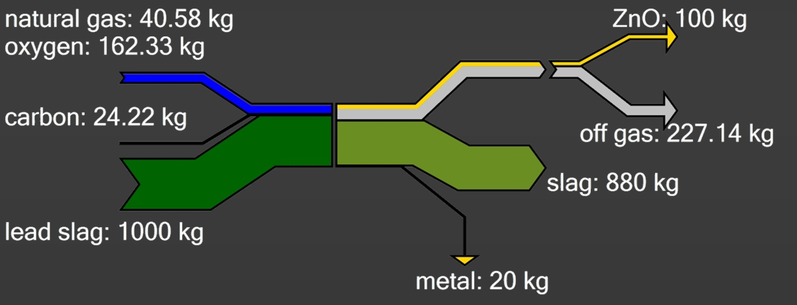
Recycling of dumped slags from lead production II
Railly&Hill Metal Recovery Inc.
Mass-balance of the process:
Advantages of the process:
Recovery of zinc and lead
Recovery of other metals
Low investment costs
Slag can be used in other areas
High quality of the products
High flexibility if other metals have to be recovered

Slide 25
Summary
  Different kinds of slags are under investigation
  Characterization and thermodynamic calculations
  Trials from lab scale up to pilot scale
  Different furnace concepts are available and under investigation
  Different additives were used to find the right melting point / basicity / viscosity and another residues recycling
  Renewable reducing agents were tested (charcoal)
  Requirements for slag utilizations were determined
Notes:
Sagen, dass bereits neue Reststoffe aus der Metallurgie charakterisiert werden
Abgasführung, Nachverbrennung von Zn im Aggregat
This is a summary of the performet tasks. At first there was a literature research followed from thermodynamic calculations for a characterising of the residues or slags. The practical test for removing the heavy metals were done on the TBRC.
The next steps will be the tests from the norm. This is the first time the eluate behaviour and the volume stability test. If all requirements will be succeeded the possibility for industrial use of the slags in the cement industry and road constuction schould be evaluated.

Slide 26





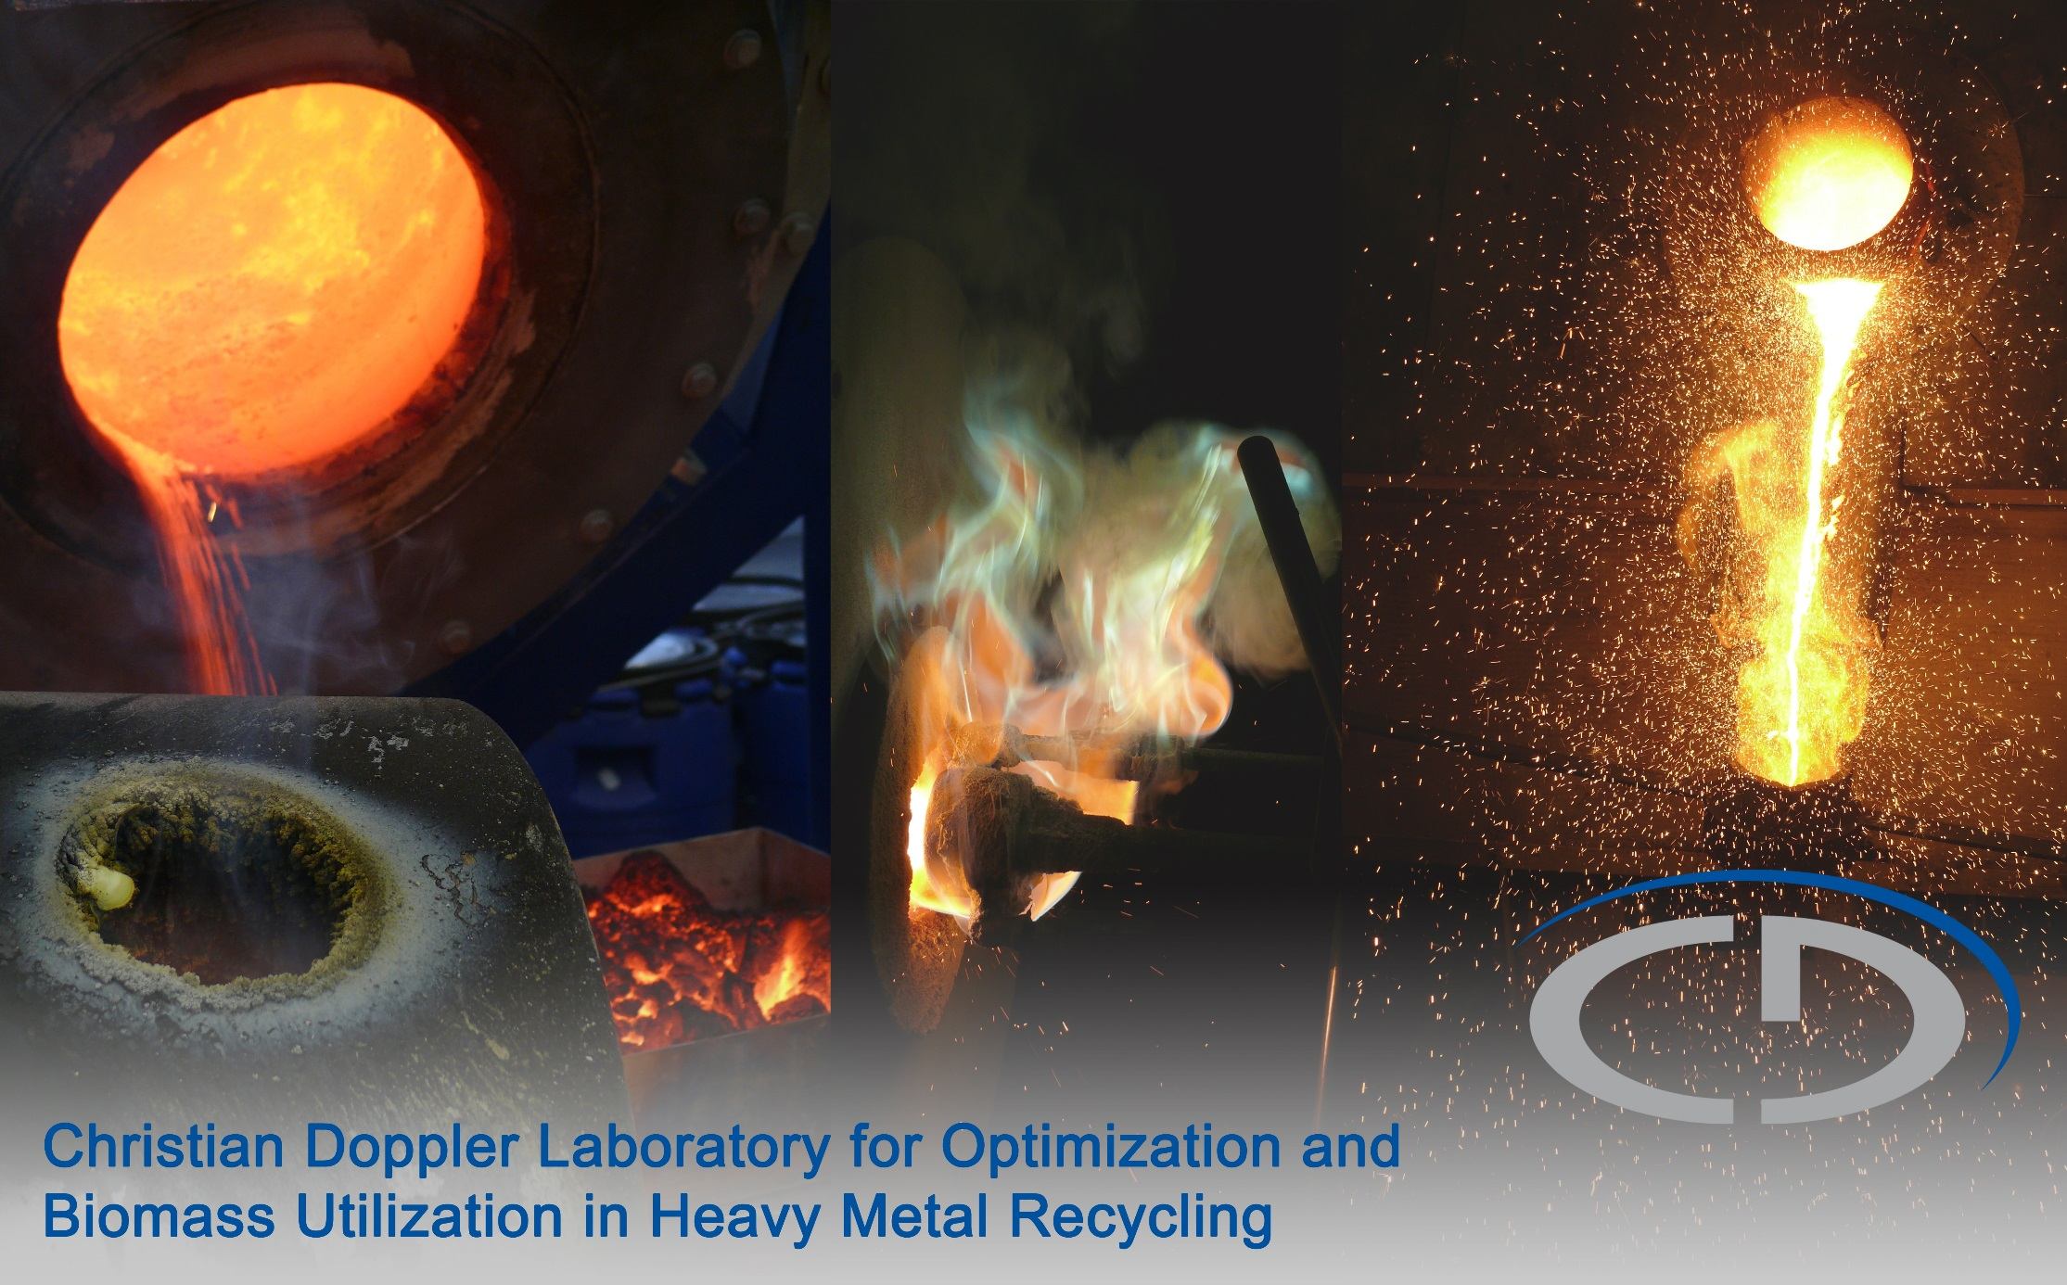
Christian Doppler Labor für Optimierung und Biomasseeinsatz beim Recycling von Schwermetallen
Thank you for your attention!
Notes:
Menge an W-Schlacke: 2.5 Mio. t/a
Menge an Slag aus Fe-Bad process: 0.5 * 2.5 Mio. t + Additives
Kosten: 100-200 US$/t

