Slide 1
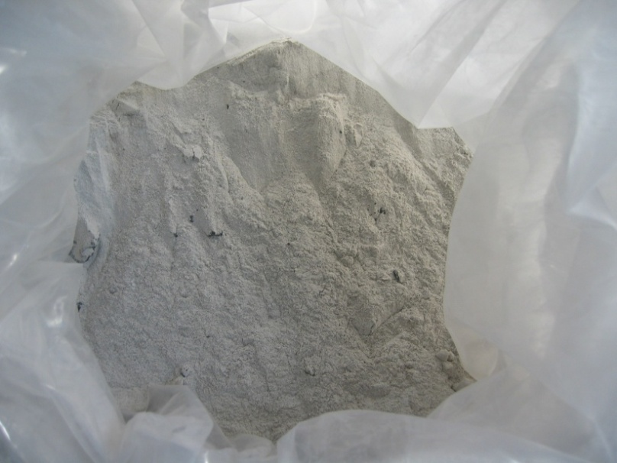
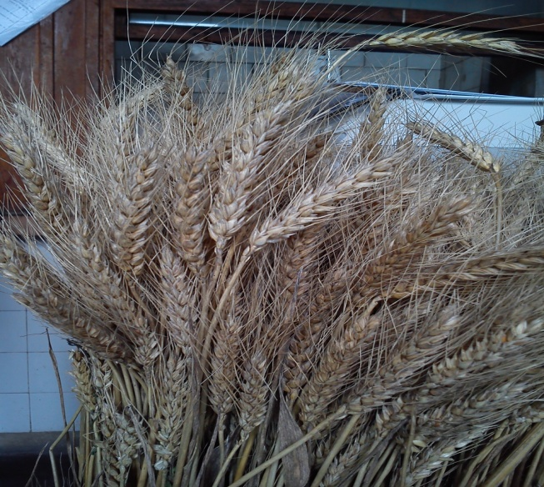
NON- TRADITIONAL SLAG VALORIZATION FOR AGRICULTURE
NATIONAL RESEARCH-DEVELOPMENT INSTITUTE FOR NON-FERROUS AND RARE METALS – I.M.N.R
.
IMNR
T. Velea¹, Ildiko Anger¹, F. Stoiciu¹, Eugenia Gament ², M. Mihalache³, L. Ilie³, Lavinia Popescu⁴, Fl. Zaman⁴, Luminita Mara¹, V. Predica¹

Slide 2
1. National R&D Institute for Nonferrous and Rare
Metals, 102 Biruintei Blvd, Pantelimon, Romania
2. National R&D Institute for Soil Science,
Agrochemistry and Environment Protection, 61
Marasti Blvd. sector 1, Bucharest, Romania
3. University of Agronomic Sciences and Veterinary
Medicine of Bucharest, 61 Marasti Blvd. sector 1,
Bucharest, Romania
4. Institute for Metallurgical Research, 39 Mehadiei
sector 6, Bucharest, Romaniastreet,
IMNR

Slide 3
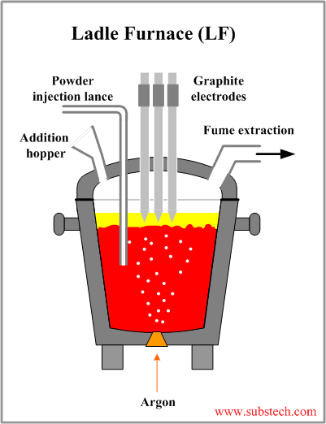
What metallurgical waste is used?
IMNR
The ladle furnace (LF) is known as a smaller version of electric arc furnace, having all three graphite electrodes.
The ladle furnace is equipped with :
an argon injection system;
with injection lance for desulfurizing agents and/or
supply system for deoxidizing additives or chemical composition adjustments

Slide 4
IMNR
The most important components of LF slag are: CaO (40-60%), Al₂O₃, SiO₂ and MgO.
Due the high content of free CaO, this slag is very alkaline.
LF slag can be used as follow:
is reintroduced into the steelmaking unit,
as a substitute for clinker or cement,
for acid mine water treatment,
as a fertilizer (fertilaizăr)in the agriculture,
as a possible chemical trap for CO₂.

Slide 5
IMNR
What is an acid soil?
The classification of acid soils using pH is the following:
pH< 5.5 - soil is strongly acid;
pH is 5.5 - 5.9 the soil is medium acid;
pH is 6.0 – 6.4 the soil is slightly acid;
pH is 6.5 – 6.9 the soil is very slightly acid and
when pH is 7.0 the soil is neutral.
The soil acidity can have influence upon soil fertility:
decrease the availability of essential elements,
decrease activity of soil microorganisms ,
increase the solubility and negative influence of toxic
elements (Al, Mn, Fe)
increase prevalence of plant diseases,
decrease of plant production, water uses and competitive
ability of different plant species.

Slide 6
IMNR
The LF slag composition used in field experiments
The LF slag composition in oxides (wt. %)
The XRD analysis identified the following crystalline phases:
Calcio-olivine (Ca₂(SiO₄))- 45% ,
Mayenite (Ca12Al14O32(O,F2))-12%,
Periclase (MgO)-12%,
Calcite(CaCO₃)-3-5%,
Fluorite(CaF₂)-6% and
Calcium Fluoride Silicate(Ca6-0.5xSi2O10-xFx)-20%.
LF slag | SiO₂ |  | Al₂O₃ | Fe₂O₃ | MnO | MgO | TiO₂
 | 19.85 | 55.12 | 6.01 | 1.18 | 0.89 | 9.42 | 0.22
 | K₂O | Cr₂O₃ | F | P₂O₅ | V₂O₅ | SO₃ | Others
 | 0.031 | 0.055 | 4.31 | 0.034 | 0.062 | 1.11 | 1.89
CaO

Slide 7
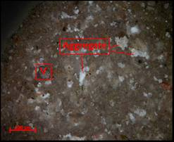
IMNR
The optical microscopy analysis shows that the slag is composed from microcrystalline and vitreous phases
Optical microscopy .N+. Reflected light. V- vitreous phase

Slide 8
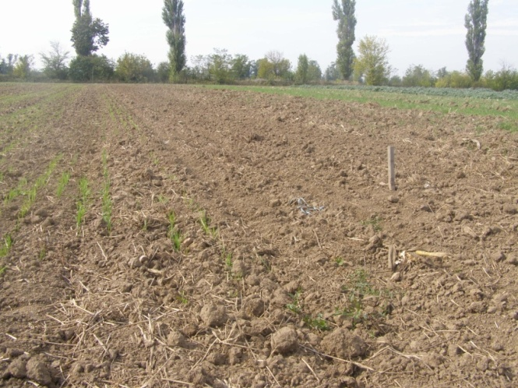
IMNR
Acid soil texture and chemical characteristics
The field from Moara Domneasca is situated in the East side of Bucharest, Romania. This area is situated in Vlasia Plain and the soil is Chromic luvisol
In the table are presented some physical and chemical characteristics of acid soil from Moara Domneasca area at two depth (0-20cm and 20-40 cm)
Depth (cm) | Bulk density (g/cm³) | Total Porosity (%) | Degree of settling (%) | pH (H₂O) | C_{org} (%) | Humus (%) | Nt (%) | P_{Al} (mg/kg) | K_{Al} (mg/kg)
0-20 | 1.48 | 42.42 | 15.28 | 5.51 | 1.21 | 2.08 | 0.147 | 74 | 230
20-40 | 1.63 | 37.19 | 26.39 | 5.55 | 1.23 | 2.12 | 0.158 | 87 | 235
Some physical and chemical characteristics of Chromic luvisol

Slide 9
IMNR
Treatment | pH H₂O |  | C_{org} % |  | N_{t} % |  | P mg/kg |  | K mg/kg
Depth (cm) | 0-20 | 20-40 | 0-20 | 20-40 | 0-20 | 20-40 | 0-20 | 20-40 | 0-20 | 20-40
V1 (soil 0 trm.) | 5.51 | 5.55 | 1.21 | 1.23 | 0.147 | 0.158 | 74 | 87 | 230 | 235
V2(1t LF slag/ha) | 5.68 | 5.77 | 1.35 | 1.31 | 0.157 | 0.153 | 106 | 108 | 225 | 270
V3 (2t LF slag/ha) | 5.80 | 5.92 | 1.28 | 1.23 | 0.153 | 0.155 | 97 | 105 | 298 | 287
V4 (3t LF slag/ha) | 5.78 | 5.95 | 1.25 | 1.21 | 0.151 | 0.157 | 85 | 87 | 299 | 326
V5 (5t LF slag/ha) | 6.01 | 6.35 | 1.32 | 1.25 | 0.157 | 0.132 | 78 | 89 | 311 | 317
The influence of LF slag on soil chemical properties

Slide 10
IMNR
The influence of LF slag on soil
pH at depth 0-20 cm
The influence of LF slag on soil total N, organic C, Humus at depth 0-20 cm

Slide 11
IMNR
The influence of LF slag on soil mobile phosphorous and mobile K at depth 0-20 cm

Slide 12
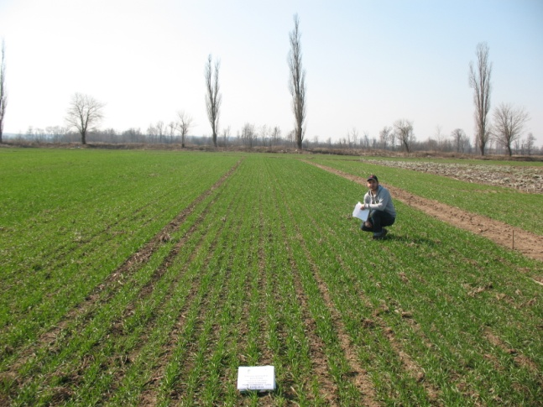
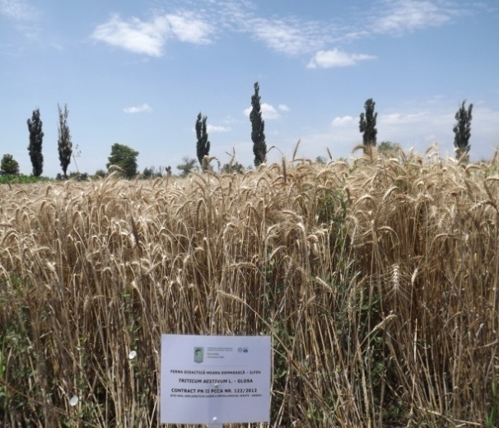
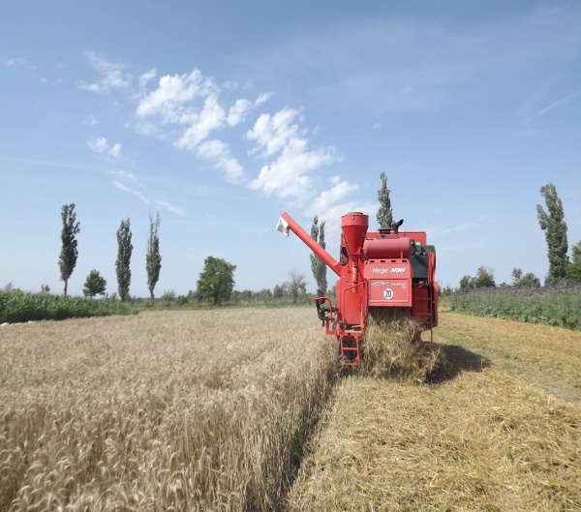
IMNR
Wheat on experimental field Moara Domneasca

Slide 13
IMNR
The influence of LF slag on wheat production

Slide 14
IMNR
The heavy metal content of the wheat grains (ppm)
Treatment | Lead | Copper | Zinc
V1 (soil 0 trm.) | 0 | 0 | 36
V2(1t LF slag/ha) | 0 | 0 | 40
V3 (2t LF slag/ha) | 0 | 0 | 34
V4 (3t LF slag/ha) | 0 | 0 | 41
V5 (5t LF slag/ha) | 0 | 0 | 41

Slide 15
IMNR
Conclusions
The LF slag from the steel refining can be used for acid soil remediation. The presence of LF slag in soil improves the soil chemical characteristics and increases the crop production.
The wheat grain contains zinc, which is very important for human health.

Slide 16
IMNR
Thank You for attention

